Slide 1
[Hyper]sensitivities
CLINID conference
Hunter Ratliff
01/23/2025
Ages, dates, and other identifying information may have been changed
I have no conflict of interest in relation to this presentation
Notes:
https://wvumdtv.zoom.us/j/4383197511?omn=93537052670

Slide 2
Case #1

Slide 3
Case 1: HPI
A 54 y/o M with PMH including T2DM (A1c 9.6), psoriasis, congenital foot deformity p/w fevers

Slide 4
Case 1: Backstory
A 54 y/o M with PMH including T2DM (A1c 9.6), psoriasis, congenital foot deformity p/w fevers
Admitted 5 weeks ago (- 36d) for MRSA bacteremia
Bacteremia 2/2 left great toe OM (s/p amputation with + margins; - 33d)
Cleared cultures on first set of repeats
Possible healed aortic valve vegetation on TEE
Has been on daptomycin + cefepime + Flagyl for past 5 weeks (1 more week to go)

Slide 5
Case 1: Backstory
A 54 y/o M with PMH including T2DM (A1c 9.6), psoriasis, congenital foot deformity, recent MRSA bacteremia 2/2 toe OM c/b possible AoV endocarditis (on DAP/FEP/MTZ for past 5 weeks) p/w fevers
Admitted 5 weeks ago (- 36d) for MRSA bacteremia 2/2 toe OM, discharged 4 weeks ago
Readmitted 2 weeks ago for fevers while on OPAT
During his two day readmission, fevers attributed to his newly discovered PICC associated DVT
No change in antimicrobials

Slide 6
Case 1: Medical history
A 54 y/o M with PMH including T2DM (A1c 9.6), psoriasis, congenital foot deformity, recent MRSA bacteremia 2/2 toe OM c/b possible AoV endocarditis (on DAP/FEP/MTZ for past 5 weeks), recent fevers from PICC associated DVT p/w fevers
Allergies: Itchy rash with chills after he got penicillin as a teenageer
Psoriasis: Has some baseline rash, managed well with topicals
Congenital foot deformity: Remote history of surgery, but no hardware

Slide 7
Case 1: HPI
A 54 y/o M with PMH including T2DM (A1c 9.6), psoriasis, congenital foot deformity, recent MRSA bacteremia 2/2 toe OM c/b possible AoV endocarditis (on DAP/FEP/MTZ for past 5 weeks), recent fevers from PICC associated DVT p/w fevers
Since most recent discharge (2 weeks ago), has noted dry cough
Eventually developed to pleuritic chest pain
No dyspnea
Four days ago, started having infusion reactions shortly after giving cefepime
Transient sensation of swelling/fullness in his bilateral submandibular jaw/neck with associated stomach/upper abdominal discomfort
No new/changed rash or pruritus
Starting yesterday, developed fevers (to 101’s)
Questionable if temporally related to cefepime

Slide 8
Case 1: Social, Exposures, Risk Factors
Geographic & Occupational: The patient lives in Morgantown, West Virginia with his wife. He denies recent travel. No worrisome risk factors for Legionella (has not worked on water tanks, AC, plumbing). States he works in “IT”; when asked further he states his employer is “one of the three letter abbreviations” and that he cannot provide any further details about his occupation.
Substance: They deny alcohol use and he does not use tobacco . They report no recreational drug use
Animal Exposures: The patient denies farm animal exposures, bird/reptile exposures, or other animal exposure (aside from their pet cat).
Tattoos & Piercing: They have have not gotten unprofessional piercings or tattoos .
Infectious PMH: They reports previous intolerances/allergies to antimicrobials (itchy rash with penicillin in teenage years); They deny history of C. diff infections. He denies known prior exposure to tuberculosis. No known sick contacts, and has not been in public (works remotely for past weeks) much because of frequency of IV antibiotics

Slide 9
Case 1: Exam
Vitals: BP 122/75 | Pulse 97 | 36.9 °C (98.4 °F) | SpO2 93% | BMI 29.71
Gen: alert and oriented, NAD, vitals reviewed
Head/Neck: NCAT; trachea appears midline, no gross LAD
ENT: EOMI grossly, anicteric sclerae; MMM
Resp: normal respiratory effort, symmetric chest rise
CV: RRR; extremities perfused
GI: non-distended; no TTP
Skin: Rash on BUE>BLE c/w known psoriasis; no nail changes
Neuro/MSK: moves extremities; b/l feet look good
Lines: No pain or erythema at site of PICC line

Slide 10
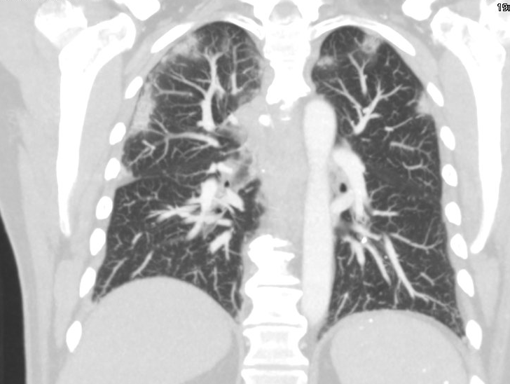
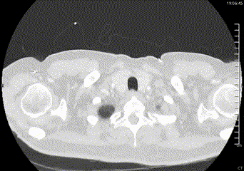
Case 1: Imaging

Slide 11
Case 1: Imaging
Multifocal bilateral groundglass and consolidative opacities, concerning for multifocal pneumonia. Groundglass nodule in the posterior left upper lobe measuring 8.9 x 5.6 mm. Multiple additional groundglass appearing nodules within the peripheral areas of the lungs.
Moderate-sized hiatal hernia.
Cholelithiasis without evidence for cholecystitis.
Prominent right thyroid nodule measuring up to 1.5 cm. Recommend follow-up ultrasound on nonemergent basis.

Slide 12
Case 1: Labs
 | Admission | Discharge (2 weeks ago)
WBC | 0.6 | 6.6
Hgb | 13.7 | 14.9
PLTs | 323 | 262
Neutrophils | <0.10 (4%) | 3.43 (52%)
Lymphocytes | 0.50 (83%) (15% reactive) | 1.48 (22%)
Monocytes | <0.10 (13%) | 0.91 (14%)
Eosinophils | <0.10 (0%) | 0.72 (11%)
Basophils | <0.10 (0%) | <0.10 (1%)
CRP: 27 (down from 90)
Chem7: Normal
LFTs: Not checked

Slide 13
Case 1: Summary
-5 weeks
(-36 days)
Admission #1 (MRSA bacteremia)
Been on daptomycin + cefepime + flagyl (past 36 days)
Amputation w/ positive margins, ?AoV veggie
A 54 y/o M w/ T2DM (A1c 9.6), psoriasis, congenital foot deformity, recent MRSA bacteremia 2/2 toe OM c/b possible AoV endocarditis, recent fevers from PICC associated DVT
2 weeks dry cough, peripheral opacities on CT
4 days of infusion reactions, seemingly with cefepime
Two episodes of fevers while on antibiotics
Leukopenia, recent eosinophilia
-4 weeks
(-27 days)
Discharged on OPAT
daptomycin + cefepime + flagyl
-2 wk / 14d
Admission #2 (PICC DVT)
All micro data negative
-12 days
Discharged
Mild dry cough starts
-4 days
Infusion reaction starts
Fevers start 30 hours before admission
Now
Admission #3

Slide 14
Case 1: Summary
Medicine pages at 8pm asking if he needs admission. Does he?
DDx for the labs?
Are his fevers infectious or non-infectious?
Empiric treatment for neutropenic fever?
A 54 y/o M w/ T2DM (A1c 9.6), psoriasis, congenital foot deformity, recent MRSA bacteremia 2/2 toe OM c/b possible AoV endocarditis, recent fevers from PICC associated DVT
2 weeks dry cough, peripheral opacities on CT
4 days of infusion reactions, seemingly with cefepime
Two episodes of fevers while on antibiotics
Leukopenia, recent eosinophilia
 | Admission | Discharge (2 weeks ago)
WBC | 0.6 | 6.6
Hgb | 13.7 | 14.9
PLTs | 323 | 262
Neut | <0.10 (4%) | 3.43 (52%)
Lymph | 0.50 (83%) | 1.48 (22%)
Mono | <0.10 (13%) | 0.91 (14%)
Eos | <0.10 (0%) | 0.72 (11%)
Baso | <0.10 (0%) | <0.10 (1%)

Slide 15
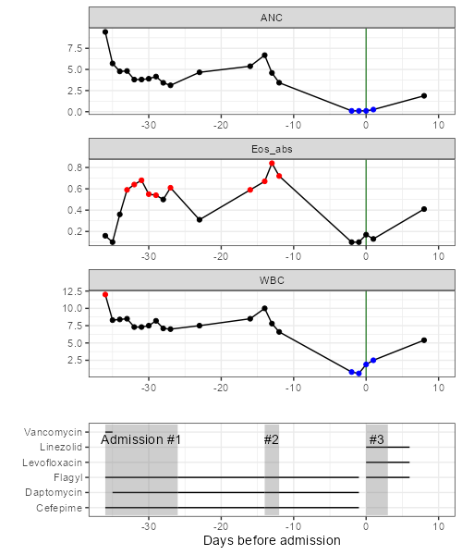
Case 1: Hospital course
Blood cultures negative
Presumed neutropenia from cefepime
Fevers stopped with stopping antibiotics
Given neutropenic fever & CT findings:
Switched to Levaquin & Zyvox
Continued flagyl for treatment of OM
Counts recovered with stopping cefepime
Doing well off antibiotics at clinic visit

Slide 16
Case #2

Slide 17
Case 2: HPI
A 37 y/o M with PMH including PWID (sober for 2 months) was admitted to OSH 10 days ago for MSSA tricuspid valve endocarditis and was transferred for advanced GI evaluation

Slide 18
Case 2: OSH (Day 1)
Admission
Blood Cx MSSA
CT C/A/P: Multiple bilateral cavitary nodules
A 37 y/o M with PMH including PWID (sober for 2 months) was admitted to OSH 10 days ago for MSSA tricuspid valve endocarditis
Presented with fevers, dyspnea, and back pain
Blood cultures positive (would be MSSA)
CT C/A/P: Multiple bilateral cavitary nodules
Transfer

Slide 19
Case 2: OSH (Day 2 & 3)
Admission
Blood Cx MSSA
CT C/A/P: Multiple bilateral cavitary nodules
Day 2
TTE: 1.3 cm tricuspid veggie
MRI L-spine normal
Started Ancef
HIV & HCV negative
TTE: 10-15mm tricuspid valve vegetation
No formal bubble study
ID consulted
Switched from vanc & ceftriaxone to Ancef
HIV & HCV screen negative
Transfer

Slide 20
Case 2: OSH (Day 4)
Admission
Blood Cx MSSA
CT C/A/P: Multiple bilateral cavitary nodules
Day 2
TTE: 1.3 cm tricuspid veggie
MRI L-spine normal
Started Ancef
HIV & HCV negative
Blood cultures clear by day 4
Not documented in the EMR, but this is when the patient first noticed a new rash
Day 4
Developed rash (per patient)
Blood cultures cleared
Transfer

Slide 21
Case 2: OSH (Day 5)
Admission
Blood Cx MSSA
CT C/A/P: Multiple bilateral cavitary nodules
Day 2
TTE: 1.3 cm tricuspid veggie
MRI L-spine normal
Started Ancef
HIV & HCV negative
“Nurses found a cigarette/pipe looking object in his bed with brown residue. I did do a urine drug screen and it is still positive for fentanyl. Should be negative by now. Usually is out of the system in 24-72 hours… Patient has been acting ‘funny’ per nursing”
Day 4
Developed rash (per patient)
Blood cultures cleared
Day 5
Nursing found a pipe with brown residue
UDS w/ fentanyl (should be negative by now)
Transfer

Slide 22
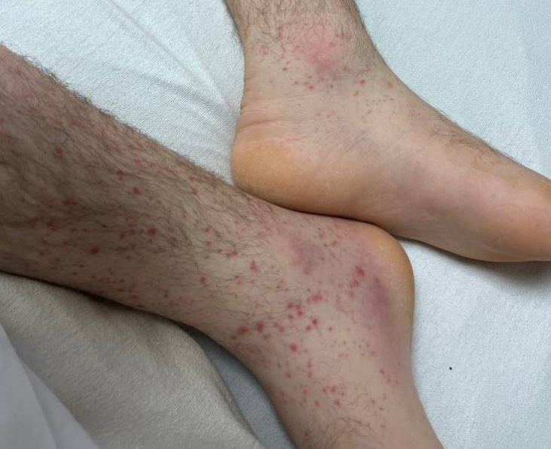
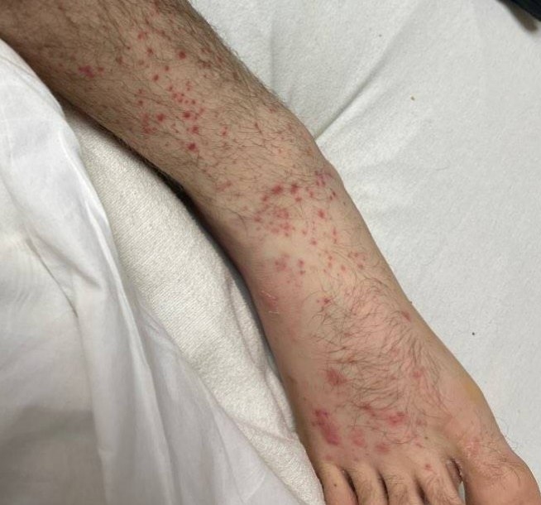
Case 2: OSH (Day 6)
Admission
Blood Cx MSSA
CT C/A/P: Multiple bilateral cavitary nodules
Day 2
TTE: 1.3 cm tricuspid veggie
MRI L-spine normal
Started Ancef
HIV & HCV negative
Now there are finally pictures of the rash
Day 4
Developed rash (per patient)
Blood cultures cleared
Day 5
Nursing found a pipe with brown residue
UDS w/ fentanyl (should be negative by now)
Day 6
Ancef changed to vanco (LFT increase)
First pictures of the rash

Slide 23
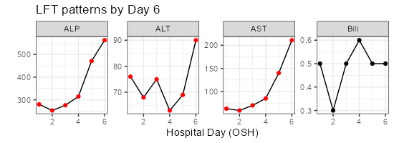
Case 2: OSH (Day 6)
Admission
Blood Cx MSSA
CT C/A/P: Multiple bilateral cavitary nodules
Day 2
TTE: 1.3 cm tricuspid veggie
MRI L-spine normal
Started Ancef
HIV & HCV negative
Some LFT elevation, so changed from Ancef to vancomycin
Day 4
Developed rash (per patient)
Blood cultures cleared
Day 5
Nursing found a pipe with brown residue
UDS w/ fentanyl (should be negative by now)
Day 6
Ancef changed to vanco (LFT increase)
First pictures of the rash

Slide 24
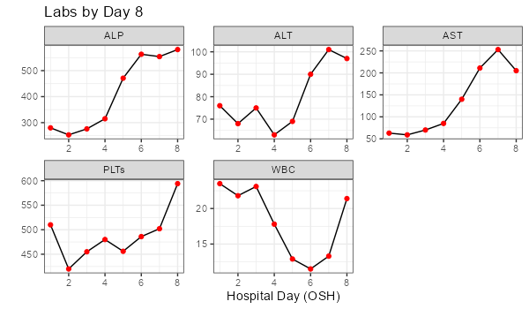
Case 2: OSH (Day 8)
Admission
Blood Cx MSSA
CT C/A/P: Multiple bilateral cavitary nodules
Day 2
TTE: 1.3 cm tricuspid veggie
MRI L-spine normal
Started Ancef
HIV & HCV negative
Develops worsening leukocytosis (back in 20s)
Ongoing LFT abnormalities (still cholestatic)
Day 4
Developed rash (per patient)
Blood cultures cleared
Day 5
Nursing found a pipe with brown residue
UDS w/ fentanyl (should be negative by now)
Day 6
Ancef changed to vanco (LFT increase)
First pictures of the rash
Day 8
WBC begin to rise, LFTs still high
Second pictures of the rash
Transfer

Slide 25
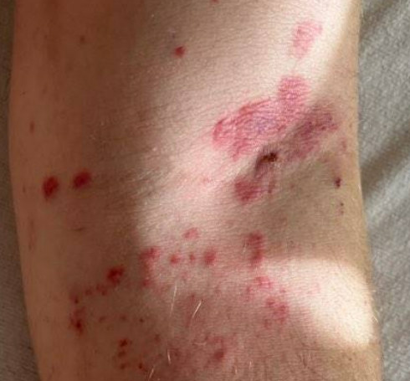
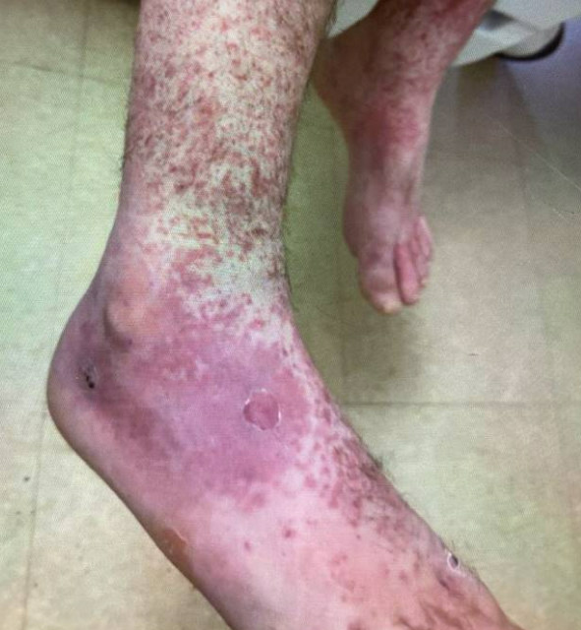
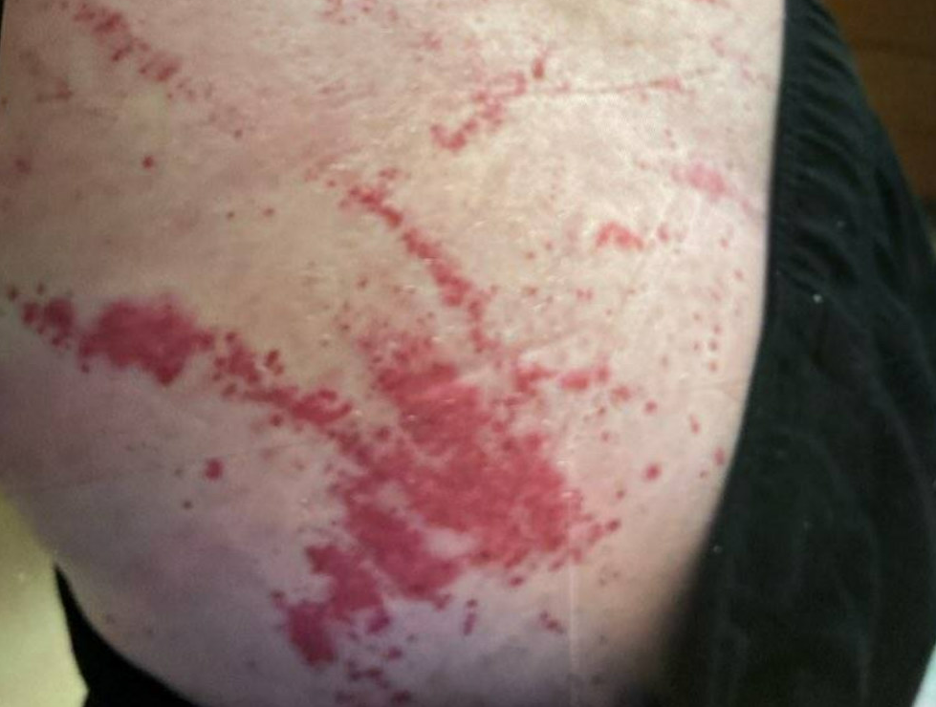
Case 2: OSH (Day 8)
Admission
Blood Cx MSSA
CT C/A/P: Multiple bilateral cavitary nodules
Day 2
TTE: 1.3 cm tricuspid veggie
MRI L-spine normal
Started Ancef
HIV & HCV negative
Top: L arm; bottom: back
Day 4
Developed rash (per patient)
Blood cultures cleared
Day 5
Nursing found a pipe with brown residue
UDS w/ fentanyl (should be negative by now)
Day 6
Ancef changed to vanco (LFT increase)
First pictures of the rash
Day 8
WBC begin to rise, LFTs still high
Second pictures of the rash
Transfer

Slide 26
Case 2: OSH (Day 9 & 10)
Admission
Blood Cx MSSA
CT C/A/P: Multiple bilateral cavitary nodules
Day 2
TTE: 1.3 cm tricuspid veggie
MRI L-spine normal
Started Ancef
HIV & HCV negative
CT C/A/P: severe mural thickening/edema involving the crossing duodenum and proximal jejunum c/w infectious vs ischemic enteritis
Surgery recommended transfer for advanced GI evaluation (& in case he needs high risk surgery)
Added cefepime & flagyl
Day 4
Developed rash (per patient)
Blood cultures cleared
Day 5
Nursing found a pipe with brown residue
UDS w/ fentanyl (should be negative by now)
Day 6
Ancef changed to vanco (LFT increase)
First pictures of the rash
Day 8
WBC begin to rise, LFTs still high
Day 9
CT C/A/P: ischemic enteritis?
Added cefepime & Flagyl
Transfer

Slide 27
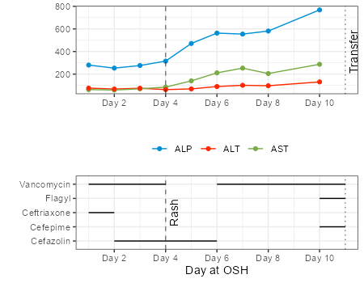
Case 2: Outside hospital course
Micro (OSH)
Initial & repeat BCx: MSSA
Cleared by day 4
HIV & HCV screen negative
HBV non-immune
Imaging
CT C/A/P (Day 0): Multiple bilateral cavitary nodules
MRI L-spine (Day 1): Normal
TTE (Day 1): 1.3 cm tricuspid veggie
CT C/A/P (HD #9): severe mural thickening/edema involving the crossing duodenum and proximal jejunum c/w infectious vs ischemic enteritis

Slide 28
Case 2: HPI & Social History
Geographic & Occupational: The patient lives in Parkersburg, West Virginia w/ his two teenage children. He denies recent travel. They are not working presently.
Substance: They deny alcohol use and he is a current 1/2 ppd smoker. They report prior IVDU with opiates and meth, but have not used for the past 2 months and is presently on methadone. Still smokes weed. Denies shared needles
Animal Exposures: The patient denies farm animal exposures or other animal exposure (aside from their pet cat, dogs, and snake).
Sexual: Not sexually active
Infectious PMH: They deny previous intolerances/allergies to antimicrobials; He denies known prior exposure to tuberculosis.

Slide 29
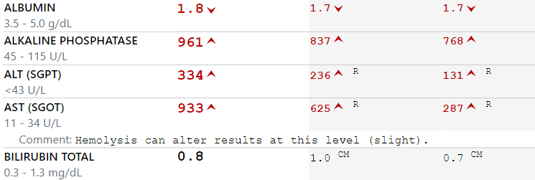
Case 2: Labs
WBC | 10.8
Hgb | 9.4
PLTs | 631
Neutrophils | 7.83 (73%)
Lymphocytes | 1.91 (18%)
Monocytes | 0.65 (6%)
Eosinophils | 0.19 (1.8%)
Basophils | <0.10 (0.4%)
Admission
Day 3

Slide 30
Case 2: Consultants
Advanced GI’s opinion

Slide 31
Case 2: Summary
Admission
Blood Cx MSSA
CT C/A/P: Multiple bilateral cavitary nodules
Day 2
TTE: 1.3 cm tricuspid veggie
MRI L-spine normal
Started Ancef
HIV & HCV negative
A 37 y/o M with PMH including PWID (sober for 2 months) was admitted to OSH 10 days ago for MSSA tricuspid valve endocarditis.
# MSSA bacteremia
# Tricuspid valve endocarditis
# Elevated LFTs
# Worsening WBC
# New rash
# Ischemic vs infectious enteritis
Day 4
Developed rash (per patient)
Blood cultures cleared
Day 5
Nursing found a pipe with brown residue
UDS w/ fentanyl (should be negative by now)
Day 6
Ancef changed to vanco (LFT increase)
First pictures of the rash
Day 8
WBC begin to rise, LFTs still high
Day 9
CT C/A/P: ischemic enteritis?
Added cefepime & Flagyl
Transfer

Slide 32
Case 2: Summary
Is there a unifying diagnosis that ties in:
LFTs
Rash
CT findings
Additional workup?
What would you do about the antibiotics?
# MSSA bacteremia
# Tricuspid valve endocarditis
# Ischemic vs infectious enteritis
# Elevated LFTs
# Worsening WBC
# New rash

Slide 33
The red flags
Substance: They deny alcohol use and he is a current 1/2 ppd smoker. They report prior IVDU with opiates and meth, but have not used for the past 2 months and is presently on methadone. Still smokes weed. Denies shared needles
Admission
Day 3

Slide 34
The red flags
Other hospital

Slide 35
The red flags
Other hospital
Ruby

Slide 36
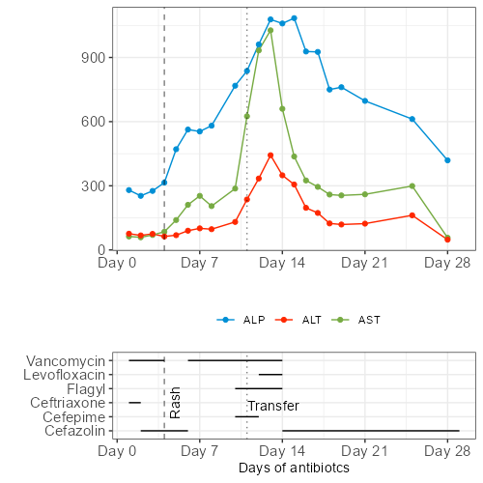
Case 2: Hospital course
We started Levaquin & Flagyl for intraabdominal coverage
Diagnosed with acute HCV, switched back to Ancef without issue
TEE did not show left sided disease
Still don’t know about a PFO

Slide 37
Case 2: Hospital course
We started Levaquin & Flagyl for intraabdominal coverage
Diagnosed with acute HCV, switched back to Ancef without issue
TEE did not show left sided disease
Still don’t know about a PFO
Dermatology saw patient, suspected early leukocytoclastic vasculitis
Consideration given to IgA vasculitis & cryoglobulinemic vasculitis
Biopsy: Superficial perivascular neutrophil-rich dermatitis
Immunofluorescence was negative for IgA vasculitis
Cryoglobulins: negative
Since vasculitis workup was negative (LCV is a small vessel vasculitis), enteritis was presumed emboli to the SMA

Slide 38
Discussion
Links to articles discussed here

Slide 39
Side effects of beta-lactams
Identify select side effects of beta-lactams
Leukopenia
Eosinophilia
Liver injury
Define acute HCV infection and recognize the appropriate workup
Explore the differential diagnosis for vasculitis in the second case
Cryoglobulins
Antibiotic induced
Infectious

Slide 40
Antibiotic neutropenia: Lam (2023) ^{[1.1]}
Seven year review from Canada
2513 cases, 90% had 4-6 wk DOT
Cefazolin
Ceftazidime
Ceftriaxone
Rifampin
Vancomycin
Ampicillin
Cloxacillin
Penicillin G
Zosyn
Ertapenem
Antibiotic induced neutropenia developed in 2.2% of patients
Other estimates have rates as high as 34%

Slide 41
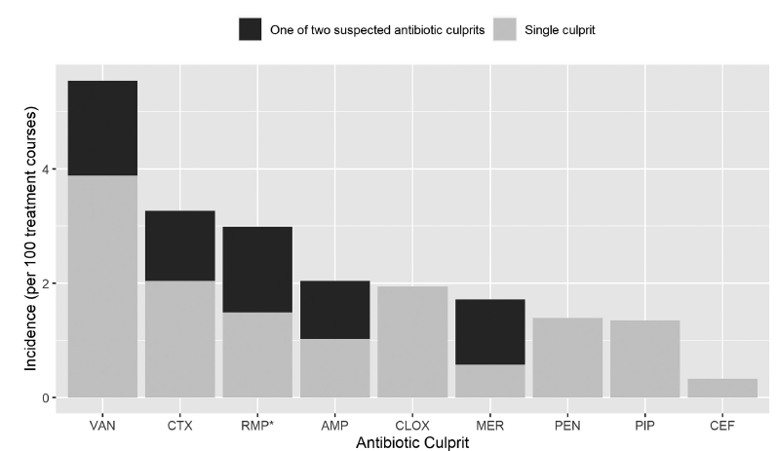
Antibiotic neutropenia: Lam (2023) ^{[1.1]}
Seven year review from Canada
2513 cases, 90% had 4-6 wk DOT
Cefazolin
Ceftazidime
Ceftriaxone (2.0%)
Rifampin
Vancomycin (3.9%)
Ampicillin
Cloxacillin (1.9%)
Penicillin G
Zosyn
Ertapenem
Antibiotic induced neutropenia developed in 2.2% of patients
Other estimates have rates as high as 34%
Other studies have found higher rates with penicillin, Zosyn, and other semi-synthetic penicillins

Slide 42
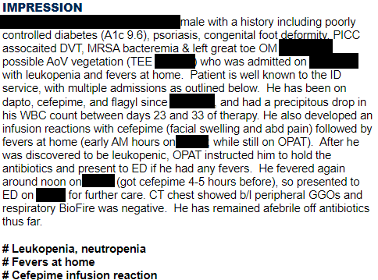
Antibiotic neutropenia: Lam (2023) ^{[1.1]}
Seven year review from Canada
2513 cases, 90% had 4-6 wk DOT
Cefazolin
Ceftazidime
Ceftriaxone
Rifampin
Vancomycin
Ampicillin
Cloxacillin
Penicillin G
Zosyn
Ertapenem
Antibiotic induced neutropenia developed in 2.2% of patients
Other estimates have rates as high as 34%
Median days to neutropenia 25 (IQR 19 to 30)
Similar to other studies
Only one in four had any symptoms

Slide 43
Antibiotic neutropenia: Lam (2023) ^{[1.1]}
Seven year review from Canada
2513 cases, 90% had 4-6 wk DOT
Cefazolin
Ceftazidime
Ceftriaxone (2.0%)
Rifampin
Vancomycin (3.9%)
Ampicillin
Cloxacillin (1.9%)
Penicillin G
Zosyn
Ertapenem
Antibiotic induced neutropenia developed in 2.2% of patients
Other estimates have rates as high as 34%
In 16% of cases, the culprit beta-lactam antibiotic was changed to another beta-lactam agent containing a structurally different side chain
Counts recovered in 100% of cases
Applied similar principles to IgE-mediated hypersensitivity
Median days to neutropenia 25 (IQR 19 to 30)
Similar to other studies
Only one in four had any symptoms

Slide 44
Beta-Lactam OPAT: Zukauckas (2022) ^{[1.2]}
18 month review from Utah, n=264
Only focused on beta-lactams (so had patients on cefepime, unlike Lam)
67% were on cephalosporins

Slide 45
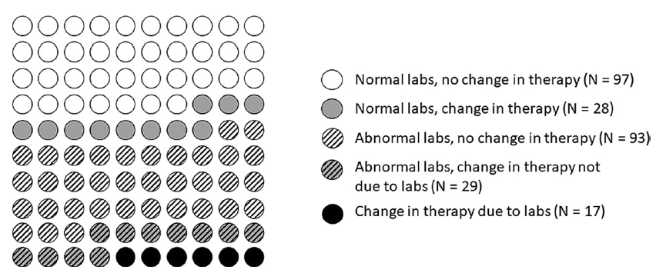
Beta-Lactam OPAT: Zukauckas (2022) ^{[1.2]}
18 month review from Utah, n=264
Unlike Lam (2023), had patients with cefepime
52% of patients had abnormal labs
35% had no change in OPAT
11% had a change, but not due to labs
Only 5.7% had a change in therapy due to labs

Slide 46
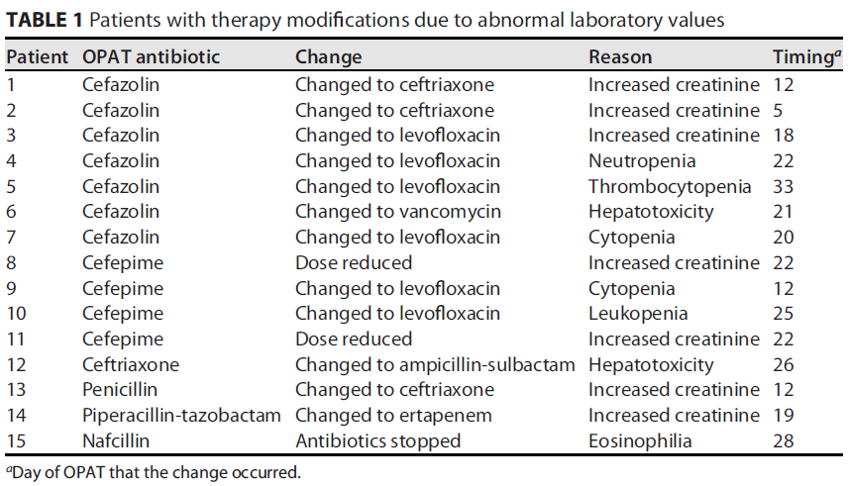
Beta-Lactam OPAT: Zukauckas (2022) ^{[1.2]}

Slide 47
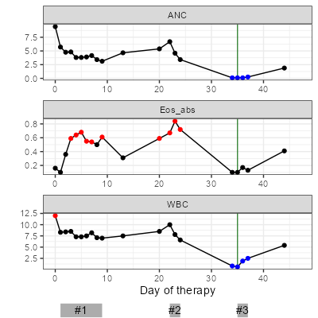
Eosinophilia ^{[1.3]}
Estimates vary, but development of eosinophilia is common. In one study ^{[1.3]}:
Incidence: One in four patients
Median onset: 15 days (IQR 8 to 22)
Peak: 726/mL (IQR 595 to 990)

Slide 48
Eosinophilia ^{[1.3]}
Estimates vary, but development of eosinophilia is common. In one study ^{[1.3]}:
Incidence: One in four patients (210/827)
Median onset: 15 days (IQR 8 to 22)
Peak: 726/mL (IQR 595 to 990)
Table 2 ^{[1.3]} Predictors of eosinophilia. Multivariate was only done if univariate model had p < .50

Slide 49
Eosinophilia ^{[1.3]}
Estimates vary, but development of eosinophilia is common. In one study ^{[1.3]}:
Incidence: One in four patients (210/827)
Median onset: 15 days (IQR 8 to 22)
Peak: 726/mL (IQR 595 to 990)
Most are asymptomatic, but some cases are associated with hypersensitivity reaction (HSR)
21% ^{[1.4]} to 30% ^{[1.3]} of cases a/w HSR
Cases with HSR had earlier onset of eosinophilia (11 vs 17 days)

Slide 50
Eosinophilia ^{[1.3]}
Estimates vary, but development of eosinophilia is common. In one study ^{[1.3]}:
Incidence: One in four patients (210/827)
Median onset: 15 days (IQR 8 to 22)
Peak: 726/mL (IQR 595 to 990)
Most are asymptomatic, but some cases are associated with hypersensitivity reaction (HSR)
21% ^{[1.4]} to 30% ^{[1.3]} of cases a/w HSR
Cases with HSR had earlier onset of eosinophilia (11 vs 17 days)
Peripheral eosinophilia increases rates of rash (x4) and renal injury (x2) compared to those without eosinophilia
 | HR (95% CI) | P-value
Rash | 4.16 (2.54-6.83) | <0.0001
Renal injury | 2.13 (1.36-3.33) | 0.0009
Liver injury | 1.75 (0.92-3.33) | 0.09
Any injury | 2.65 (1.94-3.62) | <0.0001
Table 3 ^{[1.3]} Eosinophilia as predictor of subsequent HSR

Slide 51
Eosinophilia ^{[1.3]}
Estimates vary, but development of eosinophilia is common. In one study ^{[1.3]}:
Incidence: One in four patients (210/827)
Median onset: 15 days (IQR 8 to 22)
Peak: 726/mL (IQR 595 to 990)
Most are asymptomatic, but some cases are associated with hypersensitivity reaction (HSR)
21% ^{[1.4]} to 30% ^{[1.3]} of cases a/w HSR
Cases with HSR had earlier onset of eosinophilia (11 vs 17 days)
Peripheral eosinophilia increases rates of rash (x4) and renal injury (x2) compared to those without eosinophilia
 | HR (95% CI) | P-value
Rash | 4.16 (2.54-6.83) | <0.0001
Renal injury | 2.13 (1.36-3.33) | 0.0009
Liver injury | 1.75 (0.92-3.33) | 0.09
Any injury | 2.65 (1.94-3.62) | <0.0001
Table 3 ^{[1.3]} Eosinophilia as predictor of subsequent HSR
Don’t forget the base rate
70% of patients with eosinophilia do fine;
eosinophilia should only heighten awareness for possible HSR

Slide 52
Cephalosporin induced DILI ^{[3.1]}
Case #2 (acute HCV)
Well described, and fairly common as a class
Up to 11% in frequency
Most cases are very mild
Almost all are asymptomatic
<1% of cases have AST/ALT over x5 ULN
Likely due to hypersensitivity
Abrupt onset, 1-4 weeks after first dose

Slide 53
Cephalosporin induced DILI ^{[3.1]}
Well described, and fairly common as a class
Up to 11% in frequency
Most cases are very mild
Almost all are asymptomatic
<1% of cases have AST/ALT over x5 ULN
Likely due to hypersensitivity
Abrupt onset, 1-4 weeks after first dose
Cefazolin
In the top 10-15 causes of drug induced jaundice
Often cholestatic pattern, but can be hepatocellular pattern
Commonly accompanied by fever, rash &/or eosinophilia
Notes:
https://www.ncbi.nlm.nih.gov/books/NBK548666/

Slide 54
Cephalosporin induced DILI ^{[3.1]}
Well described, and fairly common as a class
Up to 11% in frequency
Most cases are very mild
Almost all are asymptomatic
<1% of cases have AST/ALT over x5 ULN
Likely due to hypersensitivity
Abrupt onset, 1-4 weeks after first dose
Cefazolin
In the top 10-15 causes of drug induced jaundice
Often cholestatic pattern, but can be hepatocellular pattern
Commonly accompanied by fever, rash &/or eosinophilia
Ceftriaxone
3% - 46% frequency
Most common is “pseudolithiasis”
Gallstones made of ceftriaxone
Only 5% have symptoms
Resolve with stopping the drug
Can also have the immunoallergic form of cholestatic hepatitis (seen as a class)
Notes:
https://www.ncbi.nlm.nih.gov/books/NBK548666/

Slide 55
Acute HCV
Identify select side effects of beta-lactams
Leukopenia
Eosinophilia
Liver injury
Define acute HCV infection and recognize the appropriate workup
Explore the differential diagnosis for vasculitis in the second case
Cryoglobulins
Antibiotic induced
Infectious

Slide 56
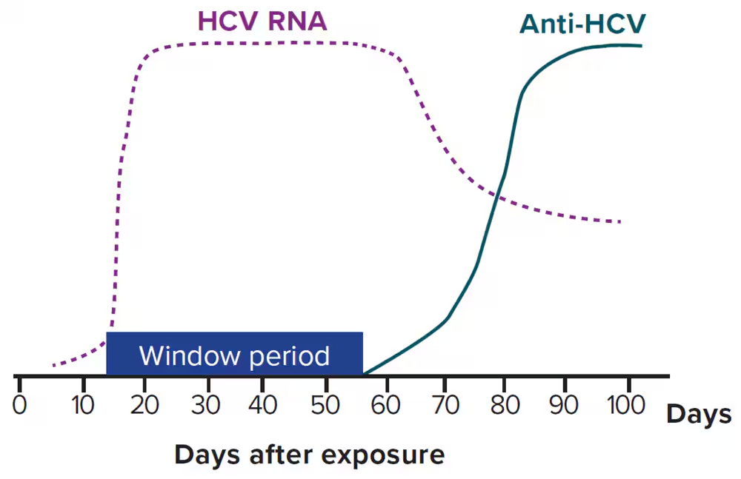
Acute HCV: Timing ^{[2.1, 3.2]}
By convention, “acute HCV” refers to the first 6 months of HCV infections
HCV RNA becomes detectable in days to 8 weeks, most often by 2 weeks
HCV antibodies seroconvert between 2-6 months
LFT abnormalities will often be present before the antibody is present

Slide 57
Acute HCV: When to get a PCR ^{[2.1, 3.2]}
Guidelines suggest obtaining HCV Ab & PCR if exposure is <6 months & signs/labs suggestive of acute hepatitis
i.e. acute, moderate transaminitis (>5x ULN)
Most “acute hepatitis panels” (Quest, Labcorp, ARUP) don’t include standalone HCV PCR, only antibody with reflex to PCR
LFT abnormalities will often be present before the antibody is present

Slide 58
What was the cause of the vasculitis?
Identify key side effects of beta-lactams
Leukopenia
Eosinophilia
Liver injury
Define acute HCV infection and recognize the appropriate workup
Explore the differential diagnosis for vasculitis in the second case
Cryoglobulins
Antibiotic induced
Infectious

Slide 59
Vasculitis: Patient’s results
SKIN PUNCH BIOPSY: Superficial perivascular neutrophil-rich dermatitis, suggestive of an early phase of leukocytoclastic (aka hypersensitivity) vasculitis
Examination of multiple levels reveals features suggestive but not fully diagnostic of leukocytoclastic vasculitis. Fibrinoid degeneration of the blood vessel wall (fibrinoid necrosis) is NOT observed; however, there is a mildly dense predominantly lymphocytic, but neutrophil-rich with scattered eosinophils superficial perivascular infiltrate and areas of focal nuclear dust (karyorrhexis) and erythrocyte extravasation. GMS, Gram, and PAS stain are negative for microorganisms.
Leukocytoclastic vasculitis is a time-dependent process that initially presents as lymphocyte-predominant perivasculitis, and fully developed pathologic changes may not have evolved fully. The histologic differential diagnosis would include a dermal hypersensitivity reaction, such as urticaria. Clinical correlation is recommended.
SKIN BIOPSY, FOR DIRECT IMMUNOFLUORESCENCE: Entirely negative immunofluorescence exam
By immunofluorescence microscopy; direct immunofluorescence with conjugates including anti-IgG, anti-IgA, anti-IgM, anti-C3, and anti-fibrinogen is negative for immunoreactants.

Slide 60
Vasculitis: Overview of classification
Small-vessel vasculitis
Medium-vessel vasculitis
Polyarteritis nodosa (PAN)
Kawasaki disease (KD)
ANCA associated
GPA, eosinophilic GPA
Microscopic polyangiitis
Large-vessel vasculitis
Giant cell arteritis (GCA)
Takayasu arteritis (TAK)
Immune complex
Anti-GBM
IgA (HSP)
Cryoglobulinemia
Variable-vessel vasculitis
Behçet's syndrome
Cogan's syndrome

Slide 61
Vasculitis: Overview of classification
Small-vessel vasculitis
Medium-vessel vasculitis
Polyarteritis nodosa (PAN)
Kawasaki disease (KD)
Single-organ vasculitis
Cutaneous small-vessel vasculitis
Primary CNS vasculitis
Others
Single-organ vasculitis
Cutaneous small-vessel vasculitis
Primary CNS vasculitis
Others
ANCA associated
GPA, eosinophilic GPA
Microscopic polyangiitis
Large-vessel vasculitis
Giant cell arteritis (GCA)
Takayasu arteritis (TAK)
Vasculitis associated with systemic disease
Rheumatoid vasculitis, lupus vasculitis, IBD vasculitis, others
Immune complex
Anti-GBM
IgA (HSP)
Cryoglobulinemia
Variable-vessel vasculitis
Behçet's syndrome
Cogan's syndrome
Vasculitis associated with probable etiology
HCV cryoglobulinemia
HBV, syphilis, cancer
Drug associated ANCA vasculitis
Drug associated immune complex
Others

Slide 62
Vasculitis: Overview of classification
Small-vessel vasculitis
Medium-vessel vasculitis
Polyarteritis nodosa (PAN)
Kawasaki disease (KD)
Single-organ vasculitis
Cutaneous small-vessel vasculitis
Primary CNS vasculitis
Others
Single-organ vasculitis
Cutaneous small-vessel vasculitis
Primary CNS vasculitis
Others
ANCA associated
GPA, eosinophilic GPA
Microscopic polyangiitis
Large-vessel vasculitis
Giant cell arteritis (GCA)
Takayasu arteritis (TAK)
Vasculitis associated with systemic disease
Rheumatoid vasculitis, lupus vasculitis, IBD vasculitis, others
Immune complex
Anti-GBM
IgA (HSP)
Cryoglobulinemia
Variable-vessel vasculitis
Behçet's syndrome
Cogan's syndrome
Vasculitis associated with probable etiology
HCV cryoglobulinemia
HBV, syphilis, cancer
Drug associated ANCA vasculitis
Drug associated immune complex
Others
Leukocytoclastic vasculitis (LCV) (hypersensitivity vasculitis)
Histopathologic term, not a diagnosis
Inflammatory infiltrate of small vessels composed of neutrophils

Slide 63
Vasculitis: Cryoglobulinemia
Small-vessel vasculitis
Medium-vessel vasculitis
Polyarteritis nodosa (PAN)
Kawasaki disease (KD)
Single-organ vasculitis
Cutaneous small-vessel vasculitis
Primary CNS vasculitis
Others
Single-organ vasculitis
Cutaneous small-vessel vasculitis
Primary CNS vasculitis
Others
ANCA associated
GPA, eosinophilic GPA
Microscopic polyangiitis
Large-vessel vasculitis
Giant cell arteritis (GCA)
Takayasu arteritis (TAK)
Vasculitis associated with systemic disease
Rheumatoid vasculitis, lupus vasculitis, IBD vasculitis, others
Immune complex
Anti-GBM
IgA (HSP)
Cryoglobulinemia
Variable-vessel vasculitis
Behçet's syndrome
Cogan's syndrome
Vasculitis associated with probable etiology
HCV cryoglobulinemia
HBV, syphilis, cancer
Drug associated ANCA vasculitis
Drug associated immune complex
Others

Slide 64
Vasculitis: Cryoglobulinemia
Main association with cryoglobulinemic vasculitis is chronic^{[2.4]} HCV infection or connective tissue diseases
Causes a mixed cryoglobulinemia syndrome
B-cell hyperactivation → expansion of cryoglobulin-producing B-cell clones → Aggregation of immunoglobulins
80% of patients present with triad of purpura, weakness, and arthralgia ^{[2.4]}
Skin Biopsy: Leukocytoclastic vasculitis
Immunofluorescence: deposits of IgM, IgG, and/or C3 complement

Slide 65
Vasculitis: Cryoglobulinemia
Small-vessel vasculitis
Immune complex
Anti-GBM
IgA (HSP)
Cryoglobulinemia
Main association with cryoglobulinemic vasculitis is chronic^{[2.4]} HCV infection or connective tissue diseases
Causes a mixed cryoglobulinemia syndrome
B-cell hyperactivation → expansion of cryoglobulin-producing B-cell clones → Aggregation of immunoglobulins
80% of patients present with triad of purpura, weakness, and arthralgia ^{[2.4]}
Vasculitis associated with probable etiology
HCV cryoglobulinemia
HBV, syphilis, cancer
Drug associated
Drug associated
Others
Skin Biopsy: Leukocytoclastic vasculitis
Immunofluorescence: deposits of IgM, IgG, and/or C3 complement
Unlikely in our case
Serum cryoglobulins negative
No deposits on IF
Typically have other manifestations too
Acute HCV is uncommon cause (most cases are in chronic HCV)

Slide 66
Vasculitis: Antibiotic associated
Small-vessel vasculitis
Medium-vessel vasculitis
Polyarteritis nodosa (PAN)
Kawasaki disease (KD)
Single-organ vasculitis
Cutaneous small-vessel vasculitis
Primary CNS vasculitis
Others
Single-organ vasculitis
Cutaneous small-vessel vasculitis
Primary CNS vasculitis
Others
ANCA associated
GPA, eosinophilic GPA
Microscopic polyangiitis
Large-vessel vasculitis
Giant cell arteritis (GCA)
Takayasu arteritis (TAK)
Vasculitis associated with systemic disease
Rheumatoid vasculitis, lupus vasculitis, IBD vasculitis, others
Immune complex
Anti-GBM
IgA (HSP)
Cryoglobulinemia
Variable-vessel vasculitis
Behçet's syndrome
Cogan's syndrome
Vasculitis associated with probable etiology
HCV cryoglobulinemia
HBV, syphilis, cancer
Drug associated ANCA vasculitis
Drug associated immune complex
Others

Slide 67
Vasculitis: Antibiotic associated
Drug induced leukocytoclastic vasculitis account for 10% of all vasculitis cases
Antibiotics (quinolones, beta lactams, sulfas) are common causes
Skin lesions (palpable purpura) begins 7-21 days after exposure
Mechanism unclear, but antibiotic can act as haptens ^{[2.2, 2.4]}
Most cases are type III hypersensitivity (immune complex) reaction
Uncommon to see ANCA associated drug induced from antibiotics (versus hydralazine)
Half of patients may have systemic manifestations (most often renal)
Skin Biopsy: Leukocytoclastic vasculitis
Immunofluorescence: deposits of IgM, IgG, and/or C3 complement; only seen early on (within 48h of rash)

Slide 68
Vasculitis: Antibiotic associated
Single-organ vasculitis
Cutaneous small-vessel vasculitis
Primary CNS vasculitis
Others
Drug induced leukocytoclastic vasculitis account for 10% of all vasculitis cases
Antibiotics (quinolones, beta lactams, sulfas) are common causes
Skin lesions (palpable purpura) begins 7-21 days after exposure
Mechanism unclear, but antibiotic can act as haptens ^{[2.2, 2.4]}
Most cases are type III hypersensitivity (immune complex) reaction
Uncommon to see ANCA associated drug induced from antibiotics (versus hydralazine)
Half of patients may have systemic manifestations (most often renal)
Vasculitis associated with probable etiology
HCV cryoglobulinemia
HBV, syphilis, cancer
Drug associated ANCA vasculitis
Drug associated immune complex
Others
Skin Biopsy: Leukocytoclastic vasculitis
Immunofluorescence: deposits of IgM, IgG, and/or C3 complement; only seen early on (within 48h of rash)
Less likely in our case
Rash developed 4 days after getting antibiotics
No further rash on Ancef

Slide 69
Vasculitis: Endocarditis
Small-vessel vasculitis
Medium-vessel vasculitis
Polyarteritis nodosa (PAN)
Kawasaki disease (KD)
Single-organ vasculitis
Cutaneous small-vessel vasculitis
Primary CNS vasculitis
Others
Single-organ vasculitis
Cutaneous small-vessel vasculitis
Primary CNS vasculitis
Others
ANCA associated
GPA, eosinophilic GPA
Microscopic polyangiitis
Large-vessel vasculitis
Giant cell arteritis (GCA)
Takayasu arteritis (TAK)
Vasculitis associated with systemic disease
Rheumatoid vasculitis, lupus vasculitis, IBD vasculitis, others
Immune complex
Anti-GBM
IgA (HSP)
Cryoglobulinemia
Variable-vessel vasculitis
Behçet's syndrome
Cogan's syndrome
Vasculitis associated with probable etiology
HCV cryoglobulinemia
HBV, syphilis, cancer
Drug associated ANCA vasculitis
Drug associated immune complex
Others (endocarditis)

Slide 70
Vasculitis: Endocarditis
Tricky because endocarditis’ embolic phenomenon can mimic vasculitis, but endocarditis can also rarely cause vasculitis itself
In one review ^{[2.5]}, higher risk for immunologic phenomenon in subacute endocarditis (atypical pathogen, right sided)
Variable mechanisms
Most often immune complex mediated
Even cryoglobulinemic vasculitis (in a patient with chronic HCV ^{[2.5]})
Some reports of inducing autoantibody formation (ANCA vasculitis) ^{[2.2]}
Often diagnosed by improvement of vasculitis with treatment of endocarditis (including valve replacement)
Skin Biopsy: Leukocytoclastic vasculitis or septic emboli
Immunofluorescence: deposits of IgM, IgG, and/or C3 complement if immune complex mediated, otherwise nonspecific ^{[2.3]}

Slide 71
Vasculitis: Endocarditis
Tricky because endocarditis’ embolic phenomenon can mimic vasculitis, but endocarditis can also rarely cause vasculitis itself
In one review ^{[2.5]}, higher risk for immunologic phenomenon in subacute endocarditis (atypical pathogen, right sided)
Variable mechanisms
Most often immune complex mediated, even cryoglobulinemic ^{[2.5]}
Some reports of inducing autoantibody formation (ANCA vasculitis) ^{[2.2]}
Diagnosed by improvement with treatment of endocarditis
Vasculitis associated with probable etiology
HCV cryoglobulinemia
HBV, syphilis, cancer
Drug associated ANCA vasculitis
Drug associated immune complex
Others (endocarditis)
Skin Biopsy: Leukocytoclastic vasculitis or septic emboli
Immunofluorescence: deposits of IgM, IgG, and/or C3 complement if immune complex mediated, otherwise nonspecific ^{[2.3]}
Possible in our case
Prompt resolution of rash with antibiotics
Doesn’t have to be mediated by immune complexes (so IF could be negative)

Slide 72
Learning points & take aways

Slide 73
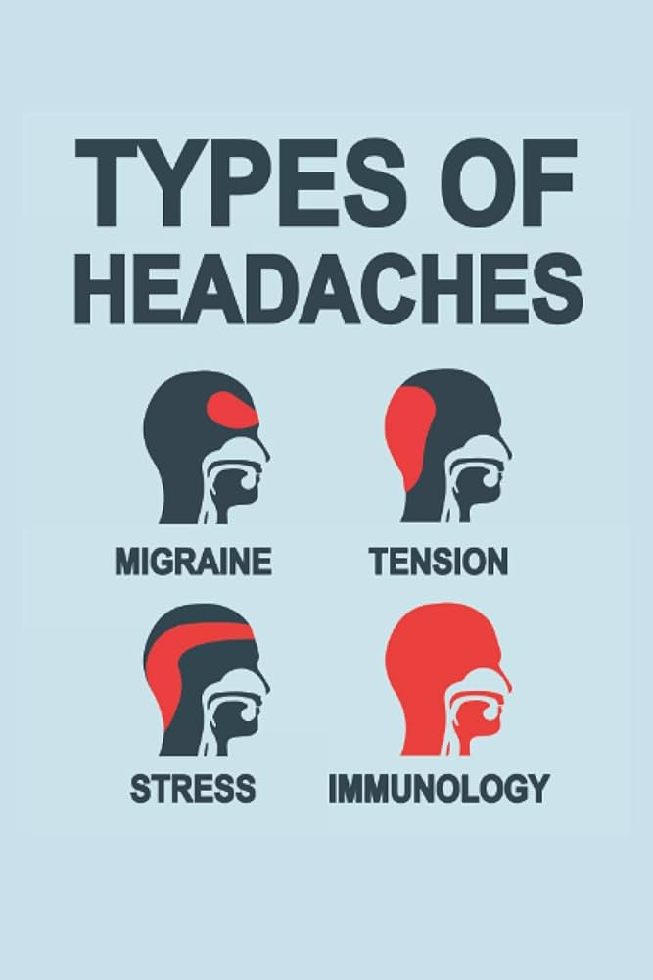
Learning points & take aways
Abnormal labs occur frequently during OPAT, but labs alone rarely drive a change in therapy
Antibiotic associated neutropenia is common (2.2% - 34%), often occurring in the third week of therapy. Most patients will be asymptomatic
Cephalosporin induced liver injury is most often a mild cholestatic elevation occurring 1-4 weeks after the first dose
Eosinophilia should heighten awareness for possible hypersensitivity reactions, particularly when it occurs early in the treatment course (in the first two weeks)
HCV’s eclipse period is ~2 weeks; window period is 2-6 months
LFT abnormalities often occur before seroconversion, so should obtain PCR
Vasculitis is complicated; biopsy alone may not reveal the diagnosis so clinical context is key
Endocarditis, particularly subacute endocarditis, may cause an immune complex mediated LCV, though can also cause cryoglobulinemic or ANCA vasculitis
Slides available on hunterratliff1.com/talk/; Citations available via QR code or via the “citations” button on the website

