Slide 1
A visit to the dentist
CLINID conference
Hunter Ratliff
03/20/2025
Ages, dates, and other identifying information may have been changed
I have no conflict of interest in relation to this presentation
Notes:
(https://wvumdtv.zoom.us/j/4383197511?omn=93537052670)

Slide 2
Case #1

Slide 3
Case 1: HPI
A 27 y/o M with PMH including poorly controlled DM p/w chronic groin wound drainage & productive cough

Slide 4
Case 1: HPI
A 27 y/o M with PMH including poorly controlled DM p/w chronic groin wound drainage & productive cough
Tenderness with purulent drainage from wounds
High blood sugar
Right sided chest tightness & productive cough
Ongoing for “months”

Slide 5
Case 1: HPI
A 27 y/o M with PMH including poorly controlled DM p/w chronic groin wound drainage & productive cough
Tenderness with purulent drainage from wounds
High blood sugar
Right sided chest tightness & productive cough
Ongoing for “months”
ROS
No fevers, chills, night sweats
DOE, but no dyspnea at rest
Chronic diarrhea

Slide 6
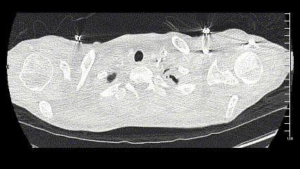
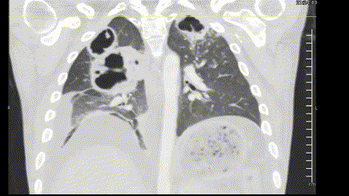
Case 1: HPI
A 27 y/o M with PMH including poorly controlled DM p/w chronic groin wound drainage & productive cough

Slide 7
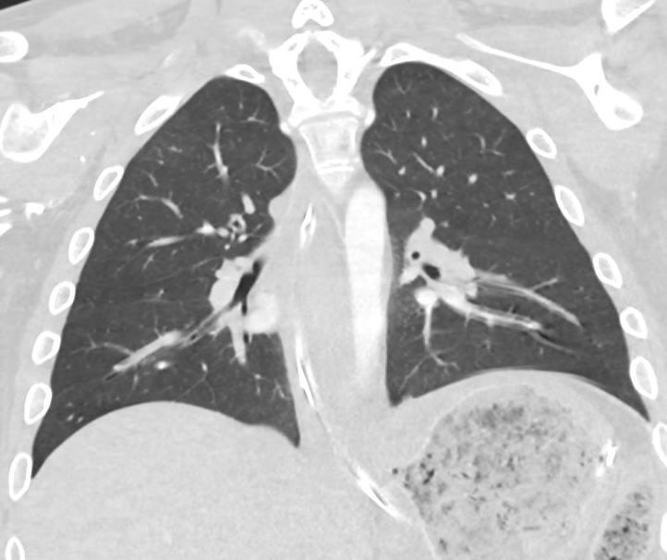
Case 1: HPI
Prior CT (5 months ago)

Slide 8
Case 1: Social & Exposure History
Geographic & Travel | The patient lives in Ohio with parents He denies recent foreign or domestic travel
Occupational | Not working; no hobbies; doesn’t do outdoor activities
Substance & needles | Denies EtOH (prior ID notes state “alcohol abuse” in problem list) Vapes tobacco Smokes weed, no other drugs; never IVDU Remote hx of unprofessional tattoos
Animals | No animals (including birds, bats), aside from pet cat
Exposures | No TB risk factors No exposures to soil; no dead/decaying wood or vegetation No water exposures (e.g. hot tubs, humidifiers)

Slide 9
Case 1: Physical exam
Vitals: BP 102/61 (on levophed) | Pulse 102 | Temp 36.6 °C | SpO2 94% | BMI 25.13 kg/m²
Gen: alert and oriented, NAD
Head/Neck: NCAT; trachea appears midline, no gross LAD
ENT: EOMI grossly, anicteric sclerae; good detention
Resp: normal respiratory effort, CTAB
CV: RRR; extremities perfused
GI: non-distended; no TTP
Neuro/MSK: moves extremities, CN exam normal
Psych: normal mood; appropriate affect

Slide 10
Case 1: Chart review
Multiple admissions for DKA
A1c >15
3 months ago: NSTI groin & scrotum
Done at OSH, so no micro records
Completed abx while inpatient
2.5 months ago: Wheeling for wounds
No surgical procedures done
ID saw him there, was on Vanc/Unasyn for 4 days
Pt declined OPAT
Sent home on doxy/Augmentin
Micro: Lots of negative blood cultures in recent months

Slide 11
Case 1: Chart review
Multiple admissions for DKA
A1c >15
3 months ago: NSTI groin & scrotum
Done at OSH, so no micro records
Completed abx while inpatient
2.5 months ago: Wheeling for wounds
No surgical procedures done
ID saw him there, was on Vanc/Unasyn for 4 days
Pt declined OPAT
Sent home on doxy/Augmentin
Micro: Lots of negative blood cultures in recent months
Hospital course (thus far)
Admitted to MICU w/ septic shock
Groin I&D with general surgery
Left groin abscess at the site that was spontaneously draining
A moderate amount of pus was expressed from abscess
No true NSTI (per note)
Gram stain: GPC, yeast
Pulm does bronch in OR
ID consult on hospital day 2

Slide 12
Case 1: Summary
-5 months
Normal CT chest
-3 mo
Groin NSTI (OSH)
A 27 y/o M with PMH including poorly controlled DM, recent NSTI of groin p/w chronic groin wound drainage & productive cough and found to have numerous cavitary lesions
Debridement, unknow what Cx or abx he got
Ongoing wounds since then
Now
This admission
DDx?
Workup?

Slide 13
Let's place some bets
Mycobacterial
Mycobacterium tuberculosis
NTM: M kansasii, M abscessus, MAC
Endemic mycoses
Histo
Blasto
Cocci
Other fungal
Crypto
Aspergillus
Mucor
Necrotizing bacteria
Staph aureus
Enterobacterales: Kleb, E cloacae
Nonfermenters: Pseudomonas, Steno
Oral & anaerobes
Streptococcus anginosus group
Bacteroides, fusobacterium, prevotella
Filamentous gram positive rods
Nocardia
Actinomyces

Slide 14
Case 1: Workup
BAL | Result
Asp GM | Neg
Asp PCR | Neg
MTB PCR | Neg
PJP PCR | Neg
Micro | Result
Blood | Neg
Urine | Neg
OR (groin) | GPC Yeast
BAL (routine) | GNR
BAL (AFB) | Neg
BAL (fungal) | Neg
Serum / Urine | Result
Histo Ag | Neg
Blasto Ag | Neg
Crypto Ag | 1:1280
Fungitell | 34
Asp GM | Neg
uStrep Ag | Neg

Slide 15
Case 1: Workup
BAL | Result
Asp GM | Neg
Asp PCR | Neg
MTB PCR | Neg
PJP PCR | Neg
Micro | Result
Blood | Neg
Urine | Neg
OR (groin) | GPC Yeast
BAL (routine) | GNR
BAL (AFB) | Neg
BAL (fungal) | Neg
Serum / Urine | Result
Histo Ag | Neg
Blasto Ag | Neg
Crypto Ag | 1:1280
Fungitell | 34
Asp GM | Neg
uStrep Ag | Neg

Slide 16
Case 1: Workup
BAL | Result
Asp GM | Neg
Asp PCR | Neg
MTB PCR | Neg
PJP PCR | Neg
Micro | Result
Blood | Neg
Urine | Neg
OR (groin) | GPC Yeast
BAL (routine) | GNR
BAL (AFB) | Neg
BAL (fungal) | Neg
Serum / Urine | Result
Histo Ag | Neg
Blasto Ag | Neg
Crypto Ag | ---
Fungitell | 34
Asp GM | Neg
uStrep Ag | Neg

Slide 17
Case 1: Workup
BAL | Result
Asp GM | Neg
Asp PCR | Neg
MTB PCR | Neg
PJP PCR | Neg
Micro | Result
Blood | Neg
Urine | Neg
OR (groin) | GPC Yeast
BAL (routine) | GNR
BAL (AFB) | Neg
BAL (fungal) | Neg
Serum / Urine | Result
Histo Ag | Neg
Blasto Ag | Neg
Crypto Ag | ---
Fungitell | 34
Asp GM | Neg
uStrep Ag | Neg

Slide 18
Case 1: Workup
BAL | Result
Asp GM | Neg
Asp PCR | Neg
MTB PCR | Neg
PJP PCR | Neg
Micro | Result
Blood | Neg
Urine | Neg
OR (groin) | 4+ Mixed GP & GN 4+ Strep Anginosus 3+ CONS 2+ C albicans 1+ Proteus mirabilis
BAL (routine) | GNR (gram stain)
BAL (AFB) | Neg
BAL (fungal) | Neg
Serum / Urine | Result
Histo Ag | Neg
Blasto Ag | Neg
Crypto Ag | ---
Fungitell | 34
Asp GM | Neg
uStrep Ag | Neg

Slide 19
Case 1: Workup
BAL | Result
Asp GM | Neg
Asp PCR | Neg
MTB PCR | Neg
PJP PCR | Neg
Micro | Result
Blood | Neg
Urine | Neg
OR (groin) | 4+ Mixed GP & GN organisms 4+ Strep Anginosus 3+ CONS 2+ C albicans 1+ Proteus mirabilis
BAL (routine) | >100k cfu Kleb pneumo Mucoid kleb in the lab
BAL (AFB) | Neg
BAL (fungal) | Neg
Serum / Urine | Result
Histo Ag | Neg
Blasto Ag | Neg
Crypto Ag | 1:1280
Fungitell | 34
Asp GM | Neg
uStrep Ag | Neg

Slide 20
Case 1: Workup
4 fold decrease
Date of CrAG | Titer
Day 2 | 1 : 1280
Day 3 | 1 : 320
Micro | Result
Blood | Neg
Urine | Neg
OR (groin) | 4+ Mixed GP & GN organisms 4+ Strep Anginosus 3+ CONS 2+ C albicans 1+ Proteus mirabilis
BAL (routine) | >100k cfu Kleb pneumo Mucoid kleb in the lab
BAL (AFB) | Neg
BAL (fungal) | Neg
HIV: negative
CD4: 780 (56%, ratio 2.0)

Slide 21
Case 1: Workup
Date of CrAG | Titer
Day 2 | 1 : 1280
Day 3 | 1 : 320
Micro | Result
Blood | Neg
Urine | Neg
OR (groin) | 4+ Mixed GP & GN organisms 4+ Strep Anginosus 3+ CONS 2+ C albicans 1+ Proteus mirabilis
BAL (routine) | >100k cfu Kleb pneumo Mucoid kleb in the lab
BAL (AFB) | Neg
BAL (fungal) | Neg
LP | Result
Opening Pr (cm H2O) | 13
WBC (Neut, lymph) | 50 (56%, 40%)
RBC | 875
Pro / Glu | 40 / 131
Biofire | Neg
Cx (routine/AFB/fungal) | Neg
India ink | Neg
Crypto Ag | Neg

Slide 22
Case 1: Next steps
Micro | Result
Blood | Neg
OR (groin) | 4+ Mixed GP & GN organisms 4+ Strep Anginosus 3+ CONS 2+ C albicans 1+ Proteus mirabilis
BAL (routine) | >100k cfu Kleb pneumo Mucoid kleb in the lab
BAL (fungal) | Neg
A 27 y/o M with PMH including poorly controlled DM, recent NSTI of groin p/w chronic groin wound drainage & productive cough and found to have numerous cavitary lesions that have grown mucoid kleb pneumo, but serum CrAG was also strongly positive
Is this kleb or crypto (or both)?
What do you do for treatment?
W/O treatment
Date of CrAG | Titer
Day 2 | 1 : 1280
Day 3 | 1 : 320

Slide 23
Case 1: Hospital course
Asked for TTE (normal), CD4 (780, 56%, ratio 2.0)
Initially on Zyvox + Zosyn (for NSTI) → Unasyn
After LP was done, added fluconazole 400
Signed off:
Unasyn → Augmentin x6 weeks (w/ repeat imaging)
Fluconazole (for 6 months?)
Worsening pleural effusion, got chest tube
Pleural fluid also grew kleb pneumo again
Started heading towards neutropenia on Unasyn
Switched to ceftriaxone + Flagyl → cefpodoxime + Flagyl
Still on fluconazole

Slide 24
Case 1: Hospital course
Asked for TTE (normal), CD4 (780, 56%, ratio 2.0)
Initially on Zyvox + Zosyn (for NSTI) → Unasyn
After LP was done, added fluconazole 400
Signed off:
Unasyn → Augmentin x6 weeks (w/ repeat imaging)
Fluconazole (for 6 months?)
Worsening pleural effusion, got chest tube
Pleural fluid also grew kleb pneumo again
Started heading towards neutropenia on Unasyn
Switched to ceftriaxone + Flagyl → cefpodoxime + Flagyl
Still on fluconazole

Slide 25
Discussion
Links to articles discussed here

Slide 26
Hypermucoviscous Klebsiella pneumoniae
(HmKp)
Define HmKp and distinguish it from classical Klebsiella pneumoniae based on genetic & virulence factors
Analyze the geographic distribution of HmKp highlighting its emergence as a global pathogen
Recognize the unique clinical manifestations of HmKp infections and differences in disease severity compared to classical Klebsiella pneumoniae infections

Slide 27
HmKp: What is it? [1.1]
Hypermucoviscous Klebsiella pneumoniae (HmKp) is a phenotype of K pneumoniae that produces a thick, mucoid capsule

Slide 28
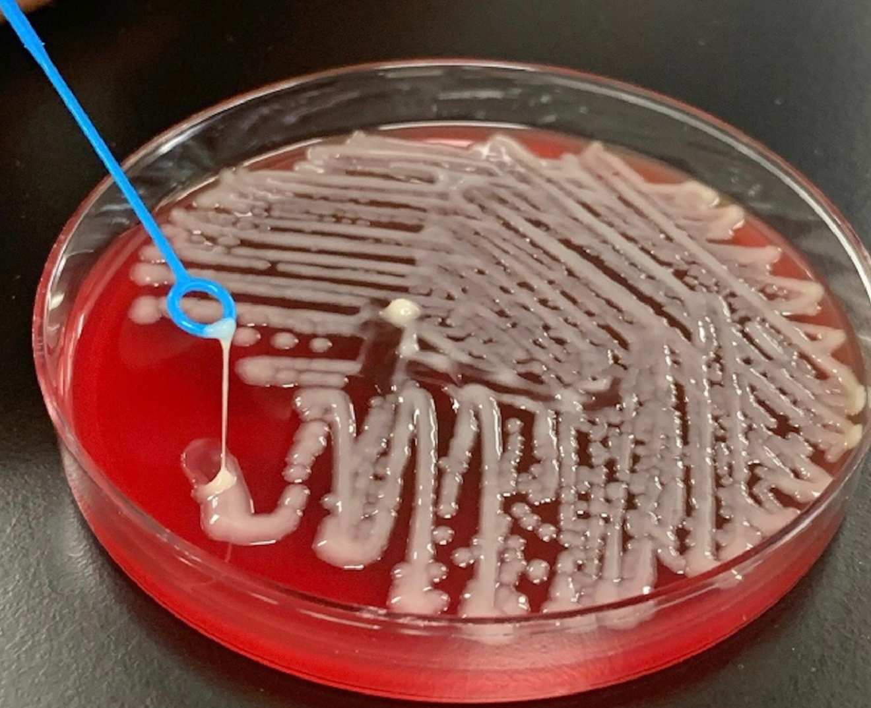
HmKp: What is it? [1.1]
Hypermucoviscous Klebsiella pneumoniae (HmKp) is a phenotype of K pneumoniae that produces a thick, mucoid capsule
Identified with the string test
Stretches over 5mm with an inoculation loop
>5 mm

Slide 29
HmKp: What is it? [1.1]
Virulence genes on plasmids (rmpA & rmpA2)
Overproduction of capsular polysaccharides
Reduced complement deposition & phagocytosis
>5 mm
Evades immune defenses

Slide 30
HmKp: Who gets it? [1.1][1.2]
Initial identified in East/Southeast Asia, but spreading world wide
More often community acquired (as opposed to other strains of K pneumo)
Often younger, healthier folks
Immunosuppression isn’t major risk factor, with the exception of diabetes

Slide 31
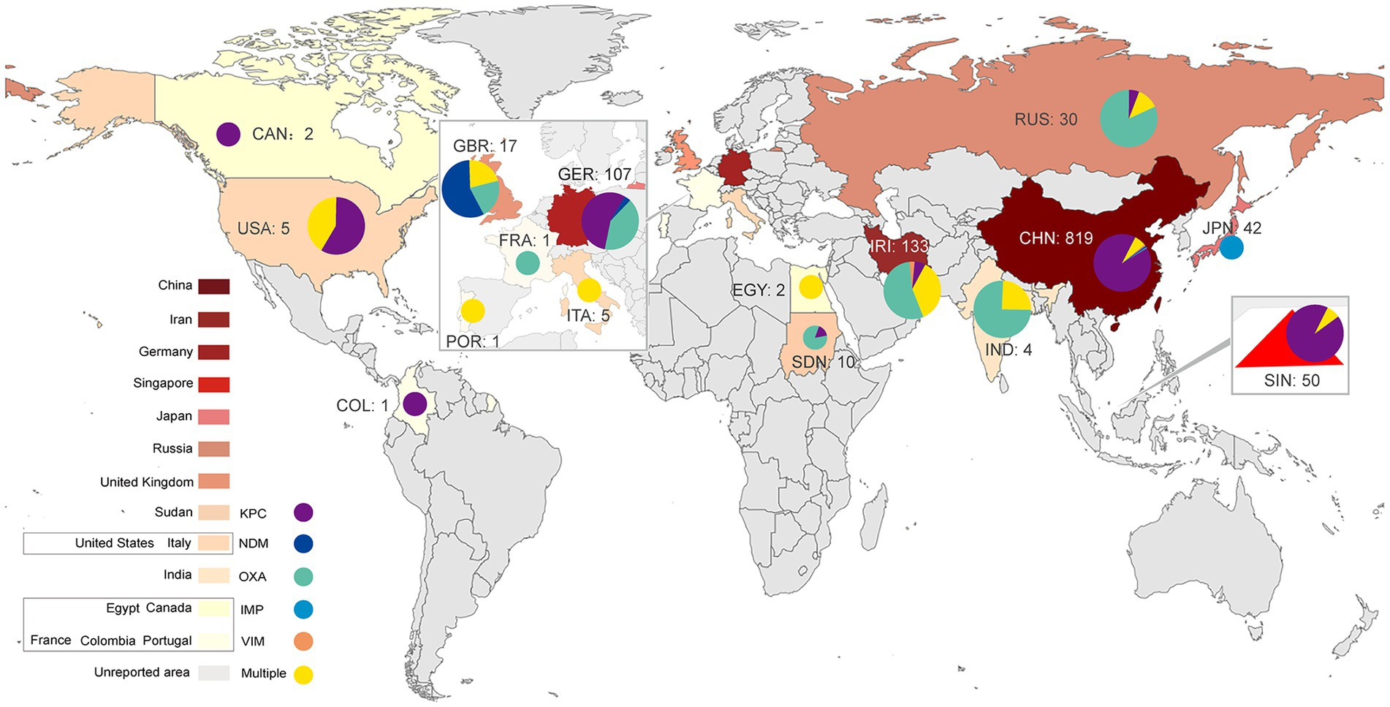
HmKp: Who gets it? [1.3]
May be associated with extensive antimicrobial resistance, especially internationally
Figure 1 [1.3]:
Global distribution of CR-hvKP (2015–2022)

Slide 32
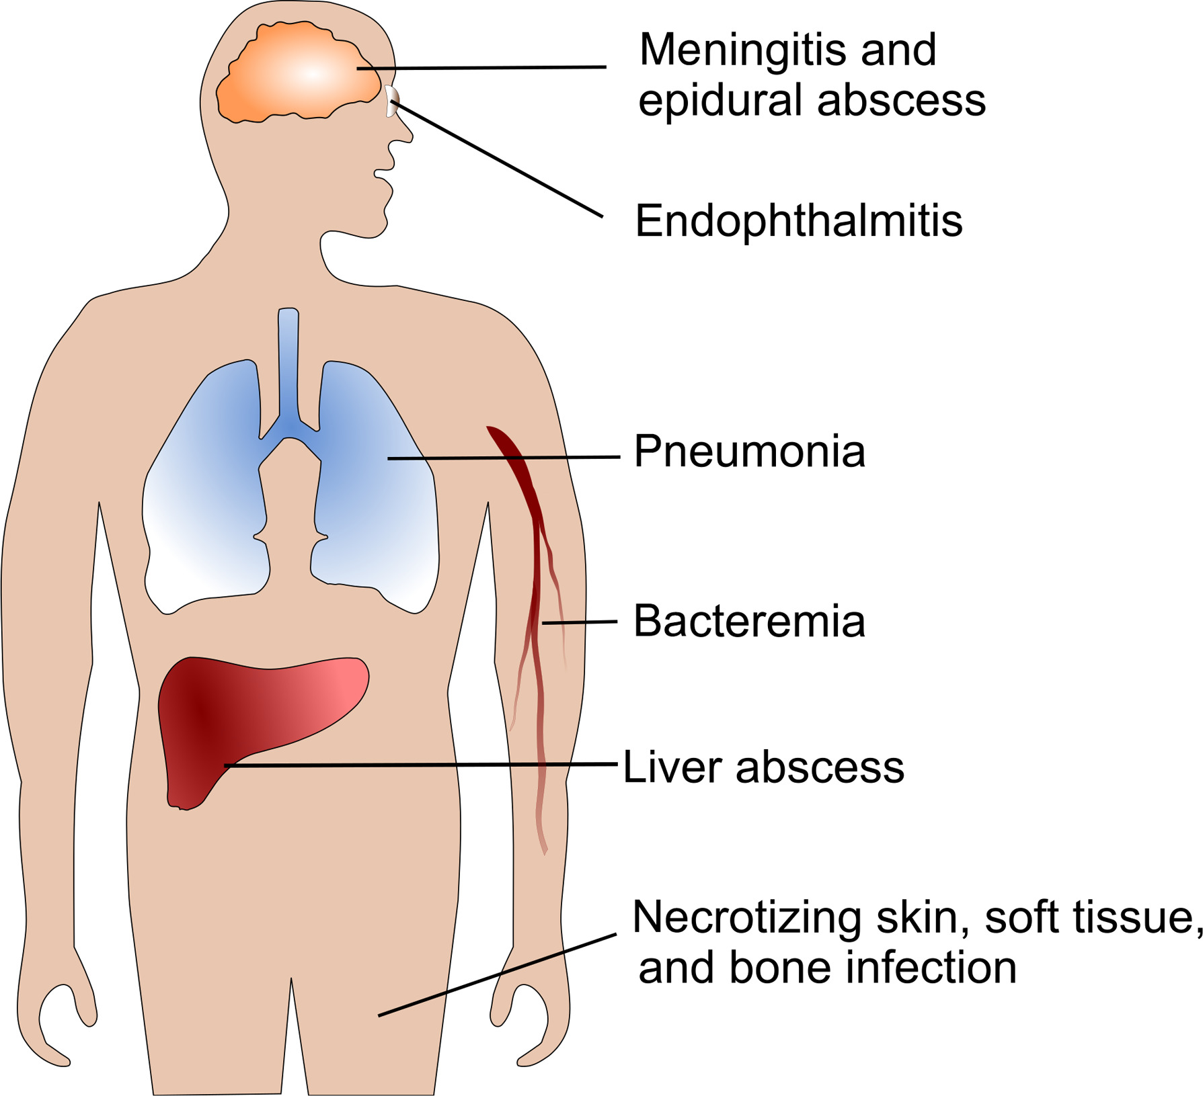
HmKp: Clinical manifestations [1.1][1.4]
High risk for metastatic spread (12-28%)
Classically: liver abscess in healthy adults
Most common sides
Meningitis
Pleural empyema
Endophthalmitis
Many reports with NSTIs (as was maybe our case)
Has been reported to seed almost anywhere
Figure 1 [1.4]: Common sites of primary and metastatic infections caused by hvKp

Slide 33
Evidence Bayes’ed
medicine
Review Bayes’ theorem and it’s applications (without talking too much about math)
Highlight the key relationship between pre-test probability and testing characteristics (sensitivity, specificity)
P(E|H) P(H)
P(H|E) =
P(E)

Slide 34
Bayes theorem
Named after Thomas Bayes
Law of conditional probability
Bayes Theorem
P(B|A) P(A)
P(A|B) =
P(B)

Slide 35
Bayes theorem
Posterior: Probability the “hypothesis” being true, given observed “evidence”
Bayes Theorem
H = hypothesis
E = evidence
A|B = means “A given B”
P(E|H) P(H)
P(H|E) =
P(E)

Slide 36
Bayes theorem
Posterior: Probability the “hypothesis” being true, given observed “evidence”
Likelihood: Probability that “evidence” occurs if “hypothesis” is true
Bayes Theorem
H = hypothesis
E = evidence
A|B = means “A given B”
P(E|H) P(H)
P(H|E) =
P(E)

Slide 37
Bayes theorem
Posterior: Probability the “hypothesis” being true, given observed “evidence”
Likelihood: Probability that “evidence” occurs if “hypothesis” is true
Prior: The pre-test probability the “hypothesis” is true
Bayes Theorem
H = hypothesis
E = evidence
A|B = means “A given B”
P(E|H) P(H)
P(H|E) =
P(E)

Slide 38
Bayes theorem
Posterior: Probability the “hypothesis” being true, given observed “evidence”
Likelihood: Probability that “evidence” occurs if “hypothesis” is true
Prior: The pre-test probability the “hypothesis” is true
Evidence: The probability of the “evidence” occurring (regardless of “hypothesis”)
Bayes Theorem
H = hypothesis
E = evidence
A|B = means “A given B”
P(E|H) P(H)
P(H|E) =
P(E)

Slide 39
The good news
Bayes Theorem
Posterior: Probability the “hypothesis” being true, given observed “evidence”
Likelihood: Probability that “evidence” occurs if “hypothesis” is true
Prior: The pre-test probability the “hypothesis” is true
Evidence: The probability of the “evidence” occurring
P(E|H) P(H)
You don’t need to do the math!
The important takeaway is that the chance our hypothesis is right, given the evidence is equally influenced by of BOTH
The quality of the test (e.g. sensitivity, specificity)
The pre-test probability (e.g. the base rate)
P(H|E) =
P(E)

Slide 40
What the pre-test probability?
How often would you expect this to be caused by cryptococcus?
One in 10?
One in 20?
One in 50?
One in 100?
One in 1000?
A 27 y/o M with PMH including poorly controlled DM, recent NSTI of groin was found to have numerous cavitary lesions
BAL: Kleb pneumo
No risk factors for Cryptococcus
No fungal growth or yeast on slides

Slide 41
Serum cryptococcal antigen
Serum |  | CrAg EIA
 |  | Positive | Negative
CrAg LFA | Positive | 96 | 7
 | Negative | 0 | 94
 |  | Disease
 |  | Positive | Negative
Test | Positive | True Pos | False Pos
 | Negative | False Neg | True Neg
Sensitivity = TP / (TP + FN)
Specificity = TN / (TN + FP)
Sensitivity = 96 / (96 + 0) = 100%
Specificity = 94 / (94 + 7) = 93.1%
Source: https://www.immy.com/package_inserts/cr2003/CR2003%20IFU%20(Int'l)%20-%20English.pdf

Slide 42
Serum cryptococcal antigen
Serum |  | CrAg EIA
 |  | Positive | Negative
CrAg LFA | Positive | 96 | 7
 | Negative | 0 | 94
Likelihood ratio
LR+ = sensitivity / (1 - specificity)
LR+ = Pr(T+ | D+) / Pr(T+ | D-)
LR+ = 1 / (1 - .931) = 14.5
LR+ = sensitivity / (1 - specificity)
LR+ = Pr(T+ | D+) / Pr(T+ | D-)
LR+ = 1 / (1 - .931) = 14.5
Sensitivity = 96 / (96 + 0) = 100%
Specificity = 94 / (94 + 7) = 93.1%
Source: https://www.immy.com/package_inserts/cr2003/CR2003%20IFU%20(Int'l)%20-%20English.pdf

Slide 43
Post-test probability
How often would you expect this to be caused by cryptococcus?
One in 10?
One in 20?
One in 50?
One in 100?
One in 1000?

Slide 44
Post-test probability
How often would you expect this to be caused by cryptococcus?
One in 10?
One in 20?
One in 50?
One in 100?
One in 1000?
Among 44 cryptococcosis patients with DM2 as the only identifiable risk factor for disease, the annual incidence of cryptococcosis was 0.001% (1 in a thousand), with a prevalence of 0.002%. [1.5]

Slide 45
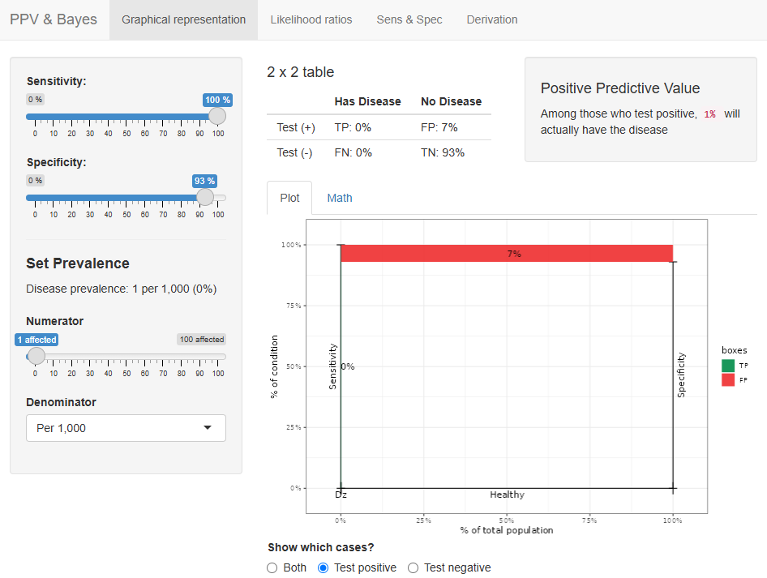
https://hunterratliff1.shinyapps.io/BayesPPV/

Slide 46
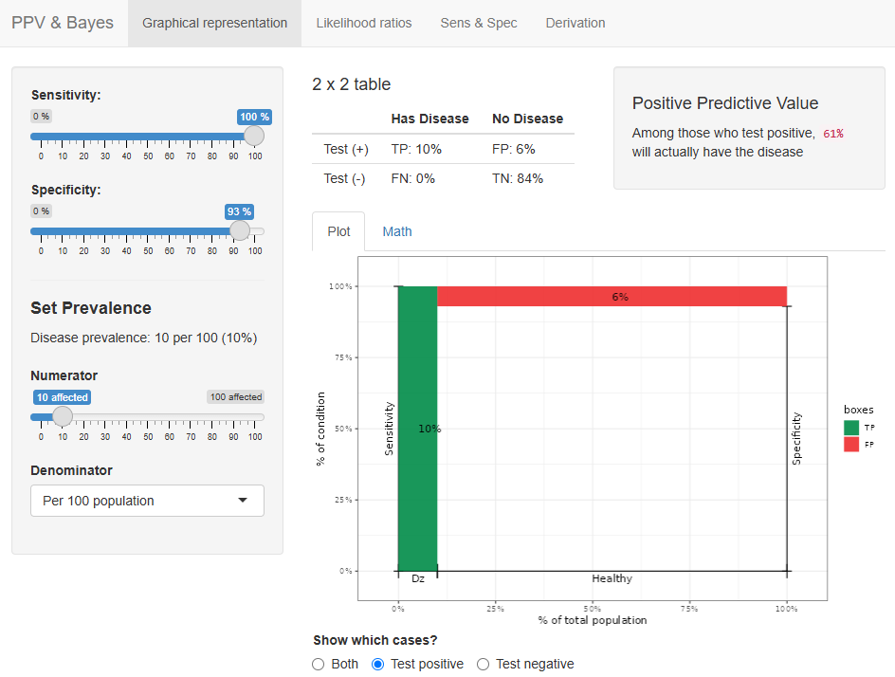
https://hunterratliff1.shinyapps.io/BayesPPV/

Slide 47
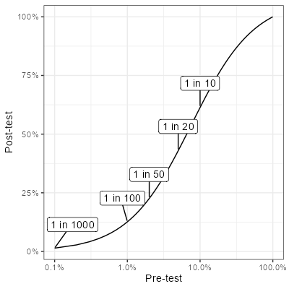
Post-test probability
How often would you expect this to be caused by cryptococcus?
One in 10? Pr(post) = 61.7%
One in 20? Pr(post) = 43.2%
One in 50? Pr(post) = 22.8%
One in 100? Pr(post) = 12.8%
One in 1000? Pr(post) = 1.4%

Slide 48
Case #2

Slide 49
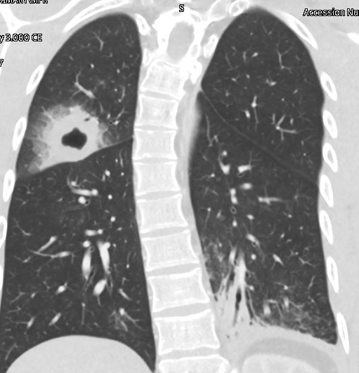
Case 2: HPI
A 22 y/o M with no PMH who p/w subacute cough
4 weeks ago: sore throat → fevers, cough, anorexia
After 7-10 days, still having productive cough
But all other symptoms resolved
Never took antibiotics
Went to urgent care due to cough
Obtained CXR → Sent to ED
Cracked a tooth 4 years ago, but no new symptoms
Had routine dental cleaning (2 weeks ago)
This was well after onset of fever & cough
Says exam & X-rays were normal

Slide 50
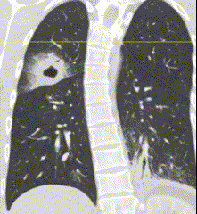
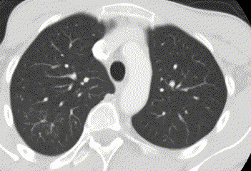
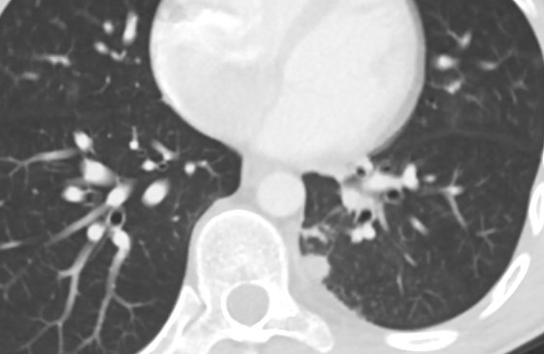
Case 2: HPI
A 22 y/o M with no PMH who p/w subacute cough
4 weeks ago: sore throat → fevers, cough, anorexia
After 7-10 days, still having productive cough
But all other symptoms resolved
Never took antibiotics
Went to urgent care due to cough
Obtained CXR → Sent to ED
Cracked a tooth 4 years ago, but no new symptoms
Had routine dental cleaning (2 weeks ago)
This was well after onset of fever & cough
Says exam & X-rays were normal
CT chest impression
Ill-defined 4 cm thick-walled cavitary mass posterior RUL
10 mm round subpleural nodule posterior medial LLL

Slide 51
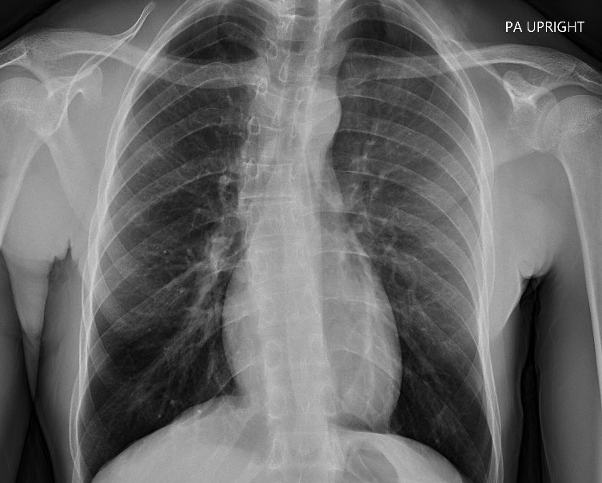
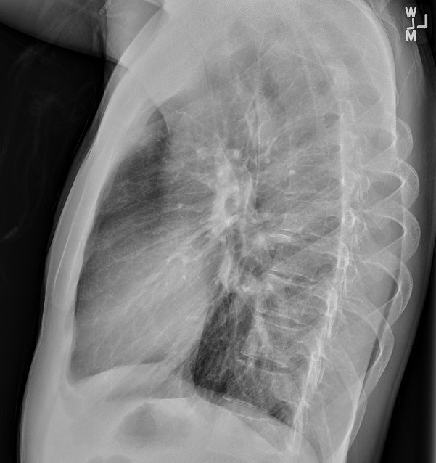
Case 2: HPI
A 22 y/o M with no PMH who p/w subacute cough
4 weeks ago: sore throat → fevers, cough, anorexia
After 7-10 days, still having productive cough
But all other symptoms resolved
Never took antibiotics
Went to urgent care due to cough
Obtained CXR → Sent to ED
Cracked a tooth 4 years ago, but no new symptoms
Had routine dental cleaning (2 weeks ago)
This was well after onset of fever & cough
Says exam & X-rays were normal
Prior XR (14 months ago)

Slide 52
Case 2: HPI
A 22 y/o M with no PMH who p/w subacute cough
4 weeks ago: sore throat → fevers, cough, anorexia
After 7-10 days, still having productive cough
But all other symptoms resolved
Never took antibiotics
Went to urgent care due to cough
Obtained CXR → Sent to ED
Cracked a tooth 4 years ago, but no new symptoms
Had routine dental cleaning (2 weeks ago)
This was well after onset of fever & cough
Says exam & X-rays were normal

Slide 53
Case 2: HPI
A 22 y/o M with no PMH who p/w subacute cough
4 weeks ago: sore throat → fevers, cough, anorexia
After 7-10 days, still having productive cough
But all other symptoms resolved
Never took antibiotics
Went to urgent care due to cough
Obtained CXR → Sent to ED
Cracked a tooth 4 years ago, but no new symptoms
Had routine dental cleaning (2 weeks ago)
This was well after onset of fever & cough
Says exam & X-rays were normal

Slide 54
Case 2: Social & Exposure History
Geographic & Travel | The patient lives in Tennessee (between Nashville & Memphis) for past year Before that, lived in Washington state for a few years Visits parents in Morgantown frequently A few months ago, some time in northern California for a family reunion Has driven through the Southwest states (Arizona, Texas), but did not spend much time there Only international travel has been to Canada (Alberta/BC area)

Slide 55
Case 2: Social & Exposure History
Geographic & Travel | The patient lives in Tennessee (between Nashville & Memphis) for past year Before that, lived in Washington state for a few years Visits parents in Morgantown frequently A few months ago, some time in northern California for a family reunion Has driven through the Southwest states (Arizona, Texas), but did not spend much time there Only international travel has been to Canada (Alberta/BC area)
Environmental exposures | Did live in house with ?mold No caves, landscaping, wood, or dust/dirt/soil exposure Helping parents with their house renovations | Occupational | Doordash driver in TN
 |  | Substance & needles | NoEtOH, tobacco, drugs No tattoos or piercings
 |  | TB | No TB risk factors

Slide 56
Case 2: Social & Exposure History
Geographic & Travel | The patient lives in Tennessee (between Nashville & Memphis) for past year Before that, lived in Washington state for a few years Visits parents in Morgantown frequently A few months ago, some time in northern California for a family reunion Has driven through the Southwest states (Arizona, Texas), but did not spend much time there Only international travel has been to Canada (Alberta/BC area)
Environmental exposures | Did live in house with ?mold No caves, landscaping, wood, or dust/dirt/soil exposure Helping parents with their house renovations | Occupational | Doordash driver in TN
 |  | Substance & needles | NoEtOH, tobacco, drugs No tattoos or piercings
 |  | TB | No TB risk factors
Animals | Rodent exposure (cleaned mouse feces) w/o appropriate PPE While working as delivery driver, he pet a cat on the street (unclear if feral) Otherwise, no other animal exposures (including birds, bats, pets)

Slide 57
Case 2: Exam & initial labs
Vitals: BP 100/57| Pulse 62 | Temp 37.1 °C | SpO2 98% | BMI 18 kg/m²
Gen: alert and oriented, NAD, physically fit
ENT: EOMI grossly, anicteric sclerae, MMM; good detention
Resp: normal respiratory effort, CTAB
CV: RRR
GI: no TTP
Neuro/MSK: moves extremities
CBC w/ diff: Normal
BMP: Normal
LFTs: Not available
HIV: Negative

Slide 58
Case 2: Summary
-3 years
Living in Washington State
Lived in a house with “mold”
International travel to British Columbia
A 22 y/o M with no PMH who p/w subacute cough x 1 month
New 4cm RUL cavity, 1cm LLL nodule (vs XR 14 mo ago)
Lots of fun travel & exposures
Some dental issues?
HIV negative
-1 year
Moved to Tennessee
Normal CXR around this time
Travel to northern California
Did cross country trips too
House renovations (in WV)
-1 month
Fever, cough, sore throat
Self resolved after 7-10 days
-3 weeks
Symptoms gone aside from cough
Did go to the dentist
Now
Admission

Slide 59
Let's place some bets
Mycobacterial
Mycobacterium tuberculosis
NTM: M kansasii, M abscessus, MAC
Endemic mycoses
Histo
Blasto
Cocci
Other fungal
Crypto
Aspergillus
Mucor
Necrotizing bacteria
Staph aureus
Klebsiella pneumoniae
Pseudomonas, E cloacae, Steno
Oral & anaerobes
Streptococcus anginosus group
Bacteroides, fusobacterium, prevotella
Filamentous gram positive rods
Nocardia
Actinomyces

Slide 60
Case 2: Workup
Serum / Urine | Result
Histo Ag
Blasto Ag
Crypto Ag
Fungitell
Asp GM
Strep Ag
Legionella Ag
QuantGOLD
BAL | Result
Asp GM
Asp PCR
MTB PCR
PJP PCR
Legionella DNA
Micro | Result
Blood
BAL (routine)
BAL (AFB)
BAL (fungal)

Slide 61
Case 2: Workup
Serum / Urine | Result
Histo Ag | Neg
Blasto Ag | Neg
Crypto Ag | Neg
Fungitell | <31
Asp GM | Neg
Strep Ag | Neg
Legionella Ag | Neg
QuantGOLD | Neg
BAL | Result
Asp GM | Neg
Asp PCR | Neg
MTB PCR | Neg
PJP PCR | Neg
Legionella DNA | Neg
Micro | Result
Blood | NG
BAL (routine) | NG
BAL (AFB) | NG
BAL (fungal) | NG
Any other tests?

Slide 62
Case 2: Workup
Serum / Urine | Result
Histo Ag | Neg
Blasto Ag | Neg
Crypto Ag | Neg
Fungitell | <31
Asp GM | Neg
Strep Ag | Neg
Legionella Ag | Neg
QuantGOLD | Neg
BAL | Result
Asp GM | Neg
Asp PCR | Neg
MTB PCR | Neg
PJP PCR | Neg
Legionella DNA | Neg
Micro | Result
Blood | NG
BAL (routine) | NG
BAL (AFB) | NG
BAL (fungal) | NG
?
Any other tests?

Slide 63
Case 2: Workup
BAL | Result
Asp GM | Neg
Asp PCR | Neg
MTB PCR | Neg
PJP PCR | Neg
Legionella DNA | Neg
Micro | Result
Blood | NG
BAL (routine) | NG
BAL (AFB) | NG
BAL (fungal) | NG
Coccidioides antibody, serum
-3 years
Living in Washington State
Complement fixation
Antibody detected (1:2)
Immunodiffusion
Antibody not detected
Lived in a house with “mold”
International travel to British Columbia

Slide 64
Case 2: Workup
Complement fixation
Antibody detected (1:2)
All serum titers > 1:2 should be considered evidence indicative of coccidioidomycosis, although titers of 1:2 and 1:4 should be confirmed by immunodiffusion testing. Titers exceeding 1:16 usually reflect disseminated disease. In general, higher titers are correlated with disease severity, and changes in serial titers are of prognostic value.
A negative CF test does not, however, rule out diagnosis. Only 70% of patients with cavitary diseases are positive, and only 30% of patients with nodular disease are positive.
Immunodiffusion
Antibody not detected
The immunodiffusion (ID) procedure correlates both in sensitivity and clinical utility with the CF test. The ID test, which detects IgG directed to the "F" antigen, becomes positive within 4 weeks after infection and remains positive throughout clinically active disease. It is most useful in confirming the specificity of low CF titers, where lines of identity are formed with reference antisera. Positive ID reactions are diagnostic for coccidioidomycosis and usually indicate active or recent disease and remain detectable for up to 1 year thereafter.

Slide 65
Case 2: Workup
Complement fixation
Antibody detected (1:2)
All serum titers > 1:2 should be considered evidence indicative of coccidioidomycosis, although titers of 1:2 and 1:4 should be confirmed by immunodiffusion testing. Titers exceeding 1:16 usually reflect disseminated disease. In general, higher titers are correlated with disease severity, and changes in serial titers are of prognostic value.
A negative CF test does not, however, rule out diagnosis. Only 70% of patients with cavitary diseases are positive, and only 30% of patients with nodular disease are positive.
Immunodiffusion
Antibody not detected
The immunodiffusion (ID) procedure correlates both in sensitivity and clinical utility with the CF test. The ID test, which detects IgG directed to the "F" antigen, becomes positive within 4 weeks after infection and remains positive throughout clinically active disease. It is most useful in confirming the specificity of low CF titers, where lines of identity are formed with reference antisera. Positive ID reactions are diagnostic for coccidioidomycosis and usually indicate active or recent disease and remain detectable for up to 1 year thereafter.
Prior XR (14 months ago)

Slide 66
Coccidioides
Links to articles discussed here

Slide 67
Coccidioides
Describe the epidemiology of Coccidioides, including geographic distribution & seasonal patterns
Explain the modes of transmission and key risk factors for Coccidioides infection
Discuss the diagnostic approaches for coccidioidomycosis, including serologic testing, culture, and molecular methods
Characterize the spectrum of disease caused by Coccidioides

Slide 68
Coccidioides (Valley fever)
California, AZ, Washington
Coccidioides immitis more common in California
C posadasii elsewhere
No clinical difference
https://www.cdc.gov/valley-fever/areas/index.html

Slide 69
Coccidioides (Valley fever)
California, AZ, Washington
Coccidioides immitis more common in California
C posadasii elsewhere
No clinical difference
Also seen in Mexico, Central America, and some areas of South America
https://www.cdc.gov/valley-fever/areas/index.html

Slide 70
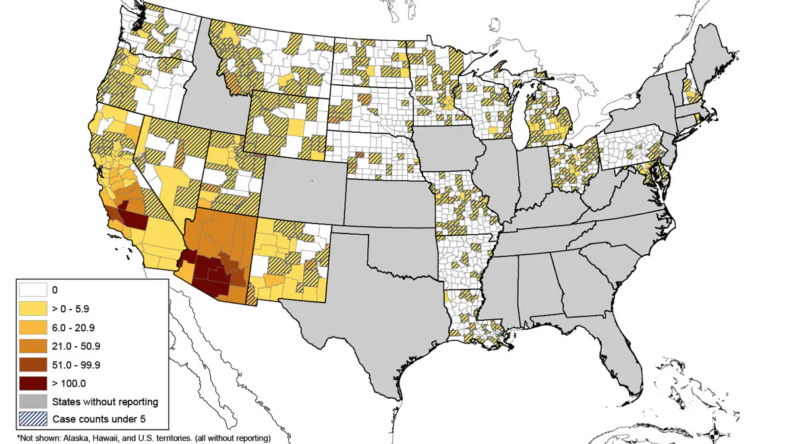
Coccidioides (Valley fever)
County incidence (per 100,000) from 2011 - 2017 https://www.cdc.gov/valley-fever/areas/index.html

Slide 71
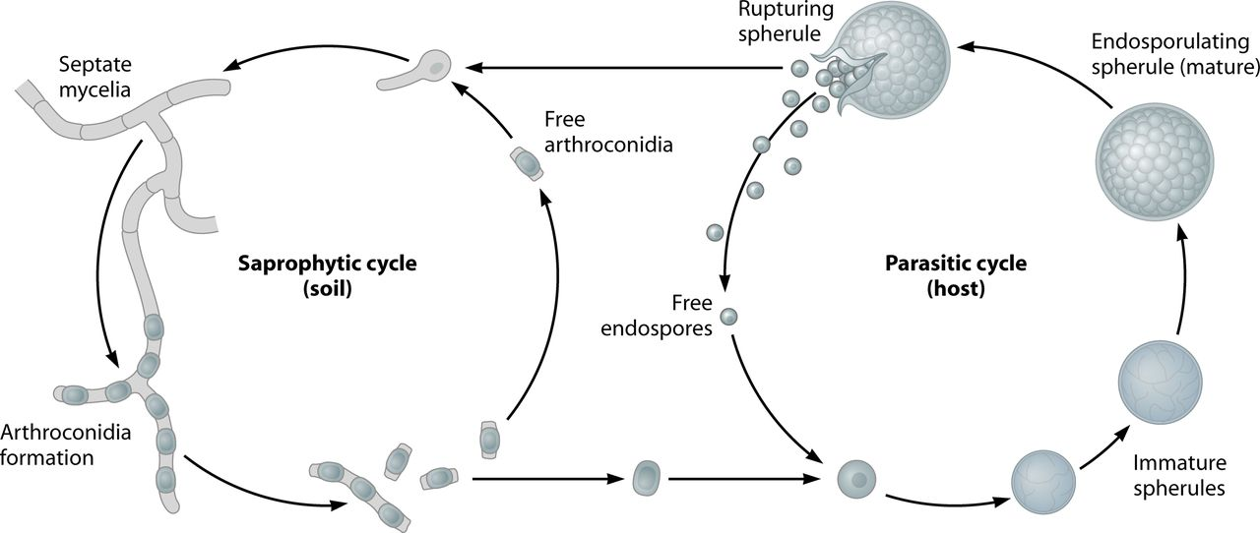
Coccidioides: Transmission [2.1]
Inhalation of arthroconidia from contaminated soil
Dust storms
Construction
Earthquakes
More common in the dry season

Slide 72
Coccidioides: Diagnosis [2.2]
Most common: EIA (screen) → immunodiffusion (confirmation)
May have false negative early in the disease (re-test 1-3 weeks later)
EIA is prone to false positives
If immunodiffusion is positive → quantification should be done (either QID or CF)

Slide 73
Coccidioides: Diagnosis [2.2]
Most common: EIA (screen) → immunodiffusion (confirmation)
May have false negatives early in the disease (re-test 1-3 weeks later)
EIA is prone to false positives
If immunodiffusion is positive → quantification should be done (either QID or CF)
Complement-fixation (CF) assay was the original method of diagnosis
Still helpful in running on the CSF
Not as sensitive or specific as ID

Slide 74
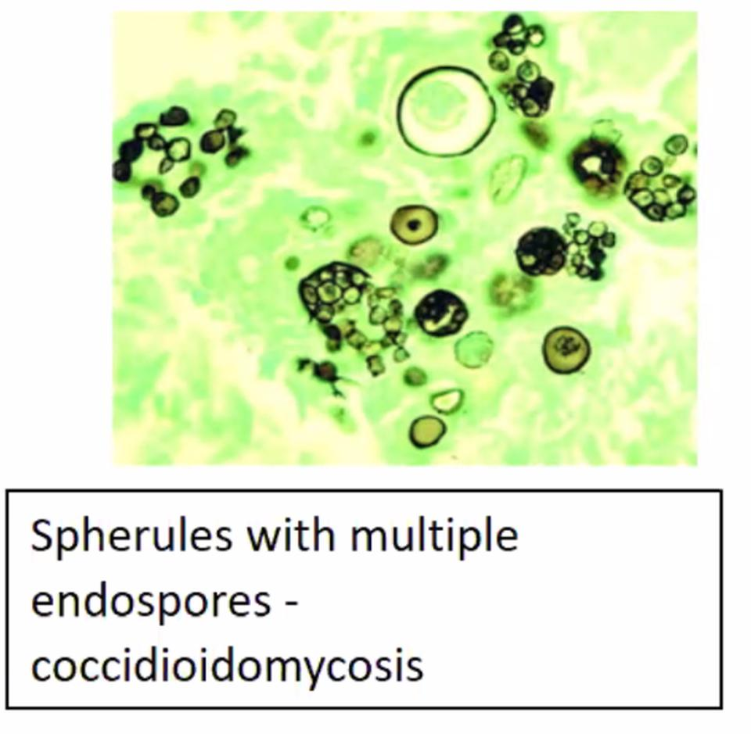
Coccidioides: Diagnosis [2.2]
Most common: EIA (screen) → immunodiffusion (confirmation)
May have false negatives early in the disease (re-test 1-3 weeks later)
EIA is prone to false positives
If immunodiffusion is positive → quantification should be done (either QID or CF)
Complement-fixation (CF) assay was the original method of diagnosis
Still helpful in running on the CSF
Not as sensitive or specific as ID
Culture: Coccidioides grows on most media
Growth usually evident within a week

Slide 75
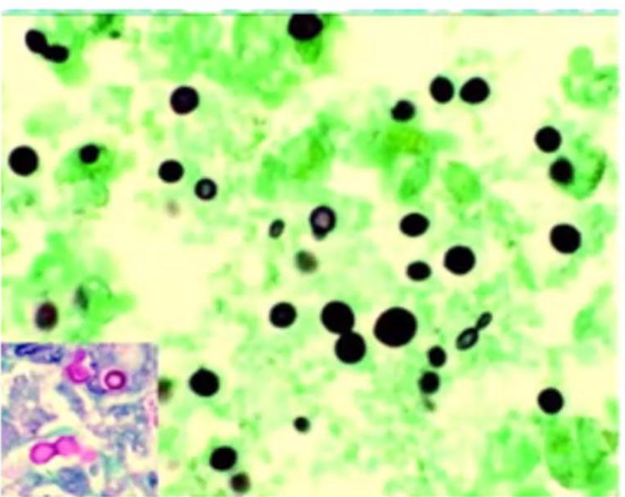
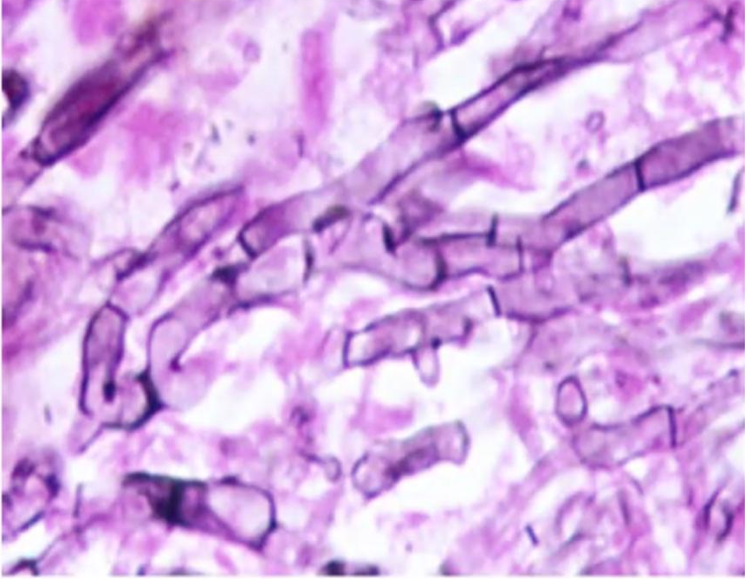
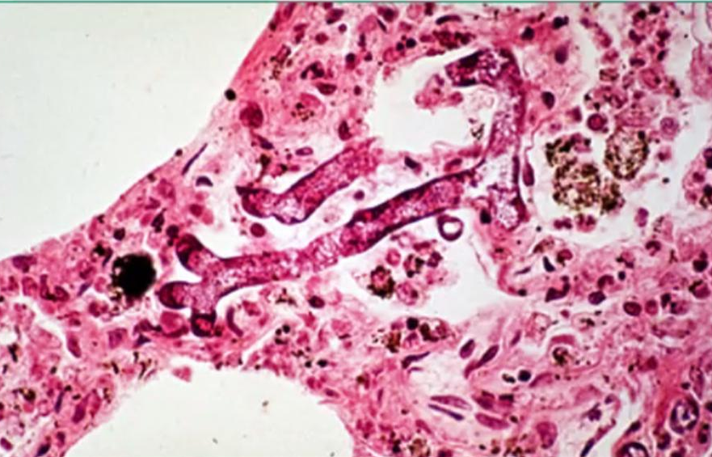
Adapted from @TheIDTrivia, @GeraldMD, & Febrile podcast #69
 | Coccidioidomycosis | Blastomycosis | Histoplasmosis
BAL | Spherules with multiple endospores | Broad based, single-budding | Small yeast, narrow based budding. May be in macrophages
 | Cryptococcus | Aspergillosis | Mucor and Rhizopus
BAL | Narrow budding yeast with mucicarmine (+) capsules | Septate hyphae Acute angle branching Forms conidial heads | Ribbon-like hyphae Right angle branching Rare septations

Slide 76
Adapted from @TheIDTrivia, @GeraldMD, & Febrile podcast #69
 | Coccidioidomycosis | Blastomycosis | Histoplasmosis
Risk factors | Working in dusty areas | Working, playing, or hunting in wooded areas | Chickens, barns, caves, or any bird droppings
B-D glucan | +/- | No | +/-
Galacto- mannan | No | +/- | +/-
 | Cryptococcus | Aspergillosis | Mucorales
Risk factors | Steroids, AIDs, sarcoid, liver dz | Steroids, neutropenia, transplant, viral infections | DM, DKA, steroids, burns, transplant
B-D glucan | No | Yes | No
Galacto- mannan | +/- | Yes | No
Notes:
https://img.grepmed.com/uploads/8687/management-coccidioides-summary-valleyfever-diagnosis-original.jpeg
https://img.grepmed.com/uploads/12640/diagnosis-cocci-coccidioidomycosis-coccidioides-workup-original.jpeg

Slide 77
Coccidioides: Spectrum of disease [2.1]
Majority of patients (2/3) are asymptomatic
Asymptomatic

Slide 78
Coccidioides: Spectrum of disease [2.1]
Primary pulmonary disease
In endemic areas, can account for 1 in 4 cases of CAP
Often self limiting, some will have “multiple visits for unimproved symptoms (despite abx)”
Asymptomatic
Pulmonary

Slide 79
Coccidioides: Spectrum of disease [2.1]
Primary pulmonary disease
In endemic areas, can account for 1 in 4 cases of CAP
Often self limiting, some will have “multiple visits for unimproved symptoms (despite abx)”
Systemic symptoms: Fevers, night sweats
Immunologic: arthralgias (“desert rheumatism”), erythema nodosum, erythema multiforme
Labs: One in four have peripheral eosinophilia
Asymptomatic
Pulmonary

Slide 80
Coccidioides: Spectrum of disease [2.1]
Primary pulmonary disease
Systemic symptoms: Fevers, night sweats
Immunologic: arthralgias, erythema nodosum, erythema multiforme
Labs: Eosinophilia
Radiographically
Unilateral (upper > lower) infiltrate
Associated hilar LAD
Nodules &/or cavities (4-8%)
These do not mean they have disseminated disease!
Asymptomatic
Pneumonia
Nodules

Slide 81
Coccidioides: Spectrum of disease [2.1]
Disseminated disease is rare
Skin and soft tissue: Granulomatous infections (not the immunologic phenomena)
Bone & joint: May progress to osteomyelitis
Others: GU, peritoneum, eyes, pericardium
Asymptomatic
Pneumonia
Nodules
Disseminated

Slide 82
Coccidioides: Spectrum of disease [2.1]
Disseminated disease is rare
Skin and soft tissue
Bone & joint
Others
Most feared is CNS
Most common symptom: headache
95% mortality if untreated
High rates of relapse
Asymptomatic
Pneumonia
Nodules
Disseminated

Slide 83
Coccidioides: Spectrum of disease [2.1]
Disseminated disease is rare
Skin and soft tissue
Bone & joint
Others
Most feared is CNS
Most common symptom: headache
95% mortality if untreated
High rates of relapse
CSF studies
Common to have eosinophilia
Uncommon to grow on Cx
Asymptomatic
Pneumonia
Nodules
Disseminated

Slide 84
Learning points & take aways

Slide 85
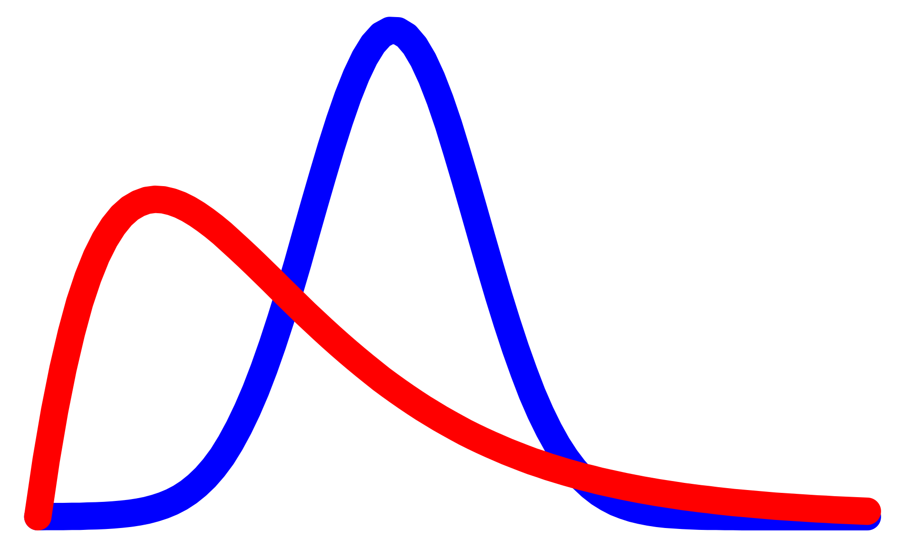
Learning points & take aways
Hypermucoviscous Klebsiella pneumoniae (HmKp) is a thick, mucoid phenotype of K pneumoniae (string test),
Predisposition to cause more severe infections in immunocompetent hosts
Likes to metastasize: Liver, CNS, lungs, brain
Can have extensive antimicrobial resistance, especially internationally
Coccidioides is most often asymptomatic or mild pulmonary infections, but can be severe in immunocompromise
Risk factors: Travel to the Western US + dry dirt/soil exposure
Testing for coccidioides is multi-step, and subject to false positives & false negatives
Interpreting the test results depends on both the nature of the test itself and the pre-test probability
You don’t need to know Bayes Theorem itself, but online calculators can help improve our numeracy
Slides available on hunterratliff1.com/talk/; Citations available via QR code or via the “citations” button on the website

