Slide 1
A visit to the dentist
- Part 2 -
CLINID conference
Hunter Ratliff
05/15/2025
Ages, dates, and other identifying information may have been changed
I have no conflict of interest in relation to this presentation

Slide 2
Updates on prior cases

Slide 3
Case #1

Slide 4
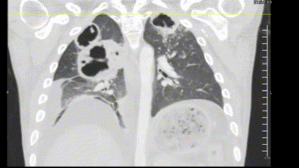
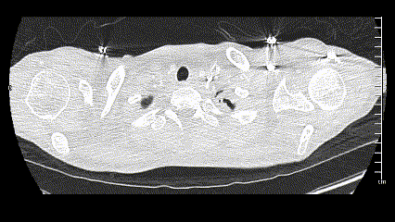
Case 1: Kleb/Crypto
A 27 y/o M with PMH including poorly controlled DM, recent NSTI of groin p/w chronic groin wound drainage & productive cough and found to have numerous cavitary lesions

Slide 5
Case 1: Kleb/Crypto
Micro | Result
BAL (routine) | >100k mucoid kleb pneumo
A 27 y/o M with PMH including poorly controlled DM, recent NSTI of groin p/w chronic groin wound drainage & productive cough and found to have numerous cavitary lesions that have grown mucoid kleb pneumo, but serum CrAG was also strongly positive
Date | CrAG
Day 2 | 1 : 1280
Day 3 | 1 : 320

Slide 6
Case 1: Kleb/Crypto
Micro | Result
BAL (routine) | >100k mucoid kleb pneumo
A 27 y/o M with PMH including poorly controlled DM, recent NSTI of groin p/w chronic groin wound drainage & productive cough and found to have numerous cavitary lesions that have grown mucoid kleb pneumo, but serum CrAG was also strongly positive
Date | CrAG
Day 2 | 1 : 1280
Day 3 | 1 : 320
Augmentin (6 weeks)
  Repeat CT
Fluconazole (6 months?)

Slide 7
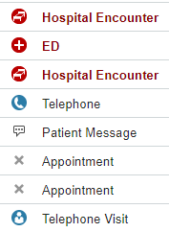
Case 1: Updates since conference

Slide 8
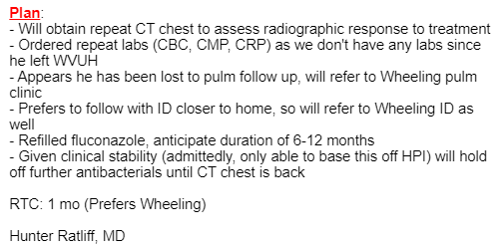

Case 1: Updates since conference

Slide 9
Case 1: Updates since conference
Hopelessly lost to follow up
No imaging
Does refill his fluconazole

Slide 10
Case 1: Updates since conference
Admitted to Ruby
Admitted with..?

Slide 11
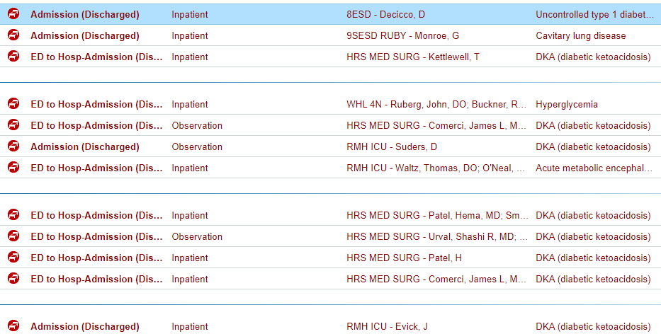
Case 1: Updates since conference
Admitted to Ruby (DKA)
No real infectious concerns
They get a CT chest (as one does for DKA)

Slide 12
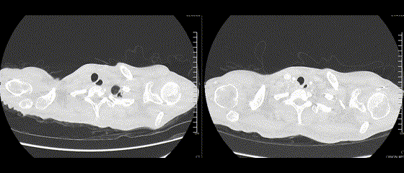
Case 1: Updates since conference
Admitted to Ruby (DKA)
No real infectious concerns
They get a CT chest (as one does for DKA)

Slide 13
Case 1: Updates since conference
Last conference (2 months ago)
Admitted to Ruby (DKA)
No real infectious concerns
They get a CT chest (as one does for DKA)

Slide 14
Case #2

Slide 15
Case 2: Coccidioides
-3 years
Living in Washington State
Lived in a house with “mold”
International travel to British Columbia
A 22 y/o M with no PMH who p/w subacute cough x 1 month. Found to have a new 4cm RUL cavity, 1cm LLL nodule (vs XR 14 mo ago)
-1 year
Moved to Tennessee
Normal CXR around this time
Travel to northern California
Did cross country trips too
House renovations (in WV)
-1 month
Fever, cough, sore throat
Self resolved after 7-10 days
-3 weeks
Symptoms gone aside from cough
Did go to the dentist
Now
Admission

Slide 16
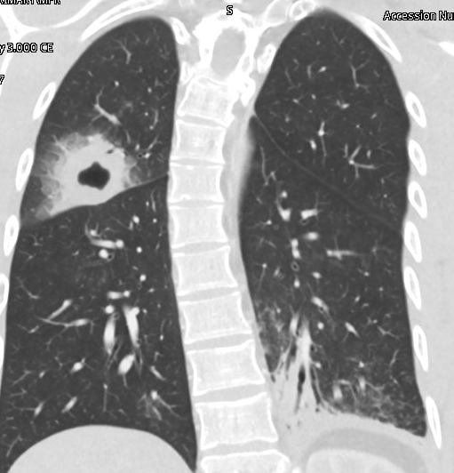
Case 2: Coccidioides
-3 years
Living in Washington State
Lived in a house with “mold”
International travel to British Columbia
A 22 y/o M with no PMH who p/w subacute cough x 1 month. Found to have a new 4cm RUL cavity, 1cm LLL nodule (vs XR 14 mo ago)
-1 year
Moved to Tennessee
Normal CXR around this time
Travel to northern California
Did cross country trips too
House renovations (in WV)
-1 month
Fever, cough, sore throat
Self resolved after 7-10 days
-3 weeks
Symptoms gone aside from cough
Did go to the dentist
Now
Admission
Coccidioides antibody, serum
Complement fixation
Antibody detected (1:2)
Immunodiffusion
Antibody not detected

Slide 17
Case 2: Coccidioides
-3 years
Living in Washington State
Lived in a house with “mold”
International travel to British Columbia
A 22 y/o M with no PMH who p/w subacute cough x 1 month. Found to have a new 4cm RUL cavity, 1cm LLL nodule (vs XR 14 mo ago)
-1 year
Moved to Tennessee
Normal CXR around this time
Travel to northern California
Did cross country trips too
House renovations (in WV)
-1 month
Fever, cough, sore throat
Self resolved after 7-10 days
-3 weeks
Symptoms gone aside from cough
Did go to the dentist
Now
Admission
Augmentin (4 weeks)
Coccidioides antibody, serum
Complement fixation
Antibody detected (1:2)
Immunodiffusion
Antibody not detected

Slide 18
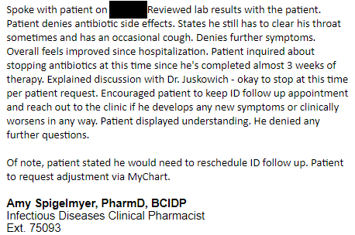
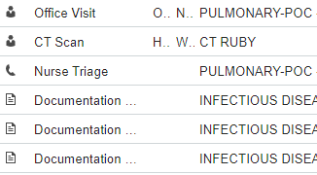

Case 1: Updates since conference

Slide 19
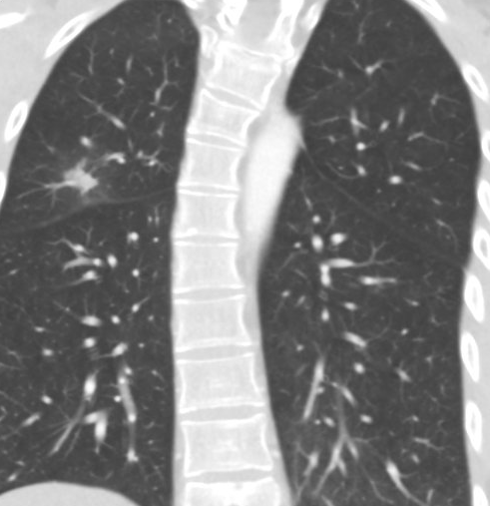
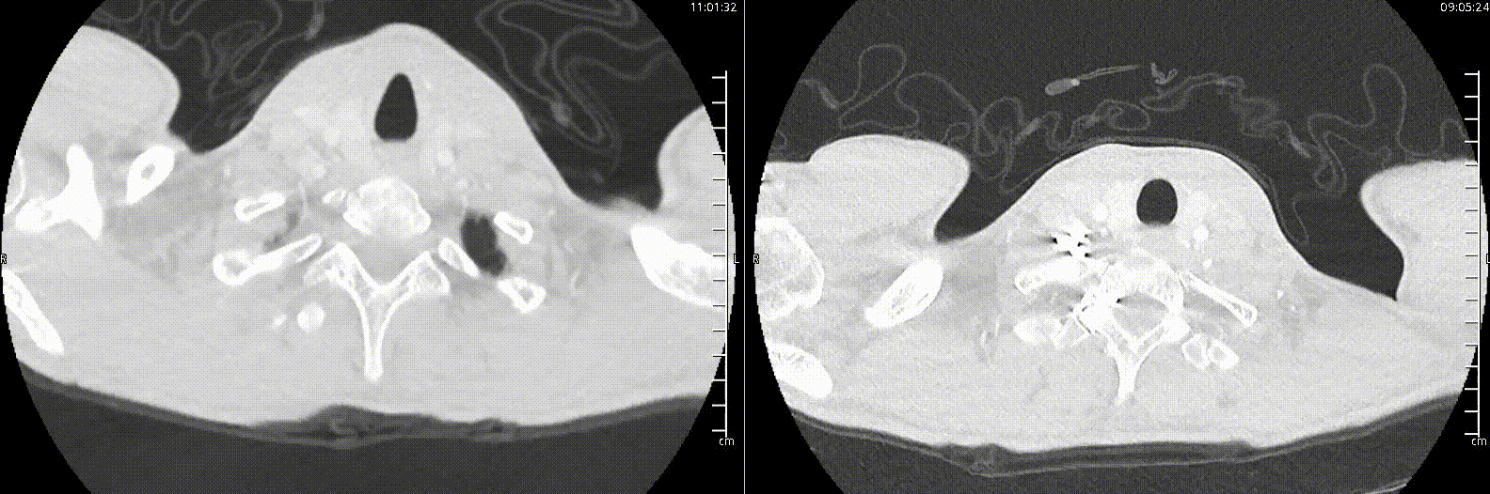
Case 1: Updates since conference
Last conference (1.5 months ago)

Slide 20
Case 1: Updates since conference
Pulmonology clinic
Doing great
RTC: PRN

Slide 21
New cases!

Slide 22
Case #3

Slide 23
Case 3: HPI
A 60 y/o M with PMH including untreated large granular lymphocytic leukemia, TTP (on pred 20) p/w
Hypoxia
AMS
Hyponatremia

Slide 24
Case 3: HPI
A 60 y/o M with PMH including untreated large granular lymphocytic leukemia, TTP (on pred 20) p/w AMS, hyponatremia, & hypoxia
Generally feeling weak for past week
Productive cough
Unable to ascertain further symptoms

Slide 25
Case 3: HPI
A 60 y/o M with PMH including untreated large granular lymphocytic leukemia, TTP (on pred 20) p/w AMS, hyponatremia, & hypoxia
Generally feeling weak for past week
Productive cough
Unable to ascertain further symptoms
Medical Hx / medications
Leukemia: Not on meds / chemo
Admission one month ago for non-ID reasons

Slide 26
Case 3: HPI
A 60 y/o M with PMH including untreated large granular lymphocytic leukemia, TTP (on pred 20) p/w AMS, hyponatremia, & hypoxia
Generally feeling weak for past week
Productive cough
Unable to ascertain further symptoms
Medical Hx / medications
Leukemia: Not on meds / chemo
Admission one month ago for non-ID reasons
Dx with hyperviscosity syndrome, perhaps MGUS?
Also had w/up for thrombocytopenia, favored to be TTP
  Start prednisone 20
  No PJP ppx

Slide 27
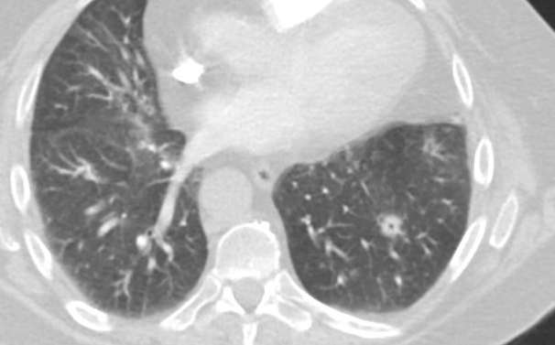
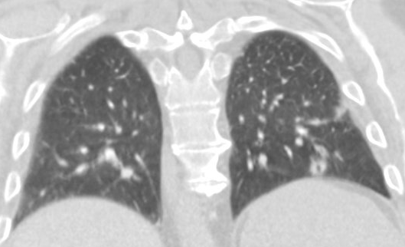
Case 3: HPI
A 60 y/o M with PMH including untreated large granular lymphocytic leukemia, TTP (on pred 20) p/w AMS, hyponatremia, & hypoxia
Medical Hx / medications
Leukemia: Not on meds / chemo
Admission one month ago for non-ID reasons
Dx with hyperviscosity syndrome, perhaps MGUS?
Also had w/up for thrombocytopenia, favored to be TTP
  Start prednisone 20
  No PJP ppx
Incidental left lower lobe lung mass
  10 x 12 mm
1.5 months ago

Slide 28
Case 3: Exposure History
Geographic & Travel | Lives in West Virginia Never international travel
Occupational | Cattle farmer
Substance & needles | No EtOH, tobacco, drugs No needle exposures
Animals | Cattle
Exposures & hobbies | Does work outdoors, namely with the cattle No known TB risk factors

Slide 29
Case 3: Exam (per MICU note)
Vitals: 36.5 | 71 | 101/63 | 96%
General: appears chronically ill
Eyes: Conjunctiva clear, Pupils equal and round, Sclera non-icteric
HENT: Head atraumatic and normocephalic. Vesicular/blisters under lower lip. Two ulcers on lower lip that is blood filled but contained.
Neck: Trachea Midline
Lungs: Clear to auscultation bilaterally
Cardiovascular: Regular rate and rhythm, no murmur, click, rub or gallop
Abdomen: Soft, non-tender, Bowel sounds normal, non-distended
Extremities: No cyanosis or edema
Skin: Skin warm and dry
Neurologic: Alert and oriented x 3. Answers questions but has confusion.

Slide 30
Case 3: Labs
CBC | Result
WBC | 23.7
Hgb | 9.5
Platelets | 113
Neut % | 25%
Lymph % | 72%
Eos % | 0%
Chem7 | Result
Na | 107
K | 2.9
Cl | 82
HCO3 | 12
Cr | 1.16
Misc | Result
sOsm | 288
Lactate | 5.3
LFTs | WNL

Slide 31
Case 3: Labs
5 hour repeat
CBC | Result
WBC | 23.7
Hgb | 9.5
Platelets | 113
Neut % | 25%
Lymph % | 72%
Eos % | 0%
Chem7 | Initial
Na | 107
K | 2.9
Cl | 82
HCO3 | 12
Cr | 1.16
Chem7 | Repeat | VBG
Na | 127 | 131
K | 3.4 | 3.8
Cl | 102 | 99
HCO3 | 16 | 20
Cr | 1.32 | ---
Misc | Initial | Repeat
sOsm | 288 | 281
Lactate | 5.3 | 2.6
LFTs | WNL

Slide 32

[Q3.1] DDx
free response, vote

Slide 33
[Q3.2] Additional work up?
Word cloud

Slide 34
Case 3: Imaging
1.5 months ago
A 60 y/o M with PMH including untreated large granular lymphocytic leukemia, TTP (on pred 20) p/w AMS, hyponatremia, & hypoxia

Slide 35
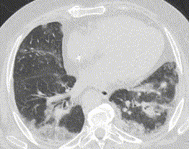
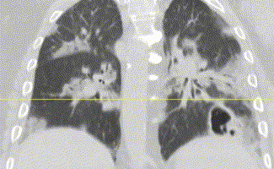
Case 3: Imaging
1.5 months ago
Interval increased size of a LLL lesion with cavitation (1.2 → 2.8 cm). A halo of groundglass opacity surrounds this consolidation
Impression: Constellation of findings are compatible with fungal infection in the lung, with concern for focal invasive aspergillosis

Slide 36
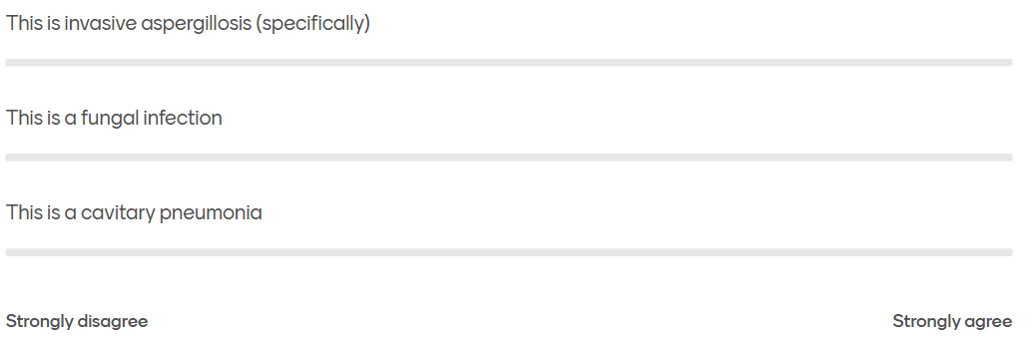
[Q3.3] invasive aspergillosis or something else?
Slider response (disagree vs agree)

Slide 37
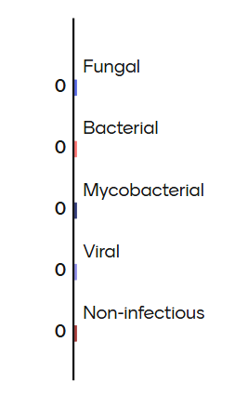
[Q3.4] What’s going on?
Distribute responses (on 100pt scale)

Slide 38
Case 3: Workup
Serum / Urine | Result
Histo Ag | Neg
Blasto Ag | Neg
Crypto Ag
Fungitell | <31
Asp GM | Neg
Legionella Ag | Pos
QuantGOLD | Neg
BAL | Result
Asp GM | Neg
Asp PCR | Neg
MTB PCR | Neg
PJP PCR | Neg
Legionella DNA | Neg
Micro | Result
Blood | Neg
Urine | Neg
BAL (routine) | NG
BAL (AFB) | NG
BAL (fungal)
Resp Biofire | Result
… | …

Slide 39
Case 3: Workup
Serum / Urine | Result
Histo Ag | Neg
Blasto Ag | Neg
Crypto Ag | Neg
Fungitell | <31
Asp GM | Neg
Legionella Ag | Pos
QuantGOLD | Neg
BAL | Result
Asp GM | Neg
Asp PCR | Neg
MTB PCR | Neg
PJP PCR | Neg
Legionella DNA | Neg
Micro | Result
Blood | Neg
Urine | Neg
BAL (routine) | NG
BAL (AFB) | NG
BAL (fungal)
Resp Biofire | Result
… | …

Slide 40
Case 3: Workup
Serum / Urine | Result
Histo Ag | Neg
Blasto Ag | Neg
Crypto Ag | Neg
Fungitell | <31
Asp GM | Neg
Legionella Ag | Pos
QuantGOLD | Neg
BAL | Result
Asp GM | Neg
Asp PCR | Neg
MTB PCR | Neg
PJP PCR | Neg
Legionella DNA | Neg
Micro | Result
Blood | Neg
Urine | Neg
BAL (routine) | NG
BAL (AFB) | NG
BAL (fungal)
Resp Biofire | Result
… | …

Slide 41
Case 3: Workup
Serum / Urine | Result
Histo Ag | Neg
Blasto Ag | Neg
Crypto Ag | Neg
Fungitell | <31
Asp GM | Neg
Legionella Ag | Pos
QuantGOLD | Neg
BAL | Result
Asp GM | Neg
Asp PCR | Neg
MTB PCR | Neg
PJP PCR | Neg
Legionella DNA | Neg
Micro | Result
Blood | Neg
Urine | Neg
BAL (routine) | NG
BAL (AFB) | NG
BAL (fungal)
Resp Biofire | Result
Metapneumovirus | Pos
Parainfluenza 4 | Pos

Slide 42
Case 3: Workup
Serum / Urine | Result
Histo Ag | Neg
Blasto Ag | Neg
Crypto Ag | Neg
Fungitell | <31
Asp GM | Neg
Legionella Ag | Pos
QuantGOLD | Neg
BAL | Result
Asp GM | Neg
Asp PCR | Neg
MTB PCR | Neg
PJP PCR | Neg
Legionella DNA | Neg
Micro | Result
Blood | Neg
Urine | Neg
BAL (routine) | NG
BAL (AFB) | NG
BAL (fungal) | C. tropicalis
Resp Biofire | Result
Metapneumovirus | Pos
Parainfluenza 4 | Pos

Slide 43
Case 3: Summary
A 60 y/o M with PMH including untreated T-cell LGL, ITP/TTP (on pred 20) p/w AMS, hyponatremia, & hypoxia found to have expanding LLL cavitary lesion w/ halo sign
Biofire: hMPV, paraflu
Urine legionella: positive
BAL: normal

Slide 44
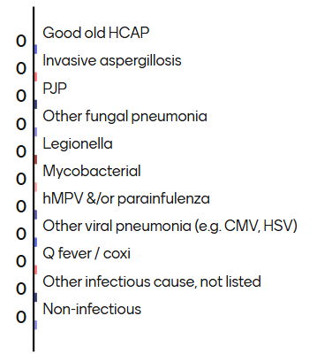
[Q3.5] DDx now?
What is driving his pulmonary process?
Distribute responses (on 100pt scale)

Slide 45
[Q3.6] How long to treat for legionella
Guess the number

Slide 46
Case 3: Hospital course
Legionella
Improved with 2 weeks of levofloxacin
Fungal pneumonia?
Initially on AmBisome
Transitioned to voriconazole once all the studies came back normal
Plan for 3+ month course with reimaging

Slide 47
Case 3: Hospital course
Legionella
Improved with 2 weeks of levofloxacin
Quickly worsened after stopping
  Improved with resuming
Extended course to total of 4 weeks
Fungal pneumonia?
Initially on AmBisome
Transitioned to voriconazole once all the studies came back normal
Plan for 3+ month course with reimaging

Slide 48
Case 3: Hospital course
Legionella
Improved with 2 weeks of levofloxacin
Quickly worsened after stopping
  Improved with resuming
Extended course to total of 4 weeks
Fungal pneumonia?
Initially on AmBisome
Transitioned to voriconazole once all the studies came back normal
Plan for 3+ month course with reimaging
CMV viremia (skipped over this)
Treated with Valcyte until virally suppressed
PCR: 15k → 544
Herpes labialis: Treated with Valcyte (due to above)

Slide 49
Case 3: Hospital course
Legionella
Improved with 2 weeks of levofloxacin
Quickly worsened after stopping
  Improved with resuming
Extended course to total of 4 weeks
Fungal pneumonia?
Initially on AmBisome
Transitioned to voriconazole once all the studies came back normal
Plan for 3+ month course with reimaging
CMV viremia (skipped over this)
Treated with Valcyte until virally suppressed
PCR: 15k → 544
Herpes labialis: Treated with Valcyte (due to above)
Steroids/PJP
Remained on steroids so started atovaquone 1500 q24h

Slide 50
Case 3: Hospital course
Legionella
Improved with 2 weeks of levofloxacin
Quickly worsened after stopping
  Improved with resuming
Extended course to total of 4 weeks
Fungal pneumonia?
Initially on AmBisome
Transitioned to voriconazole once all the studies came back normal
Plan for 3+ month course with reimaging
Some concerns for drug interactions, so switched vori to Cresemba
CMV viremia (skipped over this)
Treated with Valcyte until virally suppressed
PCR: 15k → 544
Herpes labialis: Treated with Valcyte (due to above)
Steroids/PJP
Remained on steroids so started atovaquone 1500 q24h

Slide 51
Case #3.5
He’s back…

Slide 52
Case 4: HPI
Recent admission
A 60 y/o M with PMH including untreated large granular lymphocytic leukemia, TTP (on pred 20 for past two months), recent admission for legionella p/w worsening respiratory status

Slide 53
Case 4: HPI
Recent admission
A 60 y/o M with PMH including untreated large granular lymphocytic leukemia, TTP (on pred 20 for past two months), recent admission for legionella p/w worsening respiratory status
Only was out of the hospital for 1-2 days, now intubated

Slide 54
Case 4: HPI
Recent admission
A 60 y/o M with PMH including untreated large granular lymphocytic leukemia, TTP (on pred 20 for past two months), recent admission for legionella p/w worsening respiratory status
Only was out of the hospital for 1-2 days, now intubated
Respiratory status has declined despite:
Negative workup (aside from legionella & viruses)
Levofloxacin
Cresemba
Valcyte
Atovaquone ppx
Notes:
Resolution: 450 x 150
tibble(
day = 1:31
) %>%
mutate(levoflox = between(day, 2, 16)|between(day, 20, 28),
vori = between(day, 5, 25),
isav = day >=25,
valGAN = day >=6,
Admitted = between(day, 1, 26)|day>=28) %>%
pivot_longer(-day, names_to = "Antimicrobial") %>%
filter(value) %>%
ggplot(aes(x=day, y=Antimicrobial)) +
geom_point() +
# geom_point(aes(color=value)) +
sjPlot::theme_sjplot() +
labs(x="Hospital Day", y="") +
scale_x_continuous(breaks=0:4*7, limits = c(0,28))

Slide 55
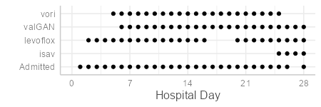
Case 4: HPI
Recent admission
A 60 y/o M with PMH including untreated large granular lymphocytic leukemia, TTP (on pred 20 for past two months), recent admission for legionella p/w worsening respiratory status
Admit #1
#2
Notes:
Resolution: 450 x 150
tibble(
day = 1:31
) %>%
mutate(levoflox = between(day, 2, 16)|between(day, 20, 28),
vori = between(day, 5, 25),
isav = day >=25,
valGAN = day >=6,
Admitted = between(day, 1, 26)|day>=28) %>%
pivot_longer(-day, names_to = "Antimicrobial") %>%
filter(value) %>%
ggplot(aes(x=day, y=Antimicrobial)) +
geom_point() +
# geom_point(aes(color=value)) +
sjPlot::theme_sjplot() +
labs(x="Hospital Day", y="") +
scale_x_continuous(breaks=0:4*7, limits = c(0,28))

Slide 56
Case 4: Summary
A 60 y/o M with PMH including untreated large granular lymphocytic leukemia, TTP (on pred 20 for past two months), recent admission for legionella p/w worsening respiratory status
Only was out of the hospital for 1-2 days, now intubated despite levofloxacin, Cresemba, Valcyte, & atovaquone
Admit #1
#2

Slide 57
[Q4.1] DDx now? Why is he getting worse?
Free response

Slide 58
Case 4: Prior workup (last admission)
Serum / Urine | Result
Histo Ag | Neg
Blasto Ag | Neg
Crypto Ag | Neg
Fungitell | <31
Asp GM | Neg
Legionella Ag | Pos
QuantGOLD | Neg
BAL | Result
Asp GM | Neg
Asp PCR | Neg
MTB PCR | Neg
PJP PCR | Neg
Legionella DNA | Neg
Micro | Result
Blood | Neg
Urine | Neg
BAL (routine) | NG
BAL (AFB) | NG
BAL (fungal) | C. tropicalis

Slide 59
Case 4: Prior workup (last admission)
Serum / Urine | Result
Histo Ag | Neg
Blasto Ag | Neg
Crypto Ag | Neg
Fungitell | <31
Asp GM | Neg
Legionella Ag | Pos
QuantGOLD | Neg
BAL | Result
Asp GM | Neg
Asp PCR | Neg
MTB PCR | Neg
PJP PCR | Neg
Legionella DNA | Neg
Micro | Result
Blood | Neg
Urine | Neg
BAL (routine) | NG
BAL (AFB) | NG
BAL (fungal) | C. tropicalis Nocardia nova
24 days after BAL

Slide 60
Case 4: Prior workup (last admission)
Serum / Urine | Result
Histo Ag | Neg
Blasto Ag | Neg
Crypto Ag | Neg
Fungitell | <31
Asp GM | Neg
Legionella Ag | Pos
QuantGOLD | Neg
BAL | Result
Asp GM | Neg
Asp PCR | Neg
MTB PCR | Neg
PJP PCR | Neg
Legionella DNA | Neg
Micro | Result
Blood | Neg
Urine | Neg
BAL (routine) | NG
BAL (AFB) | NG
BAL (fungal) | C. tropicalis Nocardia nova
Growth in lab
BAL
24 days after BAL

Slide 61
Cases 3-4: Nocardia nova
Very, very late growth of Nocardia (24 days after BAL)
Tobramycin | 32 (R)
Linezolid | 1 (S)
Bactrim | .25/4.8 (S)
Doxycycline | 8 (R)
Ciprofloxacin | 16 (R)
Augmentin | 128 (R)
Moxifloxacin | 4 (R)
Amikacin | <0.5 (S)
Imipenem | 2 (S)
Ceftriaxone | 32 (I)
Clarithromycin | <.03 (S)
Minocycline | 4 (I)

Slide 62
Cases 3-4: Nocardia nova
Very, very late growth of Nocardia (24 days after BAL)
Missed during prior admission
  To be fair, he was discharged the next day and readmitted 2 days later
  So while Nocardia Tx wasn’t started until 28 days after BAL, only went 4 days without treatment (from time of results)
Tobramycin | 32 (R)
Linezolid | 1 (S)
Bactrim | .25/4.8 (S)
Doxycycline | 8 (R)
Ciprofloxacin | 16 (R)
Augmentin | 128 (R)
Moxifloxacin | 4 (R)
Amikacin | <0.5 (S)
Imipenem | 2 (S)
Ceftriaxone | 32 (I)
Clarithromycin | <.03 (S)
Minocycline | 4 (I)

Slide 63
Cases 3-4: Nocardia nova
Very, very late growth of Nocardia (24 days after BAL)
Missed during prior admission
  To be fair, he was discharged the next day and readmitted 2 days later
  So while Nocardia Tx wasn’t started until 28 days after BAL, only went 4 days without treatment (from time of results)
Multiple other (non-infectious issues) developed while in MICU (stokes, CRRT, etc)
Went CMO after palliative consult
Tobramycin | 32 (R)
Linezolid | 1 (S)
Bactrim | .25/4.8 (S)
Doxycycline | 8 (R)
Ciprofloxacin | 16 (R)
Augmentin | 128 (R)
Moxifloxacin | 4 (R)
Amikacin | <0.5 (S)
Imipenem | 2 (S)
Ceftriaxone | 32 (I)
Clarithromycin | <.03 (S)
Minocycline | 4 (I)

Slide 64
Case #5

Slide 65
Case 5: HPI
A 37 y/o M with PMH including poorly controlled DM (A1c 9.7), TBI, sacral decubitus ulcer p/w DKA & hypoxia

Slide 66
Case 5: HPI
A 37 y/o M with PMH including poorly controlled DM (A1c 9.7), TBI, sacral decubitus ulcer p/w DKA & hypoxia
Influenza A positive on admission
Respiratory status improved a little, but then worsened

Slide 67
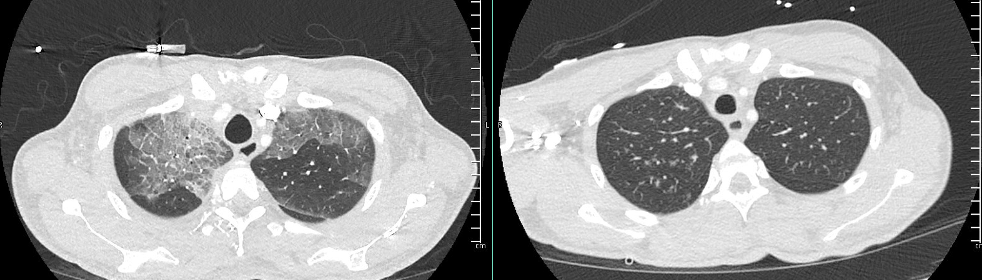
Case 5: HPI
A 37 y/o M with PMH including poorly controlled DM (A1c 9.7), TBI, sacral decubitus ulcer p/w DKA & hypoxia
Influenza A positive on admission
Respiratory status improved a little, but then worsened
A week ago (admission)

Slide 68
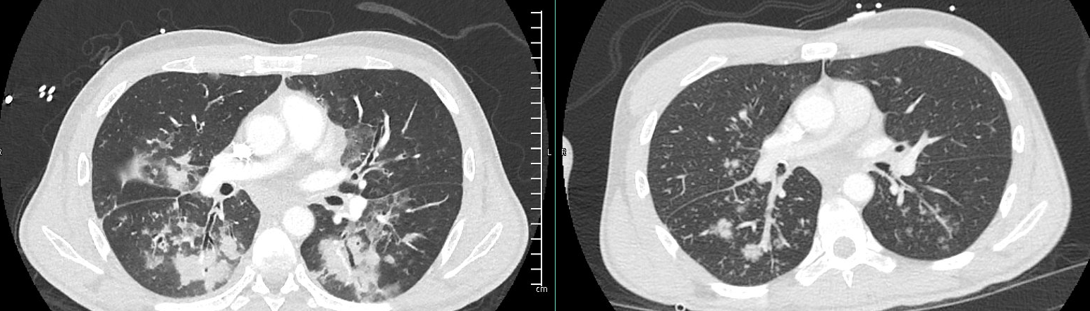
Case 5: HPI
A 37 y/o M with PMH including poorly controlled DM (A1c 9.7), TBI, sacral decubitus ulcer p/w DKA & hypoxia
Influenza A positive on admission
Respiratory status improved a little, but then worsened
A week ago (admission)

Slide 69
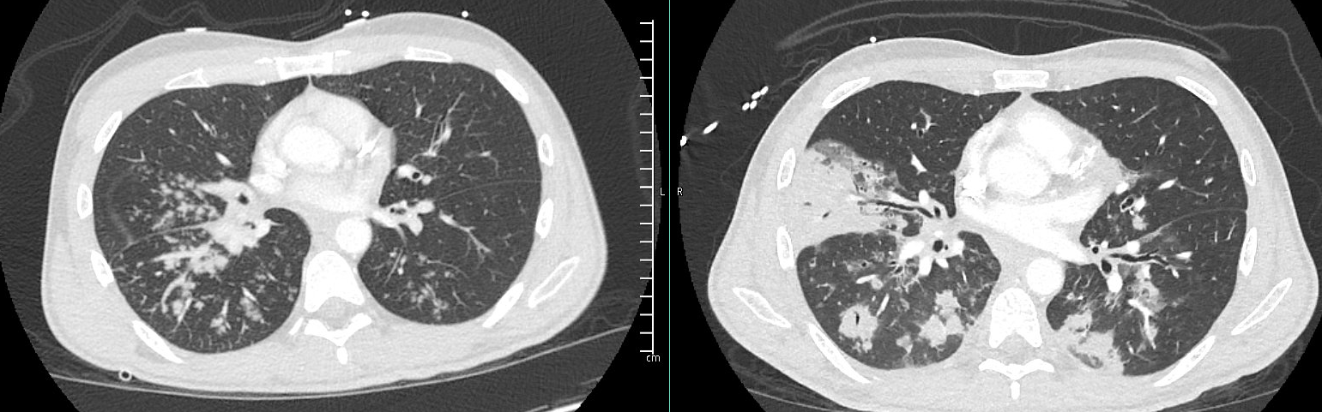
Case 5: HPI
A 37 y/o M with PMH including poorly controlled DM (A1c 9.7), TBI, sacral decubitus ulcer p/w DKA & hypoxia
Influenza A positive on admission
Respiratory status improved a little, but then worsened
A week ago (admission)

Slide 70
Case 5: HPI
A 37 y/o M with PMH including poorly controlled DM (A1c 9.7), TBI, sacral decubitus ulcer p/w DKA & hypoxia
Influenza A positive on admission
Respiratory status improved a little, but then worsened
DDx?
(No MentiMeter for this one)

Slide 71
Case 5: HPI
A 37 y/o M with PMH including poorly controlled DM (A1c 9.7), TBI, sacral decubitus ulcer p/w DKA & hypoxia
Influenza A positive on admission
Respiratory status improved a little, but then worsened
Initial BCx: MRSA (1 of 2 sets)

Slide 72
Case 5: HPI
A 37 y/o M with PMH including poorly controlled DM (A1c 9.7), TBI, sacral decubitus ulcer p/w DKA & hypoxia
Influenza A positive on admission
Respiratory status improved a little, but then worsened
Initial BCx: MRSA (1 of 2 sets)
TTE: No valvular pathology
Couldn’t produce sputum

Slide 73
Case 5: Staph aureus *
Risk factors / clues
Recent influenza
Immunocompromise (DM)
Necrotizing pneumonia
* Presumed to be from Staph aureus, since he improved on Zyvox (but took his time to get better)

Slide 74
Case #6

Slide 75
Case 6: HPI
A 30 y/o F with PMH including tobacco use p/w worsening cough
Two months ago, CT in ED showed right pleural effusion
  Symptoms not improved with doxycycline
No overt fevers, but chills & anorexia for past month
Had seen CT surgery a month ago, who ordered repeat CT
  Repeat CT prompted this admission

Slide 76
Case 6: HPI
A 30 y/o F with PMH including tobacco use p/w worsening cough
Chronic, nonproductive cough for past year
  Worsened in past two months
  Now some dyspnea, chronic leukocytosis
Two months ago, CT in ED showed right pleural effusion
  Symptoms not improved with doxycycline
No overt fevers, but chills & anorexia for past month
Had seen CT surgery a month ago, who ordered repeat CT
  Repeat CT prompted this admission

Slide 77
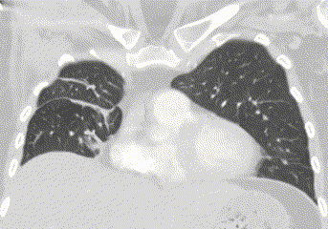
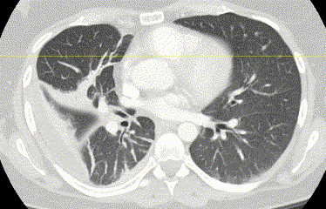
Case 6: HPI
Two months ago
A 30 y/o F with PMH including tobacco use p/w worsening cough
Chronic, nonproductive cough for past year
  Worsened in past two months
  Now some dyspnea, chronic leukocytosis
Two months ago, CT in ED showed right pleural effusion
  Symptoms not improved with doxycycline & cefpodoxime
No overt fevers, but chills & anorexia for past month
Had seen CT surgery a month ago, who ordered repeat CT
  Repeat CT prompted this admission

Slide 78
Case 6: HPI
Two months ago
A 30 y/o F with PMH including tobacco use p/w worsening cough
Chronic, nonproductive cough for past year
  Worsened in past two months
  Now some dyspnea, chronic leukocytosis
Two months ago, CT in ED showed right pleural effusion
  Symptoms not improved with doxycycline & cefpodoxime
No overt fevers, but chills & anorexia for past month
Had seen CT surgery a month ago, who ordered repeat CT
  Repeat CT prompted this admission

Slide 79
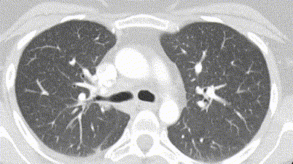
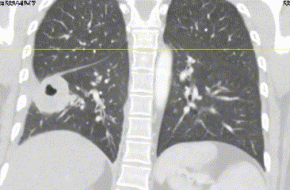
Case 6: Imaging
Two months ago

Slide 80
Case 6: Social & Exposure History
Geographic & Travel | Resides in in house a mile out of town (in the woods) Lives with boyfriend and two kids No recent foreign or domestic travel. Never international travel
Occupational | Not working, takes care of the kids (6 & 8 years old)
Substance & needles | Social use of EtOH Smokes 1 ppd Used to smoke weed (many years ago); never IVDU Remote hx of unprofessional tattoos
Animals | Cats, dogs, snakes at home No frequent bird exposures, but has cared for her parents chickens in the past
Exposures & hobbies | No known TB risk factors, including incarceration, homelessness, healthcare exposures, known contacts with TB, international travel In the past year, she has gone in caves (unclear if there were bats)

Slide 81
Case 6: Summary
-2 mo
Worsening of chronic cough
CT showed right pleural effusion
Rx’ed doxy & cefpodoxime w/ no improvement
A 30 y/o F with PMH including tobacco use p/w worsening cough x2 months after right pleural effusion that was unimproved with doxy & cefpodoxime.
Systemic symptoms x1 month
CT chest now with 3.8cm RLL cavitary lesion
Smoker, birds, caves
-1 mo
Developed WBC, chills, anorexia
Saw CT surgery in clinic, ordered repeat CT
-1 d
Repeat CT 3.8cm RLL cavitary lesion
Direct admitted for workup
Now
Admission

Slide 82
[Q6.1] DDx
free response, vote

Slide 83
[Q6.2] Additional work up?
Word cloud

Slide 84
Case 6: DDx?
Serum / Urine | Result
Histo Ag | Neg
Blasto Ag | Neg
Crypto Ag | Neg
Fungitell | ---
Asp GM | Neg
Legionella Ag | ---
Strep pneumo Ag | Neg
QuantGOLD | ---
BAL | Result
Asp GM | Neg
Asp PCR | Neg
MTB PCR | ---
PJP PCR | Neg
Legionella DNA | ---
Micro | Result
Blood | NG
BAL (routine)
BAL (AFB) | NG
BAL (fungal) | NG

Slide 85
Case 6: DDx?
Serum / Urine | Result
Histo Ag | Neg
Blasto Ag | Neg
Crypto Ag | Neg
Fungitell | ---
Asp GM | Neg
Legionella Ag | ---
Strep pneumo Ag | Neg
QuantGOLD | ---
BAL | Result
Asp GM | Neg
Asp PCR | Neg
MTB PCR | ---
PJP PCR | Neg
Legionella DNA | ---
Micro | Result
Blood | NG
BAL (routine)
BAL (AFB) | NG
BAL (fungal) | NG
Additional HPI
Extensive dental work six months ago

Slide 86
Case 6: DDx?
Serum / Urine | Result
Histo Ag | Neg
Blasto Ag | Neg
Crypto Ag | Neg
Fungitell | ---
Asp GM | Neg
Legionella Ag | ---
Strep pneumo Ag | Neg
QuantGOLD | ---
BAL | Result
Asp GM | Neg
Asp PCR | Neg
MTB PCR | ---
PJP PCR | Neg
Legionella DNA | ---
Micro | Result
Blood | NG
BAL (routine) | 4+ Strep anginosus
BAL (AFB) | NG
BAL (fungal) | NG

Slide 87
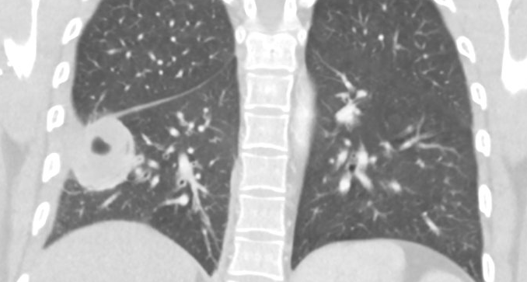
Case 6: Strep anginosus
Hospital course
TTE normal
Rx: ceftriaxone & flagyl (4 weeks)
Repeat CT outpatient

Slide 88
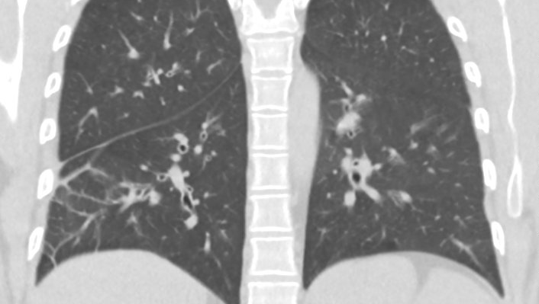
Case 6: Strep anginosus
Hospital course
TTE normal
Rx: ceftriaxone & flagyl (4 weeks)
Repeat CT outpatient
Clinic
Doing well after 4 weeks of OPAT
Hadn’t gotten repeat CT, so extended duration by 2 weeks with cefpodoxime & flagyl
CT (at 7 weeks) near complete resolution
After treatment

Slide 89

Discussion
Links to articles discussed here

Slide 90
Legionella & Hyponatremia
Recognize the spectrum of clinical manifestations seen in Legionella infections
Discuss the various testing modalities used to diagnose Legionella
Compare the common treatments used in Legionnaires’ disease, including duration of treatment
Appraise the literature regarding hyponatremia in Legionella (& critique what I learned in medical school)
Learning objectives

Slide 91
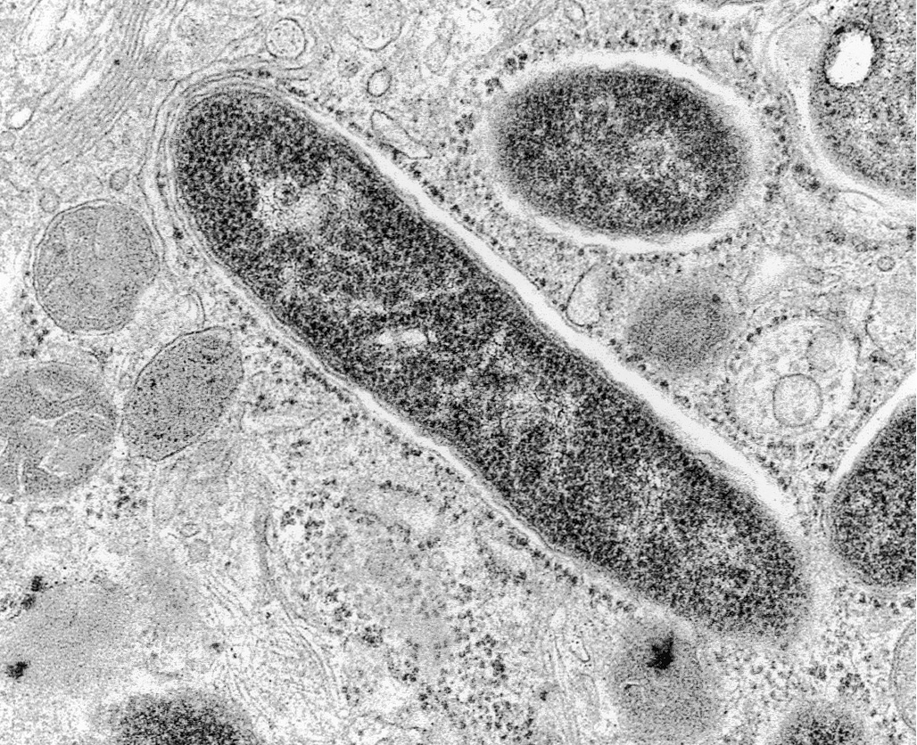
Legionnaires’ disease [1]
Bacterial pneumonia caused by Legionella
Intracellular small gram-negative bacilli
  Fun fact: Coxiella burnetii (Q fever) is closest living relative to Legionella
Classically associated with pulse temperature dissociation, pulmonary symptoms, hyponatremia, elevated LFTs [5]
  More on this later
Often associated with altered mental status, with a normal neurologic exam

Slide 92
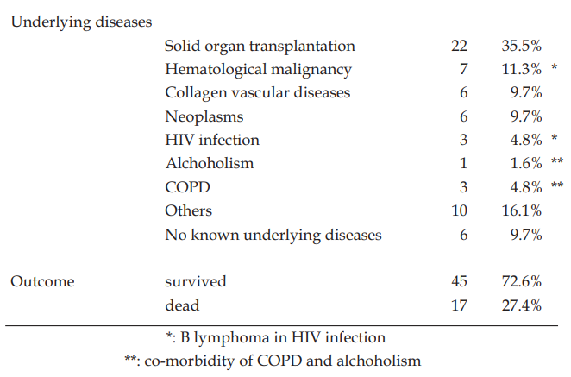
Legionella cavitation? [9]
Cavitary disease is quite rare, but has been described (2009 review of 79 cases) [9]
90% are immunosuppressed at baseline (35% SOT)
  70% were on steroids at time of diagnosis
One in four died

Slide 93
Legionella cavitation? [9]
Cavitary disease is quite rare, but has been described (2009 review of 79 cases) [9]
90% are immunosuppressed at baseline (35% SOT)
  70% were on steroids at time of diagnosis
One in four died
Unclear if they looked at co-infections
(more on this later)

Slide 94
Legionella: Testing
Urine antigen
Urine antigen is ideal test (in terms of sensitivity & specificity)
  Only for serogroup 1
Antigenuria may persist for weeks, even after pneumonia has resolved
DFA
Less sensitive, and prone to false positives if lab is inexperienced
Can be done of fixed lung tissue
Test / Specimen | Sensitivity | Specificity
Culture | 20 - 95% | 100%
Urine antigen | 60 - 95% | >99%
Immunofluorescence microscopy | 20 - 50% | 99%
PCR (sputum, urine) | 70 - 95% | 95 - 99%
Optimal approach
Some authors [1] suggest more than one test (e.g. urine antigen + PCR) to increase yield

Slide 95

Legionella: Treatment
Generally, fluoroquinolones (FQ) are about as effective as macrolides
Little head-to-head comparisons of FQ vs azithromycin
Retrospective study of critically ill patients found reduced mortality for levoflox vs non-azithro macrolides [2]
Propensity matched analyses showed similar outcomes between levofloxacin & azithro [3][4]

Slide 96
Legionella: Treatment [1]
Duration is normally similar to that of other forms of CAP
  Similar principles apply for lung abscesses (may need prolonged extension)
  Relapse has been described in immunocompromise
No benefit to combo therapy, even in severe disease / immunosuppression [2]

Slide 97
Legionella: Treatment [1]
Up to 10% of patients with Legionella may have co-infections with other pathogens
  Includes typical respiratory bacteria (H flu, pneumococcus), staph aureus
  Also PJP, nocardia, aspergillus, tuberculosis, cryptococcus
  More common in immunosuppression & severe disease

Slide 98
Legionella: Treatment [1]
Up to 10% of patients with Legionella may have co-infections with other pathogens
  Includes typical respiratory bacteria (H flu, pneumococcus), staph aureus
  Also PJP, nocardia, aspergillus, tuberculosis, cryptococcus
  More common in immunosuppression & severe disease
Generally, patients respond well to therapy
  Within hours to days
  Radiographic findings may lag

Slide 99
Legionella: Treatment [1]
Up to 10% of patients with Legionella may have co-infections with other pathogens
  Includes typical respiratory bacteria (H flu, pneumococcus), staph aureus
  Also PJP, nocardia, aspergillus, tuberculosis, cryptococcus
  More common in immunosuppression & severe disease
Generally, patients respond well to therapy
  Within hours to days
  Radiographic findings may lag
Failure to respond to therapy should prompt search for alternative causes

Slide 100
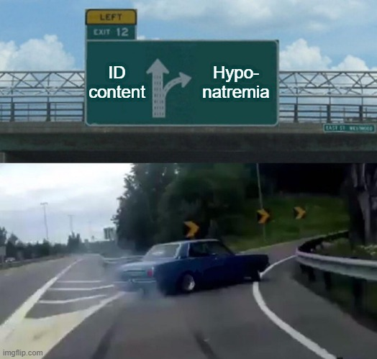
Legionella & hyponatremia
Classically, legionella is associated with hyponatremia…
I thought it might be interesting to look up why
Then I remembered why I don’t like sodium

Slide 101
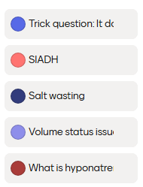
Why the low sodium?
Multiple choice

Slide 102
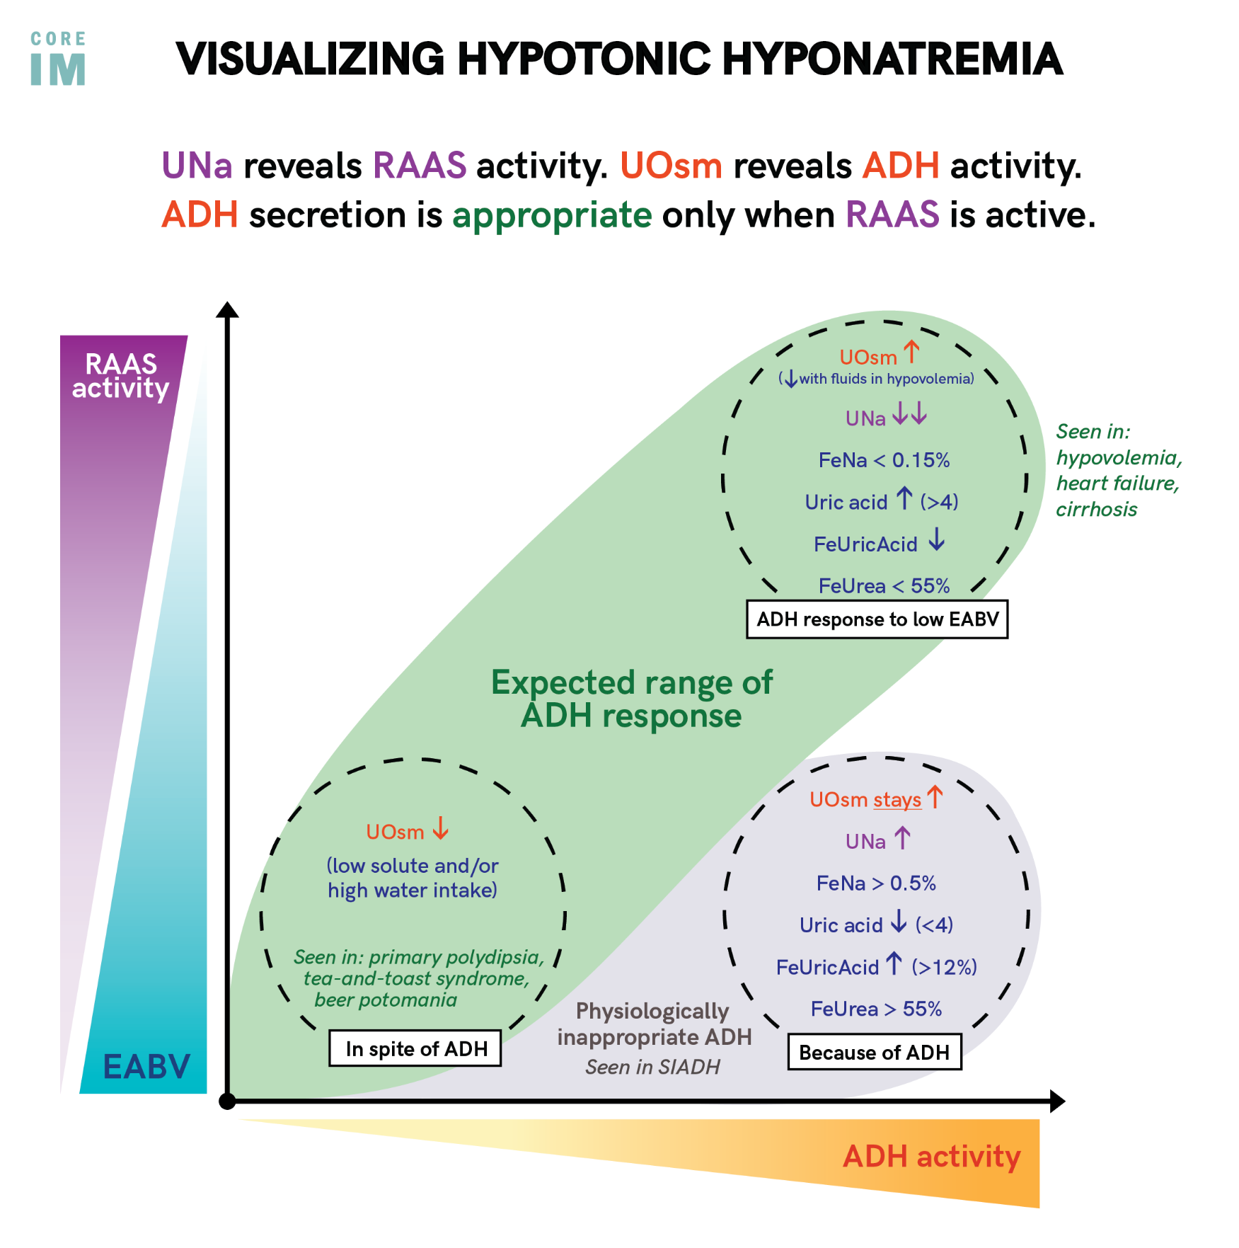
Quick refresher
Hyponatremia is a problem with water retention, not salt per se
ADH makes the kidneys hold on to water
EABV = Effective arterial blood volume

Slide 103
Quick refresher
Hyponatremia is a problem with water retention, not salt per se
ADH makes the kidneys hold on to water
↑↑ ADH makes sense when kidneys think there is low blood volume (EABV)
  Includes states like CHF, cirrhosis
EABV = Effective arterial blood volume

Slide 104
Quick refresher
Hyponatremia is a problem with water retention, not salt per se
ADH makes the kidneys hold on to water
↑↑ ADH makes sense when kidneys think there is low blood volume (EABV)
  Includes states like CHF, cirrhosis
SIADH: ↑↑ ADH disproportionate to ↓EABV
EABV = Effective arterial blood volume

Slide 105
Quick refresher
Hyponatremia is a problem with water retention, not salt per se
ADH makes the kidneys hold on to water
↑↑ ADH makes sense when kidneys think there is low blood volume (EABV)
SIADH: ↑↑ ADH disproportionate to ↓EABV
There is also renal salt wasting (formerly cerebral salt wasting), too complicated to discuss here
Appears similar to SIADH but better with normal saline (not water restriction)
EABV = Effective arterial blood volume

Slide 106
Does Legionella cause hyponatremia?
Pneumonia (of all types) have been associated with SIADH
Legionella disproportionately causes hyponatremia

Slide 107
Does Legionella cause hyponatremia?
Pneumonia (of all types) have been associated with SIADH
Legionella disproportionately causes hyponatremia
Highlighted by a large, multicenter prospective study (Schuetz et al, 2013) [5]
Post-hoc analysis of 873 patients enrolled in a pneumonia trial looking at procalcitonin

Slide 108
Does Legionella cause hyponatremia?
Pneumonia (of all types) have been associated with SIADH
Legionella disproportionately causes hyponatremia
Highlighted by a large, multicenter prospective study (Schuetz et al, 2013) [5]
Post-hoc analysis of 873 patients enrolled in a pneumonia trial looking at procalcitonin
They compared:
Legionnaires’ dz (n=27)
vs
Other form of CAP
(n=846)

Slide 109
Does Legionella cause hyponatremia?
Pneumonia (of all types) have been associated with SIADH
Legionella disproportionately causes hyponatremia
Highlighted by a large, multicenter prospective study (Schuetz et al, 2013) [5]
Post-hoc analysis of 873 patients enrolled in a pneumonia trial looking at procalcitonin
Used left over blood to measure copeptin, in addition to serum sodium levels (on admission)
They compared:
Legionnaires’ dz (n=27)
vs
Other form of CAP
(n=846)
Copeptin / CT-ProVasopressin
C terminal provasopressin (referred to as CT-ProVasopressin in the article) is a stable laboratory surrogate of ADH levels

Slide 110
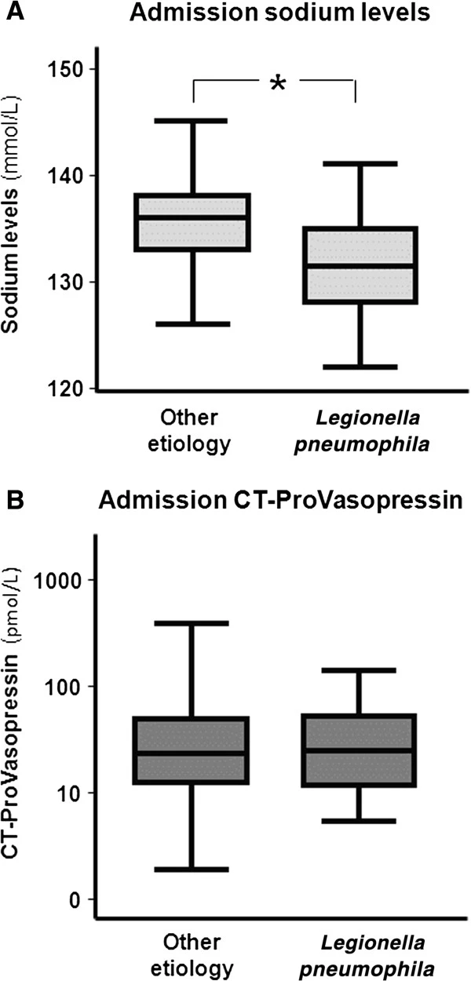
Schuetz et al (2013) [5]
Patients with Legionnaires’ disease
More frequently had low sodium levels
  Defined as Na < 130 (mmol/L)
  44.4% vs 8.2% (p < 0.01)

Slide 111
Schuetz et al (2013) [5]
Patients with Legionnaires’ disease
More frequently had low sodium levels
  44.4% vs 8.2% (p < 0.01)
Had similar levels of CT-ProVasopressin/copeptin
  39.4 ±7 vs 51.2 ±2.7 (p = 0.43)

Slide 112
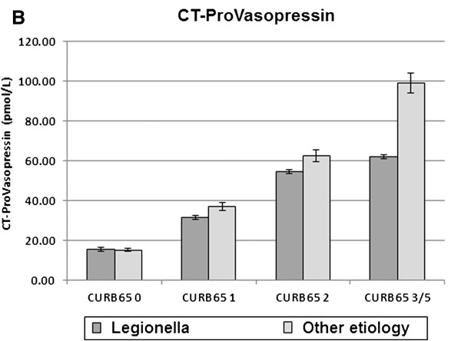
Schuetz et al (2013) [5]
Patients with Legionnaires’ disease
More frequently had low sodium levels
  44.4% vs 8.2% (p < 0.01)
Had similar levels of CT-ProVasopressin/copeptin
  39.4 ±7 vs 51.2 ±2.7 (p = 0.43)
Interestingly, copeptin levels were associated with increased severity of pneumonia, just not with the etiology of the pneumonia

Slide 113
Schuetz et al (2013) [5]
Author’s conclusions
Although legionella is associated with hyponatremia, there is no evidence that ADH is driving this process.
Rather, an ADH-independent process may be driving hyponatremia, such as direct renal effects of cytokines or toxins, as well as natriuretic hormones
Patients with Legionnaires’ disease
More frequently had low sodium levels
  44.4% vs 8.2% (p < 0.01)
Had similar levels of CT-ProVasopressin/copeptin
  39.4 ±7 vs 51.2 ±2.7 (p = 0.43)
Interestingly, copeptin levels were associated with increased severity of pneumonia, just not with the etiology of the pneumonia
Why it matters?
Volume management with sepsis & ARDS is challenging
Fluid restricting when it’s not ADH makes things worse

Slide 114
If not SIADH, then what does cause hyponatremia?
Not a whole lot on the pathophysiology that I could find on PubMed
A few interesting case reports on acquired Fanconi syndrome in Legionella
Author’s conclusions
Although legionella is associated with hyponatremia, there is no evidence that ADH is driving this process.
Rather, an ADH-independent process may be driving hyponatremia, such as direct renal effects of cytokines or toxins, as well as natriuretic hormones

Slide 115
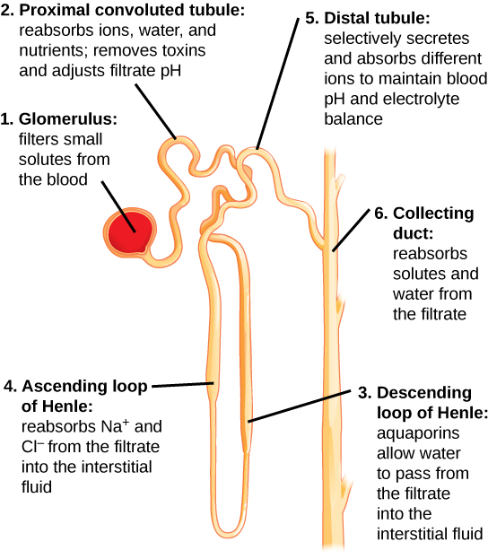
Fanconi syndrome (more nephrology)
Fanconi syndrome is generalized dysfunction of the PCT
Same syndrome that occurs with aminoglycosides, tenofovir, tetracyclines

Slide 116
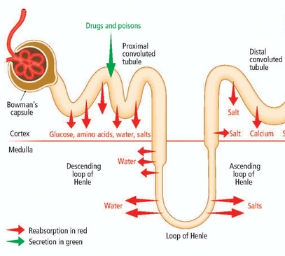
Fanconi syndrome (more nephrology)
Fanconi syndrome is generalized dysfunction of the PCT
PCT reabsorbs key nutrients, such as phosphate, glucose, and amino acids
Results in:
  Hypokalemia
  Hypophosphatemia
  Hypouricemia
  Metabolic acidosis
+/- hyponatremia (collecting duct can compensate, with use of ADH)

Slide 117
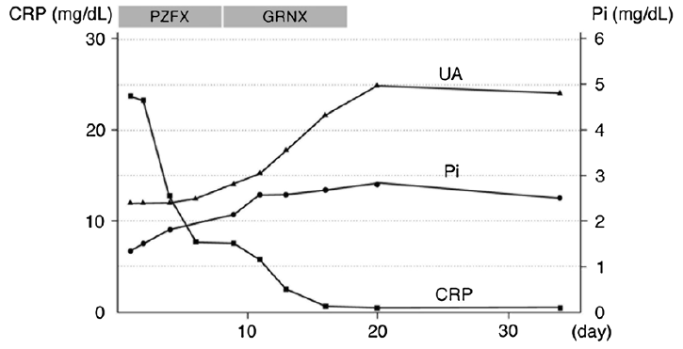
Kinoshita-Katahashi et al (2013) [6]
Case report of 2 cases of acquired Fanconi syndrome + Legionella out of Japan
CRP
Phos
Case 1
Key
Serum uric acid
Serum phosphate

Slide 118
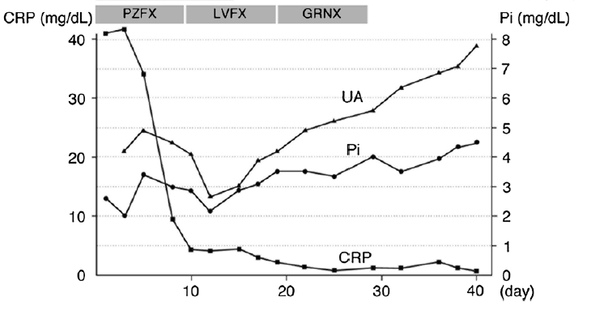
Kinoshita-Katahashi et al (2013) [6]
Case report of 2 cases of acquired Fanconi syndrome + Legionella out of Japan
CRP
Phos
Case 2
Key
Serum uric acid
Serum phosphate

Slide 119
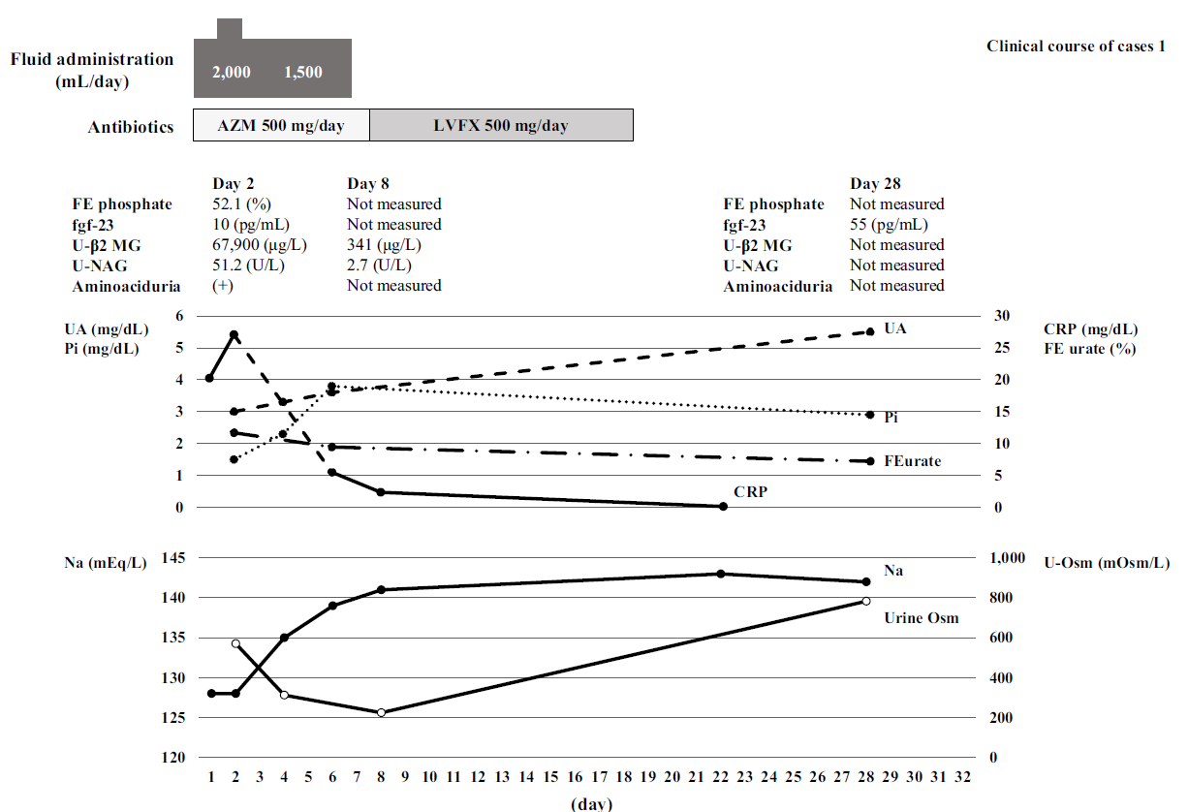
Ryuge et al (2016) [7]
Another 2 cases of acquired Fanconi syndrome + Legionella out of Japan
Case 1
Key
Serum uric acid
Serum phosphate
Urine FE urea
Urine Osm

Slide 120
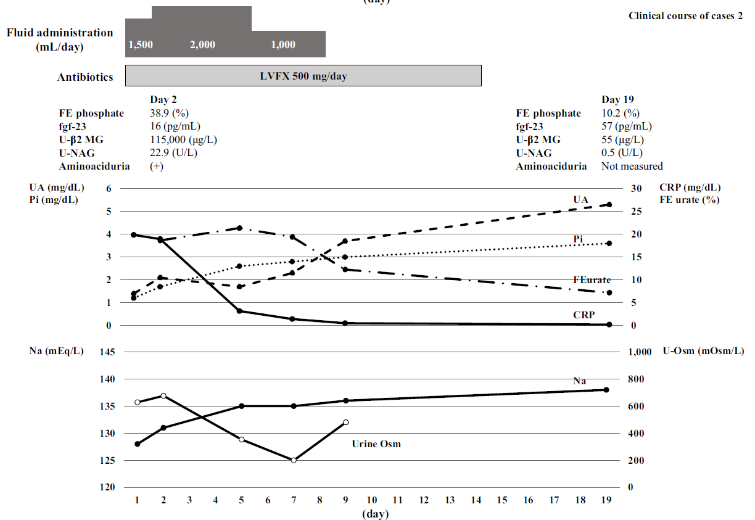
Ryuge et al (2016) [7]
Another 2 cases of acquired Fanconi syndrome + Legionella out of Japan
Case 2
Key
Serum uric acid
Serum phosphate
Urine FE urea
Urine Osm

Slide 121
Speculation
An additional case report [8] discusses evidence of Legionella involvement in the kidneys themselves
Specifically, an autopsy case report showed positive immunofluorescence in the renal proximal tubules
Schuetz et al (2013) [5]
Although legionella is associated with hyponatremia, there is no evidence that ADH is driving this process.
Rather, an ADH-independent process may be driving hyponatremia, such as direct renal effects of cytokines or toxins, as well as natriuretic hormones

Slide 122
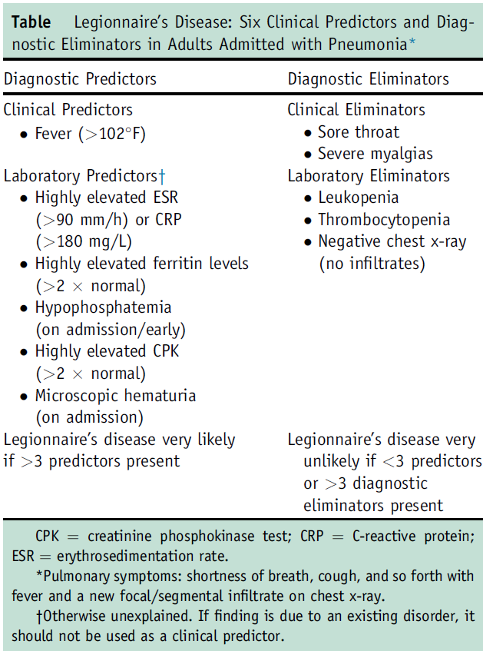
Speculation
An additional case report [8] discusses evidence of Legionella involvement in the kidneys themselves
Specifically, an autopsy case report showed positive immunofluorescence in the renal proximal tubules
Some authors [10] include hypophosphatemia as a diagnostic clue for Legionella
This may imply that the kidneys (PCT specifically) are taking more of a hit than previously expected

Slide 123
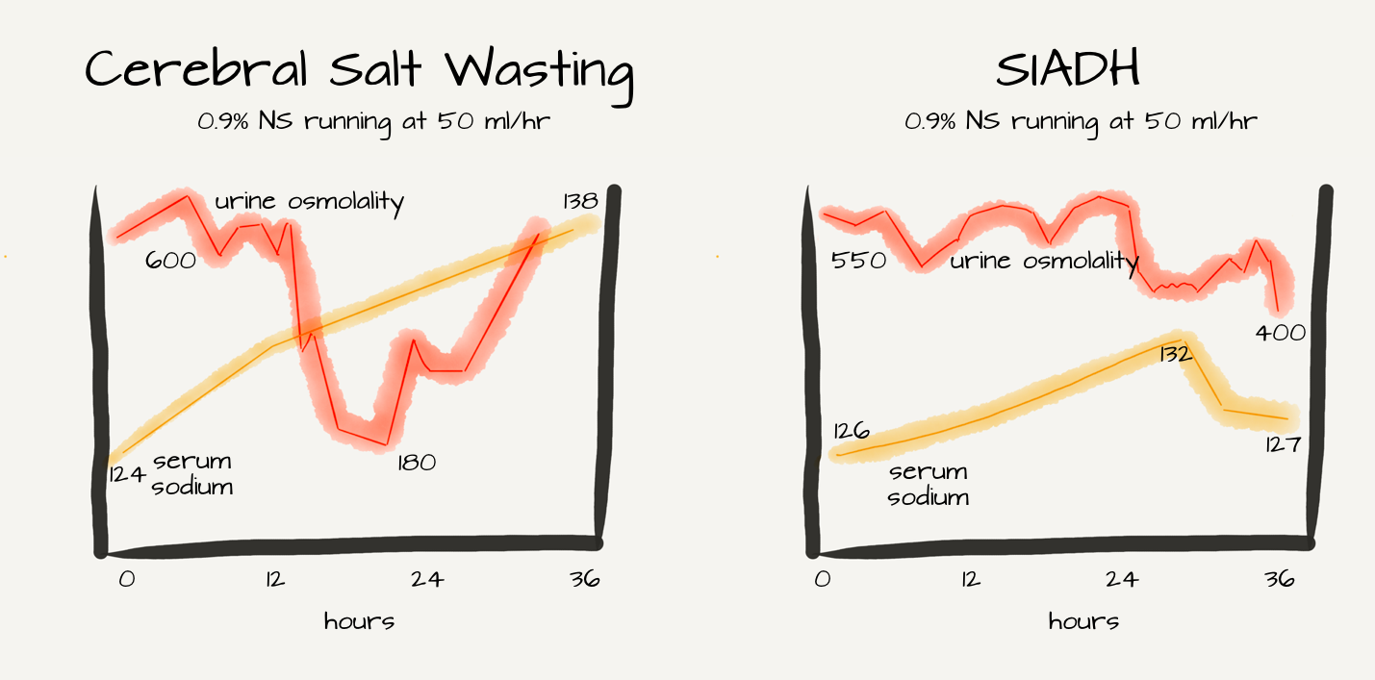
Speculation
An additional case report [8] discusses evidence of Legionella involvement in the kidneys themselves
Specifically, an autopsy case report showed positive immunofluorescence in the renal proximal tubules
Some authors [10] include hypophosphatemia as a diagnostic clue for Legionella
This may imply that the kidneys (PCT specifically) are taking more of a hit than previously expected
Renal salt wasting?
https://ajkdblog.org/2018/03/15/nephmadness-2018-hyponatremia-region/

Slide 124
Learning points & take aways

Slide 125

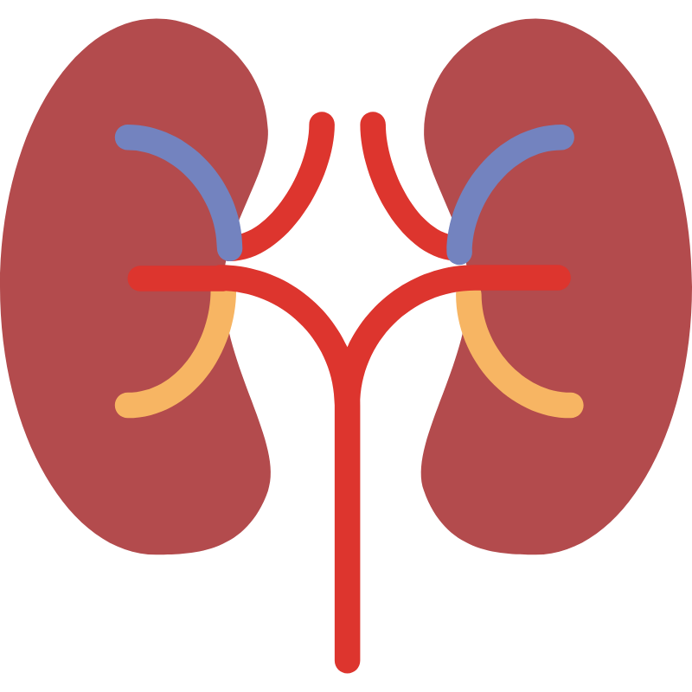
Learning points & take aways
When testing for legionella, combination testing (e.g. uAg + PCR) is best
Legionella rarely causes cavitary disease (though can happen in immunocompromise)
Up to 10% of patients with Legionella will have co-infections with other pathogens
  May be typical respiratory bacteria (H flu, pneumococcus), staph aureus
  But don’t forget about PJP, nocardia, aspergillus, tuberculosis, cryptococcus
Legionella can cause hyponatremia
  Traditionally thought to be from SIADH
  An analysis of trial data (Schuetz et al [5]) suggests it is not from SIADH
  Possibly mediated by direct injury to the kidney?
Prior talks
  Nocardia: www.hunterratliff1.com/talk/cid-2024-09/
  Hyponatremia (for ABIM): www.hunterratliff1.com/talk/acp_prep/
Slides available on hunterratliff1.com/talk/; Citations available via QR code or via the “citations” button on the website

