Slide 1
CLINID conference
Hunter Ratliff
06/12/2025
Ages, dates, and other identifying information may have been changed
I have no conflict of interest in relation to this presentation
Notes:
Link to share Menti: https://www.menti.com/alu8fic6knx4

Slide 2
Case #1

Slide 3
Case 1: HPI
A 60 y/o F with PMH including ESRD (iHD via AVF), s/p TAVR, afib, severe pulm HTN & COPD p/w chills.

Slide 4
Case 1: HPI
A 60 y/o F with PMH including ESRD (iHD via AVF), s/p TAVR, afib, severe pulm HTN & COPD p/w chills.
Five days prior to admission was having chills at dialysis center
They ordered blood cultures 3 days ago

Slide 5
Case 1: HPI
A 60 y/o F with PMH including ESRD (iHD via AVF), s/p TAVR, afib, severe pulm HTN & COPD p/w chills.
Five days prior to admission was having chills at dialysis center
They ordered blood cultures 3 days ago
Two weeks ago left ear fullness (no pain, discharge, tinnitus, or hearing loss)

Slide 6
Case 1: HPI
A 60 y/o F with PMH including ESRD (iHD via AVF), s/p TAVR, afib, severe pulm HTN & COPD p/w chills.
Five days prior to admission was having chills at dialysis center
They ordered blood cultures 3 days ago
Two weeks ago left ear fullness (no pain, discharge, tinnitus, or hearing loss)
Chronic cough (no dyspnea or change in quantity/quality of sputum)
No issues with her RUE AVF (aside from frequent bleeding at HD, which is chronic)

Slide 7
Case 1: Medical history
A 60 y/o F with PMH including ESRD (iHD via AVF), s/p TAVR, afib, severe pulm HTN & COPD p/w chills.
Five days of chills & malaise
Two weeks ago left ear fullness (resolved)
Chronic cough
No issues with her RUE AVF aside from
chronic bleeding
Medical / Surgical History
ESRD via RUE AVF (10+ years)
Severe pulm HTN (PCWP 45)
Group 2 & 3 (from heart/lungs)
COPD, HFpEF (5L home O2)
Atrial fibrillation
Warfarin (bleeding on DOAC)
Also on dronedarone
Hx TAVR (2021)
DM (A1c 6.8)
Mobility: Ambulates with walker

Slide 8
Case 1: Social history, exposures, & risk factors
Geographic & Travel | Lives in West Virginia No travel
Occupational | Retired. Used to work at convenience store
Substance & needles | No EtOH, tobacco, drugs No needle exposures
Animals | Pet dog at home Daughter has kittens
Exposures & hobbies | None

Slide 9
Case 1: Physical exam
Vitals: 115/65 | 93 bpm | 36.8 °C | 94% | 42.68 kg/m²
Gen: alert and oriented, NAD
ENT: EOMI grossly, sclera color: anicteric sclerae; MMM
Resp: normal respiratory effort on 5L O2, symmetric chest rise
CV: irregular but no murmurs; extremities perfused
GI: non-distended; no rebound or guarding
Ext: no clubbing or cyanosis; 1+ BLE edema; RUE AVF w/ thrill but no TTP, calor, or discharge

Slide 10
Case 1: Physical exam
Vitals: 115/65 | 93 bpm | 36.8 °C | 94% | 42.68 kg/m²
Gen: alert and oriented, NAD
ENT: EOMI grossly, sclera color: anicteric sclerae; MMM
Resp: normal respiratory effort on 5L O2, symmetric chest rise
CV: irregular but no murmurs; extremities perfused
GI: non-distended; no rebound or guarding
Ext: no clubbing or cyanosis; 1+ BLE edema; RUE AVF w/ thrill but no TTP, calor, or discharge
Blood cultures from HD were positive → Direct admission

Slide 11
Case 1: Summary
Wed
Chills at HD, some fatigue
A 60 y/o F with PMH including ESRD (iHD via AVF), s/p TAVR, afib, severe pulm HTN & COPD p/w 5 days of chills & malaise and was admitted for positive blood cultures.
Info that may (or may not) be helpful:
Left ear fullness (2 weeks ago, resolved)
Chronic cough
Friday
Chills again → collected BCx
Sunday
Positive blood cultures
Now
(Monday)
Admission

Slide 12
Case 1: Micro data

Slide 13
[Q1.1] Initial treatment
Initial treatment choice
(multiple choice)
Notes:
Link to share Menti: https://www.menti.com/alu8fic6knx4

Slide 14
Case 1: Micro data

Slide 15
Case 1: Micro data

Slide 16
Case 1: Cardiac workup
Transthoracic echo
Quality: Technically difficult study due to limited acoustic windows
Indications: Fungemia
Mitral Valve: Anterior and posterior mitral valve leaflets appear calcified. Moderate mitral annular calcification. Moderate mitral stenosis. Mild mitral regurgitation
Aortic Valve: There is a 23 mm transcatheter valve (Sapien III) in the aortic position. The aortic prosthesis demonstrates a normal transvalvular gradient for valve type and size. There is no evidence of paravalvular aortic regurgitation.
Conclusions: No change was seen from previous echocardiogram.

Slide 17
Case 1: Cardiac workup
Transthoracic echo
Quality: Technically difficult study due to limited acoustic windows
Indications: Fungemia
Mitral Valve: Anterior and posterior mitral valve leaflets appear calcified. Moderate mitral annular calcification. Moderate mitral stenosis. Mild mitral regurgitation
Aortic Valve: There is a 23 mm transcatheter valve (Sapien III) in the aortic position. The aortic prosthesis demonstrates a normal transvalvular gradient for valve type and size. There is no evidence of paravalvular aortic regurgitation.
Conclusions: No change was seen from previous echocardiogram.
Medical / Surgical History
ESRD via RUE AVF
Severe pulm HTN, COPD, HFpEF
PCWP 45
On 5L home O2
Hx TAVR (2021)
Do we need transesophageal echo?
Anesthesia + pulmonary hypertension = bad time

Slide 18
Case 1: Cardiac workup
Transesophageal echo
Quality: The study images were of technically good quality
S/P #23 Sapien S3 Ultra Valve. Leaflet cusps are thickened and restricted. Mild transvalvular regurgitation. No paravalvular regurgitation. The is linear mobile density measuring 1.1 x 0.2 cm attached to the cusp in the right coronary position. In the setting of bacteremia fungemia this may represent vegetation.
Mitral leaflets are calcified and restricted. Mild mitral stenosis. Moderate mitral regurgitation

Slide 19
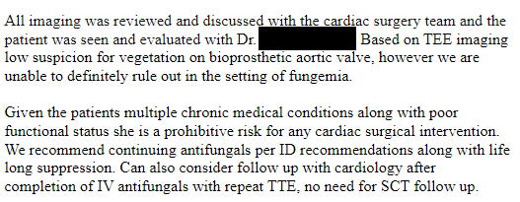
Case 1: Surgical candidacy
STS Risk Score: https://acsdriskcalc.research.sts.org/calculation
Isolated AVR
Mortality 18.5%
Morbidity and Mortality 37.1%

Slide 20
Case 1: Susceptibilities
We all agree on the IV therapy, but what about after IV therapy?
Amphotericin B | 0.5 | None
Rezafungin | 0.016 | Suscept
Anidulafungin | 0.03 | Suscept
Micafungin | 0.016 | Suscept
Voriconazole | 0.12 | None
Isavuconazole | 0.12 | None
Posaconazole | 1 | None
Itraconazole | 0.5 | None
Fluconazole | 4 | SDD
Caspofungin | 0.12 | Suscept

Slide 21
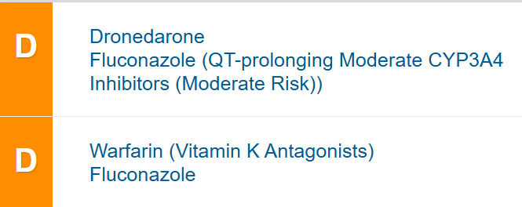
Case 1: Susceptibilities
We all agree on the IV therapy, but what about after IV therapy?
Atrial fibrillation
Warfarin (bleeding on DOAC)
Also on dronedarone
Hx TAVR (2021)
Amphotericin B | 0.5 | None
Rezafungin | 0.016 | Suscept
Anidulafungin | 0.03 | Suscept
Micafungin | 0.016 | Suscept
Voriconazole | 0.12 | None
Isavuconazole | 0.12 | None
Posaconazole | 1 | None
Itraconazole | 0.5 | None
Fluconazole | 4 | SDD
Caspofungin | 0.12 | Suscept
i.e. paperwork

Slide 22
[Q1.2] What to do at the end?
PO transition
(multiple choice, has wrong answers)

Slide 23
Case 1: The transition to Cresemba
A 60 y/o F with PMH including recent C glabrata prosthetic aortic valve endocarditis, afib (on warfarin & dronedarone), ESRD, severe pulm HTN (on 5L oxygen)
Talk with cardiology → won’t change their meds (patient does not want to go off warfarin)

Slide 24
Case 1: The transition to Cresemba
A 60 y/o F with PMH including recent C glabrata prosthetic aortic valve endocarditis, afib (on warfarin & dronedarone), ESRD, severe pulm HTN (on 5L oxygen)
Talk with cardiology → won’t change their meds (patient does not want to go off warfarin)
You do some paperwork

Slide 25
Case 1: The transition to Cresemba
A 60 y/o F with PMH including recent C glabrata prosthetic aortic valve endocarditis, afib (on warfarin & dronedarone), ESRD, severe pulm HTN (on 5L oxygen)
Talk with cardiology → won’t change their meds (patient does not want to go off warfarin)
You do some paperwork
And some more paperwork…

Slide 26
Case 1: The transition to Cresemba
A 60 y/o F with PMH including recent C glabrata prosthetic aortic valve endocarditis, afib (on warfarin & dronedarone), ESRD, severe pulm HTN (on 5L oxygen)
Talk with cardiology → won’t change their meds (patient does not want to go off warfarin)
You do some paperwork
And some more paperwork…
And some more (she has finished 6 weeks at this point, but still getting OPAT)

Slide 27
Case 1: The transition to Cresemba
A 60 y/o F with PMH including recent C glabrata prosthetic aortic valve endocarditis, afib (on warfarin & dronedarone), ESRD, severe pulm HTN (on 5L oxygen)
Talk with cardiology → won’t change their meds (patient does not want to go off warfarin)
You do some paperwork
And some more paperwork…
And some more (she has finished 6 weeks at this point, but still getting OPAT)
Cresemba approved!!!

Slide 28
But then…

Slide 29
Case 1: The transition to Cresemba
60 y/o F with PMH including recent C glabrata prosthetic aortic valve endocarditis, afib (on warfarin & dronedarone), ESRD, severe pulm HTN (on 5L oxygen) s/p 6+ weeks of mica
Two weeks after starting Cresemba, developed profound emesis, followed by persistent diarrhea

Slide 30
Case 1: The transition to Cresemba
60 y/o F with PMH including recent C glabrata prosthetic aortic valve endocarditis, afib (on warfarin & dronedarone), ESRD, severe pulm HTN (on 5L oxygen) s/p 6+ weeks of mica
Two weeks after starting Cresemba, developed profound emesis, followed by persistent diarrhea
3-4 watery bowel movements per day
Associated stomach cramping
Thinks symptoms are worse in the hours after taking Cresemba

Slide 31
Case 1: The transition to Cresemba
60 y/o F with PMH including recent C glabrata prosthetic aortic valve endocarditis, afib (on warfarin & dronedarone), ESRD, severe pulm HTN (on 5L oxygen) s/p 6+ weeks of mica
Two weeks after starting Cresemba, developed profound emesis, followed by persistent diarrhea
3-4 watery bowel movements per day
Associated stomach cramping
Thinks symptoms are worse in the hours after taking Cresemba
Missed a few HD sessions due to GI symptoms
I can poop while I’m at dialysis (very reasonable)

Slide 32
Case 1: The transition to Cresemba
60 y/o F with PMH including recent C glabrata prosthetic aortic valve endocarditis, afib (on warfarin & dronedarone), ESRD, severe pulm HTN (on 5L oxygen) s/p 6+ weeks of mica
Two weeks after starting Cresemba, developed profound emesis, followed by persistent diarrhea
3-4 watery bowel movements per day
Associated stomach cramping
Thinks symptoms are worse in the hours after taking Cresemba
Missed a few HD sessions due to GI symptoms
I can poop while I’m at dialysis (very reasonable)
Brief admission to Ruby, GI biofire negative (no C diff testing)

Slide 33
Case 1: The transition to Cresemba
60 y/o F with PMH including recent C glabrata prosthetic aortic valve endocarditis, afib (on warfarin & dronedarone), ESRD, severe pulm HTN (on 5L oxygen) s/p 6+ weeks of mica
Two weeks after starting Cresemba, developed profound emesis, followed by persistent diarrhea
3-4 watery bowel movements per day
Associated stomach cramping
Thinks symptoms are worse in the hours after taking Cresemba
Missed a few HD sessions due to GI symptoms
I can poop while I’m at dialysis (very reasonable)
Brief admission to Ruby, GI biofire negative (no C diff testing)
Warfarin management
Warfarin can no longer be managed by Ruby pharmacist
Her family medicine doc is doing the warfarin management now
They don’t use Epic

Slide 34
[Q1.3] Refractory diarrhea
GI intolerance
(multiple choice, has wrong answers)

Slide 35
Case 1: The transition to Cresemba fluconazole
60 y/o F with PMH including recent C glabrata prosthetic aortic valve endocarditis, afib (on warfarin & dronedarone), ESRD, severe pulm HTN (on 5L oxygen) s/p 6+ weeks of mica who developed intractable GI symptoms 2 weeks after starting Cresemba. She does not want to consider DOAC again due to bleeding issues
Order C diff testing
Sent fluconazole to her pharmacy (on a Thursday)

Slide 36
Case 1: The transition to Cresemba fluconazole
60 y/o F with PMH including recent C glabrata prosthetic aortic valve endocarditis, afib (on warfarin & dronedarone), ESRD, severe pulm HTN (on 5L oxygen) s/p 6+ weeks of mica who developed intractable GI symptoms 2 weeks after starting Cresemba. She does not want to consider DOAC again due to bleeding issues
Order C diff testing → PCR positive , Toxin negative
Sent fluconazole to her pharmacy (on a Thursday)
Medicaid denies fluconazole (despite it being the preferred formulary option)

Slide 37
Case 1: The transition to Cresemba fluconazole
60 y/o F with PMH including recent C glabrata prosthetic aortic valve endocarditis, afib (on warfarin & dronedarone), ESRD, severe pulm HTN (on 5L oxygen) s/p 6+ weeks of mica who developed intractable GI symptoms 2 weeks after starting Cresemba. She does not want to consider DOAC again due to bleeding issues
Order C diff testing → PCR positive , Toxin negative
Sent fluconazole to her pharmacy (on a Thursday)
Medicaid denies fluconazole (despite it being the preferred formulary option)
Tell her to keep taking Cresemba until gets fluconazole
Eventually gets admitted to Ruby because of symptoms & delay with the switch

Slide 38
Case 1: The transition to Cresemba fluconazole
60 y/o F with PMH including recent C glabrata prosthetic aortic valve endocarditis, afib (on warfarin & dronedarone), ESRD, severe pulm HTN (on 5L oxygen) s/p 6+ weeks of mica who developed intractable GI symptoms 2 weeks after starting Cresemba. She does not want to consider DOAC again due to bleeding issues
Order C diff testing → PCR positive , Toxin negative
Sent fluconazole to her pharmacy (on a Thursday)
Medicaid denies fluconazole (despite it being the preferred formulary option)
Tell her to keep taking Cresemba until gets fluconazole
Eventually gets admitted to Ruby because of symptoms & delay with the switch
Got some PO vanco, but also got PO fluconazole

Slide 39
Case 1: The transition to Cresemba fluconazole
60 y/o F with PMH including recent C glabrata prosthetic aortic valve endocarditis, afib (on warfarin & dronedarone), ESRD, severe pulm HTN (on 5L oxygen) s/p 6+ weeks of mica who developed intractable GI symptoms 2 weeks after starting Cresemba. She does not want to consider DOAC again due to bleeding issues
Order C diff testing → PCR positive , Toxin negative
Sent fluconazole to her pharmacy (on a Thursday)
Medicaid denies fluconazole (despite it being the preferred formulary option)
Tell her to keep taking Cresemba until gets fluconazole
Eventually gets admitted to Ruby because of symptoms & delay with the switch
Got some PO vanco, but more importantly, got PO fluconazole
Things got better for her GI system!!!

Slide 40
But then…

Slide 41
Case 1: Fluconazole doesn’t play nice
60 y/o F with PMH including recent C glabrata prosthetic aortic valve endocarditis, afib (on warfarin & dronedarone), ESRD, severe pulm HTN (on 5L oxygen) s/p 6+ weeks of mica who didn’t Cresemba (GI Sx) and is now on fluconazole
You can probably guess what happens…

Slide 42
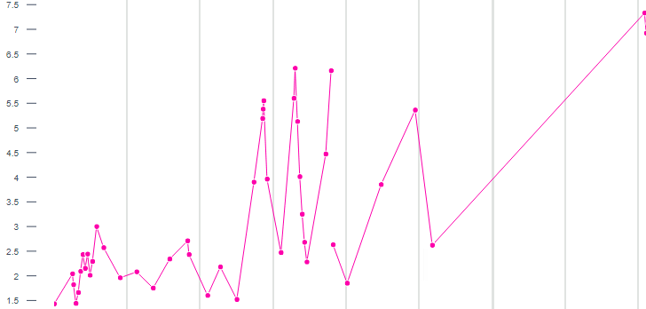
Case 1: Fluconazole doesn’t play nice
60 y/o F with PMH including recent C glabrata prosthetic aortic valve endocarditis, afib (on warfarin & dronedarone), ESRD, severe pulm HTN (on 5L oxygen) s/p 6+ weeks of mica who didn’t Cresemba (GI Sx) and is now on fluconazole
Admissions / ED visits
(unrelated reasons)
7.5 —
6.5 —
5.5 —
4.5 —
3.5 —
2.5 —
1.5 —

Slide 43
Case 1: Fluconazole doesn’t play nice
60 y/o F with PMH including recent C glabrata prosthetic aortic valve endocarditis, afib (on warfarin & dronedarone), ESRD, severe pulm HTN (on 5L oxygen) s/p 6+ weeks of mica who didn’t Cresemba (GI Sx) and is now on fluconazole
Admissions / ED visits
(unrelated reasons)
7.5 —
6.5 —
5.5 —
4.5 —
3.5 —
2.5 —
1.5 —

Slide 44
Case 1: Fluconazole doesn’t play nice
60 y/o F with PMH including recent C glabrata prosthetic aortic valve endocarditis, afib (on warfarin & dronedarone), ESRD, severe pulm HTN (on 5L oxygen) s/p 6+ weeks of mica who didn’t Cresemba (GI Sx) and is now on fluconazole now admitted for bleeding from fistula
7.5 —
6.5 —
5.5 —
4.5 —
3.5 —
2.5 —
1.5 —

Slide 45
Case 1: Fluconazole doesn’t play nice
60 y/o F with PMH including recent C glabrata prosthetic aortic valve endocarditis, afib (on warfarin & dronedarone), ESRD, severe pulm HTN (on 5L oxygen) s/p 6+ weeks of mica who didn’t Cresemba (GI Sx) and is now on fluconazole now admitted for bleeding from fistula
Inpatient team switched back to Cresemba
Tolerated it well
7.5 —
6.5 —
5.5 —
4.5 —
3.5 —
2.5 —
1.5 —

Slide 46
Case 1: Hospital course
Later in that admission, had a rapid clinical decline prompting MICU transfer

Slide 47
Case 1: Hospital course
Later in that admission, had a rapid clinical decline prompting MICU transfer
Acute on chronic respiratory failure → hypotension requiring pressors

Slide 48
Case 1: Hospital course
Later in that admission, had a rapid clinical decline prompting MICU transfer
Acute on chronic respiratory failure → hypotension requiring pressors
Resp Biofire: coronavirus HKU1
All other micro data was unrevealing (including negative blood cultures)

Slide 49
Case 1: Hospital course
Later in that admission, had a rapid clinical decline prompting MICU transfer
Acute on chronic respiratory failure → hypotension requiring pressors
Resp Biofire: coronavirus HKU1
All other micro data was unrevealing (including negative blood cultures)
Given comorbidities, patient/family did not want escalation of care
Eventually CMO

Slide 50
Case #2

Slide 51
Case 2: HPI
A 30 y/o F with PMH including substance use, Hx tricuspid endocarditis transferred with…

Slide 52
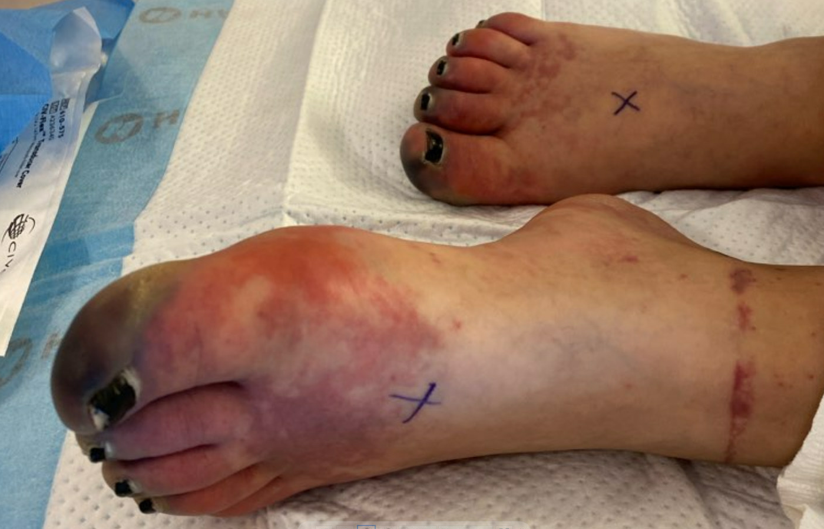
Case 2: HPI
A 30 y/o F with PMH including substance use, Hx tricuspid endocarditis transferred with…

Slide 53
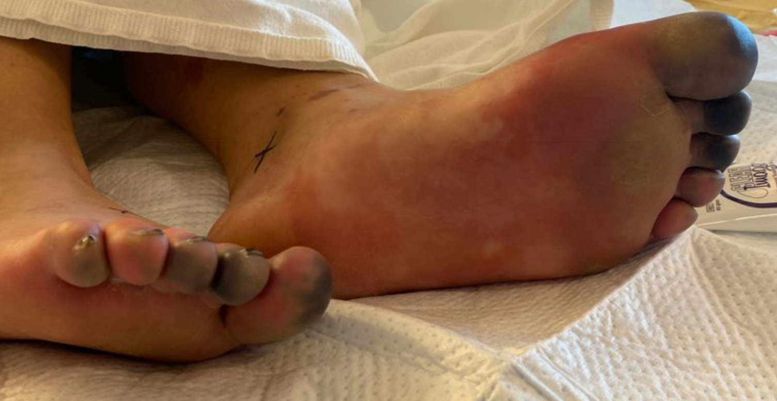
Case 2: HPI
A 30 y/o F with PMH including substance use, Hx tricuspid endocarditis transferred with…

Slide 54
Case 2: Medical Hx
-5 years
MRSA native TV IE s/p repair
Treated with vanc → AMA
Returned → TV repair → AMA 4 days later
A 30 y/o F with PMH including substance use, Hx tricuspid endocarditis transferred with
5 years ago - Ruby
MRSA bacteremia
1.4 cm TV vegetation
Left AMA (but came back later)
Got TV repair (but then left AMA again)

Slide 55
Case 2: Medical Hx
-5 years
MRSA native TV IE s/p repair
Treated with vanc → AMA
Returned → TV repair → AMA 4 days later
A 30 y/o F with PMH including substance use, Hx tricuspid endocarditis transferred with
-2 years
MRSA bacteremia
Left the ED, never able to be contacted
Unclear if ever treated
24 months ago - Satellite ED
BCx in the ED grew MRSA
Patient left before being admitted
Never was able to get in contact with her
-1.5 years
Bioprosthetic TV replacement
Outside hospital
18 months ago - OSH
Got Bioprosthetic TV replacement
Details unclear

Slide 56
Case 2: Medical Hx
-5 years
MRSA native TV IE s/p repair
Treated with vanc → AMA
Returned → TV repair → AMA 4 days later
A 30 y/o F with PMH including substance use, Hx tricuspid endocarditis transferred with
-2 years
MRSA bacteremia
Left the ED, never able to be contacted
Unclear if ever treated
13 months ago - Ruby
Sternotomy got infected
MSSA bacteremia
TEE showed TV veggie
Also septic arthritis
Plan for 6 week DOT
2 weeks gentamicin + oxacillin
4 weeks of oxacillin
Left AMA before finishing last 2 weeks of oxacillin
-1.5 years
Bioprosthetic TV replacement
Outside hospital
-13 mo
MSSA tricuspid PVE, sternotomy infxn
Only completed 2 weeks of gentamicin + 4 weeks oxacillin
Left AMA after about 4 weeks

Slide 57
Case 2: Outside hospital
-5 years
MRSA native TV IE s/p repair
Treated with vanc → AMA
Returned → TV repair → AMA 4 days later
A 30 y/o F with PMH including substance use, Hx tricuspid endocarditis transferred with
-2 years
MRSA bacteremia
Left the ED, never able to be contacted
Unclear if ever treated
Review of outside records
P/W chest pain
“Felt like prior episodes” of IE
Admitted for 3 days
Hypotensive, only needed levophed
TTE normal
Persistent fevers
Blood cultures positive for…
Bioprosthetic TV replacement
-1.5 years
Outside hospital
-13 mo
MSSA tricuspid PVE, sternotomy infxn
Only completed 2 weeks of gentamicin + 4 weeks oxacillin
Left AMA after about 4 weeks
-3 days
Outside hospital
Hypotensive, needed pressors
TTE normal

Slide 58
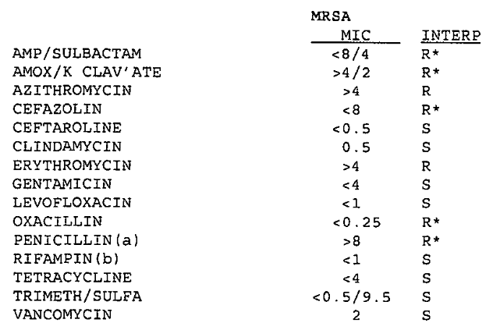
Case 2: Micro data
30 y/o F with PMH including hx PWID, Hx native TV S. aureus IE s/p TV replacement (-1.5 yr), HCV who p/w “feeling like prior IE” and was admitted to OSH for 3 days with MRSA bacteremia & septic shock

Slide 59
Case 2: Micro data
30 y/o F with PMH including hx PWID, Hx native TV S. aureus IE s/p TV replacement (-1.5 yr), HCV who p/w “feeling like prior IE” and was admitted to OSH for 3 days with MRSA bacteremia & septic shock
Fevering despite…
Vancomycin
Gentamicin
Rifampin
Ceftaroline

Slide 60
Case 2: Summary
-5 years
MRSA native TV IE s/p repair
AMA → TV repair → AMA 4 days later
-2 years
MRSA bacteremia
Left the ED, never able to be contacted
-1.5 years
Bioprosthetic TV replacement (OSH)
30 y/o F with PMH including hx PWID, Hx native TV S. aureus IE s/p TV replacement (-1.5 yr), HCV who p/w “feeling like prior IE” and was admitted to OSH for 3 days with MRSA bacteremia & septic shock
-13 mo
MSSA tricuspid PVE, sternotomy infxn
Only completed 2 weeks of gentamicin + 4 weeks oxacillin before AMA
-3 days
Outside hospital
Hypotensive, needed pressors
Febrile despite vanc, ceftaroline, gent, and rifampin
Now
Ruby
Fevering despite…
Vancomycin
Gentamicin
Rifampin
Ceftaroline

Slide 61
[Q2.1-3] Initial treatment
Initial treatment choice
(multiple choice)
Part A: (vanc vs dapto) (+/- gent)
Part B: Additional agents (stratified by part A)

Slide 62
Case 2: Hospital course
Started on vancomycin & gentamicin on transfer to Ruby
Okay, so I may have lied about the AKI (but did have septic pulmonary emboli)

Slide 63
Case 2: Hospital course
Started on vancomycin & gentamicin on transfer to Ruby
Blood cultures did clear at OSF (on cultures collected prior to transfer)
I guess the kitchen sink approach does work!

Slide 64
Case 2: Hospital course
Started on vancomycin & gentamicin on transfer to Ruby
Blood cultures did clear at OSF (on cultures collected prior to transfer)
Added on rifampin once blood cultures cleared
Ruby’s lab | MIC | Susceptibility
Ceftaroline | KB | Susceptible
Daptomycin | 1 | Susceptible
Vancomycin | 2 | Susceptible
Linezolid | KB | Susceptible

Slide 65
Case 2: Hospital course
Started on vancomycin & gentamicin on transfer to Ruby
Blood cultures did clear at OSF (on cultures collected prior to transfer)
Added on rifampin once blood cultures cleared
TTE: Inconclusive

Slide 66
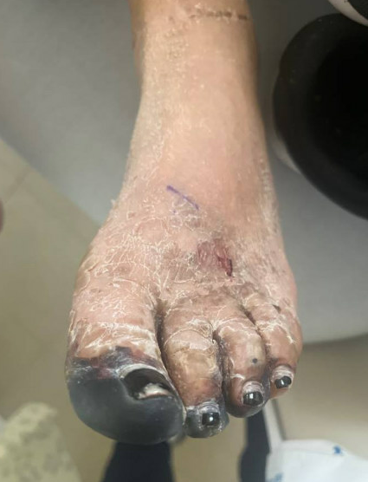
Case 2: Hospital course
Started on vancomycin & gentamicin on transfer to Ruby
Blood cultures did clear at OSF (on cultures collected prior to transfer)
Added on rifampin once blood cultures cleared
TEE: Vegetation on bioprosthetic tricuspid valve
Interestingly no left sided endocarditis

Slide 67
Case 2: Hospital course
Started on vancomycin & gentamicin on transfer to Ruby
Blood cultures did clear at OSF (on cultures collected prior to transfer)
Added on rifampin once blood cultures cleared
TEE: Vegetation on bioprosthetic tricuspid valve
Interestingly no left sided endocarditis
Transferred to Hospitalist 7

Slide 68
But then…

Slide 69
Case 2: Hospital course
Transferred to Hospitalist 7 → AKI on vanco + gent

Slide 70
Case 2: Hospital course
Transferred to Hospitalist 7 → AKI on vanco + gent
Gentamicin stopped 3 days early due to AKI (see, I didn’t totally lie!)

Slide 71
Case 2: Hospital course
Transferred to Hospitalist 7 → AKI on vanco + gent
Gentamicin stopped 3 days early due to AKI (see, I didn’t totally lie!)
Vanco switched to dapto (at week 2.5 of Tx) for AKI as well
Rifampin stopped here as well

Slide 72
Case 2: Hospital course
Transferred to Hospitalist 7 → AKI on vanco + gent
Gentamicin stopped 3 days early due to AKI
Vanco switched to dapto (at week 2.5 of Tx)
Rifampin stopped here as well
She stayed for the full treatment this time
Discharged to Hope & Healing

Slide 73
Case 2: Hospital course
Transferred to Hospitalist 7 → AKI on vanco + gent
Gentamicin stopped 3 days early due to AKI
Vanco switched to dapto (at week 2.5 of Tx)
Rifampin stopped here as well
She stayed for the full treatment this time
Discharged to Hope & Healing
One week Zyvox → PO suppressive doxycycline

Slide 74
Case 2: A counterfactual
What would you do if doxycycline were not an option for suppression?
For the sake of argument, assume this applies to doxy & mino too
>16
R

Slide 75
[Q2.4] Suppression
MRSA suppression for endovascular infections
(multiple choice, all that apply)

Slide 76
Discussion
Links to articles discussed here

Slide 77
Suppressive antimicrobial therapy in endocarditis
Review the current guidelines for suppressive antimicrobial therapy (SAT) in endocarditis
This won’t take long
Examine RCT & large prospective cohort studies of SAT in endocarditis
Appraise some studies from France

Slide 78
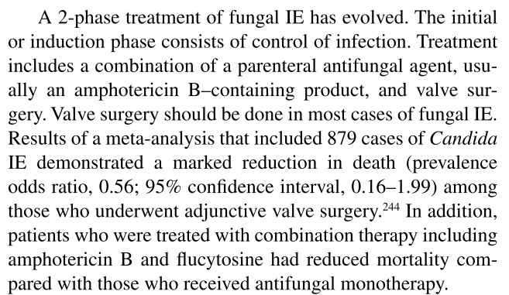
AHA / IDSA guidelines [1]
AHA / IDSA (2015)

Slide 79
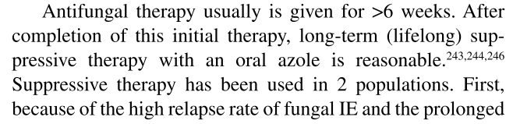
AHA / IDSA guidelines [1]
AHA / IDSA (2015)

Slide 80
AHA / IDSA guidelines [1]
AHA / IDSA (2015)

Slide 81
AHA / IDSA guidelines [1]
AHA / IDSA (2015)

Slide 82
European Society of Cardiology [2]
ESC (2023)

Slide 83
European Society of Cardiology [2]
ESC (2023)
ESC (2023)

Slide 84
European Society of Cardiology
ESC (2023)
ESC (2023)

Slide 85
European Society of Cardiology [2]
ESC (2023)
ESC (2023)

Slide 86
European Society of Cardiology [2]
ESC (2023)
ESC (2023)
Strong wording!

Slide 87
Suppressive antimicrobial therapy in endocarditis
Review the current guidelines for suppressive antimicrobial therapy (SAT) in endocarditis
Examine RCT & large prospective cohort studies of SAT in endocarditis
This won’t take long either as there aren’t any
I guess we are left talking about large case series then…

Slide 88
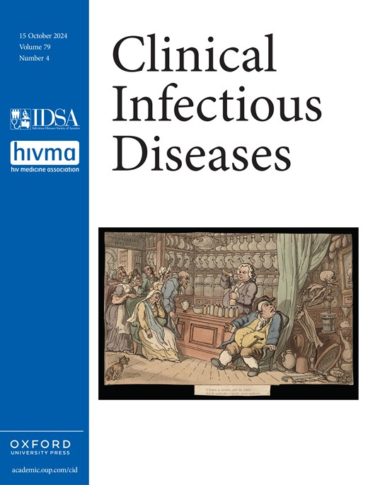
Horne et al, 2024 [3]
Good review on “The Use of Long-term Antibiotics for Suppression of Bacterial Infections”
It won’t tell you anything you don’t already know
It’s a review, not a systematic review

Slide 89
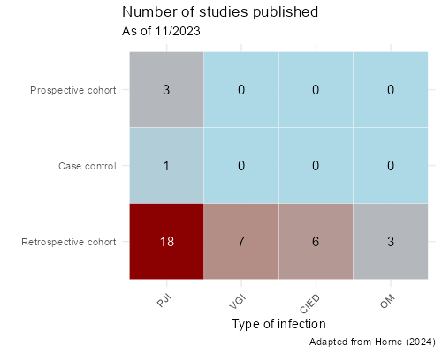
Horne et al, 2024 [3]
Abbreviations:
PJI = Periprosthetic Joint Infections
VGI = Vascular Graft Infections
CIED = Cardiac Implantable Electronic Device Infections
Most are LVADs
OM = Osteomyelitis and Spinal Hardware Infections

Slide 90
Horne et al, 2024 [3]
Abbreviations:
PJI = Periprosthetic Joint Infections
VGI = Vascular Graft Infections
CIED = Cardiac Implantable Electronic Device Infections
Most are LVADs
OM = Osteomyelitis and Spinal Hardware Infections

Slide 91
Suppressive antimicrobial therapy in endocarditis
Review the current guidelines for suppressive antimicrobial therapy (SAT) in endocarditis
Examine RCT & large prospective cohort studies of SAT in endocarditis
I guess we are left talking about large case series then…

Slide 92
French studies (Beaumont, Lemmet)
In France, they have multidisciplinary endocarditis teams (METs) at many of their tertiary care centers
Comprised of infectious diseases, cardiology, surgery, radiology, pharmacy, and other specialists (e.g. microbiology, neurology)
Have regularly scheduled meetings (like tumor board for IE)

Slide 93
French studies (Beaumont, Lemmet)
In France, they have multidisciplinary endocarditis teams (METs) at many of their tertiary care centers
Comprised of infectious diseases, cardiology, surgery, radiology, pharmacy, and other specialists (e.g. microbiology, neurology)
Have regularly scheduled meetings (like tumor board for IE)

Slide 94
French studies (Beaumont, Lemmet)
In France, they have multidisciplinary endocarditis teams (METs) at many of their tertiary care centers
Comprised of infectious diseases, cardiology, surgery, radiology, pharmacy, and other specialists (e.g. microbiology, neurology)
Have regularly scheduled meetings (like tumor board for IE)
Relevance for this literature review:
They keep large registries of their patients
Less intra-consultant variability on management decisions

Slide 95
French studies
 | Beaumont, 2024 | Lemmet, 2024
Timeframe | Paris, France (2016-2022) | Strasbourg, France (2020-2023)
Design | Descriptive case series from single referral centers in France

Slide 96
French studies
 | Beaumont, 2024 | Lemmet, 2024
Timeframe | Paris, France (2016-2022) | Strasbourg, France (2020-2023)
Design | Descriptive case series from single referral centers in France
Inclusion | Finished initial therapy, were recommended to start SAT (& started it); Could be native -or- prosthetic valve IE -or- CIED
Dx criteria | Definite or possible IE via 2023 Duke-ISCVID criteria | IE based on 2023 ECS criteria
Exclusion | LVADs, vascular graft, Q fever | ---
Abbreviations
SAT = Suppressive antimicrobial therapy
IE = Infective endocarditis
CIED = Cardiac im­plantable electronic device

Slide 97
French studies
 | Beaumont (Paris, 2016-2022) | Lemmet (Strasbourg, 2020-2023)
Patients | IE or CIED (n=42) | IE or CIED (n=22)
Outcomes | Mortality Relapse (infection with same pathogen) Side effects of SAT
Duration of follow up | 3 years | 2 years
Other notes | Supplemented mortality analysis with a national database to capture out of hospital deaths (but couldn’t ascertain reason for death)

Slide 98
Beaumont (2024): Demographics [4]
42 patients included
Majority male (86%)
Median age 73 (IQR 61-82)
High charlson comorbidity index median = 3
95% had at least one prosthetic cardiac device
Only one PWID (person who injects drugs)

Slide 99
Beaumont (2024): Pathogens [4]
All 42 cases were community-acquired
Enterococcus faecalis (36%)
Staphylococcus aureus (29%)
11 of these 12 cases were MSSA

Slide 100
Beaumont (2024): Pathogens [4]
All 42 cases were community-acquired
Enterococcus faecalis (36%)
Staphylococcus aureus (29%)
11 of these 12 cases were MSSA
Streptococci spp (14%)
Coagulase-negative staph (9%)
Other (12%)
Only one (2%) fungal (C albicans)
Only one (2%) gram negative (ESBL E cloacae; Tx w/ mino)

Slide 101
Beaumont (2024): Suppressive agents [4]
Doxycycline (45%)
Amoxicillin (45%)
Bactrim (5%, n=2)
Fluconazole & minocycline (2%, n=1)

Slide 102
Beaumont (2024): Surgical indications [4]
38/42 cases (90%) had a theoretical indication for surgery
50% of the indicated surgeries were valvular
42% CIED extraction
Extraction considered surgical as ¾ had material implanted >4 years
High risk of conversion to sternotomy
8% had both indications

Slide 103
Beaumont (2024): SAT indications [4]
Suppressive antimicrobial therapy (SAT) indications:
Surgery theoretically indicated but not done (67%)
Had surgery, but incomplete source control (14%)
Persistent infection source (12%)
Multiple reasons (7%)

Slide 104
Beaumont (2024): Side effects [4]
12% had adverse events of SAT at 1 year (Kaplan-Meier estimator)
Most side effects were mild, without therapy interruption

Slide 105
Beaumont (2024): Side effects [4]
12% had adverse events of SAT at 1 year (Kaplan-Meier estimator)
Most side effects were mild, without therapy interruption:
Mild diarrhea
Doxy: epigastric burning or moderate thrombocytopenia
Mino: blue coloration of scars
No C diff (across entire cohort)

Slide 106
Beaumont (2024): Side effects [4]
12% had adverse events of SAT at 1 year (Kaplan-Meier estimator)
Most side effects were mild, without therapy interruption:
Mild diarrhea
Doxy: epigastric burning or moderate thrombocytopenia
Mino: blue coloration of scars
No C diff (across entire cohort)
Severe AEs
The only severe adverse event was AKI
From Bactrim (big surprise)
Resolved after stopping (switched to doxy + Augmentin)
Recall, only two patients received bactrim

Slide 107
Beaumont (2024): Interruption & compliance [4]
13% had interruption of SAT at 1 year (Kaplan-Meier estimator)
Two thirds were inadvertent (SAT was discontinued because of oversight regarding the indication)
None resulted in recurrence
12% of patients had poor compliance (judged by the EMR)

Slide 108
Beaumont (2024): Recurrence [4]
Two had reinfections (4.8%, 1 in 21)
One was a transplant patient
CRBSI with S epi → switched to mino
One was the PWID
Reinfected with group B strep
Terms used here
Relapse = Infection with same pathogen
Reinfection = Infection w/ another pathogen
Recurrence = Relapse + reinfection

Slide 109
Beaumont (2024): Recurrence [4]
Two had reinfections (4.8%, 1 in 21)
One was a transplant patient
CRBSI with S epi → switched to mino
One was the PWID
Reinfected with group B strep
Terms used here
Relapse = Infection with same pathogen
Reinfection = Infection w/ another pathogen
Recurrence = Relapse + reinfection
PWID (only one in this cohort)
Had an index infection with S epi
Tx with Bactrim
Not the AKI patient
PVE (aortic & mitral) + CIED
They were the only death that could be attributed to infection
More on this later

Slide 110
Beaumont (2024): Recurrence [4]
Two had reinfections (4.8%, 1 in 21)
One was a transplant patient
CRBSI with S epi → switched to mino
One was the PWID
Reinfected with group B strep
Three had relapse (7.1%; 1 in 14) from
the same pathogen
E faecalis on Amox (no prosthetic devices)
Had severe diverticulosis
Increased Amox 2g → 3g (no relapses)
MSSA on Doxy (CIED)
Possible femoral graft infection
4 hospitalizations
E faecalis on Amox
This one is a bit of a mystery

Slide 111
Beaumont (2024): Recurrence [4]
Two had reinfections (4.8%, 1 in 21)
One was a transplant patient
CRBSI with S epi → switched to mino
One was the PWID
Reinfected with group B strep
Three had relapse (7.1%; 1 in 14) from
the same pathogen
E faecalis on Amox (no prosthetic devices)
Had severe diverticulosis
Increased Amox 2g → 3g (no relapses)
MSSA on Doxy (CIED)
Possible femoral graft infection
4 hospitalizations
E faecalis on Amox
This one is a bit of a mystery

Slide 112
Beaumont (2024): Recurrence [4]
Two had reinfections (4.8%, 1 in 21)
One was a transplant patient
CRBSI with S epi → switched to mino
One was the PWID
Reinfected with group B strep
Three had relapse (7.1%; 1 in 14) from
the same pathogen
E faecalis on Amox (no prosthetic devices)
Had severe diverticulosis
Increased Amox 2g → 3g (no relapses)
MSSA on Doxy (CIED)
Possible femoral graft infection
4 hospitalizations
E faecalis on Amox
This one is a bit of a mystery

Slide 113
Beaumont (2024): Recurrence [4]
Two had reinfections (4.8%, 1 in 21)
One was a transplant patient
CRBSI with S epi → switched to mino
One was the PWID
Reinfected with group B strep
Three had relapse (7.1%; 1 in 14) from
the same pathogen
E faecalis on Amox (no prosthetic devices)
Had severe diverticulosis
Increased Amox 2g → 3g (no relapses)
MSSA on Doxy (CIED)
Possible femoral graft infection
4 hospitalizations
E faecalis on Amox
This one is a bit of a mystery

Slide 114
Beaumont (2024): Recurrence [4]
Two had reinfections (4.8%, 1 in 21)
One was a transplant patient
CRBSI with S epi → switched to mino
One was the PWID
Reinfected with group B strep
Three had relapse (7.1%; 1 in 14) from
the same pathogen
E faecalis on Amox (no prosthetic devices)
Had severe diverticulosis
Increased Amox 2g → 3g (no relapses)
MSSA on Doxy (CIED)
Possible femoral graft infection
4 hospitalizations
E faecalis on Amox
This one is a bit of a mystery
Strange thing is…
All of the isolates from relapses were still susceptible to their SAT, but had developed resistance to the induction therapy

Slide 115
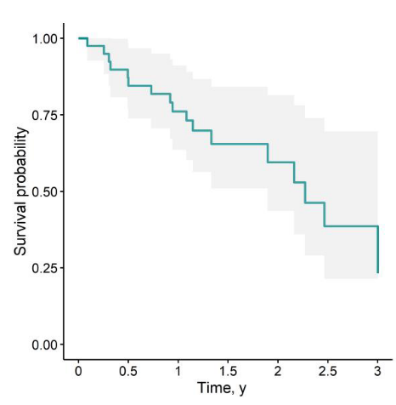
Beaumont (2024): Mortality [4]
84.3% 1 year survival (Kaplan-Meier estimator)
One in three died during follow-up
Median time to mortality 13.5 months (IQR 6.7 - 25.3)

Slide 116
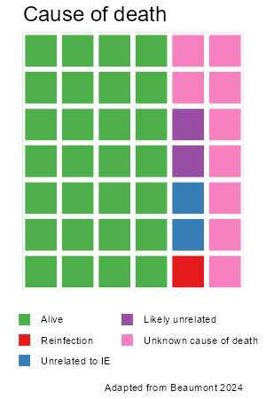
Beaumont (2024): Mortality [4]
84.3% 1 year survival
One in three died during follow-up
Median time to mortality 13.5 months
Of the five deaths documented in EMR (9 unknown causes of death)
One died from reinfection (PWID)
Two died from unrelated causes
Two died from likely unrelated causes
i.e. end-stage heart failure, without any bacterial documentation on blood cultures

Slide 117
French studies
 | Beaumont (Paris, ‘16-22) n=42 | Lemmet (Strasbourg, ‘20-23) n=22
Timeframe | Paris, France (2016-2022) | Strasbourg, France (2020-2023)
Design | Descriptive case series from single referral centers in France
Inclusion | Finished initial therapy, were recommended to start SAT (& started it); Could be native or prosthetic valve
Dx criteria | Definite or possible IE -or- CIED via 2023 Duke-ISCVID criteria | IE based on 2023 ECS criteria
Follow up | 3 years | 2 years
Outcomes | Mortality Relapse Side effects of SAT

Slide 118
Lemmet (2024): Similarities & differences [5]
Similarities
Similar rates & types of prosthetic devices
Same rate of surgery being indicated but not done (90%)
For similar reasons
Similar rates of inadvertent disruption in SAT
Pathogens | Beaumont | Lemmet
Enterococcus spp | 15 (36%) | 6 (27%)
Staph aureus | 12 (29%) | 6 (27%)
Streptococcus spp | 6 (14%) | 5 (23%)
CONS | 4 (9%) | 4 (18%)
Fungal | 1 (2%) | 0
Gram negative | 1 (2%) | 1 (4.5%)
Differences
Lemmet had:
Higher CCI: Mean of 6.6 (vs median of 3)
About 5 years older
No PWID

Slide 119
Lemmet (2024): Suppressive agents [5]
Amoxicillin (41%) - Used for all E faecalis (n=4) & Strep spp (n=5)
Doxy (13%) - Staph (both S aureus & S epi)
Clinda (4.5%, n=1) - Staph aureus
Parenteral agents (4.5%, n=1) - Teicoplanin (given after HD for E faecium)

Slide 120
Lemmet (2024): Suppressive agents [5]
Amoxicillin (41%) - Used for all E faecalis (n=4) & Strep spp (n=5)
Doxy (13%) - Staph (both S aureus & S epi)
Clinda (4.5%, n=1) - Staph aureus
Parenteral agents (4.5%, n=1) - Teicoplanin (given after HD for E faecium)
Bactrim (32%, n=7) - Mainly for Staph (both S aureus & S epi)
The median age for Bactrim patients is 88 years old!
They’ve have a 88 years old on 1 DS BID for over 14 months
Over half of their cohort has CKD (not on HD)

Slide 121
Lemmet (2024): Side effects [5]
14% (n=3) had side effects from SAT
Rash attributed to Bactrim (non-severe) at day 8
Switched to Doxy
Elevated LFTs attributed to Bactrim
Tooth discoloration attributed to amoxicillin
Switched to Bactrim

Slide 122
Lemmet (2024): Recurrence & Mortality [5]
Two patients (9%) had recurrence
E. faecium (native MV) on Bactrim SS daily @16 months
Thought to be from cholangitis
MSSA (CIED) on Bactrim SS daily @10 months

Slide 123
Lemmet (2024): Recurrence & Mortality [5]
Two patients (9%) had recurrence
E. faecium (native MV) on Bactrim SS daily @16 months
Thought to be from cholangitis
MSSA (CIED) on Bactrim SS daily @10 months
75% 1 year survival (Kaplan-Meier estimator)
Four deaths were unrelated to IE
One was unknown

Slide 124
Learning points & take aways

Slide 125
Learning points & take aways
Data on SAT (suppressive antimicrobial therapy) for prosthetic valve endocarditis is lacking, to say the least
Multidisciplinary Endocarditis Teams (METs) are used in France, would maybe not be a bad idea here too
Observational data implies high mortality risk in these comorbid patients
Often unrelated to their endocarditis (but perhaps related to why they are not surgical candidates)
Side effects & disruptions in SAT are common
Side effects often mild
Disruptions often unintentional, but some folks do fine off of SAT
Some places in France must really like Bactrim (Cotrimoxazole)
They gave Bactrim 1 DS BID to an 88 year old (who likely had CKD!)
Slides available on hunterratliff1.com/talk/; Citations available via QR code or via the “citations” button on the website

Slide 126
Case #3

Slide 127
Case 3: HPI
A 35 y/o M with PMH including opiate use disorder (PWID, with recent relapse), multiple episodes of mitral valve endocarditis (MRSA 8 years ago s/p repair of native MV; E faecalis s/p repair & annuloplasty 2.5 years ago)
Clinic follow up for Serratia marcescens bacteremia
TEE: 1.5 cm vegetation on prosthetic MV ring, c/w a prosthetic ring vegetation
Allergies
Sulfa: Urticaria

Slide 128
Case 3: HPI
A 35 y/o M with PMH including opiate use disorder (PWID, with recent relapse), multiple episodes of mitral valve endocarditis (MRSA 8 years ago s/p repair of native MV; E faecalis s/p repair & annuloplasty 2.5 years ago)
Clinic follow up for Serratia marcescens bacteremia
TEE: 1.5 cm vegetation on prosthetic MV ring, c/w a prosthetic ring vegetation
Severe sensorineural hearing loss 2/2 Vanc + gentamicin s/p right cochlear implant
Allergies
Sulfa: Urticaria

Slide 129
Case 3: HPI
A 35 y/o M with PMH including opiate use disorder (PWID, with recent relapse), multiple episodes of mitral valve endocarditis (MRSA 8 years ago s/p repair of native MV; E faecalis s/p repair & annuloplasty 2.5 years ago)
Clinic follow up for Serratia marcescens bacteremia
TEE: 1.5 cm vegetation on prosthetic MV ring, c/w a prosthetic ring vegetation
Severe sensorineural hearing loss 2/2 Vanc + gentamicin s/p right cochlear implant
Allergies
Sulfa: Urticaria
Worried about long term side effects from antibiotics (understandably)

