Slide 1
Headaches
CID conference
07/18/2024
Ages, dates, and other less-relevant (and identifying) information may have been changed

Slide 2
Case #1

Slide 3
HPI: Outside ED visit
Positive ROS: fatigue, weakness, lightheadedness, dry cough
Negative ROS: Fevers, chill, dyspnea, bleeding
A 31 y/o M with no PMH presented to OSF ED for three weeks of frontal headaches
Had two root canals in recent months. Following the most recent root canal (~3 weeks ago), he had a headache and fevers. His dentist prescribed him a week of Amoxicillin which resolved his fevers, but headaches have still been worsening
Additionally, his left ear feels “muffled” but no pain or discharge. States this feels similar to sinus infections he’s had in the past. He had one episode of syncope since the headache started, which the patient states was from lightheadedness

Slide 4
HPI: Outside ED visit
A 31 y/o M with no PMH presented to OSF ED for three weeks of frontal headaches
Had two root canals in recent months. Following the most recent root canal (~3 weeks ago), he had a headache and fevers. His dentist prescribed him a week of Amoxicillin which resolved his fevers, but headaches have still been worsening
ED staff also talked with his fiance (been together 8 years) who gave additional context as the fiance is a nurse. He reports patient was seen by a dermatologist a month ago and diagnosed with self-limiting rash on his forehead. Can’t remember the name of diagnosis*.
Fiance says d/t persistence of headache despite ABX, patient was Rx’ed steroids. Once he started the steroids, that’s when the fiance thinks things took a turn for the worse.

Slide 5
Workup: Outside ED visit
VS: 36.5 C | 92 bpm | 116/74 | 99% | BMI 20
General: Alert, mildly ill appearing, fatigued
Neuro:
CN: II-XII intact
Motor: equal and normal bilaterally
Language: Speech normal
Sodium: 131
Mg: 1.3
WBC: 3.5 (88% neutrophils)
Hgb: 9.0
Plt: 280
CT Head: Unremarkable
Resp Biofire: Negative

Slide 6
Outside ED Visit #1
Forehead rash
-1 month
Told by dermatologist it was self limiting
Notes are inconsistent on what exact diagnosis was
Headache improved with migraine cocktail
Given IV Mg for electrolyte abnormalities
Was discharged with PCP follow up
Holter for episode of syncope
PO iron for anemia
-3 weeks
Root canal
Frontal headaches Fever (resolved with augmentin)
Dizzy, ? syncope
-1 week
Took steroids
Urgent care Rx’ed steroids (unclear why)
Fiance says he got much worse after steroids
Day 0
ED visit #1
Improved with migraine cocktail
Discharged from ED

Slide 7
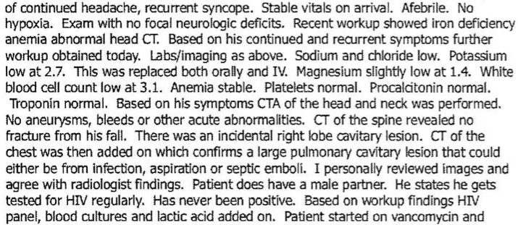
Outside ED #2
He returns to the ED two days later with further episodes of syncope. Per ED note
Zosyn and was admitted for further workup

Slide 8
Additional information from H&P / collateral
Social: Works as director of funeral home. Monogamous with partner for past 8 years. No needles, IVDU, etc. No animals besides pet puppies (7 of them, very cute). No birds
From fiance: Was able to find out the rash patient had a month ago was molluscum contagiosum. Partner also said since patient started taking steroids, was having vision problems and ataxia.
From parents: They’d noticed unintentional weight loss, ongoing at least past three months

Slide 9
OSH Imaging
CT chest:
MRI brain:

Slide 10
Outside Hospital Course
Admitted and found to be hyponatremic (124), overcorrected
Hospital Day 1: Had a seizure on hospital day one and went to the ICU
Hospital Day 2:
Developed left sided hemiplegia, right gaze deviation, GCS 6 → intubated
LP done
Transferred to Ruby

Slide 11
Discussion
What did the blood cultures from the first ED visit grow?

Slide 12
Discussion
-3 months
Weight loss
A 31 y/o M with no PMH presented to OSF ED for three weeks of frontal headaches
-1 month
Molluscum contagiosum
-3 weeks
Root canal, headaches
Progressively worsening headaches
-1 week
Started steroids
Development of S/Sx of elevated ICP
Day 0
ED visit #1
There was some discussion about ordering an HIV screen in the ED notes, but they defered it to the PCP
Day 2
Admission
BCx from ED visit #1 returned positive at time of admission
Day 3: Seizure episode
Day 4: GCS 6, LP done
Day 4
Sent to our NCCU

Slide 13
Case #2

Slide 14
HPI
Positive ROS:
Left facial droop
Somnolence
Dysarthria
Neck stiffness
Incontinence
A 66 y/o M with PMH Afib (warfarin), obesity, polycythemia, AVB s/p PPM, hx of numerous cancers (skin, colon, prostate) presented to ED for three days of generalized weakness
He was recently seen in the ED (two weeks ago) where he reported three weeks of headaches. Was diagnosed with sinusitis and Rx’ed Augmentin & azithromycin
Five days ago @ urgent care: Given doxy & medrol dose pack but no improvement
Too sleepy to give much else HPI wise

Slide 15
Social History, Exposures, Risk Factors
Geographic & Occupational: Lives in WV with wife. Used to work in maintenance, but retired and spends time woodworking. No foreign travel
Substance: Former heavy smoker, quit 12 years ago. No EtOH or drugs
Environmental exposures: Freshwater (6 months ago)
Animal Exposures: No farm animals, chickens, birds. Keeps bees
Infectious PMH: Remote history of osteomyelitis (30+ years ago). Right foot hardware. No TB

Slide 16
Exam
VS: 37 C | 66 bpm | 140/74 | 94% | BMI 34
Constitutional: Acutely ill appearing gentleman.
Neurologic: Patient difficult to arouse. Requires frequent stimuli. Intermittently follows commands.
Neck: supple. Nuchal rigidity present.
Eyes: Sclera non-icteric, conjunctiva non-injected.
HENT: Buccal mucosa moist. Healthy dentition present.
Respiratory: Respirations are non labored on 2 L NC. No crackles or wheeze on auscultation.
Cardiovascular: Heart has a regular rate and rhythm without murmur.
Gastrointestinal: Abdomen is soft and non-distended. Non-tender to palpation. Normoactive bowel sounds present.
Musculoskeletal: No swelling of the upper or lower extremities. Surgical to right ankle well approximated. No erythema.
Integumentary: No diffuse rashes. Skin is warm and non-diaphoretic.

Slide 17
Workup
WBC: 15 (91% neutrophils)
Lactate: 2.2
ESR: 2
INR: 5.2
HIV & HCV negative
---------
CT Head: No stroke
MRI: Sorry! (he has a pacemaker)

Slide 18
Workup
WBC: 15 (91% neutrophils)
Lactate: 2.2
ESR: 2
INR: 5.2
HIV & HCV negative
---------
CT Head: No stroke
MRI: Sorry! (he has a pacemaker)

Slide 19
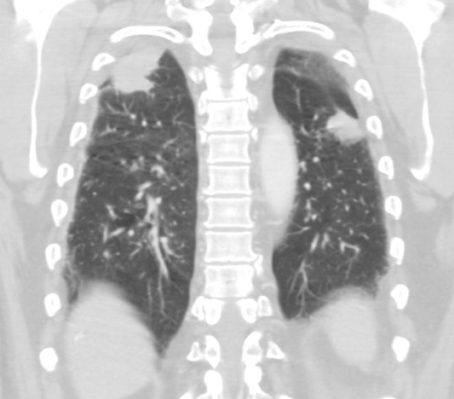
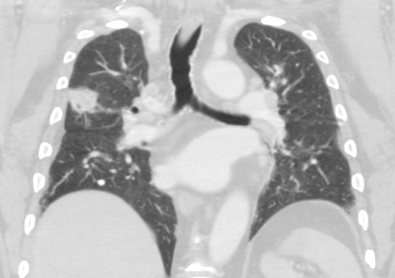
Workup
WBC: 15 (91% neutrophils)
Lactate: 2.2
ESR: 2
INR: 5.2
HIV & HCV negative
---------
CT Head: No stroke
MRI: Sorry! (he has a pacemaker)
CT chest: bilateral upper lobe consolidations. Mediastinal & bilateral perihilar LAD

Slide 20
Workup
WBC: 15 (91% neutrophils)
Lactate: 2.2
ESR: 2
INR: 5.2
HIV & HCV negative
---------
CT Head: No stroke
MRI: Sorry! (he has a pacemaker)
CT chest: bilateral upper lobe consolidations. Mediastinal & bilateral perihilar LAD
Lumbar Puncture?
Oh right, the INR

Slide 21
Hospital Course
ID consulted for possible meningitis
Started on steroids -plus- ceftriaxone, acyclovir, vancomycin, and ampicillin
LP deferred until INR came down
Hospital day 2: LP was done
ID paged overnight

Slide 22
Discussion
A 66 y/o M with PMH Afib (warfarin), obesity, polycythemia, AVB s/p PPM, hx of numerous cancers (skin, colon, prostate) presented to ED for three days of generalized weakness

Slide 23
Hospital Courses

Slide 24
Case #1
Case #2
Opening pressure: >55 cmH2O
On transfer to Ruby, we saw he hadn’t seen his HIV doc in years
EVD placed
Started on intrathecal AmBisome
CD4: 5 (5%), VL 618k
MTB PCR negative
Opening pressure: >45 cmH2O
Still not clear why immunocompromised, HIV negative
EVD placed
Started on intrathecal AmBisome
CD4: 281 (CD8 34)
Repeat a week later improved to CD4 491; CD8 52

Slide 25
Discussion
Links to articles discussed here

Slide 26
Cryptococcal meningitis
Epidemiology, pathophys
Recent guidelines on management
Intrathecal?
All articles

Slide 27
Cryptococcus
HIV associated crypto meningitis accounts for 19% of HIV mortality world wide (highest burden in sub-Saharan Africa)
Cryptococcus neoformans: More often HIV → predilection for CNS
Cryptococcus gattii: immunocompetent → lungs & cryptococcomas
Host factors:
HIV
SOT &/or ↓ CMI (e.g. JAK_{inh})
Cirrhosis
If no known risk factors, the 2024
guidelines recommend workup for
immunodeficiencies (supp table 1)
Exposures:
Bird poop!
Decaying wood (case #2)
Tree hollows
Soil

Slide 29
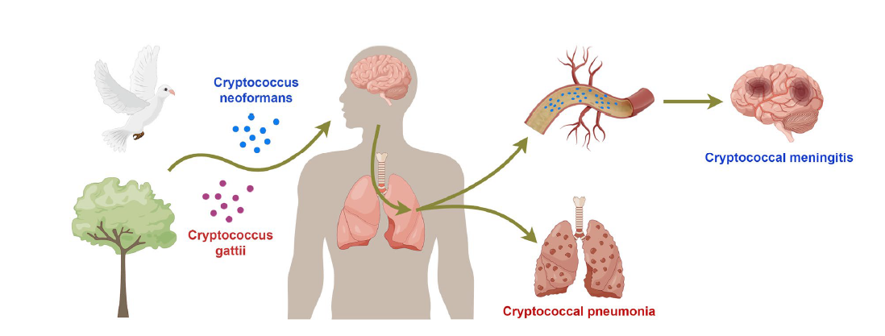
Pathophysiology
Elevated ICP
Crypto gunks up the arachnoid granules → poor CSF resorption → nonobstructive hydrocephalus
Cryptococcus also produces D-mannitol within CSF → osmotic effect
Altered pro & anti-inflammatory cytokines (part of why steroids worsen outcomes, both cases)

Slide 32
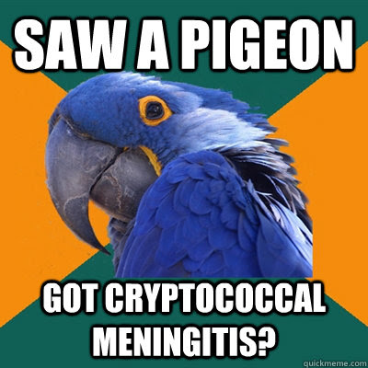

Slide 33
Global guideline for the diagnosis and management of cryptococcosis:
An initiative of the ECMM and ISHAM in cooperation with the ASM
Epidemiology, pathophys
Recent guidelines on management
HIV CM
Other CM
ICP management
ART
Intrathecal?
Lancet Infect Dis (2024)
https://doi.org/10.1016/
All articles

Slide 34
Really good guidelines!
So well organized
Supplemental material dives into lots of detail
Main manuscript high level & succinct
Topics not covered by me today
Non-meningitis cryptococcus (pulmonary & otherwise)
Antifungal resistance
Relapse (clinical & microbiologic)
Management of C-IRIS
[1]

Slide 35
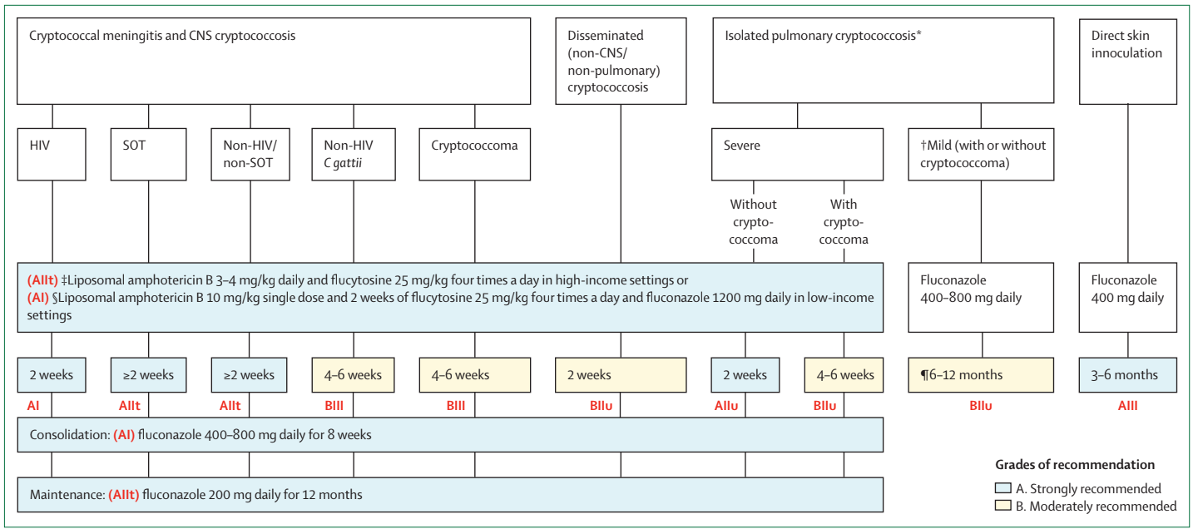
Figure 1 with overview of treatment

Slide 36
HIV associated CM
[1] [2]
Alternate induction therapies for low incomes settings
AMBITION-cm (multisite trial in Africa) non-inferior to standard of care
More problematic in higher resource settings
Only 1 in 3 tolerated 5-FC x14 days in USA (drug-drug, hepatotoxicity, etc)

Slide 37
HIV associated CM
[1] [2]
Some advocate for repeat LP to assess CSF before consolidation
Mycologic success a/w better outcomes, ↓ relapse, ↓ C-IRIS
Question for the group: Does two weeks start from sterile cultures?
Some suggest fluconazole 800 for consolidation in lower-income settings

Slide 38
HIV associated CM
[1] [2]
Move to maintenance fluconazole 200 for a year
Or recovery of immune system (CD4 >100)
Not much data, some use vori / posa / isavu if concerned for toxicity or interactions

Slide 39
SOT associated CM
[1] [2]
Highest risk in heart and small bowel transplant
Serum crypto Ag may be negative (if mild lung dz or lung transplant)
No RCTs for SOT, guidelines extrapolated from HIV
Fun fact: Quick reduction of immunosuppression (esp calcineurin inhibitors) can cause C-IRIS

Slide 40
Non-HIV, non-SOT associated CM
[1] [2]
Presentation varies, risk factors are hematologic malignancies or cirrhosis
Other medical conditions: Sarcoidosis, rheumatoid arthritis
Immunosuppressants: steroids, JAK inhibitors, CLL meds (Ibrutinib, alemtuzumab), fingolimod, eculizumab
Workup should include thorough history, HIV screen, T cell flow cytometry (CD4/CD8/NK)
Consult with immunologist, especially if history of other infections (case #2)

Slide 41
ICP management
Paramount aspect of acute management
Needs to be done by removing CSF (not medical management)
Steroids increase mortality unless being used for C-IRIS (case #2)
Serial LPs, lumbar drains, or ventriculostomies (depending on resources & patient need)
At minimum after 2-3 days &/or at 7 days
Later in disease course may become obstructive hydrocephalus (scarring/inflammation) → VPS
ICP goals (if ICP > 20 cm)
Reduce closing pressure to 50% of opening pressure (or to normal)
No harm in reducing by >50%, as is the case with EVDs
[1] [2]

Slide 42
ART
Unclear how early is too early for starting ART
COAT trial stopped early due to ↑ mortality in early ART arm (1-2 wk) vs deferred (5-6 wk)
Folks in this trial were on Amb-D + FLC 800 x2 wk (i.e. not current standard of care)
But in prospective study, patient who got ART @~15 days (after culture negative CSF, on average) had ↓ neurologic complications, ↓ micro relapse, ↓ C-IRIS, and trended towards reduced mortality @24 wks
These folks were on better antifungal medications than in COAT trial
What’s a girl to do?
Generally, wait 4-6 weeks, especially in lower resource settings
Page S71 of supplemental material has guidance, including for those with prior ART exposure who may need to go on second line therapy (case #1)
[1] [2]

Slide 43
ART
Unclear how early is too early for starting ART
COAT trial stopped early due to ↑ mortality in early ART arm (1-2 wk) vs deferred (5-6 wk)
Folks in this trial were on Amb-D + FLC 800 x2 wk (i.e. not current standard of care)
But in prospective study, patient who got ART @~15 days (after culture negative CSF, on average) had ↓ neurologic complications, ↓ micro relapse, ↓ C-IRIS, and trended towards reduced mortality @24 wks
These folks were on better antifungal medications than in COAT trial
What’s a girl to do?
Generally, wait 4-6 weeks, especially in lower resource settings
Page S71 of supplemental material has guidance, including for those with prior ART exposure who may need to go on second line therapy (case #1)
[1] [2]

Slide 44
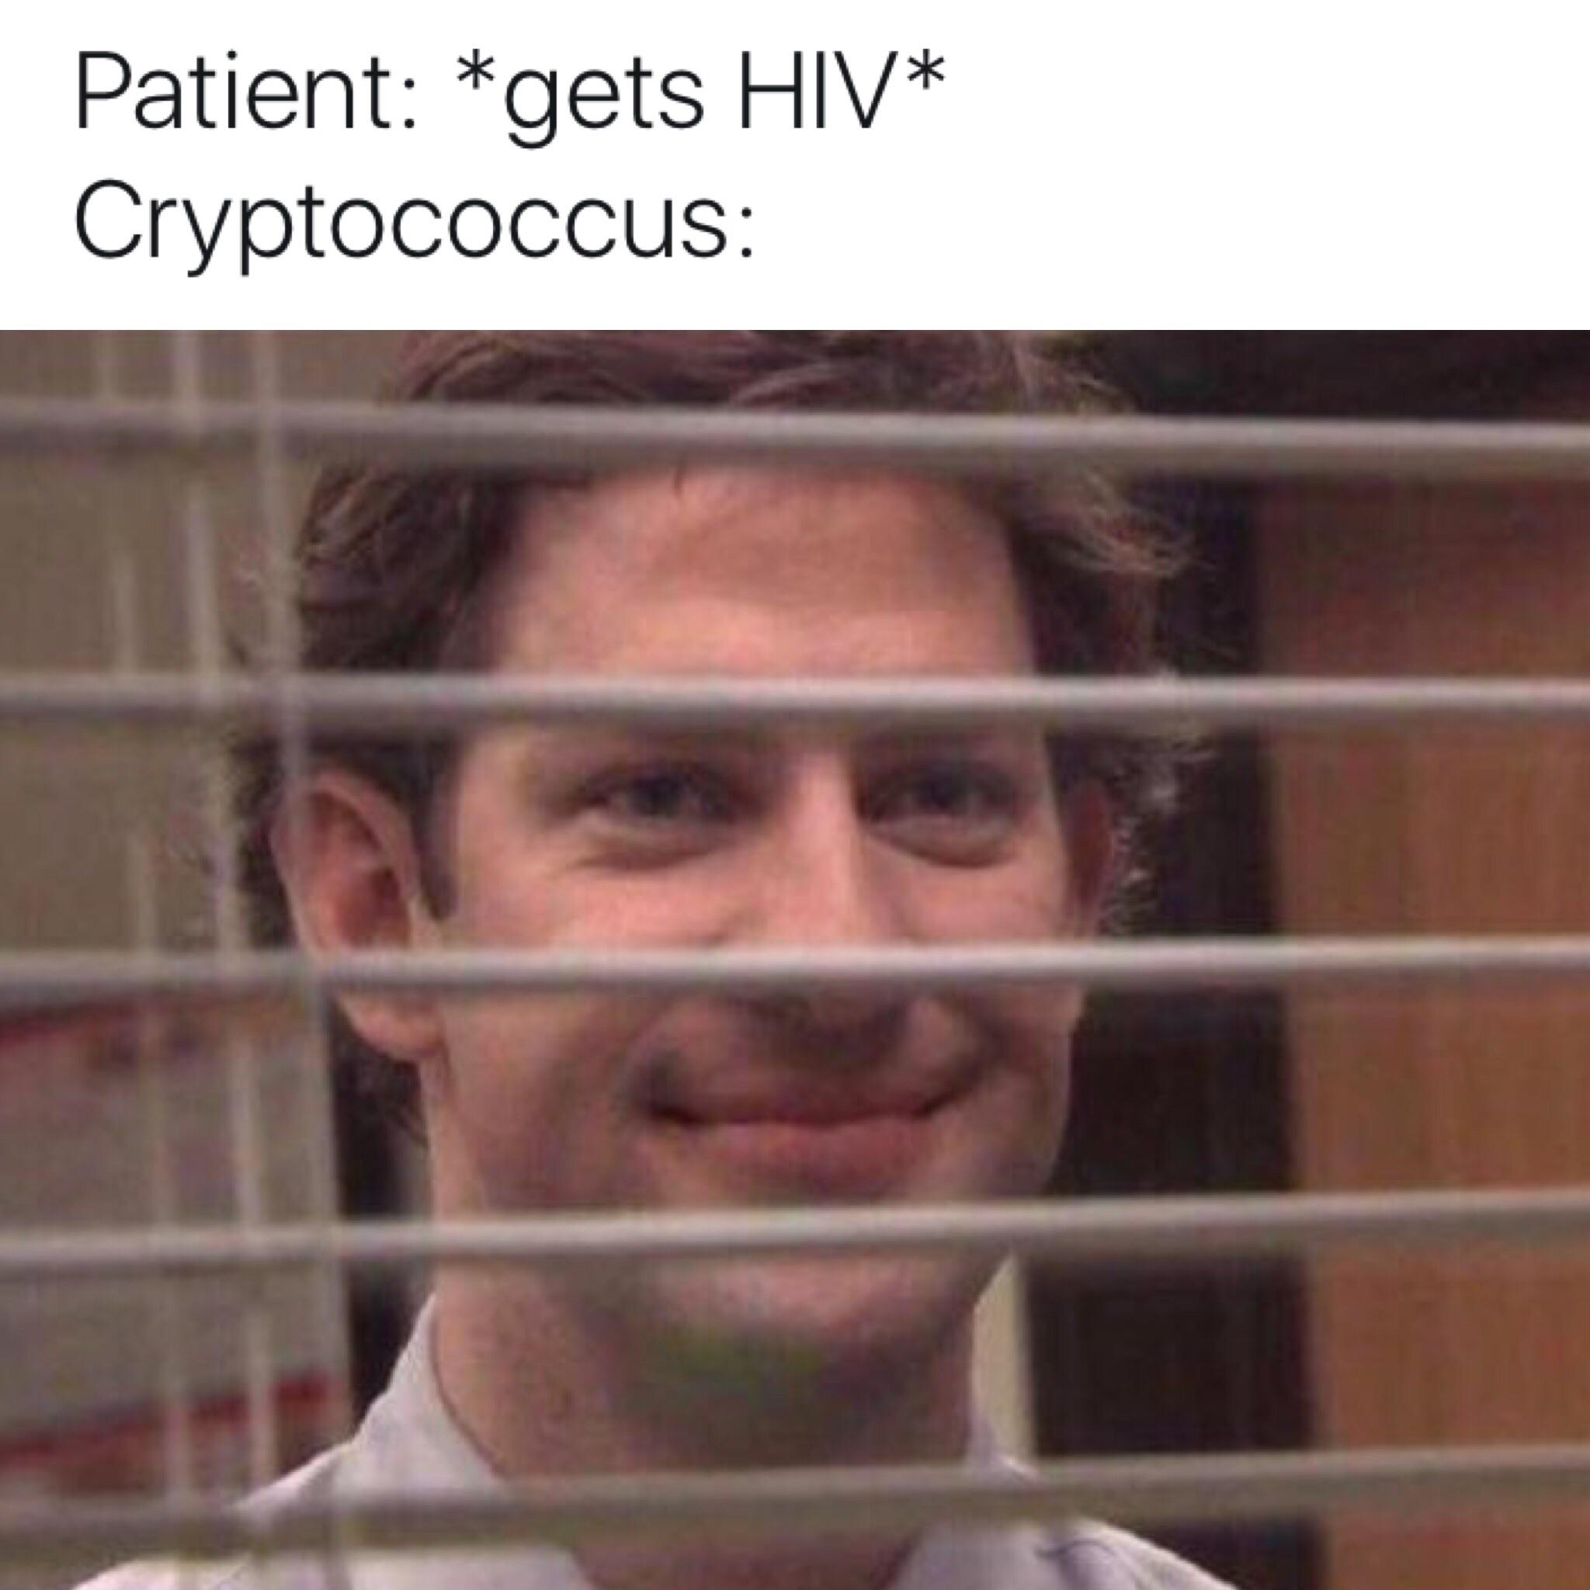

Slide 45
Intrathecal (IT) antimicrobials
Epidemiology, pathophys
Recent guidelines on management
Intrathecal?

Slide 46
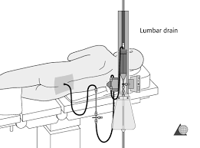
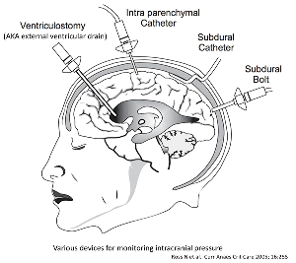
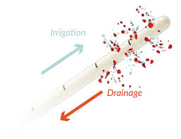
Refresher on stuff neurosurgery does
[3] IDSA 2017
Lumbar drain
EVD
IRRAflow
Basically an LP but you put a drain in
Less patient mobility, maybe less accurate over time
Goes in the ventricles, so risk of ventriculitis
1 per 100 EVD days [3]
Most accurate ICP monitor
An EVD capable of irrigating
Maybe higher risk of leak?
Notes:
Risk of ventriculitis study (https://pubmed.ncbi.nlm.nih.gov/28203777/) see https://emcrit.org/ibcc/evd/

Slide 47
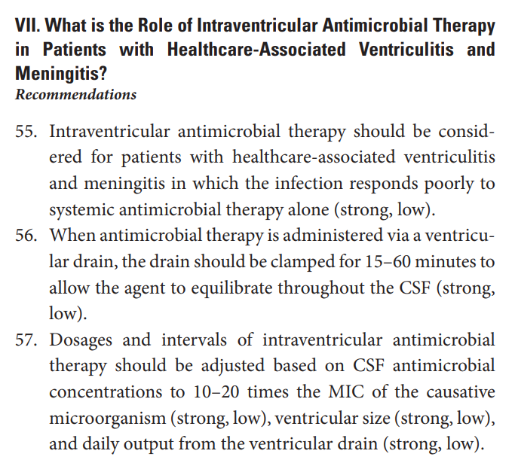
Guidelines
[3] IDSA 2017

Slide 48
Guidelines
Ampho specifically
Only mentioned for Candida shunt infections that don’t respond to IV or shunt removal
[3] IDSA 2017

Slide 49
Intraventricular antimicrobials: The literature
Not a whole lot there!
Recent review of all antimicrobials (Clin Microbiol Rev, 2020) [4]
RTCs: Two studies (both bacterial meningitis), no evidence for routine use in meningitis / meningoencephalitis
Meta-analysis: One for GN ventriculitis/meningitis (World Neurosurgery, 2018) [5]
11 studies, 348 patients
Promising for carbapenem-resistant bacteria (OR mortality: 0.22; OR eradication 10.06)
Not superior for other situations
For amphotericin specifically
No RTCs or systematic reviews on pubmed
Only a few cohorts
[4] [5]

Slide 50
Situations to (maybe?) use IT antimicrobials
Maybe use in CNS infections with
Drugs that don’t get into CNS easily +/- have systemic toxicity
Aminoglycosides, colistin, daptomycin, tigecycline, and vancomycin
MRD pathogens
MRSA, VRE, CRE, CRAB
Often seen in external / internal ventricular shunt infections
Maybe don’t use if
Antibiotics has risk for seizures when given IV (beta lactams)
Please don’t give imipenem in the CNS
Some data to indicate increased risk of seizures from IT therapy generally
Doesn’t have an EVD for other reasons
Procedure has risks, IT catheters can cause nosocomial infections themselves
Authors of the review point out some of the historic toxicity may have been from inappropriate dosing
[4] [3]

Slide 51
IT amphotericin
Dosing: 0.1 - 0.5 mg q24h (1mg q24h for AmBisome)
Complicated pharmacology
Authors suggest co-administration of systemic antimicrobials to prevent selection pressure for MDRs in the other compartments
Side effects: Fever, arachnoiditis, nausea/emesis, Parkinson syndrome, tinnitus, encephalopathy
Effectiveness: One study from 1986
 | Systemic + IT (n=6) | Systemic alone (n=7) | P value
Death | 1 (16%) | 6 (86%) | P=0.025
CSF sterilized | 6 (100%) | 3 (43%) | P=0.049
[4]

Slide 52
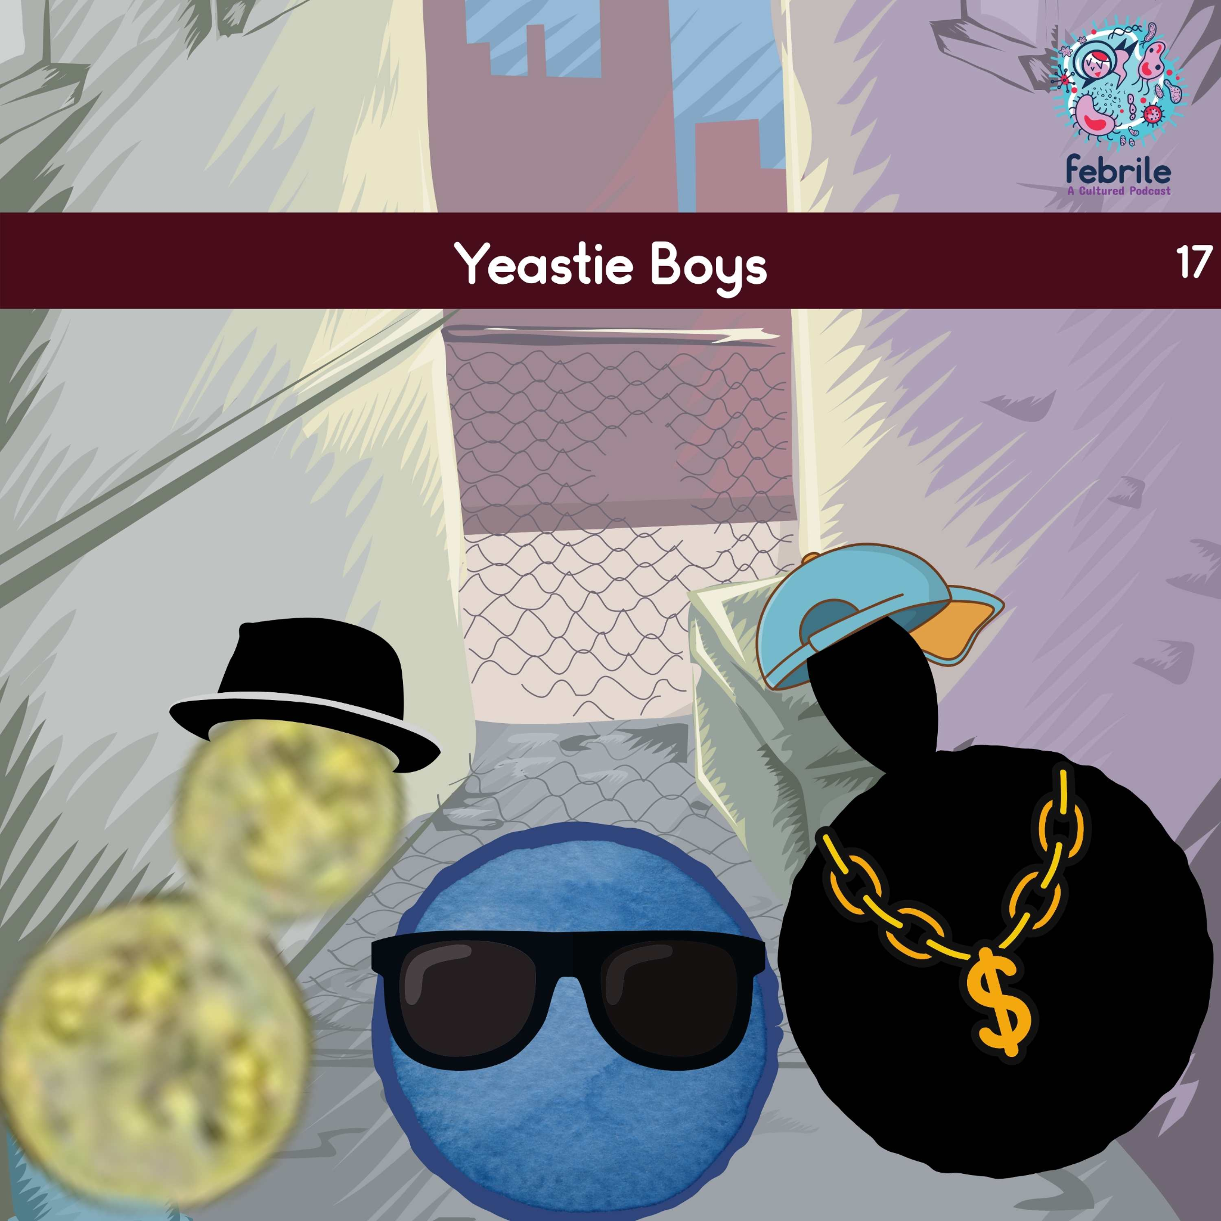
Thoughts? Questions?
https://febrilepodcast.com/episode-17-yeastie-boys/

