Slide 1
LVADventures
CID conference
Hunter Ratliff
08/08/2024
Ages, dates, and other identifying information may have been changed

Slide 2
Case #1

Slide 3
Case 1: HPI
A 75 y/o M with PMH HFrEF s/p ICD & LVAD (HM3; implanted 2 years ago), well controlled DM, afib on warfarin presented as a direct admission for positive blood cultures that were obtained outpatient

Slide 4
Case 1: HPI
Positive ROS:
Night sweats
Diarrhea
Dizziness
Anorexia
Negative ROS:
Fevers
N/V
Abdominal pain
Urinary symptoms (besides oliguria)
New respiratory symptoms
A 75 y/o M with PMH HFrEF s/p ICD & LVAD (HM3; implanted 2 years ago), well controlled DM, afib on warfarin presented as a direct admission for positive blood cultures that were obtained outpatient
He was discharged from the hospital 10 days ago (more on this later), and following discharge he reports generalized malaise and night sweats.
Symptoms have been progressively worsening since discharge
Reports diarrhea (watery, nonbloody) but no other GI symptoms
He cannot recall any discharge or pain from his driveline site
Routine labs (discharge follow up) obtained at the VA were abnormal, so they asked him to get blood cultures. Patient was called to come in after BCx were abnormal

Slide 5
Case 1: Recent admission
Had a short (24 hour) admission 10 days ago for altered mental status
Presented for 3 days of slurred speech (NIHSS = 1)
Admitted for vague chest pain
During TTE, had witnessed episode of loss of consciousness
Had LVAD alarms for low flow at time of LOC
Neurology saw him for possible seizure
CT stroke was unremarkable
EEG unremarkable
Attributed to cardiogenic syncope
Discharged on increased dose of Lasix

Slide 6
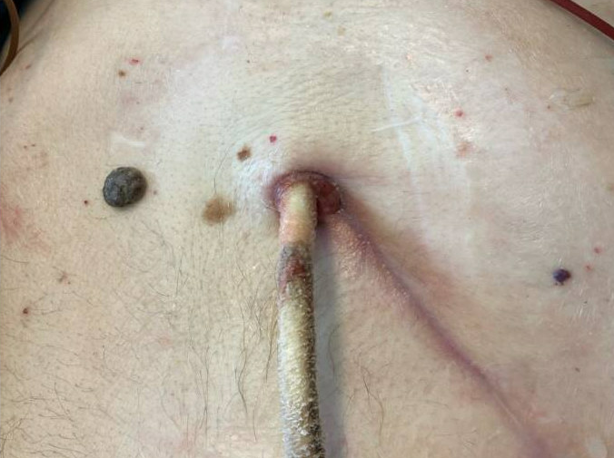
Case 1: Physical Exam
VS: 36.4 C | 77 bpm | MAP 80 | 99% | BMI 20.2
Gen: alert and oriented, NAD, historical alternans?
Head/Neck: NCAT; trachea appears midline
ENT: EOMI grossly, anicteric sclerae; MMM
Resp: normal respiratory effort, symmetric chest rise
CV: VAD hum; extremities perfused
GI: non-distended; no rebound or guarding
Ext: no clubbing or cyanosis
Neuro/MSK: moves extremities
Psych: normal mood; appropriate affect

Slide 7
Case 1: Infectious Hx
-24 mo
LVAD placed
Uncomplicated course
Social history pretty boring
-11 mo
Stenotrophomonas in driveline
Treated with Bactrim
-9 mo
Pseudomonas in driveline & OR Cx
Pretreated with Bactrim (prior to Cx)
Grew two strains of PsA
Treated with fluoroquinolone
-5 mo
Pseudomonas in driveline
S Epi in driveline
PsA treated with quinolones
S epi treated as contaminant
Now
Current admission

Slide 8
Case 1: Labs
WBC: 22.0 Hgb: 10.8 PLT: 310
Chem7: normal LFT: normal
UA: LE (+), nitrate (+), bacteria (-)
A1c: 7.0
INR: 4.3

Slide 9
Case 1: Labs
WBC: 22.0 Hgb: 10.8 PLT: 310
Chem7: normal LFT: normal
UA: LE (+), nitrate (+), bacteria (-)
A1c: 7.0
INR: 4.3
------------
CT C/A/P: Pretty normal. No fluid collections, prostatomegaly but kidney/ureters/bladder normal

Slide 10
Case 1: Summary
-24 mo
LVAD placed
Uncomplicated course
A 75 y/o M with PMH HFrEF s/p ICD & LVAD (2 years ago), 10 days of symptoms since last hospitalization
WBC: 22.0
UA: LE (+), nitrate (+),
bacteria (-), symptoms (-)
CT C/A/P: Normal
BCx: ???
-11 mo
Stenotrophomonas in driveline
Treated with Bactrim
-9 mo
Pseudomonas in driveline & OR Cx
Pretreated with Bactrim (prior to Cx)
Grew two strains of PsA
Treated with fluoroquinolone
-5 mo
Pseudomonas in driveline
S Epi in driveline
PsA treated with quinolones
S epi treated as contaminant
Now
BCx positive

Slide 11
Case 1: Micro data on admission
Date | Source | Result
(PTA) | Blood | GNR, non-LF
Admission | Blood | GNR

Slide 12
Case 1: Hospital course
Started on cefepime
Favored to be urinary source of bacteremia at time of consult
After BCx remained positive, requested TEE
Cardiology deferred TEE, didn’t get TTE either (had one from recent admission)
ID signed off on HD#7 recommending 6 weeks +/- suppression
Date | Source | Result
Outpatient | Blood | P. aeruginosa
Admission | Blood | PsA (2/2 sets)
Admission | Urine | P. aeruginosa
HD #2 | Blood | PsA (2/2 sets)
HD#4 | Blood | No growth

Slide 13
Case 1: Hospital course
Started on cefepime
Favored to be urinary source of bacteremia
After BCx remained positive, requested TEE
Cardiology deferred TEE, didn’t get TTE either (had one from recent admission
ID signed off on HD#7 recommending 6 weeks +/- suppression
The same day we signed off (HD#7), optho & neuro consulted for left homonymous hemianopia & left sided ataxia
CTH/CTA H/N showed right occipital intraparenchymal hematoma & small SAH
INR at time of symptom onset 3.85
No MRI due to LVAD
Attributed etiology to warfarin
Discharged off of warfarin
Doing well at recent ID follow up

Slide 14
Case #2

Slide 15
Case 2: HPI
A 53 y/o M with PMH HFrEF LVAD (HM3; implanted 2.5 years ago), DM (A1c 10.3) presents with…

Slide 16
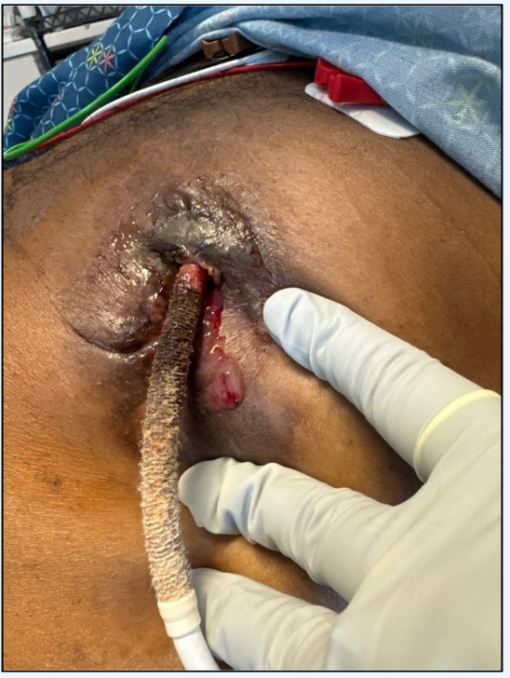
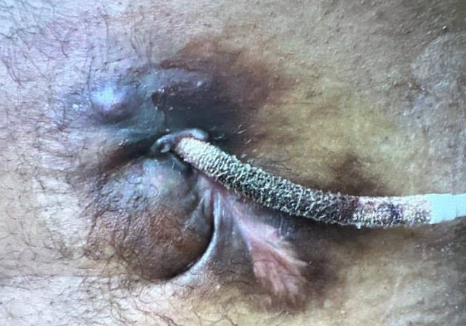
Case 2: HPI
A 53 y/o M with PMH HFrEF LVAD (HM3; implanted 2.5 years ago), DM (A1c 10.3) presents with…
For four months!
On admission
45 days before admission

Slide 17
Case 2: HPI
A 53 y/o M with PMH HFrEF LVAD (HM3; implanted 2.5 years ago), DM (A1c 10.3) presents with a four month history of a wound at his LVAD driveline site
About five months ago, he started getting a new type of dressing for his driveline
States he had a reaction to new dressing kit, so started buying dressing kits online
About a month later he noticed:
Foul smelling, creamy yellow discharge
An abscess superior to his driveline site
For past month, noticed the driveline seemed to be “loose”
Copious discharge from the site in past two days

Slide 18
Case 2: Social History, Exposures, Risk Factors
Geographic & Occupational: No recent foreign or domestic travel. They are not working, but previously worked as a barber.
Substance: They deny alcohol use and he is a former smoker (quit 3 years ago after STEMI & LVAD). They report no recreational drug use aside from weed
Sexual History: active with only their female partner (of many years). He has no known history of sexually transmitted infections.
Environmental exposures: They deny known tick/mosquito exposures, freshwater exposure, or well water exposures. Does a fair amount of gardening so he thinks it's possible he had some soil exposure (given the chronicity of the wound), but cannot recall a time where it was overtly dirty.
Animal Exposures: Has two outdoor pitbulls, three indoor dogs, and a few outdoor cats. No other animals
Tattoos & Piercing: No unprofessional piercings or tattoos .
Infectious PMH: They deny previous intolerances/allergies to antimicrobials; he reports recent antimicrobial use (Amoxicillin, see HPI). They deny history of C. diff or known prior exposure to tuberculosis.

Slide 19
Case 2: Exam
VS: 36.6 C | 67 bpm | MAP ok | 97% | BMI 21.9
Gen: alert and oriented, NAD
Head/Neck: NCAT; trachea appears midline
ENT: EOMI grossly, anicteric sclerae; MMM
Resp: normal respiratory effort, symmetric chest rise
CV: VAD hum; extremities perfused
GI: non-distended; no rebound or guarding
Ext: no clubbing or cyanosis
Neuro/MSK: moves extremities
Psych: normal mood; appropriate affect

Slide 20
Case 2: Take a guess!
-5 mo
New dressing
Possible allergic reaction to new dressing
Starts buying dressings online
-4 mo
Reported abscess
A 53 y/o M with PMH HFrEF LVAD (HM3; implanted 2.5 years ago), DM (A1c 10.3)
Hint: the order is Diptera
Foul smelling, creamy yellow discharge
Took some amoxicillin somewhere in here
-1 mo
Felt like driveline was coming loose
-2 days
Copious discharge
Now
Admission to hospital

Slide 21
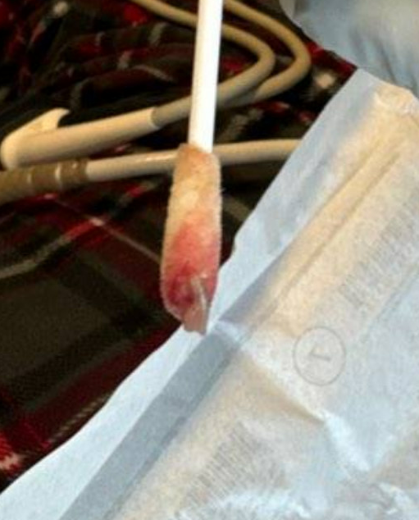
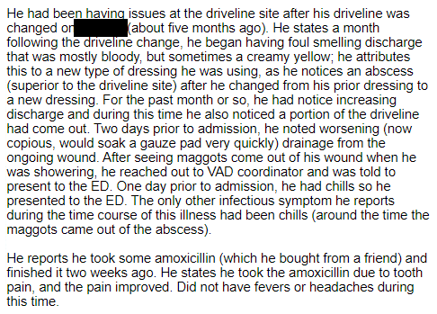
Case 2: The unexpected bug

Slide 22
Case 2: Workup
WBC: 6.2 Hgb: 11.9 Plt: 190
Chem7: normal LFTs: normal

Slide 23
Case 2: Hospital course
Clinically stable during admission
Uncomplicated I&D
Discharged on Augmentin & dapto
Wound Cx
3+ mixed anaerobes
Blood Cx
NGTD
OR Cx
Mixed anaerobes
Actinomyces

Slide 24
Discussion
Links to articles discussed here

Slide 25
LVAD infections
The VAD population
National estimates
Here at WVU
Epidemiology
Presentation & diagnosis
Treatment

Slide 26
National estimates
From data ~2016
Over 40% are placed as destination therapy
57% are placed under transplant (either listed patients or those under evaluation)
Over 40% of those who receive OHT had an LVAD before transplant

Slide 27
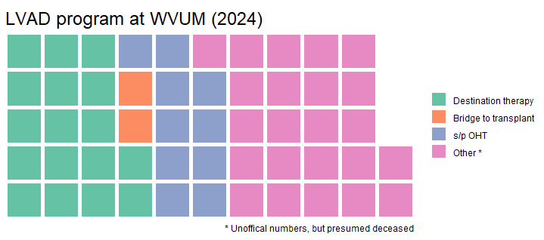
LVADs at WVU
Our WVU program totals:
45 total implants (one was HM2 → HM3)
7 patients have transferred care to our program
10 total LVAD patients in our program have been transplanted
Currently, we have a total of 19 patients
Bridge to transplant: 2
Destination therapy: 17
Two of the DT patients are working on weight loss to become BTT)

Slide 28
LVAD infections
Epidemiology
Our VAD population
Types of infection
Timing
Pathogens
Presentation & diagnosis
Risk factors
New definitions
Treatment
Points from articles

Slide 29
LVAD infections
The VAD population
Epidemiology
Types of infection
Timing
Pathogens
Presentation & diagnosis
Treatment

Slide 30
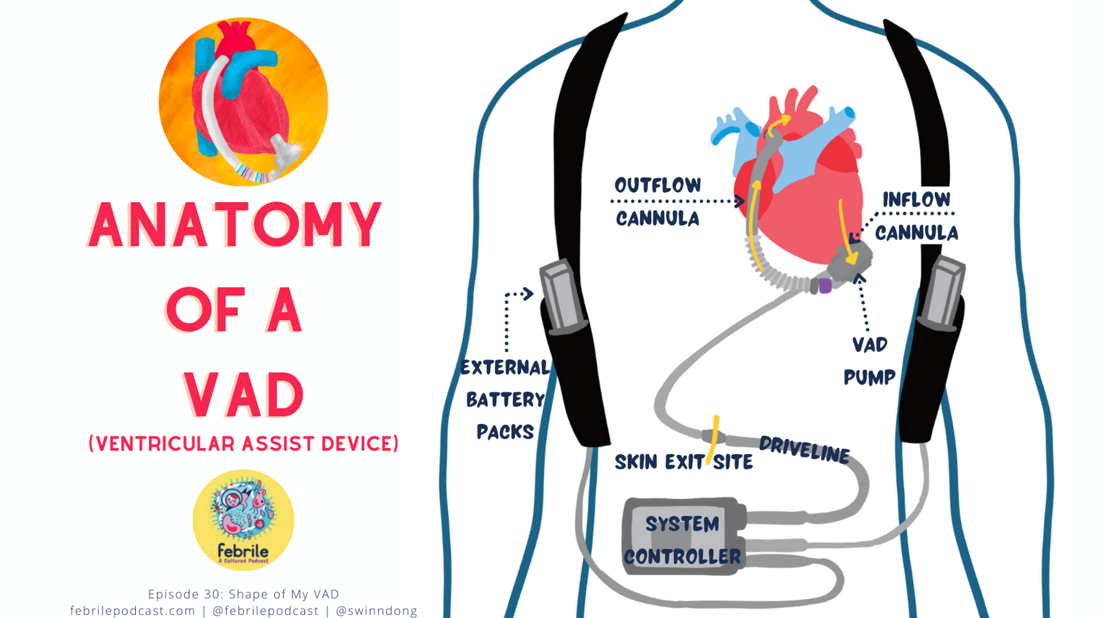
FebrilePodcast.com (episode 30)

Slide 31
VAD related
Native valve
VAD related
CLABSI
Non-VAD related (e.g. from UTI)
Figure adapted from FebrilePodcast.com [A] & 2019 AST ID guidelines [1]

Slide 32
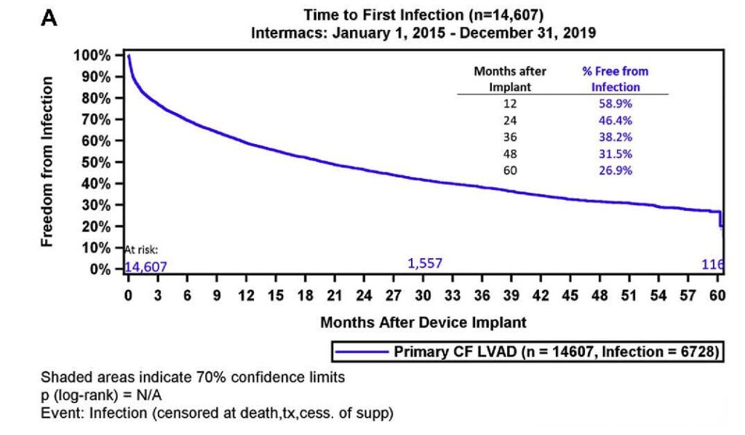
Epidemiology
Infections are quite common
Depends on the time from VAD
Figure 6 (citation B)

Slide 33
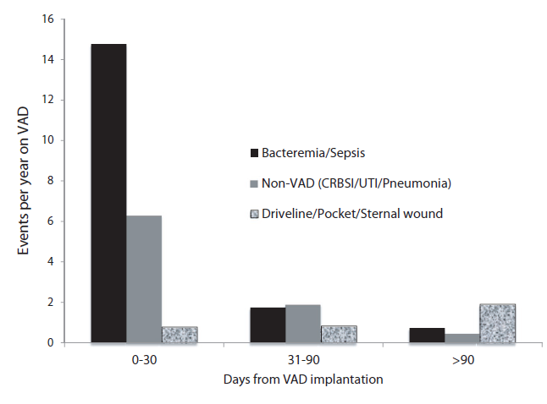
Epidemiology
Infections are quite common
Depends on the time from VAD
Early (first month) highest overall risk, mostly from non-VAD infections
Figure 2 (citation #1)
Figure 6 (citation B)

Slide 34
Epidemiology
Infections are quite common
Depends on the time from VAD
After 90 days, driveline infections are the main drivers of infection (pun fully intended)
Figure 2 (citation #1)
Figure 6 (citation B)

Slide 35
25-50%
10-50%
15-30%
7-20%
Figure adapted from FebrilePodcast.com [A] & 2019 AST ID guidelines [1]

Slide 36
LVAD infections
The VAD population
Epidemiology
Presentation & diagnosis
Workup
New definitions
Treatment

Slide 39
Old (2011) definitions of types of infections
ISHLT definitions (2011)
VAD-Specific infections
Pump pocket &/or cannula
Pocket
Driveline exit site
Superficial
Deep
VAD-related infections
Bloodstream
VAD-related
Non-VAD related
Endocarditis
VAD-related
Valvular (native valve)
Non-VAD infections
Respiratory infections, UTI, CDI, IAI
The old definitions had proven, probable, possible
Categorized based on multiple criteria (histopath/microbio, clinical criteria)
See tables in citation [5] for details
Classification of infection impacts duration of therapy

Slide 40
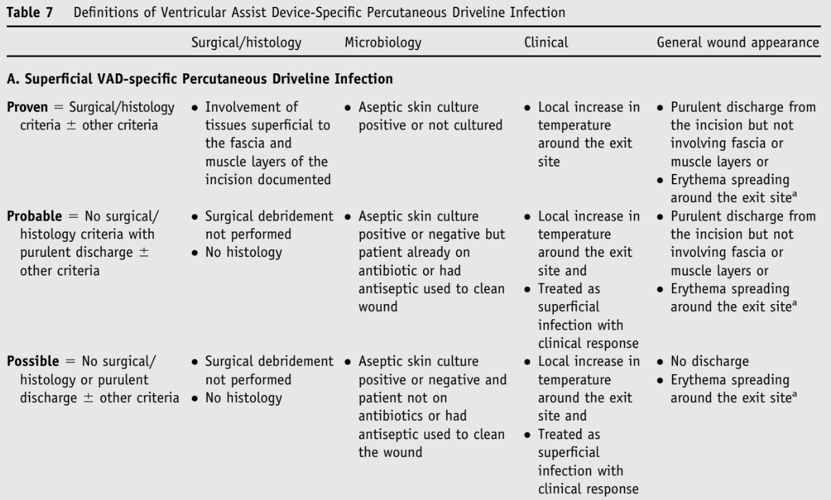
Case 2: Proven superficial driveline infection

Slide 41
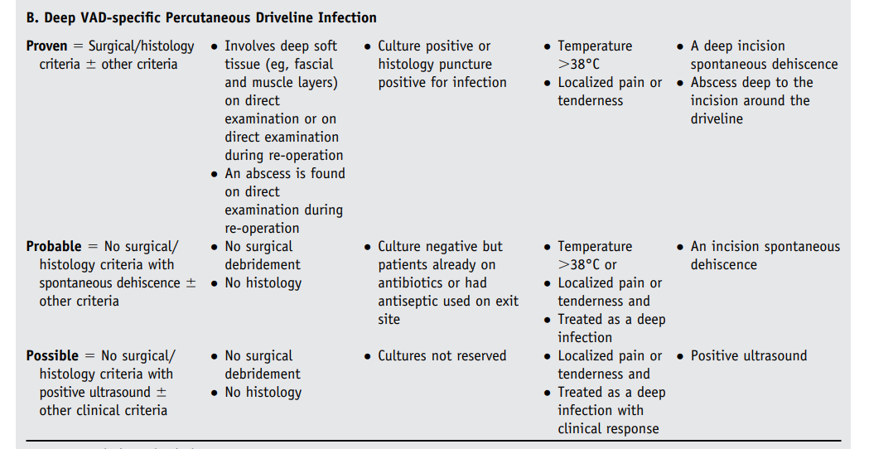
Case 2: Not? a deep driveline infection

Slide 42
New (2024) definitions of types of infections
ISHLT definitions (2011) [5]
VAD-Specific infections
Pump pocket &/or cannula
Pocket
Driveline exit site
Superficial
Deep
VAD-related infections
Bloodstream
VAD-related
Non-VAD related
Endocarditis
VAD-related
Valvular (native valve)
Non-VAD infections
Respiratory infections, UTI, CDI, IAI
ISHLT definitions (2024) [2]
MCS-specific infections
Percutaneous lead
Uncomplicated
Complicated
Device-specific bloodstream
Device endocarditis
Non-MCS-specific infections
Non-MCS bloodstream
Native valve endocarditis
ICD infection
Localized infection

Slide 43
New (2024) definitions: Percutaneous lead infection
Uncomplicated percutaneous lead infection
Pain, tenderness, erythema, drainage, and/or induration at driveline site
+/- Positive drainage culture
Blood cultures are negative
Systemic signs of infection are absent
Imaging is negative for fluid collection/abscess
Clinical improvement or resolution with
antibiotics
Complicated percutaneous lead infection
Pain, tenderness, erythema, drainage, induration, and/or fistulous tract at the percutaneous lead (driveline) site; and/or
Fluid collection/abscess at exit site noted on imaging with positive culture; and/or
Radiographic evidence of findings consistent with infection along the path of the lead; and/or
Presence of systemic signs/symptoms including fever, chills, leukocytosis, SIRS, and sepsis; and/or
Positive drainage or blood cultures (bloodstream infection); and/or
Cultures demonstrating multidrug-resistant organisms or fungi; and/or
Presence of infection of the external surfaces of an implantable component

Slide 44
LVAD infections
The VAD population
Epidemiology
Presentation & diagnosis
Treatment

Slide 46
Treatment
Drivelines: Once infected, it’s nearly impossible to eradicate without removing device
The polyester velour surface is designed to promote tissue growth (at the DLES)
But this promotes biofilm formation
Surgical VAD exchange?
Not well studied [3][4]
Often high operative risk
One case series [3] still had 40% recurrence of infection
Maggots?
Also not well studied

Slide 47
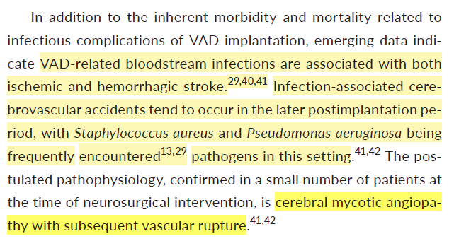
Case 1: Hospital course
Started on cefepime
Favored to be urinary source of bacteremia
After BCx remained positive, we requested TEE
Cardiology deferred TEE, didn’t get TTE either (had one from recent admission)
The same day we signed off (HD#7), optho & neuro consulted for left homonymous hemianopia & left sided ataxia
CTH/CTA H/N showed right occipital intraparenchymal hematoma & small SAH
INR at time of symptom onset 3.85
No MRI due to LVAD
Attributed etiology to warfarin
2019 AST ID guidelines [1]

Slide 48
Thoughts? Questions?
Sources:
https://www.hunterratliff1.com/talk/
Click on the “citations” button!

