Slide 1
Spinal spookiness
CID conference
Hunter Ratliff
10/31/2024
Ages, dates, and other identifying information may have been changed
I have no conflict of interest in relation to this presentation

Slide 2
Primary (#3B71CA)
Emphasis (#2f5aa2)
BG subtle (#e2eaf7)
Secondary (#9FA6B2)
Emphasis (#404247)
BG subtle (#f1f2f3)
Spinal spookiness
Success (#14A44D)
Emphasis (#0c622e)
BG subtle (#dcf1e4)
Danger (#DC4C64)
Emphasis (#b03d50)
BG subtle (#fae4e8)
Warning (#E4A11B)
Emphasis (#896110)
BG subtle (#fbf1dd)
Info (#54B4D3)
Emphasis (#3b7e94)
BG subtle (#e5f4f8)
CID conference
Hunter Ratliff
10/31/2024
Ages, dates, and other identifying information may have been changed
I have no conflict of interest in relation to this presentation

Slide 3
Case #1

Slide 4
Case 1: HPI
A 60 y/o female p/w altered mental status after being found down

Slide 5
Case 1: HPI
A 60 y/o female p/w altered mental status after being found down
38.2°C | 110 bpm | 121/60 | SpO2 80% (ambient air)
Pulm: crackles at the left base
Abd: soft, normal bowel sounds
Neuro: A&O x1, no focal deficits

Slide 6
Case 1: HPI
A 60 y/o female p/w altered mental status after being found down
38.2°C | 110 bpm | 121/60 | SpO2 80% (ambient air)
Pulm: crackles at the left base
Abd: soft, normal bowel sounds
Neuro: A&O x1, no focal deficits

Slide 7
Case 1: A little more
A 60 y/o female p/w altered mental status after being found down
38.2°C | 110 bpm | 121/60 | SpO2 80% (ambient air)
Pulm: crackles at the left base
Abd: soft, normal bowel sounds
Neuro: A&O x1, no focal deficits
Diagnosed with CAP → Unasyn & levofloxacin
WBC: 46.8 CXR: LLL atelectasis
AST: 336 ALT: 59

Slide 8
Case 1: Even more
A 60 y/o female p/w altered mental status after being found down. She was febrile to 38.2, hypoxic to 80%, and A&Ox1. Tx for CAP w/ Unsayn & levaquin
By day 3,
Intubated for resp failure & AKI → transferred
Plts: 54 Developed DIC w/ schistocytes → PLEX for TTP
WBC: 46.8 LDH: 3300
AST: 336 ALT: 59
Questions? DDx?

Slide 9
Case 1: The micro data
A 60 y/o female p/w altered mental status after being found down. She was febrile to 38.2, hypoxic to 80%, and A&Ox1. Tx for CAP w/ Unsayn & levaquin.
By day 3, intubated for resp failure & developed DIC w/ thrombocytopenia. Received PLEX for possible TTP
OSH BCx: gram-positive rods (1/2 bottles)
OSH UCx: Pseudomonas aeruginosa
Switched to Merrem & gentamicin
WBC: 46.8 LDH: 3300 Plts: 54
AST: 336 ALT: 59

Slide 10
Case 1: Summary
A 60 y/o female p/w altered mental status after being found down. She was febrile to 38.2, hypoxic to 80%, and A&Ox1. Tx for CAP w/ Unsayn & levaquin.
By day 3, intubated for resp failure & developed DIC w/ thrombocytopenia. Received PLEX for possible TTP.
Switched to Merrem & gent for UTI w/ PsA
WBC: 46.8 LDH: 3300 Plts: 54
AST: 336 ALT: 59 Cr: 1.2
OSH BCx: gram-positive rods (1/2 bottles)
OSH UCx: Pseudomonas aeruginosa

Slide 11
Case 1: Hospital course
Receiving hospital calls to ask about blood culture. Tech reviews it and changes it to gram-negative rod
Vitek: Yersinia pestis
bioMérieux’s API: poorly viable E. coli or Proteus spp
Community hospital sends subculture to the academic hospital

Slide 12
Case 1: Hospital course
Receiving hospital calls to ask about blood culture. Tech reviews it and changes it to gram-negative rod
Vitek: Yersinia pestis
bioMérieux’s API: poorly viable E. coli or Proteus spp
Community hospital sends subculture to the academic hospital
They send isolate to San Diego health department
Confirmed Yersinia pestis on PCR
Review of blood smear on admission showed bipolar-staining bacteria

Slide 13
Discussion
QR CODE
Links to articles discussed here

Slide 14
The plague
Objectives:
Describe the geographic distribution of Yersinia pestis
Identify vectors and routes of transmission
Review microbiology and pathogenesis
Compare the clinical manifestations of the plague
Discuss diagnostic modalities & treatment options

Slide 15
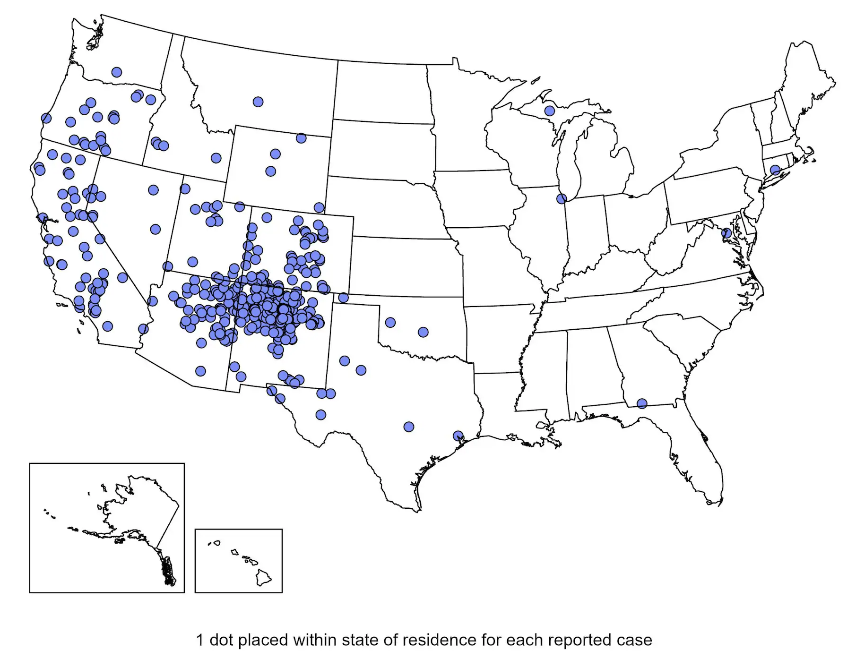
Geographic distribution
Mainly southwest US & former soviet union
Plague is endemic in western portion of US
Some outbreaks in Africa, Asia, South America
Most human cases this century have been in Africa
WHO cases
2000-2009: 21,700 with 1612 deaths
Case fatality rate of 7.4%
2010-2018: 4420 with 751
CDC: reported human plague cases, 1970-2022 [3.1]
Notes:
https://www.cdc.gov/plague/maps-statistics/index.html

Slide 16
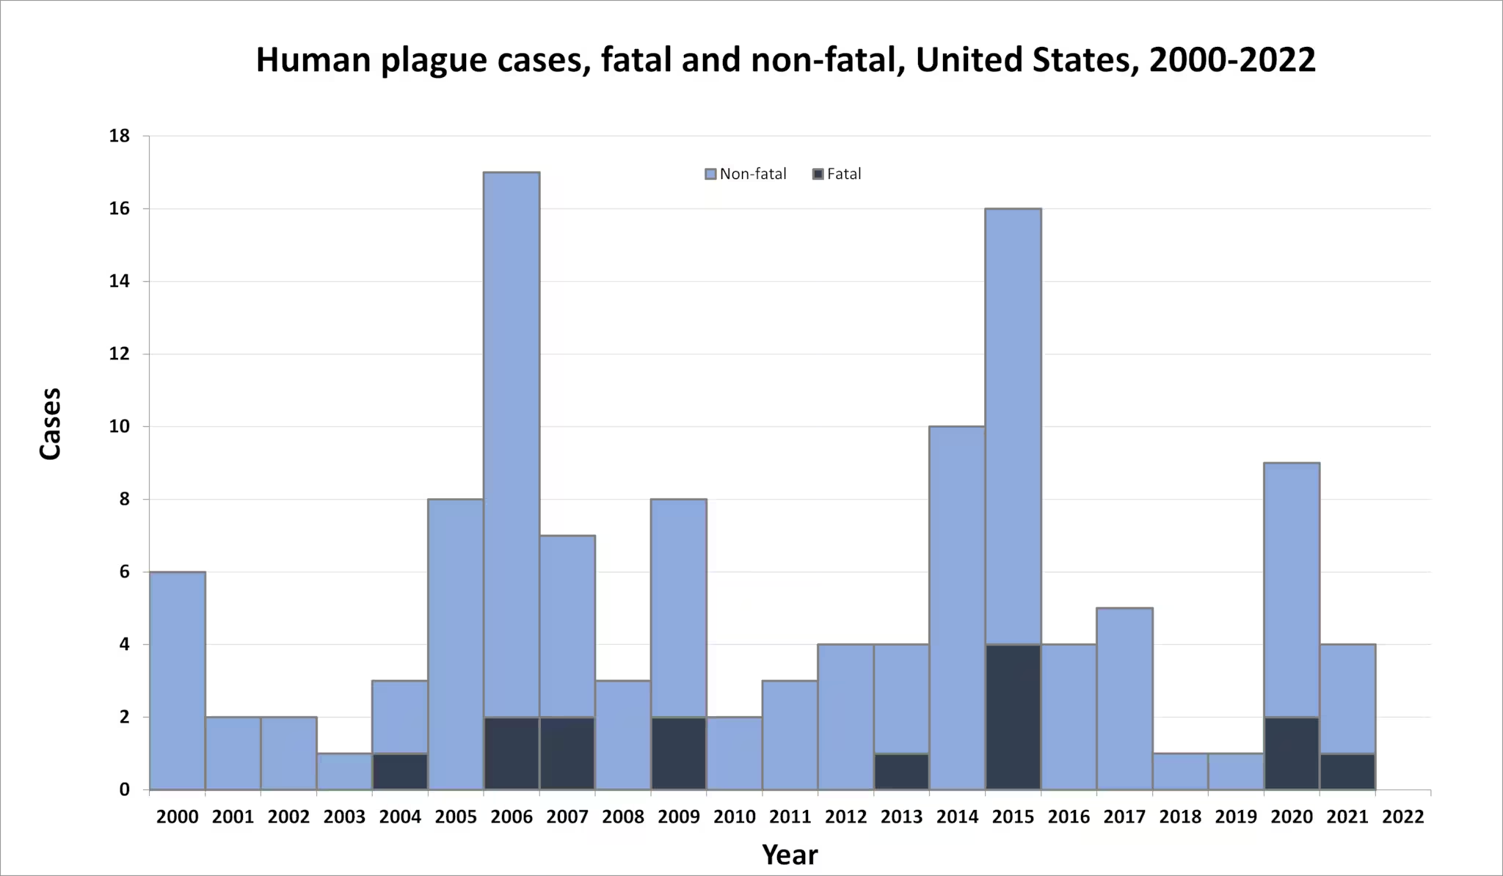
CDC [3.1]
Notes:
https://www.cdc.gov/plague/maps-statistics/index.html

Slide 17
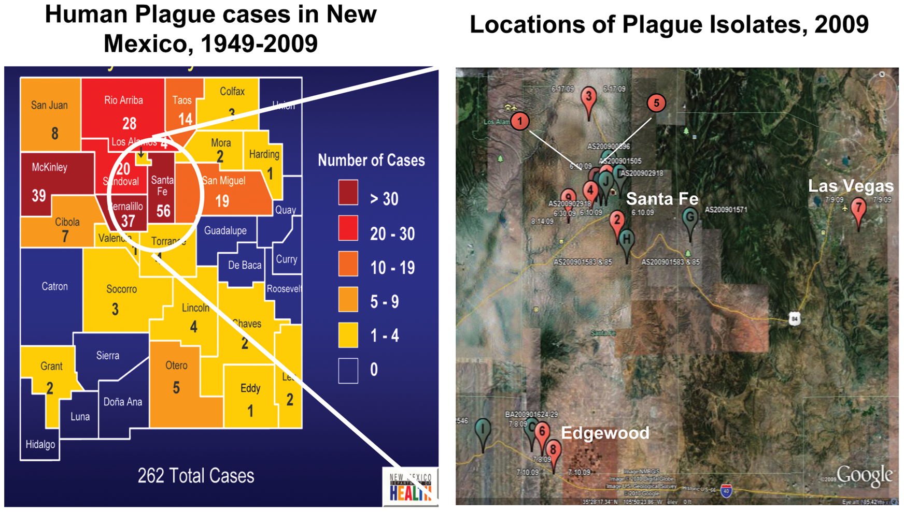
New Mexico
PLOS One - Gibson (2012) [1.1]

Slide 18
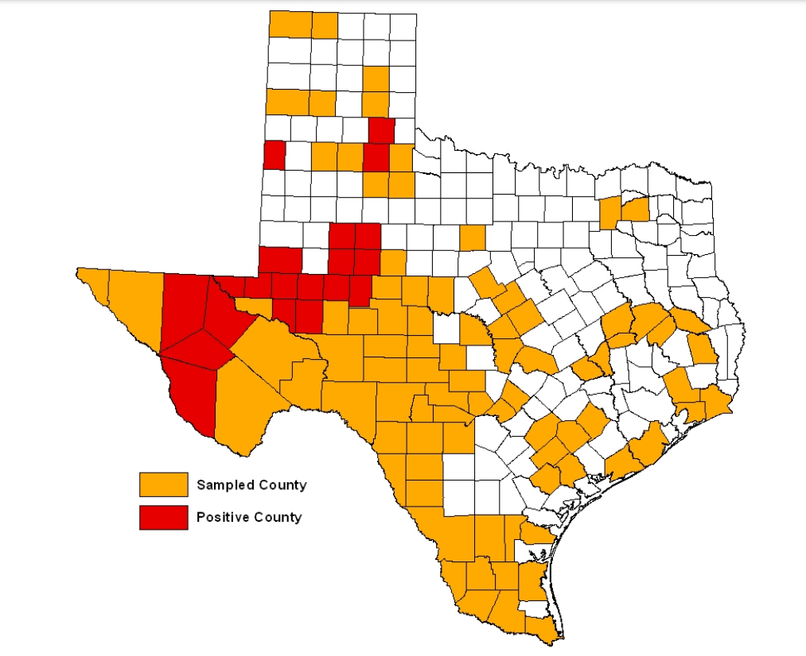
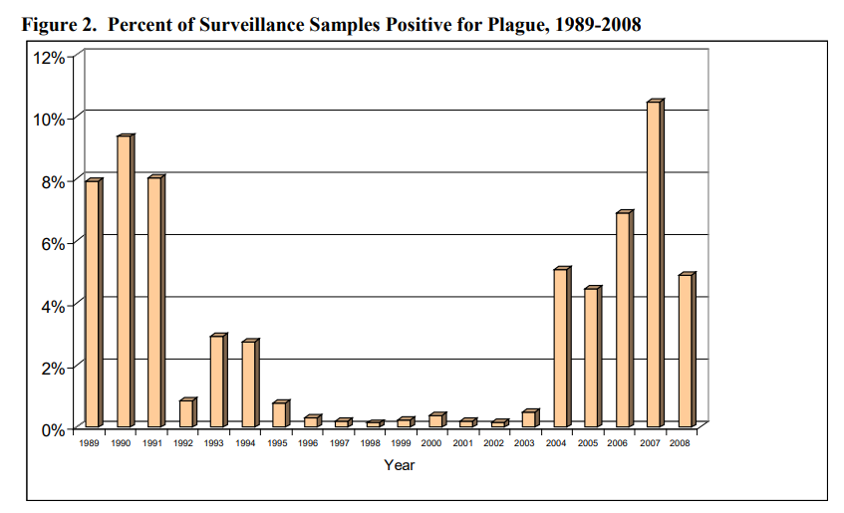
Texas
Texas DHSH data [1.2]
Year: 2008
Notes:
https://www.dshs.texas.gov/notifiable-conditions/zoonosis-control/zoonosis-control-diseases-and-conditions/plague-yersinia-pestis/plague-yersinia-pestis-reports

Slide 19
Transmission
Objectives:
Describe the geographic distribution of Yersinia pestis
Identify vectors and routes of transmission
Review microbiology and pathogenesis
Compare the clinical manifestations of the plague
Discuss diagnostic modalities & treatment options

Slide 20
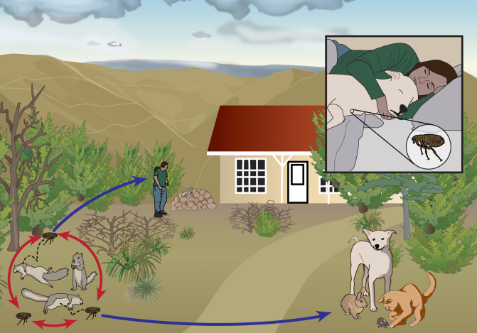
Ecology & Transmission
Transmitted by fleas among wild rodents (squirrels, prairie dogs, rats)
If ↑↑ among rodents ⇒ rodents die ⇒ fleas get hungry ⇒ fleas find other food
May bite humans directly
Cats get very sick and may cough droplets that infect humans
Dogs can carry fleas that bite humans
CDC [3.2]
Notes:
https://www.cdc.gov/plague/resources/plagueecologyus.pdf

Slide 21
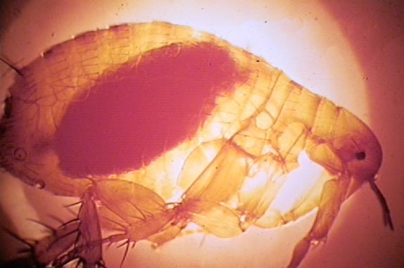
Flea transmission
High amounts of bacterial replication within the flea’s digestive tract ⇒ Blocks flea gut
Flea gets very hungry so ↑ feeds
Also vomits infected blood into new host
Regurgs up to 24k CFUs !
Infectious dose (for SQ) may be <10 CFUs
The Oriental rat flea (Xenopsylla cheopis) engorged with blood
https://en.wikipedia.org/wiki/Black_Death

Slide 22
Flea transmission
High amounts of bacterial replication within the flea’s digestive tract ⇒ Blocks flea gut
Flea gets very hungry so ↑ feeds
Also vomits infected blood into new host
Regurgs up to 24k CFUs !
Infectious dose (for SQ) may be <10 CFUs
Later studies showed transmission without GI obstruction.
Hgb poorly soluble (“pseudo-obstruction”)
Occurs with rats & guinea pigs
Not with mice or gerbils
Gives flea GERD ⇒ reflux when feeding
The Oriental rat flea (Xenopsylla cheopis) engorged with blood
https://en.wikipedia.org/wiki/Black_Death

Slide 23
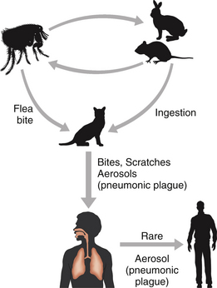
Other transmissions
Transmitted with direct contact with infectious fluids
Biggest concern is airborne transmission
Infectious dose somewhere between 100 and 15,000 cfu when inhaled
DHS [3.3]
https://veteriankey.com/yersinia-pestis-plague-and-other-yersinioses/
Notes:
https://www.niaid.nih.gov/research/biocontainment-research-facilities
https://www.dhs.gov/sites/default/files/2024-08/24_0808_st_mql_yersinia_pestis_plaque.pdf

Slide 24
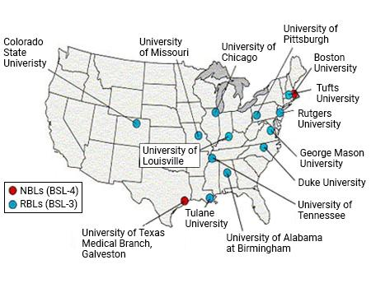
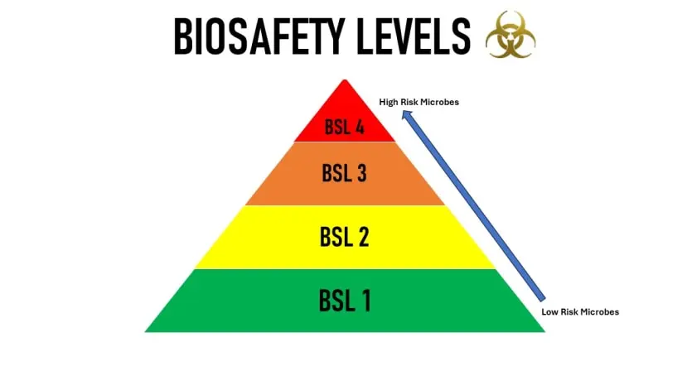
Other transmissions
Transmitted with direct contact with infectious fluids
Biggest concern is airborne transmission
Infectious dose somewhere between 100 and 15,000 cfu when inhaled
Possible agent of bioterrorism
PPE: N95, googles, gown, gloves
Risk group 3 pathogen
DHS says should be handled with BSL-3 practices
American Society for Microbiology says minimum BSL-2 (for diagnostic)
DHS [3.3]
Notes:
https://www.niaid.nih.gov/research/biocontainment-research-facilities
https://www.dhs.gov/sites/default/files/2024-08/24_0808_st_mql_yersinia_pestis_plaque.pdf

Slide 25
Microbiology & clinical presentation
Objectives:
Describe the geographic distribution of Yersinia pestis
Identify vectors and routes of transmission
Review microbiology and pathogenesis
Compare the clinical manifestations of the plague
Discuss diagnostic modalities & treatment options

Slide 26
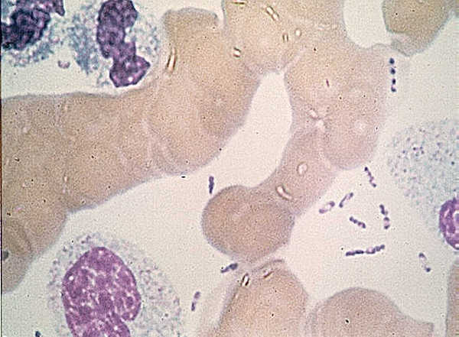
Microbiology
Yersinia pestis is gram negative (cocco)bacillus
Bipolar staining on Giemsa, Wright’s, or Wayson staining (“safety pin”)
Automated identification systems may misidentify (e.g. Acinetobacter, PsA)
Once again, tell the lab if there is concern for Y pestis (for multiple reasons)
https://en.wikipedia.org/wiki/Wayson_stain

Slide 27
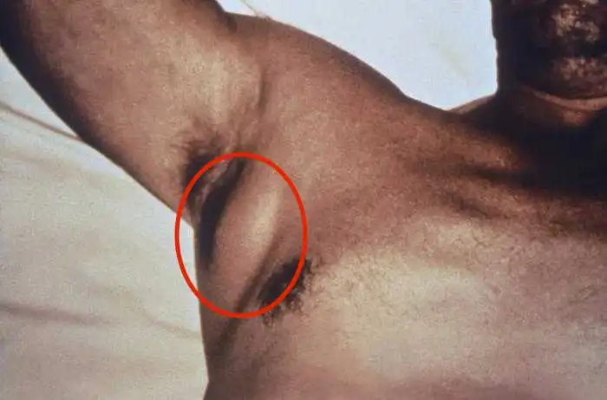
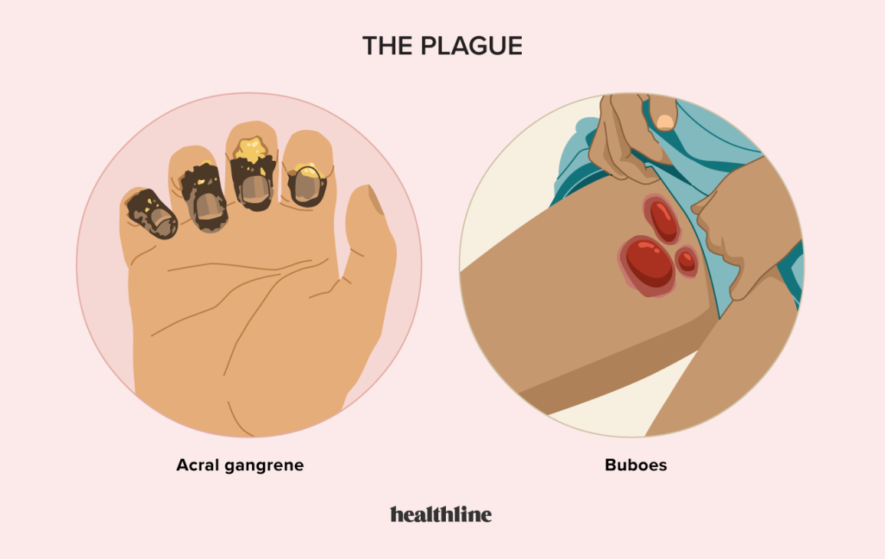
Clinical syndromes
Bubonic plague (80-95%)
Sudden onset of fever +/- headache ⇒ severe nonfluctuant painful lymphadenopathy
Often inguinal
Epitrochlear buboes a/w cats
Untreated, 50% develop to septicemic plague
Septicemic plague (10-20%)
AKA Yersinia pestis bacteremia
Very sick w/o localizing symptoms
Progresses to DIC w/ multiorgan failure

Slide 28
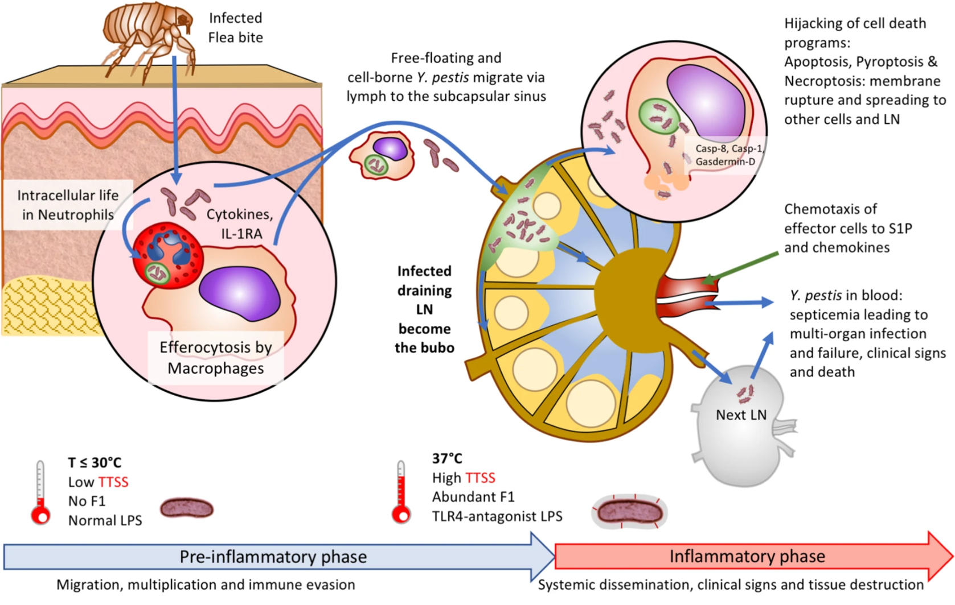
Clinical syndromes
Bubonic plague (80-95%)
Sudden onset of fever +/- headache ⇒ severe nonfluctuant painful lymphadenopathy
Often inguinal
Epitrochlear buboes a/w cats
Untreated, 50% develop to septicemic plague
Septicemic plague (10-20%)
AKA Yersinia pestis bacteremia
Very sick w/o localizing symptoms
Progresses to DIC w/ multiorgan failure
Sepsis and immune evasion mediated by temp
at 37 C ⇒ ↑ F1 antigen expression & ↑ LPS
Nature Gene - Demeure (2019) [1.3]

Slide 29
Clinical syndromes
Pneumonic plague
Primary: from inhalation, luckily is rare
Rapid onset of severe pneumonia
High fever, cough, hypoxemia, hemoptysis
If untreated, death within days
Secondary: (develops in 10% of cases)
Often 2/2 untreated bubonic plague w/ hematologic seeding
Similar manifestations to primary
Bubonic plague (80-95%)
Sudden onset of fever +/- headache ⇒ severe nonfluctuant painful lymphadenopathy
Often inguinal
Epitrochlear buboes a/w cats
Untreated, 50% develop to septicemic plague
Septicemic plague (10-20%)
AKA Yersinia pestis bacteremia
Very sick w/o localizing symptoms
Progresses to DIC w/ multiorgan failure
Other / Misc
Any type can have +/- meningitis
Can develop septicemic or pneumonic without bubos (must have ↑↑↑↑↑↑ index of suspicion)
10-20% of septicemic have no preceding bubos

Slide 30
Diagnosis & management
Objectives:
Describe the geographic distribution of Yersinia pestis
Identify vectors and routes of transmission
Review microbiology and pathogenesis
Compare the clinical manifestations of the plague
Discuss diagnostic modalities & treatment options

Slide 31
Diagnosis
Often will grow on culture, either of blood or pus / buboes
40% of cases of peripheral blood Giemsa-Wright stains were positive
Rapid tests
Mostly in case of bioterrorism
Serologic tests
Mostly helpful after the fact
Diagnostic clues
WBC >20k & ↓ platelets (50% of cases)
Painful, nonfluctuant, lymphadenopathy
Esp. fever + hypotension + regional lymphadenitis
Fever after contact with dead rodents
Hilar or mediastinal adenopathy in what otherwise appears to be bacterial pneumonia

Slide 32
Treatment
First line options: Aminoglycosides (Streptomycin, Gent), fluoroquinolones, tetracyclines
Most experience has been with aminoglycosides (namely streptomycin)
Someone managed to do a RTC with 65 patients. Cure rates were similar at 7 days
Gentamicin (94%)
Doxycycline (97%)
Resistance rates are low
Mostly thought to horizontal exchange from other Enterobacteriaceae plasmids
Still, CDC suggests dual therapy for severe cases and if from bioterrorism
Meningitis: Chloramphenicol and moxi or levoflox

Slide 33
Isolation, PEP, vaccines
Best advice: Don’t be around rats, especially dead ones!
Isolation:
Droplet precautions for 48h of antibiotics (& improvement) or pneumonia ruled out
Standard precautions if no pneumonia
Eye/face shield & mask if lancing buboes
PEP: 7 days of doxy or a quinolone
Immunizations:
No longer available in the US
Some vaccines under development

Slide 34
Case #2

Slide 35
Case 2: HPI
A 57 y/o M with PMH including ILD, remote SCC of tongue, prior C-spine Sx p/w 3 weeks of RLE>LLE numbness
Background:
ILD: Biopsy confirmed on PRN O2. Has been on Nintedanib (Ofev) for two years, and prednisone 10 for the past 3 months
SCC of tongue: Over 30 years ago s/p resection and in remission

Slide 36
Case 2: HPI
A 57 y/o M with PMH including ILD, remote SCC of tongue, prior C-spine Sx p/w 3 weeks of RLE>LLE numbness.
-17 days: Woke up with sudden onset numbness from R hip down to R foot. Maybe some numbness in left foot. Seen by chiropractor next day who said go to ED as this isn’t normal
Seen in the ED, CT LS-spine showing L4-L5 disc bulge
D/C with steroids & spine referral
-13 days, (ED #2): Spine center reviews ED notes and finds patient also c/o perirectal numbness, so tells him to return to ED
Gets MRI LS-spine without contrast with same findings as CT
PVR normal
Ortho notes numbness is not dermatomal and have low c/f cauda equina
Discharged (without a diagnosis, just that it’s not CES)

Slide 37
Case 2: HPI
A 57 y/o M with PMH including ILD, remote SCC of tongue, prior C-spine Sx p/w 3 weeks of RLE>LLE numbness.
-17 days: Woke up with sudden onset numbness from R hip down to R foot. Maybe some numbness in left foot. Seen by chiropractor next day who said go to ED as this isn’t normal
Seen in the ED, CT LS-spine showing L4-L5 disc bulge
D/C with steroids & spine referral
-13 days, (ED #2): Spine center reviews ED notes and finds patient also c/o perirectal numbness, so tells him to return to ED
Gets MRI LS-spine without contrast with same findings as CT
PVR normal
Ortho notes numbness is not dermatomal and have low c/f cauda equina
Discharged (without a diagnosis, just that it’s not CES)

Slide 38
Case 2: HPI
A 57 y/o M with PMH including ILD, remote SCC of tongue, prior C-spine Sx p/w 3 weeks of RLE>LLE numbness.
-2.5 weeks: Woke up with sudden onset numbness from R hip down to R foot. Maybe some numbness in left foot. LS-spine CT & MRI (w/o) showing L4-L5 disc bulge. Got steroids (ED #1) & ortho consult (ED #2)
-1 day: Pulm sees in clinic and he looks unwell. Now with saddle anesthesia, BLE numbness, and worsening of baseline diarrhea. They are worried about GBS so send him to the ED for neuro. Neurology finally does a detailed assessment and finds…

Slide 39
Case 2: HPI
A 57 y/o M with PMH including ILD, remote SCC of tongue, prior C-spine Sx p/w 3 weeks of RLE>LLE numbness.
-2.5 weeks: Woke up with sudden onset numbness from R hip down to R foot. Maybe some numbness in left foot. LS-spine CT & MRI (w/o) showing L4-L5 disc bulge. Got steroids (ED #1) & ortho consult (ED #2)
-1 day: Pulm sees in clinic and he looks unwell. Now with saddle anesthesia, BLE numbness, and worsening of baseline diarrhea. They are worried about GBS so send him to the ED for neuro. Neurology finally does a detailed assessment and finds…
Afebrile, vitals normal
Decreased sensation to pin prick in BLE length dependent fashion
Hypersensitive to pinprick in plantars
Decreased vibratory sense knees, ankles, and toes
Strength normal
Labs
WBC 11.2 (63% NΦ)
CMP normal
HIV screen negative
Blood cultures negative

Slide 40
Case 2: HPI
A 57 y/o M with PMH including ILD, remote SCC of tongue, prior C-spine Sx p/w 3 weeks of RLE>LLE numbness.
-2.5 weeks: Woke up with sudden onset numbness from R hip down to R foot. Maybe some numbness in left foot. LS-spine CT & MRI (w/o) showing L4-L5 disc bulge. Got steroids (ED #1) & ortho consult (ED #2)
-1 day: Pulm sees in clinic and he looks unwell. Now with saddle anesthesia, BLE numbness, and worsening of baseline diarrhea. They are worried about GBS so send him to the ED for neuro. Neurology finally does a history and finds…
Recent travel to North Carolina where he went to the beach
He also had burning sensation across upper chest and back (bandlike, ?b/l)
But has scattered bullous lesions on his skin with a red base
Rash is on his feet and his chest (unclear if the same area where he has burning sensation)
Now they order MRI whole spine with contrast

Slide 41
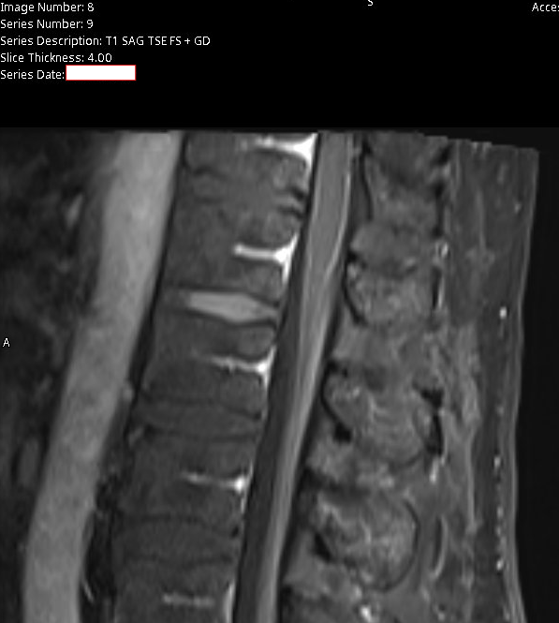
Workup
MRI whole spine (with contrast):
There is no abnormal enhancement identified within the cervical and upper thoracic spine.
There is however suggestion of mild diffuse non-nodular enhancement noted to the conus and extending to the cauda equina nerve roots
Could be artifactual, however with the clinical history this could be seen with Guillain-Barre syndrome
MRI brain: Normal
Pan CT: Normal
T2 post contrast

Slide 42
Workup
MRI whole spine (with contrast):
There is no abnormal enhancement identified within the cervical and upper thoracic spine.
There is however suggestion of mild diffuse non-nodular enhancement noted to the conus and extending to the cauda equina nerve roots
Could be artifactual, however with the clinical history this could be seen with Guillain-Barre syndrome
MRI brain: Normal
Pan CT: Normal
T2 post contrast
Lumbar puncture
OP: 16 mm H2O
WBC: 67 (79% LΦ)
RBC: 400
Pro: 98
Glu: 52
G/S: Few PMNs

Slide 43
Case 2: Summary
-3 mo
Prednisone taper
Been on Pred 10 daily
-2.5 wk
Sudden onset RLE numbness
A 57 y/o M with PMH including ILD (on Ofev & pred), remote SCC of tongue, prior C-spine Sx p/w 3 weeks of progressively worsening RLE>LLE numbness and was admitted for cauda equina syndrome like symptoms despite no evidence of cord compression radiographically
CT & MRI LS-spine: L4-L5 disc bulge
Travel to NC where he went to the beach
Developed painful band around his chest
Worsened diarrhea from baseline
Now
Sent to ED by pulm (c/f GBS)
Has BLE numbness, saddle anesthesia & urinary retention
Neuro exam: sensory & vibration abnl
Noted bullous (?) lesions on chest & feet
Obtained more imagining
MRI brain normal
Cervical / upper thoracic MRI unrevealing
Pan CT normal
CSF
WBC: 67 (79% LΦ)
RBC: 400
Pro: 98
Glu: 52
G/S: Few PMNs
MRI: Lumbosacral w/ contrast
Mild diffuse non-nodular enhancement noted to the conus and extending to the cauda equina nerve roots
Lumbar puncture
WBC: 67 (79% LΦ)
RBC: 400
Pro: 98
Glu: 52

Slide 44
Case 2: Hospital course
Initial c/f leptomeningeal carcinomatosis
Normal CT → c/f autoimmune → did LP
Dx: Elsberg Syndrome
AKA HSV lumbosacral radiculitis
Given solumedrol (x5 days) & acyclovir (x14 days) → OPAT
Discharged w/ OPAT
Got volume overload so readmitted
This is when ID saw him for the first time
Diarrhea improved with holding Ofev
Lumbar puncture
OP: 16 mm H2O
WBC: 67 (79% LΦ)
RBC: 400
Pro: 98
Glu: 52
G/S: Few PMNs
CSF studies
Cultures: Neg
Biofire: HSV-2
West Nile: Neg
Crypto Ag: Neg
Flow cytometry: Neg
Pathology: Neg

Slide 45
Case 2: Hospital course
Initial c/f leptomeningeal carcinomatosis
Normal CT → c/f autoimmune → did LP
Dx: Elsberg Syndrome
AKA HSV lumbosacral radiculitis
Given solumedrol (x5 days) & acyclovir (x14 days) → OPAT
Discharged w/ OPAT
Got volume overload so readmitted
This is when ID saw him for the first time
Diarrhea improved with holding Ofev
Lumbar puncture
OP: 16 mm H2O
WBC: 67 (79% LΦ)
RBC: 400
Pro: 98
Glu: 52
G/S: Few PMNs
CSF studies
Cultures: Neg
Biofire: HSV-2
West Nile: Neg
Crypto Ag: Neg
Flow cytometry: Neg
Pathology: Neg

Slide 46
Discussion
Links to articles discussed here

Slide 47
Elsberg Syndrome
Objectives
Recognize the clinical manifestations of lumbosacral myeloradiculitis
Review both of the retrospective cohort studies on PubMed

Slide 48
Elsberg syndrome (ES)
Described in 1914 by a neurosurgeon (Dr Elsberg)
Five younger adults (37-45 y/o) with syndrome of
Urinary retention
Constipation
Radicular pain
Paraesthesia
Paresis of the lower limbs
He presumed an infectious or toxic etiology
“During the past five years in a large number of spinal operations under our observation… we have met with 5 cases so alike in their histories, in their clinical findings, and in the morbid appearances on the operating table that we have been led to class them together, in the belief that we have here a definite clinical and pathological entity”
- Charles Elsberg, 1914

Slide 49
Elsberg syndrome (ES)
Neurotropic viruses (namely HSV-2), were later identified as a cause of lumbosacral radiculitis or myeloradiculitis
Can present as cauda equina syndrome, as it causes lumbosacral radiculopathy &/or myelopathy.
Distinction: ES is an -itis (which causes the -opathy)
Thus easily missed on routine evaluation
Neurotropic viruses causing ES
HSV-2, VZV, CMV, WNV, Cv19
Annual incidence
1.2 episodes / million adults
Likely more, because under recognized

Slide 50
Elsberg syndrome (ES)
Neurotropic viruses (namely HSV-2), were later identified as a cause of lumbosacral radiculitis or myeloradiculitis
Can present as cauda equina syndrome, as it causes lumbosacral radiculopathy &/or myelopathy.
Distinction: ES is an -itis (which causes the -opathy)
Thus easily missed on routine evaluation
MRI findings are nonspecific and may be negative
Savoldi et al (2017) [2.1] is an excellent review of radiographic findings
In most case reports, CSF has lymphocytic pleocytosis
Negative CSF PCR does not rule out the diagnosis, especially if delayed diagnosis
Neurotropic viruses causing ES
HSV-2, VZV, CMV, WNV, Cv19
Annual incidence
1.2 episodes / million adults
Likely more, because under recognized
Treatment
Acyclovir or valacyclovir
Not well established degree of benefit
Unclear if role for steroids

Slide 51
Article #1

Slide 52
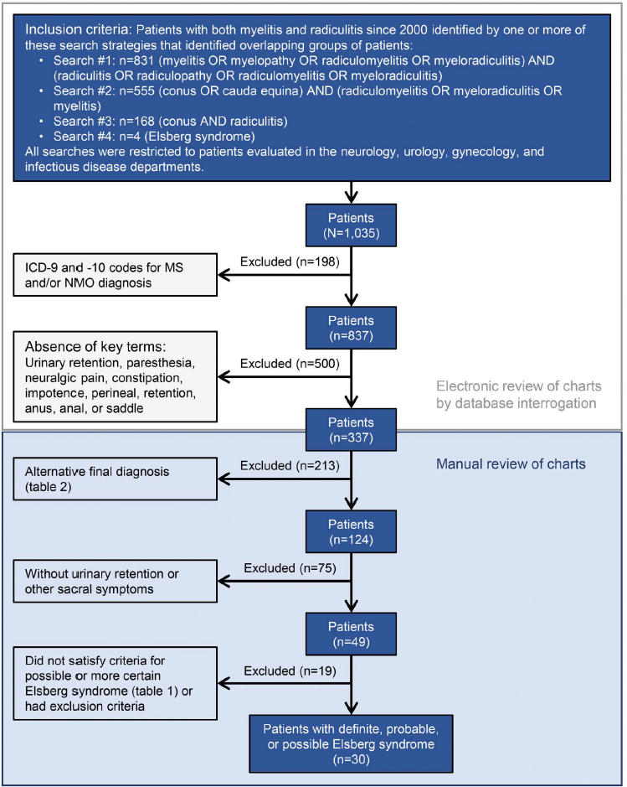
Savoldi et al (2017)
Methodology: Retro review @Mayo (2000 to 2016)
Patients seen by neuro, urology, gyn, or ID
Pretty robust & conservative electronic search
1,035 → 337 chart reviewed
Identified 49 patients meeting inc/exc criteria
Developed diagnostic criteria (definite, probable, possible, excluded)
Total of 30 patients had at least possible Elsberg syndrome

Slide 53
Savoldi et al (2017)
Symptom | N (%)
Urinary retention | 23 (77%)
Catheter required for retention | 21 (70%)
Urinary incontinence | 7 (23%)
Bowel incontinence | 3 (10%)
Saddle anesthesia | 15 (50%)
Constipation | 13 (43%)
Loss of limb sensation | 24 (80%)
Leg weakness | 15 (50%)
Lower extremity hyporeflexia | 10 (33%)
Results: 80% male, median age of 53
Only one patient (3.3%) immunosuppressed
Only 10% had skin manifestations before onset
Only 60% of patients had any kind of viral testing (PCR or serology from lesions, serum, or CSF)
PCR positive in 17% of patients (3 / 17)
Most had LP done (83%)
But median delay from symptoms to CSF collection 32 days
CSF cell count, median (range) | 9 (0 - 1057)
Mean % lymphs (among those w/ >5 WBCs) | 69%
Mean CSF protein | 143

Slide 54
Savoldi et al (2017)
Acyclovir was given to 20% of patients (ES was on the DDx for only 10% of patients)
Half of patients got some form of steroids
Of the patients with follow up data (n=13):
One patient (7.7%) died of encephalomyelitis
Three (23%) had no neurologic recovery
Eight (44%) had moderate recovery
One (7.7%) had complete recovery
Two patients relapsed (15%) at 33 & 82 months

Slide 55
Pelle Trier Petersen · Jacob Bodilsen · Micha Phill Grønholm Jepsen · Lykke Larsen · Merete Storgaard · Birgitte Rønde Hansen · Hans Rudolf Lüttichau · Jannik Helweg‑Larsen · Lothar Wiese · Christian Østergaard Andersen · Henrik Nielsen · Christian Thomas Brandt · Danish Study Group of Infections of the Brain (DASGIB)

Slide 56
Petersen et al (2023)
Methods: Danish nationwide population-based observational cohort study used data from the Danish Study Group for Infections of the Brain (DASGIB) database from 2015 to 2020
DASGIB includes patients admitted for CNS infections at departments of ID in Denmark

Slide 57
Petersen et al (2023)
Methods: Danish nationwide population-based observational cohort study used data from the Danish Study Group for Infections of the Brain (DASGIB) database from 2015 to 2020
DASGIB includes patients admitted for CNS infections at departments of ID in Denmark
Stricter inclusion criteria: Urinary retention --AND-- (at least one) of below:
Positive CSF PCR
CSF WBC > 10 --AND-- (at least one) of below:
Viral lumbosacral radiculitis considered the most likely diagnosis ---or---
Evidence of neurotropic virus, including:
Positive intrathecal antibody index
Positive serology
Positive PCR of other samples

Slide 58
Petersen et al (2023)
Methods: Danish nationwide population-based observational cohort study used data from the Danish Study Group for Infections of the Brain (DASGIB) database from 2015 to 2020
DASGIB includes patients admitted for CNS infections at departments of ID in Denmark
Outcomes:
DASGIB database has Glasgow Outcome Scale assessed at discharge and at outpatient follow-up visits (at 30, 90, and 180 days)
They did chart review for additional sequelae (including persistent urinary retention) at 30 days
Glasgow Outcome Scale
1. Death
2. Vegetative state
3. Severe disability
4. Moderate disability
5. Good recovery

Slide 59
Petersen et al (2023)
Symptom | N (%)
Headaches | 23 (82%)
Neck stiffness | 6 (23%)
Photophobia/hyperacusis | 12 (55%)
Urinary retention (by def) | 28 (100%)
Catheter required for retention | 17 (61%)
Constipation | 20 (71%)
Leg paraesthesia | 10 (36%)
Leg paresis | 2 (7%)
Leg radicular pain | 13 (46%)
Identified 28 cases across five years
79% patients female, median age 35 years old
Only one patient (4%) was immunosuppressed
39% had genital herpes
Median of 5 days from symptom onset to admission
Many had febrile illness beforehand
85% of patients had another sign of radiculitis (besides urine retention)
All but one patient (96%) were treated with acyclovir or valacyclovir
Median duration 14 days (IQR 7 - 14)
CSF cell count, median (IQR) | 153 (31- 514)
CSF % lymphs, median (IQR) | 1% (1 - 4)
CSF protein, median (IQR) | 70 (46 - 131)

Slide 60
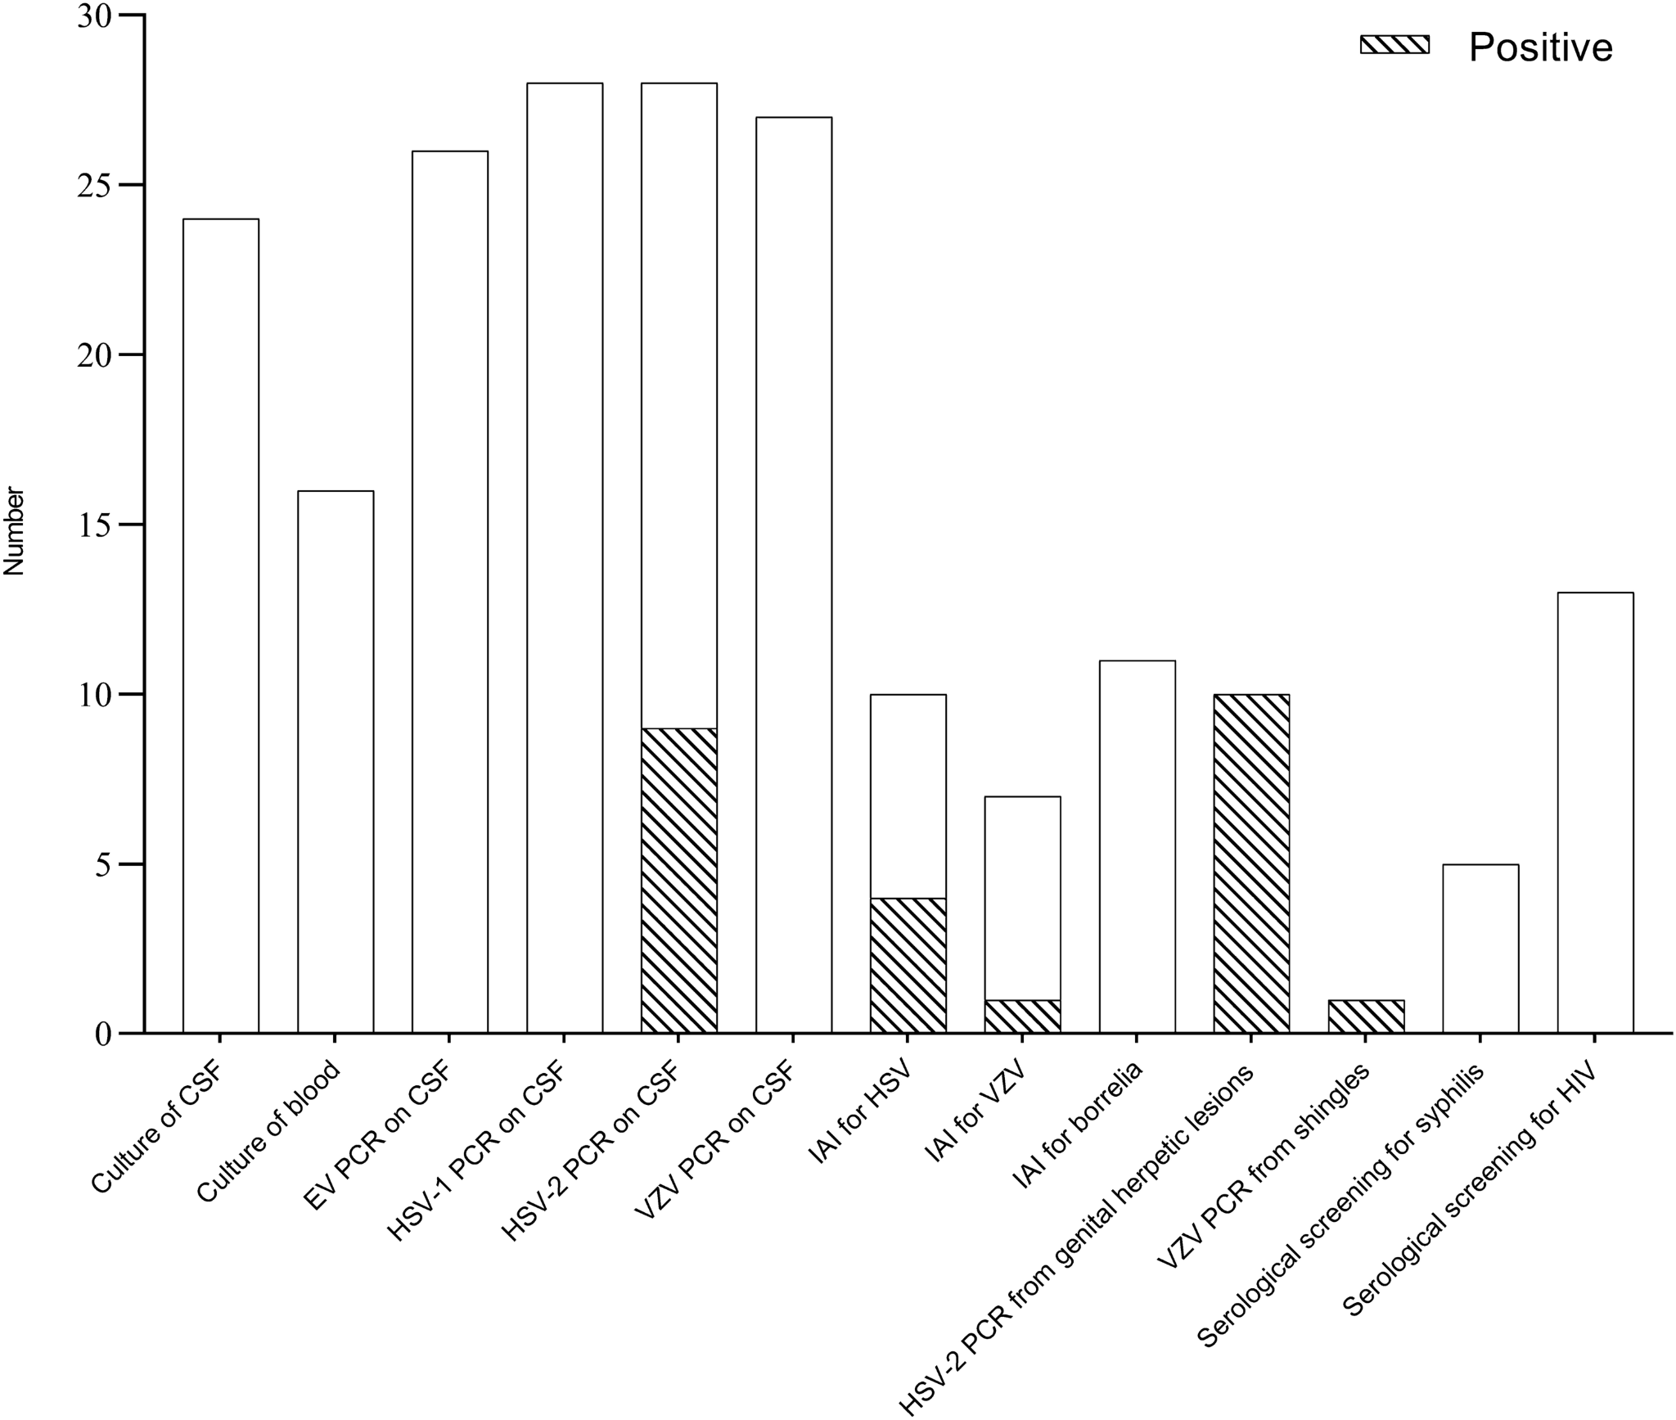

Slide 61
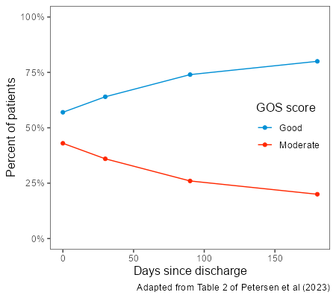
Petersen et al (2023)
Long term outcomes:
At discharge, 43% had moderate disability
This improved to 20% by 180 days following discharge
Symptom | Cohort N (%) | 30 days N (%)
Headaches | 23 (82%) | 9 (33%)
Catheter required for retention | 17 (61%) | 3 (11%)
Leg paraesthesia | 10 (36%) | 2 (7%)
Leg paresis | 2 (7%) | 1 (4%)
Leg radicular pain | 13 (46%) | 2 (7%)

Slide 62
Learning points & take aways

Slide 63
Learning points & take aways
Yersinia pestis is endemic in Asia, Africa, & western US (esp four corners & cali-oregon)
Ask about all rodents & pet exposure to rodents
The lab likes to know if they have agents of bioterrorism so please tell them
Diagnostic clues for the plague:
WBC >20k + ↓ platelets +/- DIC
Fever + hypotension + painful, nonfluctuant, regional lymphadenitis
Treat with aminoglycosides, fluoroquinolones, or tetracyclines
Elsberg Syndrome (lumbosacral myeloradiculitis) is caused by HSV-2
Also seen with VZV, CMV, WNV, Cv19
Elsberg Syndrome is a rare cause of cauda equina syndrome
Urinary retention is common +/- skin lesions
Commonly preceded by febrile illness
Lymphocytic pleocytosis
Treatment is not well studied, but often receive acyclovir &/or steroids
Slides available on hunterratliff1.com/talk/; Citations available via QR code or via the “citations” button on the website

