Slide 1
Malignant fevers
CID conference
Hunter Ratliff
12/19/2024
Ages, dates, and other identifying information may have been changed
I have no conflict of interest in relation to this presentation

Slide 2
Case #1

Slide 3
Case 1: HPI
A 45 y/o F with PMH including colorectal cancer w/ liver mets (on fruquintinib), recurrent ESBL UTIs p/w epigastric / left flank pain

Slide 4
Case 1: HPI
A 45 y/o F with PMH including colorectal cancer w/ liver mets (on fruquintinib), recurrent ESBL UTIs p/w epigastric / left flank pain
Discharged four days ago for pancreatitis
  s/p ERCP, biliary sphincterotomy, & stenting

Slide 5
Case 1: HPI
A 45 y/o F with PMH including colorectal cancer w/ liver mets (on fruquintinib), recurrent ESBL UTIs p/w epigastric / left flank pain
Discharged four days ago for pancreatitis
  s/p ERCP, biliary sphincterotomy, & stenting
Pain is similar to last admission
  Radiates to the right shoulder
  Associated nausea & anorexia

Slide 6
Case 1: HPI
A 45 y/o F with PMH including colorectal cancer w/ liver mets (on fruquintinib), recurrent ESBL UTIs p/w epigastric / left flank pain
Discharged four days ago for pancreatitis
  s/p ERCP, biliary sphincterotomy, & stenting
Pain is similar to last admission
  Radiates to the right shoulder
  Associated nausea & anorexia
No fevers or urinary sx
  Got nitrofurantoin a week ago for “UTI”

Slide 7
Case 1: HPI
A 45 y/o F with PMH including colorectal cancer w/ liver mets (on fruquintinib), recurrent ESBL UTIs p/w epigastric / left flank pain
Discharged four days ago for pancreatitis
  s/p ERCP, biliary sphincterotomy, & stenting
Pain is similar to last admission
  Radiates to the right shoulder
  Associated nausea & anorexia
No fevers or urinary sx
  Got nitrofurantoin a week ago for “UTI”
Oncology History
Diagnosed w/ rectal cancer 3 yr ago
  Mets to liver & lungs
Recently started on fruquintinib
  Oral VEGF inhibitor
  Still has port
Chemo held two weeks ago (as it can cause pancreatitis)

Slide 8
Case 1: Initial exam & labs
Exam
VS: 37 °C | HR 116 | BP 122/63
General: Appears uncomfortable
GI: NTND, TTP over hypogastric region & left flank

Slide 9
Case 1: Initial exam & labs
Exam
VS: 37 °C | HR 116 | BP 122/63
General: Appears uncomfortable
GI: NTND, TTP over hypogastric region & left flank
CBC: Normal (WBC 7.1)
Lipase: 753 (similar to prior admission)

Slide 10
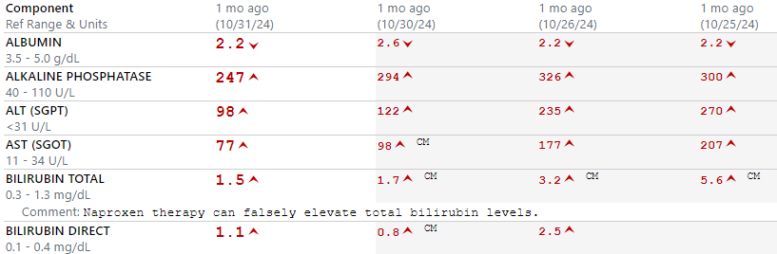
Case 1: Initial exam & labs
Exam
VS: 37 °C | HR 116 | BP 122/63
General: Appears uncomfortable
GI: NTND, TTP over hypogastric region & left flank
CBC: Normal (WBC 7.1)
Lipase: 753 (similar to prior admission)
Prior admission (-4 d)

Slide 11
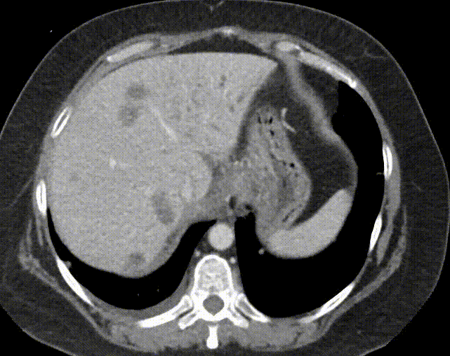
Case 1: Initial imaging
CT A/P on admission
Pancreas: Edematous pancreas. Prominent pancreatic ductal caliber, likely secondary to findings at the porta hepatis. Subtle peripancreatic stranding persists, without peripancreatic fluid. No solid pancreatic mass is evident
Biliary System: Interval placement of a CBD stent with improved but persistent biliary ductal dilatation. There is expected associated nondependent pneumobilia
Lymph Nodes: Necrotic conglomerate of masses at the porta hepatis which may reflect pathologic lymph nodes. Bulky retroperitoneal adenopathy

Slide 12
Case 1: Initial imaging
CT A/P on admission
Pancreas: Edematous pancreas. Prominent pancreatic ductal caliber, likely secondary to findings at the porta hepatis. Subtle peripancreatic stranding persists, without peripancreatic fluid. No solid pancreatic mass is evident
Biliary System: Interval placement of a CBD stent with improved but persistent biliary ductal dilatation. There is expected associated nondependent pneumobilia
Lymph Nodes: Necrotic conglomerate of masses at the porta hepatis which may reflect pathologic lymph nodes. Bulky retroperitoneal adenopathy

Slide 13
Case 1: Initial imaging
CT A/P on admission
Pancreas: Edematous pancreas. Prominent pancreatic ductal caliber, likely secondary to findings at the porta hepatis. Subtle peripancreatic stranding persists, without peripancreatic fluid. No solid pancreatic mass is evident
Biliary System: Interval placement of a CBD stent with improved but persistent biliary ductal dilatation. There is expected associated nondependent pneumobilia
Lymph Nodes: Necrotic conglomerate of masses at the porta hepatis which may reflect pathologic lymph nodes. Bulky retroperitoneal adenopathy

Slide 14
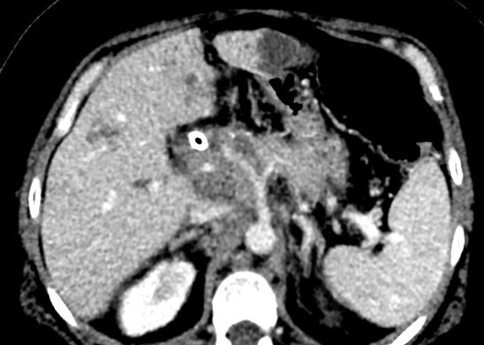
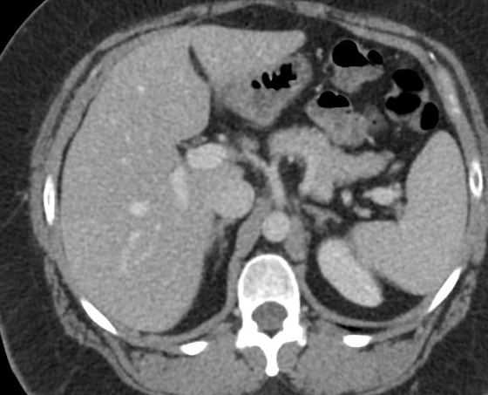
Aside: Where is the porta hepatis?
This admission
CT from 18 months ago
L lobe
Common hepatic a.
Common hepatic a.
R lobe
CBD?
Portal vein
Celiac a.
IVC
IVC
Necrotic conglomerate of masses at the porta hepatis which may reflect pathologic lymph nodes

Slide 15
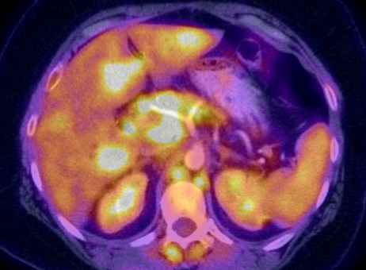
Where is the porta hepatis?
PET CT from 1.5 months ago
This admission
Common hepatic a.
IVC

Slide 16
Case 1: Back to the case
A 45 y/o F with PMH including colorectal cancer w/ liver mets (chemo -2wk), obstructive jaundice s/p recent ERCP w/ stent, recurrent ESBL UTIs p/w abdominal pain and admitted for suspected ERCP induced pancreatitis (after recent admission for drug-induced pancreatitis)
Hospital day 1: GI consulted, says CT looks better with the stent from last admission (low concern for obstruction)
Days 2-6: LFTs improving, working on pain control & advancing diet
Hospital day 7: fevers & tachycardia, multiple episodes of diarrhea & suprapubic pain

Slide 17
Case 1: Summary
-18 days
Admission for drug induced
pancreatitis
Gets ERCP w/ biliary stent
Treated for UTI
A 45 y/o F with PMH including colorectal cancer w/ liver mets (chemo -2wk), obstructive jaundice s/p recent ERCP w/ stent, recurrent ESBL UTIs p/w abdominal pain and admitted for suspected ERCP induced pancreatitis. Fevers on hospital day 7 in the context of new diarrhea & suprapubic pain
-11 days
Discharged home
-7 days
Readmitted for ERCP induced pancreatitis
LFTs improve with time
Advance the diet
Now
Fevers, looking septic

Slide 18
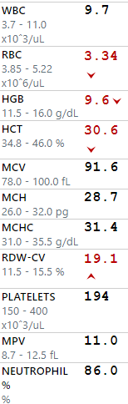
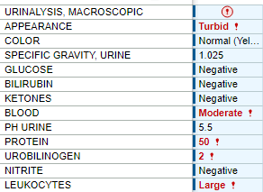
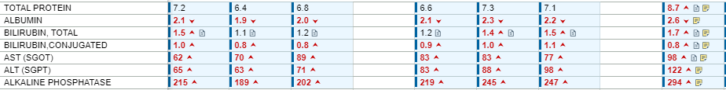
Case 1: Hospital course
Blood Cx: ???
Urine Cx: ???
Guess what grew?
Now
Admit

Slide 19
Case 1: Hospital course
Blood Cx: Cronobacter sakazakii
Urine Cx: GNR
Treatment?
Now
Admit
Where is the source?
Additional HPI / social Hx?

Slide 20
Case 1: Hospital course
Blood Cx: Cronobacter sakazakii
Urine Cx: E coli
Started on Merrem
GI said maybe cholangitis

Slide 21
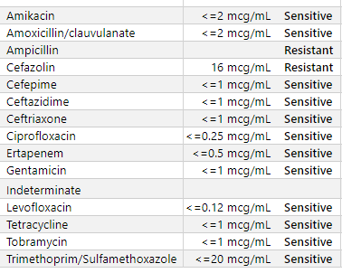
Case 1: Hospital course
Blood Cx: Cronobacter sakazakii
Urine Cx: E coli
Repeat CT A/P: unchanged
48h BCx cleared
Cronobacter sakazakii
Merrem
↓
Levaquin + Flagyl
x10 d for cholangitis
↓
Bactrim + Flagyl

Slide 22

Discussion
Links to articles discussed here

Slide 23
Cronobacter sakazakii
Objectives:
Describe the microbiology (and disturbing taxonomy) of Cronobacter sakazakii
Compare the clinical manifestations & risk factors in neonates & adults
Review the unique methods of resistance that makes it a food borne pathogen
Discuss the possibility of nosocomial spread in adults

Slide 24
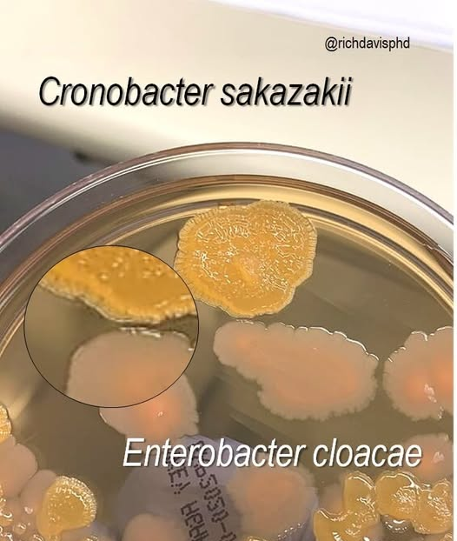
Microbiology & taxonomy
Gram negative rod in Enterobacteriaceae family
Unique in its xerotolerance, meaning it can survive in dried food (milk, baby formula) [1.1]
Formerly known as
  Enterobacter sakazakii complex
  “yellow-pigmented E. cloacae”

Slide 25
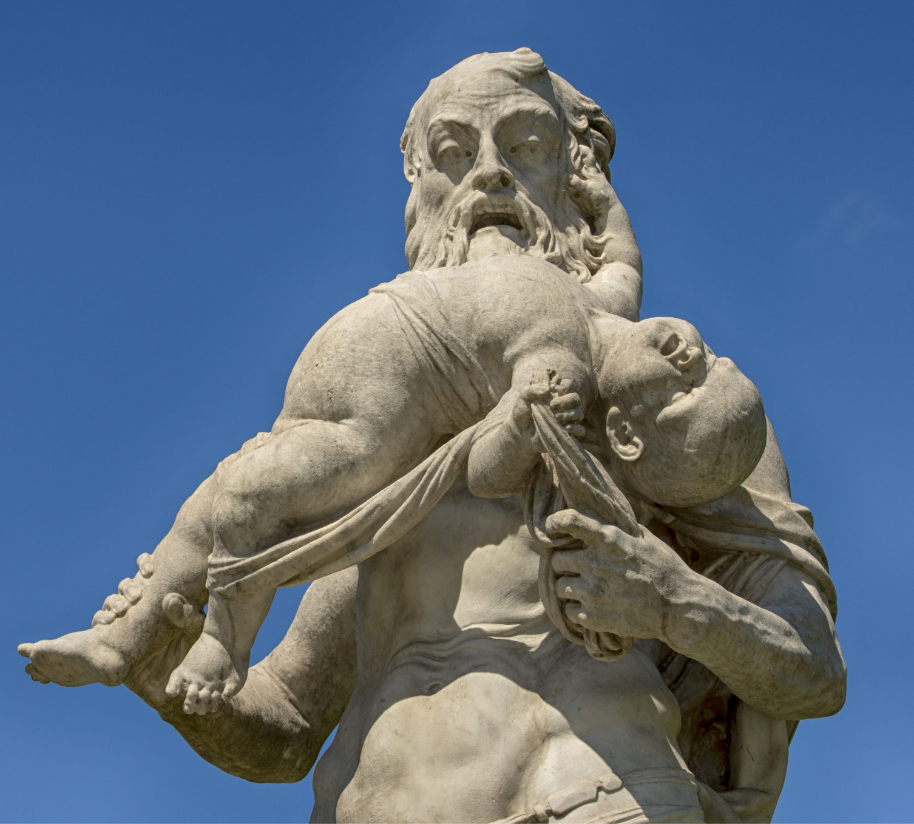
Microbiology & taxonomy
Gram negative rod in Enterobacteriaceae family
Unique in its xerotolerance, meaning it can survive in dried food (milk, baby formula) [1.1]
Formerly known as
  Enterobacter sakazakii complex
  “yellow-pigmented E. cloacae”
Named after Cronus (Titan in greek mythology) who devoured his children

Slide 26
Cronobacter in infants
Most notorious association for Cronobacter is association with baby formula & infants [1.2]
  May cause bacteremia, meningitis and necrotizing enterocolitis
CDC estimates 2-4 cases per year [source]
  But not a reportable disease in all states
In infants with invasive infections: [1.2]
  20-40% case fatality rate
  78% had powdered formula exposure
In the US, most cases are community onset
  In part because hospitals stopped using powdered formula inpatient after a 2001 outbreak at NICU in Tennessee

Slide 27
Cronobacter in infants
Most notorious association for Cronobacter is association with baby formula & infants [1.2]
  May cause bacteremia, meningitis and necrotizing enterocolitis
CDC estimates 2-4 cases per year [source]
  But not a reportable disease in all states
In infants with invasive infections: [1.2]
  20-40% case fatality rate
  78% had powdered formula exposure
In the US, most cases are community onset
  In part because hospitals stopped using powdered formula inpatient after a 2001 outbreak at NICU in Tennessee

Slide 28
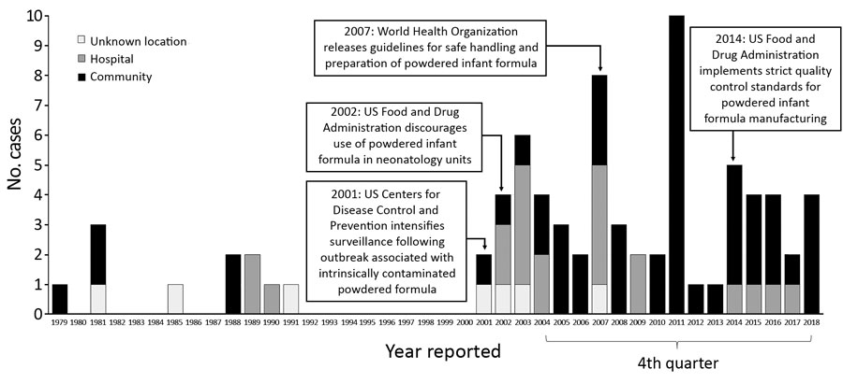
Reported invasive Cronobacter infections among infants, United States, 1979–2018
Strysko et al (Emerging Infectious Diseases, 2020) [1.2]

Slide 29
Cronobacter in adults
Case reports/series in adults [1.3] [1.5]
  Bacteremia
  Hepatobiliary infection
  UTI
  Osteomyelitis
  Aspiration pneumonia
Empiric treatment: depends on which study you read
  Most say it's more friendly than other Enterobacteriaceae [1.4]
  But some say high rates of resistance to ampicillin & cephalosporins [1.3]

Slide 30
Cronobacter in adults
Case reports/series in adults [1.3] [1.5]
  Bacteremia
  Hepatobiliary infection
  UTI
  Osteomyelitis
  Aspiration pneumonia
Empiric treatment: depends on which study you read
  Most say it's more friendly than other Enterobacteriaceae [1.4]
  But some say high rates of resistance to ampicillin & cephalosporins [1.3]
Risk factors
Age
Malignancy
Transplant
Steroids, DM
Cirrhosis, EtOH

Slide 31
Cronobacter in adults
Case reports/series in adults [1.3] [1.5]
  Bacteremia
  Hepatobiliary infection
  UTI
  Osteomyelitis
  Aspiration pneumonia
Empiric treatment: depends on which study you read
  Most say it's more friendly than other Enterobacteriaceae [1.4]
  But some say high rates of resistance to ampicillin & cephalosporins [1.3]
Risk factors
Age
Malignancy
Transplant
Steroids, DM
Cirrhosis, EtOH

Slide 32
A nosocomial infection in adults too?
In one study of 536 patients (321 admitted, 215 outpatient) in Slovakia, Cronobacter strains were isolated from throat & sputum samples of [1.4]
5.3% of patients admitted to the hospital
None of the outpatients
The highest proportion of patients testing positive were in the neurology department (16.7%, n=9), with 8 of these patients being in the neuro ICU
Previous studies also found disproportionately high rates in the mouths of stroke patients
Perhaps due to impaired swallowing

Slide 33
A nosocomial infection in adults too?
In one study of 536 patients (321 admitted, 215 outpatient) in Slovakia, Cronobacter strains were isolated from throat & sputum samples of [1.4]
5.3% of patients admitted to the hospital
None of the outpatients
The highest proportion of patients testing positive were in the neurology department (16.7%, n=9), with 8 of these patients being in the neuro ICU
Previous studies also found disproportionately high rates in the mouths of stroke patients
Perhaps due to impaired swallowing

Slide 34
A nosocomial infection in adults too?
In one study of 536 patients (321 admitted, 215 outpatient) in Slovakia, Cronobacter strains were isolated from throat & sputum samples of [1.4]
5.3% of patients admitted to the hospital
None of the outpatients
The highest proportion of patients testing positive were in the neurology department (16.7%, n=9), with 8 of these patients being in the neuro ICU
Previous studies also found disproportionately high rates in the mouths of stroke patients
Perhaps due to impaired swallowing

Slide 35
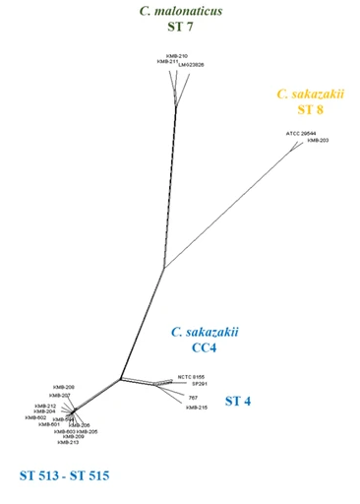
A nosocomial infection in adults too?
They did whole genome sequencing of their isolates [1.4]
12/18 strains belonged to a single clonal complex
Some strains had increased xerotolerance, thermotolerance, and resistance to osmotic stress (all encoded by the same genomic island)

Slide 36
A nosocomial infection in adults too?
They did whole genome sequencing of their isolates [1.4]
12/18 strains belonged to a single clonal complex
Some strains had increased xerotolerance, thermotolerance, and resistance to osmotic stress (all encoded by the same genomic island)

Slide 37
A nosocomial infection in adults too?
They did whole genome sequencing of their isolates [1.4]
12/18 strains belonged to a single clonal complex
Some strains had increased xerotolerance, thermotolerance, and resistance to osmotic stress (all encoded by the same genomic island)

Slide 38
A nosocomial infection in adults too?
They did whole genome sequencing of their isolates [1.4]
12/18 strains belonged to a single clonal complex
Some strains had increased xerotolerance, thermotolerance, and resistance to osmotic stress (all encoded by the same genomic island)
The implication being the same clonal complex was probably:
Circulating in the hospital environment
Spread by food transmission

Slide 39
Case #2

Slide 40
Case 2
A 29 y/o F with PMH including extraskeletal Ewing sarcoma on chemo p/w fevers

Slide 41
Case 2: HPI
A 29 y/o F with PMH including extraskeletal Ewing sarcoma on chemo p/w fevers x1 day
Onset of fevers last night, came to ED within 8 hours
L axillary fullness
  Onset around time of fevers
Left knee slightly warm
  No pain
  No swelling
  Full range of motion

Slide 42
Case 2: HPI
A 29 y/o F with PMH including extraskeletal Ewing sarcoma on chemo p/w fevers x1 day
Onset of fevers last night, came to ED within 8 hours
L axillary fullness
  Onset around time of fevers
Left knee slightly warm
  No pain
  No swelling
  Full range of motion

Slide 43
Case 2: HPI
A 29 y/o F with PMH including extraskeletal Ewing sarcoma on chemo p/w fevers x1 day
Onset of fevers last night, came to ED within 8 hours
L axillary fullness
  Onset around time of fevers
Left knee slightly warm
  No pain
  No swelling
  Full range of motion

Slide 44
Case 2: Background
A 29 y/o F with PMH including extraskeletal Ewing sarcoma on chemo p/w fevers x1 day
Got new chemo 8 days prior to admission (via PICC)
D1 trabectedin
D2 and D4 irinotecan
D5 pegfilgrastim
Onset of fevers last night, came to ED within 8 hours
L axillary fullness
  Onset around time of fevers
Left knee slightly warm
  No pain
  No swelling
  Full range of motion

Slide 45
Case 2: Background
A 29 y/o F with PMH including extraskeletal Ewing sarcoma on chemo (8 days ago got trabectedin, irinotecan via PICC) p/w fevers x1 day
Onset of fevers last night, came to ED within 8 hours
L axillary fullness
  Onset around time of fevers
Left knee slightly warm
  No pain
  No swelling
  Full range of motion
Sarcoma in pelvis caused hydronephrosis, so got ureteral stent (two weeks ago)
ESBL E coli in urine 4 months ago

Slide 46
Case 2: HPI
A 29 y/o F with PMH including extraskeletal Ewing sarcoma on chemo (8 days ago got trabectedin, irinotecan via PICC) , hydronephrosis s/p ureteral stent (two weeks ago), Hx ESBL UTI p/w fevers x1 day
Onset of fevers last night, came to ED within 8 hours
L axillary fullness
  Onset around time of fevers
Left knee slightly warm
  No pain
  No swelling
  Full range of motion
Negative ROS
Oral lesions
Nausea or vomiting
Diarrhea
Blood in stool
Urinary changes (dysuria, frequency, incontinence)

Slide 47
Case 2: Social History, Exposures, Risk Factors
Geographic & Occupational: The patient lives in Paden City, West Virginia w/ her daughter. She denies recent travel.
Substance: They deny alcohol use and she does not use tobacco . They report no recreational drug use
Environmental exposures: They deny soil/landscaping/dust exposure.
Animal Exposures: The patient denies farm animal exposures or other animal exposure (aside from their pet hamster).
Tattoos & Piercing: They have have not gotten unprofessional piercings or tattoos .
Infectious PMH: They deny previous intolerances/allergies to antimicrobials; she denies recent antimicrobial use. They deny history of C. diff infections.

Slide 48
Case 2: Exam
Vitals: Tmax 100 °F (at home) | BP 93/58 | HR 92 | SpO2 98% | BMI 24.64 kg/m²
Gen: alert and oriented, NAD, vitals reviewed
Head/Neck: NCAT; trachea midline, no gross LAD
ENT: EOMI grossly, anicteric sclerae; MMM
Resp: normal respiratory effort, CTAB
CV: RRR; extremities perfused
GI: non-distended; no rebound or guarding
Ext: no clubbing, cyanosis, or edema
Skin: Anterior L knee scab with some erythema
Neuro/MSK: L knee FROM w/o TTP or effusion
Psych: normal mood; appropriate affect

Slide 49
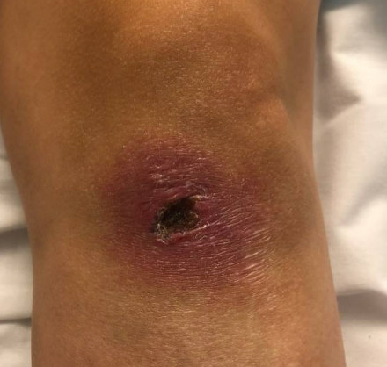
Case 2: Exam
Vitals: Tmax 100 °F (at home) | BP 93/58 | HR 92 | SpO2 98% | BMI 24.64 kg/m²
Gen: alert and oriented, NAD, vitals reviewed
Head/Neck: NCAT; trachea midline, no gross LAD
ENT: EOMI grossly, anicteric sclerae; MMM
Resp: normal respiratory effort, CTAB
CV: RRR; extremities perfused
GI: non-distended; no rebound or guarding
Ext: no clubbing, cyanosis, or edema
Skin: Anterior L knee scab with some erythema
Neuro/MSK: L knee FROM w/o TTP or effusion
Psych: normal mood; appropriate affect

Slide 50
Case 2: Summary
A 29 y/o F with PMH including extraskeletal Ewing sarcoma on chemo (8 days ago got trabectedin, irinotecan via PICC) , hydronephrosis s/p ureteral stent (two weeks ago), Hx ESBL UTI p/w fevers x1 day
Febrile (100 at home)
L axillary fullness
Left knee slightly warm with rash but no pain, swelling

Slide 51
Case 2: Summary
A 29 y/o F with PMH including extraskeletal Ewing sarcoma on chemo (8 days ago got trabectedin, irinotecan via PICC) , hydronephrosis s/p ureteral stent (two weeks ago), Hx ESBL UTI p/w fevers x1 day
Febrile (100 at home)
L axillary fullness
Left knee slightly warm with rash but no pain, swelling
Additional questions?
DDx?
Empiric treatment?

Slide 52
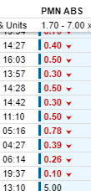
Case 2: Additional HPI & Data
Notably she states she was giving her daughter a bath 24h prior to onset of fever. During the bath, she states that she saw bath water get under the left PICC dressing. Following that, she felt L axillary fullness and fevers so came to ED
Admission

Slide 53


Case 2: Additional HPI & Data
Notably she states she was giving her daughter a bath 24h prior to onset of fever. During the bath, she states that she saw bath water get under the left PICC dressing. Following that, she felt L axillary fullness and fevers so came to ED
Admission

Slide 54
Case 2: Additional HPI & Data
Notably she states she was giving her daughter a bath 24h prior to onset of fever. During the bath, she states that she saw bath water get under the left PICC dressing. Following that, she felt L axillary fullness and fevers so came to ED
Timeline for the rash
She fell and injured her left knee approximately 2-3 weeks
Has had the scab since then (i.e. before developed neutropenia)
Erythema around the scab has been stable

Slide 55
Case 2: Hospital course
A 29 y/o F with PMH including extraskeletal Ewing sarcoma on chemo (8 days ago got trabectedin, irinotecan via PICC) , hydronephrosis s/p ureteral stent (two weeks ago), Hx ESBL UTI p/w fevers x1 day in the context of neutropenia & getting bathwater under PICC dressing
Started on Merrem given Hx of ESBL
PICC removed
BCx from PICC grew Pseudomonas, peripheral culture NGTD
  Got single dose tobramycin pending susceptibilities
Treated for 14 days with cipro 750 BID

Slide 56
Discussion
Links to articles discussed here

Slide 57
Ecthyma gangrenosum
Describe the pathogenesis of Ecthyma gangrenosum
Identify the common (and uncommon) causative pathogens
Review the clinical presentation and progression of lesions
Even though the patient did not have it

Slide 58
Pathogens causing ecthyma gangrenosum
Classically thought to only occur:
With Pseudomonas
In immunocompromised
Review of 167 cases found
73% were P aeruginosa
17% other bacteria
15% fungal
Immune status | Septicemia | P. aeruginosa | Bacterial | Fungal
Compromised | Yes | 32 | 2 | 2
Compromised | No | 41 | 15 | 11
Healthy | Yes | 38 | 0 | 0
Healthy | No | 12 | 12 | 2
Total |  | 123 (73%) | 29 (17%) | 15 (9%)
Adapted from Vaiman et al (2014) [2.1]

Slide 59
Pathogens causing ecthyma gangrenosum
Classically thought to only occur:
With Pseudomonas
In immunocompromised
Review of 167 cases found
73% were P aeruginosa
17% other bacteria
15% fungal
Bacterial
Other Pseudomonas (P cepacia, P maltophilia, P stutzeri)
Aeromonas hydrophila
E coli
Kleb pneumoniae
Citrobacter freundii
Staph aureus
Staph epi
S maltophilia
Strep spp
NTMs
Fungal
Candida (C albicans, C tropicalis)
Mucor pusillus
Fusarium spp
Scytalidium dimidiatum
Metarhizium anisopliae
[2.1][2.2]

Slide 60
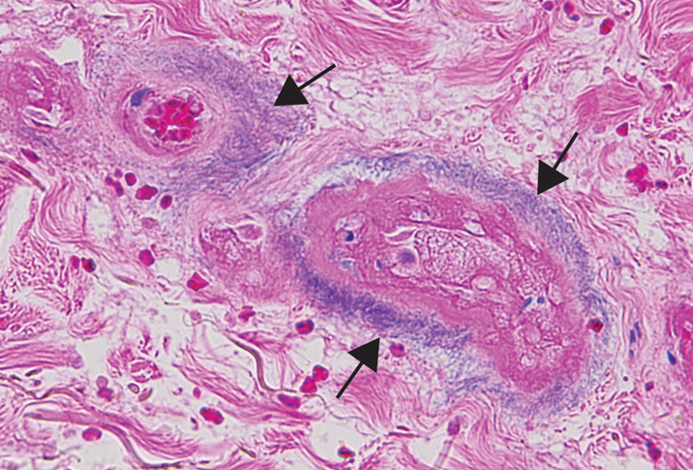
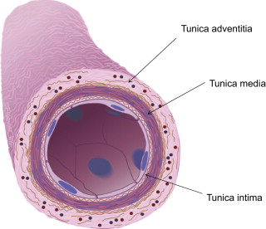
Pathogenesis of ecthyma gangrenosum
Source: Either bacteremia or local infection (breakdown of skin)
Bacteria invade the tunica media & adventitia of blood vessels → causes thrombosis & ischemic necrosis
In the case of Pseudomonas, it is thought that toxins play a direct role in tissue necrosis
  Phospholipase C breaks down phospholipids in cell membranes
  Pyocyanin produces reactive oxygen species
  Elastase degrades elastin and other structural proteins
  Exotoxin A inhibits protein synthesis that cells use to repair tight junction proteins
Basophilic bacterial rods around necrotic vessels (arrows)
doi:10.12788/cutis.0373
Notes:
https://www.mdedge.com/dermatology/article/247594/dermatopathology/tender-annular-plaque-thigh

Slide 61
Pathogenesis of ecthyma gangrenosum
Source: Either bacteremia or local infection (breakdown of skin)
Bacteria invade the tunica media & adventitia of blood vessels → causes thrombosis & ischemic necrosis
In the case of Pseudomonas, it is thought that toxins play a direct role in tissue necrosis
  Phospholipase C breaks down phospholipids in cell membranes
  Pyocyanin produces reactive oxygen species
  Elastase degrades elastin and other structural proteins
  Exotoxin A inhibits protein synthesis that cells use to repair tight junction proteins
Basophilic bacterial rods around necrotic vessels (arrows)
doi:10.12788/cutis.0373
Notes:
https://www.mdedge.com/dermatology/article/247594/dermatopathology/tender-annular-plaque-thigh

Slide 62
Clinical presentation
Most often painless, erythematous macules that rapidly progress to hemorrhagic bullae and necrotic ulcers with a central black eschar
Predisposition to some areas more than others: [2.3]
  Anogenital / perineal (most common)
  Axillary / inguinal
  Extremities
  Truncal lesions are rare (but have been reported)
As discussed before, immunocompromise (especially neutropenia) is the classic risk factor, but has been seen in immunocompetent hosts [2.1] [2.3]

Slide 63
Learning points & take aways

Slide 64
Learning points & take aways
Cronobacter sakazakii is a ubiquitous pathogen that can survive in very dry (xerotolerance) and high heat (thermotolerance) environments
  Including dried food products (e.g. infant formula)
Immunocompromise, including the extremes in age (neonates, elderly) predispose to infections. It is particularly deadly for infants
Cronobacter can cause invasive (bacteremia) and gastrointestinal disease (cholangitis, necrotizing enterocolitis) in both adults and neonates
Although classically associated with neutropenic pseudomonal infections, ecthyma gangrenosum can be seen in immunocompetent hosts and non-pseudomonal bloodstream infections
  Fusarium spp, staph aureus, candida, aeromonas, among others
Ask your patients how long they have had any rashes
Slides available on hunterratliff1.com/talk/; Citations available via QR code or via the “citations” button on the website

