Slide 1

Stomach aches
CLINID conference
Hunter Ratliff
07/31/2025
Ages, dates, and other identifying information may have been changed
I have no conflict of interest in relation to this presentation

Slide 2
Case #1

Slide 3
Case 1: HPI
A 21 y/o M with no PMH p/w sudden onset abdominal pain

Slide 4
Case 1: HPI
A 21 y/o M with no PMH p/w sudden onset abdominal pain
Woke up with severe abdominal pain
  Acute onset 3 hours after eating chicken wings
  Constant pain generalized → worst BLQ
Associated with nausea & emesis
  Threw up over 20 times
  Some diarrhea
No association with urinary symptoms
  No fevers or chills

Slide 5
Case 1: HPI
A 21 y/o M with no PMH p/w sudden onset abdominal pain
Woke up with severe abdominal pain
  Acute onset 3 hours after eating chicken wings
  Constant pain generalized → worst BLQ
Associated with nausea & emesis
  Threw up over 20 times
  Some diarrhea
No association with urinary symptoms
  No fevers or chills
Medical Hx: None
Surgical Hx: None
Medications: None
Social history
WVU student athlete
No drugs, some EtOH
Sexually active with “a few” female partners
  Inconsistent condom use
  No known STI Hx

Slide 6
Case 1: Physical Exam
A 21 y/o M with no PMH p/w sudden onset (3 hours after after eating chicken wings) generalized abdominal pain
Vitals: BP 177/71 | Pulse 109 | Temp 38.1°C (100.6 °F) | Resp 22 | SpO2 97% | BMI 22.7
Gen: In acute distress, uncomfortable, constantly moving in bed
HEENT: NCAT; anicteric sclerae
Resp: Respiratory effort is normal without distress
CV: RRR; no murmur, extremities perfused
GI: abdominal tenderness (in all quadrants), tensing up abdomen and unable to relax
Ext: no clubbing or cyanosis

Slide 7
Case 1: HPI
A 21 y/o M with no PMH p/w sudden onset abdominal pain
Woke up with severe abdominal pain
  Acute onset 3 hours after eating chicken wings
  Constant pain generalized → worst BLQ
Associated with nausea & emesis x20
  Threw up over 20 times
  Some diarrhea
No fevers/chills or urinary symptoms
Otherwise healthy student athlete, drinks some, sexually active
Labs
WBC: 0.8 (ANC <0.10; abs lymph 0.48)
Hgb: 16 Platelets: 250
Glu: 207 HCO3: 18 pH: 7.49
Cr: 0.9 LFTs: Normal
Lactate: 5.1
UA: (+) glucose, (+) ketones
Physical Exam
VS: 38.1°C | 177/71 | 109 bmp
Gen: Uncomfortable, constantly moving in bed
GI: Diffuse TTP, tensing up abdomen, unable to relax

Slide 8
Case 1: HPI
A 21 y/o M with no PMH p/w sudden onset abdominal pain
Woke up with severe abdominal pain
  Acute onset 3 hours after eating chicken wings
  Constant pain generalized → worst BLQ
Associated with nausea & emesis x20
  Threw up over 20 times
  Some diarrhea
No fevers/chills or urinary symptoms
Otherwise healthy student athlete, drinks some, sexually active
Labs
WBC: 0.8 (ANC <0.10; abs lymph 0.48)
Hgb: 16 Platelets: 250
Glu: 207 HCO3: 18 pH: 7.49
Cr: 0.9 LFTs: Normal
Lactate: 5.1
UA: (+) glucose, (+) ketones
Physical Exam
VS: 38.1°C | 177/71 | 109 bmp
Gen: Uncomfortable, constantly moving in bed
GI: Diffuse TTP, tensing up abdomen, unable to relax
Next step?

Slide 9
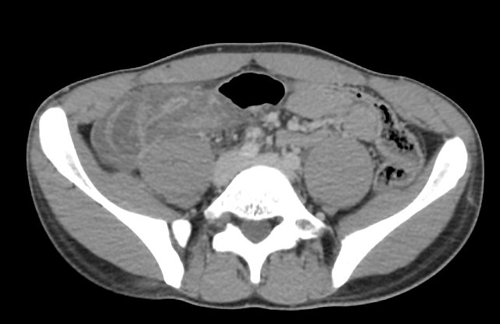
Case 1: Radiographic findings
CT A/P (with contrast)
There is fluid in the distal esophagus. No bowel obstruction. There is a complex, edematous grouping of bowel in the right lower quadrant of the abdomen. The appendix is not clearly defined. There is free fluid in the pelvis and in the right lower quadrant of the abdomen.
IMPRESSION:
Likely acute infectious or inflammatory process of the cecum and terminal ileum, with suspected superimposed ileocolic intussusception. Consider repeat examination with the benefit of enteric contrast as clinically indicated.

Slide 10
Case 1: Operative course
Emergent Ex-lap (acute abdomen = OR now)
Labs
WBC: 0.8 (ANC <0.10; abs lymph 0.48)
Hgb: 16 Platelets: 250
Glu: 207 HCO3: 18 pH: 7.49
Cr: 0.9 LFTs: Normal
Lactate: 5.1
UA: (+) glucose, (+) ketones
Woke up with severe abdominal pain
  Acute onset 3 hours after eating chicken wings
  Constant pain generalized → worst BLQ
Associated with nausea & emesis
Otherwise healthy student athlete, drinks some, sexually active
Physical Exam
VS: 38.1°C | 177/71 | 109 bmp
Gen: Uncomfortable, constantly moving in bed
GI: Diffuse TTP, tensing up abdomen, unable to relax

Slide 11
Case 1: Operative course
Emergent Ex-lap (acute abdomen = OR now)
Procedure:
Exploratory laparotomy
Ileocecectomy with anastomosis
SPY angiography
Resection of ileocolic anastomosis
Temporary abdominal closure with abthera negative pressure vacuum therapy
Operative Report
Peritonitis with 1L transudative ascites, no perforation/contamination, tight ileocolic intussusception not attempted to reduce. Open ileocecectomy with anastomosis

Slide 12
Case 1: Operative course
Emergent Ex-lap (acute abdomen = OR now)
Procedure:
Exploratory laparotomy
Ileocecectomy with anastomosis
SPY angiography
Resection of ileocolic anastomosis
Temporary abdominal closure with abthera negative pressure vacuum therapy
Operative Report
Peritonitis with 1L transudative ascites, no perforation/contamination, tight ileocolic intussusception not attempted to reduce. Open ileocecectomy with anastomosis, ischemia of anastomosis on SPY angiography with persistent lactic acidosis and vasopressor requirement therefore resected anastomosis and left open and in discontinuity

Slide 13
Case 1: Operative course
Returns to OR the next day
Procedure:
RE opening Ex-lap
SPY angiography
Ileocolonic Anastomosis
Partial omentectomy
Fascia & skin closure
Admission
1
Operative Report
Abtherra dressing was removed. Abdomen was irrigated. Small bowel & colonic staple lines appeared well perfused and generally the bowel appeared healthy. Spy angiography showed good uptake in both the small bowel and colon. Did side to side ileocolic anastomosis then closed the common enterotomy. A portion of omentum was noted to be ischemic with thrombosed vessels and this portion was excised using ligasure. Did x-rays which showed no retained sponges or instruments. The fascia & skin were then closed
OR #1 (day 1)
Ileocecectomy w/ intra-op anastomotic ischemia, left open
Zosyn
2
OR #2 (day 2)
Ileocolonic anastomosis, partial omentectomy, bowel closure

Slide 14

How many cIAI have I seen in the past year?
Starter question
Notes:
29 / 330 (around 9%)

Slide 15
[Q1.1] They didn’t consult us, but how long would you give antibiotics?
Assuming patient has good clinical response
Select a number

Slide 16
Case 1: Post-operative course
Event
Day
Ileocecectomy
1
Abd closure
2
Ileocolonic anastomosis, partial omentectomy
Finished 4 days of Zosyn (from source control)
Zosyn
STOP-IT’ed Zosyn
6

Slide 17
Case 1: Post-operative course
Event
Day
Ileocecectomy
1
Abd closure
2
Ileocolonic anastomosis, partial omentectomy
Finished 4 days of Zosyn (from source control)
Shortly after, develops leukocytosis to the 17-20 range
Zosyn
Develops WBC ~20
6

Slide 18
Case 1: Post-operative course
Event
Day
Ileocecectomy
1
Abd closure
2
Ileocolonic anastomosis, partial omentectomy
Finished 4 days of Zosyn (from source control)
Shortly after, develops leukocytosis to the 17-20 range
Then increased diarrhea
  CT A/P (IV contrast only) at this time is unrevealing
Zosyn
Develops WBC ~20
6
↑↑ diarrhea
8
Unrevealing CT A/P

Slide 19
Case 1: Post-operative course
Event
Day
Ileocecectomy
1
Abd closure
2
Ileocolonic anastomosis, partial omentectomy
Finished 4 days of Zosyn (from source control)
Shortly after, develops leukocytosis to the 17-20 range
Then increased diarrhea
  CT A/P (IV contrast only) at this time is unrevealing
Due to ongoing leukocytosis, surgery orders:
C diff screening
Repeat CT scan
(still no antimicrobials)
Zosyn
Develops WBC ~20
6
↑↑ diarrhea
8
Unrevealing CT A/P
More tests!
12

Slide 20
Case 1: Post-operative course
Event
Day
Ileocecectomy
1
Abd closure
2
Ileocolonic anastomosis, partial omentectomy
Finished 4 days of Zosyn (from source control)
Shortly after, develops leukocytosis to the 17-20 range
Then increased diarrhea
  CT A/P (IV contrast only) at this time is unrevealing
Due to ongoing leukocytosis:
Positive C diff → Start PO vanc
Repeat CT scan
Zosyn
Develops WBC ~20
6
↑↑ diarrhea
8
Unrevealing CT A/P
Positive C diff
12
PO Vanc

Slide 21
Case 1: Post-operative course
Event
Day
Ileocecectomy
1
Abd closure
2
Ileocolonic anastomosis, partial omentectomy
Finished 4 days of Zosyn (from source control)
Shortly after, develops leukocytosis to the 17-20 range
Then increased diarrhea
  CT A/P (IV contrast only) at this time is unrevealing
Due to ongoing leukocytosis:
Positive C diff → Start PO vanc
Repeat CT scan → No abscess, maybe colitis, some peritoneal thickening
Zosyn
Develops WBC ~20
6
↑↑ diarrhea
8
Unrevealing CT A/P
Positive C diff
12
CT A/P: No abscess, ?colitis, peritoneal thickening
PO Vanc

Slide 22
Case 1: Post-operative course
Event
Day
Ileocecectomy
1
Abd closure
2
Ileocolonic anastomosis, partial omentectomy
Finished 4 days of Zosyn (from source control)
Shortly after, develops leukocytosis to the 17-20 range
Then increased diarrhea
  CT A/P (IV contrast only) at this time is unrevealing
Due to ongoing leukocytosis:
Positive C diff → Start PO vanc
Repeat CT scan → No abscess, maybe colitis, some peritoneal thickening
Next day, ordered a KUB to check dobhoff…
Zosyn
Develops WBC ~20
6
↑↑ diarrhea
8
Unrevealing CT A/P
Positive C diff
12
CT A/P: No abscess, ?colitis, peritoneal thickening
PO Vanc

Slide 23
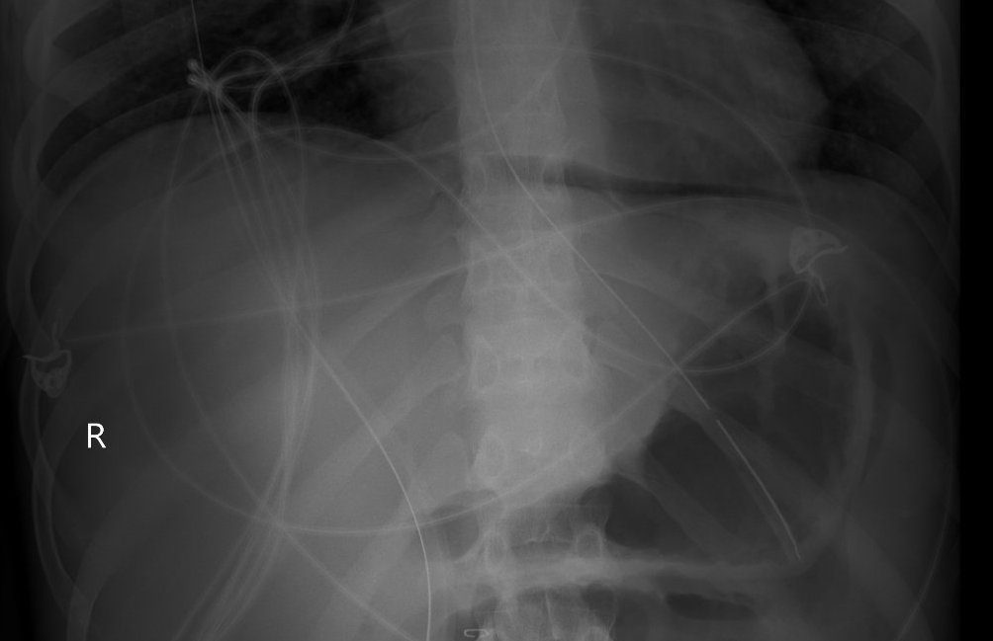
Case 1: Post-operative course
Event
Day
Ileocecectomy
1
Abd closure
2
Ileocolonic anastomosis, partial omentectomy
Finished 4 days of Zosyn (from source control)
Shortly after, develops leukocytosis to the 17-20 range
Then increased ostomy output
  CT A/P (IV contrast only) at this time is unrevealing
Due to ongoing leukocytosis:
Positive C diff → Start PO vanc
Repeat CT scan → No abscess, maybe colitis, some peritoneal thickening
Next day, ordered a KUB to check dobhoff…
Zosyn
Develops WBC ~20
6
↑↑ diarrhea
8
Unrevealing CT A/P
Positive C diff
12
CT A/P: No abscess, ?colitis, peritoneal thickening
PO Vanc

Slide 24
Case 1: Post-operative course
Event
Day
Ileocecectomy
1
Abd closure
2
Ileocolonic anastomosis, partial omentectomy
Finished 4 days of Zosyn (from source control)
Shortly after, develops leukocytosis to the 17-20 range
Then increased ostomy output
  CT A/P (IV contrast only) at this time is unrevealing
Due to ongoing leukocytosis:
Positive C diff → Start PO vanc
Repeat CT scan → No abscess, maybe colitis, some peritoneal thickening
Next day, ordered a KUB to check dobhoff…
Zosyn
Develops WBC ~20
6
↑↑ diarrhea
8
Unrevealing CT A/P
Good placement
Positive C diff
12
CT A/P: No abscess, ?colitis, peritoneal thickening
PO Vanc

Slide 25
Case 1: Post-operative course
Event
Day
Ileocecectomy
1
Abd closure
2
Ileocolonic anastomosis, partial omentectomy
Finished 4 days of Zosyn (from source control)
Shortly after, develops leukocytosis to the 17-20 range
Then increased ostomy output
  CT A/P (IV contrast only) at this time is unrevealing
Due to ongoing leukocytosis:
Positive C diff → Start PO vanc
Repeat CT scan → No abscess, maybe colitis, some peritoneal thickening
Next day, ordered a KUB to check dobhoff…
Zosyn
Develops WBC ~20
6
↑↑ diarrhea
8
Unrevealing CT A/P
Positive C diff
12
CT A/P: No abscess, ?colitis, peritoneal thickening
PO Vanc

Slide 26
Case 1: Post-operative course
Event
Day
Ileocecectomy
1
Abd closure
2
Ileocolonic anastomosis, partial omentectomy
Finished 4 days of Zosyn (from source control)
Shortly after, develops leukocytosis to the 17-20 range
Then increased diarrhea
  CT A/P (IV contrast only) at this time is unrevealing
Due to ongoing leukocytosis:
Positive C diff → Start PO vanc
Repeat CT scan → No abscess, maybe colitis, some peritoneal thickening
↑↑ pneumoperitoneum on KUB → Repeat CT scan
Zosyn
Develops WBC ~20
6
↑↑ diarrhea
8
Unrevealing CT A/P
CT A/P (Day 13)
↑↑ pneumoperitoneum & ↑↑ rim-enhancing fluid/ascites with significant free air adjacent to the ileocolonic anastomosis suspicious for anastomotic leak
Positive C diff
12
Anastomotic leak
PO Vanc
13

Slide 27
Case 1: Post-operative course
Event
Day
Ileocecectomy
1
Abd closure
2
Ileocolonic anastomosis, partial omentectomy
Finished 4 days of Zosyn (from source control)
Shortly after, develops leukocytosis to the 17-20 range
Then increased diarrhea
  CT A/P (IV contrast only) at this time is unrevealing
Due to ongoing leukocytosis:
Positive C diff → Start PO vanc
Repeat CT scan → No abscess, maybe colitis, some peritoneal thickening
↑↑ pneumoperitoneum on KUB → Ex-lap
Zosyn
Develops WBC ~20
6
↑↑ diarrhea
8
Unrevealing CT A/P
Procedure:
Reopening recent exlap
Abdominal washout
Partial omentectomy
Application of Abthera
Operative Report
1.5 L of purulent ascites, foul smelling, no clear evidence of enteric contents. Fibrinous adhesions throughout. Necrotic appearing omentum
Positive C diff
12
OR #3: Ex-lap
PO Vanco
13
CRO + MTZ

Slide 28
[Q1.2] Which pathogens need to be covered?
Friendly Enterobacterales (e.g. ceftriaxone)
Anaerobes
Enterococcus (non-VRE)
Candida (fluconazole)
AmpC / Pseudomonas
ESBL
VRE
Candida (echinocandins)
Scales slider

Slide 29
[Q1.3] Given C diff + perf, would you feel the need to cover C diff outside of the bowel?
Not at all
Flagyl (IV) would suffice
Vancomycin (IV) would suffice
Peritoneal cavity lavage with fidaxomicin!!
Multiple choice, all that apply

Slide 30
Case 1: Post-operative course
We are consulted, and follow him through numerous trips to the OR
Operative Report (#3)
1.5 L of purulent ascites, foul smelling, no clear evidence of enteric contents. Fibrinous adhesions throughout. Necrotic appearing omentum
Procedures: (#3)
Reopening recent exlap
Abdominal washout
Partial omentectomy
Application of Abthera
Ileocecectomy
Abd closure
C diff (+)
Ex-lap #3
WBC
Diarrhea
ID consult
Zosyn
Cefepime + Flagyl
Linezolid
IV Vanco
PO Vanco
Mica
1
2
6
8
12
13
14

Slide 31
Case 1: Post-operative course
We are consulted, and follow him through numerous trips to the OR
Operative Report (#4)
Malodorous purulent ascites with necrotizing peritoneum most notably in the RLQ. Purulent pockets released between loops of small bowel
Procedures: (#4)
Reopening recent exlap
Abdominal washout
Peritoneal debridement
Application of Abthera
Ileocecectomy
Abd closure
C diff (+)
Ex-lap #3
WBC
Diarrhea
Ex-lap #4
Zosyn
Cefepime + Flagyl
Linezolid
IV Vanco
PO Vanco
Mica
1
2
6
8
12
13
14

Slide 32
Case 1: Post-operative course
We are consulted, and follow him through numerous trips to the OR
Operative Report (#5)
Improvement in purulent ascites. There were still multiple interloop fluid pockets and fibrinous exudate. The peritoneum was drastically improved, pink and viable appearing
Procedures: (#5)
Reopening recent exlap
Abdominal washout
Temporary abdominal closure with AbThera
Ileocecectomy
Abd closure
C diff (+)
Ex-lap #3
Ex-lap #4
WBC
Diarrhea
Ex-lap #5
Zosyn
Cefepime + Flagyl
Linezolid
IV Vanco
PO Vanco
Mica
1
2
6
8
12
13
14
15

Slide 33
Case 1: Post-operative course
We are consulted, and follow him through numerous trips to the OR
Operative Report (#6)
Only slightly murky, though nonbilious, fluid in pelvis. Newly appreciated bile staining to loops of small bowel in proximity to RLQ. No enterotomy seen. Anastomosis intact w/ excellent perfusion diffusely. Fascia closed
Procedures: (#6)
Reopening recent exlap
Abdominal washout
Spy angiography
Wound vac application to abdominal wound
Abdominal closure
Ileocecectomy
Abd closure
C diff (+)
Ex-lap #3
Ex-lap #4
Ex-lap #5
WBC
Diarrhea
Ex-lap #6
Zosyn
Cefepime + Flagyl
Linezolid
IV Vanco
PO Vanco
Mica
1
2
6
8
12
13
14
15
16

Slide 34
Case 1: Post-operative course
 | E coli | E faecalis
Ampicillin | Resist | S
Amox/clav | Int | ---
Pip/tazo | S | ---
Cefazolin | Resist | ---
Ceftriaxone | S | ---
Ceftaz | S | ---
Cefepime | S | ---
Carbapenems | S | ---
Quinolones | S | ---
Aminogly | S | Synergy
Tetracycline | Resist | ---
Tigecycline | --- | S
TMP/SMX | S | ---
Daptomycin | --- | S
Linezolid | --- | S
Vancomycin | --- | S
Multiple laparotomies → closure on day 16
Ex-lap #3: Day 13
3+ Strep Anginosus
2+ E faecalis
2+ E coli
3+ Mixed anaerobes
Ex-lap #4: Day 14
1+ Strep Anginosus
2+ E faecalis
2+ E coli
2+ Mixed anaerobes
Ex-laps #5 & 6:
No micro sent
Ileocecectomy
Abd closure
C diff (+)
Abd closure
WBC
Diarrhea
OR #3
Ex-lap #5
OR #4
Zosyn
Cefepime + Flagyl
 | Anaerobes | Strep anginosus
No suscept | --- | ---
Linezolid
IV Vanco
PO Vanco
Mica
1
2
6
8
12
13
14
15
16

Slide 35
[Q1.4] Minimum duration of therapy
4 +/- 1 days
1 week
2 weeks
3-4 weeks
Multiple choice

Slide 36
[Q1.5] What will guide your decision to stop antimicrobials?
Resolution of WBC
Normalizing the CRP
Fever free
Radiographic findings
“Vibes”
Assign 100 points

Slide 37
Case 1: Post-operative course
From OR #3 | E coli | E faecalis
Ampicillin | Resist | S
Amox/clav | Int | ---
Pip/tazo | S | ---
Ceftriaxone | S | ---
Cefepime | S | ---
Carbapenems | S | ---
Quinolones | S | ---
Aminogly | S | Synergy
Tetracycline | Resist | ---
Daptomycin | --- | S
Linezolid | --- | S
Vancomycin | --- | S
3+ Strep anginosus
3+ Mixed anaerobes
Concerns that enteric contents may be coming from one of the JP drains..?
Ileocecectomy
Abd closure
C diff (+)
Abd closure
Ex-lap #3
Ex-lap #4
WBC
Diarrhea
Ex-lap #5
Zosyn
Cefepime + Flagyl
Linezolid
IV Vanco
End: Day 19
PO Vanco
Micafungin
1
2
6
8
12
13
14
15
16
19

Slide 38
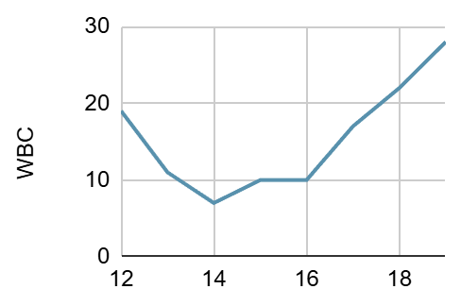
Case 1: Post-operative course
From OR #3 | E coli | E faecalis
Ampicillin | Resist | S
Amox/clav | Int | ---
Pip/tazo | S | ---
Ceftriaxone | S | ---
Cefepime | S | ---
Carbapenems | S | ---
Quinolones | S | ---
Aminogly | S | Synergy
Tetracycline | Resist | ---
Daptomycin | --- | S
Linezolid | --- | S
Vancomycin | --- | S
3+ Strep anginosus
3+ Mixed anaerobes
Concerns that enteric contents may be coming from one of the JP drains..?
Ileocecectomy
Abd closure
C diff (+)
Abd closure
Ex-lap #3
Ex-lap #4
WBC
Diarrhea
Ex-lap #5
Zosyn
Cefepime + Flagyl
Linezolid
IV Vanco
End: Day 19
PO Vanco
Micafungin
1
2
6
8
12
13
14
15
16
19

Slide 39
Case 1: Post-operative course
From OR #3 | E coli | E faecalis
Ampicillin | Resist | S
Amox/clav | Int | ---
Pip/tazo | S | ---
Ceftriaxone | S | ---
Cefepime | S | ---
Carbapenems | S | ---
Quinolones | S | ---
Aminogly | S | Synergy
Tetracycline | Resist | ---
Daptomycin | --- | S
Linezolid | --- | S
Vancomycin | --- | S
3+ Strep anginosus
3+ Mixed anaerobes
Concerns that enteric contents may be coming from one of the JP drains..?
CT A/P (Day 19)
Bilateral drains in the abdomen. Small loculated fluid collection anterior to bladder (might be in the abdominal wall), measures 3.6 x 1.3 x 3.3 cm with small foci of air
Ileocecectomy
Abd closure
C diff (+)
Abd closure
Ex-lap #3
Ex-lap #4
WBC
Diarrhea
Ex-lap #5
CT C/A/P
Zosyn
Cefepime + Flagyl
Linezolid
IV Vanco
End: Day 19
PO Vanco
Micafungin
1
2
6
8
12
13
14
15
16
19

Slide 40
Case 1: After sign off
Sign off recommendations
Stop micafungin
Continue cefepime + Flagyl + Zyvox
  At least 14 days from last OR
  Call back if no source control (did not ask them to call IR)
Continue PO vanc taper for 10 days after finishing systemic antibiotics
CT A/P (Day 19)
3.6 cm loculated collection anterior to bladder
From OR #3 | E coli | E faecalis
Ampicillin | Resist | S
Amox/clav | Int | ---
Pip/tazo | S | ---
Ceftriaxone | S | ---
Cefepime | S | ---
Carbapenems | S | ---
Quinolones | S | ---
Aminogly | S | Synergy
Tetracycline | Resist | ---
Daptomycin | --- | S
Linezolid | --- | S
Vancomycin | --- | S
3+ Strep anginosus
3+ Mixed anaerobes
Ileocecectomy
Abd closure
C diff (+)
Abd closure
Ex-lap #3
Ex-lap #4
Bladder abscess? on CT
WBC
Diarrhea
Ex-lap #5
Zosyn
Cefepime + Flagyl
Linezolid
IV Vanco
End: Day 19
PO Vanco
Micafungin
1
2
6
8
12
13
14
15
16
19

Slide 41
Case 1: After sign off
Sign off recommendations
Stop micafungin
Continue cefepime + Flagyl + Zyvox
  At least 14 days from last OR
  Call back if no source control (did not ask them to call IR)
Continue PO vanc taper for 10 days after finishing systemic antibiotics
CT A/P (Day 19)
3.6 cm loculated collection anterior to bladder
Do you agree with this plan?
From OR #3 | E coli | E faecalis
Ampicillin | Resist | S
Amox/clav | Int | ---
Pip/tazo | S | ---
Ceftriaxone | S | ---
Cefepime | S | ---
Carbapenems | S | ---
Quinolones | S | ---
Aminogly | S | Synergy
Tetracycline | Resist | ---
Daptomycin | --- | S
Linezolid | --- | S
Vancomycin | --- | S
3+ Strep anginosus
3+ Mixed anaerobes
Ileocecectomy
Abd closure
C diff (+)
Abd closure
Ex-lap #3
Ex-lap #4
Bladder abscess? on CT
WBC
Diarrhea
Ex-lap #5
Zosyn
Cefepime + Flagyl
Linezolid
IV Vanco
End: Day 19
PO Vanco
Micafungin
1
2
6
8
12
13
14
15
16
19

Slide 42
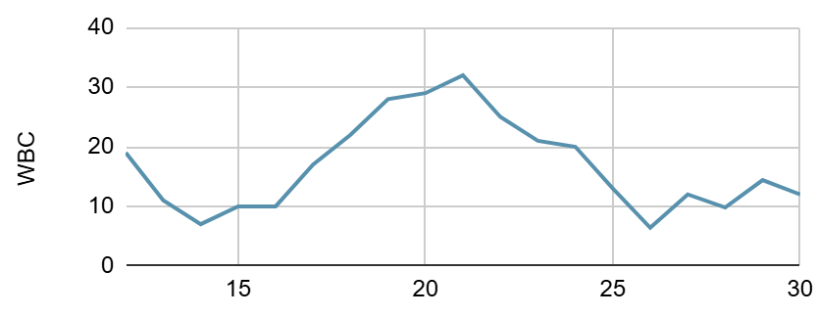
Case 1: After sign off
Sign off
Ileocecectomy
Abd closure
C diff (+)
Abd closure
Ex-lap #3
Ex-lap #4
Bladder abscess? on CT
WBC
Diarrhea
Ex-lap #5
Zosyn
Cefepime + Flagyl
Linezolid
IV Vanco
End: Day 19
PO Vanco
Micafungin
End: Day 25
1
2
6
8
12
13
14
15
16
19
25

Slide 43
Case 1: After sign off
Sign off
Ileocecectomy
Abd closure
C diff (+)
Abd closure
Ex-lap #3
Ex-lap #4
Bladder abscess? on CT
WBC
Diarrhea
Ex-lap #5
Zosyn
Cefepime + Flagyl
Linezolid
IV Vanco
End: Day 19
PO Vanco
Micafungin
End: Day 25
1
2
6
8
12
13
14
15
16
19
25
30

Slide 44
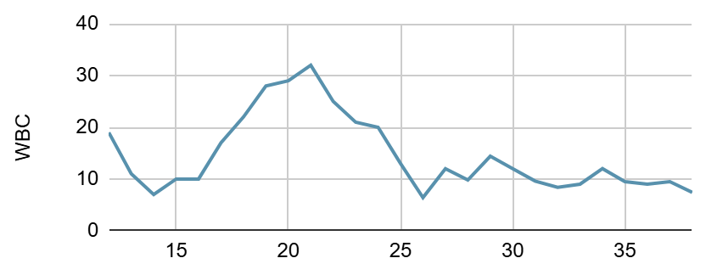
Case 1: After antibiotics finished
Ileocecectomy
Abd closure
C diff (+)
Abd closure
Ex-lap #3
Ex-lap #4
Bladder abscess?
CT
C/A/P
Ex-lap #5
Zosyn
Cefepime + Flagyl
Ended: 14 days from last OR
Linezolid
IV Vanco
End: Day 19
PO Vanco
Micafungin
End: Day 25
1
2
13
16
19
25
30
34

Slide 45
Case 1: After antibiotics finished
CT C/A/P (Day 34)
Still has a few collections, the largest 6.8 x 1.2 cm (but the bladder collection is gone)
Ileocecectomy
Abd closure
C diff (+)
Abd closure
Ex-lap #3
Ex-lap #4
Bladder abscess?
CT
C/A/P
Ex-lap #5
Zosyn
Cefepime + Flagyl
Ended: 14 days from last OR
Linezolid
IV Vanco
End: Day 19
PO Vanco
Micafungin
End: Day 25
1
2
13
16
19
25
30
34

Slide 46
Case 1: After antibiotics finished
Drains removed
Ileocecectomy
Abd closure
C diff (+)
Abd closure
Ex-lap #3
Ex-lap #4
Bladder abscess?
CT
C/A/P
Discharge
Ex-lap #5
Zosyn
Cefepime + Flagyl
Ended: 14 days from last OR
Linezolid
IV Vanco
End: Day 19
PO Vanco
Micafungin
End: Day 25
1
2
13
16
19
25
30
34
38

Slide 47
Case #2

Slide 48
Case 2: Initial care
A 52 y/o F with PMH including metastatic rectal cancer on chemotherapy p/w rectal pain & septic shock

Slide 49
Case 2: Initial care
A 52 y/o F with PMH including metastatic rectal cancer on chemotherapy p/w rectal pain & septic shock
Last dose of chemo (FOLFOX plus Avastin) was 2 days before admission (AKA day 0)
Leukopenic (0.8) and hypotensive on admission → Admitted to SICU
Admission
-2
-1
0
FOLFOX plus Avastin

Slide 50
Case 2: Initial care
A 52 y/o F with PMH including metastatic rectal cancer on chemotherapy p/w rectal pain & septic shock
Last dose of chemo (FOLFOX plus Avastin) was 2 days before admission
Leukopenic (0.8) and hypotensive on admission → Admitted to SICU
CT C/A/P showed rectal perforation
Admission
CT C/A/P (Day 0)
Rectal perforation in patient with known rectal malignancy with free air adjacent to the rectum. Likely extraluminal layering feculent material with localized inflammatory/phlegmon and developing abscess
-2
-1
0
CT
FOLFOX plus Avastin

Slide 51
Case 2: Initial care
A 52 y/o F with PMH including metastatic rectal cancer on chemotherapy p/w rectal pain & septic shock
Last dose of chemo (FOLFOX plus Avastin) was 2 days before admission
Leukopenic (0.8) and hypotensive on admission → Admitted to SICU
CT C/A/P showed rectal perforation → Started on Zosyn
CT C/A/P (Day 0)
Rectal perforation in patient with known rectal malignancy with free air adjacent to the rectum. Likely extraluminal layering feculent material with localized inflammatory/phlegmon and developing abscess
-2
-1
0
Zosyn
FOLFOX plus Avastin

Slide 52
Case 2: Initial care
A 52 y/o F with PMH including metastatic rectal cancer on chemotherapy p/w rectal pain & septic shock
Last dose of chemo (FOLFOX plus Avastin) was 2 days before admission
Leukopenic (0.8) and hypotensive on admission → Admitted to SICU
CT C/A/P showed rectal perforation → Started on Zosyn
Percutaneous drain placed by IR
IR drain
IR
CT C/A/P (Day 0)
Rectal perforation in patient with known rectal malignancy with free air adjacent to the rectum. Likely extraluminal layering feculent material with localized inflammatory/phlegmon and developing abscess
-2
-1
0
Zosyn
FOLFOX plus Avastin

Slide 53
Case 2: Initial care
A 52 y/o F with PMH including metastatic rectal cancer on chemo p/w sepsis from rectal perf
Lap sigmoid colostomy
But they do not an “I&D”
IR
OR
-2
-1
CT
1
Zosyn
CT C/A/P (Day 0)
Rectal perforation w/ free air in mesorectum. Extraluminal layering feculent material with developing abscess
FOLFOX plus Avastin

Slide 54
Case 2: Initial care
A 52 y/o F with PMH including metastatic rectal cancer on chemo p/w sepsis from rectal perf
There was some slightly murky ascites fluid but no pus or stool or evidence of peritoneal contamination…
Lap sigmoid colostomy
But they do not an “I&D”
IR
OR
-2
-1
CT
1
Zosyn
CT C/A/P (Day 0)
Rectal perforation w/ free air in mesorectum. Extraluminal layering feculent material with developing abscess
FOLFOX plus Avastin

Slide 55
Case 2: Initial care
A 52 y/o F with PMH including metastatic rectal cancer on chemo p/w sepsis from rectal perf
There was some slightly murky ascites fluid but no pus or stool or evidence of peritoneal contamination…We proceeded to mobilize the lateral attachments of the sigmoid colon to the inner-sigmoidal fossa and deepened this dissection to mobilize along the white line.
Lap sigmoid colostomy
But they do not an “I&D”
White line of Toldt
The layer of fascia that separates the mesocolon (layer of fatty tissue and connective tissue that surrounds colon) & retroperitoneum
IR
OR
-2
-1
CT
1
Zosyn
CT C/A/P (Day 0)
Rectal perforation w/ free air in mesorectum. Extraluminal layering feculent material with developing abscess
FOLFOX plus Avastin

Slide 56
Case 2: Initial care
A 52 y/o F with PMH including metastatic rectal cancer on chemo p/w sepsis from rectal perf
There was some slightly murky ascites fluid but no pus or stool or evidence of peritoneal contamination…We proceeded to mobilize the lateral attachments of the sigmoid colon to the inner-sigmoidal fossa and deepened this dissection to mobilize along the white line. There was induration/edema underlying this from the perforation that I did not want to unroof so I limited the dissection once we felt that we had good length for a loop colostomy
Lap sigmoid colostomy
But they do not an “I&D”
IR
OR
-2
-1
CT
1
Zosyn
CT C/A/P (Day 0)
Rectal perforation w/ free air in mesorectum. Extraluminal layering feculent material with developing abscess
FOLFOX plus Avastin

Slide 57
Case 2: Post-op
Did well post-op
Off of pressors & transferred out of SICU
IR
OR
CT C/A/P (Day 0)
Rectal perforation w/ free air in mesorectum. Extraluminal layering feculent material with developing abscess
BOWEL: There is free air adjacent to the rectum contains within the subperitoneal space
PERITONEAL CAVITY: Trace free fluid adjacent to the rectum with free peritoneal air
-2
-1
CT
1
2
3
Zosyn
FOLFOX plus Avastin

Slide 58
Case 2: Post-op
BOWEL: No bowel obstruction. Circumferential wall thickening of the mid to distal rectum corresponds to the known rectal malignancy. There are postsurgical changes from creation of an descending loop colostomy.
There is a complex collection of extraluminal fluid and air within the mesorectum which extends posteriorly along the presacral soft tissues which is concerning for rectal perforation with associated abscess/phlegmonous changes. Since [CT on Day 0], there has been interval placement of a transgluteal approach pigtail drain into the left aspect of the mesorectum with decreased complex fluid and air. The largest pocket of residual complex fluid and air measures 5.7 x 3.5 cm.
PERITONEAL CAVITY: No intraperitoneal free air is visible.
CT A/P (Day 5)
Interval placement of drain into the complex perirectal and presacral abscess with mildly decreased size of the complex collection (largest measures 5.7 x 3.5 cm)
IR
OR
CT C/A/P (Day 0)
Rectal perforation w/ free air in mesorectum. Extraluminal layering feculent material with developing abscess
BOWEL: There is free air adjacent to the rectum contains within the subperitoneal space
PERITONEAL CAVITY: Trace free fluid adjacent to the rectum with free peritoneal air
-2
-1
CT
1
2
3
4
CT
Zosyn
FOLFOX plus Avastin

Slide 59
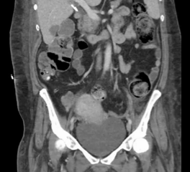
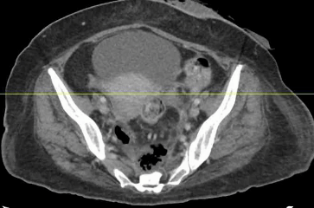
Case 2: Post-op
CT A/P (Day 5)
Interval placement of drain into the complex perirectal and presacral abscess with mildly decreased size of the complex collection (largest measures 5.7 x 3.5 cm)

Slide 60
[Q2.1] Do we have source control? In the sense that...
Teasing out to difference between preventing ongoing contamination, restoring normal anatomy, and eliminating the focus of infection
...no more fecal material is being introduced?
...all of the infected material is out of the abdomen?
...the IR drain will prevent collection from enlarging?
...a JP drain will eventually eliminate the bio-burden?
Likert

Slide 61
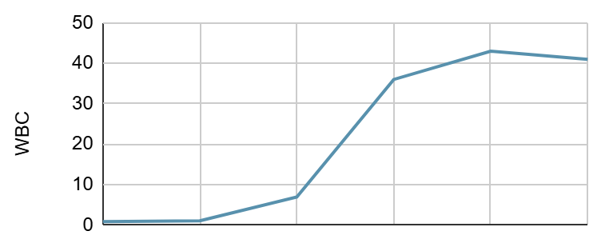
Case 2: Initial care
A 52 y/o F with PMH including metastatic rectal cancer on chemo p/w sepsis from rectal perf
CT A/P (Day 5)
Interval placement of drain into the complex perirectal and presacral abscess with mildly decreased size of the complex collection (largest measures 5.7 x 3.5 cm)
IR
OR
CT C/A/P (Day 0)
Rectal perforation w/ free air in mesorectum. Extraluminal layering feculent material with developing abscess
-2
-1
CT
1
2
3
4
CT
Zosyn
FOLFOX plus Avastin

Slide 62
Case 2: Initial care
IR drain | 3+ E coli | 3+ E coli | 3+ strep mitis | 3+ strep anginosus
Ampicillin | Resist | S | S | S
Amox/clav | S | S | --- | ---
Pip/tazo | S | S | --- | ---
Cefazolin | Resist | --- | --- | ---
Ceftriaxone | S | S | S | S
Ceftaz | S | S | --- | ---
Cefepime | S | S | --- | ---
Carbapenems | S | S | --- | ---
Quinolones | Resist | S | S | S
Aminogly | S | S | --- | ---
Tetracycline | S | S | Resist | S
TMP/SMX | Resist | S | --- | ---
Penicillin | --- | --- | S | S
Vancomycin | --- | --- | S | S
IR
OR
-2
-1
CT
1
2
3
4
CT
Zosyn
FOLFOX plus Avastin

Slide 63
[Q2.2] What to treat with?
Select one:
Unasyn
Ceftriaxone + Flagyl
Zosyn
Cefepime + Flagyl
Carbapenem
Add one or more:
Linezolid
Daptomycin
Antifungals
N/A
Multiple choice, two parts

Slide 64
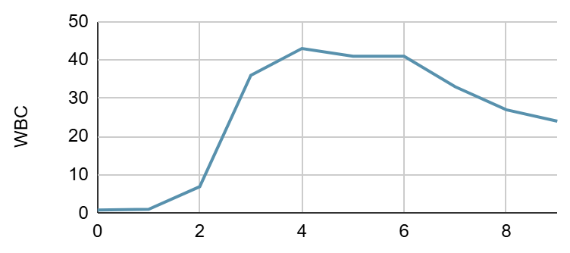
Case 2: Hospital course
A 52 y/o F with PMH including metastatic rectal cancer on chemo p/w sepsis from rectal perf
Sign off recommendations
Four weeks of Zosyn
Call back if worsening WBC
IR
OR
-2
-1
CT
1
2
3
4
CT
6
7
8
9
10
Zosyn
FOLFOX plus Avastin

Slide 65
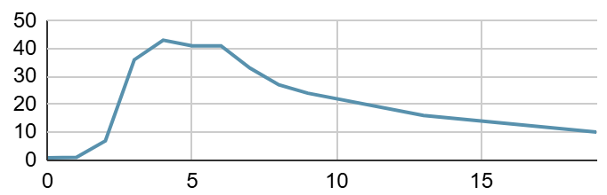
Case 2: OPAT
IR
OR
CT
1
2
3
4
CT
6
7
8
9
OPAT
Zosyn

Slide 66
Case 2: OPAT
CT A/P (Day 23)
Residual presacral fluid collection containing air measuring up to 4.5 cm; Otherwise, the extensive perirectal collections with air are significantly decreased in size
CT A/P (Day 5)
Interval placement of drain into the complex perirectal and presacral abscess with mildly decreased size of the complex collection (largest measures 5.7 x 3.5 cm)
CT A/P (Day 5)
5.7 x 3.5
(23)
IR
OR
5.7 cm x 3.5 cm
4.5 cm x 3.6 cm
CT
1
2
3
4
CT
6
7
8
9
OPAT
CT
Zosyn

Slide 67
Case 2: Readmission
Represents for “pinkish drainage” from ostomy
IR
OR
5.7 cm x 3.5 cm
4.5 cm x 3.6 cm
CT
1
2
3
4
CT
6
7
8
9
OPAT
CT
27
28
29
30
31
Zosyn
(Day 23)

Slide 68
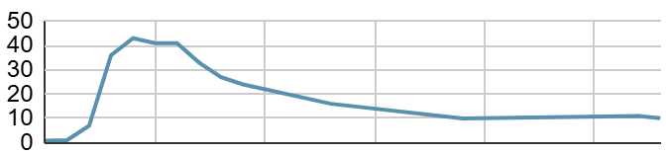
Case 2: Readmission
Represents for “pinkish drainage” from ostomy
  No infectious concerns from patient
IR
OR
5.7 cm x 3.5 cm
4.5 cm x 3.6 cm
CT
1
2
3
4
CT
6
7
8
9
OPAT
CT
27
28
29
30
31
Zosyn
(Day 23)

Slide 69
Case 2: Readmission
Represents for “pinkish drainage” from ostomy
  No infectious concerns from patient
Surg onc reviews recent imaging → not happy with the ongoing collection still being there
They decide to do laparoscopic drainage of pre-sacral abscess
CT A/P (Day 23)
Residual presacral fluid collection containing air measuring up to 4.5 cm; Otherwise, the extensive perirectal collections with air are significantly decreased in size
IR
OR
5.7 cm x 3.5 cm
4.5 cm x 3.6 cm
CT
1
2
3
4
CT
6
7
8
9
OPAT
CT
27
28
29
30
31
Zosyn
(Day 23)

Slide 70



Case 2: Readmission
Represents for “pinkish drainage” from ostomy
  No infectious concerns from patient
Surg onc reviews recent imaging → not happy with the ongoing collection still being there
They decide to do laparoscopic drainage of pre-sacral abscess
  Did not reach out to ID beforehand (i.e. it was their own initiative)
  They sent cultures
  Gold star for Dr Murken!
IR
OR
5.7 cm x 3.5 cm
4.5 cm x 3.6 cm
OR
CT
1
2
3
4
CT
6
7
8
9
OPAT
CT
27
28
29
30
31
Zosyn
(Day 23)

Slide 71
Case 2: Second cultures
OR cultures | 2+ E coli
Ampicillin | Resist
Amox/clav | Inter
Pip/tazo | Resist
Cefazolin | Resist
Ceftriaxone | S
Ceftaz | S
Cefepime | S
Carbapenems | S
Quinolones | Resist
Aminogly | S
Tetracycline | S
TMP/SMX | Resist
Only grew E coli & anaerobes
E coli not susceptible to Zosyn
IR
OR
5.7 cm x 3.5 cm
4.5 cm x 3.6 cm
OR
OR
CT
1
2
3
4
CT
6
7
8
9
OPAT
CT
27
28
29
30
31
Zosyn
(Day 23)

Slide 72
Case 2: Second cultures
OR cultures | 3+ E coli | 3+ E coli | 2+ E coli
Ampicillin | Resist | S | Resist
Amox/clav | S | S | Inter
Pip/tazo | S | S | Resist
Cefazolin | Resist | --- | Resist
Ceftriaxone | S | S | S
Ceftaz | S | S | S
Cefepime | S | S | S
Carbapenems | S | S | S
Quinolones | Resist | S | Resist
Aminogly | S | S | S
Tetracycline | S | S | S
TMP/SMX | Resist | S | Resist
Only grew E coli & anaerobes
E coli not susceptible to Zosyn
Otherwise, quite similar pattern to before
OR Cx
IR
OR
5.7 cm x 3.5 cm
4.5 cm x 3.6 cm
OR
OR
CT
1
2
3
4
CT
6
7
8
9
OPAT
CT
27
28
29
30
31
Zosyn
(Day 23)

Slide 73
[Q2.3] What antibiotic(s) do you want now?
Select one: (stratified by old answers)
Nothing more, she’s done
Ceftriaxone + Flagyl
Zosyn
Cefepime + Flagyl
Carbapenem
Multiple choice

Slide 74
[Q2.4] Duration?
Stop it now
4 +/- 1 days
7-10 days
2 weeks
3-4 weeks
Multiple choice

Slide 75
Case 2: Second hospital course
Switched to ceftriaxone & flagyl
Planned for 10 day course
Had repeat CT (post op day 4) for interval evaluation
CT A/P (Day 32)
Interval changes lap drainage with drain tip now terminating within this presacral collection. Abscess has decreased in size, now measuring 3.3 cm
3.3 cm x 2.0 cm
IR
OR
5.7 cm x 3.5 cm
4.5 cm x 3.6 cm
OR
CT
1
2
3
4
CT
6
7
8
9
OPAT
CT
27
28
29
30
31
CT
33
Zosyn
(Day 23)
CRO
Flagyl

Slide 76
Case 2: Second hospital course
Switched to ceftriaxone & flagyl
Completed 10 day course
Changed to cefpodoxime & flagyl
3.3 cm x 2.0 cm
IR
OR
5.7 cm x 3.5 cm
4.5 cm x 3.6 cm
OR
CT
1
2
3
4
CT
6
7
8
9
OPAT
CT
27
28
29
30
31
CT
33
PO abx
Zosyn
(Day 23)
CRO
Cefpodoxime
Flagyl

Slide 77
Case 2: Resolution
Switched to ceftriaxone & flagyl
Completed 10 day course
Changed to cefpodoxime & flagyl
Had repeat CT (POD #11) i.e. at end of antibiotics
Stable, but ongoing collections
Did okay off of antibiotics
3.3 cm x 2.0 cm
stable
IR
OR
5.7 cm x 3.5 cm
4.5 cm x 3.6 cm
OR
CT
1
2
3
4
CT
6
7
8
9
OPAT
CT
27
28
29
30
31
CT
33
PO abx
39
Zosyn
(Day 23)
CRO
Cefpodoxime
Flagyl

Slide 78
Case #3
(also cancer)

Slide 79
Case 3: HPI
A 43 y/o F with PMH including metastatic cervical cancer p/w possible intra-abdominal infection
Metastatic cervical cancer on palliative chemo & XRT
  Extensive radiation history (so surgery will be off the table)
Tumor burden & bulky lymphadenopathy has caused obstructive uropathy
  s/p neph tubes & stents
Progression of disease on PET/CT from a month ago

Slide 80
Case 3: Backstory
A 43 y/o F with PMH including metastatic cervical cancer (palliative chemo & XRT) c/b obstructive uropathy p/w possible intra-abdominal infection
In the past 6 weeks, multiple admissions for blood loss anemia 2/2 vaginal bleeding

Slide 81
Case 3: Backstory
A 43 y/o F with PMH including metastatic cervical cancer (palliative chemo & XRT) c/b obstructive uropathy p/w possible intra-abdominal infection
In the past 6 weeks, multiple admissions for blood loss anemia 2/2 vaginal bleeding
Most recent admission (1 month ago), massive transfusion protocol in MICU
CTA A/P (-31 days): Venous hemorrhage into uterus
CTA A/P (31 days ago)
Heterogeneous density is within the endometrial cavity, which may represent clotted blood/hematoma

Slide 82
Case 3: Backstory
A 43 y/o F with PMH including metastatic cervical cancer (palliative chemo & XRT) c/b obstructive uropathy p/w possible intra-abdominal infection
In the past 6 weeks, multiple admissions for blood loss anemia 2/2 vaginal bleeding
Most recent admission (1 month ago), massive transfusion protocol in MICU
CTA A/P (-31 days): Venous hemorrhage into uterus
Got IR embolization of bilateral uterine arteries 30 days ago
CTA A/P (31 days ago)
Heterogeneous density is within the endometrial cavity, which may represent clotted blood/hematoma

Slide 83
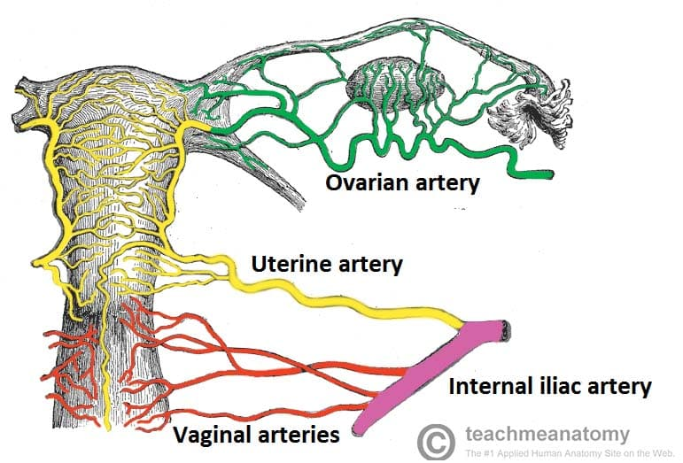
Case 3: Backstory
A 43 y/o F with PMH including metastatic cervical cancer (palliative chemo & XRT) c/b obstructive uropathy p/w possible intra-abdominal infection
In the past 6 weeks, multiple admissions for blood loss anemia 2/2 vaginal bleeding
Most recent admission (1 month ago), massive transfusion protocol in MICU
CTA A/P (-31 days): Venous hemorrhage into uterus
Got IR embolization of bilateral uterine arteries 30 days ago

Slide 84
Case 3: HPI
A 43 y/o F with PMH including metastatic cervical cancer (palliative chemo & XRT) with recent bilateral uterine artery embolization c/b obstructive uropathy p/w possible intra-abdominal infection
Presents for constipation and nausea
WBC 25
CRP 251

Slide 85
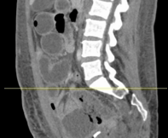
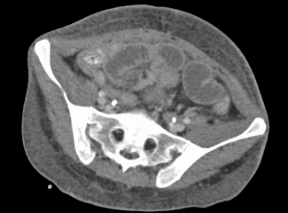
Case 3: HPI
A 43 y/o F with PMH including metastatic cervical cancer (palliative chemo & XRT) with recent bilateral uterine artery embolization c/b obstructive uropathy p/w possible intra-abdominal infection
Presents for constipation and nausea
WBC 25
CRP 251
CT A/P (Admission)
Peripherally enhancing air-containing fluid collection within pelvis, may reflect intraluminal bowel contents, abscess, or additional fluid collection, uncertain etiology on this study. Repeat examination after enteric contrast may be of benefit
There are abnormally distended small bowel loops noted throughout the abdomen, possibly related to developing obstruction. There are decompressed small bowel loops noted within the pelvis which may be due to transient narrowing or underlying stricture, metastatic disease is not excluded

Slide 86
Case 3: HPI
A 43 y/o F with PMH including metastatic cervical cancer (palliative chemo & XRT) with recent bilateral uterine artery embolization c/b obstructive uropathy p/w possible intra-abdominal infection
Colorectal surgery attestation
CT reviewed - expect pelvic abscess is necrotic tumor or uterus s/p embolization. Small bowel likely tethered to this area, though difficult to discern. Vitals normal, not peritonitic. No particular concern for bowel perforation at this point
CT A/P (Admission)
Peripherally enhancing air-containing fluid collection within pelvis, may reflect intraluminal bowel contents, abscess, or additional fluid collection, uncertain etiology on this study. Repeat examination after enteric contrast may be of benefit

Slide 87
Case 3: Hospital course
Treated with Zosyn
IR puts a drain in on day 5
-30
Admission
0
IR
Zosyn
Uterine artery embolization

Slide 88
Can we even obtain source control?
Which communicates with vaginal flora
How should I conceptualize this?
Like a fistula to the outside environment?
Ischemic mesenteric tissue?
Walled off necrosis?
Regular, necrotic tumor?
Bilateral uterine artery embolization
Necrosis of cervix and distal uterus
Ongoing tumor growth
Will not fix
IR drainage
May help with

Slide 89
[Q3.1] Which pathogens need to be covered?
Friendly Enterobacterales (e.g. ceftriaxone)
Anaerobes
Enterococcus (non-VRE)
Candida (fluconazole)
AmpC / Pseudomonas
ESBL
VRE
Candida (echinocandins)
Scales slider

Slide 90
Case 3: Discharge
Treated with Zosyn
IR puts a drain in on day 5
Completes 14 days of treatment with Augmentin
Sign off recommendations
Two weeks of antibiotics
Augmentin is reasonable PO option for discharge
-30
Admission
0
IR
6
Outpatient
Zosyn
Augmentin
End: Day 14
Uterine artery embolization

Slide 91
Case 3: Clinic follow up
Seen in gyn-onc clinic on day 20
-30
Admission
0
IR
6
20
Zosyn
Augmentin
End: Day 14
Uterine artery embolization

Slide 92
Case 3: Clinic follow up
Seen in gyn-onc clinic on day 20
They review cultures from IR drain
IRcultures | 4+ E faecium
Ampicillin | Resist
Daptomycin | SDD
Linezolid | S
Vancomycin | S
-30
Admission
0
IR
6
20
Zosyn
Augmentin
End: Day 14
Uterine artery embolization

Slide 93
Case 3: Clinic follow up
Seen in gyn-onc clinic on day 20
They review cultures from IR drain
Obtain same day CT scan
IRcultures | 4+ E faecium
Ampicillin | Resist
Daptomycin | SDD
Linezolid | S
Vancomycin | S
CT A/P (Day 20)
Persistent but decreased size of the complex collection in the pelvis. The residual collection measures 6.8 x 3.7 cm (prior measurement was 9.1 x 5.6 cm) with the indwelling pigtail percutaneous drain remaining in place within the collection
-30
Admission
0
IR
6
20
Zosyn
Augmentin
End: Day 14
Uterine artery embolization

Slide 94
[Q3.2] Would you change things?
Which antimicrobials?
For how long?
Open ended

Slide 95
Case 3: Clinic follow up
Seen in gyn-onc clinic on day 20
They review cultures from IR drain
Obtain same day CT scan
They discuss with ID → 14 days of dapto + Augmentin
Has a port so was started on OPAT promptly
-30
Admission
0
IR
6
20
Zosyn
Augmentin
End: Day 14
Augmentin
Uterine artery embolization
Dapto

Slide 96
Case 3: Readmission
Admitted to Fairmont for pain refractory to PO meds + fentanyl patch
No new infectious concerns
-30
Admission
0
IR
6
20
Fairmont
29
Zosyn
Augmentin
End: Day 14
Augmentin
Zosyn
Uterine artery embolization
Dapto

Slide 97
Case 3: Readmission
Admitted to Fairmont for pain refractory to PO meds + fentanyl patch
No new infectious concerns
Transferred to Ruby on day 26 → afternoon ID consult
-30
Admission
IR
20
29
35
Ruby
0
6
Fairmont
Zosyn
Augmentin
End: Day 14
Augmentin
Zosyn
Uterine artery embolization
Dapto

Slide 98
Case 3: Readmission
Admitted to Fairmont for pain refractory to PO meds + fentanyl patch
No new infectious concerns
Transferred to Ruby on day 26 → afternoon ID consult
Today is day 16 of this round of antibiotics (Dapto + Augmentin/Zosyn)
Is in too much pain for a CT
Labs since leaving the first admission (day 6)
  WBC has remained normal (peak was 11 on day 0)
  Stable CRP elevation (30-50s), from peak of 250s on day 0
Still having drain output
Day 16 of dapto
-30
Admission
IR
20
29
35
Ruby
0
6
Fairmont
Zosyn
Augmentin
End: Day 14
Augmentin
Zosyn
Uterine artery embolization
Dapto

Slide 99
What do we do now???
In addition to goals of care
Day 16 of dapto
-30
Admission
IR
20
29
35
Ruby
0
6
Fairmont
Zosyn
Augmentin
End: Day 14
Augmentin
Zosyn
Uterine artery embolization
Dapto

Slide 100
Case 3: Readmission
Admitted to Fairmont for pain refractory to PO meds + fentanyl patch
No new infectious concerns
Transferred to Ruby on day 26
She looks like she is ready to pass, but still remains treatment oriented
We say that cipro and flagyl are reasonable, though mainly prophylaxing at this point
Duration TBD, 2 weeks (?) or until sees us in clinic
Further goals of care → CMO
-30
Admission
IR
20
29
35
Ruby
0
6
Fairmont
39
Zosyn
Augmentin
End: Day 14
Augmentin
Zosyn
Cipro +
Flagyl
Uterine artery embolization
Dapto

Slide 101

Discussion
Links to articles discussed here

Slide 102
Complicated intra-abdominal infections

Slide 103
STOP-IT
Design: Multicenter, randomized, non-blinded controlled trial
Population: 518 adults with complicated intra-abdominal infections who had adequate source control
Intervention:
Short course: Fixed 4 ± 1 days of antibiotics after source control
Control: Antibiotics until 2 days after resolution of fever, leukocytosis, and ileus (usual duration ~8 days), maximum duration of 10 days
Primary Outcome: Composite of surgical site infection, recurrent intra-abdominal infection, or death within 30 days
Design: Superiority study

Slide 104
STOP-IT
Design: Multicenter, randomized, non-blinded controlled trial
Population: 518 adults with complicated intra-abdominal infections who had adequate source control
Intervention:
Short course: Fixed 4 ± 1 days of antibiotics after source control
Control: Antibiotics until 2 days after resolution of fever, leukocytosis, and ileus (usual duration ~8 days), maximum duration of 10 days
Primary Outcome: Composite of surgical site infection, recurrent intra-abdominal infection, or death within 30 days
Design: Superiority study

Slide 105
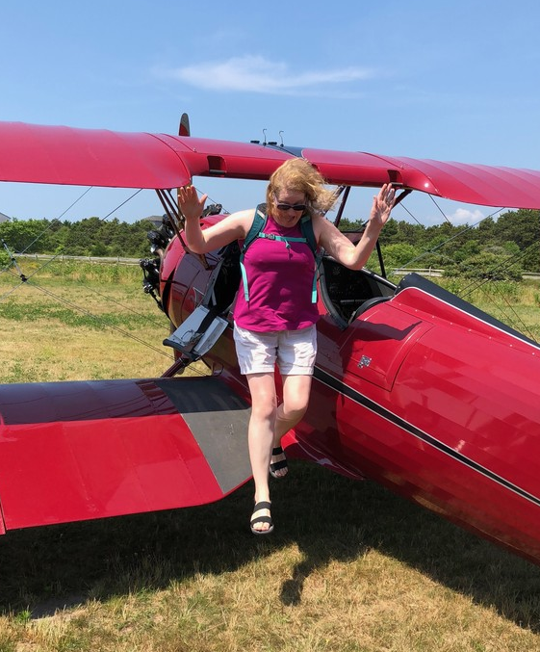
STOP-IT vs PARACHUTE
Refresher on my journal club from March
Randomized, blinded; assessed mortality when jumping from aircraft with a parachute vs empty backpack
Parachute use to prevent death and major trauma when jumping from aircraft: randomized controlled trial
(BMJ, 2018)

Slide 106
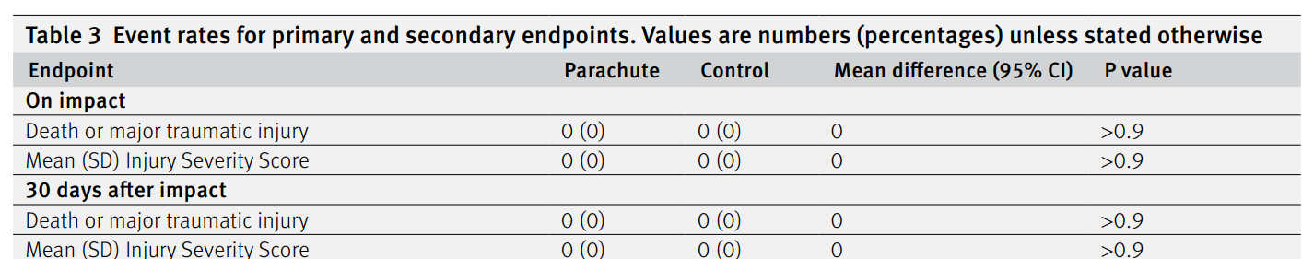
STOP-IT vs PARACHUTE
Refresher on my journal club from March
Randomized, blinded; assessed mortality when jumping from aircraft with a parachute vs empty backpack
No difference in outcomes between two groups at 30 days
  However, only able to enroll subjects who jumped from stationary planes (i.e. low risk group)
Parachute use to prevent death and major trauma when jumping from aircraft: randomized controlled trial
(BMJ, 2018)

Slide 107




STOP-IT vs PARACHUTE
“According to the original sample-size calculation…we calculated that a sample of 505 patients per group would be required to [achieve enough power] to detect a 10% difference in complication rates”
“After the first interim analysis showed nearly identical outcomes in the two cohorts, a…request for continued [funding] to reach the targeted enrollment levels was [denied due] to a concern for futility.”
Control (~8 days)
Short Duration (4 ± 1 days)
260 randomized
257 randomized
71 violated protocol (27%)
46 violated protocol (18%)
Parachute use to prevent death and major trauma when jumping from aircraft: randomized controlled trial
(BMJ, 2018)

Slide 108


STOP-IT vs PARACHUTE
“According to the original sample-size calculation…we calculated that a sample of 505 patients per group would be required to [achieve enough power] to detect a 10% difference in complication rates”
“After the first interim analysis showed nearly identical outcomes in the two cohorts, a…request for continued [funding] to reach the targeted enrollment levels was [denied due] to a concern for futility.”
Control (~8 days)
Short Duration (4 ± 1 days)
260 randomized
257 randomized
71 violated protocol (27%)
46 violated protocol (18%)
58 had outcome (22.3%)
56 had outcome (21.8%)
Parachute use to prevent death and major trauma when jumping from aircraft: randomized controlled trial
(BMJ, 2018)
Absolute difference −0.5%; 95% CI, −7.0 to 8.0; P = 0.92

Slide 109
STOP-IT vs PARACHUTE
When we apply STOP-IT, are we jumping out of a plane without a parachute?
Control (~8 days)
Short Duration (4 ± 1 days)
260 randomized
257 randomized
71 violated protocol (27%)
46 violated protocol (18%)
58 had outcome (22.3%)
56 had outcome (21.8%)
Parachute use to prevent death and major trauma when jumping from aircraft: randomized controlled trial
(BMJ, 2018)
Absolute difference −0.5%; 95% CI, −7.0 to 8.0; P = 0.92

Slide 110
STOP-IT vs PARACHUTE
When we apply STOP-IT, are we jumping out of a plane without a parachute?
Statistically speaking, perhaps
No significant difference ≠ not worse than
That said, the STOP-IT is not the only evidence we have supporting a shorter duration
Control (~8 days)
Short Duration (4 ± 1 days)
260 randomized
257 randomized
71 violated protocol (27%)
46 violated protocol (18%)
58 had outcome (22.3%)
56 had outcome (21.8%)
Parachute use to prevent death and major trauma when jumping from aircraft: randomized controlled trial
(BMJ, 2018)
Absolute difference −0.5%; 95% CI, −7.0 to 8.0; P = 0.92

Slide 111
DURAPOP trial
Short-course antibiotic therapy for critically ill patients treated for postoperative intra-abdominal infection: the DURAPOP randomised clinical trial
Intensive Care Medicine (2018)

Slide 112
DURAPOP trial
Purpose: Investigate duration for post-op cIAI in critically ill patients
Patient population: Adults admitted to the ICU for post-op infections
Must have “source control” assessed at time of enrollment
No immunocompromise (HIV, cancer, chemo)
Outcomes: Antibiotic free days (primary)
Recurrent infection
Need for more surgery / source control
45 day mortality
Emergence of MDRs

Slide 113
DURAPOP trial
Purpose: Investigate duration for post-op cIAI in critically ill patients
Patient population: Adults admitted to the ICU for post-op infections
Must have “source control” assessed at time of enrollment
No immunocompromise (HIV, cancer, chemo)
Methods: Randomized, un-blinded
Enrolled at day zero (source control) but not randomized until day 8
  Avoids over-emphasis on patients where duration of antibiotics would make no difference
Short duration: Stop at day 8
Long duration: Continue 7 more days
Enrolled
Randomized
0
1
2
3
4
5
6
7
8
Stop
9
10
11
12
13
14
15
Stop
Source control
Can drop out or die w/o affecting results

Slide 114
DURAPOP trial
Similar rates of adherence to STOP-IT
Control (15 days) n=116
Shorter (stop at 8) n=120
95 followed protocol (82%)
92 followed protocol (79%)
11 over 15 days (9.5%)
21 prolonged abx (17.5%)
10 under 15 days (8.6%)
4 under 8 days (3.3%)

Slide 115
DURAPOP trial
Similar rates of
Hospital length of stay
30.0 vs 30.5 (OR 0.80) p=0.42
Clinical failure after day 8
14% vs 24% (OR 1.18) p=0.52
Mortality
15% vs 11% (OR 0.71) p=0.43
New antibiotic therapy
39% vs 42% (OR 1.17) p=0.59
Control (15 days)
Shorter (stop at 8)

Slide 116
DURAPOP trial
Similar rates of
Hospital length of stay
30.0 vs 30.5 (OR 0.80) p=0.42
Clinical failure after day 8
14% vs 24% (OR 1.18) p=0.52
Mortality
15% vs 11% (OR 0.71) p=0.43
New antibiotic therapy
39% vs 42% (OR 1.17) p=0.59
Control (15 days)
Shorter (stop at 8)
Higher rates of…
Additional source control
28% vs 40% (OR 1.61) p=0.10
Mainly via percutaneous drains
9% vs 19% (OR 2.26) p=0.04
Bacteremia
4% vs 11% (OR 2.69) p=0.06

Slide 117
DURAPOP trial
Similar rates of
Hospital length of stay
30.0 vs 30.5 (OR 0.80) p=0.42
Clinical failure after day 8
14% vs 24% (OR 1.18) p=0.52
Mortality
15% vs 11% (OR 0.71) p=0.43
New antibiotic therapy
39% vs 42% (OR 1.17) p=0.59
Control (15 days)
Higher rates of…
Recurrent infection (very high)
93% vs 74% (OR 0.22) p=0.21
Emergence of MRDO bacteria
50% vs 43% (OR 0.74) p=0.28
Shorter (stop at 8)
Higher rates of…
Additional source control
28% vs 40% (OR 1.61) p=0.10
Mainly via percutaneous drains
9% vs 19% (OR 2.26) p=0.04
Bacteremia
4% vs 11% (OR 2.69) p=0.06

Slide 118
CABI trial
The CABI Trial: an Unblinded Parallel Group Randomised Controlled Feasibility Trial of Long-Course Antibiotic Therapy (28 Days) Compared with Short Course (≤ 10 Days) in the Prevention of Relapse in Adults Treated for Complicated Intra-Abdominal Infection
Journal of Gastrointestinal Surgery (2021)

Slide 119
CABI trial
Purpose: Pilot trial comparing ≤10 days to 28 days antibiotics for cIAI. Hypothesized that longer is better
Primary outcomes: willingness of participants to be randomised and feasibility of trial procedures
To be counted as a relapse, had to have been off of antibiotics
Assessed at 30 & 90 days
Patient population: Not as clearly defined
Included patients who did not get source control
Had to have fever + neutrophilia + clinical judgement to be cIAI
172 screened → 84 eligible (49%) → 31 enrolled (37%)
Methods: 1:1 randomization, not blinded

Slide 120



CABI trial
Long Duration (28 days)
Short Duration (<10 days)
13 patients included
17 patients included
four stopped early
one lost to follow up
28 days duration
9 days duration

Slide 121




CABI trial
Only group that had relapse was the short duration group
Only adverse events were in the long duration group
Side effect was LFTs (day 20 of Augmentin)
One death was when antibiotics were stopped at day 4
Long Duration (28 days)
Short Duration (<10 days)
13 patients included
17 patients included
four stopped early
one lost to follow up
28 days duration
9 days duration
zero relapse
4 relapses (24%)
1 side effect (7.7%)
1 death (7.7%)
no side effects
no deaths
zero C diff
zero C diff

Slide 122
CABI trial
Key strengths (and weaknesses) revolve around source control
Unique study in that they included those who did not have source control
Short Duration: 6 had no source control (35%)
Long Duration: 2 had no source control (15%)
There were other imbalances in the short duration group
59% were post-op infections (vs 31%)
24% had anastomotic leak (vs 8%)
82% had fluid collections (vs 62%)
Long Duration (28 days)
Short Duration (<10 days)
13 patients included
17 patients included
four stopped early
one lost to follow up
28 days duration
9 days duration
zero relapse
4 relapses (24%)
1 side effect (7.7%)
1 death (7.7%)
no side effects
no deaths
zero C diff
zero C diff
30% of patients in England do not get source control

Slide 123
CABI trial
Key strengths (and weaknesses) revolve around source control
Unique study in that they included those who did not have source control
Short Duration: 6 had no source control (35%)
Long Duration: 2 had no source control (15%)
There were other imbalances in the short duration group
59% were post-op infections (vs 31%)
24% had anastomotic leak (vs 8%)
82% had fluid collections (vs 62%)
Long Duration (28 days)
Short Duration (<10 days)
13 patients included
17 patients included
four stopped early
one lost to follow up
28 days duration
9 days duration
zero relapse
4 relapses (24%)
1 side effect (7.7%)
1 death (7.7%)
no side effects
no deaths
zero C diff
zero C diff
30% of patients in England do not get source control

Slide 124
Learning points & take aways

Slide 125
Learning points & take aways
Complicated intra-abdominal infections are complicated!
Trial data is lacking, and where it does exist, interpretation can be challenging
STOP-IT
  Only had patients with source control
  P > 0.05 ≠ not worse than
DURAPOP
  ICU patients with source control
  P > 0.05 ≠ not worse than
CABI
  Included w/o source control
  But arms of study imbalanced
Slides available on hunterratliff1.com/talk/; Citations available via QR code or via the “citations” button on the website

