Slide 1

Gut Reactions (in TxID)
CLINID conference
Hunter Ratliff
10/30/2025
Ages, dates, and other identifying information may have been changed
I have no conflict of interest in relation to this presentation

Slide 2
Case #1

Slide 3
Case 1: HPI
A 47 y/o F with PMH including ESRD s/p DDKT (2021) p/w diarrhea

Slide 4
Case 1: HPI
A 47 y/o F with PMH including ESRD s/p DDKT (2021) p/w diarrhea
Watery diarrhea x 1 month
  Pretty bad for first week, stable in past 3 weeks
  Never any blood
Associated with stomach cramps, rare nausea

Slide 5
Case 1: HPI
A 47 y/o F with PMH including ESRD s/p DDKT (2021) p/w diarrhea
Watery diarrhea x 1 month
  Pretty bad for first week, stable in past 3 weeks
  Never any blood
Associated with stomach cramps, rare nausea
Unintentional* weight loss of 15 pounds
  *Also started semaglutide (Ozempic) around this time
No food associations, not waking up with diarrhea

Slide 6
Case 1: HPI
A 47 y/o F with PMH including ESRD s/p DDKT (2021) p/w diarrhea
Watery diarrhea x 1 month
  Pretty bad for first week, stable in past 3 weeks
  Never any blood
Associated with stomach cramps, rare nausea
Unintentional* weight loss of 15 pounds
  *Also started semaglutide (Ozempic) around this time
No food associations, not waking up with diarrhea
Was doing “alright” outpatient; only came to the hospital after transplant team found abnormal renal function on outpatient labs

Slide 7
Case 1: Transplant history
A 47 y/o F with PMH including ESRD s/p DDKT (2021) p/w one month of watery diarrhea
Unclear etiology of ESRD (perhaps related to HELLP), was on HD for 7.5 years before transplant
CMV D (-) / R (-) EBV D+/R+ HCV -/-
  S/P routine PPx (3 months of valtrex; 1 year of bactrim)
  No infectious issues
Currently on tacro & cellcept
  No Hx of rejection

Slide 8
Case 1: Social history, exposures, & risk factors
Geographic & Travel | Lives in rural PA with husband & two teenagers. Not around young kids No travel
Occupational | Works in a local diner, where she prepares food Nobody in the home or workplace have been ill
Substance & needles | No EtOH, tobacco, or drugs No needles
Animals | Mainly her pet cat (doesn’t do the litter) Adopted a pet rabbit 2 weeks ago Have chickens & a cow, but she doesn’t interact with them
Exposures | No recent abx No hx of C diff or MDROs

Slide 9
Case 1: Physical exam
Normal exam
BP | 132/84 | Pulse | 77 | SpO2 | 99 %
Temp | 36.9 °C (98.4 °F) | RR | 18 | BMI | 38 kg/m²
General | Alert and oriented, NAD
HEENT | NCAT; trachea appears midline, no gross LAD; EOMI
Resp | Normal respiratory effort, symmetric chest rise
CV | RRR; extremities perfused
GI | Non-distended; no TTP
Extremities | No clubbing, cyanosis, or edema
Neuro/MSK | Moves extremities
Psych | Normal mood; appropriate affect

Slide 10

Case 1: Summary
A 47 y/o F with PMH including ESRD s/p DDKT (2021) p/w one month of watery diarrhea.
No systemic symptoms (besides 15# wt loss)
  Perhaps confounded by Ozempic
Looks good on exam
  Only here because of labs
Cursory exposure history is unrevealing
  Rabbit → Cryptosporidium (?)
Do you want additional HPI info or a GI biofire?

Slide 11
Case 1: Additional HPI
A week before onset of diarrhea, there was major flooding around her home
After the flood, her spring water was cloudy
  They sanitize their water using UV light
  Didn’t boil the water
No issues with her septic tank
  Most of her neighbors also use septic tanks

Slide 12
Case 1: Labs
CBC | Result
WBC | 6.0
Hgb | 10.7
Platelets | 244
Neut % | 76%
Lymph % | 9%
Eos % | 1%
Chem7 | Result
Na | 137
K | 4.1
HCO3 | 17
BUN | 28
Cr | 2.16
Baseline Cr | 0.95

Slide 13
Case 1: Labs
CBC | Result
WBC | 6.0
Hgb | 10.7
Platelets | 244
Neut % | 76%
Lymph % | 9%
Eos % | 1%
Chem7 | Result
Na | 137
K | 4.1
HCO3 | 17
BUN | 28
Cr | 2.16
Baseline Cr | 0.95
Biofire | Result
Adenovirus
Astrovirus
Cyclospora
Campylobacter
Cryptosporidium
E histolytica
E coli
Giardia lamblia
Biofire | Result
Norovirus
Rotavirus
Salmonella spp
Sapovirus
Shigella
Vibrio cholerae
Yersinia spp

Slide 14
[1.1] Guess the biofire
Adenovirus
Astrovirus
Norovirus
Rotavirus or sapovirus
Campylobacter
EAEC / EPEC / ETEC / EIEC
Shigella
Salmonella
Vibrio
Yersinia enterocolitica
E histolytica
Giardia or cryptosporidium

Slide 15
Case 1: Labs
CBC | Result
WBC | 6.0
Hgb | 10.7
Platelets | 244
Neut % | 76%
Lymph % | 9%
Eos % | 1%
Chem7 | Result
Na | 137
K | 4.1
HCO3 | 17
BUN | 28
Cr | 2.16
Baseline Cr | 0.95
Biofire | Result
Adenovirus | Neg
Astrovirus | Neg
Cyclospora | Neg
Campylobacter | Pos
Cryptosporidium | Neg
E histolytica | Neg
E coli | EPEC
Giardia lamblia | Neg
Biofire | Result
Norovirus | Pos
Rotavirus | Neg
Salmonella spp | Neg
Sapovirus | Neg
Shigella | Neg
Vibrio cholerae | Neg
Yersinia spp | Neg

Slide 16
Case 1: Labs
CBC | Result
WBC | 6.0
Hgb | 10.7
Platelets | 244
Neut % | 76%
Lymph % | 9%
Eos % | 1%
Chem7 | Result
Na | 137
K | 4.1
HCO3 | 17
BUN | 28
Cr | 2.16
Baseline Cr | 0.95
Biofire | Result
Adenovirus | Neg
Astrovirus | Neg
Cyclospora | Neg
Campylobacter | Pos
Cryptosporidium | Neg
E histolytica | Neg
E coli | EPEC
Giardia lamblia | Neg
Biofire | Result
Norovirus | Pos
Rotavirus | Neg
Salmonella spp | Neg
Sapovirus | Neg
Shigella | Neg
Vibrio cholerae | Neg
Yersinia spp | Neg
Stool Cx: Campylobacter jejuni
Normal flora, heavy growth on the Campylobacter plate

Slide 17
Case 1: Summary
Treatment?
A 47 y/o F with PMH including ESRD s/p DDKT (2021, CMV -/-) p/w one month of watery diarrhea → AKI. Occurred after recent flooding of her spring water
Biofire: norovirus, Campylobacter, Enteropathogenic E coli
Stool Cx: Campylobacter jejuni
Additional diagnostics?

Slide 18
Case 1: Summary
Treatment?
A 47 y/o F with PMH including ESRD s/p DDKT (2021, CMV -/-) p/w one month of watery diarrhea → AKI. Occurred after recent flooding of her spring water
Biofire: norovirus, Campylobacter, Enteropathogenic E coli
Stool Cx: Campylobacter jejuni
Additional diagnostics?
What to do if worsens or
no improvement?

Slide 19
Case 1: Hospital course
Started antimicrobial therapy:
  Azithromycin 500 q24h x 3 days
  Nitazoxanide 500 q12h x 3 days
Did not test for:
  C diff
  CMV

Slide 20
Case 1: Hospital course
Started antimicrobial therapy:
  Azithromycin 500 q24h x 3 days
  Nitazoxanide 500 q12h x 3 days
Did not test for: C diff, CMV
Reconsulted the next morning since diarrhea had gotten worse
What to do if worsens or
no improvement?

Slide 21
Case 1: Hospital course
Started antimicrobial therapy:
  Azithromycin 500 q24h x 3 days
  Nitazoxanide 500 q12h x 3 days
Did not test for: C diff, CMV
Reconsulted the next morning since diarrhea had gotten worse
Therapeutic ID consult: All better by the time we saw the patient

Slide 22
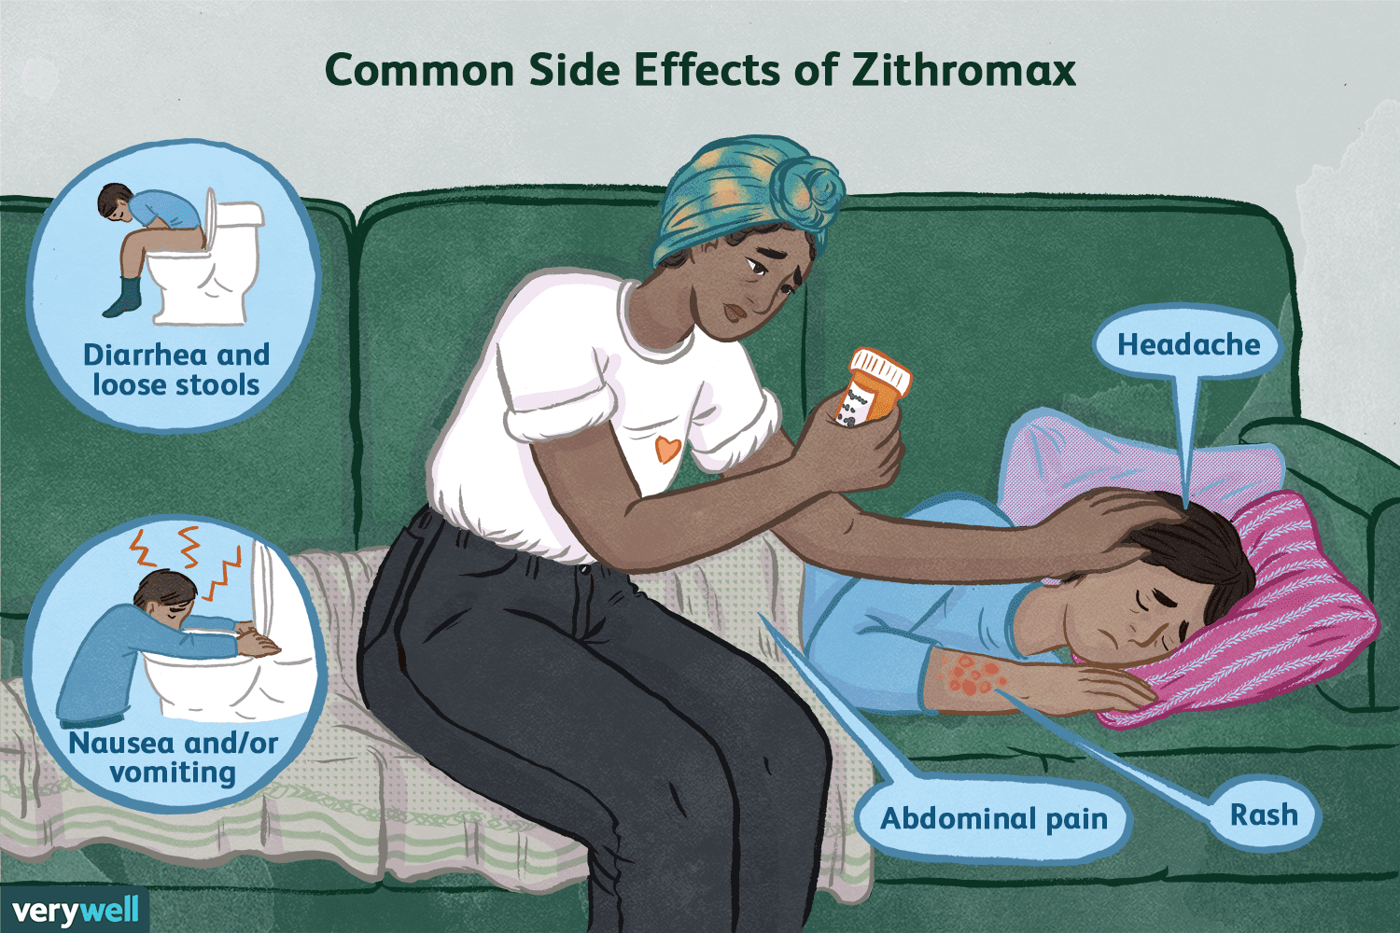
Case 1: Hospital course
Started antimicrobial therapy:
  Azithromycin 500 q24h x 3 days
  Nitazoxanide 500 q12h x 3 days
Did not test for: C diff, CMV
Reconsulted the next morning since diarrhea had gotten worse
Therapeutic ID consult: All better by the time we saw the patient
  Seemed to be transient
  Perhaps related to azithromycin

Slide 23


Case 1: Hospital course
Day 1
Day 2
Day 3
Day 4
Ready to go home by evening of day 2, but found out that we are one dose short of nitazoxanide
Inpatient Pharmacy
Discharge Pharmacy

Slide 24
Case 1: Hospital course
Ready to go home by evening of day 2, but found out that we are one dose short of nitazoxanide
After extensive Epic chats (during the 6pm hour), will be able to get the last dose to Ruby, but will be 24h
So there are two options:
  Stay in the hospital an extra day to get the medication Meds-to-bed
  Discharge home, drive back on day 4 to get last dose from discharge pharmacy
Day 1
Day 2
Day 3
Day 4

Slide 25

What if there is a third choice?

Slide 26
Three choices
Stay in the hospital an extra day
Each day in the hospital has estimated daily risk of…
Adverse drug reaction: 0.5% (1:200)
Infection: 1.6% (1:60)
Ulcer: 0.5% (1:200)
Any AE: ~ 1 in 50
Hauck & Zhao (2011)
PMID 21945976

Slide 27
Three choices
Stay in the hospital an extra day
Drive for 3 hours to pick up dose
Each day in the hospital has estimated daily risk of…
Adverse drug reaction: 0.5% (1:200)
Infection: 1.6% (1:60)
Ulcer: 0.5% (1:200)
Around 0.08% to 0.125% chance of motor vehicle crash
Any AE: ~ 1 in 50
Crash: ~ 1 in 1000
Hauck & Zhao (2011)
PMID 21945976
ChatGPT
(insurance and DOT data)

Slide 28
Three choices
Stay in the hospital an extra day
Drive for 3 hours to pick up dose
Skip the 6th dose
Each day in the hospital has estimated daily risk of…
Adverse drug reaction: 0.5% (1:200)
Infection: 1.6% (1:60)
Ulcer: 0.5% (1:200)
Around 0.08% to 0.125% chance of motor vehicle crash
????
Any AE: ~ 1 in 50
Crash: ~ 1 in 1000
Noro: ???
Hauck & Zhao (2011)
PMID 21945976
ChatGPT
(insurance and DOT data)

Slide 29
[1.2] Which is more dangerous: healthcare, driving or norovirus?

Slide 30
Three choices
Stay in the hospital an extra day
Drive for 3 hours to pick up dose
Skip the 6th dose
Each day in the hospital has estimated daily risk of…
Adverse drug reaction: 0.5% (1:200)
Infection: 1.6% (1:60)
Ulcer: 0.5% (1:200)
Around 0.08% to 0.125% chance of motor vehicle crash
????
Any AE: ~ 1 in 50
Crash: ~ 1 in 1000
Hauck & Zhao (2011)
PMID 21945976
ChatGPT
(insurance and DOT data)

Slide 31
Three choices
Stay in the hospital an extra day
Drive for 3 hours to pick up dose
Skip the 6th dose
Each day in the hospital has estimated daily risk of…
Adverse drug reaction: 0.5% (1:200)
Infection: 1.6% (1:60)
Ulcer: 0.5% (1:200)
Around 0.08% to 0.125% chance of motor vehicle crash
This is what the patient picked
Didn’t keep her follow up with transplant, but seems to have done fine
Any AE: ~ 1 in 50
Crash: ~ 1 in 1000
Hauck & Zhao (2011)
PMID 21945976
ChatGPT
(insurance and DOT data)
No source, but this is what ended up happening

Slide 32
Case #2

Slide 33
Case 2: HPI
A 65 y/o M with PMH including cirrhosis s/p OLT (2 years ago) w/ recurrent C diff p/w fever

Slide 34
Case 2: HPI
A 65 y/o M with PMH including cirrhosis s/p OLT (2 years ago) w/ recurrent C diff p/w fever
Transplant history
NASH cirrhosis w/ portal hypertension, hx SBP
Transplant 20 months ago c/b
  Explant hemorrhage
  DVT
  An episode of C diff
CMV D(neg) / R(neg)
EBV +/+
On tacro

Slide 35
Case 2: HPI
A 65 y/o M with PMH including cirrhosis s/p OLT (2 years ago) w/ recurrent C diff p/w fever
Transplant history
NASH cirrhosis w/ portal hypertension, hx SBP
Transplant 20 months ago c/b
  Explant hemorrhage
  DVT
  An episode of C diff
Splenectomy
Had splenic artery rupture a year ago, requiring splenectomy
…also had C diff at that time

Slide 36
Case 2: Infectious Hx
OLT + CDI
20
A 65 y/o M s/p OLT (2 years ago) w/ recurrent C diff p/w fever
-1.5 yr
19
18
17
16
Transplant history
NASH cirrhosis w/ portal hypertension, hx SBP
Transplant 20 months ago c/b
  Explant hemorrhage
  DVT
  An episode of C diff
15
14
-1 yr
13
12
11
10
9
8
-6 mo
7
6
5
4
3
2
Now
1

Slide 37
Case 2: Infectious Hx
OLT + CDI
20
A 65 y/o M s/p OLT (2 years ago) w/ recurrent C diff p/w fever
After transplant, two more C diff episodes
-1.5 yr
19
18
17
CDI
-15 mo
16
CDI
15
14
-1 yr
13
12
11
10
9
8
-6 mo
7
6
5
4
3
2
Now
1

Slide 38
Case 2: Infectious Hx
OLT + CDI
20
A 65 y/o M s/p OLT (2 years ago) w/ recurrent C diff p/w fever
After transplant, two more C diff episodes
-1.5 yr
19
18
17
CDI
-15 mo
16
CDI
15
Splenectomy
Had splenic artery rupture a year ago, requiring splenectomy
…also had C diff at that time
14
-1 yr
13
Spleen + CDI
12
11
10
9
8
-6 mo
7
6
5
4
3
2
Now
1

Slide 39

Case 2: Infectious Hx
OLT + CDI
20
A 65 y/o M s/p OLT (2 years ago) w/ recurrent C diff p/w fever
In the first 6 months after transplant, 4 episodes : Peritransplant (-20mo), (-16 mo), diverticulitis episode (-14.5 mo), splenectomy (-12 mo)
Episode #5: Insurance still denying fidaxomicin, so started on prolonged vanc taper
-1.5 yr
19
18
17
CDI
-15 mo
16
CDI
15
14
Spleen + CDI
-1 yr
13
12
CDI (vanc taper)
11
-9 mo
10
9
8
-6 mo
7
6
5
4
3
2
Now
1

Slide 40
Case 2: Infectious Hx
OLT + CDI
20
A 65 y/o M s/p OLT (2 years ago) w/ recurrent C diff p/w fever
In the first 6 months after transplant, 4 episodes : Peritransplant (-20mo), (-16 mo), diverticulitis episode (-14.5 mo), splenectomy (-12 mo)
Episode #5: Insurance still denying fidaxomicin, so started on prolonged vanc taper
Gets a fecal microbiota transplant
-1.5 yr
19
18
17
CDI
-15 mo
16
CDI
15
14
Spleen + CDI
-1 yr
13
12
CDI (vanc taper)
11
-9 mo
10
9
FMT
8
-6 mo
7
6
5
4
3
2
Now
1

Slide 41
Case 2: Infectious Hx
OLT + CDI
20
A 65 y/o M s/p OLT (2 years ago) w/ recurrent C diff p/w fever
In the first 6 months after transplant, 4 episodes : Peritransplant (-20mo), (-16 mo), diverticulitis episode (-14.5 mo), splenectomy (-12 mo)
Episode #5: Insurance still denying fidaxomicin, so started on prolonged vanc taper
Gets a fecal microbiota transplant (insurance doesn’t pay for commercial products, so he gets frozen FMT)
-1.5 yr
19
18
17
CDI
-15 mo
16
CDI
15
14
Spleen + CDI
-1 yr
13
12
CDI (vanc taper)
11
-9 mo
10
9
FMT
8
-6 mo
7
6
5
4
3
2
Now
1

Slide 42
Case 2: Infectious Hx
OLT + CDI
20
A 65 y/o M s/p OLT (2 years ago) w/ recurrent C diff p/w fever
In the first 6 months after transplant, 4 episodes : Peritransplant (-20mo), (-16 mo), diverticulitis episode (-14.5 mo), splenectomy (-12 mo)
Episode #5: Insurance still denying fidaxomicin, so started on prolonged vanc taper → FMT #1
4 months later, ED Rx Keflex for toe injury → fulminant C diff → gets FMT #2 (Rebyota)
-1.5 yr
19
18
17
CDI
-15 mo
16
CDI
15
14
Spleen + CDI
-1 yr
13
12
CDI (vanc taper)
11
-9 mo
10
9
FMT
8
-6 mo
7
6
CDI + FMT
5
-3 mo
4
3
2
Now
1

Slide 43
Case 2: Infectious Hx
OLT + CDI
20
A 65 y/o M s/p OLT (2 years ago) w/ recurrent C diff p/w fever
In the first 6 months after transplant, 4 episodes : Peritransplant (-20mo), (-16 mo), diverticulitis episode (-14.5 mo), splenectomy (-12 mo)
Episode #5: Insurance still denying fidaxomicin, so started on prolonged vanc taper → FMT #1
4 months later, ED Rx Keflex for toe injury → fulminant C diff → gets FMT #2 (Rebyota). Doesn’t seem to help so gets prolonged vanc taper → FMT #3 (VOWST)
-1.5 yr
19
18
17
CDI
-15 mo
16
CDI
15
14
Spleen + CDI
-1 yr
13
12
CDI (vanc taper)
11
-9 mo
10
9
FMT
8
-6 mo
7
6
CDI + FMT
5
CDI
-3 mo
4
FMT
3
2
Now
1

Slide 44
Case 2: Infectious Hx
OLT + CDI
20
A 65 y/o M s/p OLT (2 years ago) w/ recurrent C diff p/w fever
In the first 6 months after transplant, 4 episodes : Peritransplant (-20mo), (-16 mo), diverticulitis episode (-14.5 mo), splenectomy (-12 mo)
Episode #5: Insurance still denying fidaxomicin, so started on prolonged vanc taper → FMT #1
4 months later, ED Rx Keflex for toe injury → fulminant C diff → gets FMT #2 (Rebyota). Doesn’t seem to help so gets prolonged vanc taper → FMT #3 (VOWST)
Does well for 6 weeks but then has his eighth episode of C diff → prolonged vanc taper followed by indefinite BID vanco
-1.5 yr
19
18
17
CDI
-15 mo
16
CDI
15
14
Spleen + CDI
-1 yr
13
12
CDI (vanc taper)
11
-9 mo
10
9
FMT
8
-6 mo
7
6
CDI + FMT
5
CDI
-3 mo
4
FMT
3
CDI (vanc ppx)
2
Now
1

Slide 45
Case 2: HPI
OLT + CDI
20
A 65 y/o M with PMH including cirrhosis s/p OLT (2 years ago) w/ recurrent C diff, s/p splenectomy who p/w fever.
Fevers started yesterday
  Tmax 102 F
  Associated rigors & myalgias
-1.5 yr
19
18
17
CDI
-15 mo
16
CDI
15
14
Spleen + CDI
-1 yr
13
12
CDI (vanc taper)
11
-9 mo
10
9
FMT
8
-6 mo
7
6
CDI + FMT
5
CDI
-3 mo
4
FMT
3
CDI (vanc ppx)
2
Now
1

Slide 46
Case 2: HPI
OLT + CDI
20
A 65 y/o M with PMH including cirrhosis s/p OLT (2 years ago) w/ recurrent C diff, s/p splenectomy who p/w fever.
Fevers started yesterday
  Tmax 102 F
  Associated rigors & myalgias
No other symptoms (until he got to the ED)
  Then had headache & photophobia
-1.5 yr
19
18
17
CDI
-15 mo
16
CDI
15
14
Spleen + CDI
-1 yr
13
12
CDI (vanc taper)
11
-9 mo
10
9
FMT
8
-6 mo
7
6
CDI + FMT
5
CDI
-3 mo
4
FMT
3
CDI (vanc ppx)
2
Now
1

Slide 47
Case 2: HPI
OLT + CDI
20
A 65 y/o M with PMH including cirrhosis s/p OLT (2 years ago) w/ recurrent C diff, s/p splenectomy who p/w fever.
Fevers started yesterday
  Tmax 102 F
  Associated rigors & myalgias
No other symptoms (until he got to the ED)
  Then had headache & photophobia
Got vanc + cefepime in ED
  Then started having diarrhea
-1.5 yr
19
18
17
CDI
-15 mo
16
CDI
15
14
Spleen + CDI
-1 yr
13
12
CDI (vanc taper)
11
-9 mo
10
9
FMT
8
-6 mo
7
6
CDI + FMT
5
CDI
-3 mo
4
FMT
3
CDI (vanc ppx)
2
Now
1

Slide 48
Case 2: HPI
OLT + CDI
20
A 65 y/o M with PMH including cirrhosis s/p OLT (2 years ago) w/ recurrent C diff, s/p splenectomy who p/w fever.
Fevers started yesterday
  Tmax 102 F
  Associated rigors & myalgias
No other symptoms (until he got to the ED)
  Then had headache & photophobia
Got vanc + cefepime in ED
  Then started having diarrhea
-1.5 yr
19
18
17
CDI
-15 mo
16
CDI
15
14
Spleen + CDI
-1 yr
Initial thoughts?
Further questions?
13
12
CDI (vanc taper)
11
-9 mo
10
9
FMT
8
-6 mo
7
6
CDI + FMT
5
CDI
-3 mo
4
FMT
3
CDI (vanc ppx)
2
Now
1

Slide 49
Case 2: Social history, exposures, & risk factors
Geographic & Travel | Lives with wife in rural PA close to Maryland border. Traveled to Alaska & Canada a few years ago, but no recent travel
Occupational | On disability, used to work in a quarry
Substance & needles | Rare EtOH use No tobacco or drugs
Animals | Indoor/outdoor cats No bites or scratches

Slide 50
Case 2: Physical exam
BP | 102/50 | Pulse | 63 | SpO2 | 94 %
Temp | 38.3 °C (100.9 °F) | RR | 18 | BMI | 31 kg/m²
General | Alert and oriented, NAD
HEENT | NCAT; trachea appears midline, no gross LAD; EOMI
Resp | Normal respiratory effort, CTAB
CV | RRR; extremities perfused
GI | Non-distended, soft; no TTP
Extremities | No clubbing, cyanosis, or edema; no wounds
Neuro/MSK | Moves extremities, no nuchal rigidity
Psych | Normal mood; appropriate affect

Slide 51
Case 2: Initial thoughts
OLT + CDI
20
-1.5 yr
19
A 65 y/o M with PMH including cirrhosis s/p OLT (2 years ago) w/ recurrent C diff, s/p splenectomy who p/w fever.
Fevers started yesterday, 38.3 in ED
Tmax 102 F at home
Associated rigors & myalgias
No other symptoms (until he got to the ED)
Then had headache & photophobia
Got vanc + cefepime in ED
Then started having diarrhea
18
17
CDI
-15 mo
16
CDI
15
24h before admission
14
Spleen + CDI
-1 yr
13
Fevers + rigors + myalgias
12
CDI (vanc taper)
11
-9 mo
10
Came to ED
9
FMT
8
Headache
+ photophobia
-6 mo
7
6
CDI + FMT
5
CDI
Vanc + cefepime
-3 mo
4
FMT
3
CDI (vanc ppx)
Diarrhea
2
Now
1

Slide 52
Case 2: Further HPI
A 65 y/o M with PMH including cirrhosis s/p OLT (-20 mo) w/ recurrent C diff (s/p FMT x3, on indefinite vanco PPx), s/p splenectomy who p/w one day of fevers (102 F) with associated rigors
Had issues with his outpatient Rx → been off vancomycin for ~4 days
24h before admission
Fevers + rigors + myalgias
Came to ED
Headache
+ photophobia
Vanc + cefepime
Diarrhea

Slide 53
Case 2: Further HPI
A 65 y/o M with PMH including cirrhosis s/p OLT (-20 mo) w/ recurrent C diff (s/p FMT x3, on indefinite vanco PPx), s/p splenectomy who p/w one day of fevers (102 F) with associated rigors
Had issues with his outpatient Rx → been off vancomycin for ~4 days
Both he and his wife clarify, it’s always diarrhea *then* fevers when he has C diff (they don’t think he had C diff before coming in)
24h before admission
Fevers + rigors + myalgias
Came to ED
Headache
+ photophobia
Vanc + cefepime
Diarrhea

Slide 54
Case 2: Further HPI
A 65 y/o M with PMH including cirrhosis s/p OLT (-20 mo) w/ recurrent C diff (s/p FMT x3, on indefinite vanco PPx), s/p splenectomy who p/w one day of fevers (102 F) with associated rigors
Had issues with his outpatient Rx → been off vancomycin for ~4 days
Both he and his wife clarify, it’s always diarrhea *then* fevers when he has C diff (they don’t think he had C diff before coming in)
“I always get a bit of a headache in these hospital beds, and the bright hospital lights always bother me”
He is struggling to keep his eyes open when the lights are turned on for the exam
24h before admission
Fevers + rigors + myalgias
Came to ED
Headache
+ photophobia
Vanc + cefepime
Diarrhea

Slide 55
Case 2: Labs
CBC | Admit | ED | -1d
WBC | 19.1 | 22.3 | 8.8
Hgb | 8.7 | 11.6 | 11.0
Platelets | 261 | 341 | 336
Neut % | 82% | 83% | 67%
Lymph % | 7% | 6% | 13%
Eos % | 7% | 1.3% | 7.8%
From day before admission
Obtained for IV iron infusion
Was feeling well at that time

Slide 56
Case 2: Labs
CBC | Admit | ED | -1d
WBC | 19.1 | 22.3 | 8.8
Hgb | 8.7 | 11.6 | 11.0
Platelets | 261 | 341 | 336
Neut % | 82% | 83% | 67%
Lymph % | 7% | 6% | 13%
Eos % | 7% | 1.3% | 7.8%
Chem7 | Admit | ED | -9d
Na | 140 | 136 | 140
K | 4.3 | 5.6 | 5.6
HCO3 | 17 | 20 | 24
BUN | 55 | 53 | 54
Cr | 2.83 | 2.73 | 2.7
LFTs | Admit | ED | -9d
AST | --- | 25 | 22
ALT | --- | 21 | 18
Alk Phos | --- | 122 | 115
Bili | --- | 0.5 | 0.3
Albumin | --- | 3.6 | 3.8
From day before admission
Obtained for IV iron infusion
Was feeling well at that time

Slide 57
[2.1] Pretest probability of positive C diff screen

Slide 58
[2.2] What antimicrobials to choose?
In addition to IV +/- PO vancomycin

Slide 59
Case 2: Labs
CBC | Admit | ED | -1d
WBC | 19.1 | 22.3 | 8.8
Hgb | 8.7 | 11.6 | 11.0
Platelets | 261 | 341 | 336
Neut % | 82% | 83% | 67%
Lymph % | 7% | 6% | 13%
Eos % | 7% | 1.3% | 7.8%
Chem7 | Admit | ED | -9d
Na | 140 | 136 | 140
K | 4.3 | 5.6 | 5.6
HCO3 | 17 | 20 | 24
BUN | 55 | 53 | 54
Cr | 2.83 | 2.73 | 2.7
LFTs | Admit | ED | -9d
AST | --- | 25 | 22
ALT | --- | 21 | 18
Alk Phos | --- | 122 | 115
Bili | --- | 0.5 | 0.3
Albumin | --- | 3.6 | 3.8
From day before admission
Obtained for IV iron infusion
Was feeling well at that time

Slide 60
Case 2: Labs
CBC | Admit | ED | -1d
WBC | 19.1 | 22.3 | 8.8
Hgb | 8.7 | 11.6 | 11.0
Platelets | 261 | 341 | 336
Neut % | 82% | 83% | 67%
Lymph % | 7% | 6% | 13%
Eos % | 7% | 1.3% | 7.8%
Chem7 | Admit | ED | -9d
Na | 140 | 136 | 140
K | 4.3 | 5.6 | 5.6
HCO3 | 17 | 20 | 24
BUN | 55 | 53 | 54
Cr | 2.83 | 2.73 | 2.7
C diff | Admit
PCR | Pos
Toxin | Pos
LFTs | Admit | ED | -9d
AST | --- | 25 | 22
ALT | --- | 21 | 18
Alk Phos | --- | 122 | 115
Bili | --- | 0.5 | 0.3
Albumin | --- | 3.6 | 3.8
From day before admission
Obtained for IV iron infusion
Was feeling well at that time

Slide 61
Case 2: Initial recommendations
A 65 y/o M with PMH including cirrhosis s/p OLT (-20 mo) w/ recurrent C diff (s/p FMT x3, on indefinite vanco PPx), s/p splenectomy who p/w one day of fevers (102 F) with associated rigors
Diagnostic recommendations
Get CT C/A/P to look for source, most worried about GI
Get head CT
→ → lumbar puncture
Send serum crypto antigen
Therapeutic recommendations
Agree with fidaxomicin for C diff
Continue with vancomycin (watch AKI)
Continue Zosyn
24h before admission
Fevers + rigors + myalgias
Came to ED
Headache
+ photophobia
Vanc + cefepime
Diarrhea

Slide 62
Case 2: Initial recommendations
A 65 y/o M with PMH including cirrhosis s/p OLT (-20 mo) w/ recurrent C diff (s/p FMT x3, on indefinite vanco PPx), s/p splenectomy who p/w one day of fevers (102 F) with associated rigors
Diagnostic recommendations
Get CT C/A/P → normal. Rectal wall thickening consistent with diarrheal infection
Get head CT → normal
→ → lumbar puncture → delayed
Send serum crypto antigen → negative
Therapeutic recommendations
Agree with fidaxomicin for C diff
Continue with vancomycin (watch AKI)
Continue Zosyn
24h before admission
Fevers + rigors + myalgias
Came to ED
Headache
+ photophobia
Vanc + cefepime
Diarrhea

Slide 63
Case 2: Initial recommendations
A 65 y/o M with PMH including cirrhosis s/p OLT (-20 mo) w/ recurrent C diff (s/p FMT x3, on indefinite vanco PPx), s/p splenectomy who p/w one day of fevers (102 F) with associated rigors
Diagnostic recommendations
Get CT C/A/P → normal.
Get head CT → normal
→ → lumbar puncture → delayed
Send serum crypto antigen → negative
By day 3, he feels totally back to normal (& fever free)
Therapeutic recommendations
Agree with fidaxomicin for C diff
Continue with vancomycin (watch AKI)
Continue Zosyn
24h before admission
Fevers + rigors + myalgias
Came to ED
Headache
+ photophobia
Vanc + cefepime
Diarrhea

Slide 64
Case 2: Timing of symptoms
A 65 y/o M with PMH including cirrhosis s/p OLT (-20 mo) w/ recurrent C diff (s/p FMT x3, on indefinite vanco PPx), s/p splenectomy who p/w one day of fevers (102 F) with associated leukocytosis & fevers on admission
Blood cultures stay negative, and he does quite well on vanc/zosyn
48h before admission
IV iron
24h later
Fevers + rigors + myalgias
The IV iron
During his first IV iron infusion he felt itchy
The most recent infusion was his second infusion
Came to ED
Headache
+ photophobia
Vanc + cefepime
Diarrhea

Slide 65
Case 2: Timing of symptoms
A 65 y/o M with PMH including cirrhosis s/p OLT (-20 mo) w/ recurrent C diff (s/p FMT x3, on indefinite vanco PPx), s/p splenectomy who p/w one day of fevers (102 F) with associated leukocytosis & fevers on admission
Blood cultures stay negative, and he does quite well on vanc/zosyn
48h before admission
IV iron
24h later
Fevers + rigors + myalgias
The IV iron
During his first IV iron infusion he felt itchy
The most recent infusion was his second infusion
Doing better
Back to normal on fidaxomicin, vancomycin, and Zosyn
Never got an LP though…
Came to ED
Headache
+ photophobia
Vanc + cefepime
Diarrhea

Slide 66
Case 2: Treatment course
A 65 y/o M with PMH including cirrhosis s/p OLT (-20 mo) w/ recurrent C diff (s/p FMT x3, on indefinite vanco PPx), s/p splenectomy who p/w one day of fevers (102 F) with associated leukocytosis & fevers on admission
Only localizing symptoms were CNS +/- GI
Wanted LP but got better within 24h hours → LP deferred
Diarrhea only after abx → better w/ few days of fidaxomicin
48h before admission
IV iron
24h later
Fevers + rigors + myalgias
Came to ED
Headache
+ photophobia
Vanc + cefepime
Diarrhea

Slide 67
Case 2: Treatment course
A 65 y/o M with PMH including cirrhosis s/p OLT (-20 mo) w/ recurrent C diff (s/p FMT x3, on indefinite vanco PPx), s/p splenectomy who p/w one day of fevers (102 F) with associated leukocytosis & fevers on admission
Only localizing symptoms were CNS +/- GI
Wanted LP but got better within 24h hours → LP deferred
Diarrhea only after abx → better w/ few days of fidaxomicin
With negative BCx, pan-CT, crypto Ag, & prompt resolution of Sx, the benefits of IV antibiotics outweighed by risks with C diff
Stopped vanc/zosyn & watched off abx → did well
Fidaxomicin in house → PO vanc on d/c (because of insurance)
48h before admission
IV iron
24h later
Fevers + rigors + myalgias
Came to ED
Headache
+ photophobia
Vanc + cefepime
Diarrhea

Slide 68

Discussion
Links to articles discussed here

Slide 69
Learning objectives
Recognize some pitfalls of molecular testing for infectious diarrhea, per the 2017 IDSA guidelines
Review Campylobacter enteritis in kidney transplants, with a focus on treatment and risk factors
Appraise the literature regarding treatment of norovirus in solid organ transplant
Evaluate if delayed fever from IV iron may have been the cause of case #2's fever

Slide 70
Molecular testing of infectious diarrhea
Recognize some pitfalls of molecular testing for infectious diarrhea, per the 2017 IDSA guidelines
Review Campylobacter enteritis in kidney transplants, with a focus on treatment and risk factors
Appraise the literature regarding treatment of norovirus in solid organ transplant
Evaluate if delayed fever from IV iron may have been the cause of case #2's fever

Slide 71

IDSA 2017: Infectious diarrhea diagnostics ^{[1]}
Culture independent diagnostic modalities are double-edged sword
Advantages: May be faster diagnosis → quicker treatment, decreased time in the hospital, maybe saves money

Slide 72
IDSA 2017: Infectious diarrhea diagnostics ^{[1]}
Culture independent diagnostic modalities are double-edged sword
Recommendation #14
Clinical consideration should be included in the interpretation of results of multiple-pathogen nucleic acid amplification tests because these assays detect DNA and not necessarily viable organisms

Slide 73
IDSA 2017: Infectious diarrhea diagnostics ^{[1]}
Culture independent diagnostic modalities are double-edged sword
Recommendation #14
Clinical consideration should be included in the interpretation of results of multiple-pathogen nucleic acid amplification tests because these assays detect DNA and not necessarily viable organisms
Additional HPI
Onset of symptoms a week after flooding
  Spring water looked murky
Many of neighbors have septic tanks
Some farms around
Clinical Hx must fit, especially when PCR is poly-positive
Biofire | Result | Does Hx fit?
Campylobacter | Pos | ???
E coli | EPEC | ???
Norovirus | Pos | ???

Slide 74
IDSA 2017: Infectious diarrhea diagnostics ^{[1]}
Culture independent diagnostic modalities are double-edged sword
Recommendation #14
Clinical consideration should be included in the interpretation of results of multiple-pathogen nucleic acid amplification tests because these assays detect DNA and not necessarily viable organisms
Recommendation #15
All specimens that test positive for bacterial pathogens by culture-independent diagnostic testing…(gastrointestinal tract panels)...should be cultured in the clinical laboratory

Slide 75
IDSA 2017: Infectious diarrhea diagnostics ^{[1]}
Culture independent diagnostic modalities are double-edged sword
Recommendation #14
Clinical consideration should be included in the interpretation of results of multiple-pathogen nucleic acid amplification tests because these assays detect DNA and not necessarily viable organisms
Recommendation #15
All specimens that test positive for bacterial pathogens by culture-independent diagnostic testing…(gastrointestinal tract panels)...should be cultured in the clinical laboratory
Multiple reasons to culture:
Outbreak investigation
Confirming viable pathogens
Susceptibility testing

Slide 76

IDSA 2017: Infectious diarrhea diagnostics ^{[1]}
Culture independent diagnostic modalities are double-edged sword
Recommendation #14
Clinical consideration should be included in the interpretation of results of multiple-pathogen nucleic acid amplification tests because these assays detect DNA and not necessarily viable organisms
Recommendation #15
All specimens that test positive for bacterial pathogens by culture-independent diagnostic testing…(gastrointestinal tract panels)...should be cultured in the clinical laboratory
Multiple reasons to culture:
Outbreak investigation
Confirming viable pathogens
Susceptibility testing
Should this be a reflex order?
At least for Campy?

Slide 77
Campylobacter enteritis
Recognize some pitfalls of molecular testing for infectious diarrhea, per the 2017 IDSA guidelines
Review Campylobacter enteritis in kidney transplants, with a focus on treatment and risk factors
Appraise the literature regarding treatment of norovirus in solid organ transplant
Evaluate if delayed fever from IV iron may have been the cause of case #2's fever

Slide 78
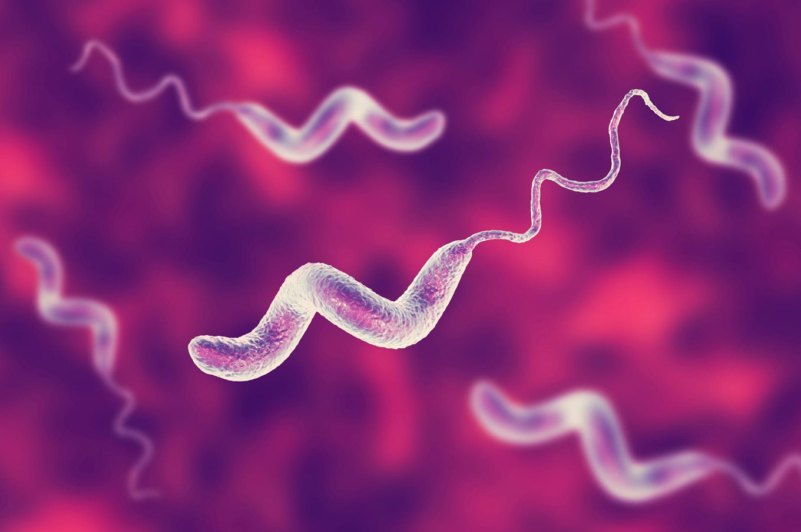
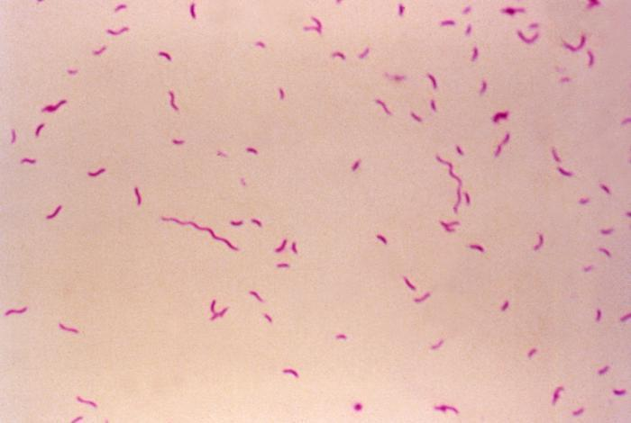
Campylobacter
Motile, comma shaped, gram negative rod
  Kampulos (Greek) = ‘bent’

Slide 79
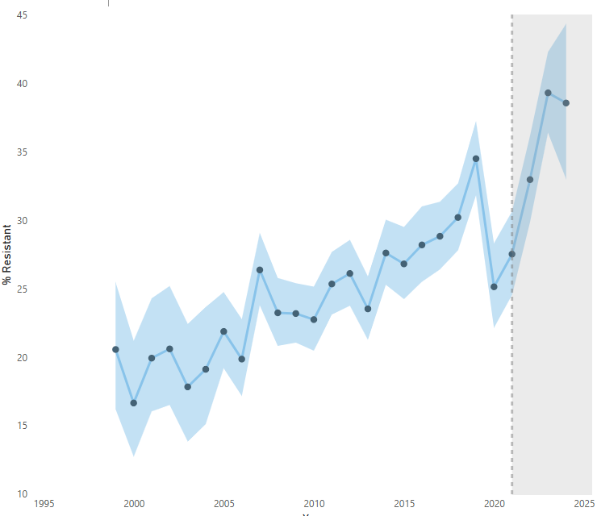
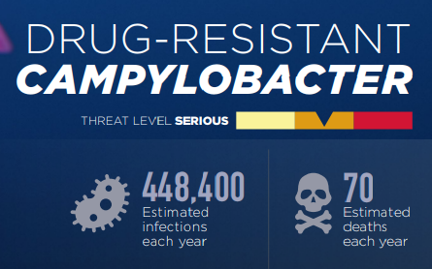
Campylobacter
Motile, comma shaped, gram negative rod
  Kampulos (Greek) = ‘bent’
Over 1 in 3 isolates tested by CDC are resistant to fluoroquinolones [2]
40%
30%
20%
2000
2010
2020
2025

Slide 80
Campylobacter
Motile, comma shaped, gram negative rod
  Kampulos (Greek) = ‘bent’
Over 1 in 3 isolates tested by CDC are resistant to fluoroquinolones [2]
Macrolides are drug of choice
  Highly suggest susceptibility testing
40%
30%
20%
2000
2010
2020
2025

Slide 81
Campylobacter in kidney transplant ^{[3]}
Campylobacter is one of the most common bacterial causes of diarrhea in kidney transplants, as highlighted in large matched case-control by Bos et al (Open Forum Infect Dis, 2024)

Slide 82
Campylobacter in kidney transplant ^{[3]}
Campylobacter is one of the most common bacterial causes of diarrhea in kidney transplants, as highlighted in large matched case-control by Bos et al (Open Forum Infect Dis, 2024)
Patient population: 10 year, multicenter retrospective review of 9 French centers
Case definition: Positive culture for campylobacter
  Stool culture (91%)
  Stool PCR (5.8%)
  Blood culture (4.9%)

Slide 83
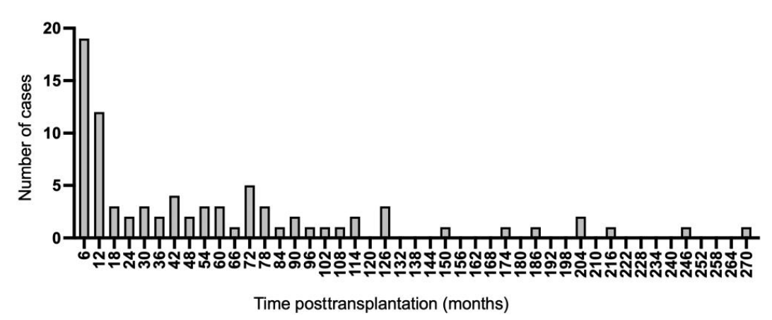
Campylobacter in kidney transplant ^{[3]}
Campylobacter is one of the most common bacterial causes of diarrhea in kidney transplants, as highlighted in large matched case-control by Bos et al (Open Forum Infect Dis, 2024)
Median onset: 2.4 years after transplant
Our patient (5 years)

Slide 84
Campylobacter in kidney transplant ^{[3]}
Campylobacter is one of the most common bacterial causes of diarrhea in kidney transplants, as highlighted in large matched case-control by Bos et al (Open Forum Infect Dis, 2024)
Patient population: 10 year, multicenter retrospective review of 9 French centers
Case definition: Positive culture for campylobacter
  Stool culture (91%)
  Stool PCR (5.8%)
  Blood culture (4.9%)
Cases (n=326) were matched to controls (KT without campylobacter; n=326) at the same center based on date of transplant (+/- 3 months) and similar graft function

Slide 85
Campylobacter in kidney transplant ^{[3]}
Table 1, select variables | Cases | Controls | Odd Ratio | P value
Age | 58 | 55 | 1.01 | 0.071
Cancer | 21% | 14% | 1.62 | 0.021
Rejection in past year
Acute | 8.9% | 4.0% | 2.27 | 0.005
ABMR | 4.0% | 0.9% | 4.65 | 0.007
Tx’ed w/ steroids | 6.7% | 3.0% | 2.36 | 0.022
Maintenance IS
mTORi | 14% | 9.8% | 1.54 | 0.075
Steroids | 76% | 66% | 14.71 | <0.001
Lymphocytes count | 960 | 1400 | 0.42 | <0.001
Baseline eGFR | 44.2 | 57.5 | 0.97 | <0.001

Slide 86
Campylobacter in kidney transplant ^{[3]}
Are steroids the risk factor?
Table 1, select variables | Cases | Controls | Odd Ratio | P value
Age | 58 | 55 | 1.01 | 0.071
Cancer | 21% | 14% | 1.62 | 0.021
Rejection in past year
Acute | 8.9% | 4.0% | 2.27 | 0.005
ABMR | 4.0% | 0.9% | 4.65 | 0.007
Tx’ed w/ steroids | 6.7% | 3.0% | 2.36 | 0.022
Maintenance IS
mTORi | 14% | 9.8% | 1.54 | 0.075
Steroids | 76% | 66% | 14.71 | <0.001
Lymphocytes count | 960 | 1400 | 0.42 | <0.001
Baseline eGFR | 44.2 | 57.5 | 0.97 | <0.001
Steroids
Campy
Or is it driven by rejection?
Steroids
Rejection
Campy
Lower GFR

Slide 87
Campylobacter in kidney transplant ^{[3]}
Table 2: Multivariable analyses
Variable | aOR | 95% CI | P value
Corticosteroids | 10.22 | 4.2 - 30.8 | <0.001
Acute rejection | 2.20 | 1.03 - 4.95 | 0.021
Lower lymphocytes count | 2.10 | 1.53 - 2.95 | <0.001
Lower baseline eGFR | 1.03 | 1.02 - 1.04 | <0.001
Steroids
Rejection
Campy
Lower GFR

Slide 88
Campylobacter in kidney transplant ^{[3]}
One in four patients had a co-infection (n=82)
CMV (7.7%; n=25)
Other diarrheal infections (5.3%; n=19)
  Norovirus (n=9)
  C diff (n=3)
  Rotavirus or sapovirus (n=3)
  Adenovirus (n=3)

Slide 89
Campylobacter in kidney transplant ^{[3]}
Table 4: First line treatment
Treatment | Cases | Resistance | Duration
Fluoroquinolones | 21% (n=64) | 51% (24/47) | 7.7 (SD 4.3)
Macrolides | 40% (n=120) | 0% (0/79) | 5.4 (SD 2.5)
No treatment | 11% (n=33) | N/A | N/A
Among those Rx’ed macrolides: No clinical failures, mean duration of 5.4 days
Among those with non-severe disease, 17% received no antimicrobial treatment; all had remission without any relapse

Slide 90
Norovirus in SOT
Recognize some pitfalls of molecular testing for infectious diarrhea, per the 2017 IDSA guidelines
Review Campylobacter enteritis in kidney transplants, with a focus on treatment and risk factors
Appraise the literature regarding treatment of norovirus in solid organ transplant
Evaluate if delayed fever from IV iron may have been the cause of case #2's fever

Slide 91

Norovirus in transplant
Highly contagious RNA virus belonging to the Caliciviridae family
  Genetically, at least 7 genogroups
Most common cause of gastroenteritis
  Self-limiting for most
  May be prolonged / chronic with immunocompromise

Slide 92
Norovirus in transplant
The data is…not great

Slide 93
Norovirus in transplant
The data is…not great
Reducing immunosuppression?
Reducing immunosuppression is often suggested
Carries the risk of worsened graft function
Unclear if immunologically mediated or from consequence of norovirus itself

Slide 94
Norovirus & nitazoxanide
The data is…not great
Reducing immunosuppression?
Nitazoxanide? (NTZ) [4]
Suggested based on blinded placebo RCT of healthy adults
  NTZ x3 days -vs- placebo
Reduced symptom duration 2.5 days → 1.5 days (p=0.03)
  Only 13 had norovirus

Slide 95
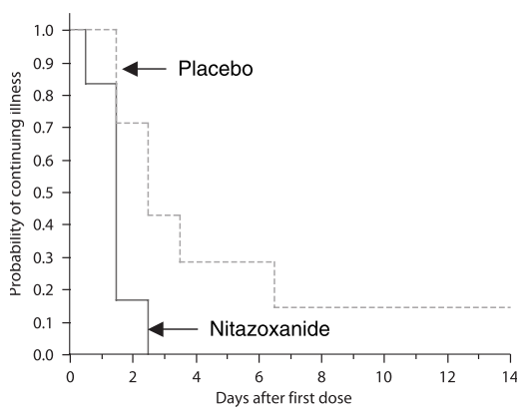
Norovirus & nitazoxanide
The data is…not great
Reducing immunosuppression?
Nitazoxanide? (NTZ) [4]
Suggested based on blinded placebo RCT of healthy adults
  NTZ x3 days -vs- placebo
Reduced symptom duration 2.5 days → 1.5 days (p=0.03)
  Only 13 had norovirus

Slide 96
Norovirus & nitazoxanide
The data is…not great
Issues & limitations with NTZ
Other (non-randomized) studies have shown some benefit in SOT, but limited by publication bias
  Citation #5 has a good review of other studies, highlighting the mixed results
Reducing immunosuppression?
Nitazoxanide? (NTZ) [4]
In 13 healthy adults w/ norovirus, RCT found NTZ x3 days reduced symptom duration 2.5 → 1.5 days (p=0.03)

Slide 97
Norovirus & nitazoxanide
The data is…not great
Issues & limitations with NTZ
Data in SOT limited by publication bias
No plausible mechanism
  Unlike protozoa, viruses do not use anaerobic metabolism
  Some have proposed that NTZ stimulated host innate immunity, this seems to not be the case [5]
Reducing immunosuppression?
Nitazoxanide? (NTZ) [4]
In 13 healthy adults w/ norovirus, RCT found NTZ x3 days reduced symptom duration 2.5 → 1.5 days (p=0.03)

Slide 98
Norovirus & nitazoxanide
The data is…not great
Issues & limitations with NTZ
Data in SOT limited by publication bias
No plausible mechanism [5]
Reducing immunosuppression?
Nitazoxanide? (NTZ) [4]
In 13 healthy adults w/ norovirus, RCT found NTZ x3 days reduced symptom duration 2.5 → 1.5 days (p=0.03)
Somebody should
do a trial!

Slide 99
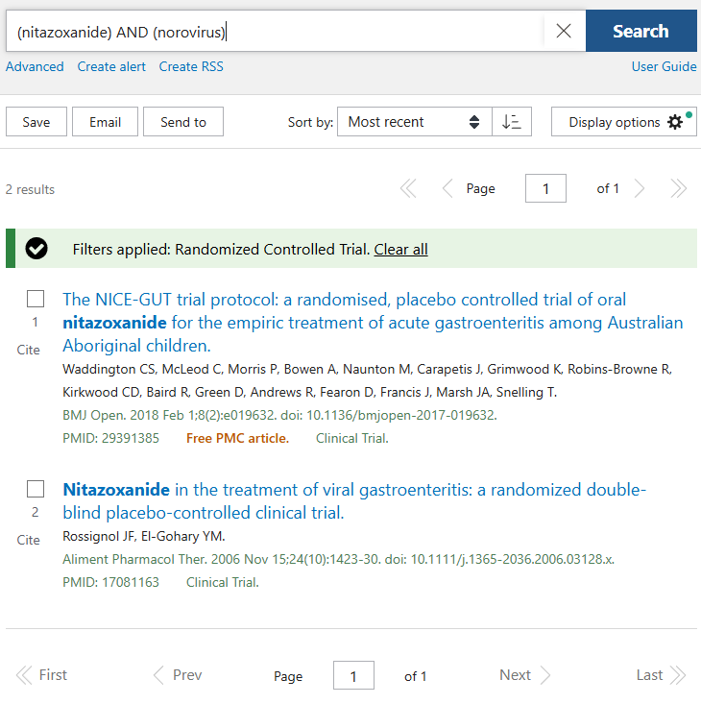
Norovirus & nitazoxanide
The data is…not great
Issues & limitations with NTZ
Data in SOT limited by publication bias
No plausible mechanism [5]
Reducing immunosuppression?
Nitazoxanide? (NTZ) [4]
In 13 healthy adults w/ norovirus, RCT found NTZ x3 days reduced symptom duration 2.5 → 1.5 days (p=0.03)
Somebody should
do a trial

Slide 100
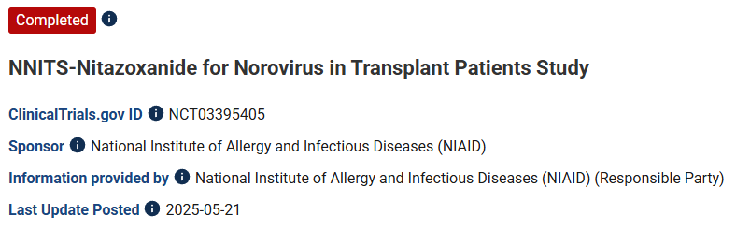
Norovirus & nitazoxanide
The data is…not great
Issues & limitations with NTZ
Data in SOT limited by
No plausible mechanism [5]
publication bias
Reducing immunosuppression?
Nitazoxanide? (NTZ) [4]
In 13 healthy adults w/ norovirus, RCT found NTZ x3 days reduced symptom duration 2.5 → 1.5 days (p=0.03)
Somebody should
do a trial

Slide 101
Norovirus & nitazoxanide
Phase 2, multicenter (including UPMC) double blinded RCT; completed in 2021
Randomized to 28 days of NTZ vs placebo

Slide 102
Norovirus & nitazoxanide
Phase 2, multicenter (including UPMC) double blinded RCT; completed in 2021
Randomized to 28 days of NTZ vs placebo
Enrollment stopped early due to COVID
  Original target: 160 (total)
  Actual: 31 patients
Results are not published, but available on clinicaltrials.gov (ID: NCT03395405)

Slide 103
Norovirus & nitazoxanide
NCT03395405
 | NTZ (n=16) | Placebo (n=15)
Completed | 12 | 10
Death | 0 (0%) | 2 (13%)
Solid organ | 15 (94%) | 15 (100%)
Time to resolution (95% CI) | 19 days (1 - 31) | 11 days (2 - 14)
Serious side effects | 0 (0%) | 2 (13%)

Slide 104
Norovirus & nitazoxanide
NCT03395405
 | NTZ (n=16) | Placebo (n=15)
Completed | 12 | 10
Death | 0 (0%) | 2 (13%)
Solid organ | 15 (94%) | 15 (100%)
Time to resolution (95% CI) | 19 days (1 - 31) | 11 days (2 - 14)
Serious side effects | 0 (0%) | 2 (13%)
Hazard ratio
0.74 (0.33 - 1.64)
p=0.459

Slide 105
Norovirus in transplant
Reducing immunosuppression?
Nitazoxanide? (NTZ)
Mixed data in limited trials [4][6]
Intravenous immunoglobulins (IVIG)

Slide 106
Norovirus in transplant
Reducing immunosuppression?
Gackler (2021): IVIG might work [7]
60 kidney transplants
  31 with chronic norovirus
18 of the patients received IVIG
  20 g/day x 3 days
  All the patients had chronic norovirus
Nitazoxanide? (NTZ)
Mixed data in limited trials [4][6]
Intravenous immunoglobulins (IVIG)

Slide 107
Norovirus in transplant
Reducing immunosuppression?
Gackler (2021): IVIG might work [7]
60 kidney transplants
  31 with chronic norovirus
18 of the patients received IVIG
  20 g/day x 3 days
  All the patients had chronic norovirus
72% (n=13) of IVIG patients had no further symptoms or readmissions
  Most of them (10 in 13) still had positive PCR
No side effects of IVIG
Nitazoxanide? (NTZ)
Mixed data in limited trials [4][6]
Intravenous immunoglobulins (IVIG)

Slide 108
Norovirus in transplant
Reducing immunosuppression?
Gackler (2021): IVIG might work [7]. 72% of chronic
norovirus had no further symptoms after IVIG
Nair (2023): No difference at 6 months [8]
79 solid SOT patients
  48% had baseline diarrhea
Nitazoxanide? (NTZ)
Mixed data in limited trials [4][6]
Intravenous immunoglobulins (IVIG)
No trials, mixed results [7][8]

Slide 109
Norovirus in transplant
Reducing immunosuppression?
chronic
Gackler (2021): IVIG might work [7]. 72% of
norovirus had no further symptoms after IVIG
Nair (2023): No difference at 6 months [8]
79 solid SOT patients
  48% had baseline diarrhea
9% received IVIG (n=7)
  Does not specify breakdown between chronic & acute norovirus
Improvement at 6 months (p=0.24)
  IVIG: 71%
  No IVIG: 88%
Nitazoxanide? (NTZ)
Mixed data in limited trials [4][6]
Intravenous immunoglobulins (IVIG)
No trials, mixed results [7][8]

Slide 110
Norovirus in transplant
Reducing immunosuppression?
Oral immunoglobulins have also been used [9]
Usual dosing is 25 mg/kg given q6h for 8 doses
Must be given post-pylorically (via dobhoff) to avoid stomach acid [13]
Nitazoxanide? (NTZ)
Mixed data in limited trials [4][6]
Intravenous immunoglobulins (IVIG)
No trials, mixed results [7][8]
Oral immunoglobulins (POIG)

Slide 111
Norovirus in transplant: POIG
Author | Population | Results |  | Notes
Florescu 2011 ^{[10]} | 12 immunocompromised* Matched to w/o POIG | Favored resolution at 7 days (OR 65; p=.078) No change in total duration (12.1 vs 11.9 day) |  | *Mostly kids with SOT (small bowel mostly)
Gairard 2014 ^{[11]} | Case series of 12 BOLT | 11 / 12 successfully treated 1 only mildly improved |  | 4 patients had recurrence later on
Nussbaum 2020 ^{[12]} | Case series of 9 SOT | 2/3rds had complete resolution by d/c All patients had resolution by 90 days |  | Didn’t clear the PCR
Buskandar 2025 ^{[13]} | Case series of 7 SOT All had failed NTZ therapy | All had resolution without recurrence No safety issues
All studies used 25 mg/kg q6h x 8 doses, with the exception of Buskandar [13] (used 50 mg/kg)

Slide 112
Norovirus in transplant
Reducing immunosuppression?
Oral immunoglobulins have also been used with promising results in one case-control [10] and small (n<15) case series [11, 12, 13]
But, larger retrospective studies [14] have not shown clear benefit
Nitazoxanide? (NTZ)
Mixed data in limited trials [4][6]
Intravenous immunoglobulins (IVIG)
No trials, mixed results [7][8]
Oral immunoglobulins (POIG)
No trials, generally positive results

Slide 113
Norovirus in transplant
Reducing immunosuppression?
Oral immunoglobulins have also been used with promising results in one case-control [10] and small (n<15) case series [11, 12, 13]
But, larger retrospective studies [14] have not shown clear benefit
Of the 152 SOT patients, only 9 received POIG
So still not a “large” study of POIG
Nitazoxanide? (NTZ)
Mixed data in limited trials [4][6]
Intravenous immunoglobulins (IVIG)
No trials, mixed results [7][8]
Oral immunoglobulins (POIG)
No trials, generally positive results

Slide 114
Fever from IV iron?
Recognize some pitfalls of molecular testing for infectious diarrhea, per the 2017 IDSA guidelines
Review Campylobacter enteritis in kidney transplants, with a focus on treatment and risk factors
Appraise the literature regarding treatment of norovirus in solid organ transplant
Evaluate if delayed fever from IV iron may have been the cause of case #2's fever

Slide 115
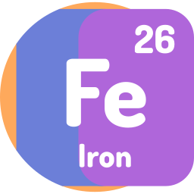
Fevers with IV iron
Not the most common side effect, but has been documented

Slide 116
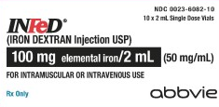
Fevers with IV iron
Not the most common side effect, but has been documented
5.2 Delayed Reactions
Large intravenous doses…have been associated with an increased incidence of adverse reactions. The adverse reactions are frequently delayed (1 to 2 days) reactions typified by one or more of the following symptoms: arthralgia, backache, chills, dizziness, moderate to high fever, headache, malaise, myalgia, nausea, and vomiting.
Iron dextran package insert [link]

Slide 117
Fevers with IV iron
Not the most common side effect, but has been documented
5.2 Delayed Reactions
Large intravenous doses…have been associated with an increased incidence of adverse reactions. The adverse reactions are frequently delayed (1 to 2 days) reactions typified by one or more of the following symptoms: arthralgia, backache, chills, dizziness, moderate to high fever, headache, malaise, myalgia, nausea, and vomiting.
The onset is usually 24 to 48 hours after administration and symptoms generally subside within 3 to 4 days. The etiology of these reactions is not known.
Iron dextran package insert [link]

Slide 118
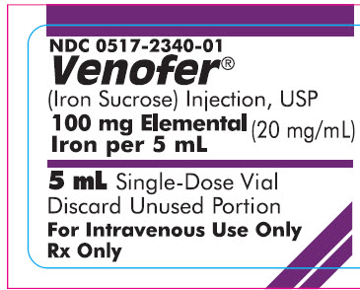
Fevers with IV iron
Not the most common side effect, but has been documented
6.1 Adverse Reactions in Clinical Trials
From six trials of patients with CKD
Iron sucrose package insert [link]
 | HD | PD | CKD alone
# Patients | 231 | 75 | 139
Pyrexia | 3.0% | 1.3% | 0.7% *
* The rate of fevers with PO iron was 0.7%

Slide 119
Learning points & take aways

Slide 120
Learning points & take aways
Stool PCRs are great, but clinical context and cultures are still needed [1]
Campylobacter is a common etiology of bacterial enteritis in KT, especially if on steroids
Treat Campylobacter in KT similar to immunocompetent folks:
  Macrolides first line, still send for susceptibilities (↑ rates of MDR [2])
  Limited data suggests does not need longer duration and non-severe cases may not need abx [3]
Treatment of Norovirus in SOT really doesn’t have great data
  Literature is limited by publication bias and being underpowered. That said, interventions seem to be generally safe (exception: reducing immunosuppression), but maybe not effective
  Nitazoxanide had promising trial data for immunocompetent patients [4] but ?worse than placebo in trial of SOT (unpublished) [6]. In vitro studies suggest it doesn’t even help the immune system [5]
  IVIG and oral IG (post-pyloric [13]) have plausible mechanisms and could help avoiding changes in immunosuppression. But data is mostly limited to case reports
IV iron has been reported to cause delayed reactions (1-2 days later), including self-resolving fevers
Slides available on hunterratliff1.com/talk/; Citations available via QR code or via the “citations” button on the website

