Slide 1


Hot blooded
CLINID conference
Hunter Ratliff
12/18/2025
Ages, dates, and other identifying information may have been changed
I have no conflict of interest in relation to this presentation

Slide 2
Case #1

Slide 3
Case 1: HPI
A 66 y/o M with PMH including heart block (no PPM/ICD) p/w fevers to 103

Slide 4
Case 1: HPI
A 66 y/o M with PMH including heart block (no PPM/ICD) p/w fevers to 103
Feeling unwell for about a week. Seems like everything stated after he had a root canal 8 days ago (right premaxillary molar)

Slide 5
Case 1: HPI
A 66 y/o M with PMH including heart block (no PPM/ICD) p/w fevers to 103
Feeling unwell for about a week. Seems like everything stated after he had a root canal 8 days ago (right premaxillary molar)
A few days later, bifrontal headaches

Slide 6
Case 1: HPI
A 66 y/o M with PMH including heart block (no PPM/ICD) p/w fevers to 103
Feeling unwell for about a week. Seems like everything stated after he had a root canal 8 days ago (right premaxillary molar)
A few days later, bifrontal headaches
…then fevers

Slide 7
Case 1: HPI
A 66 y/o M with PMH including heart block (no PPM/ICD) p/w fevers to 103
Feeling unwell for about a week. Seems like everything stated after he had a root canal 8 days ago (right premaxillary molar)
A few days later, bifrontal headaches
…then fevers
…then a little confused

Slide 8
Case 1: HPI
A 66 y/o M with PMH including heart block (no PPM/ICD) p/w fevers to 103
Feeling unwell for about a week. Seems like everything stated after he had a root canal 8 days ago (right premaxillary molar)
A few days later, bifrontal headaches
…then fevers
…then a little confused
…then a lota confused and sleeping though most of the day

Slide 9
Case 1: HPI
A 66 y/o M with PMH including heart block (no PPM/ICD) p/w fevers to 103
Feeling unwell for about a week. Seems like everything stated after he had a root canal 8 days ago (right premaxillary molar)
A few days later, bifrontal headaches ← improved with tylenol & motrin
…then fevers ← fevered through tylenol & motrin (around the clock)
…then a little confused
…then a lota confused and sleeping though most of the day

Slide 10
Case 1: HPI
A 66 y/o M with PMH including heart block (no PPM/ICD) p/w fevers to 103 i/s/o R maxillary root canal (8 days ago)
Went to the ED a few days ago and was prescribed Augmentin for possible dental abscess seen on CT
Headache (improving)
Fever (despite antipyretics)
Root
Canal
AMS → Sleepy
-8
-5
-4
ED
-1
ED

Slide 11
Case 1: HPI
A 66 y/o M with PMH including heart block (no PPM/ICD) p/w fevers to 103 i/s/o R maxillary root canal (8 days ago)
Went to the ED a few days ago and was prescribed Augmentin for possible dental abscess seen on CT
Augmentin has not helped
  Also got a few days of amoxicillin after his root canal
  Might have caused mild diarrhea
Headache (improving)
Fever (despite antipyretics)
Root
Canal
AMS → Sleepy
-8
-5
-4
ED
-1
ED

Slide 12
Case 1: Social history, exposures, & risk factors
Geographic | Lives with wife in town
Travel | Traveled to Cumberland area after root canal (for a day trip)
Substance | None
Animals | Pet dog
Exposures | Spends some time outdoors, but not a grassy areas. They deny known tick/mosquito exposures (case was later in the fall)

Slide 13
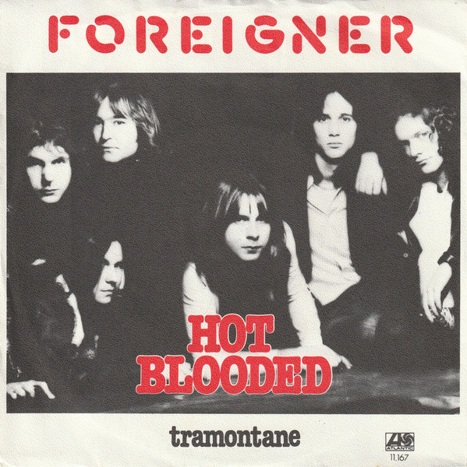
Case 1: Physical exam
BP | 130/64 | Pulse | 87 | SpO2 | 95 %
Temp | 39.5 °C (103.1 °F) | RR | 18 | BMI | 25 kg/m²
General | Alert and oriented, NAD
HEENT | NCAT; trachea appears midline, no gross LAD; EOMI
Resp | Normal respiratory effort, symmetric chest rise
CV | RRR; extremities perfused
Neuro | Unrevealing, not encephalopathic; gait not assessed
Psych | Poor recall into the past 48 hours

Slide 14
Case 1: Summary
A 66 y/o M with no real PMH p/w headache → fevers → intermittent encephalopathy i/s/o R maxillary root canal (8 days ago). Told that he may have a small dental abscess, but not getting better on Augmentin
Any more HPI?
Headache (improving)
Initial workup?
Fever (despite antipyretics)
Root
Canal
AMS → Sleepy
-8
-5
-4
ED
-1
ED
Amox
Augmentin

Slide 15
Case 1: Labs
CBC | ED #1 | Now
WBC | 7.9 | 8.7
Hgb | 13.7 | 13.7
Platelets | 187 | 230
Neut % | 73% | 83%
Lymph % | 19% | 10%
Eos % | 0% | 0.9%
CRP | <0.4 | <0.4
Chem7 | Result
Na | 130
K | 3.5
HCO3 | 21
BUN | 17
Cr | 1.1
LFTs | Result
AST | 35
ALT | 27
Alk Phos | 41
Bili | 1
Albumin | 3.8

Slide 16
Case 1: Imaging
CT (prior ED visit)
Postsurgical changes. Small hypodense focus involving the right oral cavity with adjacent fat stranding in soft tissues raises suspicion for abscess formation. Recommend dental consultation

Slide 17
Case 1: Imaging
OMFS consult
No signs or symptoms of odontogenic infection clinically at this time
Recommend 1 week of Augmentin
Outpatient follow up with OMFS
CT (prior ED visit)
Postsurgical changes. Small hypodense focus involving the right oral cavity with adjacent fat stranding in soft tissues raises suspicion for abscess formation. Recommend dental consultation

Slide 18
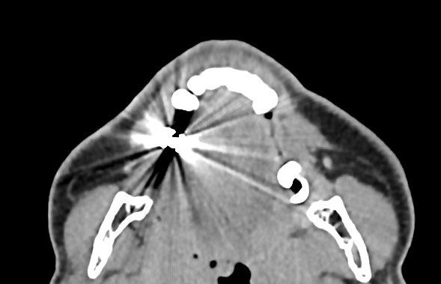
Case 1: Imaging
OMFS consult
No signs or symptoms of odontogenic infection clinically at this time
Recommend 1 week of Augmentin
Outpatient follow up with OMFS
CT (prior ED visit)
Postsurgical changes. Small hypodense focus involving the right oral cavity with adjacent fat stranding in soft tissues raises suspicion for abscess formation. Recommend dental consultation
CT (now)
Artifact from dental amalgam limits evaluation. No acute abnormality. No organized collection

Slide 19
Case 1: Lumbar puncture
Lumbar punct | Result
Opening Pr (cm H2O) | ---
WBC | 105
Neut (%) | 1%
Lymph (%) | 82%
RBC | 1
Protein | 92
Glucose | 50
Pending | Result
Blood Cx | ???
uStrep/Legionella | ???
CSF biofire | ???
CSF cultures | ???
HSV/VZV PCR | ???
Negative screens
HIV
Lyme
Syphilis

Slide 20
Case 1: Summary
LP
WBC | 105
Neut (%) | 1%
Lymph (%) | 82%
RBC | 1
Protein | 92
Glucose | 50
Pending | Result
Blood Cx | ???
uStrep/Legionella | ???
CSF biofire | ???
CSF cultures | ???
HSV/VZV PCR | ???
A 66 y/o M with no real PMH p/w headache → fevers → intermittent encephalopathy i/s/o R maxillary root canal (8 days ago). Told that he may have a small dental abscess, but not getting better on Augmentin
CT facial bones
No collections or acute abnormalities
DDx?
More workup?
Headache (improving)
Fever (despite antipyretics)
Root
Canal
AMS → Sleepy
Treatment?
-8
-5
-4
ED
-1
ED
Amox
Augmentin

Slide 21
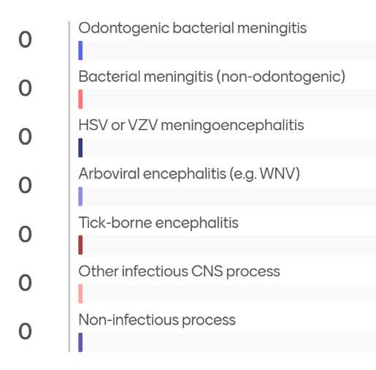
[Q1.1] DDx
Notes:
Chat GPT 5.2
Arboviral encephalitis (West Nile most likely): 32%
HSV encephalitis: 22%
VZV meningoencephalitis: 12%
Tick-borne viral encephalitis (e.g., Powassan): 10%
Partially treated bacterial meningitis (incl. odontogenic source): 9%
Listeria meningoencephalitis: 6%
Drug-induced aseptic meningitis (beta-lactam–associated): 5%
TB/fungal/chronic meningitis mimics: 4%
Gemini 3 Pro
La Crosse Encephalitis: 45%
HSV Encephalitis: 35%
Listeria Meningitis: 10%
West Nile Virus: 5%
Other (Enterovirus, unrecognized abscess): 5%

Slide 22
Case 1: Initial recs
Thought process
History is concerning for systemic infection &/or meningitis
Trigger seems to be related to dental procedure
Await/obtain
West nile
Blood cultures
MRI brain
CSF HSV/VZV
Biofire
Strep/Legionella
Hospital course
Initially still febrile
Antimicrobials
Ceftriaxone 2 q12h
CNS vanco (also covering oral strep)
Flagyl q12h (for mouth bugs)
Acyclovir

Slide 23
Case 1: Hospital course
Thought process
History is concerning for systemic infection &/or meningitis
Trigger seems to be related to dental procedure
Await:
West nile
Blood cultures
MRI brain
CSF HSV/VZV → Negative
Biofire → Negative
Strep/Legionella → Negative
Hospital course
CSF PCRs normal, stop acyclovir
Antimicrobials
Ceftriaxone 2 q12h
CNS vanco (also covering oral strep)
Flagyl q12h (for mouth bugs)
Acyclovir

Slide 24
Case 1: Hospital course
Thought process
History is concerning for systemic infection &/or meningitis
Trigger seems to be related to dental procedure
Await:
West nile (pending)
Blood cultures → Negative
MRI brain → Normal
Hospital course
Really doing quite well
But workup has all been negative
Antimicrobials
Ceftriaxone 2 q12h
CNS vanco (also covering oral strep)
Flagyl q12h (for mouth bugs)

Slide 25
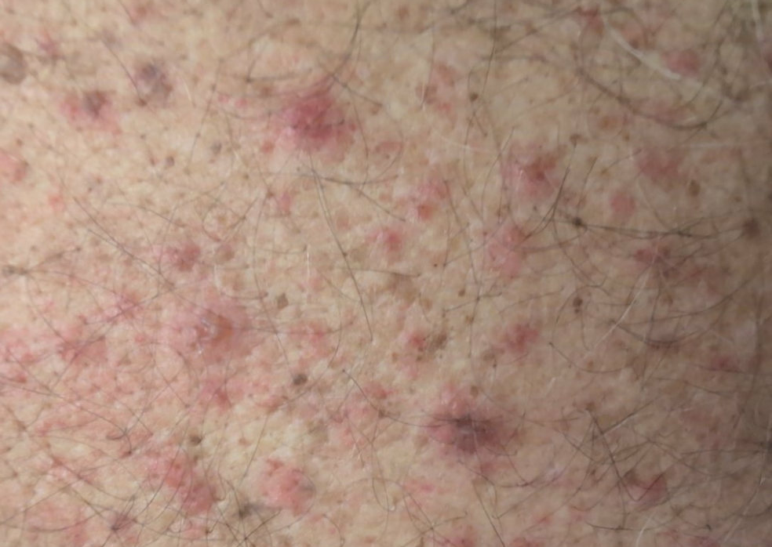
Case 1: Hospital course
Thought process
History is concerning for systemic infection &/or meningitis
Trigger seems to be related to dental procedure
Hospital course
Really doing quite well
  But workup has all been negative
Develops itchy pustular rash on day 2-3
Antimicrobials
Ceftriaxone 2 q12h
CNS vanco (also covering oral strep)
Flagyl q12h (for mouth bugs)

Slide 26
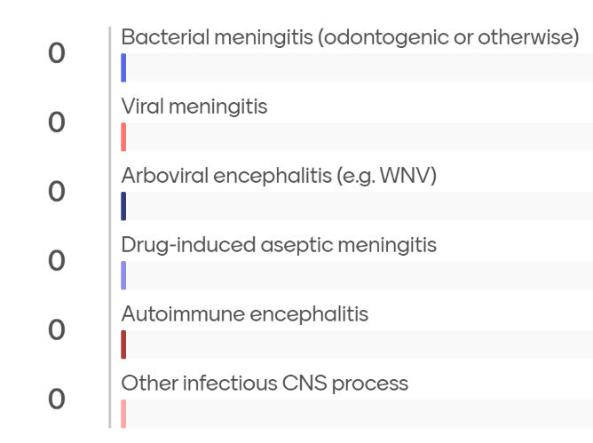
[Q1.2] DDx now?
Notes:
Chat GPT 5.2
Drug-induced aseptic meningitis / encephalopathy (beta-lactam–associated): 65%
Arboviral encephalitis (West Nile or related): 15%
Other viral meningoencephalitis not on standard panels: 7%
Partially treated bacterial meningitis (odontogenic or other): 5%
Tick-borne viral encephalitis (e.g., Powassan): 4%
Autoimmune / inflammatory encephalitis: 2%
Listeria meningoencephalitis: 2%
Gemini 3 Pro
La Crosse Encephalitis (California Serogroup): 85%
Reasoning: Perfect geographic match (Cumberland), clinical phenotype (hyponatremic aseptic meningitis), and negative workup for HSV/Bacteria. The patient's improvement supports a viral etiology.
West Nile Virus Encephalitis: 10%
Reasoning: Clinically indistinguishable from La Crosse without serology. Lower probability only because "Cumberland" is a specific buzzword for La Crosse.
Enteroviral Meningitis: 5%
Reasoning: Common cause of aseptic meningitis in the fall. Less specific geography.

Slide 27
Case 1: Hospital course
Hospital course
Develops itchy pustular rash on day 2-3
  Is this from our antibiotics?
Thought process
History is concerning for systemic process w/ aseptic meningitis, seemingly related to dental procedure

Slide 28
Case 1: Hospital course
Hospital course
Develops itchy pustular rash on day 2-3
  Is this from our antibiotics?
Has this all been from antibiotics?
Thought process
History is concerning for systemic process w/ aseptic meningitis, seemingly related to dental procedure
Headache (improving)
Fever (despite antipyretics)
Root
Canal
AMS → Sleepy
-8
-5
-4
ED
-1
ED
Amox
Augmentin

Slide 29
Case 1: Hospital course
Hospital course
Develops itchy pustular rash on day 2-3
  Is this from our antibiotics?
Has this all been from antibiotics?
Or NSAIDs?
Thought process
History is concerning for systemic process w/ aseptic meningitis, seemingly related to dental procedure
Thought process
History is concerning for systemic process w/ aseptic meningitis, seemingly related to dental procedure
Headache (improving)
Fever (despite antipyretics)
Root
Canal
AMS → Sleepy
-8
-5
-4
ED
-1
ED
NSAIDs
Amox
Augmentin

Slide 30
Case 1: Hospital course
Hospital course
Develops itchy pustular rash on day 2-3
  Is this from our antibiotics?
Has this all been from antibiotics?
Or NSAIDs?
  Normally doesn’t take NSAIDs, but his dentist advised ibuprofen for headaches
  Also normally doesn’t take amoxicillin
Thought process
History is concerning for systemic process w/ aseptic meningitis, seemingly related to dental procedure
Headache (improving)
Fever (despite antipyretics)
Root
Canal
AMS → Sleepy
-8
-5
-4
ED
-1
ED
NSAIDs
Amox
Augmentin

Slide 31
Case 1: Hospital course
Hospital course
Develops itchy pustular rash on day 2-3
  Is this from our antibiotics?
Has this all been from antibiotics?
Or NSAIDs?
  Normally doesn’t take NSAIDs, but his dentist advised ibuprofen for headaches
  Also normally doesn’t take amoxicillin
Stop all antimicrobials, avoid NSAIDs
Remained fever free and did well
Thought process
History is concerning for systemic process w/ aseptic meningitis, seemingly related to dental procedure
Thought process
History is concerning for systemic process w/ aseptic meningitis, seemingly related to dental procedure
# Drug induced aseptic meningitis
Headache (improving)
Fever (despite antipyretics)
Root
Canal
AMS → Sleepy
-8
-5
-4
ED
-1
ED
NSAIDs
Amox
Augmentin

Slide 32
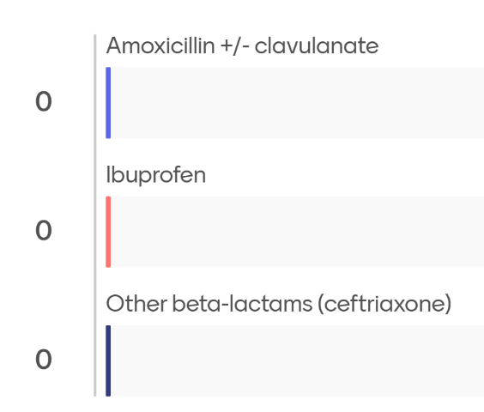
[Q1.3] What caused it?
Notes:
Chat GPT 5.2 (select responses)
Prompt: You are correct, it was drug-induced aseptic meningitis. Which drug caused it?
The culprit was amoxicillin–clavulanate (Augmentin).
Strong temporal relationship: symptoms began shortly after exposure to amoxicillin and then Augmentin following the dental procedure.
Well-described association: amoxicillin (and other beta-lactams) are among the most commonly reported causes of drug-induced aseptic meningitis (DIAM).
Re-exposure phenomenon: patients may tolerate amoxicillin previously, then develop DIAM after re-exposure—often with more severe or faster-onset symptoms.
Prompt: What about NSAIDs?
Yes — NSAIDs are absolutely on the list, and in fact they are one of the classic causes of drug-induced aseptic meningitis (DIAM). The key is how well they fit this specific case
…

Slide 33
Case #2

Slide 34
Case 2: HPI
A 63 y/o M with PMH including HIV (Descovy+Tivicay), prior positive PPD, HFrEF, s/p mechanical AVR & MVR (2 years ago) p/w a month of fevers

Slide 35
Case 2: HPI
Patient states approximately a month ago he was with a group of friends who all came down with a similar (supposedly viral) illness. He reports onset of fevers, headaches (which he describes as "flu-like headaches"; occasionally with blurry vision when severe), rhinorrhea with postnasal drip, productive cough (particularly in the morning), and ear fullness. He was initially treated with Claritin, Flonase, and Tessalon Perles.

Slide 36
Case 2: HPI
Patient states approximately a month ago he was with a group of friends who all came down with a similar (supposedly viral) illness. He reports onset of fevers, headaches (which he describes as "flu-like headaches"; occasionally with blurry vision when severe), rhinorrhea with postnasal drip, productive cough (particularly in the morning), and ear fullness. He was initially treated with Claritin, Flonase, and Tessalon Perles.
Over the 1st week of his illness, cough improved (but worsened after stopping Tessalon Perles), rhinorrhea has been less severe (though he continues to be on Claritin), and fevers are no longer as high (though he is still having them); overall symptoms initially improved, but are still lingering. These continued fevers are 99-100 F, but he does feels subjectively febrile during these episodes

Slide 37
Case 2: HPI
At onset (-1mo, late spring/early summer): Sick contacts with ?summer flu
Symptoms: fevers, headaches +/- vision changes, nasal drip with productive cough
Treatment: Claritin, Flonase, and Tessalon Perles
Response: Mild improvement, but still fevering (and other symptoms)
He was later treated with doxy and prednisone, but noticed zero improvement. Later was treated with clindamycin ( which he is still on presently), and has not improved, though he is now having diarrhea. During this time he has had some abnormal heart rhythms (SVT & Afib RVR), one of which prompted ED visit but he was able to vagal his way out of another one

Slide 38
Case 2: HPI
At onset (-1mo, late spring/early summer): Sick contacts with ?summer flu
Symptoms: fevers, headaches +/- vision changes, nasal drip with productive cough
Treatment: Claritin, Flonase, and Tessalon Perles
Response: Mild improvement, but still fevering (and other symptoms)
He was later treated with doxy and prednisone, but noticed zero improvement. Later was treated with clindamycin ( which he is still on presently), and has not improved, though he is now having diarrhea. During this time he has had some abnormal heart rhythms (SVT & Afib RVR), one of which prompted ED visit but he was able to vagal his way out of another one
Negative ROS
During the entire course of this illness, denies night sweats, weight changes, myalgias, dyspnea, urinary changes, rashes/skin changes, or GI symptoms (aside from aforementioned diarrhea on clindamycin). No known tick exposures.

Slide 39
Case 2: HPI
At onset (-1mo, late spring/early summer): Sick contacts with ?summer flu
Symptoms: fevers, headaches +/- vision changes, nasal drip with productive cough
Treatment: Claritin, Flonase, and Tessalon Perles
Response: Mild improvement, but still fevering (and other symptoms)
He was later treated with doxy and prednisone, but noticed zero improvement. Later was treated with clindamycin ( which he is still on presently), and has not improved, though he is now having diarrhea. During this time he has had some abnormal heart rhythms (SVT & Afib RVR), one of which prompted ED visit but he was able to vagal his way out of another one
Negative ROS
During the entire course of this illness, denies night sweats, weight changes, myalgias, dyspnea, urinary changes, rashes/skin changes, or GI symptoms (aside from aforementioned diarrhea on clindamycin). No known tick exposures.
Negative workup
CBC & CMP
CXR
TTE (poor windows)

Slide 40
Case 2: PMH
Problem list
HIV (Dx 2010, RF=MSM)
  No Hx of OIs
  CD4 > 500, virally suppressed
?rheumatic heart disease s/p mechanical AVR & MVR (2 years ago)
CAD
HFrEF
VitD deficiency
Hx HCV (Tx 3 years ago) with SVR
Hx cat-scratch (2016), s/p Tx
Hx Positive PPD, spontaneously converted to non reactive years ago
  Was in Africa for a 1-2 years in 80s
  Teaches college courses at a prison

Slide 41
Case 2: HPI
Problem list
HIV (Dx 2010, RF=MSM)
  No Hx of OIs
  CD4 > 500, virally suppressed
?rheumatic heart disease s/p mechanical AVR & MVR (2 years ago)
CAD
HFrEF
VitD deficiency
Hx HCV (Tx 3 years ago) with SVR
Hx cat-scratch (2016), s/p Tx
Hx Positive PPD, spontaneously converted to non reactive years ago
  Was in Africa for a 1-2 years in 80s
  Teaches college courses at a prison
Medications
Descovy + Tivicay
Warfarin (mechanical valves)
Atorvastatin + aspirin 81 + sublingual nitroglycerin (PRN)
Entresto + metoprolol + eplerenone + dapagliflozin + furosemide
Ergocalciferol
Recent meds | Taking
Loratadine | Yes
Flonase | Yes
Tessalon Perles | No
Doxycycline | No
Prednisone | No
Clindamycin | Yes

Slide 42
Case 2: Physical exam
BP | 139/82 | Pulse | 80 | SpO2 | 94%
Temp | 36.8 °C (98.2 °F) | RR | 18 | BMI | 45 kg/m²
General | Alert and oriented, slightly diaphoretic, non-toxic appearing
HEENT | NCAT; trachea appears midline, no gross LAD; EOMI
Resp | Normal respiratory effort, symmetric chest rise
CV | RRR; no murmur (but don’t trust the examiner)
GI | Non-distended; no TTP
Extremities | No clubbing, cyanosis, or edema

Slide 43
Case 2: Summary
A 63 y/o M with PMH including controlled HIV, prior positive PPD, HFrEF, s/p AVR & MVR p/w FUO x 4 weeks.
Had viral illness symptoms (+sick contacts) at onset, improved after a week but still ongoing. Not improved with doxy, prednisone, or clinda. Routine labs normal, as is CXR, but diaphoretic on exam and still having fevers to 38C despite some improvement in his other symptoms
Any more HPI?
Top 3 DDx?
Initial management?

Slide 44
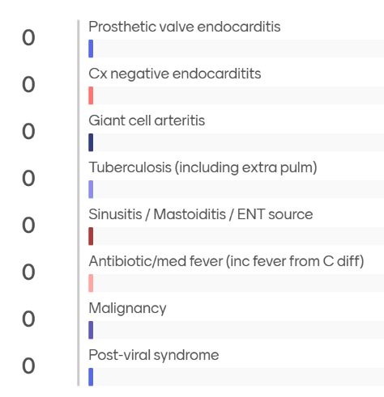
[Q2.1]
Initial FUO DDx

Slide 45
Case 2: Clinic course
# FUO
# Cough, recent URI
# s/p mechanical MVR & AVR
Etiology of ongoing fevers unclear, patient is slightly diaphoretic on exam and though non-toxic appearing, does not appear well
We discussed concern for possible PVE
Suggested direct admission to Ruby, but pt declined
Asked patient to hold clindamycin to increase diagnostic yield of BCx (will collect labs on Saturday)
# HIV
C/w Descovy + Tivicay (100% compliance)
Do think FUO unrelated to HIV status, well controlled
Orders Placed This Encounter:
CBC, CMP, CRP
Blood cultures to be collected on Saturday
2v CXR, BNP
uLegionella, lyme

Slide 46
Case 2: Clinic course
# FUO
# Cough, recent URI
# s/p mechanical MVR & AVR
Etiology of ongoing fevers unclear, patient is slightly diaphoretic on exam and though non-toxic appearing, does not appear well
We discussed concern for possible PVE
Suggested direct admission to Ruby, but pt declined
Asked patient to hold clindamycin to increase diagnostic yield of BCx (will collect labs on Saturday)
# HIV
C/w Descovy + Tivicay (100% compliance)
Do think FUO unrelated to HIV status, well controlled
Orders Placed This Encounter:
CBC, CMP, CRP
Blood cultures to be collected on Saturday
2v CXR, BNP
uLegionella, lyme
All normal
But still fevering…

Slide 47

Case 2: Admission
A 63 y/o M with PMH including controlled HIV, prior positive PPD, HFrEF, s/p AVR & MVR p/w FUO x 6 weeks.
Had viral illness symptoms (+sick contacts) at onset, improved after a week but still ongoing. Not improved with doxy, prednisone, or clinda. Routine labs normal, as is CXR, but diaphoretic on exam and still having fevers to 38C despite some improvement in his other symptoms
Additional HPI
There has been some construction taking place at the college where he works
Fevers mainly happening in the morning
Ear issues resolved, but still headache & fevers
Workup?

Slide 48
Case 2: What will reveal the diagnosis?
Infectious | Result
Endocarditis BCx | Neg
Lyme | Neg
Tick panel | Neg
Blood parasite smear | Neg
Blasto Ag | Neg
Histo Ag | ---
Crypto Ag | Neg
QuantGold | Neg
Lumbar puncture | ???
Strep/Legionella | Neg
UA | Neg
Imaging | Result
CT C/A/P | Neg
MRI brain | Neg
TEE | Neg
Molecular | Result
Resp biofire | Neg
GI biofire | ---
Serum CMV | Neg
Monospot | Neg

Slide 49
Case 2: What will reveal the diagnosis?
Infectious | Result
Endocarditis BCx | Neg
Lyme | Neg
Tick panel | Neg
Blood parasite smear | Neg
Blasto Ag | Neg
Histo Ag | ---
Crypto Ag | Neg
QuantGold | Neg
Lumbar puncture | ???
Strep/Legionella | Neg
UA | Neg
Imaging | Result
CT C/A/P | Neg
MRI brain | Neg
TEE | Neg
Molecular | Result
Resp biofire | Neg
GI biofire | ---
Serum CMV | Neg
Monospot | Neg

Slide 50
Case 2: What will reveal the diagnosis?
Infectious | Result
Endocarditis BCx | Neg
Lyme | Neg
Tick panel | Neg
Blood parasite smear | Neg
Blasto Ag | Neg
Histo Ag | ---
Crypto Ag | Neg
QuantGold | Neg
Lumbar puncture | ???
Strep/Legionella | Neg
UA | Neg
Imaging | Result
CT C/A/P | Neg
MRI brain | Neg
TEE | Neg
CTA heart | Neg
Molecular | Result
Resp biofire | Neg
GI biofire | ---
Serum CMV | Neg
Monospot | Neg

Slide 51
Case 2: What will reveal the diagnosis?
Infectious | Result
Endocarditis BCx | Neg
Lyme | Neg
Tick panel | Neg
Blood parasite smear | Neg
Blasto Ag | Neg
Histo Ag | ---
Crypto Ag | Neg
QuantGold | Neg
Lumbar puncture | ---
Strep/Legionella | Neg
UA | Neg
Imaging | Result
CT C/A/P | Neg
MRI brain | Neg
TEE | Neg
CTA heart | Neg
Cardiac PET | ???
Whole body PET | ???
Molecular | Result
Resp biofire | Neg
GI biofire | ---
Serum CMV | Neg
Monospot | Neg
Karius (mNGS) | ???
Non-ID | Result
Flow cytometry | ???
Tumor markers | ???
Rheum consult | ???
No fevers recorded…
Getting tylenol (& ASA)
Still “feeling hot”
Ongoing headache

Slide 52
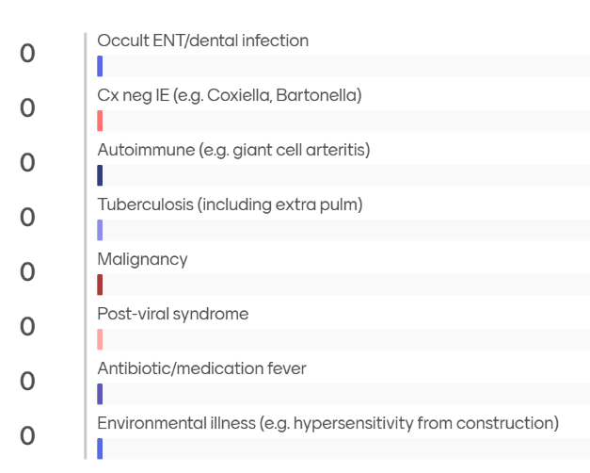
[Q2.2]
Revised DDx

Slide 53
Case 2: What will reveal the diagnosis?
Infectious | Result
Endocarditis BCx | Neg
Lyme | Neg
Tick panel | Neg
Blood parasite smear | Neg
Blasto Ag | Neg
Histo Ag | ---
Crypto Ag | Neg
QuantGold | Neg
Lumbar puncture | ---
Strep/Legionella | Neg
UA | Neg
Imaging | Result
CT C/A/P | Neg
MRI brain | Neg
TEE | Neg
CTA heart | Neg
Cardiac PET | ---
Whole body PET | ---
Molecular | Result
Resp biofire | Neg
GI biofire | ---
Serum CMV | Neg
Monospot | Neg
Karius (mNGS) | ?????
Non-ID | Result
Flow cytometry | ---
Tumor markers | ---
Rheum consult | ???

Slide 54
Case 2: What will reveal the diagnosis?
Infectious | Result
Endocarditis BCx | Neg
Lyme | Neg
Tick panel | Neg
Blood parasite smear | Neg
Blasto Ag | Neg
Histo Ag | ---
Crypto Ag | Neg
QuantGold | Neg
Lumbar puncture | ---
Strep/Legionella | Neg
UA | Neg
Imaging | Result
CT C/A/P | Neg
MRI brain | Neg
TEE | Neg
CTA heart | Neg
Cardiac PET | Neg
Whole body PET | ---
Molecular | Result
Resp biofire | Neg
GI biofire | ---
Serum CMV | Neg
Monospot | Neg
Karius (mNGS) | ---
Non-ID | Result
Flow cytometry | ---
Tumor markers | ---
Rheum consult | ---
Review the med list?
(to be fair, the patient prompted this)

Slide 55
Case 2: Was it the medications?
Recalls that he was started on Eplerenone just before symptom onset - raised the possibility of drug fever/side effects.
Medications
Descovy + Tivicay
Warfarin (mechanical valves)
Atorvastatin + aspirin 81 + sublingual nitroglycerin (PRN)
Entresto + metoprolol + eplerenone + dapagliflozin + furosemide
Ergocalciferol
Cardiology note (before fevers)
We will discontinue spironolactone on account of gynecomastia and start patient on eplerenone 50 mg once a day.
Recent meds | Taking
Loratadine | Yes
Flonase | Yes
Tessalon Perles | No
Doxycycline | No
Prednisone | No
Clindamycin | Yes

Slide 56
Case 2: Was it the medications?
Recalls that he was started on Eplerenone just before symptom onset - raised the possibility of drug fever/side effects.
# FUO - possibly a drug fever
Asked to discuss with Cardiologist coming off the Eplerenone to see if symptoms resolve
Medications
Descovy + Tivicay
Warfarin (mechanical valves)
Atorvastatin + aspirin 81 + sublingual nitroglycerin (PRN)
Entresto + metoprolol + eplerenone + dapagliflozin + furosemide
Ergocalciferol
Cardiology note (before fevers)
We will discontinue spironolactone on account of gynecomastia and start patient on eplerenone 50 mg once a day.
Cardiology note (before fevers)
We will discontinue spironolactone on account of gynecomastia and start patient on eplerenone 50 mg once a day.
Recent meds | Taking
Loratadine | Yes
Flonase | Yes
Tessalon Perles | No
Doxycycline | No
Prednisone | No
Clindamycin | Yes

Slide 57
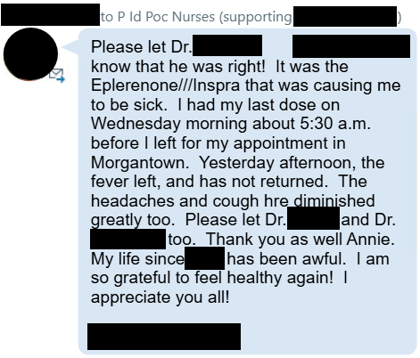
Case 2: Was it the medications?
Recalls that he was started on Eplerenone just before symptom onset - raised the possibility of drug fever/side effects.
# FUO - possibly a drug fever
Asked to discuss with Cardiologist coming off the Eplerenone to see if symptoms resolve
Cardiology note (before fevers)
We will discontinue spironolactone on account of gynecomastia and start patient on eplerenone 50 mg once a day.

Slide 58
Case #3
Rapid fire

Slide 59
Case 3: HPI
A 57 y/o M with PMH including COPD, T2DM (A1c 9), CV disease (CAD, CVA), OUD (on MAT) was admitted for acute hypoxic respiratory failure c/b ARDS and has a prolonged ICU course. ID consulted on hospital day 32 for new sepsis

Slide 60
Case 3: ICU course
57 y/o M w/ COPD, DM (A1c 9), CV disease admitted to MICU for ARDS 2/2 severe pneumonia H flu & GBS. Prolonged ICU course. ID consulted on hospital day 32 for new sepsis
Initial BAL: Haemophilus influenzae → Intubation → VV ECMO for 3 weeks
Acute renal failure requiring CRRT
3-4 pneumothoraces (but who’s counting)
Low grade MRSA bacteremia on day 18 (same MRSA isolate in BAL)
  ID not involved, but they did a decent job (cleared quick, TTE negative)
  ECMO circuit obviously still in
Cefepime
Ceftaroline
Vanc / Zyvox
Vanc
X
= Neg BCx
1
2
3
4
5
6
7
8
9
10
11
12
13
14
15
16
17
18
19
20
21
22
23
24
25
26
27
28
29
30
31
32
VV ECMO
ID consult
BAL: H flu & GBS
BAL: MRSA
BCx: MRSA
BAL: MRSA

Slide 61
Case 3: ICU course
57 y/o M w/ COPD, DM (A1c 9), CV disease admitted to MICU for ARDS 2/2 severe pneumonia H flu & GBS. Prolonged ICU course. ID consulted on hospital day 32 for new sepsis
Initial BAL: Haemophilus influenzae → Intubation → VV ECMO for 3 weeks
Low grade MRSA bacteremia on day 18 (same MRSA isolate in BAL)
Slowly improving, so weaned from ECMO by day 28
  Around the same time, drastic WBC increase & almost fevered
  Now needing levophed (hemodynamics not an issue before)
Cefepime
Ceftaroline
Vanc / Zyvox
Vanc
X
= Neg BCx
1
2
3
4
5
6
7
8
9
10
11
12
13
14
15
16
17
18
19
20
21
22
23
24
25
26
27
28
29
30
31
32
VV ECMO
ID consult
BAL: H flu & GBS
BAL: MRSA
BCx: MRSA
BAL: MRSA

Slide 62
Case 3: ICU course
57 y/o M w/ COPD, DM (A1c 9), CV disease admitted to MICU for ARDS 2/2 severe pneumonia H flu & GBS. Prolonged ICU course, including VAP c/b MRSA bacteremia (day 18). ID consulted on hospital day 32 for new sepsis
CBC | D28 | D29 | D30 | D31 | D32
WBC | 18 | 40 | 33 | 25 | 25
Hgb | 11.3 | 10.1 | 9.7 | 8.6 | 9.6
Platelets | 186 | 176 | 136 | 105 | 119
CRP | --- | --- | --- | --- | ---
Cefepime
Ceftaroline
Vanc / Zyvox
Vanc
X
= Neg BCx
1
2
3
4
5
6
7
8
9
10
11
12
13
14
15
16
17
18
19
20
21
22
23
24
25
26
27
28
29
30
31
32
VV ECMO
ID consult
BAL: H flu & GBS
BAL: MRSA
BCx: MRSA
BAL: MRSA

Slide 63
Case 3: HPI
57 y/o M w/ COPD, DM (A1c 9), CV disease admitted to MICU for ARDS 2/2 severe pneumonia H flu & GBS. Prolonged ICU course, including VAP c/b MRSA bacteremia (day 18). ID consulted on hospital day 32 for new sepsis
CBC | D28 | D29 | D30 | D31 | D32
WBC | 18 | 40 | 33 | 25 | 25
Hgb | 11.3 | 10.1 | 9.7 | 8.6 | 9.6
Platelets | 186 | 176 | 136 | 105 | 119
CRP | --- | --- | --- | --- | ---
ID consulted because they were expecting infectious workup to be “more” positive than MRSA on BAL… Are we missing something?
Cefepime
Ceftaroline
Vanc / Zyvox
Vanc
X
= Neg BCx
1
2
3
4
5
6
7
8
9
10
11
12
13
14
15
16
17
18
19
20
21
22
23
24
25
26
27
28
29
30
31
32
VV ECMO
ID consult
BAL: H flu & GBS
BAL: MRSA
BCx: MRSA
BAL: MRSA

Slide 64
Case 3: Summary
Day 29: worsening hemodynamics & leukocytosis. Repeat blood cultures are negative, vent settings stable, and respiratory Cx are still growing MRSA
57 y/o M w/ COPD, DM (A1c 9), CV disease admitted to MICU for ARDS 2/2 severe pneumonia H flu & GBS. Prolonged ICU course, including VAP c/b MRSA bacteremia (day 18). ID consulted on hospital day 32 for new sepsis
CBC | D28 | D29 | D30 | D31 | D32
WBC | 18 | 40 | 33 | 25 | 25
Hgb | 11.3 | 10.1 | 9.7 | 8.6 | 9.6
Plts | 186 | 176 | 136 | 105 | 119
CRP | --- | --- | --- | --- | ---
DDx?
Cefepime
Ceftaroline
Vanc / Zyvox
Vanc
X
= Neg BCx
1
2
3
4
5
6
7
8
9
10
11
12
13
14
15
16
17
18
19
20
21
22
23
24
25
26
27
28
29
30
31
32
VV ECMO
ID consult
BAL: H flu & GBS
BAL: MRSA
BCx: MRSA
BAL: MRSA

Slide 65
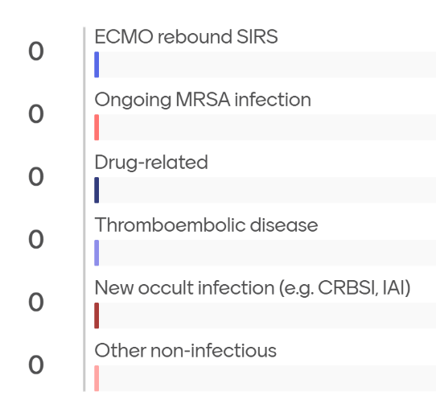
[Q3.1] DDx

Slide 66
Case 3: Infectious workup
57 y/o M w/ COPD, DM (A1c 9), CV disease admitted to MICU for ARDS 2/2 severe pneumonia H flu & GBS. Prolonged ICU course, including VAP c/b MRSA bacteremia (day 18). ID consulted on hospital day 32 for new sepsis (worsening hemodynamics & leukocytosis)
CTA C/A/P (D29): Extensive SQ emphysema from pneumothorax, but otherwise unrevealing
Duplex (D29): Acute RUE DVT
Lines were all exchanged at time of decannulation (has new fem CVC)
LFTs unremarkable (stable alk phos elevation)
Pressor requirements improve alongside leukocytosis
Cefepime
Ceftaroline
Vanc / Zyvox
Vanc
X
= Neg BCx
1
2
3
4
5
6
7
8
9
10
11
12
13
14
15
16
17
18
19
20
21
22
23
24
25
26
27
28
29
30
31
32
VV ECMO
ID consult
BAL: H flu & GBS
BAL: MRSA
BCx: MRSA
BAL: MRSA

Slide 67
Skipped for time

Slide 68
Case 3: ID recs
57 y/o M w/ COPD, DM (A1c 9), CV disease admitted to MICU for ARDS 2/2 severe pneumonia H flu & GBS. Prolonged ICU course, including VAP c/b MRSA bacteremia (day 18). ID consulted on hospital day 32 for new sepsis (worsening hemodynamics & leukocytosis)
Recommendations
Might have been ECMO decannulation masquerading as sepsis (+/- DVT)
Obtain HIV and HCV screen
4 weeks of vanco from negative BCx
Cefepime
Ceftaroline
Vanc / Zyvox
Vanc
X
= Neg BCx
1
2
3
4
5
6
7
8
9
10
11
12
13
14
15
16
17
18
19
20
21
22
23
24
25
26
27
28
29
30
31
32
VV ECMO
ID consult
BAL: H flu & GBS
BAL: MRSA
BCx: MRSA
BAL: MRSA

Slide 69
Case 3: Hospital course
57 y/o M w/ COPD, DM (A1c 9), CV disease admitted to MICU for ARDS 2/2 severe pneumonia H flu & GBS. Prolonged ICU course, including VAP c/b MRSA bacteremia (day 18). ID consulted on hospital day 32 for new sepsis (worsening hemodynamics & leukocytosis)
After we sign off, he develops a leukocytosis again → BCx recollected → Low grade MRSA bacteremia again
Decannulated
ID consult
BCx: MRSA
CBC | D28 | D29 | D30 | D31 | D32 | D33 | D34 | D35 | D36 | D37 | D38
WBC | 18 | 40 | 33 | 25 | 25 | 21 | 16.7 | 27.5 | 22.0 | 19.2 | 18.0
Hgb | 11.3 | 10.1 | 9.7 | 8.6 | 9.6 | 9.1 | 8.6 | 9.9 | 8.7 | 8.4 | 8.8
Plts | 186 | 176 | 136 | 105 | 119 | 148 | 156 | 199 | 206 | 233 | 255
CRP | --- | --- | --- | --- | --- | --- | --- | --- | --- | 61 | ---

Slide 70
Case 3: Hospital course
57 y/o M w/ COPD, DM (A1c 9), CV disease admitted to MICU for ARDS 2/2 severe pneumonia H flu & GBS. Prolonged ICU course, including VAP c/b MRSA bacteremia (day 18). ID consulted on hospital day 32 for new sepsis (worsening hemodynamics & leukocytosis)
After we sign off, he develops a leukocytosis again → BCx recollected → Low grade MRSA bacteremia again
Recommendations
Get TEE (negative)
Line sepsis BCx for his HD line
4 weeks of vanco from negative BCx
  Add 1 week of ceftaroline
Decannulated
ID consult
BCx: MRSA
CBC | D28 | D29 | D30 | D31 | D32 | D33 | D34 | D35 | D36 | D37 | D38
WBC | 18 | 40 | 33 | 25 | 25 | 21 | 16.7 | 27.5 | 22.0 | 19.2 | 18.0
Hgb | 11.3 | 10.1 | 9.7 | 8.6 | 9.6 | 9.1 | 8.6 | 9.9 | 8.7 | 8.4 | 8.8
Plts | 186 | 176 | 136 | 105 | 119 | 148 | 156 | 199 | 206 | 233 | 255
CRP | --- | --- | --- | --- | --- | --- | --- | --- | --- | 61 | ---

Slide 71

Discussion
Links to articles discussed here

Slide 72
Time to learn!
Drug induced aseptic meningitis
Drug fever (caused by eplerenone)
ECMO decannulation fever

Slide 73
Drug induced aseptic meningitis
Rare cause of aseptic meningitis. Most common culprits are:
NSAIDs ^{[1]}: leading overall cause (mainly ibuprofen)^{[4]}
Antibiotics (11%) [4]: Most commonly TMP-SMX
  Amox or Augmentin accounted for 5% of all cases

Slide 74
Drug induced aseptic meningitis
Rare cause of aseptic meningitis. Most common culprits are:
NSAIDs ^{[1]}: leading overall cause (mainly ibuprofen)^{[4]}
Antibiotics (11%) [4]: Most commonly TMP-SMX
  Amox or Augmentin accounted for 5% of all cases
IVIG: May occur in up to 1% of patients, sometimes with month long delay [1]
Monoclonal antibodies and immune checkpoint inhibitors [1]

Slide 75
Drug induced aseptic meningitis
Rare cause of aseptic meningitis. Most common culprits are:
NSAIDs ^{[1]}: leading overall cause (mainly ibuprofen)^{[4]}
Antibiotics (11%) [4]: Most commonly TMP-SMX
  Amox or Augmentin accounted for 5% of all cases
IVIG: May occur in up to 1% of patients, sometimes with month long delay [1]
Monoclonal antibodies and immune checkpoint inhibitors [1]
Perhaps a predisposition to occur in those with autoimmune conditions [1], especially from NSAIDs [3]
Perhaps related to hypersensitivity reaction

Slide 76
DIAM: Pathophysiology ^{[4]}
Pathophysiology not well understood, but favored to be immune mediated &/or hypersensitivity reactions (likely type III or IV)

Slide 77
DIAM: Pathophysiology ^{[4]}
Pathophysiology not well understood, but favored to be immune mediated &/or hypersensitivity reactions (likely type III or IV)
Some studies found increased immune complex production in CSF (type III)
  Seen in NSAID cases [3] and some antibiotic cases
  Not a consistent finding, so still controversial

Slide 78
DIAM: Pathophysiology ^{[4]}
Pathophysiology not well understood, but favored to be immune mediated &/or hypersensitivity reactions (likely type III or IV)
Some studies found increased immune complex production in CSF (type III)
  Seen in NSAID cases [3] and some antibiotic cases
  Not a consistent finding, so still controversial
For other etiologies, possible cytokine release (monoclonal antibodies & IVIG)

Slide 79
DIAM: Pathophysiology ^{[4]}
Pathophysiology not well understood, but favored to be immune mediated &/or hypersensitivity reactions (likely type III or IV)
Some studies found increased immune complex production in CSF (type III)
  Seen in NSAID cases [3] and some antibiotic cases
  Not a consistent finding, so still controversial
For other etiologies, possible cytokine release (monoclonal antibodies & IVIG)
Timing fits well: Delayed onset, recurrence if rechallenged (in some cases)

Slide 80
DIAM: Pathophysiology
Pathophysiology not well understood, but favored to be immune mediated &/or hypersensitivity reactions (likely type III or IV) [4]
Onset: Usually within a week (hours to days)
After stopping the drug, improvement occurs within 2-3 days [1]

Slide 81
DIAM: Pathophysiology
Pathophysiology not well understood, but favored to be immune mediated &/or hypersensitivity reactions (likely type III or IV) [4]
Onset: Usually within a week (hours to days)
After stopping the drug, improvement occurs within 2-3 days [1]
Often have recurrence if rechallenged
Amoxicillin: >95% of re-challenges had recurrence [2]
NSAIDs: 61% had recurrence [3]

Slide 82
DIAM: Diagnosis
Relies heavily on the exposure to the drug and ruling out alternate causes
Similar/identical symptoms as bacterial or viral meningitis
  Fever, headache, photophobia, meningismus
CSF profile can mimic other causes

Slide 83
DIAM: Diagnosis
Relies heavily on the exposure to the drug and ruling out alternate causes
Similar/identical symptoms as bacterial or viral meningitis
  Fever, headache, photophobia, meningismus
CSF profile can mimic other causes
CSF findings | NSAIDs [3] (mainly ibuprofen) | Beta-lactams [2] (mainly amox)
WBC, median (range) | 280 (9-5,000) | 160 (18-640)
Predominant cell type | Neutrophilic (72.2% of cases) | Usually neutrophilic, but some lymphocytic
Protein, median (range) | 132 (32 – 857) | Usually elevated
Glucose, median (range) | 62 (27 - 109) | Usually normal, sometimes low

Slide 84
Drug fever
Drug induced aseptic meningitis
Drug fever (caused by eplerenone)
ECMO decannulation fever

Slide 85
Drug fevers caused by eplerenone
<<< this slide is intentionally left blank >>>

Slide 86
Drug fevers (overall) [5]
Drugs are estimated to be the cause of 3 to 7% of febrile episodes in hospitalized patients

Slide 87
Drug fevers (overall) [5]
Drugs are estimated to be the cause of 3 to 7% of febrile episodes in hospitalized patients
Antibiotics account for a third of cases
Beta-lactams are the most common causes
Other common culprits include sulfonamides & minocycline

Slide 88
Drug fevers (overall) [5]
Drugs are estimated to be the cause of 3 to 7% of febrile episodes in hospitalized patients
Antibiotics account for a third of cases
Beta-lactams are the most common causes
Other common culprits include sulfonamides & minocycline
Other common (non-antibiotics)
Anticonvulsants (phenytoin, carbamazepine)
Allopurinol, methyldopa, heparin, quinidine, and more

Slide 89
Drug fevers: Classification [5]
Hypersensitivity reaction: Classically, onset is 7 - 10 days. Can vary substantially
Infusion-related reaction: Onset minutes to hours
DRESS: Severe rash + fever + visceral involvement + eosinophilia (2-6 weeks onset)
Hyperthermic Syndromes: includes serotonin syndrome (hours to days) and neuroleptic malignant syndrome (1-2 weeks)

Slide 90
Drug fevers: Clinical presentation [5]
Fevers!

Slide 91
Drug fevers: Clinical presentation [5]
Fevers!
Otherwise, lacks localizing symptoms
May have peripheral eosinophilia (25% of cases)
Rash only in 5% of cases

Slide 92
Drug fevers: Clinical presentation [5]
Fevers!
Otherwise, lacks localizing symptoms
May have peripheral eosinophilia (25% of cases)
Rash only in 5% of cases
Onset from starting | Median 2 days (IQR 1 - 10.5 days) If hypersensitivity reaction, 7-10 days
Resolution after stopping | Median 3 days (IQR 1 - 11.5 days)
Rechallenge | If rechallenged (38% of cases), fever recurred 100% of the time Not advisable to rechallenge in some cases (e.g DRESS)

Slide 93
Fever/SIRS after ECMO
Drug induced aseptic meningitis
Drug fever (caused by eplerenone)
ECMO decannulation fever

Slide 94
ECMO decannulation SIRS
Very common phenomenon: occurs in 44 - 75% of ECMO survivors [7, 8, 9]
Not clearly defined but usually characterized by
Fever (often within 24 hours)
Leukocytosis
Vasopressor escalation

Slide 95
Non-infectious? Normal response
Resetting thermoregulation [7][8]
ECMO (and CRRT) make the blood cooler → hypothalamus set point is increased
Decannulation is like removing the cooling blanket

Slide 96
Non-infectious? Normal response
Resetting thermoregulation [7][8]
ECMO (and CRRT) make the blood cooler → hypothalamus set point is increased
Decannulation is like removing the cooling blanket
Cytokine release [7]
While cannulated, blood is being exposed to non-endothelialized material
ECMO blunts the fever curve (as above)

Slide 97
Non-infectious? Normal response
Resetting thermoregulation [7][8]
ECMO (and CRRT) make the blood cooler → hypothalamus set point is increased
Decannulation is like removing the cooling blanket
Cytokine release [7]
While cannulated, blood is being exposed to non-endothelialized material
ECMO blunts the fever curve (as above)
Thrombosis [7][8]
Decannulation is associated with thrombosis in up to 10% of cases
We all know what happens with DVTs…

Slide 98
Non-infectious? Not always
Infections are common [7][8]
By definition, these patients have “central lines” (that are quite large gauge)
  Manipulation occurs during removal / decannulation
VV ECMO has high rates of VAP
59 to 72% of patients have an infectious source identified for their fever [8][9]
  This varied a lot by study. Citation #7 only had
    34% who had an infection identified
    8% of the febrile cohort had bloodstream infections

Slide 99
Non-infectious? Not always
Infections are common [7][8]
By definition, these patients have “central lines” (that are quite large gauge)
  Manipulation occurs during removal / decannulation
VV ECMO has high rates of VAP
59 to 72% of patients have an infectious source identified for their fever [8][9]
  This varied a lot by study. Citation #7 only had
    34% who had an infection identified
    8% of the febrile cohort had bloodstream infections

Slide 100
How to tell if it’s an infectious fever
Quite simple… wait to see if they die (odds ratio of death if from infection is 6) [7]

Slide 101
How to tell if it’s an infectious fever
Quite simple… wait to see if they die (if from infection, odds ratio of death is 6) [7]

Slide 102
How to tell if it’s an infectious fever
Very challenging to distinguish infectious SIRS from “sterile SIRS”
Both conditions have similar levels of cytokines [8]
Timing of SIRS is similar (early on)

Slide 103
How to tell if it’s an infectious fever
Very challenging to distinguish infectious SIRS from “sterile SIRS”, especially before day 7
Suggestive of “sterile SIRS”
Transient fever (median 4 days)
Prompt hemodynamic improvement
WBC peaks below 30k

Slide 104
How to tell if it’s an infectious fever
Very challenging to distinguish infectious SIRS from “sterile SIRS”, especially before day 7
Suggestive of “sterile SIRS”
Transient fever (median 4 days)
Prompt hemodynamic improvement
WBC peaks below 30k
Red flags
Hypothermia (OR_{death} = 6.67) [7]
CRP doesn’t normalize
Prolonged fever

Slide 105
How to tell if it’s an infectious fever
Very challenging to distinguish infectious SIRS from “sterile SIRS”, especially before day 7
Suggestive of “sterile SIRS”
Transient fever (median 4 days)
Prompt hemodynamic improvement
WBC peaks below 30k
Red flags
Hypothermia (OR_{death} = 6.67) [7]
CRP doesn’t normalize
Prolonged fever
Decannulated
ID consult
BCx: MRSA
CBC | D28 | D29 | D30 | D31 | D32 | D33 | D34 | D35 | D36 | D37 | D38
WBC | 18 | 40 | 33 | 25 | 25 | 21 | 16.7 | 27.5 | 22.0 | 19.2 | 18.0
Hgb | 11.3 | 10.1 | 9.7 | 8.6 | 9.6 | 9.1 | 8.6 | 9.9 | 8.7 | 8.4 | 8.8
Plts | 186 | 176 | 136 | 105 | 119 | 148 | 156 | 199 | 206 | 233 | 255
CRP | --- | --- | --- | --- | --- | --- | --- | --- | --- | 61 | ---

Slide 106

How good is ChatGPT with these cases?

Slide 107
Methods
Models used:
ChatGPT 5.2
Gemini 3 Pro
Materials provided to the LLMs:
Identical versions of these slides* in PDF format
Prompts (see upcoming slides)
(*) My slides always have some details altered so as to not contain any PHI. I omitted screenshots of anything taken from Epic, but otherwise gave the LLMs the same information (these slides) as I gave you

Slide 108
Case 1: Summary
LP
WBC | 105
Neut (%) | 1%
Lymph (%) | 82%
RBC | 1
Protein | 92
Glucose | 50
Pending | Result
Blood Cx | ???
uStrep/Legionella | ???
CSF biofire | ???
CSF cultures | ???
HSV/VZV PCR | ???
A 66 y/o M with no real PMH p/w headache → fevers → intermittent encephalopathy i/s/o R maxillary root canal (8 days ago). Told that he may have a small dental abscess, but not getting better on Augmentin
CT facial bones
No collections or acute abnormalities
Chat GPT
You are an infectious disease physician and an expert in clinical reasoning. Reason through the attached case. At the end, assign a probability to each of your differential diagnoses
DDx?
More workup?
Headache (improving)
Fever (despite antipyretics)
Root
Canal
AMS → Sleepy
Treatment?
-8
-5
-4
ED
-1
ED
Amox
Augmentin

Slide 109
Case 1.1 - ChatGPT (excerpts)
What stands out in this case
Syndrome: acute meningoencephalitis (headache → high fevers → fluctuating confusion/somnolence).
CSF pattern: WBC 105 with 82% lymphocytes, protein 92, glucose 50, RBC 1 → strongly favors viral/arboviral etiologies (or “atypical”/partially treated bacterial), and argues against classic untreated pyogenic meningitis.
Systemic inflammation: CBC essentially normal, CRP <0.4 despite 103°F fever (that discordance is very compatible with several viral encephalitides).
Timing: symptoms begin after a root canal and short courses of amoxicillin/Augmentin, but imaging and OMFS exam don’t support an ongoing odontogenic abscess.
Season/exposure: later fall + outdoors in an endemic region makes arboviruses/tick-borne CNS infections plausibly relevant even without recalled bites.

Slide 110
Case 1.1 - ChatGPT DDx
Based on the information provided so far (before pending results):
Arboviral encephalitis (West Nile most likely): 32%
HSV encephalitis: 22%
VZV meningoencephalitis: 12%
Tick-borne viral encephalitis (e.g., Powassan): 10%
Partially treated bacterial meningitis (incl. odontogenic source): 9%
Listeria meningoencephalitis: 6%
Drug-induced aseptic meningitis (beta-lactam–associated): 5%
TB/fungal/chronic meningitis mimics: 4%
If you share the pending test results (CSF BioFire, HSV/VZV PCR, cultures, blood cultures, and any MRI findings), I’ll update the probabilities sharply—those data are highly discriminating in this differential

Slide 111
Case 1.1 - ChatGPT (excerpts)
Differential diagnosis (with reasoning)
Arboviral encephalitis (esp. West Nile virus)
Best fit for: older adult, fever + encephalopathy, lymphocytic CSF with elevated protein and near-normal glucose; often minimal routine lab inflammation. Season (late summer/fall) supports it.
[omitted 2-4 for space]
Partially treated bacterial meningitis (odontogenic source or other):
Prior amoxicillin/Augmentin could blunt CSF neutrophils/culture yield. However the CSF glucose is not low and CRP is strikingly low, making this less likely than viral causes
Drug-induced aseptic meningitis (beta-lactam–associated):
Temporal association is plausible (multiple beta-lactam exposures), and CSF can be lymphocytic. But here the illness appears to start before Augmentin and is quite febrile with encephalopathy, so this is a “keep on the list” rather than leading diagnosis.
[omitted 7-8 for space]

Slide 112
Case 1: Hospital course
Thought process
History is concerning for systemic infection &/or meningitis
Trigger seems to be related to dental procedure
Await:
West nile
Blood cultures → Negative
MRI brain → Negative
CSF HSV/VZV → Negative
Biofire → Negative
Strep/Legionella → Negative
Chat GPT
Reason through the remaining information (attached). At the end, assign a probability to each of your differential diagnoses. The next slide will reveal the diagnosis
Hospital course
CSF PCRs normal, stop acyclovir
Really doing quite well
  But workup has all been negative
Develops itchy pustular rash on day 2-3
Antimicrobials
Ceftriaxone 2 q12h
CNS vanco (also covering oral strep)
Flagyl q12h (for mouth bugs)
Acyclovir

Slide 113
Case 1.2 - ChatGPT (excerpts)
3. New critical clue: itchy pustular rash on hospital day 2–3
Appears after several days of beta-lactams and vancomycin
Described as itchy, pustular, diffuse (on slide 4)
This is a major inflection point.
Reframing the illness as a unified syndrome
At this stage, we must ask:
What explains high fevers + meningoencephalitis + lymphocytic CSF + negative infectious workup + rapid improvement + delayed pustular rash?
This combination strongly points away from infection and toward drug-mediated or immune-mediated aseptic meningitis.

Slide 114
Case 1.2 - ChatGPT DDx
Final probability assignment (after full data):
Drug-induced aseptic meningitis / encephalopathy (beta-lactam–associated): 65%
Arboviral encephalitis (West Nile or related): 15%
Other viral meningoencephalitis not on standard panels: 7%
Partially treated bacterial meningitis (odontogenic or other): 5%
Tick-borne viral encephalitis (e.g., Powassan): 4%
Autoimmune / inflammatory encephalitis: 2%
Listeria meningoencephalitis: 2%

Slide 115
Case 2
Chat GPT

Slide 116
Prompt (new session)
You are an infectious disease physician and an expert in clinical reasoning. You are attending a weekly conference where the ID fellows present cases seen during their time on service.
You know this particular fellow cleverly titles their presentation with punny titles (“Hot Blooded” in this case), and you’ve already reasoned through case #1. The first case was about an acute febrile meningoencephalopathy with lymphocytic CSF after a dental procedure, prompting broad empiric treatment for infectious meningitis, though extensive CSF, blood, and MRI evaluation was negative. Careful timeline reconstruction revealed early NSAID exposure for headache, followed by antibiotics, with rapid clinical improvement and a delayed pruritic rash supporting drug-induced aseptic meningitis, most likely NSAID-triggered (with possible beta-lactam contribution).

Slide 117
Case 2: Summary
A 63 y/o M with PMH including controlled HIV, prior positive PPD, HFrEF, s/p AVR & MVR p/w FUO x 4 weeks.
Had viral illness symptoms (+sick contacts) at onset, improved after a week but still ongoing. Not improved with doxy, prednisone, or clinda. Routine labs normal, as is CXR, but diaphoretic on exam and still having fevers to 38C despite some improvement in his other symptoms
Any more HPI?
Top 3 DDx?
Initial management?
Chat GPT
You are now working on the second case.
The first portion of the second case is attached. Reason through the case. At the end, assign a probability to each of your differential diagnoses

Slide 118
Case 2.1 - ChatGPT (excerpts)
Problem representation
63M with well-controlled HIV (CD4 >500, suppressed) and mechanical AVR + MVR placed ~2 years ago presents with ~4 weeks of persistent fevers that began with a clustered URI-like illness among friends (rhinorrhea/postnasal drip, productive morning cough, ear fullness, “flu-like” headaches sometimes with blurry vision when severe). Most symptoms partially improved after week 1, but fevers persist (often 99–100°F but with documented fevers to ~38°C per summary), and he is diaphoretic. No weight loss, night sweats, rash, dyspnea, myalgias. No known tick exposure. No response to doxycycline + prednisone, nor clindamycin (now diarrhea). CBC/CMP normal, CXR normal, TTE with poor windows. Intermittent SVT/Afib RVR episodes during illness.
This is essentially FUO/subacute fever with initial URI prodrome, but the big “can’t-miss” anchor is prosthetic valves + inadequate echo windows.

Slide 119
Case 2.1 - ChatGPT (excerpts)
High-yield discriminators embedded in the vignette
1) Prosthetic material + persistent fever = endocarditis until proven otherwise
Even if the symptoms started like a viral syndrome, the risk profile (mechanical AVR/MVR) forces us to treat prosthetic valve endocarditis (PVE) as a top diagnosis early….
2) “Headache + blurred vision when severe” raises specific “don’t miss” alternatives
This could still be “sinus pressure headaches,” but in FUO land you have to consciously screen for giant cell arteritis (age >50, headache, transient visual symptoms; fever of unknown origin can be presenting feature)...
3) Occupational/exposure history hints at “zoonotic / TB-ish” possibilities
“Was in Africa for 1–2 years in the 80s” and “teaches college courses at a prison”...
Prior “cat-scratch” history is remote (2016), but Bartonella is also a classic culture-negative endocarditis cause…

Slide 120
Case 2.1 - ChatGPT (excerpts)
Initial management priorities (what I’d push the fellows to do right away)
Confirm the fever: objective documented temperatures at home/in clinic, pattern, associated rigors.
Stop clindamycin unless there’s a proven indication (it’s not helping; causing diarrhea).
Blood cultures x3 and basic inflammatory markers (ESR/CRP), plus repeat CBC w diff.
TEE (or advanced cardiac imaging) urgently given mechanical AVR/MVR and poor TTE.
If headaches/visual symptoms persist: evaluate for GCA in parallel without letting it derail the endocarditis workup.

Slide 121
Case 2.1 - ChatGPT DDx
Probabilistic differential (based only on Break 1)
These are my best estimates with current information; they’ll change a lot with vitals trend, labs (ESR/CRP), blood cultures, imaging, and a more detailed exposure history.
Prosthetic valve endocarditis (including culture-negative PVE): 40%
Occult ENT infection (sinusitis/mastoiditis/other head & neck source): 18%
Giant cell arteritis (or other large-vessel vasculitis): 12%
Tuberculosis (esp. extrapulmonary): 8%
Prolonged viral/post-viral syndrome: 8%
Antibiotic complication (C. diff) contributing to fever now: 6%
Malignancy (lymphoma/solid tumor) presenting as FUO: 4%
Other atypical zoonoses causing culture-negative endocarditis (Coxiella/Bartonella/Brucella, etc.) as primary diagnosis distinct from “PVE bucket”: 4%

Slide 122
Case 2: What will reveal the diagnosis?
Infectious | Result
Endocarditis BCx | Neg
Lyme | Neg
Tick panel | Neg
Blood parasite smear | Neg
Blasto Ag | Neg
Histo Ag | ---
Crypto Ag | Neg
QuantGold | Neg
Lumbar puncture | ---
Strep/Legionella | Neg
UA | Neg
Imaging | Result
CT C/A/P | Neg
MRI brain | Neg
TEE | Neg
CTA heart | Neg
Cardiac PET | ---
Whole body PET | ---
Viral | Result
Resp biofire | Neg
GI biofire | ---
Serum CMV | Neg
Monospot | Neg
Karius (mNGS) | ?????
Chat GPT
Reason through the remaining information (attached). At the end, assign a probability to each of your differential diagnoses.
Non-ID | Result
Flow cytometry | ---
Tumor markers | ---
Rheum consult | ???

Slide 123
Case 2.2 - ChatGPT (excerpts)
How Break 2 changes the reasoning
Prosthetic valve endocarditis (PVE): much less likely, but not fully gone
A negative TEE + negative CTA heart + negative cardiac PET substantially lowers the probability of clinically meaningful PVE…
“Infectious FUO” broadly: the net is tightening
At this point, the remaining infectious possibilities tend to be:
culture-negative endocarditis pathogens not captured by routine BCx (Coxiella, Bartonella…)
occult localized infection not imaged (notably sinuses/mastoid/dental) consistent with persistent headache
less common infections where routine screening is insensitive early or needs targeted testing
Noninfectious causes climb
vasculitis / inflammatory disease (even though normal CRP would argue against many; we need actual values)
drug fever / autonomic dysregulation / factitious fever

Slide 124
Case 2.2 - ChatGPT DDx
Updated probability assignment (Break 1 + Break 2 combined)
These are my best estimates with current information; they’ll change a lot with vitals trend, labs (ESR/CRP), blood cultures, imaging, and a more detailed exposure history.
Occult ENT/dental infection (sinus/mastoid/dental/deep neck): 22%
Culture-negative prosthetic valve endocarditis (Coxiella/Bartonella/other): 18%
Giant cell arteritis / other vasculitis: 15%
Post-viral / prolonged convalescent inflammatory syndrome: 12%
Malignancy (esp. lymphoma or occult hematologic): 10%
Tuberculosis (esp. extrapulmonary): 8%
Medication-related fever and/or antibiotic complication (incl. C. diff if clinically fits): 7%
Other atypical infections not yet targeted (e.g., Brucella, Whipple): 5%
Construction-related environmental illness (hypersensitivity/toxic exposure): 3%
If you attach the next segment (where LP/Karius/rheum consult results usually land), I’ll “Bayes-update” these sharply

Slide 125
Case 3
Chat GPT

Slide 126
Case 3: Summary
Day 29: worsening hemodynamics & leukocytosis. Repeat blood cultures are negative, vent settings stable, and respiratory Cx are still growing MRSA
57 y/o M w/ COPD, DM (A1c 9), CV disease admitted to MICU for ARDS 2/2 severe pneumonia H flu & GBS. Prolonged ICU course, including VAP c/b MRSA bacteremia (day 18). ID consulted on hospital day 32 for new sepsis
CBC | D28 | D29 | D30 | D31 | D32
WBC | 18 | 40 | 33 | 25 | 25
Hgb | 11.3 | 10.1 | 9.7 | 8.6 | 9.6
Plts | 186 | 176 | 136 | 105 | 119
CRP | --- | --- | --- | --- | ---
DDx?
Cefepime
Ceftaroline
Vanc / Zyvox
Vanc
X
= Neg BCx
1
2
3
4
5
6
7
8
9
10
11
12
13
14
15
16
17
18
19
20
21
22
23
24
25
26
27
28
29
30
31
32
VV ECMO
ID consult
BAL: H flu & GBS
BAL: MRSA
BCx: MRSA
BAL: MRSA

Slide 127
Case 3.1 - ChatGPT DDx
Probability-weighted differential
Assigning probabilities based on only the data up to this point (recognizing these will shift with additional labs/imaging):
Post-ECMO inflammatory rebound / sterile SIRS – 35%
Best explains timing, leukocytosis, shock physiology, and negative cultures.
Ongoing MRSA-driven inflammatory response without true new infection – 20%
Colonized lungs driving inflammation rather than bacteremia.
Drug-related inflammatory syndrome (ceftaroline > vancomycin) – 15%
Plausible timeline and pattern, though lacking classic features.
Occult thromboembolic disease (PE) – 15%
Dangerous, culture-negative, and often missed without targeted imaging.
New occult infection (line-related, intra-abdominal, etc.) – 10%
Always possible, but current evidence is thin.
Other immune dysregulation (HLH-like, marrow stress) – 5%
On the list, but not leading without more supportive labs.

Slide 128
Gemini might anchor a little too much

Slide 129
Case 1.1 - Gemini (excerpts)
Differential Diagnosis & Reasoning
Geography: The mention of travel to the "Cumberland area" is a high-yield board clue. The Cumberland Plateau and Appalachian region (encompassing parts of TN, NC, WV, VA, KY, and MD) is the endemic hotspot for La Crosse Encephalitis. This might not be fair, since he didn’t actually go to Cumberland (but similar-ish travel Hx)
Season: The presentation is "later in the fall," which aligns with the end of the mosquito season (late spring to early fall) and the incubation period of arboviruses.
Labs: Hyponatremia (Na 130) is a classic association with La Crosse Encephalitis (due to SIADH), observed more frequently than in other arboviral infections.
CSF Profile: The CSF shows a lymphocytic pleocytosis (WBC 105, 82% Lymphs) with elevated protein (92) and normal glucose, which is consistent with viral meningoencephalitis.
Incubation: While primarily a pediatric disease, it affects adults and can be severe. The incubation period (5-15 days) fits the timeline if he was exposed shortly before or during his trip (neuro symptoms started ~3-5 days after the trip).

Slide 130
Case 1.1 - Gemini DDx
Final Diagnosis & Probability
The strongest specific clue is the geographic location ("Cumberland") combined with the clinical syndrome of hyponatremic lymphocytic meningoencephalitis. While the root canal provides a tempting red herring (or a potential HSV trigger), the "Cumberland" detail is likely the key discriminator intended to point toward the endemic arbovirus.
La Crosse Encephalitis: 45%
HSV Encephalitis: 35%
Listeria Meningitis: 10%
West Nile Virus: 5%
Other (Enterovirus, unrecognized abscess): 5%

Slide 131
Case 1.2 - Gemini DDx
The patient suffered from La Crosse Encephalitis (acquired during travel to the Cumberland area), explaining the fever, confusion, headache, hyponatremia, and lymphocytic CSF. He is recovering as expected for a viral etiology. During his treatment, he developed AGEP, a drug reaction to the high-dose antibiotics (Ceftriaxone or Vancomycin) he was receiving.
La Crosse Encephalitis (California Serogroup)
  Probability: 85%
  Reasoning: Perfect geographic match (Cumberland), clinical phenotype (hyponatremic aseptic meningitis), and negative workup for HSV/Bacteria. The patient's improvement supports a viral etiology.
West Nile Virus Encephalitis
  Probability: 10%
  Reasoning: Clinically indistinguishable from La Crosse without serology. Lower probability only because "Cumberland" is a specific buzzword for La Crosse.
Enteroviral Meningitis
  Probability: 5%
  Reasoning: Common cause of aseptic meningitis in the fall. Less specific geography.
(Note: The rash is diagnosed as AGEP (Drug Reaction) with >90% certainty, secondary to the antibiotic treatment.)

Slide 132
Case 1.2 - Gemini (trying to help it now)
User: A colleague raised the possibility of drug-induced aseptic meningitis. What are your thoughts on this possibility?
This is an excellent and sophisticated thought from your colleague. Given the clinical course, Drug-Induced Aseptic Meningitis (DIAM) is a valid and important differential diagnosis to consider, specifically Amoxicillin-induced.[1][2]
Here is a breakdown of why this hypothesis is strong, but ultimately why La Crosse Encephalitis remains the leading diagnosis…While DIAM explains the meningitis, it fails to explain three specific "high-yield" features of this case that point directly to La Crosse virus:

Slide 133
Case 1.2 - Gemini (trying to help it now)
User: A colleague raised the possibility of drug-induced aseptic meningitis. What are your thoughts on this possibility?
This is an excellent and sophisticated thought from your colleague. Given the clinical course, Drug-Induced Aseptic Meningitis (DIAM) is a valid and important differential diagnosis to consider, specifically Amoxicillin-induced.[1][2]
Here is a breakdown of why this hypothesis is strong, but ultimately why La Crosse Encephalitis remains the leading diagnosis…While DIAM explains the meningitis, it fails to explain three specific "high-yield" features of this case that point directly to La Crosse virus:

Slide 134
Case 1.2 - Gemini (trying to help it now)
Here is a breakdown of why this hypothesis is strong, but ultimately why La Crosse Encephalitis remains the leading diagnosis…While DIAM explains the meningitis, it fails to explain three specific "high-yield" features of this case that point directly to La Crosse virus:
The Geography ("Cumberland"): In clinical reasoning vignettes, specific geographic details are rarely accidental…
Hyponatremia (Na 130): Hyponatremia due to SIADH is a hallmark feature of La Crosse Encephalitis…While dehydration can occur with DIAM…
Encephalopathy vs. Meningitis: DIAM typically presents as meningitis (headache, stiff neck, photophobia). This patient presented with significant encephalopathy [which] is much more characteristic of a viral invasion of the brain parenchyma (La Crosse)

Slide 135
Case 1.2 - Gemini (trying to help it now)
Final Synthesis
The most likely scenario is Hickam's Dictum (the patient has two distinct problems):
La Crosse Encephalitis caused the admission syndrome (fever, encephalopathy, hyponatremia) following his travel to the Cumberland area.
AGEP (the rash) was a superimposed iatrogenic complication from the high-dose antibiotics used to treat him.
Revised Differential Diagnosis & Probabilities
La Crosse Encephalitis: 80%
Drug-Induced Aseptic Meningitis: 15%
West Nile Virus: 5%

Slide 136
Learning points & take aways

Slide 137
Learning points & take aways
Slides available on hunterratliff1.com/talk/; Citations available via QR code or via the “citations” button on the website

Slide 138
Emphasis (#2f5aa2)
Primary (#3B71CA)
BG subtle (#e2eaf7)
Emphasis (#404247)
Secondary (#9FA6B2)
BG subtle (#f1f2f3)
Emphasis (#0c622e)
Success (#14A44D)
BG subtle (#dcf1e4)
Emphasis (#b03d50)
Danger (#DC4C64)
BG subtle (#fae4e8)
Emphasis (#896110)
Warning (#E4A11B)
BG subtle (#fbf1dd)
Emphasis (#3b7e94)
Info (#54B4D3)
BG subtle (#e5f4f8)
CID conference
Hunter Ratliff
XX/XX/2025
Ages, dates, and other identifying information may have been changed
I have no conflict of interest in relation to this presentation
Don’t forget to use extensions/add-ons
Notes:
Ignore the content in this slide

Slide 139
Emphasis (#2f5aa2)
Primary (#3B71CA)
BG subtle (#e2eaf7)
Emphasis (#b03d50)
Danger (#DC4C64)
BG subtle (#fae4e8)
Emphasis (#C1443C)
Pink (#FF6F61)
BG subtle (#FFE9E6)
Emphasis (#3b7e94)
Info (#54B4D3)
BG subtle (#e5f4f8)
Emphasis (#0c622e)
Success (#14A44D)
BG subtle (#dcf1e4)
Emphasis (#1F7A6C)
Mint/Aqua (#48C9B0)
BG subtle (#f1f2f3)
Emphasis (#404247)
Secondary (#9FA6B2)
BG subtle (#f1f2f3)
Emphasis (#896110)
Warning (#E4A11B)
BG subtle (#fbf1dd)
Emphasis (#6B3E26)
Brown (#A0522D)
BG subtle (#F3E4DB)
Emphasis (#6C3483)
Purple (#8E44AD)
BG subtle (#F0E6F5)
Emphasis (#2C3E50)
Slate grey (#5D6D7E)
BG subtle (#E8ECF1)
1
2
3
4
5
6
7
8
9
10
11
12
13
14
15
16
17
18
19
20
1
2
3
4
5
6
7
8
9
10
1
2
3
4
15
6
7
8
9
20
1
2
3
4
25
6
7
8
9
30
1
2
3
4
5
6
7
8
9
10
1
2
3
4
15
6
7
8
9
20
1
2
3
4
25
6
7
8
9
30
1
2
3
4
35
6
7
8
9
40
1
2
3
4
5
6
7
8
9
10
1
2
3
4
15
6
7
8
9
20
1
2
3
4
25
6
7
8
9
30
1
2
3
4
35
6
7
8
9
40
1
2
3
4
45
6
7
8
9
50
To scale these, select the entire row, go to format options, and make the width the desired width

