Slide 1



The heart of the matter
CLINID conference
Hunter Ratliff
01/29/2025
Ages, dates, and other identifying information may have been changed
I have no conflict of interest in relation to this presentation

Slide 2
Case #1

Slide 3
Case 1: HPI
A 74 y/o F with PMH including DM (A1c 7) c/b R DFU, CAD s/p CABG, Hx mechanical MVR (2015 & 2021) on warfarin, s/p TAVR (9 mo ago), CKD3 p/w worsening R foot wound
Past few days, foot has been red, warm, and swollen
Two days ago might have had episode of chills, but none since
Mild cough for past 3 days
Chronic diarrhea for some time

Slide 4
Case 1: HPI
A 74 y/o F with PMH including DM (A1c 7) c/b R DFU, CAD s/p CABG, Hx mechanical MVR (2015 & 2021) on warfarin, s/p TAVR (9 mo ago), CKD3 p/w worsening R foot wound
Past few days, foot has been red, warm, and swollen
Two days ago might have had episode of chills, but none since
Mild cough for past 3 days
Chronic diarrhea for some time

Slide 5
Case 1: HPI
A 74 y/o F with PMH including DM (A1c 7) c/b R DFU, CAD s/p CABG, Hx mechanical MVR (2015 & 2021) on warfarin, s/p TAVR (9 mo ago), CKD3 p/w worsening R foot wound
Past few days, foot has been red, warm, and swollen
Two days ago might have had episode of chills, but none since
Mild cough for past 3 days
Chronic diarrhea for some time

Slide 6
Case 1: Social history, exposures, & risk factors
Geographic & Travel | Lives alone in PA No travel
Substance & needles | No EtOH, tobacco, or drugs On insulin
Animals | Two dogs at home, no bites or scratches; dogs are cuddly and sleep with her No other animals
Exposures | Doesn’t go outside much; wound hasn’t gotten dirty or soiled

Slide 7
Case 1: Physical exam
BP | 108/48 | Pulse | 53 | SpO2 | 96 %
Temp | 36.6 °C (97.9 °F) | RR | 18 | BMI | 27 kg/m²
General | Alert and oriented, NAD
Resp | Normal respiratory effort, symmetric chest rise
CV | systolic murmur heard throughout pericardium; extremities perfused
GI | Non-distended; no TTP
Extremities | erythematous RLE up to mid shin, plantar foot ulcer
Neuro/MSK | Moves extremities

Slide 8
Case 1: Labs
CBC | Result
WBC | 17.7
Hgb | 10.8
Platelets | 261
Neut % | 85%
Lymph % | 4%
Eos % | 0%
CRP | 255
Chem7 | Result
Na | 134
K | 4.6
HCO3 | 23
BUN | 46
Cr | 1.2

Slide 9
Case 1: Labs
CBC | Result
WBC | 17.7
Hgb | 10.8
Platelets | 261
Neut % | 85%
Lymph % | 4%
Eos % | 0%
CRP | 255
Chem7 | Result
Na | 134
K | 4.6
HCO3 | 23
BUN | 46
Cr | 1.2
LFTs | Result
AST | 32
ALT | 18
Alk Phos | 81
Bili | 0.5
Albumin | 2.2
Coags | Result
INR | 1.55
INR goal 2.5 - 3.5

Slide 10
Case 1: Micro
Date | Culture | Result
Today | Blood

Slide 11
Case 1: Micro
Date | Culture | Result
Today | Blood | STREPTOCOCCUS DYSGALACTIAE

Slide 12
Case 1: Micro
Date | Culture | Result
Today | Blood | STREPTOCOCCUS DYSGALACTIAE
-7 wk | Blood | STREPTOCOCCUS DYSGALACTIAE
-10.56 wk | Blood | No growth
-11 wk | Blood | STREPTOCOCCUS DYSGALACTIAE
Went to Mon

Slide 13
Case 1: Backstory
Admit | Date | BCx results
#3 (Ruby) | Today | STREPTOCOCCUS DYSGALACTIAE
#2 (Mon) | -7 wk | STREPTOCOCCUS DYSGALACTIAE
#1 (Ruby) | -10.56 wk | No growth
 | -11 wk | STREPTOCOCCUS DYSGALACTIAE
Admitted with MICU with n/v and rigors
Admission BCx were positive
Never any pressors

Slide 14
Case 1: Backstory
Admit | Date | BCx results
#3 (Ruby) | Today | STREPTOCOCCUS DYSGALACTIAE
#2 (Mon) | -7 wk | STREPTOCOCCUS DYSGALACTIAE
#1 (Ruby) | -10.56 wk | No growth
 | -11 wk | STREPTOCOCCUS DYSGALACTIAE
Admitted with MICU with n/v and rigors
Admission BCx were positive
Never any pressors
Podiatry: “Right foot ulcer appears stable with no acute signs of infection. Recommend look for other source of current bacteremia…no surgery planned”

Slide 15
Case 1: Backstory
Medicine notes
Admit | Date | BCx results
#3 (Ruby) | Today | STREPTOCOCCUS DYSGALACTIAE
#2 (Mon) | -7 wk | STREPTOCOCCUS DYSGALACTIAE
#1 (Ruby) | -10.56 wk | No growth
 | -11 wk | STREPTOCOCCUS DYSGALACTIAE
# Right lower extremity cellulitis
# Streptococcus dysgalactiae bacteremia
- podiatry evaluated the patient recommended no surgery
- repeat blood cultures negative
- deescalate antibiotics to Rocephin based on sensitivities
- Possible ID consult based on MRI results

Slide 16
Case 1: Backstory
Medicine notes
Admit | Date | BCx results
#3 (Ruby) | Today | STREPTOCOCCUS DYSGALACTIAE
#2 (Mon) | -7 wk | STREPTOCOCCUS DYSGALACTIAE
#1 (Ruby) | -10.56 wk | No growth
 | -11 wk | STREPTOCOCCUS DYSGALACTIAE
# Right lower extremity cellulitis
# Streptococcus dysgalactiae bacteremia
- podiatry evaluated the patient recommended no surgery
- repeat blood cultures negative
- deescalate antibiotics to Rocephin based on sensitivities
- MRI right foot completed and demonstrates no evidence of osteomyelitis

Slide 17
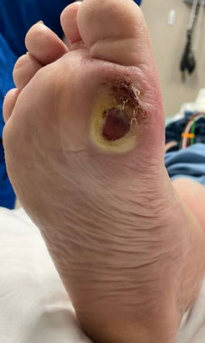
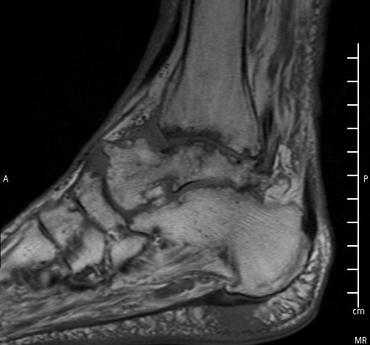
Case 1: Backstory
Medicine notes
Admit | Date | BCx results
#3 (Ruby) | Today | STREPTOCOCCUS DYSGALACTIAE
#2 (Mon) | -7 wk | STREPTOCOCCUS DYSGALACTIAE
#1 (Ruby) | -10.56 wk | No growth
 | -11 wk | STREPTOCOCCUS DYSGALACTIAE
# Right lower extremity cellulitis
# Streptococcus dysgalactiae bacteremia
- podiatry evaluated the patient recommended no surgery
- repeat blood cultures negative
- deescalate antibiotics to Rocephin based on sensitivities
- MRI right foot completed and demonstrates no evidence of osteomyelitis

Slide 18
Case 1: Backstory
Medicine notes
Admit | Date | BCx results
#3 (Ruby) | Today | STREPTOCOCCUS DYSGALACTIAE
#2 (Mon) | -7 wk | STREPTOCOCCUS DYSGALACTIAE
#1 (Ruby) | -10.56 wk | No growth
 | -11 wk | STREPTOCOCCUS DYSGALACTIAE
# Right lower extremity cellulitis
# Streptococcus dysgalactiae bacteremia
- podiatry evaluated the patient recommended no surgery
- repeat blood cultures negative
- deescalate antibiotics to Rocephin based on sensitivities
- Given two prosthetic valves, ordered TEE
- Possible ID consult based on MRI results
- infectious disease consult pending TEE results
MRI hindfoot w/o osteomyelitis

Slide 19
Case 1: Backstory
Medicine notes
Admit | Date | BCx results
#3 (Ruby) | Today | STREPTOCOCCUS DYSGALACTIAE
#2 (Mon) | -7 wk | STREPTOCOCCUS DYSGALACTIAE
#1 (Ruby) | -10.56 wk | No growth
 | -11 wk | STREPTOCOCCUS DYSGALACTIAE
# Right lower extremity cellulitis
# Streptococcus dysgalactiae bacteremia
- podiatry evaluated the patient recommended no surgery
- repeat blood cultures negative
- deescalate antibiotics to Rocephin based on sensitivities
- Given two prosthetic valves, ordered TEE
- Possible ID consult based on MRI results
- infectious disease consult pending TEE results
MRI hindfoot w/o osteomyelitis
TEE continues to be delayed due to elevated INR

Slide 20
Case 1: Backstory (admission #1)
Transthoracic echo
In the presences of prosthetic valves, TEE is the diagnostic modality of choice to evaluate SBE
Left ventricular systolic function is normal
Normal right ventricular systolic function
Transesophageal echo
No stigmata of endocarditis
Normal functioning bioprosthetic mitral and Sapien aortic valves
Mild thickening noted in the aortic cusps in the left coronary position

Slide 21
Case 1: Admission #1
Admit | Date | BCx results
#3 (Ruby) | Today | STREPTOCOCCUS DYSGALACTIAE
#2 (Mon) | -7 wk | STREPTOCOCCUS DYSGALACTIAE
#1 (Ruby) | -10.56 wk | No growth
 | -11 wk | STREPTOCOCCUS DYSGALACTIAE
Got foot MRI, but of the wrong area
Received 1 week of zyvox → ceftriaxone
No ID consult → Discharged

Slide 22
Case 1: Between admissions
Admit | Date | BCx results
#3 (Ruby) | Today | STREPTOCOCCUS DYSGALACTIAE
#2 (Mon) | -7 wk | STREPTOCOCCUS DYSGALACTIAE
#1 (Ruby) | -10.56 wk | No growth
 | -11 wk | STREPTOCOCCUS DYSGALACTIAE
Had routine follow up with structural heart team. They noted her recent bacteremia and reviewed TEE with no concerns

Slide 23
Case 1: Admission #2
Admit | Date | BCx results
#3 (Ruby) | Today | STREPTOCOCCUS DYSGALACTIAE
#2 (Mon) | -7 wk | STREPTOCOCCUS DYSGALACTIAE
#1 (Ruby) | -10.56 wk | No growth
 | -11 wk | STREPTOCOCCUS DYSGALACTIAE
Went to Ruby ED because she had the same tremor as her prior admission (i.e. rigors)

Slide 24
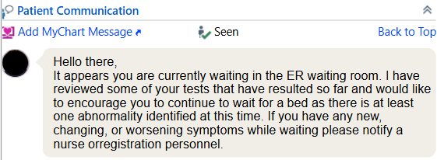
Case 1: Admission #2
Admit | Date | BCx results
#3 (Ruby) | Today | STREPTOCOCCUS DYSGALACTIAE
#2 (Mon) | -7 wk | STREPTOCOCCUS DYSGALACTIAE
#1 (Ruby) | -10.56 wk | No growth
 | -11 wk | STREPTOCOCCUS DYSGALACTIAE
Went to Ruby ED because she had the same tremor as her prior admission

Slide 25
Case 1: Admission #2
Admit | Date | BCx results
#3 (Ruby) | Today | STREPTOCOCCUS DYSGALACTIAE
#2 (Mon) | -7 wk | STREPTOCOCCUS DYSGALACTIAE
#1 (Ruby) | -10.56 wk | No growth
 | -11 wk | STREPTOCOCCUS DYSGALACTIAE
Went to Ruby ED because she had the same tremor as her prior admission
Left without being seen (d/t wait time)
Went to Mon and admitted
Had sesamoidectomy at Mon (a week later)
Bone Cx had MRSA
Discharged on ceftaroline
  Unclear if 4 or 6 wk of Tx

Slide 26
Case 1: Summary
-9 mo
TAVR
A 74 y/o F with PMH including DM (A1c 7) c/b R DFU, CAD s/p CABG, Hx mechanical MVR (2015 & 2021) on warfarin, s/p TAVR (9 mo ago), CKD3 p/w worsening R foot wound and found to be bacteremic with strep dysgalactiae for the third time in the past 3 months
-11 wk
S dysgalactiae
Cleared Bcx in 48h
-7 wk
S dysgalactiae
Went to Mon
Now
BCx positive again

Slide 27
[Q1.1] You can buy one test…
MRI of foot
TTE
TEE
PET scan

Slide 28
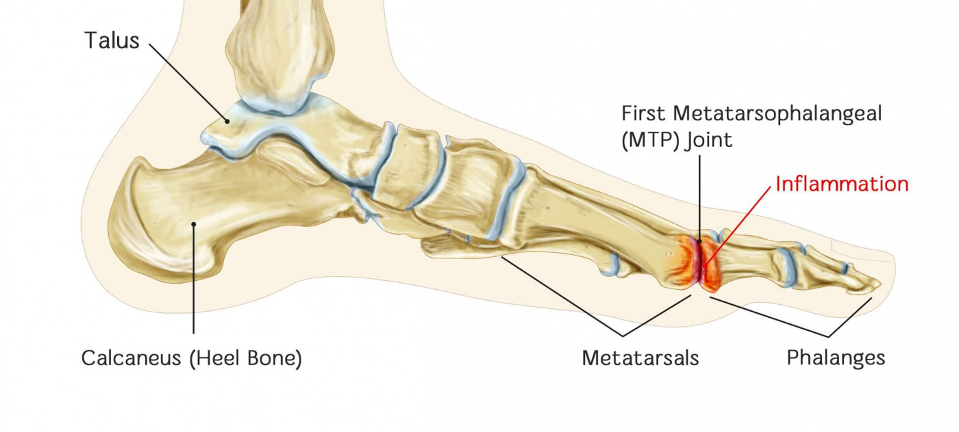
Case 1: Hospital course
The foot
The heart
MRI forefoot: Septic arthritis / osteomyelitis involving the great toe metatarsophalangeal joint
OR: Amputation of right great toe
OR Cx: MRSA & E cloacae
Transthoracic echo: adequate quality. Normal functioning bioprosthetic mitral and Sapien aortic valves
Transesophageal echo: Overall no evidence of infective endocarditis
Aortic prosthesis: Normal-appearing with no paravalvular leak or evidence of vegetation
Mitral: Mild leaflet thickening and leaflet restriction. However, normal gradients and only mild mitral regurgitation. No paravalvular leak or vegetation

Slide 29
Case 1: Hospital course
The foot
The heart
MRI forefoot: Septic arthritis / osteomyelitis involving the great toe metatarsophalangeal joint
OR: Amputation of right great toe
OR Cx: MRSA & E cloacae
Transthoracic echo: adequate quality. Normal functioning bioprosthetic mitral and Sapien aortic valves
Transesophageal echo: Overall no evidence of infective endocarditis
Aortic prosthesis: Normal-appearing with no paravalvular leak or evidence of vegetation
Mitral: Mild leaflet thickening and leaflet restriction. However, normal gradients and only mild mitral regurgitation. No paravalvular leak or vegetation

Slide 30
Case 1: Hospital course
The foot
The heart
MRI forefoot: Septic arthritis / osteomyelitis involving the great toe metatarsophalangeal joint
OR: Amputation of right great toe
OR Cx: MRSA & E cloacae
Transthoracic echo: adequate quality. Normal functioning bioprosthetic mitral and Sapien aortic valves
Transesophageal echo: Overall no evidence of infective endocarditis
Aortic prosthesis: Normal-appearing with no paravalvular leak or evidence of vegetation
Mitral: Mild leaflet thickening and leaflet restriction. However, normal gradients and only mild mitral regurgitation. No paravalvular leak or vegetation

Slide 31
Case 1: Hospital course
The foot
The heart
MRI forefoot: Septic arthritis / osteomyelitis involving the great toe metatarsophalangeal joint
OR: Amputation of right great toe
OR Cx: MRSA & E cloacae
Transthoracic echo: adequate quality. Normal functioning bioprosthetic mitral and Sapien aortic valves
Transesophageal echo: Overall no evidence of infective endocarditis
Aortic prosthesis: Normal-appearing with no paravalvular leak or evidence of vegetation
Mitral: Mild leaflet thickening and leaflet restriction. However, normal gradients and only mild mitral regurgitation. No paravalvular leak or vegetation

Slide 32
[Q1.2] What caused the bacteremia?

Slide 33
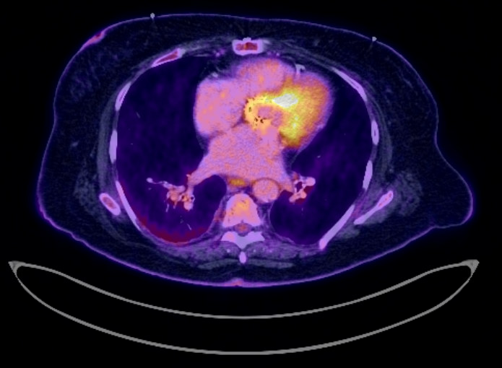
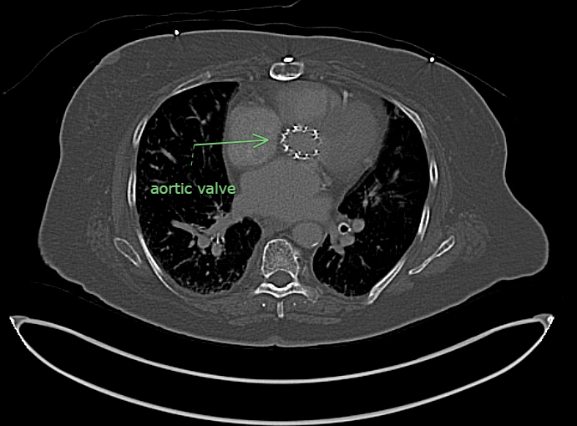

Slide 35
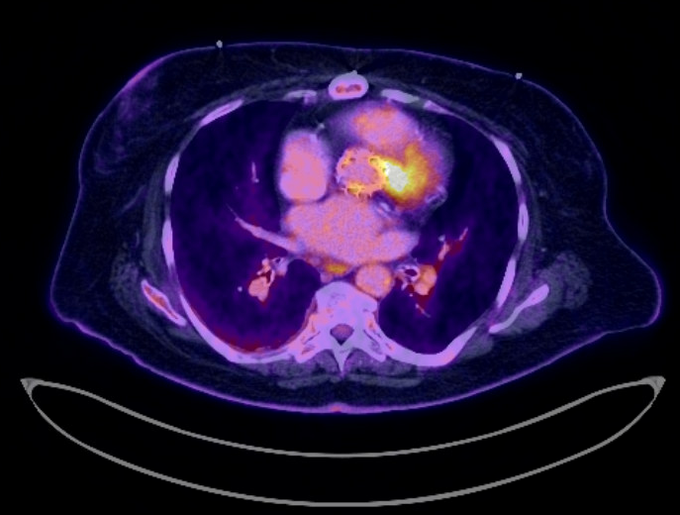
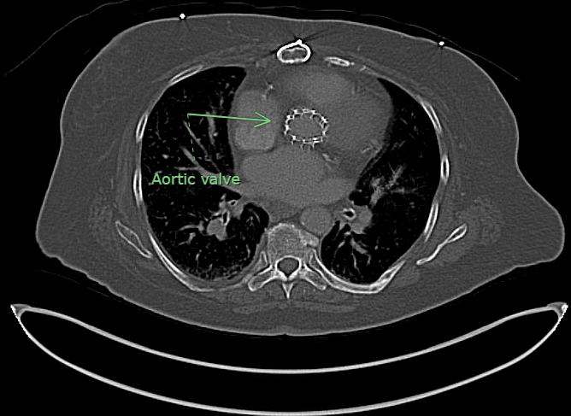

Slide 37
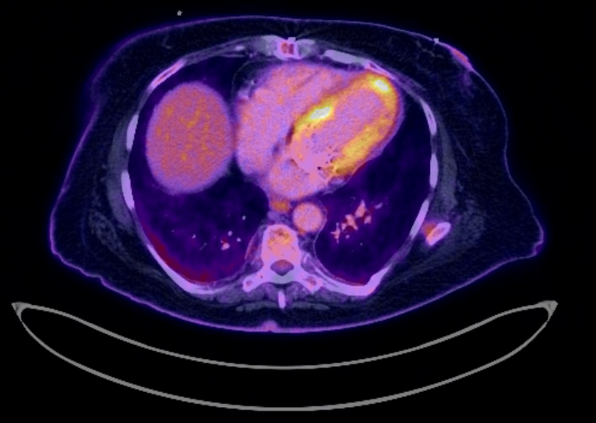
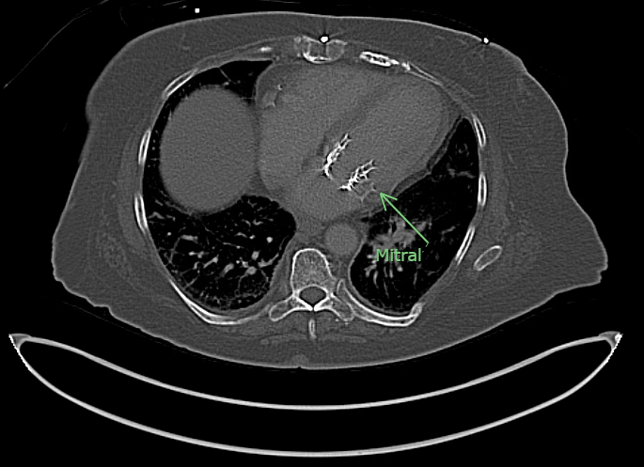

Slide 39
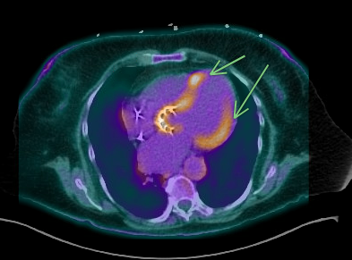
Case 1: Cardiac PET/CT
Postoperative change from mitral valve and aortic valve replacement with heterogeneous radiotracer activity, measuring SUV max up to 4.4, concerning for infection/inflammation. Mild FDG activity fusing to left ventricular wall, specifically apex area, measuring SUV max 3.5, nonspecific
IMPRESSION:
Postoperative change from mitral valve and aortic valve
replacement with heterogeneous radiotracer activity, measuring
SUV max up to 4.4, concerning for infection/inflammation.
Treatment:
6 weeks dapto + cefepime + flagyl
Followed by suppressive amox
Non-specific LV wall uptake (arrows)

Slide 40
Case #2

Slide 41
Case 2
A 79 y/o F with PMH including many cardiac issues (s/p TAVR, s/p PPM, VSD) p/w incidentally discovered aortic root abscess..?

Slide 42

Case 2: HPI
A 79 y/o F with PMH including many cardiac issues (s/p TAVR, s/p PPM, VSD) p/w incidentally discovered aortic root abscess..?
“Hey, so this patient had a TAVR five months ago
Still had dyspnea on exertion, despite the TAVR, so outpatient structural heart team decided to do a VSD closure, which they did today
Normally they go home after VSD closure, but during the procedure, it looked like she had an aortic root abscess on the TEE, so we got blood cultures and admitted her
No infectious symptoms, so this is kinda weird. Could y’all take a look?”

Slide 43


Case 2: Going back in time…

Slide 44

Case 2: Timeline of events
“Present day” is day 146
21 weeks / 5 months
A 79 y/o F with PMH including many cardiac issues (s/p TAVR, s/p PPM, VSD) p/w incidentally discovered aortic root abscess..?
Has severe aortic stenosis, so gets elective TAVR (“day 0”), discharged the following day
TAVR
0

Slide 45
Case 2: Timeline of events
“Present day” is day 146
21 weeks / 5 months
A 79 y/o F with PMH including many cardiac issues (s/p TAVR, s/p PPM, VSD) p/w incidentally discovered aortic root abscess..?
Has severe aortic stenosis, so gets elective TAVR (“day 0”), discharged the following day
Seemingly uncomplicated post-op course…
PCP notes say she has some dyspnea with walking, but no worse than pre-TAVR
TAVR
DOE?
0
1
2
3
4
5
6
7

Slide 46
Case 2: Timeline of events
“Present day” is day 146
21 weeks / 5 months
A 79 y/o F with PMH including many cardiac issues (s/p TAVR, s/p PPM, VSD) p/w incidentally discovered aortic root abscess..?
Has severe aortic stenosis, so gets elective TAVR (“day 0”), discharged the following day
Seemingly uncomplicated post-op course…
PCP notes say she has some dyspnea with walking, but no worse than pre-TAVR
Isolated dysuria → ED visit for UTI (day 18), prescribed 7 days of Keflex
Dysuria, UTI
Rx Keflex
TAVR
DOE?
0
1
2
3
4
5
6
7
8
9
10
11
12
13
14
15
16
17
18

Slide 47
Case 2: Timeline of events
“Present day” is day 146
21 weeks / 5 months
A 79 y/o F with PMH including many cardiac issues (s/p TAVR, s/p PPM, VSD) p/w incidentally discovered aortic root abscess..?
Has severe aortic stenosis, so gets elective TAVR (“day 0”), discharged the following day
Seemingly uncomplicated post-op course…
PCP notes say she has some dyspnea with walking, but no worse than pre-TAVR
Isolated dysuria → ED visit for UTI (day 18), prescribed 7 days of Keflex
Sudden onset dizziness → ED
Dysuria, UTI
Rx Keflex
TAVR
DOE?
0
1
2
3
4
5
6
7
8
9
10
11
12
13
14
15
16
17
18
19
20
21
22

Slide 48
Case 2: Timeline of events
“Present day” is day 146
21 weeks / 5 months
A 79 y/o F with PMH including many cardiac issues (s/p TAVR, s/p PPM, VSD) p/w incidentally discovered aortic root abscess..?
Has severe aortic stenosis, so gets elective TAVR (“day 0”), discharged the following day
Seemingly uncomplicated post-op course…
PCP notes say she has some dyspnea with walking, but no worse than pre-TAVR
Isolated dysuria → ED visit for UTI (day 18), prescribed 7 days of Keflex
Sudden onset dizziness → ED → 3rd degree heart block (pulse 30s) → gets a dual pacemaker
Dysuria, UTI
Rx Keflex
PPM placed
(TTE normal)
TAVR
DOE?
0
1
2
3
4
5
6
7
8
9
10
11
12
13
14
15
16
17
18
19
20
21
22
23
24
25
26

Slide 49
Case 2: Timeline of events
“Present day” is day 146
21 weeks / 5 months
A 79 y/o F with PMH including many cardiac issues (s/p TAVR, s/p PPM, VSD) p/w incidentally discovered aortic root abscess..?
Has severe aortic stenosis, so gets elective TAVR (“day 0”), discharged the following day
Dizziness → complete heart block → dual pacemaker
Develops isolated fevers (to 101.5) and chills
Dysuria, UTI
Rx Keflex
PPM placed
(TTE normal)
TAVR
DOE?
0
1
2
3
4
5
6
7
8
9
10
11
12
13
14
15
16
17
18
19
20
21
22
23
24
25
26
27
28
29
30
31

Slide 50
Case 2: Timeline of events
“Present day” is day 146
21 weeks / 5 months
A 79 y/o F with PMH including many cardiac issues (s/p TAVR, s/p PPM, VSD) p/w incidentally discovered aortic root abscess..?
Has severe aortic stenosis, so gets elective TAVR (“day 0”), discharged the following day
Dizziness → complete heart block → dual pacemaker
Develops isolated fevers (to 101.5) and chills
No other symptoms besides sinus pressure, PPM site looks good
No WBC, labs pretty normal
No antibiotics given, discharged home
Dysuria, UTI
Rx Keflex
PPM placed
(TTE normal)
TAVR
DOE?
0
1
2
3
4
5
6
7
8
9
10
11
12
13
14
15
16
17
18
19
20
21
22
23
24
25
26
27
28
29
30
31

Slide 51
Case 2: Timeline of events
“Present day” is day 146
21 weeks / 5 months
A 79 y/o F with PMH including many cardiac issues (s/p TAVR, s/p PPM, VSD) p/w incidentally discovered aortic root abscess..?
Has severe aortic stenosis, so gets elective TAVR (“day 0”), discharged the following day
Dizziness → complete heart block → dual pacemaker
Develops fevers to 101.5, sent home. Blood Cx show gram positive rods so called back to ED
Dysuria, UTI
Rx Keflex
PPM placed
(TTE normal)
BCx: G+ rods
Fevers
TAVR
DOE?
0
1
2
3
4
5
6
7
8
9
10
11
12
13
14
15
16
17
18
19
20
21
22
23
24
25
26
27
28
29
30
31

Slide 52
Case 2: Timeline of events
“Present day” is day 146
21 weeks / 5 months
A 79 y/o F with PMH including many cardiac issues (s/p TAVR, s/p PPM, VSD) p/w incidentally discovered aortic root abscess..?
Has severe aortic stenosis, so gets elective TAVR (“day 0”), discharged the following day
Dizziness → complete heart block → dual pacemaker
Develops fevers to 101.5, sent home. Blood Cx show gram positive rods so called back to ED
Repeat BCx (before abx) will be no growth
  Started on a few days of vanco & Unasyn
BCx negative
Dysuria, UTI
Rx Keflex
PPM placed
(TTE normal)
BCx: G+ rods
Fevers
TAVR
DOE?
0
1
2
3
4
5
6
7
8
9
10
11
12
13
14
15
16
17
18
19
20
21
22
23
24
25
26
27
28
29
30
31
32

Slide 53
Case 2: Timeline of events
“Present day” is day 146
21 weeks / 5 months
A 79 y/o F with PMH including many cardiac issues (s/p TAVR, s/p PPM, VSD) p/w incidentally discovered aortic root abscess..?
Has severe aortic stenosis, so gets elective TAVR (“day 0”), discharged the following day
Dizziness → complete heart block → dual pacemaker
Develops fevers to 101.5, sent home. Blood Cx show gram positive rods so called back to ED
Repeat BCx (before abx) will be no growth
  Started on a few days of vanco & Unasyn
Still no WBC | afebrile
BCx negative
Dysuria, UTI
Rx Keflex
PPM placed
(TTE normal)
BCx: G+ rods
Fevers
TAVR
DOE?
0
1
2
3
4
5
6
7
8
9
10
11
12
13
14
15
16
17
18
19
20
21
22
23
24
25
26
27
28
29
30
31
32
33
34

Slide 54
Case 2: Timeline of events
“Present day” is day 146
21 weeks / 5 months
A 79 y/o F with PMH including many cardiac issues (s/p TAVR, s/p PPM, VSD) p/w incidentally discovered aortic root abscess..?
Has severe aortic stenosis, so gets elective TAVR (“day 0”), discharged the following day
Dizziness → complete heart block → dual pacemaker
Develops fevers to 101.5, sent home. Blood Cx show gram positive rods so called back to ED
Repeat BCx (before abx) will be no growth
  Started on a few days of vanco & Unasyn
Still no WBC | afebrile | TTE no gross evidence of infective endocarditis (VSD, pulm HTN)
Tele-ID consult: Likely contaminant (if TTE normal)
BCx negative
TTE
Dysuria, UTI
Rx Keflex
PPM placed
(TTE normal)
BCx: G+ rods
Fevers
TAVR
DOE?
0
1
2
3
4
5
6
7
8
9
10
11
12
13
14
15
16
17
18
19
20
21
22
23
24
25
26
27
28
29
30
31
32
33
34
35

Slide 55
Case 2: Timeline of events
“Present day” is day 146
21 weeks / 5 months
Corynebacterium amycolatum
Units = ug/mL MIC
Penicillin 0.5 Intermed
Meropenem 0.12 Suscept
Ceftriaxone 1 Suscept
Linezolid 0.25 Suscept
Vancomycin 0.5 Suscept
Gentamicin <=2 Suscept
Performed By: ARUP Laboratories
A 79 y/o F with PMH including numerous cardiac issues (s/p TAVR, s/p PPM, VSD) p/w indentially discovered aortic root abscess..?
Has severe aortic stenosis, so gets elective TAVR (“day 0”), discharged the following day
Dizziness → complete heart block → dual pacemaker
Develops fevers to 101.5, sent home. Blood Cx show gram positive rods so called back to ED
Repeat BCx (before abx) will be no growth
  Started on a few days of vanco & Unasyn
Still no WBC | afebrile | TTE normal
Tele-ID consult: Likely contaminant
BCx negative
TTE
Dysuria, UTI
Rx Keflex
PPM placed
(TTE normal)
BCx: G+ rods
Fevers
TAVR
DOE?
0
1
2
3
4
5
6
7
8
9
10
11
12
13
14
15
16
17
18
19
20
21
22
23
24
25
26
27
28
29
30
31
32
33
34
35

Slide 56
Case 2: Timeline of events
“Present day” is day 146
21 weeks / 5 months
A 79 y/o F with PMH including many cardiac issues (s/p TAVR, s/p PPM, VSD) p/w incidentally discovered aortic root abscess..?
Has severe aortic stenosis, so gets elective TAVR (“day 0”), discharged the following day
Dizziness → complete heart block → dual pacemaker
Fevers (with ?Corynebacterium) but no growth after repeating before abx
Does fine without developing any new symptoms (dyspnea is ongoing but stable)
Two more rounds of Keflex (for urinary symptoms), but otherwise no antibiotics. Elective admission for VSD repair
Zooming timeline out now
0
18
25
31
1
2
3
4
15
6
7
8
TAVR
Keflex
PPM
BCx

Slide 57
Case 2: Timeline of events
“Present day” is day 146
21 weeks / 5 months
A 79 y/o F with PMH including many cardiac issues (s/p TAVR, s/p PPM, VSD) p/w incidentally discovered aortic root abscess..?
Has severe aortic stenosis, so gets elective TAVR (“day 0”), discharged the following day
Dizziness → complete heart block → dual pacemaker
Fevers (with ?Corynebacterium) but no growth after repeating before abx
Does fine without developing any new symptoms (dyspnea is ongoing but stable)
Two more rounds of Keflex (for urinary symptoms), but otherwise no antibiotics. Elective admission for VSD repair
0
18
25
31
1
2
3
4
15
6
7
8
9
20
1
2
3
4
88
6
7
9
30
1
2
3
4
35
6
131
8
9
40
1
2
3
4
45
6
7
147
TAVR
Keflex
PPM
BCx
Keflex (UTI)
Keflex (UTI)

Slide 58
Case 2: Timeline of events
“Present day” is day 146
21 weeks / 5 months
A 79 y/o F with PMH including many cardiac issues (s/p TAVR, s/p PPM, VSD) p/w incidentally discovered aortic root abscess..?
Has severe aortic stenosis, so gets elective TAVR (“day 0”), discharged the following day
Dizziness → complete heart block → dual pacemaker
Fevers (with ?Corynebacterium) but no growth after repeating before abx
Does fine without developing any new symptoms (dyspnea is ongoing but stable)
Two more rounds of Keflex (for urinary symptoms), but otherwise no antibiotics. Elective admission for VSD repair
TTE: no veggies
Trans-esophageal
Normal (besides VSD)
TEE not normal
VSD
0
18
25
31
35
1
2
3
4
15
6
7
8
9
20
1
2
3
4
88
6
7
98
9
30
1
2
3
4
35
6
131
8
9
40
1
2
3
4
45
6
7
147
TAVR
Keflex
PPM
BCx
Keflex (UTI)
Keflex (UTI)

Slide 59

Case 2: Back to the consult

Slide 60
Case 2: Social history, exposures, & risk factors
Geographic & Travel | Lives with her husband in WV No travel since TAVR
Occupational | (resident took the HPI, so this was not documented)
Substance & needles | No alcohol or tobacco No drugs
Animals | Has a dog, no bites or scratches No other animals
Exposures | No known tick/mosquito exposures, freshwater exposure, soil/landscaping/dust exposure, or well water exposures

Slide 61
Case 2: Physical exam
BP | 131/52 | Pulse | 61 | SpO2 | 93 %
Temp | 36.8 °C (98.2 °F) | RR | 18 | BMI | 41 kg/m²
General | Alert and oriented, NAD, vitals reviewed
HEENT | NCAT; trachea appears midline, no gross LAD; EOMI
Resp | Normal respiratory effort, symmetric chest rise
CV | 2/6 murmur heard best at RSB
GI | Non-distended; no TTP
Extremities | No clubbing, cyanosis, or edema
Neuro/MSK | Moves extremities
Skin | No rash

Slide 62
Case 2: Labs
CBC | Result
WBC | 7.0
Hgb | 14.2
Platelets | 208
Neut % | 69
Lymph % | 23
Eos % | 0%
Chem7 | Result
Na | 140
K | 4.0
HCO3 | 25
BUN | 10
Cr | .64
Other | Result
CRP | 5.3

Slide 63
Case 2: Labs
CBC | Result
WBC | 7.0
Hgb | 14.2
Platelets | 208
Neut % | 69
Lymph % | 23
Eos % | 0%
Chem7 | Result
Na | 140
K | 4.0
HCO3 | 25
BUN | 10
Cr | .64
Micro Hx | Result
Urine Cx | The past couple have grown friendly isolates of E coli
Prior BCx | Corynebacterium
Current BCx | In process
Other | Result
CRP | 5.3

Slide 64
Case 2: Intra-”op” TEE
Right atrium: Echo density in right atrium suggestive of pacer lead
Aortic valve: Normal aortic valve gradient. There is a transcatheter valve in the aortic position. 29 Navitor valve. There is no evidence of paravalvular aortic regurgitation.
Aorta: TAVR architecture seen in proximal ascending aorta. There is fluid collection seen nearly circumferential. This is concerning for potential abscess.
Conclusions
There is a color jet consistent with a membranous defect favored to be a Gerbode defect. There is left to right flow seen above the level of the tricuspid valve. There does does not appear to be interventricular communication. The defect was measured 7.4 to 7.8mm in diameter.This defect was closed with an amplatzer device. Following placement there was no apparent residual flow. The closure device does not appear to interfere with TV functioning.
There is periaortic fluid that is concerning for possible abscess.
LVEF estimated 45-55%. RV function is normal.

Slide 65
Case 2: Summary
Labs | Result
WBC | 7.0
CRP | 5.3
A 79 y/o F with many medical problems s/p TAVR (-21 wk), heart block s/p PPM (-18 wk) who had a self resolving febrile episode six days after PPM placement (31 days after TAVR) where BCx grew GPR (cleared w/o abx)
Now admitted for elective VSD closure, but was (incidentally?) found to have periaortic fluid near the graft
Never has had an elevated WBC
Trans-esophageal echo (intra-op):
Circumferential periaortic fluid collection concerning for possible abscess
TEE normal
0
18
25
31
2
3
4
15
6
7
8
9
20
1
2
3
4
88
6
7
98
9
30
1
2
3
4
35
6
131
8
9
40
1
2
3
4
45
6
7
147
TAVR
Keflex
PPM
BCx
TTE
UTI: Keflex
UTI: Keflex

Slide 66
Case 2: Micro data
Blood cultures finalized at 5 days without any growth
Labs are good on daptomycin (but they were never abnormal)

Slide 67
[Q2.1] Infectious or not?

Slide 68

Next steps?

Slide 69
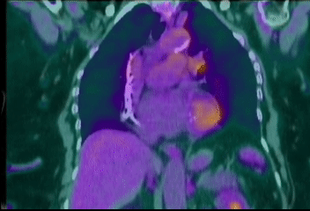
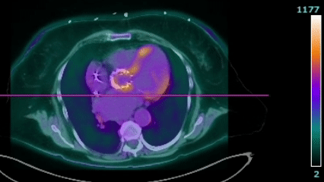
Case 2: Cardiac PET/CT

Slide 70
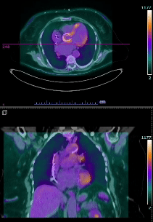
Case 2: Cardiac PET/CT
Left chest pacemaker and leads in place. Diffuse myocardial heterogeneous FDG uptake is noted, probably related to suboptimal patient preparation. Focal uptake along the aortic root (SUV 5.6) with subsequent increased FDG uptake on delayed images (SUV 8.8). These findings appear persistent in the nonattenuation corrected images and extends to the proximal aspect of the TAVR hardware. The rest of the hardware demonstrates mild heterogeneous diffuse FDG uptake, probably inflammatory and appears less prominent on the delayed images
IMPRESSION
Focal radiotracer uptake at the aortic root with progressive increase in metabolic activity on delayed images, suspicious for an infectious process

Slide 71
Case 2: When did she develop endocarditis?
Dysuria, UTI
Rx Keflex
PPM placed
(TTE normal)
TAVR
0
1
2
3
4
5
6
8
9
10
11
12
13
14
15
16
17
18
19
20
21
22
23
24
25
26
27
28
29
30
31
32
33
34
35

Slide 72
Case 2: When did she develop endocarditis?
Already had possible endocarditis
Minor (x3)
Dysuria, UTI
Rx Keflex
PPM placed
(TTE normal)
TAVR
0
1
2
3
4
5
6
8
9
10
11
12
13
14
15
16
17
18
19
20
21
22
23
24
25
26
27
28
29
30
31
32
33
34
35

Slide 73
Case 2: When did she develop endocarditis?
Already had possible endocarditis
Minor (x3)
Predisposition Minor
Dysuria, UTI
Rx Keflex
PPM placed
(TTE normal)
TAVR
0
1
2
3
4
5
6
8
9
10
11
12
13
14
15
16
17
18
19
20
21
22
23
24
25
26
27
28
29
30
31
32
33
34
35

Slide 74
Case 2: When did she develop endocarditis?
Already had possible endocarditis
Minor (x3)
Fever Minor Criteria
Develops isolated fevers (to 101.5)
Predisposition Minor
Dysuria, UTI
Rx Keflex
PPM placed
(TTE normal)
TAVR
0
1
2
3
4
5
6
8
9
10
11
12
13
14
15
16
17
18
19
20
21
22
23
24
25
26
27
28
29
30
31
32
33
34
35

Slide 75
Case 2: When did she develop endocarditis?
Already had possible endocarditis
Minor (x3)
Micro Minor Criteria
(+) BCx not meeting Major
Corynebacterium amycolatum (Both sets)
Fever Minor Criteria
Develops isolated fevers (to 101.5)
Predisposition Minor
Dysuria, UTI
Rx Keflex
PPM placed
(TTE normal)
TAVR
0
1
2
3
4
5
6
8
9
10
11
12
13
14
15
16
17
18
19
20
21
22
23
24
25
26
27
28
29
30
31
32
33
34
35

Slide 76
Case 2: When did she develop endocarditis?
Transthoracic echo
There is no gross evidence of infective endocarditis
Ejection Fraction is 65.8 %. Left ventricular systolic function is normal....There appears to be a turbulent flow across the interventricular septum, suggestive of a ventricular septal defect
Normal right ventricular size
Imaging Major Criteria
(1) Echocardiography showing vegetation, valvular/leaflet perforation… or intracardiac fistula [Communication between 2 neighboring cardiac chambers through a perforation]
Micro Minor Criteria
(+) BCx not meeting Major
Corynebacterium amycolatum (Both sets)
Fever Minor Criteria
Develops isolated fevers (to 101.5)
Predisposition Minor
Dysuria, UTI
Rx Keflex
PPM placed
(TTE normal)
TAVR
0
1
2
3
4
5
6
8
9
10
11
12
13
14
15
16
17
18
19
20
21
22
23
24
25
26
27
28
29
30
31
32
33
34
35

Slide 77
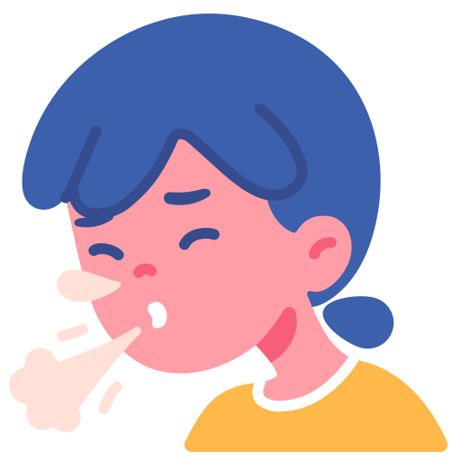
Case 2: Not so (PEN)fast…
Oh I almost forgot…

Slide 78
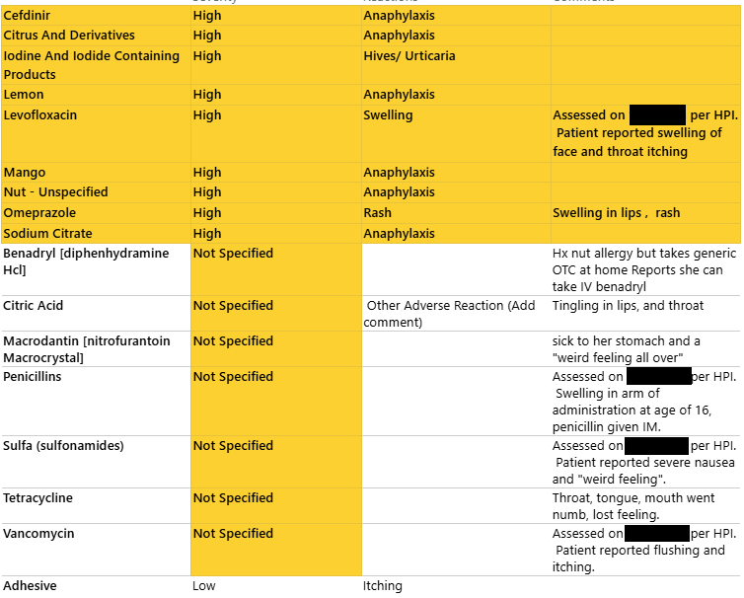

Slide 79
Case 2: Allergy Hx
Doxycycline
Numbness & tingling of lips, mouth, throat, tongue
  Occurs within minutes
Similar to many of her other drug allergies
Cefdinir - Cannot recall details
Chart say anaphylaxis
Never issues with cephalexin (different R1 and R2 from cefdinir)
Penicillin - Swelling in her arm after IM injection at age 16

Slide 80
Case 2: Allergy Hx
Doxycycline
Numbness & tingling of lips, mouth, throat, tongue
  Occurs within minutes
Similar to many of her other drug allergies
Cefdinir - Cannot recall details
Chart say anaphylaxis
Never issues with cephalexin (different R1 and R2 from cefdinir)
Penicillin - Swelling in her arm after IM injection at age 16

Slide 81
Case 2: Allergy Hx
Doxycycline
Numbness & tingling of lips, mouth, throat, tongue
  Occurs within minutes
Similar to many of her other drug allergies
Cefdinir - Cannot recall details
Chart say anaphylaxis
Never issues with cephalexin (different R1 and R2 from cefdinir)
Penicillin - Swelling in her arm after IM injection at age 16
Levofloxacin - Throat itching & swelling of face
Nitrofurantoin - Sick to her stomach and “felt weird all over”
Sulfa - Severe nausea and “weird feeling”
Vanco - Flushing and itching

Slide 82
Case 2: Allergy challenge
Doxycycline - Numbness & tingling of lips, mouth, throat, tongue. Occurs within minutes. Similar to many of her other allergies
Seen by allergy
Passes PO doxy challenge in office
Calls the next day saying “numbness/tingling of her lips, tongue and roof of mouth” after challenge
Switch doxy → linezolid
Calls the next day saying “same thing happening” with Zyvox
Resumed dapto OPAT
Other allergies/reactions
Cefdinir - Chart say anaphylaxis, but patient doesn’t recall details. No issues with cephalexin; had arm swelling with IM penicillin
Levofloxacin - throat itching & swelling of face
Nitrofurantoin - Sick to her stomach and “felt weird all over”
Sulfa - Severe nausea and “weird feeling”
Vanco - Flushing and itching
Has been on 8+ weeks of daptomycin while waiting on allergy appointment

Slide 83
Case 2: Allergy challenge
Doxycycline - Numbness & tingling of lips, mouth, throat, tongue. Occurs within minutes. Similar to many of her other allergies
Seen by allergy
Passes PO doxy challenge in office
Calls the next day saying “numbness/tingling of her lips, tongue and roof of mouth” after challenge
Switch doxy → linezolid
Calls the next day saying “same thing happening” with Zyvox
Resumed dapto OPAT
Other allergies/reactions
Cefdinir - Chart say anaphylaxis, but patient doesn’t recall details. No issues with cephalexin; had arm swelling with IM penicillin
Levofloxacin - throat itching & swelling of face
Nitrofurantoin - Sick to her stomach and “felt weird all over”
Sulfa - Severe nausea and “weird feeling”
Vanco - Flushing and itching

Slide 84
Case 2: Allergy challenge
Doxycycline - Numbness & tingling of lips, mouth, throat, tongue. Occurs within minutes. Similar to many of her other allergies
Seen by allergy
Passes PO doxy challenge in office
Calls the next day saying “numbness/tingling of her lips, tongue and roof of mouth” after challenge
Switch doxy → linezolid
Calls the next day saying “same thing happening” with Zyvox
Resumed dapto OPAT
Other allergies/reactions
Cefdinir - Chart say anaphylaxis, but patient doesn’t recall details. No issues with cephalexin; had arm swelling with IM penicillin
Levofloxacin - throat itching & swelling of face
Nitrofurantoin - Sick to her stomach and “felt weird all over”
Sulfa - Severe nausea and “weird feeling”
Vanco - Flushing and itching

Slide 85
Case 2: Allergy challenge
Doxycycline - Numbness & tingling of lips, mouth, throat, tongue. Occurs within minutes. Similar to many of her other allergies
Seen by allergy
Passes PO doxy challenge in office
Calls the next day saying “numbness/tingling of her lips, tongue and roof of mouth” after challenge
Switch doxy → linezolid
Calls the next day saying “same thing happening” with Zyvox
Resumed dapto OPAT
Other allergies/reactions
Cefdinir - Chart say anaphylaxis, but patient doesn’t recall details. No issues with cephalexin; had arm swelling with IM penicillin
Levofloxacin - throat itching & swelling of face
Nitrofurantoin - Sick to her stomach and “felt weird all over”
Sulfa - Severe nausea and “weird feeling”
Vanco - Flushing and itching

Slide 86
Case 2: Allergy challenge
Doxycycline - Numbness & tingling of lips, mouth, throat, tongue. Occurs within minutes. Similar to many of her other allergies
Seen by allergy
Passes PO doxy challenge in office
Calls the next day saying “numbness/tingling of her lips, tongue and roof of mouth” after challenge
Switch doxy → linezolid
Calls the next day saying “same thing happening” with Zyvox
Resumed dapto OPAT
Other allergies/reactions
Cefdinir - Chart say anaphylaxis, but patient doesn’t recall details. No issues with cephalexin; had arm swelling with IM penicillin
Levofloxacin - throat itching & swelling of face
Nitrofurantoin - Sick to her stomach and “felt weird all over”
Sulfa - Severe nausea and “weird feeling”
Vanco - Flushing and itching

Slide 87
Case 2: Allergy challenge
Doxycycline - Numbness & tingling of lips, mouth, throat, tongue. Occurs within minutes. Similar to many of her other allergies
Seen by allergy
Passes PO doxy challenge in office
Calls the next day saying “numbness/tingling of her lips, tongue and roof of mouth” after challenge
Switch doxy → linezolid
Calls the next day saying “same thing happening” with Zyvox
Resumed dapto OPAT
Other allergies/reactions
Cefdinir - Chart say anaphylaxis, but patient doesn’t recall details. No issues with cephalexin; had arm swelling with IM penicillin
Levofloxacin - throat itching & swelling of face
Nitrofurantoin - Sick to her stomach and “felt weird all over”
Sulfa - Severe nausea and “weird feeling”
Vanco - Flushing and itching
Has been on 8+ weeks of daptomycin while waiting on allergy appointment

Slide 88
[Q2.2] Would you ever stop antibiotics?
For endovascular infection

Slide 89

Discussion
Links to articles discussed here

Slide 90
Objectives
Differentiate the presentation of endocarditis in TAVR (Transcatheter Aortic Valve Replacement) compared to SAVR (Surgical Aortic Valve Replacement), including
  Clinical manifestations
  Microbiology
  Echo findings (and why it may be a good idea to get a PET/CT)
Review the use of PET/CT for endocarditis, including
  Practical considerations including patient prep and what radiology is looking at
  Indications for PET/CT with a focus on endocarditis as well as other indications listed in the 2024 guidelines (CIED & LVAD)
Appraise the very limited data on serial PET/CTs in the long term monitoring of endovascular infections

Slide 91

TAVR vs SAVR
Transcatheter Aortic Valve Replacement
(TAVI is implantation)
First TAVR was done in 2002
Surgical Aortic Valve Replacement
First SAVR was 1952

Slide 92
TAVR vs SAVR
Transcatheter Aortic Valve Replacement
(TAVI is implantation)
First TAVR was done in 2002
Surgical Aortic Valve Replacement
First SAVR was 1952
Modified Duke’s criteria was 2000

Slide 93
TAVR vs SAVR
Transcatheter Aortic Valve Replacement
(TAVI is implantation)
First TAVR was done in 2002
Surgical Aortic Valve Replacement
First SAVR was 1952
Originally for high risk surgical candidates
Becoming more popular for low/intermediate risk
Preferred in younger patients (not as good data on how long TAVR lasts)
Longer recovery time since it’s an open surgery

Slide 94
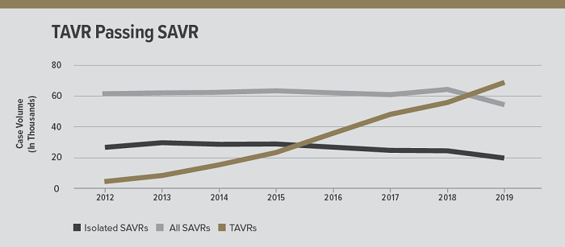
TAVR vs SAVR
TAVR
SAVR

Slide 95
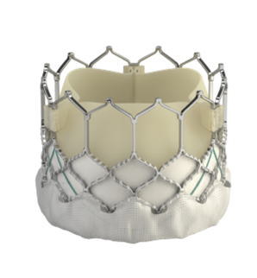
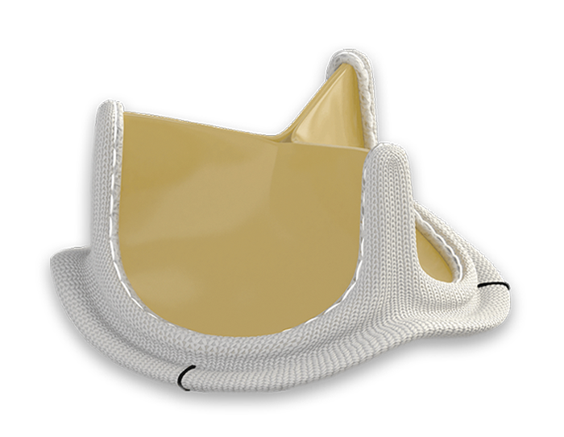
TAVR vs SAVR
TAVR
SAVR
Accessed through the groin
More metal around the valve (because of the stent frame)
May be balloon-expandable or self-expanding
Open surgery
Mechanical or bioprosthetic (all TAVRs are bioprosthetic)
Honestly, no idea how they do them

Slide 96
TAVR vs SAVR
TAVR
SAVR
Most of the new aortic valves in the present era are TAVRs
Most of the data & experience has been from SAVR [2]

Slide 97
TAVR endocarditis
Compared to SAVR endocarditis…
Lower rates of
↓ fever [2][4]
↓ embolic phenomenon (stroke, emboli) [4]
↓ Aortic regurg [4]

Slide 98
TAVR endocarditis
Compared to SAVR endocarditis…
Lower rates of
Modified Duke (2000)
Major:
BCx w/ typical pathogen
Echo showing valvular vegetation
Minor:
Predisposition
IVDU
Fever
Embolic phenomena
Immunologic phenomena
BCx not meeting major criteria
↓ fever [2][4]
↓ embolic phenomenon (stroke, emboli) [4]
↓ Aortic regurg [4]

Slide 99
TAVR endocarditis
Compared to SAVR endocarditis…
Lower rates of
ISCVID-Duke (2023)
Major imaging:
Echo showing valvular vegetation
Significant valvular regurg that is new
…
Minor imaging:
…
More than mild regurg of any etiology
New regurg on auscultation (if no echo available)
↓ fever [2][4]
↓ embolic phenomenon (stroke, emboli) [4]
↓ Aortic regurg [4]

Slide 100
TAVR endocarditis
Compared to SAVR endocarditis…
Lower rates of
Higher rates of
↓ fever [2][4]
↓ embolic phenomenon (stroke, emboli) [4]
↓ Aortic regurg [4]
↑ perivalvular involvement [2]
↑ abscesses [2]

Slide 101
TAVR endocarditis
Compared to SAVR endocarditis…
Lower rates of
Higher rates of
↓ fever [2][4]
↓ embolic phenomenon (stroke, emboli) [4]
↓ Aortic regurg [4]
↑ perivalvular involvement [2]
↑ abscesses [2]
↑↑ mortality - In retrospective matched cohorts, surgery did not improve outcomes [2]

Slide 102
TAVR endocarditis
Compared to SAVR endocarditis…
Lower rates of
Higher rates of
↓ fever [2][4]
↓ embolic phenomenon (stroke, emboli) [4]
↓ Aortic regurg [4]
↑ perivalvular involvement [2]
↑ abscesses [2]
↑↑ mortality - In retrospective matched cohorts, surgery did not improve outcomes
Come to journal club!
Will be discussing article #4

Slide 103
TAVR-IE: microbiology & timing
Higher rates of enterococcus [2][4]
  Recall, groin access is used…
  Some places are investigating using Augmentin as PPx [2]
Over half are healthcare associated [2], double the rate of SAVR

Slide 104
TAVR-IE: microbiology & timing
Higher rates of enterococcus [2][4]
  Recall, groin access is used…
  Some places are investigating using Augmentin as PPx [2]
Over half are healthcare associated [2], double the rate of SAVR
Highest risk of developing endocarditis shortly after TAVR
Six-fold increase risk in the first 100 days [2][swiss study]

Slide 105
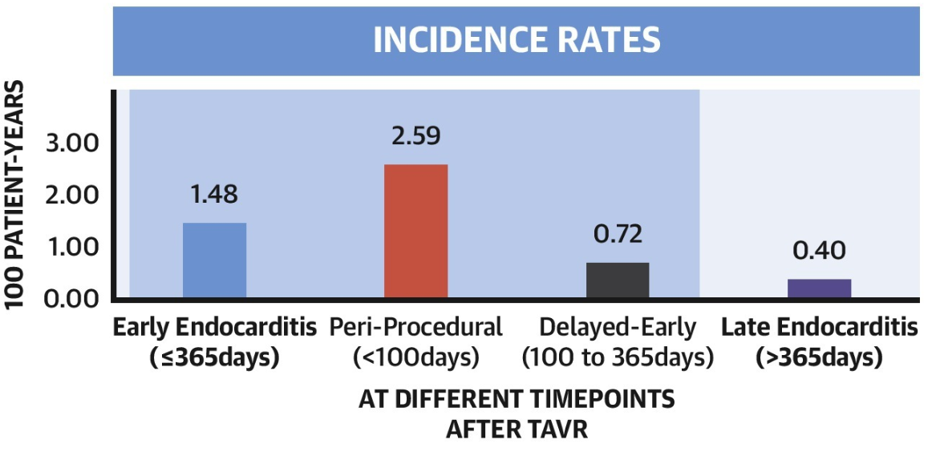
TAVR-IE: microbiology & timing
Higher rates of enterococcus [2][4]
  Recall, groin access is used…
  Some places are investigating using Augmentin as PPx [2]
Over half are healthcare associated [2], double the rate of SAVR
Highest risk of developing endocarditis shortly after TAVR
Six-fold increase risk in the first 100 days [2][swiss study]

Slide 106
TAVR-IE: microbiology & timing
Higher rates of enterococcus [2][4]
  Recall, groin access is used…
  Some places are investigating using Augmentin as PPx [2]
Over half are healthcare associated [2], double the rate of SAVR
Highest risk of developing endocarditis shortly after TAVR
Six-fold increase risk in the first 100 days [2][swiss study]
0
18
25
31
1
2
3
4
15
6
7
8
9
20
1
2
3
4
88
6
7
9
30
1
2
3
4
35
6
131
8
9
40
1
2
3
4
45
6
7
147
TAVR
Keflex
PPM
BCx
Keflex (UTI)
Keflex (UTI)

Slide 107
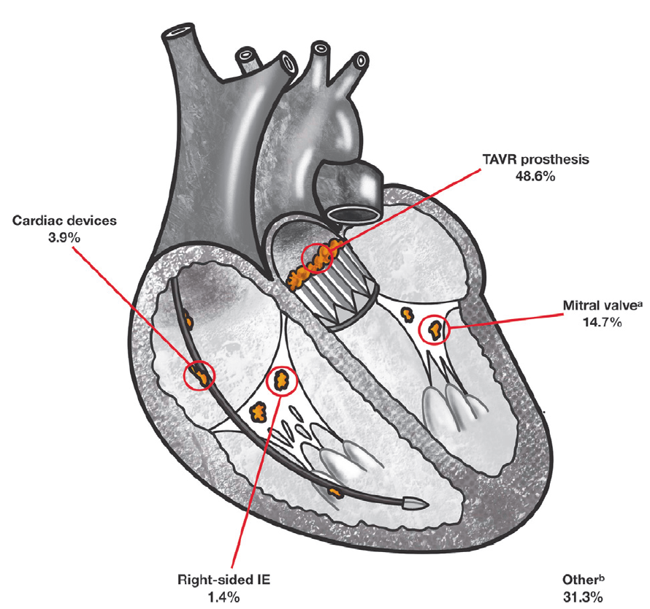
TAVR-IE: Locations [2]
One in three cases have more than one location involved
TAVR
49%
Cardiac devices
4%
Mitral
15%
Other
31%
Right sided 1.4%

Slide 108
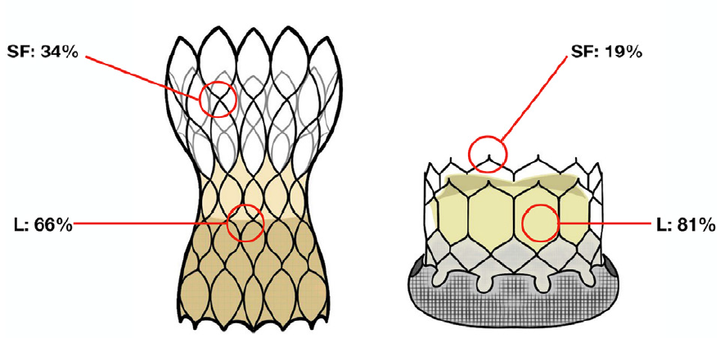
TAVR-IE: Locations [2]
One in three cases have more than one location involved
Location can differ by device used
Stent frame
34%
Stent frame
19%
Leaflets
81%
Leaflets
66%
Balloon-expandable valve
e.g. SAPIEN (BEV)
Self-expanding valve
e.g. EVOLUT (SEV)

Slide 109

TAVR-IE: Imaging considerations [2]
Modified Duke is less accurate in PVE/TAVR
  In large part due to issues with echos
TAVR-IE frequently has “atypical lesions”
  Valve thickening (28-70% of cases) [2][3]
  Obstructive patterns [2]
  Increased gradients [3]

Slide 110
TAVR-IE: Imaging considerations [2]
Modified Duke is less accurate in PVE/TAVR
  In large part due to issues with echos
TAVR-IE frequently has “atypical lesions”
  Valve thickening (28-70% of cases) [2][3]
  Obstructive patterns [2]
  Increased gradients [3]
Transesophageal echo #1 (Case #1)
No stigmata of endocarditis
Normal functioning bioprosthetic mitral and Sapien aortic valves
Mild thickening noted in the aortic cusps in the left coronary position

Slide 111

TAVR-IE: Imaging considerations [2]
Modified Duke is less accurate in PVE/TAVR
  In large part due to issues with echos
TAVR-IE frequently has “atypical lesions”
  Valve thickening (28-70% of cases) [2][3]
  Obstructive patterns [2]
  Increased gradients [3]
Sensitivity of TTE + TEE
Native: 90%
SAVR: 73%
TAVR: 67%

Slide 112
TAVR-IE: Imaging considerations [2]
Negative predictive value (TAVR)
If your pre-test probability of IE is >75%, the NPV of TTE + TEE is 47%
Sensitivity of TTE + TEE
Native: 90%
SAVR: 73%
TAVR: 67%

Slide 113
TAVR-IE: Imaging considerations [2]
Negative predictive value (TAVR)
If your pre-test probability of IE is >75%, the NPV of TTE + TEE is 47%
Sensitivity of TTE + TEE
Native: 90%
SAVR: 73%
Pre-test probability
TAVR: 67%
 | 25% | 50% | 67% | 75%
Native | 96% | 90% | 81% | 75%
TAVR | 89% | 73% | 57% | 47%
NPV
Over half of negative TTE + TEE are false negatives

Slide 114

TAVR-IE: Imaging considerations
18F-FGD PET/CT may be of benefit in PVE, especially TAVR-IE
PET/CT reclassified 33% of suspected TAVR-IE cases [2]
In another study, using the 2023-ISCVID criteria (compared to modified Duke) [3]
Significantly increased sensitivity 65% → 76%
Without significantly decreasing specificity
Largely by adding a positive major criteria for PET/CT

Slide 115
TAVR-IE: Imaging considerations
18F-FGD PET/CT may be of benefit in PVE, especially TAVR-IE
PET/CT reclassified 33% of suspected TAVR-IE cases [2]
In another study, using the 2023-ISCVID criteria (compared to modified Duke) [3]
Significantly increased sensitivity 65% → 76%
Without significantly decreasing specificity
Largely by adding a positive major criteria for PET/CT

Slide 116

Cardiac PET/CT:
Practical considerations
Differentiate the presentation of endocarditis in TAVR compared to SAVR , including
  Clinical manifestations
  Microbiology
  Echo findings (and why it may be a good idea to get a PET/CT)
Review the use of PET/CT for endocarditis, including
  Practical considerations including patient prep and what radiology is looking at
  Indications for PET/CT with a focus on endocarditis as well as other indications listed in the 2024 guidelines (CIED & LVAD)
Appraise the very limited data on serial PET/CTs in the long term monitoring of endovascular infections

Slide 117
I thought we couldn’t do PET scans?
PET has been around for awhile, but hasn’t been used much for infectious processes (until recently)
There was an old CMS rule (national coverage decision) that made 18F-FDG PET scans ineligible to be used for inflammation / inflammatory processes [1]
Still needs to meet appropriate use criteria (selected by local Medicare administrative contractors [1])

Slide 118
I thought we couldn’t do PET scans?
PET has been around for awhile, but hasn’t been used much for infectious processes (until recently)
There was an old CMS rule (national coverage decision) that made 18F-FDG PET scans ineligible to be used for inflammation / inflammatory processes [1]
Still needs to meet appropriate use criteria (selected by local Medicare administrative contractors [1])
Explained to me by AI… [citation needed]
Couldn’t bill CMS (or patients) for PET, so this was an expensive test for the hospital foot the bill for
  SPECT wasn’t covered under this rule
CMS retired the noncoverage rule in 2021 [5] (thank you cardiology & sarcoidosis)
  Now it is treated more like SPECT

Slide 119
I thought we couldn’t do PET scans?
PET has been around for awhile, but hasn’t been used much for infectious processes (until recently)
There was an old CMS rule (national coverage decision) that made 18F-FDG PET scans ineligible to be used for inflammation / inflammatory processes [1]
Still needs to meet appropriate use criteria (selected by local Medicare administrative contractors [1])
Explained to me by AI… [citation needed]
Couldn’t bill CMS (or patients) for PET, so this was an expensive test for the hospital foot the bill for
  SPECT wasn’t covered under this rule
CMS retired the noncoverage rule in 2021 [5] (thank you cardiology & sarcoidosis)

Slide 120
Cardiac PET/CT (for PVE)
Patient prep: [1][3]
Ketogenic diet (low carbs, high fat) for 24h before the scan → fasting 12h before
Reduces physiologic myocardial glucose uptake
Non-specific LV wall uptake (arrows)

Slide 121
Cardiac PET/CT (for PVE)
Patient prep: [1][3]
Ketogenic diet (low carbs, high fat) for 24h before the scan → fasting 12h before
Reduces physiologic myocardial glucose uptake
False positives:
Some surgical bioadhesives cause FDG uptake [1]
Earlier data suggested sterile inflammation can occur during first 3 months, but others report this is less of an issue for TAVRs [2]

Slide 122
Cardiac PET/CT (for PVE)
Patient prep: [1][3]
Ketogenic diet (low carbs, high fat) for 24h before the scan → fasting 12h before
Reduces physiologic myocardial glucose uptake
False positives:
Some surgical bioadhesives cause FDG uptake [1]
Earlier data suggested sterile inflammation can occur during first 3 months, but others report this is less of an issue for TAVRs [2]
False negatives:
PET/CT is less likely to be positive if patient has been on antibiotics for longer
Generally better to get the test earlier

Slide 123
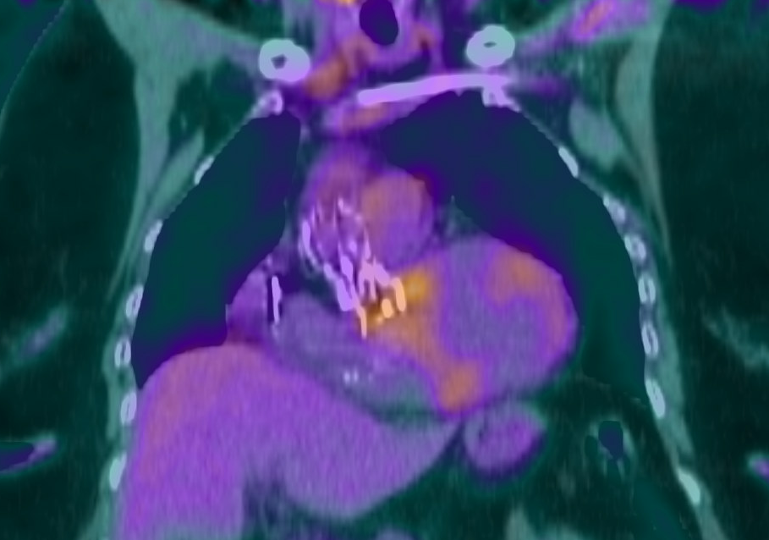
What do the look at?
Pattern of uptake: Focal / heterogeneous (e.g. not involving the whole valve) more suggestive of IE than diffuse / homogenous uptake
Relative intensity: Comparing uptake to a reference point (like the liver)
SUV_{max}: 5.36
SUV_{max}: 3.62

Slide 124
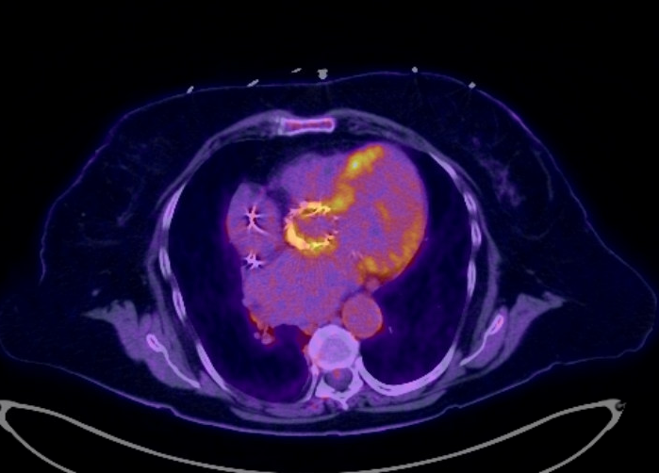
What do the look at?
Pattern of uptake: Focal / heterogeneous (e.g. not involving the whole valve) more suggestive of IE than diffuse / homogenous uptake
Relative intensity: Comparing uptake to a reference point (like the liver)
Formulas:
SUVmax ratio: SUV max / SUV aorta
Value uptake index: It’s complicated
Delayed images, non-attenuation images, etc
SUV_{max}: 5.36
SUV_{max}: 2.87

Slide 125
What do the look at?
Pattern of uptake: Focal / heterogeneous (e.g. not involving the whole valve) more suggestive of IE than diffuse / homogenous uptake
Relative intensity: Comparing uptake to a reference point (like the liver)
Formulas:
SUVmax ratio: SUV max / SUV aorta
Value uptake index: It’s complicated
Delayed images, non-attenuation images, etc
SUV_{max}: 5.36
Key takeaway
It’s much more complicated than “lights up on PET”
SUV_{max}: 2.87

Slide 126

Cardiac PET/CT:
When to use
Differentiate the presentation of endocarditis in TAVR compared to SAVR , including
  Clinical manifestations
  Microbiology
  Echo findings (and why it may be a good idea to get a PET/CT)
Review the use of PET/CT for endocarditis, including
  Practical considerations including patient prep and what radiology is looking at
  Indications for PET/CT with a focus on endocarditis as well as other indications listed in the 2024 guidelines (CIED & LVAD)
Appraise the very limited data on serial PET/CTs in the long term monitoring of endovascular infections

Slide 127


Slide 128
PET/CT-IE: Diagnostic parameters [1]
Prosthetic valve | Studies (n patients) | Sensitivity | Specificity
Wang 2020 | 15 (n = 967) | 86% | 84%
Mahmood 2019 | 8 (n = 227) | 80% | 73%
Swart 2018 | 1 (n = 237) | 74% | 91%
Gomes 2017 | 8 | 73 - 100% | 71 - 100%

Slide 129
PET/CT-IE: Diagnostic parameters [1]
Prosthetic valve | Studies (n patients) | Sensitivity | Specificity
Wang 2020 | 15 (n = 967) | 86% | 84%
Mahmood 2019 | 8 (n = 227) | 80% | 73%
Swart 2018 | 1 (n = 237) | 74% | 91%
Gomes 2017 | 8 | 73 - 100% | 71 - 100%
Native valve | Studies (n patients) | Sensitivity | Specificity
Wang 2020 | 4 (n = 385) | 31% | 98%
Albano 2021 | 12 (n = 600) | 31% | 82%
Kamani 2020 | 7 (n = 351) | 36% | 99%
Gomes 2017 | 7 | 14% | ---

Slide 130
PET/CT-IE: Appropriate utilization [1]
Appropriate (7-9)
Appropriate ranking
May be appropriate (4-6)
Rarely appropriate (1-3)
Ranking:
Linear scale from 1-9 by multidisciplinary team
Does not explicitly consider cost
Assumes whole body PET/CT (vertex to thigh)

Slide 131
PET/CT-IE: Appropriate utilization [1]
Patient population
Appropriate
Appropriate ranking
May be appropriate
Suspected IE
Rarely appropriate
Definitive
Possible or rejected, but high clinical suspicion
Native
Prosthetic

Slide 132
PET/CT-IE: Appropriate utilization [1]
Patient population
Appropriate
Appropriate ranking
May be appropriate
Suspected IE
Rarely appropriate
Definitive
Possible or rejected, but high clinical suspicion
Definitive IE:
Both: Detection of infectious source / focus in presence of hardware or persistent bacteremia
Native (7.5)
Prosthetic (8)

Slide 133
PET/CT-IE: Appropriate utilization [1]
Patient population
Appropriate
Appropriate ranking
May be appropriate
Suspected IE
Rarely appropriate
Definitive
Possible or rejected, but high clinical suspicion
Definitive IE:
Both: Detection of infectious source / focus in presence of hardware or persistent bacteremia
PVE: Left sided embolic event
Native (?)
Prosthetic (7.5)

Slide 134
PET/CT-IE: Appropriate utilization [1]
Patient population
Appropriate
Appropriate ranking
May be appropriate
Suspected IE
Rarely appropriate
Definitive
Possible or rejected, but high clinical suspicion
Definitive IE:
Both: Detection of infectious source / focus in presence of hardware or persistent bacteremia
PVE: Left sided embolic event
PVE: Monitoring of therapy
Native (2.5)
Prosthetic (5)

Slide 135
PET/CT-IE: Appropriate utilization [1]
Patient population
Possible or rejected IE with high clinical suspicion:
Both: Gram positive bacteremia (of any type)
Suspected IE
Definitive
Possible or rejected, but high clinical suspicion
Native (7.5)
Prosthetic (8)

Slide 136
PET/CT-IE: Appropriate utilization [1]
Patient population
Possible or rejected IE with high clinical suspicion:
Both: Gram positive bacteremia (of any type)
Fungemia or gram negative with negative echo
  PVE: Appropriate
  NVE: May be appropriate
Suspected IE
Definitive
Possible or rejected, but high clinical suspicion
Native (5)
Prosthetic (7.5)

Slide 137
PET/CT-IE: Appropriate utilization [1]
Patient population
Possible or rejected IE with high clinical suspicion:
Both: Gram positive bacteremia (of any type)
Fungemia or gram negative with negative echo
  PVE: Appropriate
  NVE: May be appropriate
Both: inconclusive echo or discrepant findings
Suspected IE
Definitive
Possible or rejected, but high clinical suspicion
Native (7.5)
Prosthetic (8)

Slide 138
PET/CT-IE: Appropriate utilization [1]
Patient population
Possible or rejected IE with high clinical suspicion:
Both: Gram positive bacteremia (of any type)
Fungemia or gram negative with negative echo
  PVE: Appropriate
  NVE: May be appropriate
Both: inconclusive echo or discrepant findings
Both: Mobile mass on echo with negative BCx/serologies
Suspected IE
Definitive
Possible or rejected, but high clinical suspicion
Native (7.5)
Prosthetic (7.5)

Slide 139
PET/CT-IE: Appropriate utilization [1]
Patient population
Possible or rejected IE with high clinical suspicion:
Both: Gram positive bacteremia (of any type)
Fungemia or gram negative with negative echo
  PVE: Appropriate
  NVE: May be appropriate
Both: inconclusive echo or discrepant findings
Both: Mobile mass on echo with negative BCx/serologies
Persistent bacteremia or fungemia
  PVE: Appropriate
  NVE: May be appropriate
Suspected IE
Definitive
Possible or rejected, but high clinical suspicion
Native (5.5)
Prosthetic (7.5)

Slide 140
PET/CT-IE: Appropriate utilization [1]
Patient population
Suspected IE
Broader takeaway
In suspected prosthetic valve endocarditis (that has not been classified as definitive), PET/CT is always appropriate per ASNC I2 guidelines
Definitive
Possible or rejected, but high clinical suspicion
Native
Prosthetic

Slide 141
PET/CT: Other situations [1]
Evidence of systemic
infection?
Pocket infection?
Yes
Unclear if superficial vs CIED pocket infection (7)
CIED infection
Table 5
High clinical suspicion for CIED pocket infection only (5)
No
High clinical suspicion for superficial infection only (2.5)

Slide 142
PET/CT: Other situations [1]
Imaging with vegetation?
Evidence of systemic
infection?
Definitive
Rarely appropriate (2.5)
Yes
Equivocal or non-diagnostic
Appropriate (7-8)
CIED infection
Table 5
Negative
May be appropriate (5.5)
No
Note
Works better for pocket infection than lead infection; cannot use to rule out lead infection

Slide 143
PET/CT: Other situations [1]
Evidence of systemic
infection?
BCx (+) w/o source (7.5 - 8)
BCx persistently (+) (8)
Yes
Concern for…
LVAD infection
Table 7
Driveline infection (7)
No
Cannula/pump infection (7.5)
Peripheral exit wound (2.5)

Slide 144
Predicting the future?
Differentiate the presentation of endocarditis in TAVR compared to SAVR , including
  Clinical manifestations
  Microbiology
  Echo findings (and why it may be a good idea to get a PET/CT)
Review the use of PET/CT for endocarditis, including
  Practical considerations including patient prep and what radiology is looking at
  Indications for PET/CT with a focus on endocarditis as well as other indications listed in the 2024 guidelines (CIED & LVAD)
Appraise the very limited data on serial PET/CTs in the long term monitoring of endovascular infections

Slide 145
HeartRhythm
¹⁸F-FDG PET/CT and radiolabeled leukocyte SPECT/CT imaging for the evaluation of cardiovascular infection in the multimodality context
ASNC Imaging Indications (ASNC I2) Series Expert Consensus Recommendations from ASNC, AATS, ACC, AHA, ASE, EANM, HRS, IDSA, SCCT, SNMMI, and STS
Definitive IE
Table 4 [1]
Monitoring of therapy
In the setting of persistent bacteremia in patients with PVE and/or the presence of other prosthetic material, ¹⁸F-FDG PET/CT and radiolabeled leukocyte SPECT/CT are recommended, as they can be useful detecting extracardiac foci of infection or identifying other portals of entry. Preliminary data suggest ¹⁸F-FDG PET/CT and radiolabeled leukocyte SPECT/CT may be useful in monitoring cases of PVE that are medically managed with antimicrobial treatment, but further studies are needed to inform the frequency and reliability of monitoring strategies. The role of these advanced modalities in assessment of suspected embolic events in both NVE and PVE is not fully elucidated but is recommended by the ESC guidelines workflow ²⁴
Native (2.5)
Prosthetic (5)
Appropriate
May be appropriate
Rarely appropriate

Slide 146

VASGRA study [8]
Prospective cohort study (from one Swiss hospital) of aortic vascular graft infections
Adults (n=68) with aortic vascular graft infections (AGI)
68 patients / grafts

Slide 147
VASGRA study [8]
Prospective cohort study (from one Swiss hospital) of aortic vascular graft infections
Adults (n=68) with aortic vascular graft infections (AGI)
Diagnosis established in multidisciplinary meeting (ID, surgery, radiology, nuc med, micro)
68 patients / grafts

Slide 148
VASGRA study [8]
Prospective cohort study (from one Swiss hospital) of aortic vascular graft infections
Adults (n=68) with aortic vascular graft infections (AGI)
Diagnosis established in multidisciplinary meeting (ID, surgery, radiology, nuc med, micro)
68 patients / grafts
Patients had consecutive* PET/CTs
266 PET/CT

Slide 149
VASGRA study [8]
Prospective cohort study (from one Swiss hospital) of aortic vascular graft infections
Adults (n=68) with aortic vascular graft infections (AGI)
Diagnosis established in multidisciplinary meeting (ID, surgery, radiology, nuc med, micro)
68 patients / grafts
Patients had consecutive* PET/CTs
Baseline scan
PET/CTs while on treatment
Scan at end of treatment
Control PET/CT (3 months after Tx)
* Not everyone had baseline/control scans for various reasons
266 PET/CT
Median 5 scans per patient
(IQR 3-6)

Slide 150
Let’s look at their cases

Slide 151
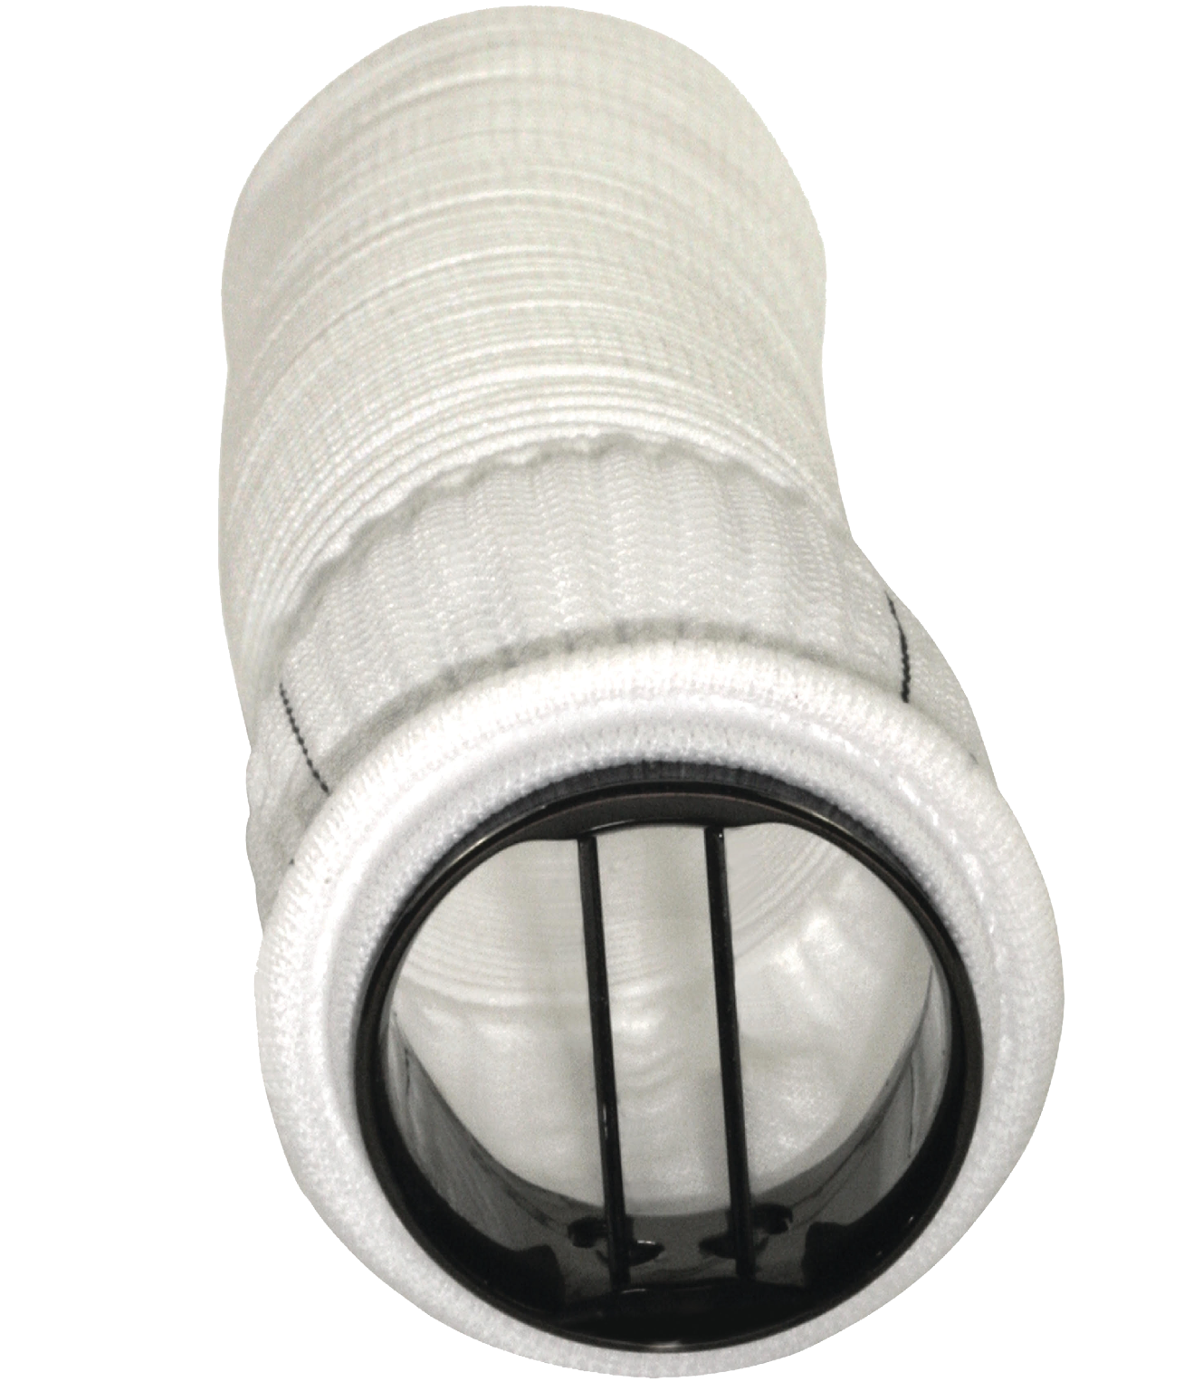
VASGRA: Case 1 [8]
53 year old develops Pasteurella multocida infection of polyester composite vascular graft (Aortic Valved Graft ATS)

Slide 152
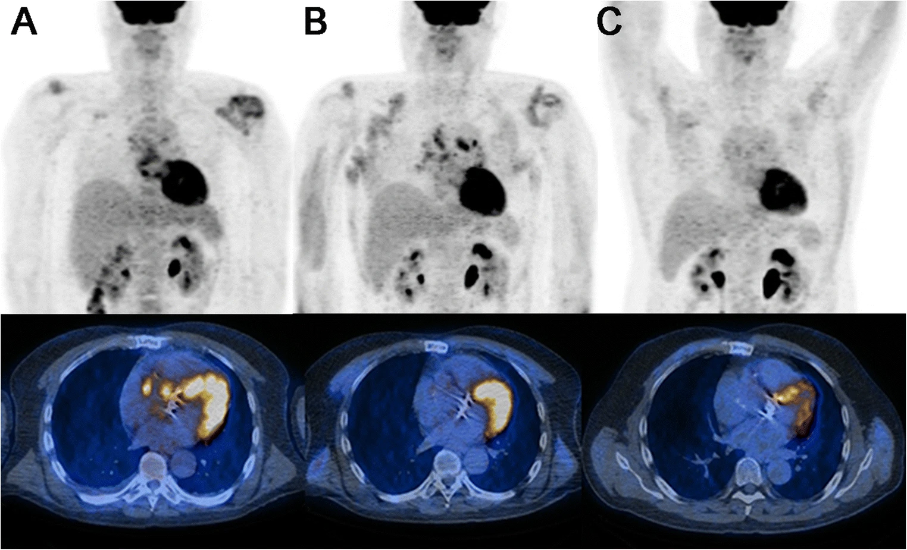
VASGRA: Case 1 [8]
53 year old develops Pasteurella multocida infection of polyester composite vascular graft (Aortic Valved Graft ATS)
A) Initial scan (SUV_{max} 7.5)
A
SUV_{max} 7.5

Slide 153
VASGRA: Case 1 [8]
53 year old develops Pasteurella multocida infection of polyester composite vascular graft (Aortic Valved Graft ATS)
A) Initial scan (SUV_{max} 7.5)
B) Complete response 3 months later (SUV_{max} 2.9)
A
B
C
SUV_{max} 7.5
SUV_{max} 2.9

Slide 154
VASGRA: Case 1 [8]
53 year old develops Pasteurella multocida infection of polyester composite vascular graft (Aortic Valved Graft ATS)
A) Initial scan (SUV_{max} 7.5)
B) Complete response 3 months later (SUV_{max} 2.9)
C) Scan 6 months after stopping antibiotics; still good
A
B
C
SUV_{max} 7.5
SUV_{max} 2.9

Slide 155
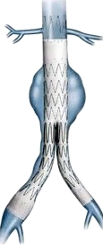
VASGRA: Case 2 [8]
71M developed Coagulase negative Staphylococci infection of endovascular abdominal aneurysm repair

Slide 156
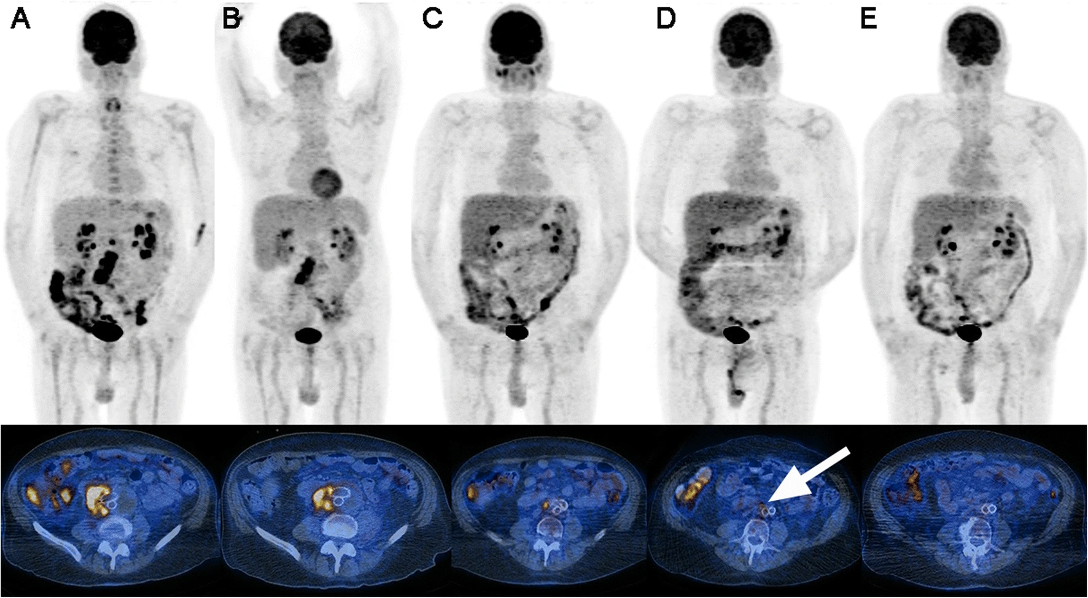
VASGRA: Case 2 [8]
71M developed Coagulase negative Staphylococci infection of endovascular abdominal aneurysm repair
A) Initial scan (SUV_{max} 12.4)
A
SUV_{max} 12.4

Slide 157
VASGRA: Case 2 [8]
71M developed Coagulase negative Staphylococci infection of endovascular abdominal aneurysm repair
A) Initial scan (SUV_{max} 12.4)
B) On antibiotics
C) Six months later (still on antibiotics)
A
B
C
6 months later
SUV_{max} 12.4

Slide 158
VASGRA: Case 2 [8]
A
Baseline scan
71M developed CONS infection of endovascular abdominal aneurysm repair
D) Only faint FDG uptake (arrow), so stopped suppression after >1 year of abx
C) On >6 months of antibiotics
C
D
End of treatment

Slide 159
VASGRA: Case 2 [8]
A
Baseline scan
71M developed CONS infection of endovascular abdominal aneurysm repair
D) Only faint FDG uptake (arrow), so stopped suppression after >1 year of abx
C) On >6 months of antibiotics
E) No uptake (3 months after stopping abx)
C
D
End of treatment
E

Slide 160
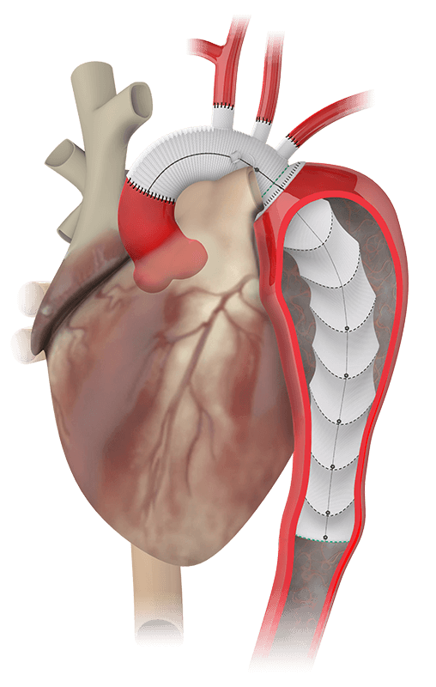
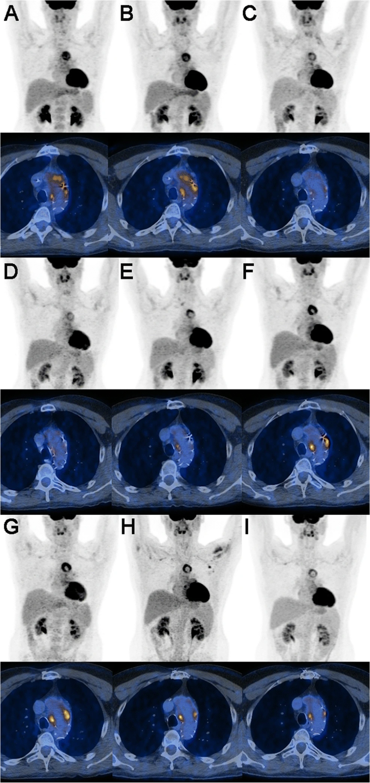
VASGRA: Case 3 [8]
48M developed ascending aortic graft infection with strep constellatus & Aggregatibacter aphrophilus.
A
June
2015
D
SUV_{max} 8.5

Slide 161
VASGRA: Case 3 [8]
48M developed ascending aortic graft infection with strep constellatus & Aggregatibacter aphrophilus.
Surgery not feasible, so treated with levofloxacin (starting in July ‘15)
A
June
2015
B
July ‘15
D
SUV_{max} 8.5
SUV_{max} 8.2

Slide 162
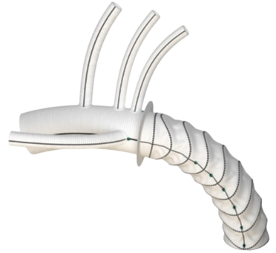
VASGRA: Case 3 [8]
48M developed ascending aortic graft infection with strep constellatus & Aggregatibacter aphrophilus.
A) Baseline
B) Started levaquin
C & D) Improvement of SUV over ~1 year
A
June
2015
B
July ‘15
C
D
April ‘16
SUV_{max} 8.5
SUV_{max} 8.2
SUV_{max} 4.6

Slide 163
VASGRA: Case 3 [8]
48M developed ascending aortic graft infection with strep constellatus & Aggregatibacter aphrophilus.
E) Starts having increased uptake after a dental procedure in June ‘16
A) Baseline
B) Started levaquin
C & D) Improvement of SUV over ~1 year
A
June
2015
B
July ‘15
C
D
April ‘16
E
July ’16
SUV_{max} 8.5
SUV_{max} 8.2
SUV_{max} 4.6
SUV_{max} 6.6

Slide 164
VASGRA: Case 3 [8]
A
June
2015
B
July ‘15
C
SUV_{max} 8.5
SUV_{max} 8.2
48M developed ascending aortic graft infection with strep constellatus & Aggregatibacter aphrophilus. Treated with levofloxacin (starting at B) with good initial response (B-D) until increased uptake (E) after dental procedure. Blood cultures (F) grew levofloxacin-resistant Prevotella spp.
D
April ‘16
E
July ’16
F
Sept ‘16
SUV_{max} 4.6
SUV_{max} 6.6
SUV_{max} 9.3
E) Starts having increased uptake after a dental procedure in June ‘16
F) Found to be bacteremic with Prevotella spp
Dental procedure

Slide 165
VASGRA: Case 3 [8]
A
June
2015
B
July ‘15
C
SUV_{max} 8.5
SUV_{max} 8.2
48M developed ascending aortic graft infection with strep constellatus & Aggregatibacter aphrophilus. Treated with levofloxacin (starting at B) with good initial response (B-D) until increased uptake (E) after dental procedure. Blood cultures (F) grew levofloxacin-resistant Prevotella spp.
D
April ‘16
E
July ’16
F
Sept ‘16
SUV_{max} 4.6
SUV_{max} 6.6
SUV_{max} 9.3
E) Starts having increased uptake after a dental procedure in June ‘16
F) Found to be bacteremic with Prevotella spp
PET/CT caught the new (prevotella) infection early
Dental procedure

Slide 166
VASGRA: Case 3 [8]
A
June
2015
B
July ‘15
C
SUV_{max} 8.5
SUV_{max} 8.2
48M developed ascending aortic graft infection with strep constellatus & Aggregatibacter aphrophilus. Treated with levofloxacin (starting at B) with good initial response (B-D) until increased uptake (E) after dental procedure. Blood cultures (F) grew levofloxacin-resistant Prevotella spp, so antimicrobials were adjusted (G-I) with good clinical response
D
April ‘16
E
July ’16
F
Sept ‘16
SUV_{max} 4.6
SUV_{max} 6.6
SUV_{max} 9.3
G
H
I
SUV_{max} 6.7

Slide 167
VASGRA: Patient characteristics [8]
46% had polymicrobial infections
48% were gram positive pathogens
25% gram negative
The rest were anaerobes (14%), fungi (6.5%), mycobacteria (2.4%), culture negative (3.3%)
25% of patients did not have surgery for their graft infection

Slide 168
VASGRA: Outcomes [8]
“Clinical cure” in 65% of patients after median of 56 weeks of antimicrobials
“22% of patients are still on antibiotics”
  Of the 15 patients still on antibiotics, 9 are lifelong suppression (13%) due to non-response on PET/CT &/or CRP
17% of patients died while on antimicrobial therapy
  Of the 12 who died on antibiotics, only 7 were from infection (10%)
After stopping antibiotics, no cases of relapse with the same pathogen
Median duration of follow-up from…
Diagnosis: 2 years
Stopping antibiotics: 1.1 years

Slide 169
VASGRA: Outcomes [8]
“Clinical cure” in 65% of patients after median of 56 weeks of antimicrobials
“22% of patients are still on antibiotics”
  Of the 15 patients still on antibiotics, 9 are lifelong suppression (13%) due to non-response on PET/CT &/or CRP
17% of patients died while on antimicrobial therapy
  Of the 12 who died on antibiotics, only 7 were from infection (10%)
After stopping antibiotics, no cases of relapse with the same pathogen
Median duration of follow-up from…
Diagnosis: 2 years
Stopping antibiotics: 1.1 years

Slide 170
VASGRA: Outcomes [8]
“Clinical cure” in 65% of patients after median of 56 weeks of antimicrobials
“22% of patients are still on antibiotics”
  Of the 15 patients still on antibiotics, 9 are lifelong suppression (13%) due to non-response on PET/CT &/or CRP
17% of patients died while on antimicrobial therapy
  Of the 12 who died on antibiotics, only 7 were from infection (10%)
After stopping antibiotics, no cases of relapse with the same pathogen
Median duration of follow-up from…
Diagnosis: 2 years
Stopping antibiotics: 1.1 years
How did PET/CT change things?

Slide 171
VASGRA: Results [8]
In cases where antibiotics were escalated
100% of patients had focal uptake on PET (i.e. abnormal PET)
1 in 8 of these patients (who were escalated) had normal CRPs
1 in 4 had no clinical signs of infections
In cases where antibiotics were continued
Mostly based on PET/CT findings and CRP
35% of patients in this group had normal CRPs (but abnormal PETs)
In cases where antibiotics were stopped
61% still had focal uptake on PET/CT, but the median SUVmax was lower (4.3) than the other groups (6.0 and 9.5)
1 in 3 still had abnormal CRPs

Slide 172
VASGRA: Results [8]
In cases where antibiotics were escalated
100% of patients had focal uptake on PET (i.e. abnormal PET)
1 in 8 of these patients (who were escalated) had normal CRPs
1 in 4 had no clinical signs of infections
In cases where antibiotics were continued
Mostly based on PET/CT findings and CRP
35% of patients in this group had normal CRPs (but abnormal PETs)
In cases where antibiotics were stopped
61% still had focal uptake on PET/CT, but the median SUVmax was lower (4.3) than the other groups (6.0 and 9.5)
1 in 3 still had abnormal CRPs

Slide 173
VASGRA: Results [8]
In cases where antibiotics were escalated
100% of patients had focal uptake on PET (i.e. abnormal PET)
1 in 8 of these patients (who were escalated) had normal CRPs
1 in 4 had no clinical signs of infections
In cases where antibiotics were continued
Mostly based on PET/CT findings and CRP
35% of patients in this group had normal CRPs (but abnormal PETs)
In cases where antibiotics were stopped
61% still had focal uptake on PET/CT, but the median SUVmax was lower (4.3) than the other groups (6.0 and 9.5)
1 in 3 still had abnormal CRPs

Slide 174
VASGRA: Results [8]
In cases where antibiotics were escalated
100% of patients had focal uptake on PET (i.e. abnormal PET)
1 in 8 of these patients (who were escalated) had normal CRPs
1 in 4 had no clinical signs of infections
In cases where antibiotics were continued
Mostly based on PET/CT findings and CRP
35% of patients in this group had normal CRPs (but abnormal PETs)
In cases where antibiotics were stopped
61% still had focal uptake on PET/CT, but the median SUV_{max} was lower (4.3) than the other groups (6.0 and 9.5)
1 in 3 still had abnormal CRPs

Slide 175
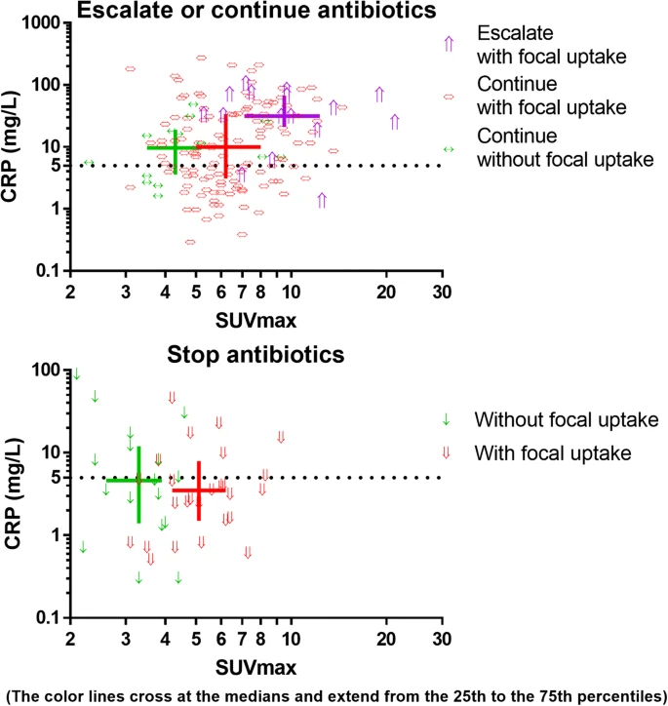
The color lines cross at the median (and extend from the 25th to 75th percentiles)
Dotted line is upper limit of normal for CRP

Slide 176
Cases where antibiotics were escalated despite normal CRPs
(12.5% of ‘escalation’ cases)
⇑
⇑
⇑

Slide 177
Cases where antibiotics were continued despite normal CRPs
(35.7% of ‘continue’ cases)

Slide 178
Cases where antibiotics were stopped despite abnormal CRPs
(36.4% of ‘stop’ cases)
The color lines cross at the median (and extend from the 25th to 75th percentiles)
Dotted line is upper limit of normal for CRP

Slide 179
Learning points & take aways

Slide 180
Learning points & take aways
The presentation of TAVR endocarditis may differ from surgical valve-replacement endocarditis
  May be more subclinical (e.g. absence of fevers or embolic phenomenon)
  Highest risk periprocedurally (first 100 days)
  Higher incidence of Enterococcus and healthcare-associated infections
Echos have reduced sensitivity (~67%) in TAVR compared to native valves due
to acoustic shadowing and artifacts
Cardiac PET/CT can significantly increases diagnostic sensitivity
  Require some patient preparation to optimize quality of images
Emerging data suggests serial PET/CT may be useful to monitor treatment
response and guide decisions on stopping antibiotics
Slides available on hunterratliff1.com/talk/; Citations available via QR code or via the “citations” button on the website

