Slide 1
Slow burn
CLINID conference
Hunter Ratliff
02/12/2025
Ages, dates, and other identifying information may have been changed
I have no conflict of interest in relation to this presentation

Slide 2
Shortcuts
Case 1: Start | Summary slide
Discussion 1: Objectives
Defining LTNP & EC | Natural history | compare & contrast
Mechanisms | viral factors | cell mediated | humoral immunity | location of integration
Inflamm-aging | CD4:CD8 ratio | monocytes | telomeres | consequences
Should you start ART?
Case 2: Start | Summary slide
Discussion 2: Objectives

Slide 3
Case #1

Slide 4
Case 1: HPI
A 37 y/o F with PMH including beta thalassemia minor, HIV (Dx 7 years ago) who presents at 32 weeks gestation for HIV management
Diagnosed 7 years ago; RF unprofessional tattoos
Had followed at CAMC in the past (records not available for review)
Has not seen CAMC in over a year
Currently not on ART
Currently asymptomatic (ROS negative)
No known history of OIs
MFM notes indicate patient believes "she feels fine & doesn't need ART"
States her two living kids and partner are HIV negative

Slide 5
Case 1: HPI
A 37 y/o F with PMH including beta thalassemia minor, HIV (Dx 7 years ago) who presents at 32 weeks gestation for HIV management
Diagnosed 7 years ago; RF unprofessional tattoos
Had followed at CAMC in the past (records not available for review)
Has not seen CAMC in over a year
Currently not on ART
Currently asymptomatic (ROS negative)
No known history of OIs
MFM notes indicate patient believes "she feels fine & doesn't need ART"
States her two living kids and partner are HIV negative

Slide 6
Case 1: HPI
A 37 y/o F with PMH including beta thalassemia minor, HIV (Dx 7 years ago) who presents at 32 weeks gestation for HIV management
Diagnosed 7 years ago; RF unprofessional tattoos
Had followed at CAMC in the past (records not available for review)
Has not seen CAMC in over a year
Currently not on ART
Currently asymptomatic (ROS negative)
No known history of OIs
MFM notes indicate patient believes "she feels fine & doesn't need ART"
States her two living kids and partner are HIV negative

Slide 7
Case 1: HPI
A 37 y/o F with PMH including beta thalassemia minor, HIV (Dx 7 years ago) who presents at 32 weeks gestation for HIV management
Diagnosed 7 years ago; RF unprofessional tattoos
Had followed at CAMC in the past (records not available for review)
Has not seen CAMC in over a year
Currently not on ART
Currently asymptomatic (ROS negative)
No known history of OIs
MFM notes indicate patient believes "she feels fine & doesn't need ART"
States her two living kids and partner are HIV negative

Slide 8
Case 1: Labs
A 37 y/o F with PMH including beta thalassemia minor, HIV (Dx 7 years ago, not on ART) who presents at 32 weeks gestation for HIV management. Lost to follow up and not on ART because "she feels fine & doesn't need ART".
CBC | Result
WBC | 7.5
Hgb | 9.5
Platelets | 267

Slide 9
Case 1: Labs
A 37 y/o F with PMH including beta thalassemia minor, HIV (Dx 7 years ago, not on ART) who presents at 32 weeks gestation for HIV management. Lost to follow up and not on ART because "she feels fine & doesn't need ART".
CBC | Result
WBC | 7.5
Hgb | 9.5
Platelets | 267
Neut abs (%) | 4800 (64%)
Lymph abs (%) | 2320 (31%)
CD4/CD8 | Result
CD8 abs (%) | ???
CD4 abs (%) | ???
CD4:CD8 | ???
Time to guess the CD4!
HIV PCR | Result
Viral load | ???
Log VL | ???

Slide 10
Case 1: Labs
A 37 y/o F with PMH including beta thalassemia minor, HIV (Dx 7 years ago, not on ART) who presents at 32 weeks gestation for HIV management. Lost to follow up and not on ART because "she feels fine & doesn't need ART".
CBC | Result
WBC | 7.5
Hgb | 9.5
Platelets | 267
Neut abs (%) | 4800 (64%)
Lymph abs (%) | 2320 (31%)
CD4/CD8 | Result
CD8 abs (%) | 940 (47%)
CD4 abs (%) | 738 (37%)
CD4:CD8 | 0.8
HIV PCR | Result
Viral load | ???
Log VL | ???

Slide 11
Case 1: Labs
A 37 y/o F with PMH including beta thalassemia minor, HIV (Dx 7 years ago, not on ART) who presents at 32 weeks gestation for HIV management. Lost to follow up and not on ART because "she feels fine & doesn't need ART".
CBC | Result
WBC | 7.5
Hgb | 9.5
Platelets | 267
Neut abs (%) | 4800 (64%)
Lymph abs (%) | 2320 (31%)
CD4/CD8 | Result
CD8 abs (%) | 940 (47%)
CD4 abs (%) | 738 (37%)
CD4:CD8 | 0.8
HIV PCR | Result
Viral load | 283
Log VL | 2.45

Slide 12
Case 1: Summary
-7 years
HIV diagnosis
A 37 y/o F with PMH including beta thalassemia minor, HIV (diagnosed 7 years ago) who presents at 32 weeks gestation for HIV management
She has had difficulty with keeping appointments and has not been on ART for awhile (details unclear) because "she feels fine & doesn't need ART"
Details unclear, but minimal time on ART
-32 weeks
Became pregnant
Now
Presenting to clinic
CD4/CD8 | Result
CD8 abs (%) | 940 (47%)
CD4 abs (%) | 738 (37%)
CD4:CD8 | 0.8
HIV PCR | Result
Viral load | 283
Log VL | 2.45

Slide 13
Is she right?
Does she need treatment for HIV?
During pregnancy?
After pregnancy?
Even if she doesn’t want to?

Slide 14
Case 1: Interim history
Started on Truvada + Tivicay
This encounter was before Descovy was FDA approved
Pregnancy is uneventful
Lost to follow up with ID

Slide 15
Case 1: Interim history
8 years after pregnancy, has ED visit (outside hospital)
CC: Earaches + dry cough
Duration: few months
Labs: absolute lymphocytes were 930
Still not on ART
-16 years
HIV diagnosis
Minimal / no ART
-9 years
Pregnancy
CD4 700’s, VL 200s (prior to ART)
On Truvada + Tivicay during pregnancy, but lost to follow up
-1.5 years
ED visit

Slide 16
Case 1: Interim history
8 years after pregnancy, has ED visit (outside hospital)
CC: Earaches + dry cough
Duration: few months
Labs: absolute lymphocytes were 930
Still not on ART
-16 years
HIV diagnosis
Minimal / no ART
-9 years
Pregnancy
CD4 700’s, VL 200s (prior to ART)
On Truvada + Tivicay during pregnancy, but lost to follow up
Fast forward to present day
16 years after her diagnosis of HIV, she is admitted to OSH with AMS & renal failure
-1.5 years
ED visit
Now
Admission for renal failure

Slide 17
Case 1: Interim history - renal failure
Admitted for lethargy / AMS
# Renal failure / ESRD
Found to be in renal failure
Nephrotic range proteinuria (>14g)
Started on iHD
# Anemia, thrombocytopenia
Seen by hematology, unclear etiology
Had BMBx, results not available
# HIV / AIDS
Seen by tele-ID, said to start Biktarvy
Not started inpatient (non-formulary)
Unclear if able to get it outpatient
-16 years
HIV diagnosis
Minimal / no ART
-9 years
Pregnancy
CD4 700’s, VL 200s (prior to ART)
On Truvada + Tivicay during pregnancy, but lost to follow up
-1.5 years
ED visit
Now
Admission for renal failure

Slide 18
Case 1: Interim history - renal failure
Admitted for lethargy / AMS
# Renal failure / ESRD
Found to be in renal failure
Nephrotic range proteinuria (>14g)
Started on iHD
# Anemia, thrombocytopenia
Seen by hematology, unclear etiology
Had BMBx, results not available
# HIV / AIDS
Seen by tele-ID, said to start Biktarvy
Not started inpatient (non-formulary)
Unclear if able to get it outpatient
-16 years
HIV diagnosis
AIDS diagnosis
16 years after her diagnosis of HIV, she is admitted to OSH with renal failure
Labs during this admission:
CD4: 34 (3.8%)
VL: 16,200
Minimal / no ART
-9 years
Pregnancy
CD4 700’s, VL 200s (prior to ART)
On Truvada + Tivicay during pregnancy, but lost to follow up
-1.5 years
ED visit
Now
Admission for renal failure

Slide 19
Case 1: Interim history - renal failure
Admitted for lethargy / AMS
# Renal failure / ESRD
Found to be in renal failure
Nephrotic range proteinuria (>14g)
Started on iHD
# Anemia, thrombocytopenia
Seen by hematology, unclear etiology
Had BMBx, results not available
# HIV / AIDS
Seen by tele-ID, said to start Biktarvy
Not started inpatient (non-formulary)
Unclear if able to get it outpatient
-16 years
HIV diagnosis
AIDS diagnosis
16 years after her diagnosis of HIV, she is admitted to OSH with renal failure
Labs during this admission:
CD4: 34 (3.8%)
VL: 16,200
Minimal / no ART
-9 years
Pregnancy
CD4 700’s, VL 200s (prior to ART)
On Truvada + Tivicay during pregnancy, but lost to follow up
-1.5 years
ED visit
Now
Admission for renal failure

Slide 20
Case 1: Interim history - renal failure
Admitted for lethargy / AMS
# Renal failure / ESRD
Found to be in renal failure
Nephrotic range proteinuria (>14g)
Started on iHD
# Anemia, thrombocytopenia (severe)
Seen by hematology, unclear etiology
Had BMBx, results not available
# HIV / AIDS
Seen by tele-ID, said to start Biktarvy
Not started inpatient (non-formulary)
Unclear if able to get it outpatient
-16 years
HIV diagnosis
AIDS diagnosis
16 years after her diagnosis of HIV, she is admitted to OSH with renal failure
Labs during this admission:
CD4: 34 (3.8%)
VL: 16,200
Minimal / no ART
-9 years
Pregnancy
CD4 700’s, VL 200s (prior to ART)
On Truvada + Tivicay during pregnancy, but lost to follow up
-1.5 years
ED visit
Now
Admission for renal failure

Slide 21
Case 1: Interim history - renal failure
Admitted for lethargy / AMS
# Renal failure / ESRD
Found to be in renal failure
Nephrotic range proteinuria (>14g)
Started on iHD
# Anemia, thrombocytopenia
Seen by hematology, unclear etiology
Had BMBx, results not available
# HIV / AIDS
Seen by tele-ID, said to start Biktarvy
Not started inpatient (non-formulary)
Unclear if able to get it outpatient
-16 years
HIV diagnosis
AIDS diagnosis
16 years after her diagnosis of HIV, she is admitted to OSH with renal failure
Labs during this admission:
CD4: 34 (3.8%)
VL: 16,200
Minimal / no ART
-9 years
Pregnancy
CD4 700’s, VL 200s (prior to ART)
On Truvada + Tivicay during pregnancy, but lost to follow up
-1.5 years
ED visit
Now
Admission for renal failure

Slide 22
Case 1: Interim history - renal failure
Admitted for lethargy / AMS
# Renal failure / ESRD
Found to be in renal failure
Nephrotic range proteinuria (>14g)
Started on iHD
# Anemia, thrombocytopenia
Seen by hematology, unclear etiology
Had BMBx, results not available
# HIV / AIDS
Seen by tele-ID, said to start Biktarvy
Not started inpatient (non-formulary)
Unclear if able to get it outpatient
-16 years
HIV diagnosis
AIDS diagnosis
16 years after her diagnosis of HIV, she is admitted to OSH with renal failure
Labs during this admission:
CD4: 34 (3.8%)
VL: 16,200
Minimal / no ART
-9 years
Pregnancy
CD4 700’s, VL 200s (prior to ART)
On Truvada + Tivicay during pregnancy, but lost to follow up
-1.5 years
ED visit
Now
Admission for renal failure

Slide 23
Case 1: Interim history
After leaving OSH, seems like she still has not been in care
No outpatient Rx for ART
Has another admission for AMS (two months after ESRD Dx)
Limited EMR records indicate ID saw her during this admission
Gets started on Biktarvy (for real)
-16 years
HIV diagnosis
Minimal /
no ART
-9 years
Pregnancy
CD4 700’s, VL 200s (prior to ART)
On Truvada + Tivicay during pregnancy, but lost to follow up
-1.5 years
ED visit
-6 months
Dx with AIDS & ESRD (no ART started)

Slide 24
Case 1: Interim history
After leaving OSH, seems like she still has not been in care
No outpatient Rx for ART
Has another admission for AMS (two months after ESRD Dx)
Limited EMR records indicate ID saw her during this admission
Gets started on Biktarvy (for real)
-16 years
HIV diagnosis
Minimal /
no ART
-9 years
Pregnancy
CD4 700’s, VL 200s (prior to ART)
On Truvada + Tivicay during pregnancy, but lost to follow up
-1.5 years
ED visit
-6 months
Dx with AIDS & ESRD (no ART started)
-4 months
Another admission (details unclear)

Slide 25
Case 1: Interim history
After leaving OSH, seems like she still has not been in care
No outpatient Rx for ART
Has another admission for AMS (two months after ESRD Dx)
Limited EMR records indicate ID saw her during this admission
Gets started on Biktarvy (for real)
Now admitted to Ruby ICU
-16 years
HIV diagnosis
Minimal /
no ART
-9 years
Pregnancy
CD4 700’s, VL 200s (prior to ART)
On Truvada + Tivicay during pregnancy, but lost to follow up
-1.5 years
ED visit
-6 months
Dx with AIDS & ESRD (no ART started)
-4 months
Another admission (details unclear)
Now
Admission to Ruby

Slide 26
Case 1: HPI
A 47 y/o F with PMH including ESRD, recently Dx AIDS (CD4 of 34 six months ago) unclear if on ART, beta thalassemia minor who presents for shock, bradycardia, hypothermia, and respiratory failure. Intubated, so HPI is limited
At outside ED, developed
Severe sinus bradycardia → Shock
Hypothermia
AMS (with mild hypoxia) → Intubated mainly for airway protection

Slide 27
Case 1: HPI
A 47 y/o F with PMH including ESRD, recently Dx AIDS (CD4 of 34 six months ago) unclear if on ART, beta thalassemia minor who presents for shock, bradycardia, hypothermia, and respiratory failure. Intubated, so HPI is limited
Admitted to OSH (same day) with dyspnea and feeling unwell
Had missed a few sessions of HD
At outside ED, developed
Severe sinus bradycardia → Shock
Hypothermia
AMS (with mild hypoxia) → Intubated mainly for airway protection

Slide 28
Case 1: HPI
A 47 y/o F with PMH including ESRD, recently Dx AIDS (CD4 of 34 six months ago) unclear if on ART, beta thalassemia minor who presents for shock, bradycardia, hypothermia, and respiratory failure. Intubated, so HPI is limited
Admitted to OSH (same day) with dyspnea and feeling unwell
Had missed a few sessions of HD
At outside ED, developed
Severe sinus bradycardia → shock
Hypothermia (concern for myxedema coma initially)
AMS (with mild hypoxia) → intubated mainly for airway protection

Slide 29
Case 1: Physical exam
BP | 92/63 --- epi 0.08 (not levophed) | Pulse | 57 | Temp | 36.1 °C (97 °F)
SpO2 | 100 % --- PEEP=5, FiO2=30% | RR | 18 | BMI | 25 kg/m²
General | Intubated, but awakes to voice
HEENT | NCAT, no LAD
Resp | CTAB
CV | RRR; extremities perfused
GI | Non-distended; no TTP
Extremities | No clubbing, cyanosis, or edema
Neuro/MSK | Appropriate for degree of sedation, follows commands

Slide 30
Case 1: Labs
CBC | Result
WBC | 8.6
Hgb | 8.4
MCV | 75
Platelets | 70
Neut % | 95%
Lymph % | 4%
Lymph abs | 340
Chem7 | Result
Na | 141
K | 3.1
HCO3 | 23
BUN | 21
Cr | 7.9
LFTs | Result
AST | 80
ALT | 40
Alk Phos | 39
Bili | 1.6
Direct Bili | 0.9
Albumin | 1.7

Slide 31
Case 1: Labs
CBC | Result
WBC | 8.6
Hgb | 8.4
MCV | 75
Platelets | 70
Neut % | 95%
Lymph % | 4%
Lymph abs | 340
Chem7 | Result
Na | 141
K | 3.1
HCO3 | 23
BUN | 21
Cr | 7.9
LFTs | Result
AST | 80
ALT | 40
Alk Phos | 39
Bili | 1.6
Direct Bili | 0.9
Albumin | 1.7
Other | Result
LDH | 203
Ferritin | 5900
CRP | 6.6
Endo | Result
TSH | 10.7
Free T4 | 0.99
Cortisol | wnl

Slide 32
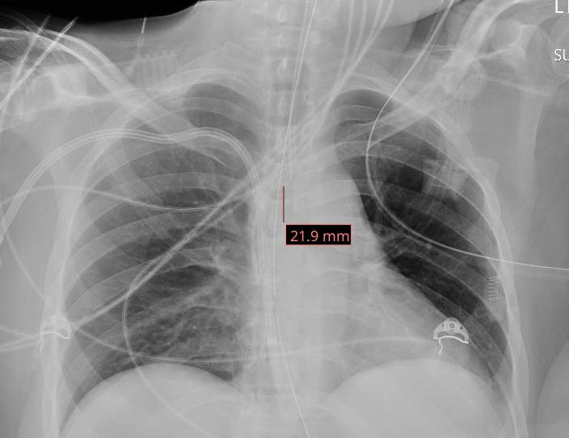

Slide 33
Case 1: Summary
-16 years
HIV diagnosis
Minimal /
no ART
A 47 y/o F with PMH including ESRD, recently Dx AIDS (CD4 of 34 six months ago) unclear if on ART, beta thalassemia minor who presents for shock, bradycardia, hypothermia, and respiratory failure after missed HD sessions.
Labs show thrombocytopenia (70) and lymphopenia (ALC 340) but otherwise pretty normal (for ESRD)
-9 years
Pregnancy
CD4 700’s, VL 200s (prior to ART)
On Truvada + Tivicay during pregnancy, but lost to follow up
-1.5 years
ED visit
-6 months
Dx with AIDS & ESRD (no ART started)
-4 months
Another admission (details unclear)
Now
Admission to Ruby
Time since diagnosis | 7 yr pregnancy | 15 yr ED | 16 yr Dx: ESRD | 16.5 yr @WVU
CD4 abs | 738 | 75 | 34 | ???
CD4 % | 37% | 9.4% | 3.8% | ???
Viral load | 283 | 38,100 | 16,200 | ???

Slide 34
Case 1: Summary
-16 years
HIV diagnosis
Minimal /
no ART
A 47 y/o F with PMH including ESRD, recently Dx AIDS (CD4 of 34 six months ago) unclear if on ART, beta thalassemia minor who presents for shock, bradycardia, hypothermia, and respiratory failure after missed HD sessions.
Labs show thrombocytopenia (70) and lymphopenia (ALC 340) but otherwise pretty normal (for ESRD)
-9 years
Pregnancy
Beta-blocker toxicity
MICU suspected beta-blocker toxicity
Renally cleared (so buildup w/o HD)
Clinical presentation:
Bradycardia w/ hypotension
Hypothermia
Altered mental status / seizures
Bronchospasm w/ respiratory depression
Responded well to treatment
But she still does have an infection…
CD4 700’s, VL 200s (prior to ART)
On Truvada + Tivicay during pregnancy, but lost to follow up
-1.5 years
ED visit
-6 months
Dx with AIDS & ESRD (no ART started)
-4 months
Another admission (details unclear)
Now
Admission to Ruby
Time since diagnosis | 7 yr pregnancy | 15 yr ED | 16 yr Dx: ESRD | 16.5 yr @WVU
CD4 abs | 738 | 75 | 34 | ???
CD4 % | 37% | 9.4% | 3.8% | ???
Viral load | 283 | 38,100 | 16,200 | ???

Slide 35
Case 1: Workup
Time since diagnosis | 7 yr pregnancy | 15 yr ED | 16 yr Dx: ESRD | 16.5 yr @WVU
CD4 abs | 738 | 75 | 34 | ???
CD4 % | 37% | 9.4% | 3.8% | ???
Viral load | 283 | 38,100 | 16,200 | ???

Slide 36
Case 1: Workup
Time since diagnosis | 7 yr pregnancy | 15 yr ED | 16 yr Dx: ESRD | 16.5 yr @WVU
CD4 abs | 738 | 75 | 34 | 104
CD4 % | 37% | 9.4% | 3.8% | 30%
Viral load | 283 | 38,100 | 16,200 | 71

Slide 37
Case 1: Workup
Time since diagnosis | 7 yr pregnancy | 15 yr ED | 16 yr Dx: ESRD | 16.5 yr @WVU
CD4 abs | 738 | 75 | 34 | 104
CD4 % | 37% | 9.4% | 3.8% | 30%
Viral load | 283 | 38,100 | 16,200 | 71
CT C/A/P
Subtle groundglass nodule and opacities in the RLL may represent infectious / inflammatory process

Slide 38
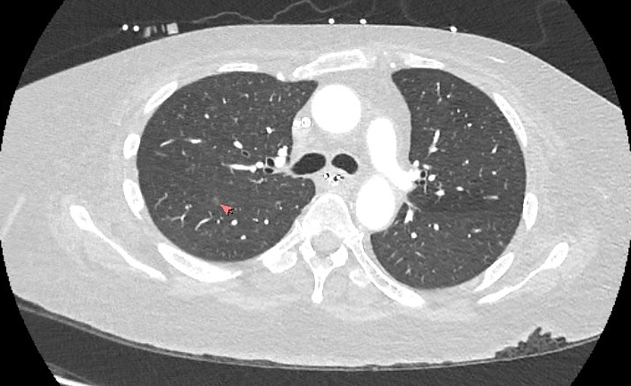
Case 1: Workup
Time since diagnosis | 7 yr pregnancy | 15 yr ED | 16 yr Dx: ESRD | 16.5 yr @WVU
CD4 abs | 738 | 75 | 34 | 104
CD4 % | 37% | 9.4% | 3.8% | 30%
Viral load | 283 | 38,100 | 16,200 | 71
CT C/A/P
Subtle groundglass nodule and opacities in the RLL may represent infectious / inflammatory process

Slide 39
Case 1: Workup
Time since diagnosis | 7 yr pregnancy | 15 yr ED | 16 yr Dx: ESRD | 16.5 yr @WVU
CD4 abs | 738 | 75 | 34 | 104
CD4 % | 37% | 9.4% | 3.8% | 30%
Viral load | 283 | 38,100 | 16,200 | 71
CT C/A/P
Subtle groundglass nodule and opacities in the RLL may represent infectious / inflammatory process
MRI brain W/WO
Unremarkable
TTE
Unremarkable

Slide 40
Case 1: Workup
Time since diagnosis | 7 yr pregnancy | 15 yr ED | 16 yr Dx: ESRD | 16.5 yr @WVU
CD4 abs | 738 | 75 | 34 | 104
CD4 % | 37% | 9.4% | 3.8% | 30%
Viral load | 283 | 38,100 | 16,200 | 71
CT C/A/P
Subtle groundglass nodule and opacities in the RLL may represent infectious / inflammatory process
MRI brain W/WO
Unremarkable
TTE
Unremarkable
Hepatitis screen
Hep C
Hep B
Spirochetes
Lyme
Syphilis

Slide 41
Case 1: Workup
Time since diagnosis | 7 yr pregnancy | 15 yr ED | 16 yr Dx: ESRD | 16.5 yr @WVU
CD4 abs | 738 | 75 | 34 | 104
CD4 % | 37% | 9.4% | 3.8% | 30%
Viral load | 283 | 38,100 | 16,200 | 71
CT C/A/P
Subtle groundglass nodule and opacities in the RLL may represent infectious / inflammatory process
MRI brain W/WO
Unremarkable
TTE
Unremarkable
Hepatitis screen
Hep C | Neg
Hep B | wnl
Spirochetes
Lyme | Neg
Syphilis | Neg

Slide 42
Case 1: Workup
Time since diagnosis | 7 yr pregnancy | 15 yr ED | 16 yr Dx: ESRD | 16.5 yr @WVU
CD4 abs | 738 | 75 | 34 | 104
CD4 % | 37% | 9.4% | 3.8% | 30%
Viral load | 283 | 38,100 | 16,200 | 71
CT C/A/P
Subtle groundglass nodule and opacities in the RLL may represent infectious / inflammatory process
MRI brain W/WO
Unremarkable
Blood cultures
Routine
AFB blood
TTE
Unremarkable
Hepatitis screen
Hep C | Neg
Hep B | wnl
Spirochetes
Lyme | Neg
Syphilis | Neg

Slide 43
Case 1: Workup
Time since diagnosis | 7 yr pregnancy | 15 yr ED | 16 yr Dx: ESRD | 16.5 yr @WVU
CD4 abs | 738 | 75 | 34 | 104
CD4 % | 37% | 9.4% | 3.8% | 30%
Viral load | 283 | 38,100 | 16,200 | 71
CT C/A/P
Subtle groundglass nodule and opacities in the RLL may represent infectious / inflammatory process
MRI brain W/WO
Unremarkable
Blood cultures
Routine | Neg
AFB blood | TBD
TTE
Unremarkable
Hepatitis screen
Hep C | Neg
Hep B | wnl
Spirochetes
Lyme | Neg
Syphilis | Neg

Slide 44
Case 1: Workup
Time since diagnosis | 7 yr pregnancy | 15 yr ED | 16 yr Dx: ESRD | 16.5 yr @WVU
CD4 abs | 738 | 75 | 34 | 104
CD4 % | 37% | 9.4% | 3.8% | 30%
Viral load | 283 | 38,100 | 16,200 | 71
CT C/A/P
Subtle groundglass nodule and opacities in the RLL may represent infectious / inflammatory process
MRI brain W/WO
Unremarkable
Blood cultures
Routine | Neg
AFB blood | TBD
TTE
Unremarkable
Serum fungal
Serum CrAg
Serum AspGM
Fungitell
Hepatitis screen
Hep C | Neg
Hep B | wnl
Spirochetes
Lyme | Neg
Syphilis | Neg

Slide 45
Case 1: Workup
Time since diagnosis | 7 yr pregnancy | 15 yr ED | 16 yr Dx: ESRD | 16.5 yr @WVU
CD4 abs | 738 | 75 | 34 | 104
CD4 % | 37% | 9.4% | 3.8% | 30%
Viral load | 283 | 38,100 | 16,200 | 71
CT C/A/P
Subtle groundglass nodule and opacities in the RLL may represent infectious / inflammatory process
MRI brain W/WO
Unremarkable
Blood cultures
Routine | Neg
AFB blood | TBD
TTE
Unremarkable
Serum fungal
Serum CrAg | Neg
Serum AspGM | Neg
Fungitell | <31
Hepatitis screen
Hep C | Neg
Hep B | wnl
Spirochetes
Lyme | Neg
Syphilis | Neg

Slide 46
Case 1: Workup
Respiratory
Resp Biofire
Urine Strep
uLegionella
Culture
Time since diagnosis | 7 yr pregnancy | 15 yr ED | 16 yr Dx: ESRD | 16.5 yr @WVU
CD4 abs | 738 | 75 | 34 | 104
CD4 % | 37% | 9.4% | 3.8% | 30%
Viral load | 283 | 38,100 | 16,200 | 71
CT C/A/P
Subtle groundglass nodule and opacities in the RLL may represent infectious / inflammatory process
MRI brain W/WO
Unremarkable
Blood cultures
Routine | Neg
AFB blood | TBD
TTE
Unremarkable
Serum fungal
Serum CrAg | Neg
Serum AspGM | Neg
Fungitell | <31
Hepatitis screen
Hep C | Neg
Hep B | wnl
Spirochetes
Lyme | Neg
Syphilis | Neg

Slide 47
Case 1: Workup
Respiratory
Resp Biofire | Neg
Urine Strep | Neg
uLegionella | Pos
Culture | Pos
Time since diagnosis | 7 yr pregnancy | 15 yr ED | 16 yr Dx: ESRD | 16.5 yr @WVU
CD4 abs | 738 | 75 | 34 | 104
CD4 % | 37% | 9.4% | 3.8% | 30%
Viral load | 283 | 38,100 | 16,200 | 71
CT C/A/P
Subtle groundglass nodule and opacities in the RLL may represent infectious / inflammatory process
MRI brain W/WO
Unremarkable
Blood cultures
Routine | Neg
AFB blood | TBD
TTE
Unremarkable
Serum fungal
Serum CrAg | Neg
Serum AspGM | Neg
Fungitell | <31
Hepatitis screen
Hep C | Neg
Hep B | wnl
Spirochetes
Lyme | Neg
Syphilis | Neg

Slide 48
Case 1: Workup
Respiratory
Resp Biofire | Neg
Urine Strep | Neg
uLegionella | Pos
Culture | Pos
Time since diagnosis | 7 yr pregnancy | 15 yr ED | 16 yr Dx: ESRD | 16.5 yr @WVU
CD4 abs | 738 | 75 | 34 | 104
CD4 % | 37% | 9.4% | 3.8% | 30%
Viral load | 283 | 38,100 | 16,200 | 71
CT C/A/P
Subtle groundglass nodule and opacities in the RLL may represent infectious / inflammatory process
MRI brain W/WO
Unremarkable
Blood cultures
Routine | Neg
AFB blood | TBD
Sputum Cx
1+ E cloacae (CRE)
1+ Kleb pneumo (CRE)
1+ Pseudomonas
TTE
Unremarkable
Serum fungal
Serum CrAg | Neg
Serum AspGM | Neg
Fungitell | <31
Hepatitis screen
Hep C | Neg
Hep B | wnl
Spirochetes
Lyme | Neg
Syphilis | Neg

Slide 49
Case 1: Workup
Respiratory Cx | 1+ E cloacae | 1+ Kleb pneumo | 1+ Pseudomonas
Pip/tazo | R | R | S
Cefepime | SDD (8) | R | S (2)
Ceftazidime | R | R | S
Meropenem | R | R | S
Ceftaz/avibactam | ? | ? | ?
Ceftolozane/tazo | ? | ? | ?
Levofloxacin | ? | ? | ?
Ciprofloxacin | ? | ? | ?
Gentamicin | ? | ? | ?

Slide 50
Case 1: Workup
Respiratory Cx | 1+ E cloacae | 1+ Kleb pneumo | 1+ Pseudomonas
Pip/tazo | R | R | S
Cefepime | SDD (8) | R | S (2)
Ceftazidime | R | R | S
Meropenem | R | R | S
Ceftaz/avibactam | R | R | ---
Ceftolozane/tazo | R | R | ---
Levofloxacin | ? | ? | ?
Ciprofloxacin | ? | ? | ?
Gentamicin | ? | ? | ?

Slide 51
Case 1: Workup
Respiratory Cx | 1+ E cloacae | 1+ Kleb pneumo | 1+ Pseudomonas
Pip/tazo | R | R | S
Cefepime | SDD (8) | R | S (2)
Ceftazidime | R | R | S
Meropenem | R | R | S
Ceftaz/avibactam | R | R | ---
Ceftolozane/tazo | R | R | ---
Levofloxacin | ? | ? | ?
Ciprofloxacin | ? | ? | ?
Gentamicin | ? | ? | ?
Respiratory
uLegionella | Pos
Culture | NDM?

Slide 52
Case 1: Workup
Respiratory Cx | 1+ E cloacae | 1+ Kleb pneumo | 1+ Pseudomonas
Pip/tazo | R | R | S
Cefepime | SDD (8) | R | S (2)
Ceftazidime | R | R | S
Meropenem | R | R | S
Ceftaz/avibactam | R | R | ---
Ceftolozane/tazo | R | R | ---
Levofloxacin | S (<0.12) | S (<0.12) | S (1)
Ciprofloxacin | S | S | S (0.5)
Gentamicin | S | S | ---
Respiratory
uLegionella | Pos
Culture | NDM?

Slide 53
Case 1: Workup
Respiratory Cx | 1+ E cloacae | 1+ Kleb pneumo | 1+ Pseudomonas
Pip/tazo | R | R | S
Cefepime | SDD (8) | R | S (2)
Ceftazidime | R | R | S
Meropenem | R | R | S
Ceftaz/avibactam | R | R | ---
Ceftolozane/tazo | R | R | ---
Levofloxacin | S (<0.12) | S (<0.12) | S (1)
Ciprofloxacin | S | S | S (0.5)
Gentamicin | S | S | ---
Respiratory
uLegionella | Pos
Culture | NDM?
EKG: QTc 490s (x2)

Slide 54
Would you use a quinolone?
Remember, she came in for heart stuff…

Slide 55
Case 1: Hospital course
We were actually consulted asking if we should resume Biktarvy
During her prior hospital stay (OSF), infectious diseases there did an extensive workup for opportunistic infections (including a Karius?)
Seemed like she had been taking her Biktarvy since that discharge (was at a SNF)
Resumed Biktarvy
Treated pneumonia (both CRE and legionella) with levofloxacin
QTc was fine on treatment

Slide 56
Case 1: Hospital course
We were actually consulted asking if we should resume Biktarvy
During her prior hospital stay (OSF), infectious diseases there did an extensive workup for opportunistic infections (including a Karius?)
Seemed like she had been taking her Biktarvy since that discharge (was at a SNF)
Resumed Biktarvy
Treated pneumonia (both CRE and legionella) with levofloxacin
QTc was fine on treatment

Slide 57
Case 1: Hospital course
We were actually consulted asking if we should resume Biktarvy
During her prior hospital stay (OSF), infectious diseases there did an extensive workup for opportunistic infections (including a Karius?)
Seemed like she had been taking her Biktarvy since that discharge (was at a SNF)
Resumed Biktarvy
Treated pneumonia (both CRE and legionella) with levofloxacin
QTc was fine on treatment

Slide 58
Case 1: Hospital course
We were actually consulted asking if we should resume Biktarvy
During her prior hospital stay (OSF), infectious diseases there did an extensive workup for opportunistic infections (including a Karius?)
Seemed like she had been taking her Biktarvy since that discharge (was at a SNF)
Resumed Biktarvy
Treated pneumonia (both CRE and legionella) with levofloxacin
QTc was fine on treatment

Slide 59

Discussion
Links to articles discussed here

Slide 60
Objectives
Define elite controllers (EC) and long term non-progressors (LTNP)
Distinguish between immunologic control and virologic control
Contrast the natural history of these conditions
Describe the rates and risk factors for progression
Investigate the current understanding of the pathophysiology in EC & LTNP, including
Factors related to the viral strain of HIV
Differences in their immune function (humoral vs cellular immunity)
Evaluate the inflammation & immunologic aging that occurs in EC/LTNP
Abnormal monocyte activation
Shorter telomere lengths
Consequences of this aging
Assess the risk/benefits of starting ART in this population, and review the 2025 guidelines from HHS
Long term non-progressors & elite controllers

Slide 61
Spectrum of HIV phenotypes [4]
Rapid progressors: Rapidly progress to AIDS in just a few year (not a focus for today)
Typical progressors: The majority of people living with HIV
Long term non-progressors: People infected with HIV but who remain clinically and immunologically stable (i.e. normal CD4) for extended periods without ART
Viremic controllers: People with HIV who maintain low viral loads (but detectable) without therapy
Elite controllers: PLWH who remain virologically suppressed without therapy (virologic control)
Rapid progressors
Typical progressors
Long term non-progressors
Viremic controllers
Elite controllers

Slide 62
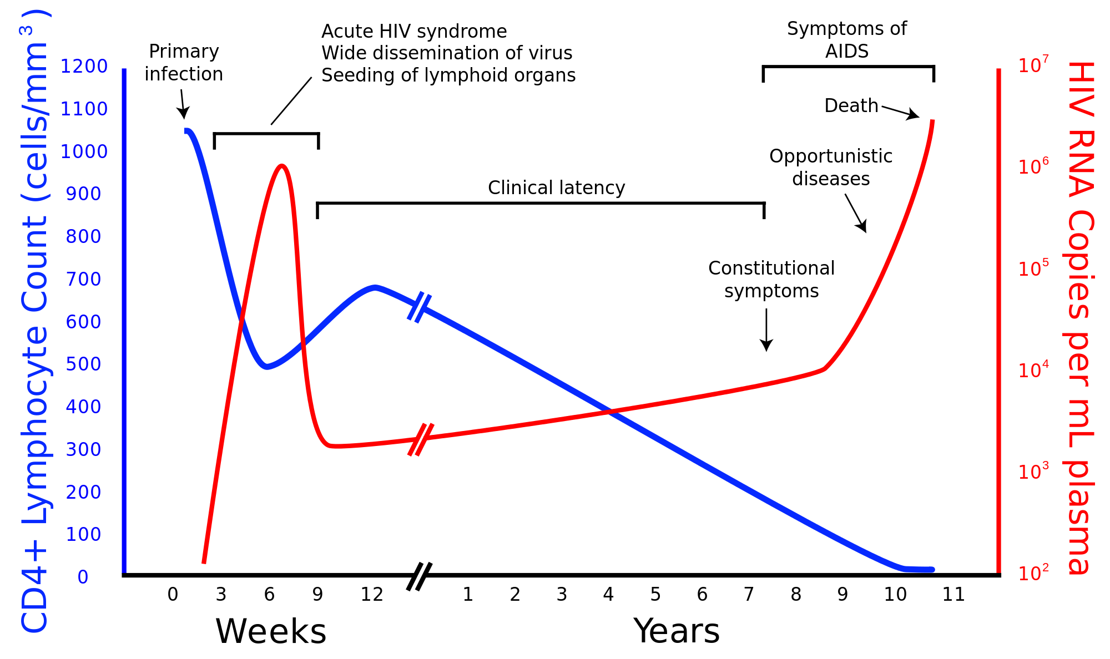
Spectrum of HIV phenotypes [4]
Typical progressors: The majority of people living with HIV
Long term non-progressors: People infected with HIV but who remain clinically and immunologically stable (i.e. normal CD4) for extended periods without ART
Viremic controllers: People with HIV who maintain low viral loads (but detectable) without therapy
Elite controllers: PLWH who remain virologically suppressed without therapy (virologic control)
Rapid progressors
Typical progressors
Long term non-progressors
Viremic controllers
Elite controllers

Slide 63
Spectrum of HIV phenotypes [4]
Typical progressors: The majority of people living with HIV
Long term non-progressors: People infected with HIV but who remain clinically and immunologically stable (i.e. normal CD4) for extended periods without ART
Viremic controllers: People with HIV who maintain low viral loads (but detectable) without therapy
Elite controllers: PLWH who remain virologically suppressed without therapy (virologic control)
Immunologic control
Rapid progressors
Typical progressors
Long term non-progressors
Viremic controllers
Elite controllers

Slide 64
Spectrum of HIV phenotypes [4]
Typical progressors: The majority of people living with HIV
Long term non-progressors: People infected with HIV but who remain clinically and immunologically stable (i.e. normal CD4) for extended periods without ART
Viremic controllers: People with HIV who maintain low viral loads (but detectable) without therapy
Elite controllers: PLWH who remain virologically suppressed without therapy (virologic control)
Virologic control
Immunologic control
Rapid progressors
Typical progressors
Long term non-progressors
Viremic controllers
Elite controllers

Slide 65
Spectrum of HIV phenotypes [4]
Typical progressors: The majority of people living with HIV
Long term non-progressors: People infected with HIV but who remain clinically and immunologically stable (i.e. normal CD4) for extended periods without ART
Viremic controllers: People with HIV who maintain low viral loads (but detectable) without therapy
Elite controllers: PLWH who remain virologically suppressed without therapy (virologic control)
Virologic control
Immunologic control
Rapid progressors
Typical progressors
Long term non-progressors
Viremic controllers
Elite controllers

Slide 66
Spectrum of HIV phenotypes [2]
 | Long term non-progressors | Elite controllers
Prevalence | ~5% of PLWH | 0.3-0.5% of PLWH [1] Subset of LTNP
Long term non-progressors
Elite controllers

Slide 67
Spectrum of HIV phenotypes [2]
 | Long term non-progressors | Elite controllers
Prevalence | ~5% of PLWH | 0.3-0.5% of PLWH [1] Subset of LTNP
Definition (off of ART) | CD4 >500 for 7-10 years | VL < 50 for 12 months
Long term non-progressors
Elite controllers

Slide 68
Spectrum of HIV phenotypes [2]
 | Long term non-progressors | Elite controllers
Prevalence | ~5% of PLWH | 0.3-0.5% of PLWH [1] Subset of LTNP
Definition (off of ART) | CD4 >500 for 7-10 years Defined by immunologic control | VL < 50 for 12 months
Immunologic control | Yes (for a while at least) | …
Virologic control | No (usually low-moderate viremia [1]) | …
Virologic control
Immunologic control
Long term non-progressors
Elite controllers

Slide 69
Spectrum of HIV phenotypes [2]
 | Long term non-progressors | Elite controllers
Prevalence | ~5% of PLWH | 0.3-0.5% of PLWH [1] Subset of LTNP
Definition (off of ART) | CD4 >500 for 7-10 years Defined by immunologic control | VL < 50 for 12 months Defined by virologic control
Immunologic control | Yes (for a while at least) | Usually
Virologic control | No (usually low-moderate viremia [1]) | Yes
Virologic control
Immunologic control
Long term non-progressors
Elite controllers

Slide 70
LTNP: Natural history
Immunologic control is rarely permanent [5]
Most establish virologic control within a year of seroconversion

Slide 71
LTNP: Natural history
Immunologic control is rarely permanent [5]
Most establish virologic control within a year of seroconversion
After some time, most controllers will lose their ability to control the virus → CD4 will drop eventually [1][3-4]

Slide 72
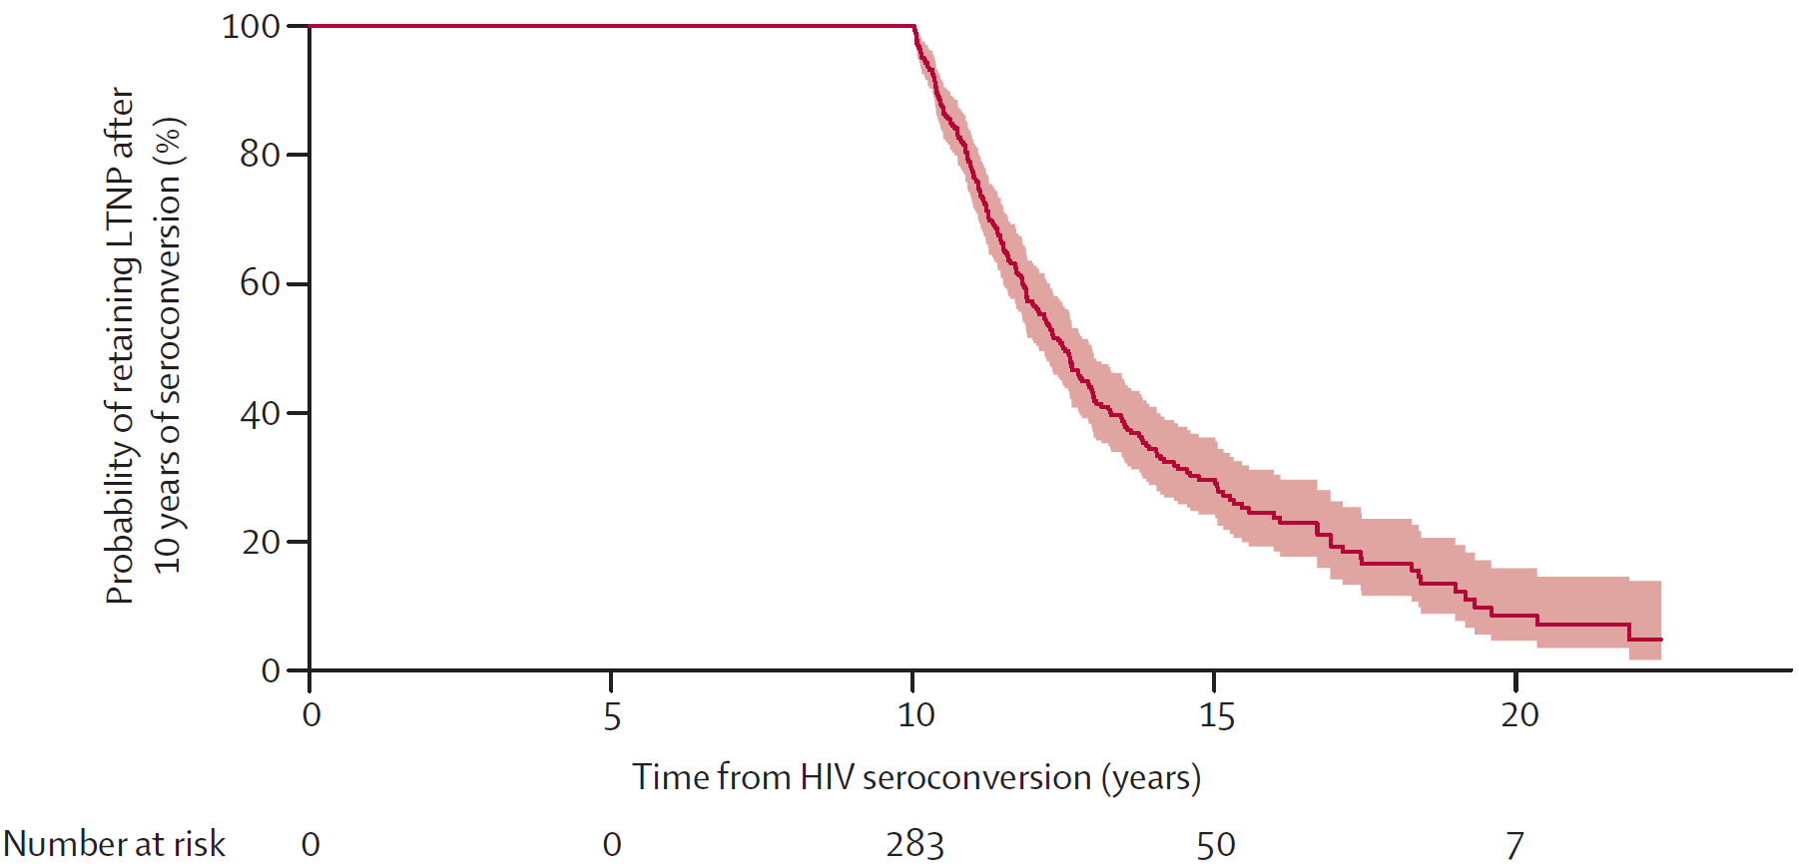
LTNP: Natural history
Immunologic control is rarely permanent [5]
Most establish virologic control within a year of seroconversion
After some time, most controllers will lose their ability to control the virus → CD4 will drop eventually [1][3-4]
Recall the definitions
LTNP are defined as those who did not have immunologic progression by 10 years.
“CD4 >500 for 7-10 years”

Slide 73
LTNP: Natural history [5]
Immunologic control is rarely permanent
After some time, most controllers will lose their ability to control the virus → CD4 will drop eventually [1][3-4]
Median time [3] to loss of immunologic control (after the 10 year period): 2.5 years
Fig 3 [3] Years after seroconversion

Slide 74
LTNP: Natural history [3]
Immunologic control is rarely permanent
After some time, CD4 will drop eventually [1][3,4,5], median of 2.5 years [3]
In a large, international database from 2014 [3] (25,629 PLWH)
Inclusion: ART-naive & AIDS-free
Defined LTNP as CD4 >500 at 10 years (n=283)
Predictors of progressing to CD4 <500:
Fig 3 [3] Years after seroconversion

Slide 75
LTNP: Natural history [3]
Immunologic control is rarely permanent
After some time, CD4 will drop eventually [1][3,4,5], median of 2.5 years [3]
In a large, international database from 2014 [3] (25,629 PLWH)
Inclusion: ART-naive & AIDS-free
Defined LTNP as CD4 >500 at 10 years (n=283)
Predictors of progressing to CD4 <500:
Not predictive: Age, sex, HIV risk factor
Not predictive: Baseline or nadir CD4
Fig 3 [3] Years after seroconversion

Slide 76
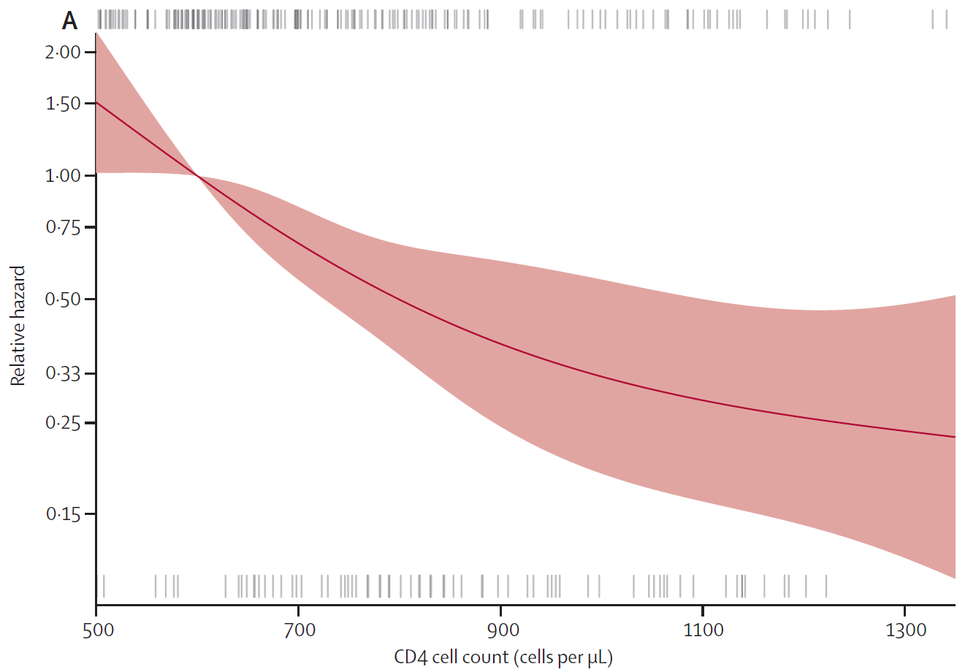
LTNP: Natural history [3]
Immunologic control is rarely permanent
After some time, CD4 will drop eventually [1][3,4,5], median of 2.5 years [3]
In a large, international database from 2014 [3] (25,629 PLWH)
Inclusion: ART-naive & AIDS-free
Defined LTNP as CD4 >500 at 10 years (n=283)
Predictors of progressing to CD4 <500:
Not predictive: Age, sex, HIV risk factor
Not predictive: Baseline or nadir CD4
CD4 count at 10 years (↓ CD4 = ↑ risk)
Viral load at 10 years (↑ VL = ↑ risk)
Lower risk
Higher
CD4
Fig 4a [3]

Slide 77
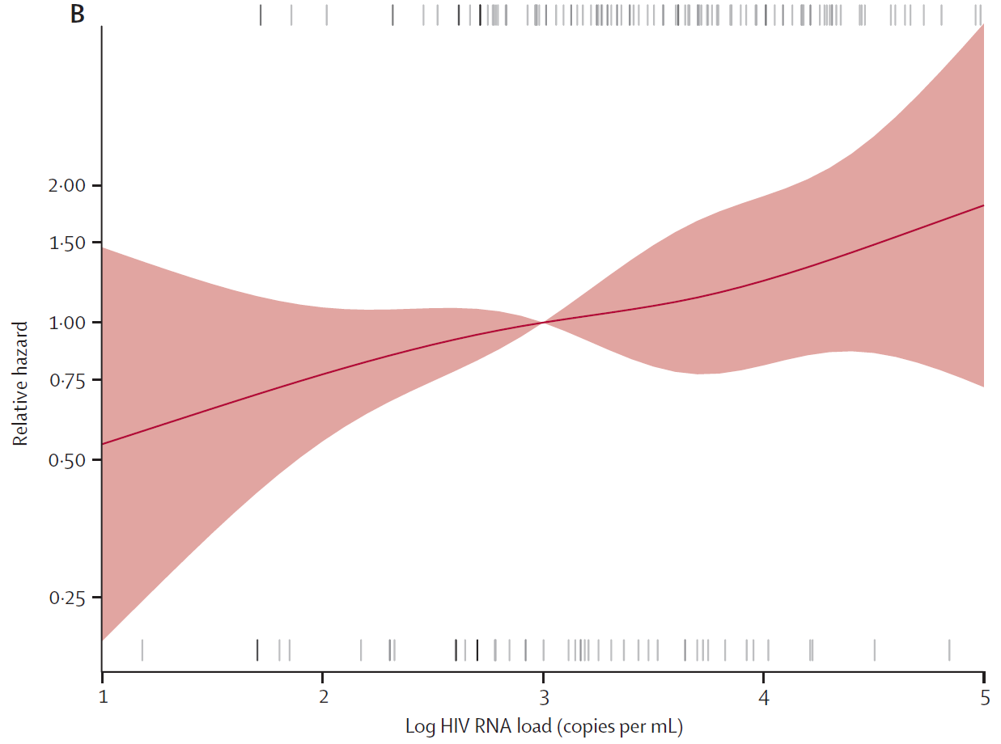
LTNP: Natural history [3]
Immunologic control is rarely permanent
After some time, CD4 will drop eventually [1][3,4,5], median of 2.5 years [3]
In a large, international database from 2014 [3] (25,629 PLWH)
Inclusion: ART-naive & AIDS-free
Defined LTNP as CD4 >500 at 10 years (n=283)
Predictors of progressing to CD4 <500:
Not predictive: Age, sex, HIV risk factor
Not predictive: Baseline or nadir CD4
CD4 count at 10 years (↓ CD4 = ↑ risk)
Viral load at 10 years (↑ VL = ↑ risk)
Lower risk
Lower
VL
Fig 4b [3]

Slide 78
LTNP: Natural history
Immunologic control is temporary [1][3,4,5]
Risk factors of progression [3] are mainly based on control at 10 years (lower CD4, higher VL)
This has led some authors [4] to conclude that “long term non-progressors” may just be “slow progressors”
This is highlighted by looking at studies with varying definitions of “LTNP” [see 5]

Slide 79
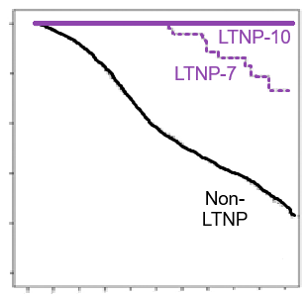
LTNP: Natural history
100%
Immunologic control is temporary [1][3,4,5]
Risk factors of progression [3] are mainly based on control at 10 years (lower CD4, higher VL)
This has led some authors [4] to conclude that “long term non-progressors” may just be “slow progressors”
This is highlighted by looking at studies with varying definitions of “LTNP” [see 5]
80%
60%
Proportion surviving (%)
40%
20%
Recall the definitions
LTNP are defined as those who did not have immunologic progression by 10 years.
“CD4 >500 for 7-10 years”
0%
0
2
4
6
8
10
12
14
16
18
20
Fig 4C [5]
Time (years)

Slide 80
EC: Natural history
Compare this with elite controllers (those with extraordinary virologic control)

Slide 81
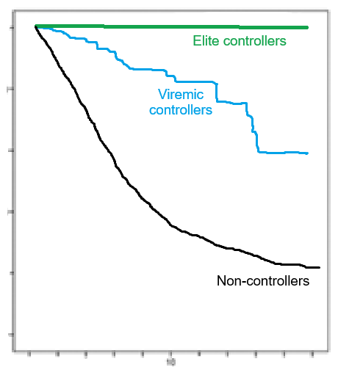
EC: Natural history
100%
80%
Compare this with elite controllers (those with extraordinary virologic control)
Tend to have excellent immunologic control [5]
Degree of viremia is partially predictive of loss of immunologic control. Even differences as small as <1 copy vs 50 copies [1]
60%
Proportion without AIDS (%)
40%
20%
0%
0
2
4
6
8
10
12
14
16
18
20
Fig 3C [5]
Time (years)

Slide 82
EC: Natural history
100%
80%
Compare this with elite controllers (those with extraordinary virologic control)
Tend to have excellent immunologic control [5]
Degree of viremia is partially predictive of loss of immunologic control. Even differences as small as <1 copy vs 50 copies [1]
60%
Proportion without AIDS (%)
40%
20%
 | Defined based on … control | Virologic control | Typical viral load
Elite controllers | Virologic | Excellent | <50 [2]
Viremic controllers | Virologic | Good | 50 - 2,000 [6]
Long term non- progressors | Immunologic | Fair | 1-10k [1] (usually 2k)
0%
0
2
4
6
8
10
12
14
16
18
20
Fig 3C [5]
Time (years)

Slide 83
Elite controllers: Do they fail with time too?
Cases elite controllers progression to AIDS is much less common than with LTNP
In one study [5], only one patient (of 25 elite controllers; 4%) developed AIDS defining illness, pulmonary TB
This is much lower than the rate of AIDS defining illnesses in the cohort with a viral load >50 (25 events in 153 patients; 16%)
In another study [1], the only AIDS defining illness was Kaposi sarcoma
CD4 cell count was 630/μL

Slide 84
Elite controllers: Do they fail with time too?
Cases elite controllers progression to AIDS is much less common than with LTNP
In one study [5], only one patient (of 25 elite controllers; 4%) developed AIDS defining illness, pulmonary TB
This is much lower than the rate of AIDS defining illnesses in the cohort with a viral load >50 (25 events in 153 patients; 16%)
In another study [1], the only AIDS defining illness was a case of Kaposi sarcoma
CD4 cell count was 630/μL

Slide 85
Elite controllers: Do they fail with time too?
Cases elite controllers progression to AIDS is much less common than with LTNP
In one study [5], only one patient (of 25 elite controllers; 4%) developed AIDS defining illness, pulmonary TB
This is much lower than the rate of AIDS defining illnesses in the cohort with a viral load >50 (25 events in 153 patients; 16%)
In another study [1], the only AIDS defining illness was a case of Kaposi sarcoma
CD4 cell count was 630/μL
Some authors propose that chronic immune activation (e.g. aberrant T-cell activation) may drive these manifestations [1]

Slide 86
Themes thus far
“Non-progressors” can be categorized via immunologic control (e.g. long term nonprogressors) and virologic control (e.g. elite controllers)
These terms likely exist on a continuum [4]
 | Defined based on | Virologic control | Typical viral load | Immunologic control
Elite controllers | Virologic control | Excellent (by def) | <50 [2] | Usually great long term
Viremic controllers | Virologic control | Good | 50 - 2,000 [6] | Good, for awhile
Long term non- progressors | Immunologic control | Fair, for awhile | 1-10k [1] (usually 2k) | By definition (but wanes w/ time)

Slide 87
Themes thus far
“Non-progressors” can be categorized via immunologic control (e.g. long term nonprogressors) and virologic control (e.g. elite controllers)
These terms likely exist on a continuum [4]
Unless you have virologic control, immunologic control is rarely permanent [1]
Stable viral load generally → stable CD4 [5]
 | Defined based on | Virologic control | Typical viral load | Immunologic control
Elite controllers | Virologic control | Excellent (by def) | <50 [2] | Usually great long term
Viremic controllers | Virologic control | Good | 50 - 2,000 [6] | Good, for awhile
Long term non- progressors | Immunologic control | Fair, for awhile | 1-10k [1] (usually 2k) | By definition (but wanes w/ time)

Slide 88
Themes thus far
“Non-progressors” can be categorized via immunologic control (e.g. long term nonprogressors) and virologic control (e.g. elite controllers)
These terms likely exist on a continuum [4]
Unless you have virologic control, immunologic control is rarely permanent [1]
Stable viral load generally → stable CD4 [5]
Progression of disease (i.e. loss of immunologic control) usually occurs due to loss of virologic control (just like untreated HIV in “typical progressors”)
Think of these cases as unfolding in slow motion (compared to typical HIV off ART)

Slide 89
Pathophysiology
Define elite controllers (EC) and long term non-progressors (LTNP)
Distinguish between immunologic control and virologic control
Contrast the natural history
Describe the risk factors for progression
Investigate the current understanding of the pathophysiology in EC & LTNP, including
Factors related to the viral strain of HIV
Differences in their immune function (humoral vs cellular immunity)
Possible other factors
Evaluate the inflammation & immunologic aging that occurs in EC/LTNP
Assess the risk/benefits of starting ART in this population, and review the 2025 guidelines from HHS
Long term non-progressors & elite controllers

Slide 90

HIV control: Viral factors
Tempting to suspect that HIV control in these patients is due to defective/attenuated viral strains, but this generally is not the case [1], with the notable exceptions below:

Slide 91
HIV control: Viral factors
Tempting to suspect that HIV control in these patients is due to defective/attenuated viral strains, but this generally is not the case [1], with the notable exceptions below:
Sydney blood bank cohort: six recipients of blood (from a LTNP) developed HIV and became all became LTNP as well [10]
This viral strain had deletions in the nef gene [2]
Most of these LTNP eventually did have progression of their disease [10]

Slide 92
HIV control: Viral factors
Tempting to suspect that HIV control in these patients is due to defective/attenuated viral strains, but this generally is not the case [1], with the notable exceptions below:
Sydney blood bank cohort: six recipients of blood (from a LTNP) developed HIV and became all became LTNP as well [10]
This viral strain had deletions in the nef gene [2]
Most of these LTNP eventually did have progression of their disease [10]
Some strains (in other LTNP) have shown other mutations in genes that reduce the rate of viral replication (e.g. ↓ IL10 ⇒ ↓expression of CCR5) [2]

Slide 93
HIV control: Viral factors
Tempting to suspect that HIV control in these patients is due to defective/attenuated viral strains, but this generally is not the case [1], with the notable exceptions below:
Sydney blood bank cohort: six recipients of blood (from a LTNP) developed HIV and became all became LTNP as well [10]
This viral strain had deletions in the nef gene [2]
Most of these LTNP eventually did have progression of their disease [10]
Some strains (in other LTNP) have shown other mutations in genes that reduce the rate of viral replication (e.g. ↓ IL10 ⇒ ↓expression of CCR5) [2]
However, most LTNPs are infected with fully pathogenic, replication-competent viruses [1]

Slide 94
Pathophysiology:
Cell mediated immunity
Define elite controllers (EC) and long term non-progressors (LTNP)
Distinguish between immunologic control and virologic control
Contrast the natural history
Describe the risk factors for progression
Investigate the current understanding of the pathophysiology in EC & LTNP, including
Factors related to the viral strain of HIV
Differences in their immune function (humoral vs cellular immunity)
Possible other factors
Evaluate the inflammation & immunologic aging that occurs in EC/LTNP
Assess the risk/benefits of starting ART in this population, and review the 2025 guidelines from HHS

Slide 95
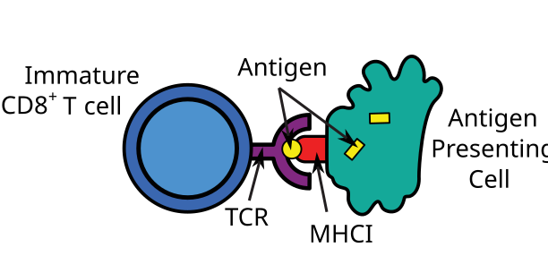
HIV control: The immune system
HLA genes encode major histocompatibility complex proteins
In this case we care about MHC-I (HLA A-C)
Adaptive immunity
 | MHC-I | MHC-II
Presents | Endogenous proteins | Exogenous proteins
HLA genes | HLA-A HLA-B HLA-C | HLA-DP HLA-DQ HLA-DR
Humoral
B-cells
Cellular
T-cells
T_{H}
(CD4)
T_{C}
(CD8)

Slide 96

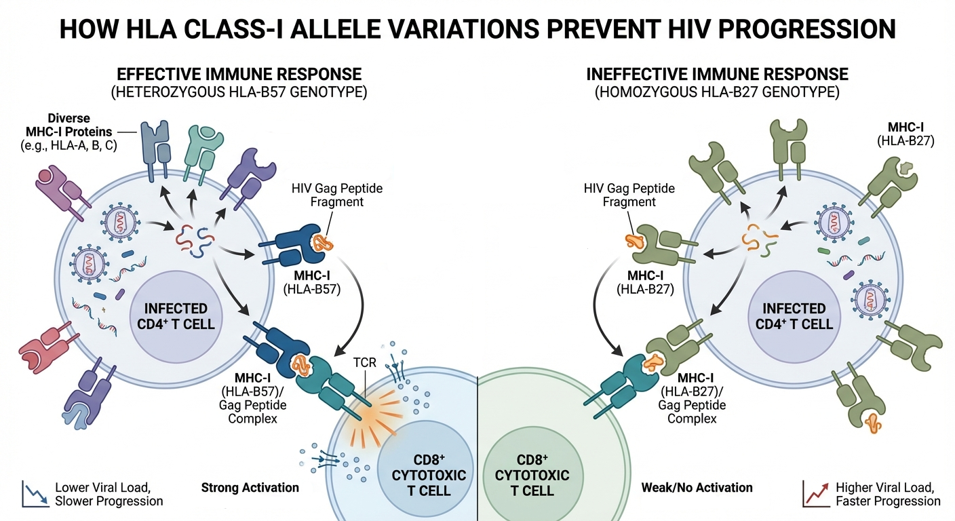
HIV control: Host genetics [2][10]
The strongest association with HIV control is the presence of specific HLA Class I alleles
Heterozygous HLA class-I genotype is linked to slower disease development by allowing the presentation of a broader spectrum of HIV peptides

Slide 97
HIV control: Host genetics [2][10]
The strongest association with HIV control is the presence of specific HLA Class I alleles
Heterozygous HLA class-I genotype is linked to slower disease development by allowing the presentation of a broader spectrum of HIV peptides
HLA-B57 variations (e.g. B5701 & B5703) in particular elicit a strong response to the Gag epitopes of HIV
Same one as for abacavir (but this time you want to have it)
Notes:
Abacavir

Slide 98
HIV control: Host genetics [2][10]
The strongest association with HIV control is the presence of specific HLA Class I alleles
Heterozygous HLA class-I genotype is linked to slower disease development by allowing the presentation of a broader spectrum of HIV peptides
HLA-B57 variations (e.g. B5701 & B5703) in particular elicit a strong response to the Gag epitopes of HIV
This in turn leads to strong activation of CD8+ cytotoxic T cells → Killing of infected CD4+ cells
Same one as for abacavir (but this time you want to have it)

Slide 99
HIV control: Host genetics [2][10]
The strongest association with HIV control is the presence of specific HLA Class I alleles, specifically HLA-B57
Studies of LTNPs with the lowest viral loads (<75) found that B57 is found in considerably higher frequencies (compared to typical progressors and healthy seronegative controls)

Slide 100
HIV control: Host genetics [2][10]
The strongest association with HIV control is the presence of specific HLA Class I alleles, specifically HLA-B57
Studies of LTNPs with the lowest viral loads (<75) found that B57 is found in considerably higher frequencies (compared to typical progressors and healthy seronegative controls)
90-95% of LTNPs carry at least one HLA-B allele that mediate a slow rate of HIV progression
E.g. B57, B13, B15, B44, B51, B58

Slide 101
HIV control: Host genetics [2][10]

Slide 102
HIV control: The immune system
Immune system
Innate immunity
Adaptive immunity
Phagocytes
Neutrophils
Macrophages
Humoral
B-cells
Cellular
T-cells
Natural killer

Slide 103
HIV control: The immune system
Adaptive >>>> innate immunity
Innate immunity only matters early in the infection
Cellular >>> humoral
Neutralizing antibodies develop too late in most infections
CD8 >> CD4
Least
important
Most
important
Immune system
Innate immunity
Adaptive immunity
Phagocytes
Neutrophils
Macrophages
Humoral
B-cells
Cellular
T-cells
Natural killer

Slide 104
HIV control: The immune system
Adaptive >>>> innate immunity
Innate immunity only matters early in the infection
Cellular >>> humoral
Neutralizing antibodies develop too late in most infections
CD8 >> CD4
Least
important
Most
important
Immune system
Innate immunity
Adaptive immunity
Phagocytes
Neutrophils
Macrophages
Humoral
B-cells
Cellular
T-cells
Natural killer
T_{H}
(CD4)
T_{C}
(CD8)

Slide 105
HIV control: The immune system
Adaptive >>>> innate immunity
Innate immunity only matters early in the infection
Cellular >>> humoral
Neutralizing antibodies develop too late in most infections
CD8 >> CD4
Least
important
Most
important
Immune system
Innate immunity
Adaptive immunity
Phagocytes
Neutrophils
Macrophages
Humoral
B-cells
Cellular
T-cells
Natural killer
T_{H}
(CD4)
T_{C}
(CD8)

Slide 106

Cell-mediated immunity (CD8)
CD8+ cytotoxic T cells are not more numerous in LTNP/ECs [10]
They exhibit higher expression of cytolytic enzymes → better kill infected CD4 cells [2][10]
Simultaneously, express high levels of cytokines (e.g. IL-2) to sustain their own proliferative capacity [1][2][10]
In some ECs, CD8+ cells are able to recognize and kill HIV infected CD4 cells even before the CD4 cells become activated or start producing new copies of HIV [2]

Slide 107
Cell-mediated immunity (CD8)
CD8+ cytotoxic T cells are not more numerous in LTNP/ECs, but are polyfunctional. Quality matters more than quantity [10]
They exhibit higher expression of cytolytic enzymes → better kill infected CD4 cells [2][10]
Simultaneously, express high levels of cytokines (e.g. IL-2) to sustain their own proliferative capacity [1][2][10]
In some ECs, CD8+ cells are able to recognize and kill HIV infected CD4 cells even before the CD4 cells become activated or start producing new copies of HIV [2]

Slide 108
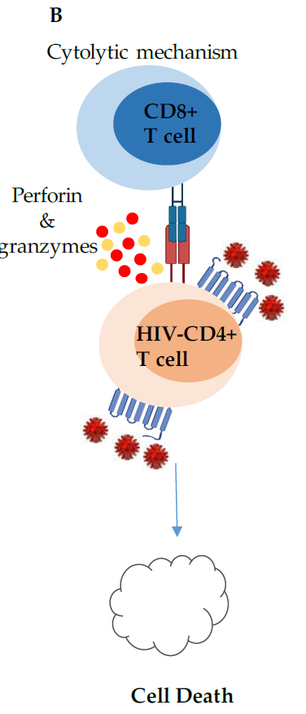
Cell-mediated immunity (CD8)
CD8+ cytotoxic T cells are not more numerous in LTNP/ECs, but are polyfunctional. Quality matters more than quantity [10]
They exhibit higher expression of cytolytic enzymes → better kill infected CD4 cells [2][10]
Simultaneously, express high levels of cytokines (e.g. IL-2) to sustain their own proliferative capacity [1][2][10]
In some ECs, CD8+ cells are able to recognize and kill HIV infected CD4 cells even before the CD4 cells become activated or start producing new copies of HIV [2]

Slide 109
Cell-mediated immunity (CD8)
CD8+ cytotoxic T cells are not more numerous in LTNP/ECs, but are polyfunctional. Quality matters more than quantity [10]
They exhibit higher expression of cytolytic enzymes → better kill infected CD4 cells [2][10]
Simultaneously, express high levels of cytokines (e.g. IL-2) to sustain their own proliferative capacity [1][2][10]
In some ECs, CD8+ cells are able to recognize and kill HIV infected CD4 cells even before the CD4 cells become activated or start producing new copies of HIV [2]

Slide 110
Cell-mediated immunity (CD8)
CD8+ cytotoxic T cells are not more numerous in LTNP/ECs, but are polyfunctional. Quality matters more than quantity [10]
They exhibit higher expression of cytolytic enzymes → better kill infected CD4 cells [2][10]
Simultaneously, express high levels of cytokines (e.g. IL-2) to sustain their own proliferative capacity [1][2][10]
In some ECs, CD8+ cells are able to recognize (and kill) HIV infected CD4 cells even before the CD4 cells become activated or start producing new copies of HIV [2]

Slide 111
Cell-mediated immunity (CD8)
CD8+ cytotoxic T cells are not more numerous in LTNP/ECs, but are polyfunctional. Quality matters more than quantity [10]
They exhibit higher expression of cytolytic enzymes → better kill infected CD4 cells [2][10]
Simultaneously, express high levels of cytokines (e.g. IL-2) to sustain their own proliferative capacity [1][2][10]
In some ECs, CD8+ cells are able to (recognize and) kill HIV infected CD4 cells even before the CD4 cells become activated or start producing new copies of HIV [2]
Speculation (on my part)
Does make one wonder if the ability of CD8 cells to recognize CD4 cells (prior to them transcribing new copies of HIV) is related to the high affinity MHC-I proteins expressed by certain HLA-B alleles [citation needed]

Slide 112
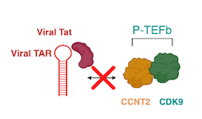
Cell-mediated immunity (CD4)
Although CD8+ cytotoxic T cells are the main players here, some elite controllers have increased CD4+ expression of p21 [2]
p21 is a cyclin-dependent kinase inhibitor
Specifically, p21 inhibits CDK9 (a cofactor for reverse transcription of HIV)

Slide 113
Cell-mediated immunity (CD4)
Although CD8+ cytotoxic T cells are the main players here, some elite controllers have increased CD4+ expression of p21 [2]
p21 is a cyclin-dependent kinase inhibitor
Specifically, p21 inhibits CDK9 (a cofactor for reverse transcription of HIV)

Slide 114
Pathophysiology:
Other mechanisms
Define elite controllers (EC) and long term non-progressors (LTNP)
Distinguish between immunologic control and virologic control
Contrast the natural history
Describe the risk factors for progression
Investigate the current understanding of the pathophysiology in EC & LTNP, including
Factors related to the viral strain of HIV
Differences in their immune function (humoral vs cellular immunity)
Possible other factors
Evaluate the inflammation & immunologic aging that occurs in EC/LTNP
Assess the risk/benefits of starting ART in this population, and review the 2025 guidelines from HHS

Slide 115

Humoral immunity [2]
Long term non-progressors
Some studies show LTNPs have higher rates of broad acting neutralizing antibodies (NAbs)
But others could not replicate this findings

Slide 116
Humoral immunity [2]
Long term non-progressors
Elite controllers
Some studies show LTNPs have higher rates of broad acting neutralizing antibodies (NAbs)
But others could not replicate this findings
Generally do not have higher rates of NAbs, but instead the antibodies produced by ECs have unique effector functions

Slide 117
Humoral immunity [2]
Long term non-progressors
Elite controllers
Some studies show LTNPs have higher rates of broad acting neutralizing antibodies (NAbs)
But others could not replicate this findings
Generally do not have higher rates of NAbs, but instead the antibodies produced by ECs have unique effector functions
Namely antibody dependent cellular cytotoxicity, which targets and kills infected cells by recruiting natural killer cells

Slide 118

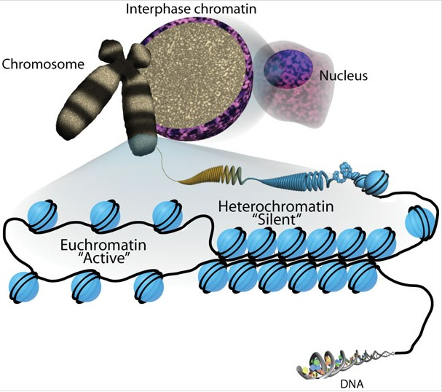
HIV control: Location of integration [2][10]
In ECs, HIV proviruses are disproportionately found integrated into non-coding regions (“gene deserts”; e.g. heterochromatin)

Slide 119
HIV control: Location of integration [2][10]
In ECs, HIV proviruses are disproportionately found integrated into non-coding regions (“gene deserts”; e.g. heterochromatin)
Non-controllers (on ART) are more likely to have integration into euchromatin → more prone to reactivation

Slide 120
HIV control: Location of integration [2][10]
In ECs, HIV proviruses are disproportionately found integrated into non-coding regions (“gene deserts”; e.g. heterochromatin)
Non-controllers (on ART) are more likely to have integration into euchromatin → more prone to reactivation
This partially explains why ECs have undetectable viral loads
All of their actively infected cells are being killed by CD8 cells
Their latent reservoir “genome” is not transcribed

Slide 121
HIV control: Location of integration [2][10]
In ECs, HIV proviruses are disproportionately found integrated into non-coding regions (“gene deserts”; e.g. heterochromatin)
Interestingly, after prolonged ART (>20 years), the sites of integration begins to mimic elite controllers
Both cases are thought to be a result of selective pressure from the immune system

Slide 122
HIV control: Location of integration [2][10]
In ECs, HIV proviruses are disproportionately found integrated into non-coding regions (“gene deserts”; e.g. heterochromatin)
Interestingly, after prolonged ART (>20 years), the sites of integration begins to mimic elite controllers
Both cases are thought to be a result of selective pressure from the immune system

Slide 123
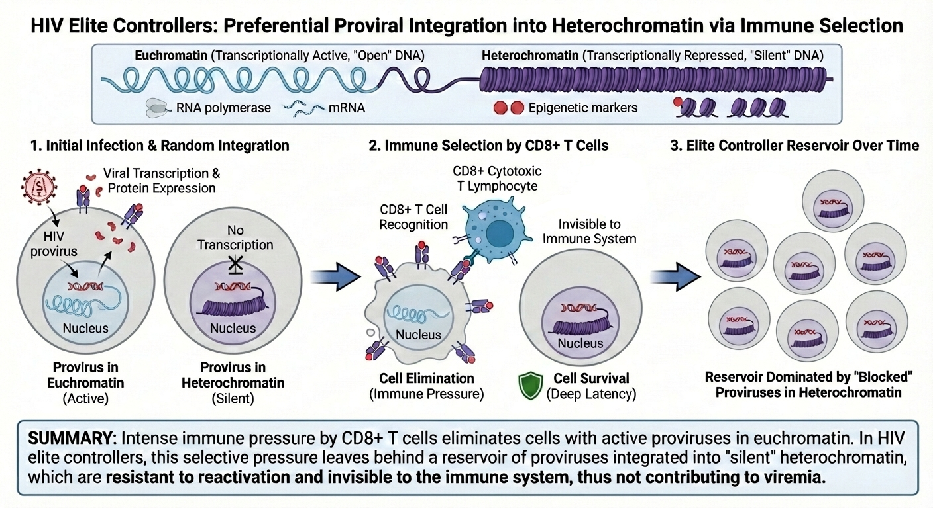
HIV control: Location of integration [2][10]

Slide 124
HIV control: Location of integration [2][10]

Slide 125
HIV control: Location of integration [2][10]

Slide 126
HIV control: Summary
✗ Is it related to their virus?
Only in rare cases (Sydney blood bank)
✗ Produce more antibodies?
Mixed data on the amount of antibodies, but some studies showed ECs have Abs that help with ADCC via NK cells
? Site of HIV integration?
Integration into transcriptionally repressed areas of the host genome likely contributes ECs ability to have undetectable VL, but this may be a selective consequence from their elite control (not the cause of it)
Notes:
✓

Slide 127
HIV control: Summary
✗ Is it related to their virus?
Only in rare cases (Sydney blood bank)
✓ Host genetics? (MHC-I)
Strong association with HLA*B (B57) in LTNPs, especially when heterozygous alleles since can better bind to fragments of HIV in infected cells → allows CD8 cells to kill infected cells
✗ Produce more antibodies?
Mixed data on the amount of antibodies, but some studies showed ECs have Abs that help with ADCC via NK cells
✓✓ Cellular immunity (CD8 >> CD4)
CD8 cytotoxic T cells in LTNP/ECs are phenotypically unique and polyfunctional (better at killing infected CD4 in a number of ways). CD4 cells likely play a minimal role in control
? Site of HIV integration?
Integration into transcriptionally repressed areas of the host genome likely contributes ECs ability to have undetectable VL, but this may be a selective consequence from their elite control (not the cause of it)
Notes:
✓

Slide 128
Possible mechanism? (speculative)
Host genetics (MHC-I)
Encodes for more effective CD8 cells
Cellular immunity (CD8)
Polyfunctional CD8 T cells are better at killing infected cells that express HIV
Site of HIV integration
Selective pressure created to favor cells with HIV integrated into transcriptionally repressed areas
Likely multifactorial
(and may be multiple mechanisms)
↓ expression of HIV → fewer chances to mutate
(and less likely to have virologic escape from the CD8 cells)
Notes:
✓

Slide 129
Inflammation & immunologic aging
Define elite controllers (EC) and long term non-progressors (LTNP)
Distinguish between immunologic control and virologic control
Investigate the current understanding of the pathophysiology in EC & LTNP, including
Factors related to the viral strain of HIV
Differences in their immune function (humoral vs cellular immunity)
Evaluate the inflammation & immunologic aging that occurs in EC/LTNP
Abnormal monocyte activation → CV risk & HAND
Shorter telomere lengths
Consequences of this aging
Assess the risk/benefits of starting ART in this population, and review the 2025 guidelines from HHS
Long term non-progressors & elite controllers

Slide 130
Immunologic aging
Both LTNP & EC still have high levels of abnormal immune activation [11]
We will start with (the least technical most familiar) example I could find, the CD4:CD8 ratio

Slide 131
Immunologic aging: CD4:CD8
CD4:CD8 ratio is helpful method of assessment of immune function
CD4:CD8 ratio <1 is bad (even in LTNP/EC) and associated with [9]
Abnormal immune function
Serious non-AIDS events
T-cell subsets (during pregnancy)
CD8 abs (%) | 940 (47%)
CD4 abs (%) | 738 (37%)
CD4:CD8 | 0.8

Slide 132
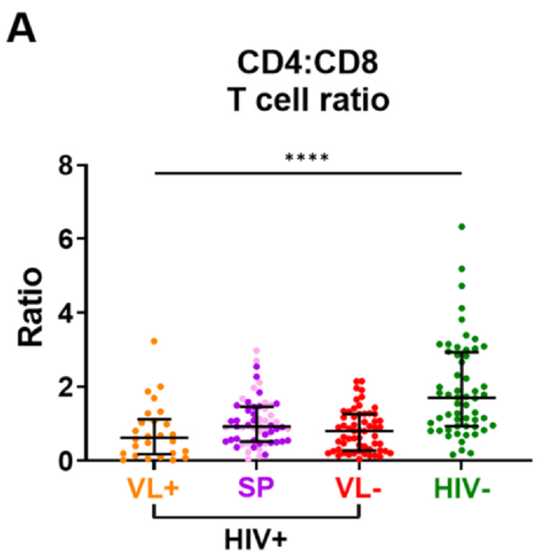
Immunologic aging: CD4:CD8
CD4:CD8 ratio <1 is bad (even in LTNP/EC) and associated with [9]
Abnormal immune function
Serious non-AIDS events
Despite their normal CD4 levels, ratio is often <1 in LTNP compared to those with undetectable VL [7]
LTNP
Figure 2A of citation [7]

Slide 133
Immunologic aging: CD4:CD8
CD4:CD8 ratio <1 is bad (even in LTNP/EC) and associated with [9]
Abnormal immune function
Serious non-AIDS events
Despite their normal CD4 levels, ratio is often <1 in LTNP compared to those with undetectable VL [7]
Ratio remains abnormal (<1) in LTNP, even after starting ART [9]
LTNP
Figure 2A of citation [7]

Slide 134
Immunologic aging: Monocytes [6]
LTNP have similar immune activation profiles as other people with HIV who are not on ART

Slide 135
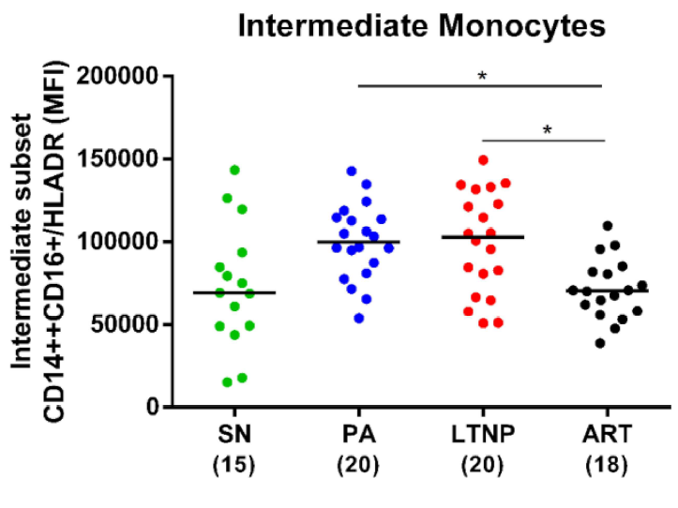
Immunologic aging: Monocytes [6]
LTNP have similar immune activation profiles as other people with HIV who are not on ART
LTNP have increased levels of pro-atherogenic monocyte subsets
Sero-
negative
Pre-
ART
LTNP
On
ART
Figure 5B of citation [6]

Slide 136
Immunologic aging: Monocytes [6]
LTNP have similar immune activation profiles as other people with HIV who are not on ART
LTNP have increased levels of pro-atherogenic monocyte subsets
FYI, I’m not an immunologist (this is an immunology journal)
Intermediate monocytes are identified by CCR5
In animal models, atherosclerotic plaque formation is recruited in a CCR5-dependent fashion
Sero-
negative
Pre-
ART
LTNP
On
ART
Figure 5B of citation [6]

Slide 137
Immunologic aging: Monocytes [6]
LTNP have similar immune activation profiles as other people with HIV who are not on ART
LTNP have increased levels of pro-atherogenic monocyte subsets
CD4+CD16+ monocytes preferentially transmigrate across the blood brain barrier
Increased monocyte activation (across the BBB) has been associated with HAND [8]
Sero-
negative
Pre-
ART
LTNP
On
ART
Figure 5B of citation [6]

Slide 138
Immunologic aging: Monocytes [6]
LTNP have similar immune activation profiles as other people with HIV who are not on ART
LTNP have increased levels of pro-atherogenic monocyte subsets
CD4+CD16+ monocytes preferentially transmigrate across the blood brain barrier
Increased monocyte activation (across the BBB) has been associated with HAND [8]
Disequilibrium between activation markers persisted irrespective of disease progression status (pre-ART vs LTNP)
But was restored by ART
Sero-
negative
Pre-
ART
LTNP
On
ART
Figure 5B of citation [6]

Slide 139
Immunologic aging: Telomere length [7]
LTNP have shorter telomere length compared to PWH on ART (or healthy controls)

Slide 140
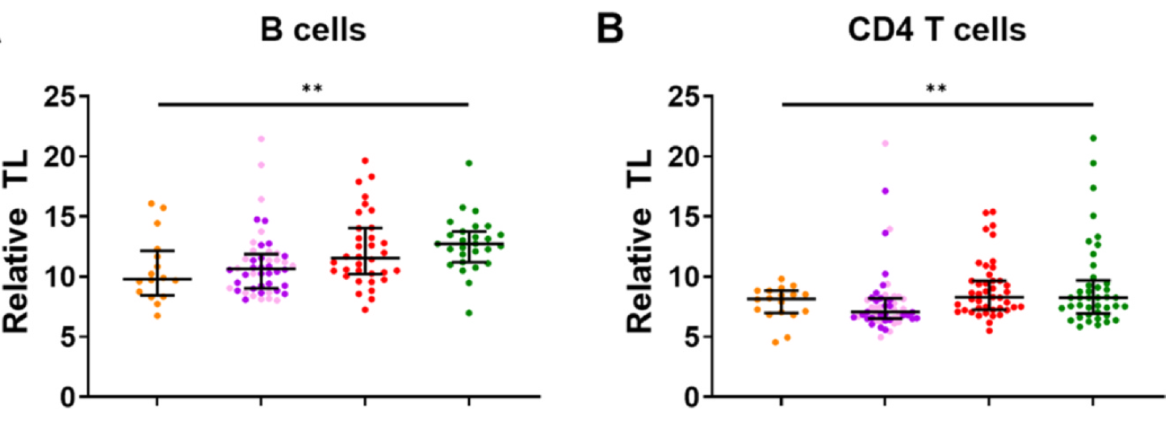
Immunologic aging: Telomere length [7]
LTNP have shorter telomere length compared to PWH on ART (or healthy controls)
Fig 3 [7]: Relative telomere length (TL) compared to age+sex matched HIV groups
LTNP
LTNP
LTNP

Slide 141
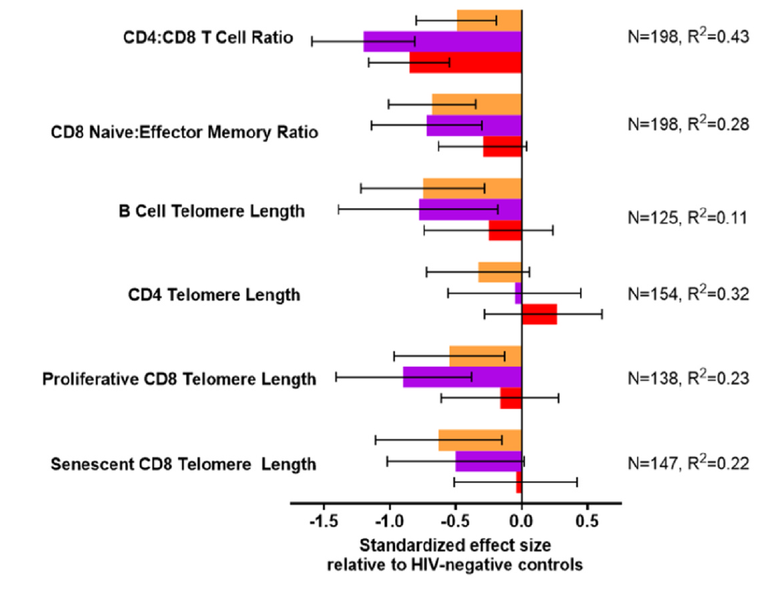

Immunologic aging: Telomere length [7]
LTNP have shorter telomere length compared to PWH on ART (or healthy controls)
Shorter telomere length seen in B cells, CD4, and CD8 cells
Pattern persisted even in elite controllers
LTNP
Fig 5 [7]

Slide 142
Immunologic aging: Telomere length [7]
LTNP have shorter telomere length compared to PWH on ART (or healthy controls)
Shorter telomere length seen in B cells, CD4, and CD8 cells
Pattern persisted even in elite controllers
In some models, the effect of LTNP status can account for more than a decade of immune aging
Their immune aging is akin to peers with uncontrolled HIV
LTNP
Fig 5 [7]

Slide 143
Immunologic aging: Outcomes
In one cohort, elite controllers not receiving ART were hospitalized more often for cardiovascular and psychiatric disease [11]

Slide 144
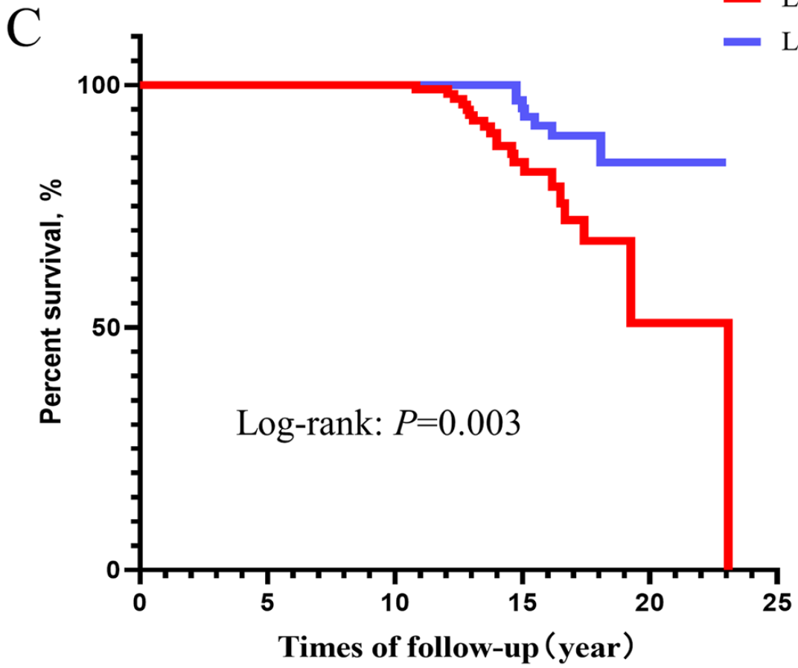
Immunologic aging: Outcomes
LTNP taking ART
In one cohort, elite controllers not receiving ART were hospitalized more often for cardiovascular and psychiatric disease [11]
Another study found LTNP not receiving ART have nearly four times higher mortality risk [9]
LTNP w/o ART
Figure 1C of citation [9]

Slide 145
Immunologic aging: Outcomes
LTNP taking ART
In one cohort, elite controllers not receiving ART were hospitalized more often for cardiovascular and psychiatric disease [11]
Another study found LTNP not receiving ART have nearly four times higher mortality risk [9]
LTNP w/o ART
# Renal failure / ESRD
Found to be in renal failure
Nephrotic range proteinuria (>14g)
Started on iHD
HIV associated nephropathy?
I couldn’t find anything directly on this in LTNP, but it seems reasonable to conclude the patient’s LTNP status did not help the kidneys
Figure 1C of citation [9]

Slide 146
Should you start ART? [11]
Data is sparse, so decision to start ART in elite controllers should be shared decision making

Slide 147
Should you start ART? [11]
Data is sparse, so decision to start ART in elite controllers should be shared decision making
No ART: Probable/possible risk of
Immune aging & inflammation (e.g. HAND)
Atherosclerosis
Increased mortality
Starting ART: Small risk of
Bone issues
Renal issues
Other metabolic changes

Slide 148
Should you start ART? [11]
Data is sparse, so decision to start ART in elite controllers should be shared decision making
The HHS guidelines [11] “for the use of antiretroviral agents in adults and adolescents with HIV” were updated in 2025 to include:

Slide 149
Should you start ART? [11]
Data is sparse, so decision to start ART in elite controllers should be shared decision making
The HHS guidelines [11] “for the use of antiretroviral agents in adults and adolescents with HIV” were updated in 2025 to include:
The Panel strongly recommends (AIII) ART for elite controllers with:
Evidence of HIV-related complications
Declining CD4 counts
Intermittent detectable viral load
Comorbidities (e.g., cardiovascular disease, cancer, HBV/HCV coinfection)
Pregnancy

Slide 150
Should you start ART? [11]
Data is sparse, so decision to start ART in elite controllers should be shared decision making
The HHS guidelines [11] “for the use of antiretroviral agents in adults and adolescents with HIV” were updated in 2025 to include:
The Panel strongly recommends (AIII) ART for elite controllers with:
Evidence of HIV-related complications
Declining CD4 counts
Intermittent detectable viral load
Comorbidities (e.g., cardiovascular disease, cancer, HBV/HCV coinfection)
Pregnancy
The Panel recommends (BII) initiation of ART for all other elite controllers

Slide 151
Should you start ART? [11]
Data is sparse, so decision to start ART in elite controllers should be shared decision making
The HHS guidelines [11] “for the use of antiretroviral agents in adults and adolescents with HIV” were updated in 2025 to include:
The Panel strongly recommends (AIII) ART for elite controllers with:
Evidence of HIV-related complications
Declining CD4 counts
Intermittent detectable viral load
Comorbidities (e.g., cardiovascular disease, cancer, HBV/HCV coinfection)
Pregnancy
The Panel recommends (BII) initiation of ART for all other elite controllers
This will likely be many of the LTNP (but not ECs)

Slide 152
Should you start ART? [11]
Data is sparse, so decision to start ART in elite controllers should be shared decision making
The HHS guidelines [11] “for the use of antiretroviral agents in adults and adolescents with HIV” were updated in 2025 to include:
Fig 3 [3] Years after seroconversion
The Panel strongly recommends (AIII) ART for elite controllers with:
Evidence of HIV-related complications
Declining CD4 counts
Intermittent detectable viral load
Comorbidities (e.g., cardiovascular disease, cancer, HBV/HCV coinfection)
Pregnancy
The Panel recommends (BII) initiation of ART for all other elite controllers
If ART is deferred, elite controllers should be followed closely, as some may experience CD4 count decline, loss of viral control, or complications related to HIV infection

Slide 153
Learning points & take aways

Slide 154
Learning points & take aways
LTNP: CD4 >500 for 7–10 years off ART → immunologic control
Immunologic control is usually temporary (more like slow progressors)
After 10 years, median time to progression 2.5 years
Elite Controllers (EC): VL <50 copies for ≥12 months off ART → virologic control
EC are a small subset of LTNP (and only ~0.3-0.5% of PLWH)
Control is associated with host genetics (HLA-B57 and other HLA-B alleles) and polyfunctional CD8+ T cells
Despite a normal CD4, the immune system is not normal → accelerated immune aging
When off ART, ↑ hospitalizations for cardiovascular (pro-atherogenic monocyte activation) and psychiatric (BBB transmigrations) events
2025 HHS ART guidance recommends ART for most EC (and likely all LTNP)
If ART is deferred, close monitoring is suggested due to risk of progression
Slides available on hunterratliff1.com/talk/; Citations available via QR code or via the “citations” button on the website

Slide 155
Saving the next case for next time

Slide 156
Case #2

Slide 157
Case 2: HPI
A 66 y/o M with PMH including CAD+PAD, CKD3, recent cholecystitis is admitted following planned robotic cholecystectomy. Has been here for a month, ID consulted for intra-abdominal abscess

Slide 158
Case 2: HPI
A 66 y/o M with PMH including CAD+PAD, CKD3, recent cholecystitis admitted after cholecystectomy; ID consulted for intra-abdominal abscess
Cholecystectomy c/b biliary leak → had ERCP for biliary stent placement
ERCP c/b pancreatitis
Cholecystectomy
Zosyn
1
2
3
4
5

Slide 159
Case 2: HPI
A 66 y/o M with PMH including CAD+PAD, CKD3, recent cholecystitis admitted after cholecystectomy; ID consulted for intra-abdominal abscess
Cholecystectomy c/b biliary leak → had ERCP for biliary stent placement
ERCP c/b pancreatitis
Develops gallbladder fossa collection and candidemia
Goes to SICU for septic shock and CRRT
Chole
Fluc
Micafungin
Zosyn
Merrem
1
2
3
4
5
6
7
8
9
10
11
12
13
BCx: C albicans
BCx:
neg
IR drain
(C albicans)

Slide 160
Case 2: HPI
A 66 y/o M with PMH including CAD+PAD, CKD3, recent cholecystitis admitted after cholecystectomy; ID consulted for intra-abdominal abscess
Cholecystectomy c/b biliary leak → had ERCP for biliary stent placement
Develops gallbladder fossa collection & candidemia → SICU for septic shock & CRRT
IR places a drain into GB collection (also grows candida albicans)
Later gets percutaneous chole tube (PCT) - No micro sent
Chole
Fluc
Micafungin
Zosyn
Merrem
1
2
3
4
5
6
7
8
9
10
11
12
13
14
15
16
17
18
19
BCx: C albicans
BCx:
neg
IR drain
(C albicans)
IR PCT
(no micro)

Slide 161
Case 2: HPI
A 66 y/o M with PMH including CAD+PAD, CKD3, recent cholecystitis admitted after cholecystectomy; c/b biliary leak, gallbladder fossa collection, candidemia. ID consulted for intra-abdominal abscess
Does better (at least for awhile) → rising WBC (20s → 30s) and low drain output
Chole
Fluc
Micafungin
Fluconazole
Zosyn
Merrem
Zosyn
1
2
3
4
5
6
7
8
9
10
11
12
13
14
15
16
17
18
19
20
21
22
23
25
26
BCx: C albicans
BCx:
neg
IR drain
(C albicans)
IR PCT
(no micro)

Slide 162
Case 2: HPI
A 66 y/o M with PMH including CAD+PAD, CKD3, recent cholecystitis admitted after cholecystectomy; c/b biliary leak, gallbladder fossa collection, candidemia. ID consulted for intra-abdominal abscess
Does better → rising WBC (20s → 30s) and low drain output → rising WBC (20s → 30s) and low drain output
Chole
Fluc
Micafungin
Fluconazole
Zosyn
Merrem
Zosyn
1
2
3
4
5
6
7
8
9
10
11
12
13
14
15
16
17
18
19
20
21
22
23
25
26
BCx: C albicans
BCx:
neg
IR drain
(C albicans)
IR PCT
(no micro)

Slide 163
Case 2: HPI
A 66 y/o M with PMH including CAD+PAD, CKD3, recent cholecystitis admitted after cholecystectomy; c/b biliary leak, gallbladder fossa collection, candidemia. ID consulted for intra-abdominal abscess
Does better → rising WBC (20s → 30s) and low drain output
IR upsizes the drain (and send for micro)
They change up the antibiotics
Chole
Linezolid
Fluc
Micafungin
Fluconazole
Zosyn
Merrem
Zosyn
Merrem
1
2
3
4
5
6
7
8
9
10
11
12
13
14
15
16
17
18
19
20
21
22
23
24
25
26
27
28
29
30
31
32
33
BCx: C albicans
BCx:
neg
IR drain
(C albicans)
IR PCT
(no micro)
Upsize of drain
(they do send micro)

Slide 164
Case 2: HPI
A 66 y/o M with PMH including CAD+PAD, CKD3, recent cholecystitis admitted after cholecystectomy; c/b biliary leak, gallbladder fossa collection, candidemia. ID consulted for intra-abdominal abscess
Does better → rising WBC (20s → 30s) and low drain output
IR upsizes the drain (and send for micro)
Despite/after drain exchange, develops persistent fevers (and back in the ICU)
Chole
Linezolid
Fluc
Micafungin
Fluconazole
Zosyn
Merrem
Zosyn
Merrem
1
2
3
4
5
6
7
8
9
10
11
12
13
14
15
16
17
18
19
20
21
22
23
24
25
26
27
28
29
30
31
32
33
BCx: C albicans
BCx:
neg
IR drain
(C albicans)
IR PCT
(no micro)
Upsize of drain
(they do send micro)

Slide 165
Case 2: HPI
A 66 y/o M with PMH including CAD+PAD, CKD3, recent cholecystitis admitted after cholecystectomy; c/b biliary leak, gallbladder fossa collection, candidemia. ID consulted for intra-abdominal abscess
Does better → rising WBC (20s → 30s) and low drain output
IR upsizes the drain (and send for micro)
Despite/after drain exchange, develops persistent fevers (and back in the ICU)
Chole
Linezolid
Fluc
Micafungin
Fluconazole
Zosyn
Merrem
Zosyn
Merrem
1
2
3
4
5
6
7
8
9
10
11
12
13
14
15
16
17
18
19
20
21
22
23
24
25
26
27
28
29
30
31
32
33
34
BCx: C albicans
BCx:
neg
IR drain
(C albicans)
IR PCT
(no micro)
Upsize of drain
(they do send micro)
ID consult

Slide 166
Case 2: Physical exam
BP | 153/98 | Pulse | 97 | SpO2 | 95 %
Temp | 37 °C (98.6 °F) | RR | 22 | BMI | 42 kg/m²
General | Alert and oriented, NAD, vitals reviewed
HEENT | NCAT; trachea appears midline, no gross LAD; EOMI
Resp | diminished at bases, L>R; on HFNC
CV | RRR; extremities perfused
GI | Non-distended; no TTP; multiple drains
Extremities | General edema, LE in compression bandages
Lines | PICC & HD line dressing clean

Slide 167
Case 2: Labs
CBC | Result
WBC | 25
Hgb | 8.3
Platelets | 429
Neut % | 84%
Lymph % | 4.5%
Eos % | 0%
Chem7 | Result
Na | 139
K | 4.3
HCO3 | 26
BUN | 46
Cr | 2.4
LFTs | Result
AST | 50
ALT | 16
Alk Phos | 527
Bili | 0.4
Albumin | 1.3

Slide 168
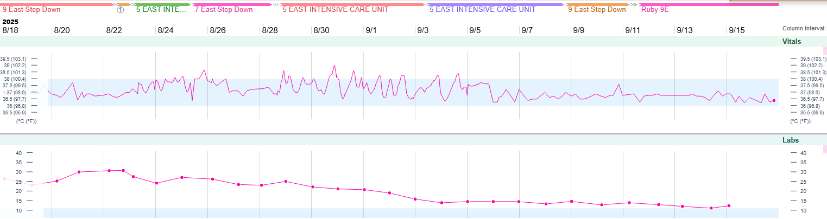
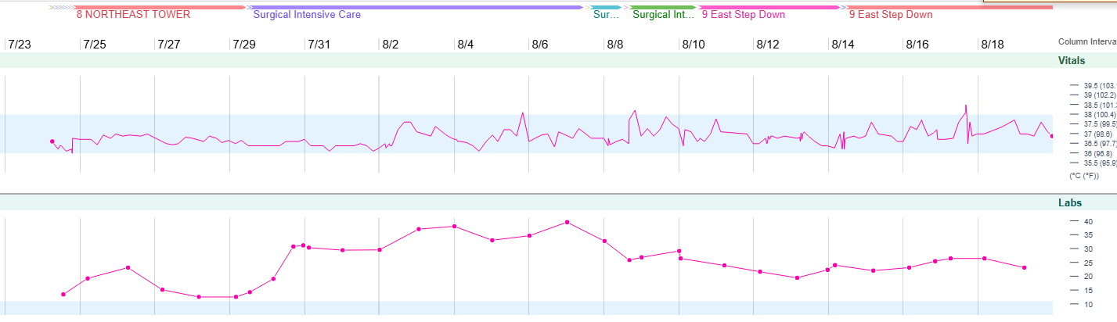
Case 2: Summary
A 66 y/o M with PMH including CAD+PAD, CKD3, recent cholecystitis admitted after cholecystectomy; c/b biliary leak, gallbladder fossa collection, candidemia.
Fever curve
Around post-op day 28, develops worsening WBC
Then develops fevers despite:
Broad spectrum abx
Repeat IR drain
WBCs
-- 40 --
-- 30 --
-- 20 --
-- 10 --
Chole
Linezolid
Fluc
Micafungin
Fluconazole
Zosyn
Merrem
Zosyn
Merrem
1
2
3
4
5
6
7
8
9
10
11
12
13
14
15
16
17
18
19
20
21
22
23
25
26
27
29
30
31
32
33
34
BCx: C albicans
BCx:
neg
IR drain
(C albicans)
IR PCT
(no micro)
Upsize of drain
(they do send micro)
ID consult

Slide 169
What might be driving the fevers?
Free response

Slide 170
If infectious, what kind of pathogens?
Free response

Slide 171
Case 2: Hospital course
We do the usual stuff:
CT A/P stable (collection still there)
Ask them to remove fem HD line
Last HD was a week ago
Cr is 2.0 - 2.2
BCx: negative
Temp
-- 38 --
WBCs
-- 40 --
-- 30 --
-- 20 --
-- 10 --
Linezolid
Fluc
Micafungin
Fluconazole
Zosyn
Merrem
Zosyn
Merrem
1
2
3
4
5
6
7
8
9
10
11
12
13
14
15
16
17
18
19
20
21
22
23
25
26
27
29
30
31
32
33
34
35
36
BCx: C albicans
BCx:
neg
IR drain
(C albicans)
IR PCT
(no micro)
Upsize of drain
(micro upcoming)
ID consult

Slide 172
Case 2: Hospital course
We do the usual stuff:
CT A/P stable (collection still there)
Ask them to remove fem HD line
Last HD was a week ago
Cr is 2.0 - 2.2
BCx: negative
Maybe he’s doing better?
Temp
-- 38 --
WBCs
-- 40 --
-- 30 --
-- 20 --
-- 10 --
Linezolid
Fluc
Micafungin
Fluconazole
Zosyn
Merrem
Zosyn
Merrem
1
2
3
4
5
6
7
8
9
10
11
12
13
14
15
16
17
18
19
20
21
22
23
25
26
27
29
30
31
32
33
34
35
36
BCx: C albicans
BCx:
neg
IR drain
(C albicans)
IR PCT
(no micro)
Upsize of drain
(micro upcoming)
ID consult

Slide 173
Case 2: Hospital course
We do the usual stuff:
CT A/P stable (collection still there)
Ask them to remove fem HD line
Last HD was a week ago
Cr is 2.0 - 2.2
BCx: negative
After they stop using a cooling blanket
Still fevering…
Temp
-- 38 --
WBCs
-- 40 --
-- 30 --
-- 20 --
-- 10 --
Linezolid
Fluc
Micafungin
Fluconazole
Zosyn
Merrem
Zosyn
Merrem
1
2
3
4
5
6
7
8
9
10
11
12
13
14
15
16
17
18
19
20
21
22
23
25
26
27
29
30
31
32
33
34
35
36
37
38
39
40
BCx: C albicans
BCx:
neg
IR drain
(C albicans)
IR PCT
(no micro)
Upsize of drain
(micro upcoming)
ID consult

Slide 174
Case 2: Micro results
IR drain exchange
4+ Multiple Gram (+) and Gram (-) Organisms
4+ Enterococcus faecium → Susceptible to linezolid
1+ Burkholderia cepacia complex (strain 1)
1+ Burkholderia cepacia complex (strain 2)
Temp
-- 38 --
WBCs
-- 40 --
-- 30 --
-- 20 --
-- 10 --
Linezolid
Fluc
Micafungin
Fluconazole
Zosyn
Merrem
Zosyn
Merrem
1
2
3
4
5
6
7
8
9
10
11
12
13
14
15
16
17
18
19
20
21
22
23
25
26
27
29
30
31
32
33
34
35
36
37
38
39
40
BCx: C albicans
BCx:
neg
IR drain
(C albicans)
IR PCT
(no micro)
Upsize of drain
(micro upcoming)
ID consult

Slide 175
Case 2: Micro results
IR drain exchange
4+ Multiple Gram (+) and Gram (-) Organisms
4+ Enterococcus faecium → Susceptible to linezolid
1+ Burkholderia cepacia complex (strain 1)
1+ Burkholderia cepacia complex (strain 2)
Temp
-- 38 --
WBCs
-- 40 --
Antimicrobial susceptibility testing is not performed for B cepacia complex due to lack of accurate test methods
-- 30 --
-- 20 --
-- 10 --
Linezolid
Fluc
Micafungin
Fluconazole
Zosyn
Merrem
Zosyn
Merrem
1
2
3
4
5
6
7
8
9
10
11
12
13
14
15
16
17
18
19
20
21
22
23
25
26
27
29
30
31
32
33
34
35
36
37
38
39
40
BCx: C albicans
BCx:
neg
IR drain
(C albicans)
IR PCT
(no micro)
Upsize of drain
(micro upcoming)
ID consult

Slide 176
What do you do for treatment?
Select many

Slide 177
Case 2: Hospital course
Really not excited to start Bactrim
Baseline CKD
We had asked to remove dialysis access
Current CrCl is around 30…
Temp
-- 38 --
WBCs
-- 40 --
-- 30 --
-- 20 --
-- 10 --
Linezolid
Fluc
Micafungin
Fluconazole
Zosyn
Merrem
Zosyn
Merrem
1
2
3
4
5
6
7
8
9
10
11
12
13
14
15
16
17
18
19
20
21
22
23
25
26
27
29
30
31
32
33
34
35
36
37
38
39
40
BCx: C albicans
BCx:
neg
IR drain
(C albicans)
IR PCT
(no micro)
Upsize of drain
(Burkholderia + E faecium + others)
ID consult

Slide 178
Case 2: Hospital course
Really not excited to start Bactrim
Baseline CKD
We had asked to remove dialysis access
Current CrCl is around 30…
Started Bactrim 1 DS q12h (soft tissue dosing)
Temp
-- 38 --
WBCs
1 DS q12
-- 40 --
-- 30 --
-- 20 --
-- 10 --
Linezolid
Fluc
Micafungin
Fluconazole
Zosyn
Merrem
Zosyn
Merrem
Bactrim
1
2
3
4
5
6
7
8
9
10
11
12
13
14
15
16
17
18
19
20
21
22
23
25
26
27
29
30
31
32
33
34
35
36
37
38
39
40
41
42
43
BCx: C albicans
BCx:
neg
IR drain
(C albicans)
IR PCT
(no micro)
Upsize of drain
(Burkholderia + E faecium + others)
ID consult

Slide 179
Case 2: Hospital course
Really not excited to start Bactrim
Baseline CKD
We had asked to remove dialysis access
Current CrCl is around 30…
Started Bactrim 1 DS q12h (soft tissue dosing)
Renal function stable → increase dose to 7 mg/kg/day
Temp
-- 38 --
WBCs
1 DS q12
7 mg/kg/day
-- 40 --
-- 30 --
-- 20 --
-- 10 --
Linezolid
Fluc
Micafungin
Fluconazole
Zosyn
Merrem
Zosyn
Merrem
Bactrim
1
2
3
4
5
6
7
8
9
10
11
12
13
14
15
16
17
18
19
20
21
22
23
25
26
27
29
30
31
32
33
34
35
36
37
38
39
40
41
42
43
44
45
46
47
48
49
50
BCx: C albicans
BCx:
neg
IR drain
(C albicans)
IR PCT
(no micro)
Upsize of drain
(Burkholderia + E faecium + others)
ID consult

Slide 180
Case 2: Hospital course
Ultimately completes 3 weeks of antimicrobials from repeat drain placement
One week of higher dosed Bactrim
No further infectious issues (and no more Burkholderia)!
Temp
-- 38 --
WBCs
1 DS q12
7 mg/kg/day
-- 40 --
-- 30 --
-- 20 --
-- 10 --
Linezolid
Fluc
Micafungin
Fluconazole
Zosyn
Merrem
Zosyn
Merrem
Bactrim
1
2
3
4
5
6
7
8
9
10
11
12
13
14
15
16
17
18
19
20
21
22
23
25
26
27
29
30
31
32
33
34
35
36
37
38
39
40
41
42
43
44
45
46
47
48
49
50
BCx: C albicans
BCx:
neg
IR drain
(C albicans)
IR PCT
(no micro)
Upsize of drain
(Burkholderia + E faecium + others)
ID consult

