Slide 1
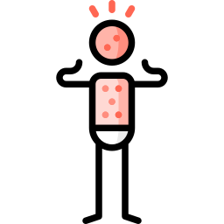
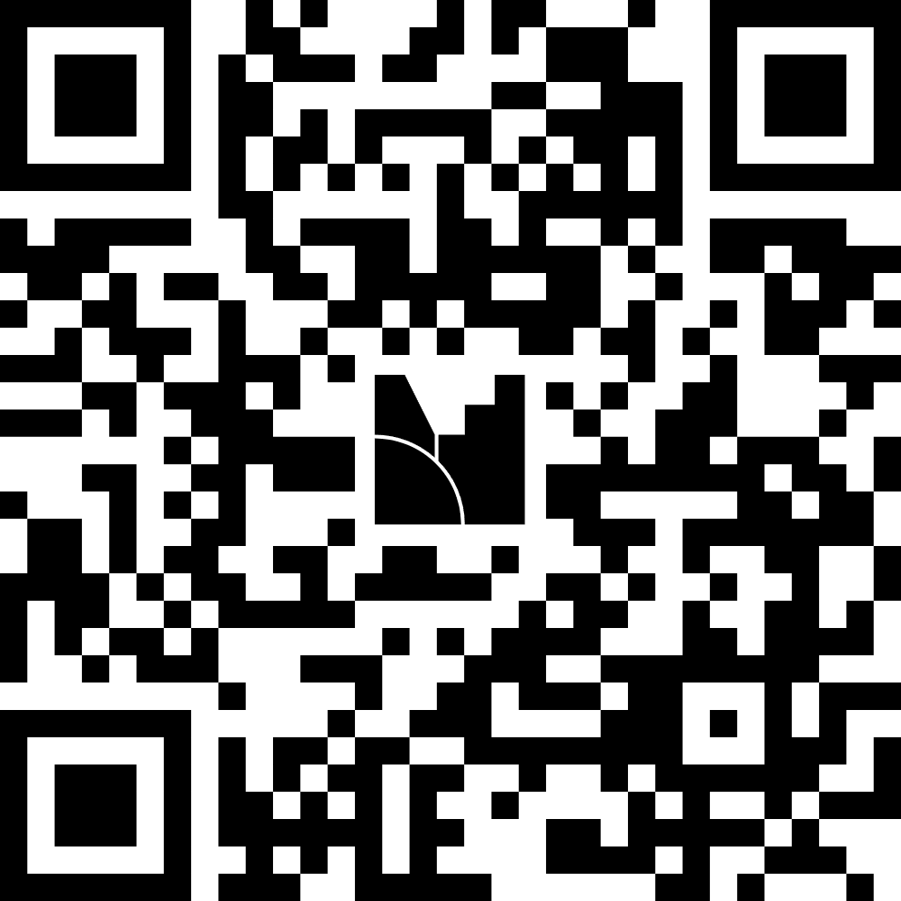
Join MentiMeter ahead of time
Or code 2424 3295 on Menti.com
Measles..?
CLINID conference
Hunter Ratliff
03/12/2025
Ages, dates, and other identifying information may have been changed
I have no conflict of interest in relation to this presentation

Slide 2
[1] Are Koplik spots pathognomonic for active measles?

Slide 3
Setting the scene
It’s Thursday afternoon on the Khakoo service
The list has been >10 patients for the past 6 days
You are finishing seeing the afternoon consults with the team
  At 3:36pm, a consult order comes in for “concern for meningitis”

Slide 4
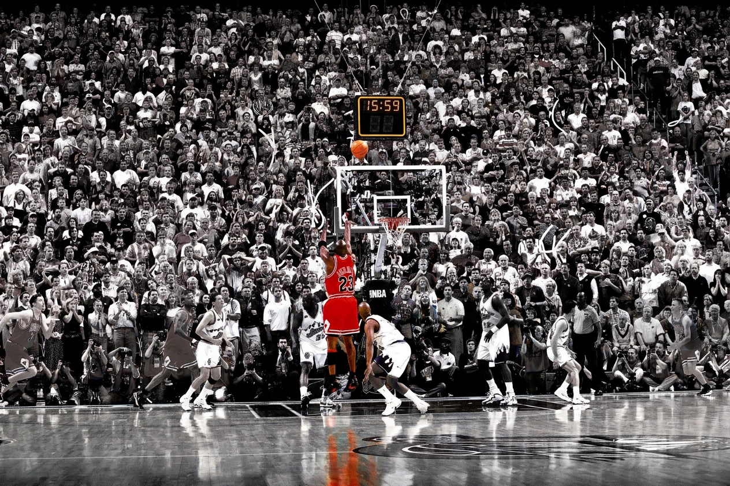
Setting the scene
AI generated content
(Nano Banana 2)
It’s Thursday afternoon on the Khakoo service
The list has been >10 patients for the past 6 days
You are finishing seeing the afternoon consults with the team
  At 3:36pm, a consult order comes in for “concern for meningitis”
At 3:59pm, a page comes in…
ED/07
Reason for Consult | measles ro
Is the patient being discharged today? | Yes
Provider Name & Callback Number | 175725

Slide 5
Case 1: HPI (per the ED/MyChart)
A 35 y/o F with no PMH p/w concern for measles

Slide 6
Case 1: HPI (per the ED/MyChart)
A 35 y/o F with no PMH p/w concern for measles
Tuesday: Developed body aches, headache, mild sore throat
Wed: Bumps on face → red spots on chest

Slide 7
Case 1: HPI (per the ED/MyChart)
A 35 y/o F with no PMH p/w concern for measles
Tuesday: Developed body aches, headache, mild sore throat
Wed: Bumps on face → red spots on chest
Patient’s name would imply some connections to South Asia
Recently received MMR vaccine because she was not immune

Slide 8
Case 1: HPI (per the ED/MyChart)
A 35 y/o F with no PMH p/w concern for measles
Tuesday: Developed body aches, headache, mild sore throat
Wed: Bumps on face → red spots on chest
Measles PEP guidance (NYC.gov)
Age Range | Measles immune status | Type of PEP
Age >12 mo | Non-immune | Give MMR vaccine
 | 1 dose MMR | Give 2nd MMR vaccine
 | Unknown status | Give MMR vaccine
Patient’s name would imply some connections to South Asia
Recently received MMR vaccine because she was not immune

Slide 9
[2] Is this measles?
Based off of what the ED told you

Slide 10
Case 1: HPI - Timeline
A 35 y/o F with no PMH p/w concern for measles due to a rash developing 13 days after MMR
14 days ago: Received MMR vaccine
MMR vaccine
ED
1
2
3
…
10
11
12
13
14

Slide 11
Case 1: HPI - Timeline
A 35 y/o F with no PMH p/w concern for measles due to a rash developing 13 days after MMR
14 days ago: Received MMR vaccine
Mon/Tues: Developed body aches, headache, mild sore throat (all better now)
Body ache
Sore throat
MMR vaccine
ED
1
2
3
…
10
11
12
13
14

Slide 12
Case 1: HPI - Timeline
A 35 y/o F with no PMH p/w concern for measles due to a rash developing 13 days after MMR
14 days ago: Received MMR vaccine
Mon/Tues: Developed body aches, headache, mild sore throat (all better now)
  Mid Tues: Runny nose and congestion (almost gone now)
Body ache
Sore throat
Runny nose
MMR vaccine
ED
1
2
3
…
10
11
12
13
14

Slide 13
Case 1: HPI - Timeline
A 35 y/o F with no PMH p/w concern for measles due to a rash developing 13 days after MMR
14 days ago: Received MMR vaccine
Mon/Tues: Developed body aches, headache, mild sore throat (all better now)
  Mid Tues: Runny nose and congestion (almost gone now)
Wednesday: Bumps on face → red spots on chest
Body ache
Sore throat
Runny nose
MMR vaccine
Rash
ED
1
2
3
…
10
11
12
13
14

Slide 14

Case 1: HPI
A 35 y/o F with no PMH p/w concern for measles due to a rash developing 13 days after MMR. Rash prodrome was body aches + sore throat, then runny nose, onset just a few days before rash.
Body ache
Sore throat
(now resolved)
Runny nose
MMR vaccine
Rash
ED
1
2
3
…
10
11
12
13
14

Slide 15
Case 1: HPI - Timeline
A 35 y/o F with no PMH p/w concern for measles due to a rash developing 13 days after MMR. Rash prodrome was body aches + sore throat, then runny nose, onset just a few days before rash.
No fever (but did have body aches)
No noticeable cough
Eyes have not been red or watery
Body ache
Sore throat
(now resolved)
Runny nose
coryza?
MMR vaccine
Rash
ED
1
2
3
…
10
11
12
13
14

Slide 16
Case 1: HPI - The rash
A 35 y/o F with no PMH p/w concern for measles due to a rash developing 13 days after MMR. Rash prodrome was body aches + sore throat, then runny nose, onset just a few days before rash.
Last night while brushing her teeth, noticed what appeared to be acne appear on face
During shower, saw similar lesions on her right shoulder
  Unclear if these appeared before, after, or at the same time as the rash on her face
This morning, rash on the face was more numerous
  Also now has some rash on her forearms
Body ache
Sore throat
(now resolved)
Runny nose
coryza?
MMR vaccine
Rash
ED
1
2
3
…
10
11
12
13
14

Slide 17
[3] Is this measles?
Before we see the rash…

Slide 18
Case 1: Physical exam
BP | 138/87 | Pulse | 90 | SpO2 | 98 %
Temp | 98.1 °F | RR | 18 | BMI | 26 kg/m²
General | Alert and oriented, NAD, vitals reviewed
ENT | Buccal mucosa: Normal, no lesions (the flashlight in the room doesn’t work)
Eyes | Anicteric sclerae; No injection
Skin | Next slide

Slide 19
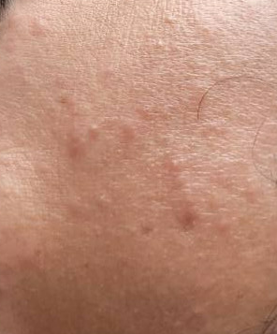
Case 1: Physical exam
Small (<5mm) nonblanching lesions
Maculopapular (papules/raised > macules)
  Some do look more acneiform
Only mild erythema/hyperpigmentation
Distribution:
Most pronounced on the face but also
  anterior chest/shoulder > forearms >> back
Not diffuse, plenty of adjacent skin is uninvolved
  minimal to no rash on upper arms and neck
  None on the legs
  Spares the palms
Unable to take actual pictures due to isolation

Slide 20
Case 1: Labs
CBC | Result
WBC | 5.2
Hgb | 12.1
Platelets | 224
Neut % | 49%
Eos % | 6%
Chem7 | Result
Na | 141
K | 3.8
HCO3 | 23
BUN | 15
Cr | 0.71

Slide 21
Case 1: Summary
Small (<5mm) nonblanching lesions
Maculopapular (papules/raised > macules)
  Some do look more acneiform
Only mild erythema/hyperpigmentation
Distribution:
Most pronounced on the face but also
  anterior chest/shoulder > forearms >> back
Not diffuse, plenty of adjacent skin is uninvolved
  minimal to no rash on upper arms and neck
  None on the legs
  Spares the palms
A 35 y/o F with no PMH p/w concern for measles due to a rash developing 13 days after MMR. Rash prodrome was body aches + sore throat, then runny nose, onset just a few days before rash.
The rash is certainly worsening
Seems like it’s likely spreading cephalocaudal (head-to-chest)
Body ache
Sore throat
(now resolved)
Runny nose
coryza?
Rash
ED
11
12
13
14

Slide 22
[4] Is this measles?
We now have all of the info

Slide 23
How should we manage this?
Let’s pretend this is a MARS call
Options:
Straight to the ED for in person eval
In person clinic visit
Video visit
eConsult

Slide 24
Case 1: Hospital course
Patient was able to access her vaccination records
Vaccinated for measles (one vaccine) in childhood, but it wasn’t the MMR
No known exposures or risk factors for wild type exposure

Slide 25
Case #1.1 (alternate universe)

Slide 26
Disaster case
An unvaccinated patient had a possible measles exposure
They were given the MMR vaccine for post exposure prophylaxis
…now they develop a rash
Is the rash from:
The vaccine --or--
Wild type measles (that was not prevented by PEP)

Slide 27
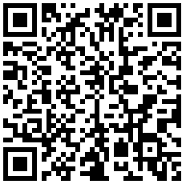
Discussion
Links to articles discussed here

Slide 28
Does MMR “cause” ‘measles’?
My journey through the weirdest literature search I’ve done in awhile…

Slide 29
Follow me along my journey
Measles that broke through MMR PEP?
Doesn’t the MMR vaccine cause a rash..?
Does ID really need to see them at 4pm?
Why are they in the ED? They might be spreading measles!

Slide 30
Reactions to MMR(V) vaccine
* I’m using the term “side effects” for self limiting reactions, which is distinct from any long lasting sequela, i.e. neurologic changes (see this Cochrane review)
MMR vaccine is well tolerated, but it does have some predictable side effects *
Doesn’t the MMR vaccine cause a rash..?
Notes:
Including the disclaimer here since I publish my slides online and I don’t know what will crawl/text mine these slides with AI
Expected side effects are not always a bad thing. If you crash a car and get a bruise from the seatbelt, the bruise is a side effect of the seatbelt; the bruise might be unwanted, but it’s a sign that it worked

Slide 31
Reactions to MMR(V) vaccine
* I’m using the term “side effects” for self limiting reactions, which is distinct from any long lasting sequela, i.e. neurologic changes (see this Cochrane review)
MMR vaccine is well tolerated, but it does have some predictable side effects *
Most common systemic† side effects [2]
Fevers (5 - 15%)
Rash (around 5%)
† excludes injection site reactions
Doesn’t the MMR vaccine cause a rash..?

Slide 32
Reactions to MMR(V) vaccine
MMR vaccine is well tolerated, but it does have some predictable side effects *
Most common systemic† side effects [2]
Fevers (5 - 15%)
Rash (around 5%)
† excludes injection site reactions
When do these reactions happen?
5 to 12 days [2,4,6]
  In the trials, onset occurs during this time frame [4] in 80% of cases (where they develop a side effect)

Slide 33
Reactions to MMR(V) vaccine
MMR vaccine is well tolerated, but it does have some predictable side effects *
Most common systemic† side effects [2]
Fevers (5 - 15%)
Rash (around 5%)
† excludes injection site reactions
When do these reactions happen?
5 to 12 days [2,4,6]
  In the trials, onset occurs during this time frame [4] in 80% of cases (where they develop a side effect)
First 3 weeks [3, CDC 2025]
Note
With recent changes at CDC/ACIP, I’ve included the year of the publication next to the citation number for all references to federal guidance from the US government (perhaps unnecessary)
Notes:
Hoping that the future isn’t dystopian…

Slide 34
Reactions to MMR - Timing of reactions [5]
MMR vaccine is well tolerated, but it does have some predictable side effects *
Most common systemic† side effects [2]
Fevers (5 - 15%)
Rash (around 5%)
Normally develops 5 to 12 days after the vaccine [2,4,6]
When do the reactions occur?

Slide 35
Reactions to MMR - Timing of reactions [5]
MMR vaccine is well tolerated, but it does have some predictable side effects *
Most common systemic† side effects [2]
Fevers (5 - 15%)
Rash (around 5%)
Normally develops 5 to 12 days after the vaccine [2,4,6]
When exactly do reactions occur?
From an old study in 1986 [5]
Robust design
  Double blinded, placebo controlled
  Matched 581 pairs of twins
Might be unethical to do now
  Ironically, based out of Helsinki, Finland
  Done during their rollout of MMR (1982-83)

Slide 36
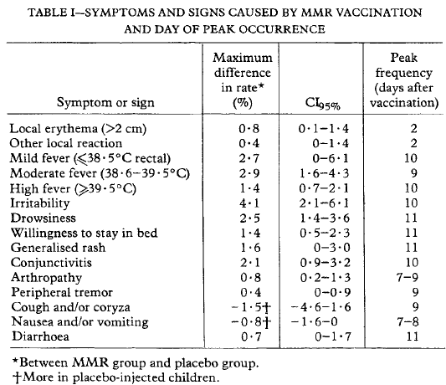
Reactions to MMR - Timing of reactions [5]
Most common systemic† side effects [2]
Fevers (5 - 15%)
Rash (around 5%)
Normally develops 5 to 12 days after the vaccine [2][4][6]
When exactly do reactions occur?
Placebo vs MMR matched study [5]
Moderate fever peaked at day 9
  38.6 - 39.5 C (101.5 - 103.1 F)
Generalized rash peaked at day 11

Slide 37
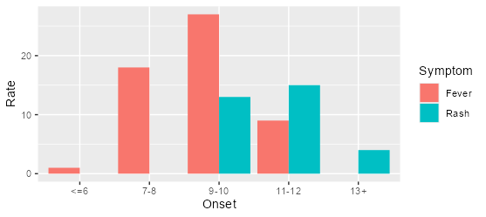
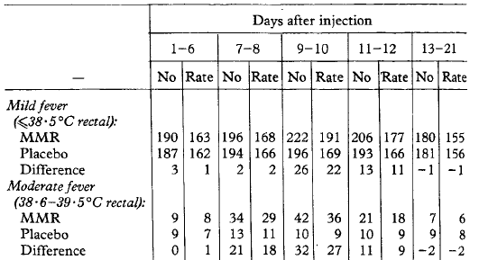
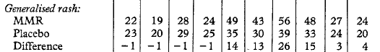
Reactions to MMR - Timing of reactions [5]
When exactly do reactions occur?
Placebo vs MMR matched study [5]
Moderate fever peaked at day 9
  38.6 - 39.5 C (101.5 - 103.1 F)
Generalized rash peaked at day 11

Slide 38
Reactions to MMR - Timing of reactions [5]
When exactly do reactions occur?
Placebo vs MMR matched study [5]
Moderate fever peaked at day 9
  38.6 - 39.5 C (101.5 - 103.1 F)
Generalized rash peaked at day 11
The distribution of symptom onset implies that fever comes before rash (similar to wild type measles)

Slide 39
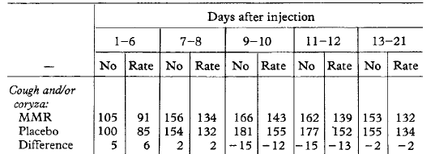
Reactions to MMR - Timing of reactions [5]
When exactly do reactions occur?
Placebo vs MMR matched study [5]
Moderate fever peaked at day 9
  38.6 - 39.5 C (101.5 - 103.1 F)
Generalized rash peaked at day 11
Interestingly, MMR group had lower rates of cough &/or coryza during this time (compared to placebo)

Slide 40
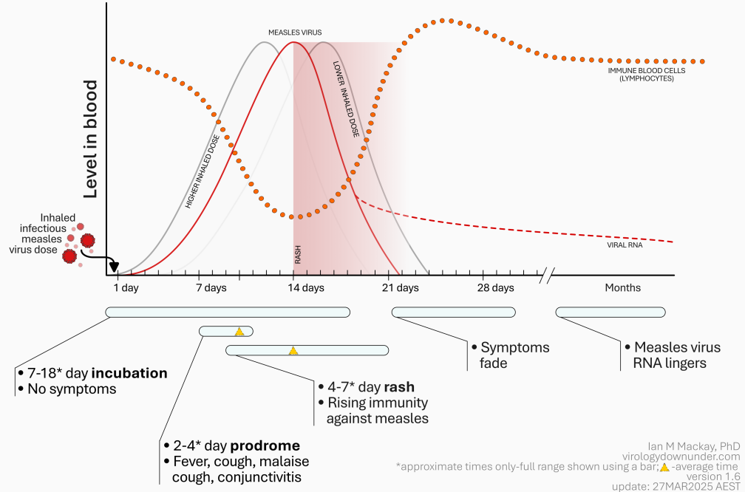
Real (wild-type) measles course
[source]

Slide 41
Real (wild-type) measles course
[source]

Slide 42
Moderate fever peaked at day 9
Generalized rash peaked at day 11

Slide 43
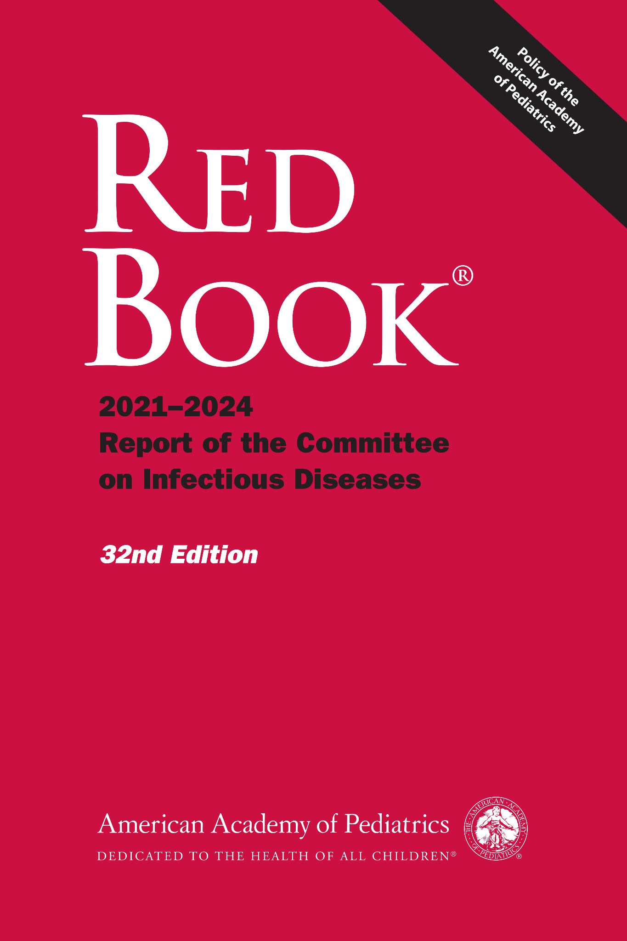
What does the Red Book say? [6]
MEASLES
Adverse Events. A body temperature of 39.4°C (103°F) or higher develops in approximately 5% to 15% of vaccine recipients, usually between 5 and 12 days after receipt of MMR vaccine
581

Slide 44
What does the Red Book say? [6]
MEASLES
Adverse Events. A body temperature of 39.4°C (103°F) or higher develops in approximately 5% to 15% of vaccine recipients, usually between 5 and 12 days after receipt of MMR vaccine; fever generally lasts 1 to 2 days but may last as long as 5 days. Most people with fever do not have other symptoms.
581

Slide 45
What does the Red Book say? [6]
MEASLES
Adverse Events. A body temperature of 39.4°C (103°F) or higher develops in approximately 5% to 15% of vaccine recipients, usually between 5 and 12 days after receipt of MMR vaccine; fever generally lasts 1 to 2 days but may last as long as 5 days. Most people with fever do not have other symptoms. Transient rashes have been reported in approximately 5% of vaccine recipients.
581

Slide 46
What does the Red Book say? [6]
MEASLES
Rates of most local and systemic adverse events for children immunized with MMRV vaccine are comparable with rates for children immunized with MMR and varicella vaccines administered concomitantly. However, recipients of a first dose of MMRV vaccine have a greater rate of fever 102°F (38.9°C) or higher than do recipients of MMR and varicella vaccine administered concomitantly (22% vs 15%, respectively).
582

Slide 47
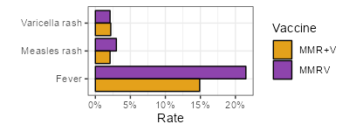
The MMRV [1,4]
MMRV is more likely to cause fevers compared to MMR + varicella (given at separate sites) [6]
The combo vaccine (MMRV) is also more likely to cause a measles-like rash

Slide 48
The MMRV [1,4]
MMRV is more likely to cause fevers compared to MMR + varicella (given at separate sites) [6]
The combo vaccine (MMRV) is also more likely to cause a measles-like rash
In the MMRV trials [4], measles-like rash and fevers were associated with stronger post-vaccination measles titers, perhaps due to increased local viral replication

Slide 49


The MMRV [1,4]
MMRV is more likely to cause fevers compared to MMR + varicella (given at separate sites) [6]
The combo vaccine (MMRV) is also more likely to cause a measles-like rash
In the MMRV trials [4], measles-like rash and fevers were associated with stronger post-vaccination measles titers, perhaps due to increased local viral replication
“Measles-like rash”
At this point, I’ve come across a few places in the literature that describe “measles-like rash”, including (pre-RFK) CDC/ACIP documents [1, 2010]

Slide 50
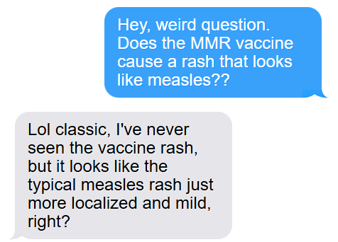
…am I starting to flirt with anti-vax?
Maybe MMR causes measles…
Then I talked to my friend who is a general pediatrician…

Slide 51
…am I starting to flirt with anti-vax?
Maybe MMR causes measles…
Then I talked to my friend who is a general pediatrician…
Rash after the MMR vaccine is one of those “clinical experience” things that you learn
  Kids like to get rashes (pediatrics doesn’t get as excited for rashes as we do)

Slide 52
…am I starting to flirt with anti-vax?
Then I talked to my friend who is a general pediatrician…
Rash after the MMR vaccine is one of those “clinical experience” things that you learn
  Kids like to get rashes (pediatrics doesn’t get as excited for rashes as we do)
She’s still early in practice, so they could not reliably tell me what the rash looks like
  She thinks the rash looks like “mild measles” but she’s not peds-ID

Slide 53
…am I starting to flirt with anti-vax?
Then I talked to my friend who is a general pediatrician…
Rash after the MMR vaccine is one of those “clinical experience” things that you learn
  Kids like to get rashes (pediatrics doesn’t get as excited for rashes as we do)
She’s still early in practice, so they could not reliably tell me what the rash looks like
  She thinks the rash looks like “mild measles” but she’s not peds-ID
But I was able to find the “pubmed” terms describing the rash following the MMR vaccine:
MMR vaccine exanthem
Vaccine-associated rash illness (VARI)
Refined search strategy
No more searching “does the MMR vaccine cause measles?”

Slide 54
Back to the Red Book [6]
MEASLES
Adverse Events. … Transient rashes have been reported in approximately 5% of vaccine recipients.
581
Receives MMR
Develops fever &/or rash

Slide 55
The more common situation
Doesn’t the MMR vaccine cause a rash..?
MEASLES
Adverse Events. … Transient rashes have been reported in approximately 5% of vaccine recipients.
581
Receives MMR
Develops fever &/or rash
Routine / elective MMR
VARI

Slide 56
Back to the Red Book [6]
MEASLES
Adverse Events. … Transient rashes have been reported in approximately 5% of vaccine recipients. Although recipients who develop fever and/or rash are not considered contagious and are not at risk for long-term sequelae of measles, suspicion for wild-type measles may be high, especially if vaccine was administered as part of an outbreak response.
581
Receives MMR
Develops fever &/or rash

Slide 57
The scary situation
Measles despite MMR PEP?
MEASLES
Adverse Events. … Transient rashes have been reported in approximately 5% of vaccine recipients. Although recipients who develop fever and/or rash are not considered contagious and are not at risk for long-term sequelae of measles, suspicion for wild-type measles may be high, especially if vaccine was administered as part of an outbreak response.
581
Measles exposure
Receives MMR
Develops fever &/or rash
VARI

Slide 58
[6] How to distinguish VARI from wild type measles?
Distribution of the rash
Timing of the rash
Fevers
The three C’s
Koplik spots
Sequencing

Slide 59
Distinguishing them clinically
There is no universally accepted definition for vaccine-associated rash illness (VARI)
  So meta-analyses are non-existent

Slide 60
Distinguishing them clinically
There is no universally accepted definition for vaccine-associated rash illness (VARI)
  So meta-analyses are non-existent
…but there is a definition for measles!
CDC’s measles case definition * [8]
An acute illness characterized by:
Generalized, maculopapular rash lasting ≥3 days; --and--
Temperature ≥101°F (38.3 C) --and--
At least one of the 3C’s
  Cough, coryza, or conjunctivitis
* There is some more nuance here

Slide 61

Martin et al [7]
During 2017, Minnesota experienced a major measles outbreak within the Somali-Minnesotan community
This population had low MMR vaccination rates (the 2014 birth cohort had 42% MMR uptake)
As part of the public health response, they administered over 51k MMR doses (beyond expected)

Slide 62
Martin et al [7]
During 2017, Minnesota experienced a major measles outbreak within the Somali-Minnesotan community
This population had low MMR vaccination rates (the 2014 birth cohort had 42% MMR uptake)
As part of the public health response, they administered over 51k MMR doses (beyond expected)
Unintended consequences
They experienced a surge in VARI
(while measles was also surging)

Slide 63
Martin et al [7]
They actually experienced my nightmare:
Elevated risk of measles exposure (from the outbreak)
And lots of people getting MMR vaccines
During 2017, Minnesota experienced a major measles outbreak within the Somali-Minnesotan community
This population low MMR vaccination rates (the 2014 birth cohort had 42% MMR uptake)
As part of the public health response, they administered over 51k MMR doses (beyond expected)
Unintended consequences
They experienced a surge in VARI
(while measles was also surging)

Slide 64
Martin et al [7]
When they compared wild-type measles cases to VARI cases:
 | Measles n=71 | VARI n=34
… | … | …

Slide 65
Martin et al [7]
When they compared wild-type measles cases to VARI cases:
Both cases had high rates of fevers
  And by definition, everyone had rashes
 | Measles n=71 | VARI n=34
Fever | 100% | 94%
… | … | …

Slide 66
Martin et al [7]
When they compared wild-type measles cases to VARI cases:
Both cases had high rates of fevers
  And by definition, everyone had rashes
Measles cases presented more “C”lassically
 | Measles n=71 | VARI n=34
Fever | 100% | 94%
Cough | 94% | 41%
Coryza | 83% | 47%
Conjunctivitis | 66% | 24%

Slide 67
Martin et al [7]
When they compared wild-type measles cases to VARI cases:
Both cases had high rates of fevers
  And by definition, everyone had rashes
Measles cases presented more “C”lassically
 | Measles n=71 | VARI n=34
Fever | 100% | 94%
Cough | 94% | 41%
Coryza | 83% | 47%
Conjunctivitis | 66% | 24%
Any of the 3 C’s | 96% | 74%
All three C’s | 58% | 6%
But wait… How do I tell the difference?

Slide 68
Martin et al [7]
When they compared wild-type measles cases to VARI cases:
Both cases had high rates of fevers
  And by definition, everyone had rashes
Measles cases presented more “C”lassically
Measles cases presented with more severe disease
Higher rates of hospitalization
 | Measles n=71 | VARI n=34
Fever | 100% | 94%
Cough | 94% | 41%
Coryza | 83% | 47%
Conjunctivitis | 66% | 24%
Any of the 3 C’s | 96% | 74%
All three C’s | 58% | 6%

Slide 69
Martin et al [7]
When they compared wild-type measles cases to VARI cases:
Both cases had high rates of fevers
  And by definition, everyone had rashes
Measles cases presented more “C”lassically
Measles cases presented with more severe disease
Higher rates of hospitalization
 | Measles n=71 | VARI n=34
Fever | 100% | 94%
Cough | 94% | 41%
Coryza | 83% | 47%
Conjunctivitis | 66% | 24%
Any of the 3 C’s | 96% | 74%
All three C’s | 58% | 6%
Contact with a known case | 99% | 0%

Slide 70
Martin et al [7]
When they compared wild-type measles cases to VARI cases:
Both cases had high rates of fevers
  And by definition, everyone had rashes
Measles cases presented more “C”lassically
Measles cases presented with more severe disease
Higher rates of hospitalization
 | Measles n=71 | VARI n=34
Fever | 100% | 94%
Cough | 94% | 41%
Coryza | 83% | 47%
Conjunctivitis | 66% | 24%
Any of the 3 C’s | 96% | 74%
All three C’s | 58% | 6%
Contact with a known case | 99% | 0%
All VARI cases still needed isolation for 4 days from rash onset (or until wild-type infection was ruled out)
But this was in the context of an outbreak (unlike our patient)

Slide 71
What about testing?
Serologies are not very helpful [8, CDC 2025], since it doesn’t distinguish between vaccine-induced immunity and natural infection
  IgM may not be detectable until 8-14 days after vaccination
  IgG may not be detectable for up to three weeks after vaccination
    IgG might have been helpful in our case (if we didn’t have immunization records), but would not be helpful in an outbreak/exposure scenario

Slide 72
What about testing?
Serologies are not very helpful [8, CDC 2025], since it doesn’t distinguish between vaccine-induced immunity and natural infection
  IgM may not be detectable until 8-14 days after vaccination
  IgG may not be detectable for up to three weeks after vaccination
    IgG might have been helpful in our case (if we didn’t have immunization records), but would not be helpful in an outbreak/exposure scenario
Measles RT-PCR does not distinguish between the vaccine RNA -vs- wild-type RNA [8, CDC 2025

Slide 73
What about testing?
Serologies and measles RT-PCR are not very helpful [8, CDC 2025]
Genotyping is able to distinguish the two
  All measles vaccines are derived from genotype A, which has gone extinct [10]
  But this is slow and expensive (but useful in outbreaks)

Slide 74
What about testing?
Serologies and measles RT-PCR are not very helpful [8, CDC 2025]
Genotyping is able to distinguish the two
  All measles vaccines are derived from genotype A, which has gone extinct [10]
  But this is slow and expensive (but useful in outbreaks)
The Measles Vaccine (MeVA) Assay comes to save the day! [8]
  RT-PCR for the measles vaccine strains --and-- the standard rRT-PCR assay (that detects all measles strains)
  Available at CDC and Association of Public Health Laboratories reference centers

Slide 75
What about testing?
Serologies and measles RT-PCR are not very helpful [8, CDC 2025]
Genotyping is able to distinguish the two
  All measles vaccines are derived from genotype A, which has gone extinct [10]
  But this is slow and expensive (but useful in outbreaks)
The Measles Vaccine (MeVA) Assay comes to save the day! [8]
  RT-PCR for the measles vaccine strains --and-- the standard rRT-PCR assay (that detects all measles strains)
  Available at CDC and Association of Public Health Laboratories reference centers
My inference ^{[citation needed]}
MeVA was not available to the folks in Minnesota during their outbreak
This must have been a true nightmare
They had to contact trace and isolate all these VARIs while waiting on sequencing
This probably should have been more than a brief report in CID
From Martin et al [7]
At the time of the outbreak, the measles vaccine-specific RT-PCR test [MeVA] was not available at the [MN health dept]
…rapid laboratory confirmation of VARI is the only way to avoid unnecessary control measures that can drain public health and healthcare resources during measles outbreaks…and preserve public health resources for true measles case responses.
Notes:
Sources implying this
https://pmc.ncbi.nlm.nih.gov/articles/PMC5328441
Also the MeVA paper references citation 7

Slide 76
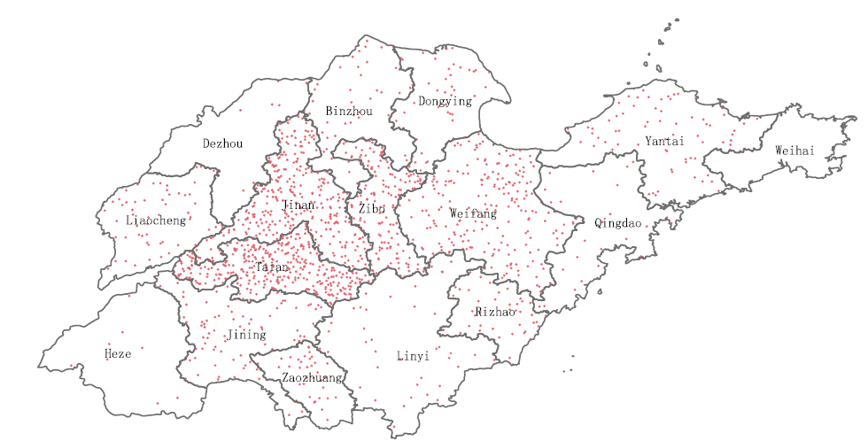

Who else has experienced this problem before?
Figure 2: Wang et al [11]

Slide 77

Cui et al [10]
Large study from China from 2011 to 2018
Surveillance Data: The study utilized data from the Measles Surveillance System (MSS) and the Chinese Measles Laboratory Network (CMLN)
Case Identification: identified 15,169 cases confirmed by genotyping
  14,902 wild-type measles cases
  Only 101 VARI cases

Slide 78
Cui et al [10]
Temporal distribution after vaccination
VARI onset: The number of cases peaks on the 8th day
  97% of cases occur within 14 days of vaccination
Wild-type onset: Cases occurring after vaccination peak earlier, on the 4 - 6th days
  Often due to infection prior to / failure of vaccine PEP

Slide 79
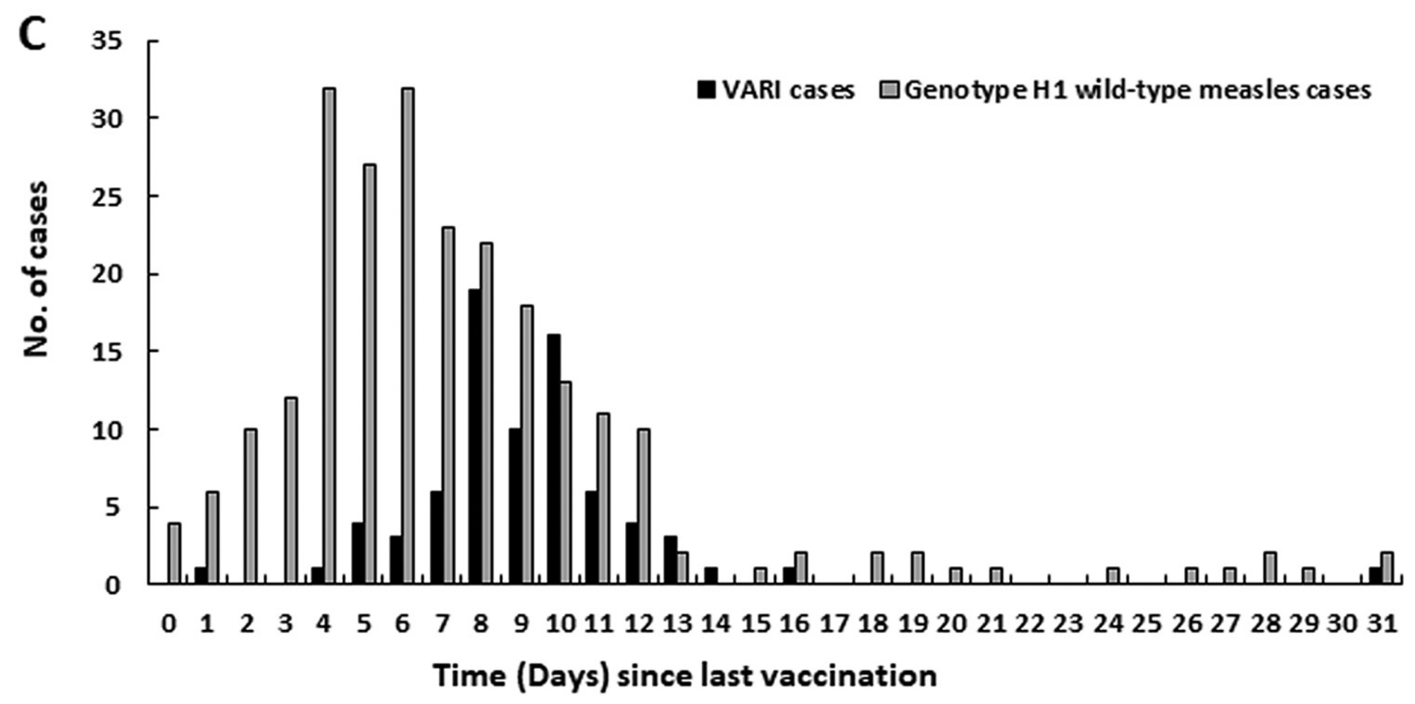
Cui et al [10]
Temporal distribution after vaccination
VARI onset: The number of cases peaks on the 8th day
  97% of cases occur within 14 days of vaccination
Wild-type onset: Cases occurring after vaccination peak earlier, on the 4 - 6th days
  Often due to infection prior to / failure of vaccine PEP

Slide 80
Cui et al [10]
Temporal distribution after vaccination
VARI onset: The number of cases peaks on the 8th day
  97% of cases occur within 14 days of vaccination
Wild-type onset: Cases occurring after vaccination peak earlier, on the 4 - 6th days
  Often due to infection prior to / failure of vaccine PEP
VARI
Wild-type measles
(Note: Hunter’s line of best fit)

Slide 81
Cui et al [10]
Temporal distribution after vaccination
VARI onset: The number of cases peaks on the 8th day
  97% of cases occur within 14 days of vaccination
Wild-type onset: Cases occurring after vaccination peak earlier, on the 4 - 6th days
  Often due to infection prior to / failure of vaccine PEP
Both groups had similar symptoms (moderate fever, rash, and one of the “3Cs”), so difficult to distinguish VARI from wild type measles

Slide 82
Cui et al [10]
Temporal distribution after vaccination
VARI onset: The number of cases peaks on the 8th day
  97% of cases occur within 14 days of vaccination
Wild-type onset: Cases occurring after vaccination peak earlier, on the 4 - 6th days
  Often due to infection prior to / failure of vaccine PEP
Both groups had similar symptoms (moderate fever, rash, and one of the “3Cs”), so difficult to distinguish VARI from wild type measles
Clinical Symptom | VARI Cases (n=76) | Wild-Type (n=9,533) | P-Value
Fever | 99% | 99% | 0.516
Rash | 100% | 99% | 1.000
"3Cs" (any) | 49% | 92% | <0.001
Cough | 39% | 91% | <0.001
Coryza | 26% | 67% | <0.001
Conjunctivitis | 18% | 64% | <0.001

Slide 83

Cui et al [10]
Temporal distribution after vaccination
VARI onset: The number of cases peaks on the 8th day
  97% of cases occur within 14 days of vaccination
Wild-type onset: Cases occurring after vaccination peak earlier, on the 4 - 6th days
  Often due to infection prior to / failure of vaccine PEP
Both groups had similar symptoms (moderate fever, rash, and one of the “3Cs”), so difficult to distinguish VARI from wild type measles
Clinical Symptom | VARI Cases (n=76) | Wild-Type (n=9,533) | P-Value
Fever | 99% | 99% | 0.516
Rash | 100% | 99% | 1.000
"3Cs" (any) | 49% | 92% | <0.001
Cough | 39% | 91% | <0.001
Coryza | 26% | 67% | <0.001
Conjunctivitis | 18% | 64% | <0.001
Koplik Spots | 25% | 47% | <0.001

Slide 84
Cui et al [10]
Temporal distribution after vaccination
VARI onset: The number of cases peaks on the 8th day
  97% of cases occur within 14 days of vaccination
Wild-type onset: Cases occurring after vaccination peak earlier, on the 4 - 6th days
  Often due to infection prior to / failure of vaccine PEP
Both groups had similar symptoms (moderate fever, rash, and one of the “3Cs”), so difficult to distinguish VARI from wild type measles
Clinical Symptom | VARI Cases (n=76) | Wild-Type (n=9,533) | P-Value
Fever | 99% | 99% | 0.516
Rash | 100% | 99% | 1.000
"3Cs" (any) | 49% | 92% | <0.001
Koplik Spots | 25% | 47% | <0.001
Complications | 4% | 13% | 0.020
100% of the “complications” (n=3/76)
in the VARI group was diarrhea

Slide 85
Cui et al [10]
No evidence of human-to-human transmission of the measles vaccine virus (they looked for mutations in the VARI cases, beyond the scope of this talk)
Temporal distribution after vaccination
VARI onset: The number of cases peaks on the 8th day
  97% of cases occur within 14 days of vaccination
Wild-type onset: Cases occurring after vaccination peak earlier, on the 4 - 6th days
  Often due to infection prior to / failure of vaccine PEP
Both groups had similar symptoms (moderate fever, rash, and one of the “3Cs”), so difficult to distinguish VARI from wild type measles
As wild-type measles increased, so did cases of VARI
Again, highlights the public health importance of VARI during outbreaks

Slide 86

Wang et al [11]
Quite similar to Cui [10], used data from China’s MSS (Measles Surveillance System) from 2015-2021. Unlike Cui, the study by Wang

Slide 87
Wang et al [11]
Quite similar to Cui [10], used data from China’s MSS (Measles Surveillance System) from 2015-2021. Unlike Cui, the study by Wang
Only on the Shandong province
Also included “clinically diagnosed” VARI cases

Slide 88
Wang -vs- Cui
 | Wang [11] | Cui [10]
Geography | Only Shandong | All of China
How did they identify VARI? | Genotype –or– clinical criteria | Only via genotyping
Number of cases
VARI | 189 | 101
Measles | 9,928 | 14,902
Wang is approaching it from very similar angle as the Minnesota DOH authors (CID article [7])

Slide 89
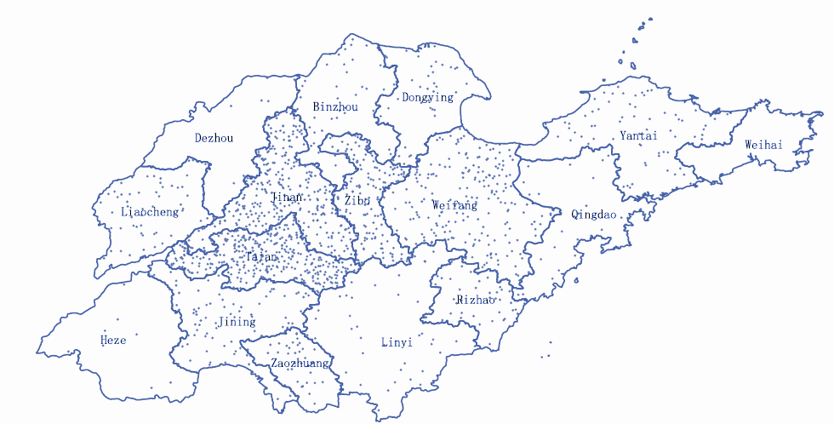
Wang et al [11]
In their geographic information system analysis, found VARI cases are geographically clustered

Slide 90
Wang et al [11]
In their geographic/GIS analysis, found VARI cases are geographically clustered
Also found fever and rash are typical in VARI, with a median onset of fever at 8 days after MMR
  Same results as Cui [10]

Slide 91
Wang et al [11]
In their geographic/GIS analysis, found VARI cases are geographically clustered
Also found fever and rash are typical in VARI, with a median onset of fever at 8 days after MMR
  Same results as Cui [10]
  Also falls in line with original MMR studies (9 days) [5]
Table 2 from Lancet study in 1986 [5]

Slide 92
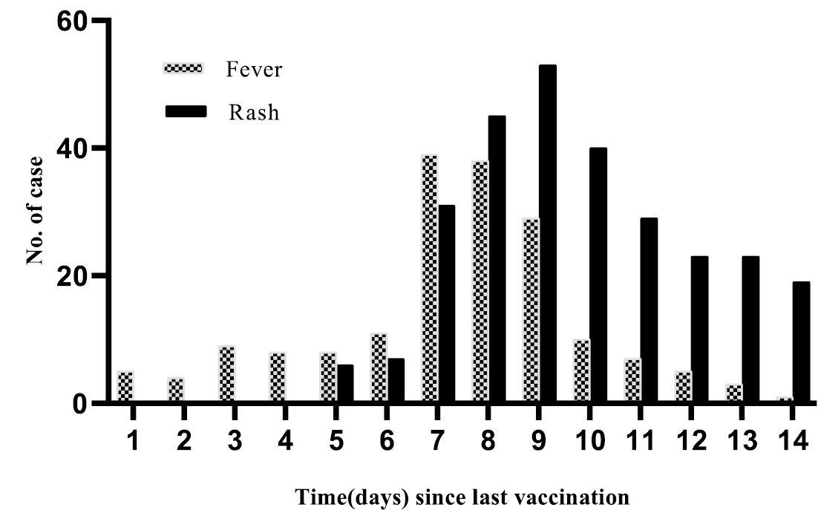
Wang et al [11]
In their geographic/GIS analysis, found VARI cases are geographically clustered
Also found fever and rash are typical in VARI, with a median onset of fever at 8 days after MMR
Clinical presentation of VARI
VARI cases
Table 2 from Lancet study in 1986 [5]
Figure 3 from Wang (2025) [11]

Slide 93
Wang et al [11]
In their geographic/GIS analysis, found VARI cases are geographically clustered
Also found fever and rash are typical in VARI, with a median onset of fever at 8 days after MMR
  Same results as Cui [10]
  Also falls in line with original MMR studies (9 days) [5]
VARI timing is pretty consistent across studies…
One in ten VARIs had Koplik spots (20/189)
  This is lower than Cui’s [10] estimate of 25%
  But there is likely cross over (since both using MSS)
VARI cases
Figure 3 from Wang (2025) [11]

Slide 94
Wang et al [11]
Of their 189 VARI cases, 109 (57%) had throat swabs collected
They were only able to genotype 30% of these cases (33/109)
Likely due to delayed sample collection and low viral load
 | Wang [11] | Cui [10]
Geography | Only Shandong | All of China
VARI criteria | Sequencing –or– clinical | Only via genotyping
# VARI | n=189 | n=101
# Measles | n=9,928 | n=14,902

Slide 95
Learning points & take aways

Slide 96

Learning points & take aways
Slides available on hunterratliff1.com/talk/; Citations available via QR code or via the “citations” button on the website

Slide 97
Emphasis (#2f5aa2)
Primary (#3B71CA)
BG subtle (#e2eaf7)
Emphasis (#b03d50)
Danger (#DC4C64)
BG subtle (#fae4e8)
Emphasis (#C1443C)
Pink (#FF6F61)
BG subtle (#FFE9E6)
Emphasis (#3b7e94)
Info (#54B4D3)
BG subtle (#e5f4f8)
Emphasis (#0c622e)
Success (#14A44D)
BG subtle (#dcf1e4)
Emphasis (#1F7A6C)
Mint/Aqua (#48C9B0)
BG subtle (#f1f2f3)
Emphasis (#404247)
Secondary (#9FA6B2)
BG subtle (#f1f2f3)
Emphasis (#896110)
Warning (#E4A11B)
BG subtle (#fbf1dd)
Emphasis (#6B3E26)
Brown (#A0522D)
BG subtle (#F3E4DB)
Emphasis (#6C3483)
Purple (#8E44AD)
BG subtle (#F0E6F5)
Emphasis (#2C3E50)
Slate grey (#5D6D7E)
BG subtle (#E8ECF1)
1
2
3
4
5
6
7
8
9
10
11
12
13
14
15
16
17
18
19
20
1
2
3
4
5
6
7
8
9
10
1
2
3
4
15
6
7
8
9
20
1
2
3
4
25
6
7
8
9
30
1
2
3
4
5
6
7
8
9
10
1
2
3
4
15
6
7
8
9
20
1
2
3
4
25
6
7
8
9
30
1
2
3
4
35
6
7
8
9
40
1
2
3
4
5
6
7
8
9
10
1
2
3
4
15
6
7
8
9
20
1
2
3
4
25
6
7
8
9
30
1
2
3
4
35
6
7
8
9
40
1
2
3
4
45
6
7
8
9
50
To scale these, select the entire row, go to format options, and make the width the desired width

