Slide 1
MARS is calling
CLINID conference
Hunter Ratliff
04/16/2025
Ages, dates, and other identifying information may have been changed
I have no conflict of interest in relation to this presentation

Slide 2
Shortcuts
Part A: (inpatient)
MARS #1: immunocompromise | GI microbiome
Part B (outpatient): Clinic time | rash | eos timeline
MARS #2: case | Mir’s water | pathogen biofilms
Part C (readmission): Alpha-gal
MARS #2: case | LSMMG | nematodes | meds
Takeaway slide

Slide 3
Case 1: HPI
A 73 y/o M with PMH including CLL, CAD, OSA, seizures p/w cardiogenic shock

Slide 4
Case 1: HPI
A 73 y/o M with PMH including CLL, CAD, OSA, seizures p/w cardiogenic shock
Admitted to OSH with three weeks of dyspnea
Had been also having chest pain while shoveling snow
?diaphoresis (but not with chest pain)

Slide 5
Case 1: HPI
A 73 y/o M with PMH including CLL, CAD, OSA, seizures p/w cardiogenic shock
Admitted to OSH with three weeks of dyspnea
Had been also having chest pain while shoveling snow
?diaphoresis (but not with chest pain)
Not much else in the initial H&P, since patient was in florid shock

Slide 6
Case 1: HPI
A 73 y/o M with PMH including CLL, CAD, OSA, seizures p/w cardiogenic shock
Admitted to OSH with three weeks of dyspnea
Had been also having chest pain while shoveling snow
?diaphoresis (but not with chest pain)
Not much else in the initial H&P, since patient was in florid shock
Baseline is 13-20
CBC | Result
WBC | 36
Hgb | 16
Platelets | 176
Creatine | 1.46
Lactate | 3.7

Slide 7
Case 1: HPI
A 73 y/o M with PMH including CLL, CAD, OSA, seizures p/w cardiogenic shock
Admitted to OSH with three weeks of dyspnea
Had been also having chest pain while shoveling snow
?diaphoresis (but not with chest pain)
Not much else in the initial H&P, since patient was in florid shock
Baseline is 13-20
CBC | Result
WBC | 36
Hgb | 16
Platelets | 176
Creatine | 1.46
Lactate | 3.7
Troponin
Inital | 1,200
+40 min | 5,200
+2 hr | 11,300
+8 hr | 24,700
Hemodynamics
Levophed: 0.13 (mcg/kg/min)
Milrinone: 0.125 (mcg/kg/min)

Slide 8
Case 1: HPI
A 73 y/o M with PMH including CLL, CAD, OSA, seizures p/w cardiogenic shock
Admitted to OSH with three weeks of dyspnea
Had been also having chest pain while shoveling snow
?diaphoresis (but not with chest pain)
Not much else in the initial H&P, since patient was in florid shock
Baseline is 13-20
CBC | Result
WBC | 36
Hgb | 16
Platelets | 176
Creatine | 1.46
Lactate | 3.7
Troponin
Inital | 1,200
+40 min | 5,200
+2 hr | 11,300
+8 hr | 24,700
Emergent cath
Confirms shock is cardiogenic (cardiac index 1.42)
99% stenosis of RCA
Placed stents x2
Hemodynamics
Levophed: 0.13 (mcg/kg/min)
Milrinone: 0.125 (mcg/kg/min)

Slide 9
Case 1: HPI
A 73 y/o M with PMH including CLL (has port), CAD, OSA, seizures p/w cardiogenic shock
Staph epi grows in both sets of blood cultures, twice
Unofficial time to positivity implies port infection
 | Port | Peripheral
Collected | 9:02 am | 6:07 am
TTP | 13 hrs | 21 hrs
BCx: Staph epi
1
2
3
4
5
Cardiogenic shock
Gets stents x2

Slide 10
Case 1: HPI
A 73 y/o M with PMH including CLL (has port), CAD, OSA, seizures p/w cardiogenic shock
Staph epi grows in both sets of blood cultures, twice
Unofficial time to positivity implies port infection
Transthoracic echo: Echodensity on aortic valve
Native aortic valve
BCx: Staph epi
TTE: lesion on native aortic valve
1
2
3
4
5
6
7
Cardiogenic shock
Gets stents x2
Transfer to Ruby

Slide 11
Case 1: Summary
A 73 y/o M with PMH including CLL (has port), CAD/PAD, OSA, seizures p/w cardiogenic shock & NSTEMI s/p stenting. Found to have persistent staph epi bacteremia and echodensity on native aortic valve
BCx: Staph epi
TTE: lesion on native aortic valve
1
2
3
4
5
6
7
Cardiogenic shock
Gets stents x2
Transfer to Ruby

Slide 12
Case 1: Transfer to Ruby
A 73 y/o M with PMH including CLL (has port), CAD/PAD s/p EVAR, OSA, seizures p/w cardiogenic shock & native aortic valve staph epi endocarditis.
Repeat blood cultures no growth
On day 7 of vancomycin
Discharge summary
Patient underwent cardiac catheterization on xx/xx/xxxx which showed 3 vessel disease. Cardiothoracic surgery was consulted and recommended PCI to RCA and mid LAD. Due to cardiogenic shock he was initiated on Levophed and milrinone. Impella was considered but vascular access was difficult.
Swan-Ganz catheter was placed. Blood cultures were obtained from his port and were positive for staphylococcus epidermidis for which ID was consulted.
Echo: native aortic valve IE
1
2
3
4
5
6
7
BCx: Staph epi
BCx: No growth

Slide 13
Case 1: Transfer to Ruby
A 73 y/o M with PMH including CLL (has port), CAD/PAD s/p EVAR, OSA, seizures p/w cardiogenic shock & native aortic valve staph epi endocarditis.
Repeat blood cultures no growth
On day 7 of vancomycin
Transesophageal echo: 1x1cm lesion on aortic valve
Discharge summary
Patient underwent cardiac catheterization on xx/xx/xxxx which showed 3 vessel disease. Cardiothoracic surgery was consulted and recommended PCI to RCA and mid LAD. Due to cardiogenic shock he was initiated on Levophed and milrinone. Impella was considered but vascular access was difficult.
Swan-Ganz catheter was placed. Blood cultures were obtained from his port and were positive for staphylococcus epidermidis for which ID was consulted.
Echo: native aortic valve IE
1
2
3
4
5
6
7
8
BCx: Staph epi
BCx: No growth

Slide 14
Case 1: Hardware
A 73 y/o M with PMH including CLL (has port), CAD/PAD s/p EVAR, OSA, seizures p/w cardiogenic shock & native aortic valve staph epi endocarditis.
Discharge summary mentions EVAR
5 years ago, had endovascular aneurysm repair for AAA
Discharge summary
Patient underwent cardiac catheterization on xx/xx/xxxx which showed 3 vessel disease. Cardiothoracic surgery was consulted and recommended PCI to RCA and mid LAD. Due to cardiogenic shock he was initiated on Levophed and milrinone. Impella was considered but vascular access was difficult due to his EVAR for Impella or IABP. Swan-Ganz catheter was placed. Blood cultures were obtained from his port and were positive for staphylococcus epidermidis for which ID was consulted.
Echo: native aortic valve IE
1
2
3
4
5
6
7
8
BCx: Staph epi
BCx: No growth

Slide 15
Case 1: Hardware
A 73 y/o M with PMH including CLL (has port), CAD/PAD s/p EVAR, OSA, seizures p/w cardiogenic shock & native aortic valve staph epi endocarditis.
Discharge summary mentions EVAR
5 years ago, had endovascular aneurysm repair for AAA
No imaging done as of yet (only had CTA PE)
Discharge summary
Patient underwent cardiac catheterization on xx/xx/xxxx which showed 3 vessel disease. Cardiothoracic surgery was consulted and recommended PCI to RCA and mid LAD. Due to cardiogenic shock he was initiated on Levophed and milrinone. Impella was considered but vascular access was difficult due to his EVAR for Impella or IABP. Swan-Ganz catheter was placed. Blood cultures were obtained from his port and were positive for staphylococcus epidermidis for which ID was consulted.
Echo: native aortic valve IE
CTA
1
2
3
4
5
6
7
8
BCx: Staph epi
BCx: No growth

Slide 16
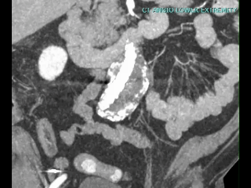
Case 1: Hardware
A 73 y/o M with PMH including CLL (has port), CAD/PAD s/p EVAR, OSA, seizures p/w cardiogenic shock & native aortic valve staph epi endocarditis.
CTA A/P with runoff
Indication: Hx EVAR, preoperative exam
Aortoiliac: Postsurgical changes from EVAR for infrarenal abdominal aortic aneurysm. Aneurysm sac at iliac bifurcation measures 5.7 cm, unchanged from [prior scans].
Echo: native aortic valve IE
CTA: Quite normal
1
2
3
4
5
6
7
8
BCx: Staph epi
BCx: No growth

Slide 17
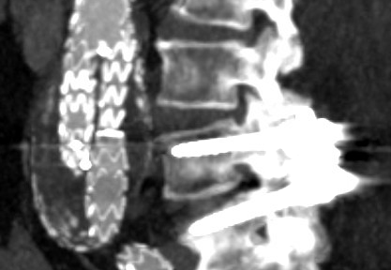
Case 1: Hardware
A 73 y/o M with PMH including CLL (has port), CAD/PAD s/p EVAR, OSA, seizures p/w cardiogenic shock & native aortic valve staph epi endocarditis.
CTA A/P with runoff
Spleen: evolving splenic infarct
Kidneys: Right renal infarct
Bones: L4-L5 posterior spinal fusion
Echo: native aortic valve IE
CTA: Quite normal
1
2
3
4
5
6
7
8
BCx: Staph epi
BCx: No growth

Slide 18
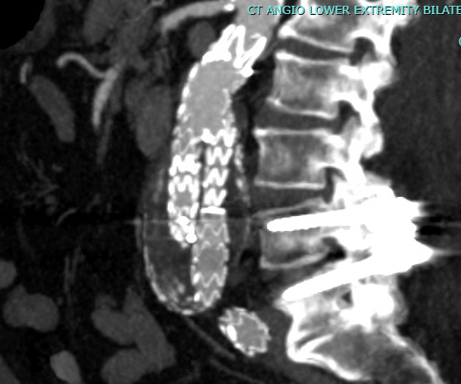
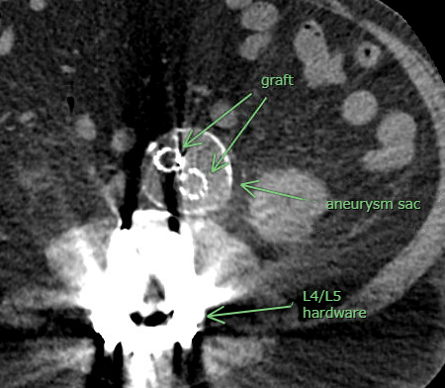
Case 1: Hardware
Graft
Aneurysm
sac
L4/L5
hardware

Slide 19
Case 1: Hardware
A 73 y/o M with PMH including CLL (has port), CAD/PAD s/p EVAR, OSA, seizures p/w cardiogenic shock & native aortic valve staph epi endocarditis.
CTA A/P with runoff
Indication: Hx EVAR, preoperative exam
Aortoiliac: Postsurgical changes from EVAR for infrarenal abdominal aortic aneurysm. Aneurysm sac at iliac bifurcation measures 5.7 cm, unchanged from [prior scans].
Spleen: evolving splenic infarct
Kidneys: Right renal infarct
Bones: L4-L5 posterior spinal fusion
IMPRESSION: stable size of infrarenal abdominal aortic aneurysm sac. Evolving splenic and renal infarcts
Echo: native aortic valve IE
CTA: Quite normal
1
2
3
4
5
6
7
8
BCx: Staph epi
BCx: No growth

Slide 20

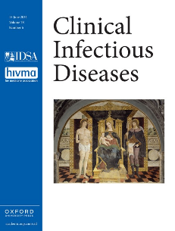
Vascular Graft Infections (VGI)
QR CODE
Objectives
Accurately diagnose & categorize (suspected & confirmed) VGIs
Describe surgical management
Review treatment options & duration
Recall my prior presentation
From October of 2024
https://www.hunterratliff1.com/talk/cid-2024-10-03/
DeSimone et al (2024)
Clinical Infectious Diseases [citation 2.1]
✨MAGIC✨
Management of Aortic Graft Infection Collaboration 🪄

Slide 21
[Q1] Is this a vascular graft infection?

Slide 22
[Q2] Utility of PET/CT or SPECT?

Slide 23
[Q3] Chance of relapse w/o suppression

Slide 24
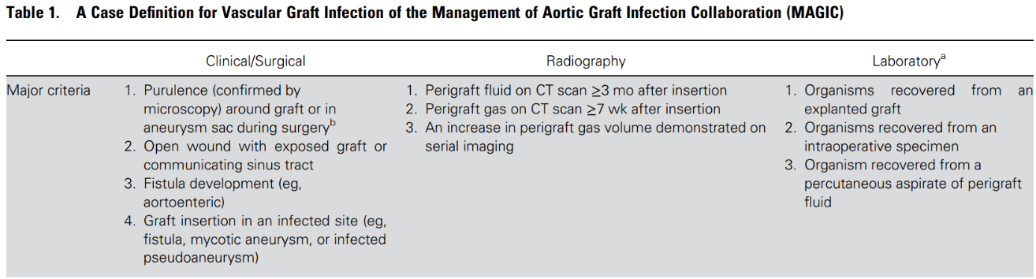
✨MAGIC✨
Management of Aortic Graft Infection Collaboration 🪄
Prior presentation (Oct’24)
https://www.hunterratliff1.com/talk/cid-2024-10-03/

Slide 25
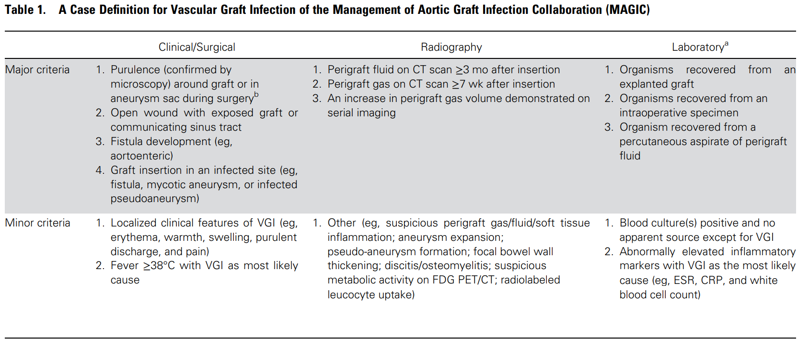
✨MAGIC✨
Management of Aortic Graft Infection Collaboration 🪄
Suspected VGI
One major – or –
Minor from 2 of 3 categories
Confirmed VGI
One major – plus – any other criterion (major or minor) from
another category
Prior presentation (Oct’24)
https://www.hunterratliff1.com/talk/cid-2024-10-03/

Slide 26
Case 1: Hospital course
A 73 y/o M with PMH including CLL (has port), CAD/PAD s/p EVAR, OSA, seizures p/w cardiogenic shock & native aortic valve staph epi endocarditis.
Vascular surgery consulted: Not concerned for graft infection
Port is removed
Echo: native aortic valve IE
CTA: Quite normal
1
2
3
4
5
6
7
8
9
BCx: Staph epi
BCx: No growth
Port removed

Slide 27
Case 1: Hospital course
A 73 y/o M with PMH including CLL (has port), CAD/PAD s/p EVAR, OSA, seizures p/w cardiogenic shock & native aortic valve staph epi endocarditis. Clinical concern for VGI but CTA normal
Asked for PET/CT or SPECT…
Can’t happen until next week
Echo: native aortic valve IE
CTA: Quite normal
PET/CT?
1
2
3
4
5
6
7
8
9
10
11
12
13
14
BCx: Staph epi
BCx: No growth
Port removed

Slide 28
Case 1: Hospital course
A 73 y/o M with PMH including CLL (has port), CAD/PAD s/p EVAR, OSA, seizures p/w cardiogenic shock & native aortic valve staph epi endocarditis. Clinical concern for VGI but CTA normal
Asked for PET/CT or SPECT…
Can’t happen until next week
CT surgery plans on replacing aortic valve before that time
Cardiogenic shock from aortic insufficiency is a class I indication
Echo: native aortic valve IE
CTA: Quite normal
PET/CT?
1
2
3
4
5
6
7
8
9
10
11
12
13
14
BCx: Staph epi
BCx: No growth
Port removed
SAVR

Slide 29
Case 1: Hospital course
A 73 y/o M with PMH including CLL (has port), CAD/PAD s/p EVAR, OSA, seizures p/w cardiogenic shock & native aortic valve staph epi endocarditis. Clinical concern for VGI but CTA normal
Opted for no nuclear imaging
Would have been on 2 weeks on antibiotics at that point
Had surgical aortic valve replacement with bioprosthetic valve
Gram stain was positive, but no growth on cultures
Pathology consistent with acute endocarditis
Echo: native aortic valve IE
CTA: Quite normal
PET/CT?
1
2
3
4
5
6
7
8
9
10
11
12
13
14
BCx: Staph epi
BCx: No growth
Port removed
SAVR

Slide 30
Case 1: Hospital course
A 73 y/o M with PMH including CLL (has port), CAD/PAD s/p EVAR, OSA, seizures p/w cardiogenic shock & native aortic valve staph epi endocarditis. Clinical concern for VGI but CTA normal
Opted for no nuclear imaging
Would have been on 2 weeks on antibiotics at that point
Had surgical aortic valve replacement with bioprosthetic valve
Gram stain was positive, but no growth on cultures
Pathology consistent with acute endocarditis
Echo: native aortic valve IE
CTA: Quite normal
PET/CT?
1
2
3
4
5
6
7
8
9
10
11
12
13
14
BCx: Staph epi
BCx: No growth
Port removed
SAVR

Slide 31
Case 1: Sign off
A 73 y/o M with PMH including CLL (had port), CAD/PAD s/p EVAR, OSA, seizures p/w cardiogenic shock & native aortic valve staph epi endocarditis. Clinical concern for VGI but CTA normal. s/p SAVR with pathology confirming bacterial endocarditis
While awaiting daptomycin susceptibilities, continue vancomycin
If susceptible, transition to daptomycin for 6 weeks from SAVR
Followed by lifelong doxy suppression
Vancomycin
Daptomycin
Cefepime
1
2
3
4
5
6
7
8
9
10
11
12
13
14
15
16
17
18
19
SAVR
Hospital discharge
BCx: Staph epi
BCx: No growth
Port removed

Slide 32
MARS is calling…

Slide 33
MARS #1: HPI
A 38 y/o M with no PMH (he is in excellent health) p/w two days of a painful vesicular rash in the T12 distribution

Slide 34
MARS #1: HPI
A 38 y/o M with no PMH (he is in excellent health) p/w two days of a painful vesicular rash in the T12 distribution
Has been stressed recently with work (needing to travel far from home)
Reportedly received Shingrex booster a few years ago
Which is kind of strange since he’s immunocompetent

Slide 35
MARS #1: HPI
A 38 y/o M with no PMH (he is in excellent health) p/w two days of a painful vesicular rash in the T12 distribution
Has been stressed recently with work (needing to travel far from home)
Reportedly received Shingrex booster a few years ago
Which is kind of strange since he’s immunocompetent
Next steps?
More questions?
DDx?

Slide 36

Has been stressed recently with work (needing to travel far from home)
Image Credit: NASA/Joel Kowsky
April 1, 2026

Slide 37

MARS #1: Host changes in spaceflight [1]
Don’t sue me
I have no affiliation with NASA (but my wife did)
I would be happy for that to change, if NASA needs a space-healthcare epidemiologist
Shout out to UTMB’s aerospace medicine residency
The “Mars/MARS” cases are hypothetical and any similarity to real persons are coincidental

Slide 38
MARS #1: Host changes in spaceflight [1]
Spaceflight (zero gravity and other factors) do some really weird stuff to human physiology
Most of these changes are non-infectious (but still really interesting)
However, there are a fair amount of immunologic changes [self citation]

Slide 39
MARS #1: Host changes in spaceflight [1]
Spaceflight (zero gravity and other factors) do some really weird stuff to human physiology
Most of these changes are non-infectious (but still really interesting)
However, there are a fair amount of immunologic changes [self citation]
Spaceflight itself causes immunocompromise
Which is why astronauts get the Shingrex vaccine [2]

Slide 40

MARS: Host immunosuppression in spaceflight [1]
Spaceflight makes you immunocompromised
26 instances of infections during the Space Shuttle program (STS-1 to STS-89; from 1989-98)
More recently, 14 out of 17 astronauts had reactivation of herpesviruses (during short duration, LEO flights, or on return)
LEO = Low earth orbit

Slide 41
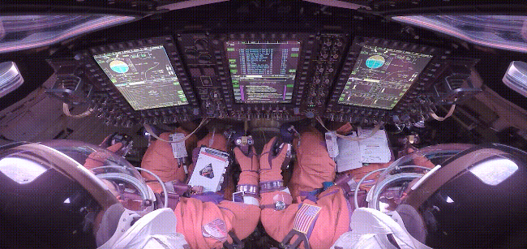
MARS: Host immunosuppression in spaceflight [1]
How?
Reversible hypoplasia of lymph tissue (spleen & thymus)
Blunted mitogen response of T lymphocytes (compared to terrestrial controls)
Animal models show widespread effects on both innate and humoral immune response
Seems to be time limited (but we haven’t done years long missions, like to Mars)

Slide 42
MARS: Host immunosuppression in spaceflight [1]
How?
Reversible hypoplasia of lymph tissue (spleen & thymus)
Blunted mitogen response of T lymphocytes (compared to terrestrial controls)
Animal models show widespread effects on both innate and humoral immune response
Seems to be time limited (but we haven’t done years long missions, like to Mars)
Why?
Gravity (lymphatic drainage) may play a role
Might also be psych response (similar issues seen with longterm submarines or antarctica)

Slide 43
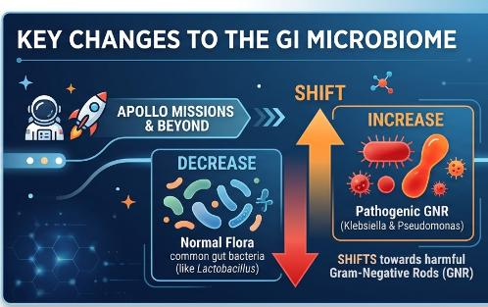
MARS: GI microbiome shift [1]
During Apollo missions:
Pathogenic increase: Gram-negative rods (Klebsiella & Pseudomonas)
Loss of flora: Significant shift away from normal healthy bacteria
Evidence from Soviet studies (Salyut & Mir) shows changes as early as two weeks into flight.

Slide 44

MARS: GI microbiome shift [1]
During Apollo missions:
Pathogenic increase: Gram-negative rods (Klebsiella & Pseudomonas)
Loss of flora: Significant shift away from normal healthy bacteria
Evidence from Soviet studies (Salyut & Mir) shows changes as early as two weeks into flight.
Potential Causes
Altered Gravity: Microgravity impacts fluid distribution
Motility Changes: GI system "not flowing right" in space environment

Slide 45
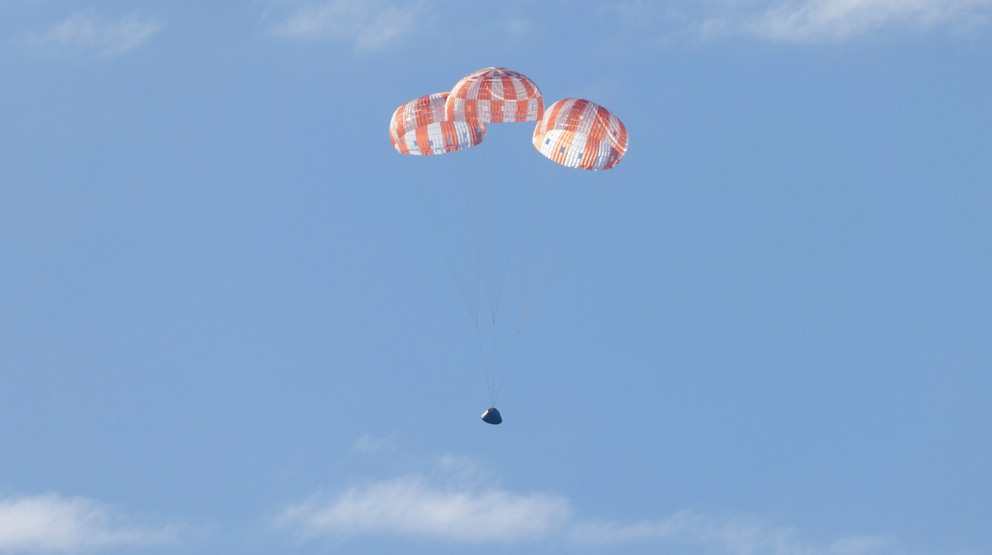
Returning to Earth
(Case #1)
Artemis II landing
Image Credit: NASA/Joel Kowsky

Slide 46
Case 1: Summary of inpatient
A 73 y/o M with PMH including CLL (had port), CAD/PAD s/p EVAR, OSA, seizures p/w cardiogenic shock & native aortic valve staph epi endocarditis. Clinical concern for VGI but CTA normal
s/p SAVR with pathology confirming bacterial endocarditis
Treated with vanco → dapto
Plan for lifelong doxy
Vancomycin
Daptomycin
Cefepime
1
2
3
4
5
6
7
8
9
10
11
12
13
14
15
16
17
18
19
SAVR
Hospital discharge
BCx: Staph epi
BCx: No growth
Port removed

Slide 47



Case 1: Eosinophilia
At the time of the initial consult, patient already had noticeable eosinophilia

Slide 48
Case 1: Eosinophilia
At the time of the initial consult, patient already had noticeable eosinophilia
Was on vancomycin and cefepime
Vancomycin
You are here
Cefepime
1
2
3
4
5
6
7
8
9
10
11
12
13
14
15
16
17
18
19
SAVR
Hospital discharge
BCx: Staph epi
Port removed

Slide 49
Case 1: Eosinophilia
At the time of the initial consult, patient already had noticeable eosinophilia
Was on vancomycin and cefepime
No rash
At least not yet…
Vancomycin
You are here
Cefepime
1
2
3
4
5
6
7
8
9
10
11
12
13
14
15
16
17
18
19
SAVR
Hospital discharge
BCx: Staph epi
Port removed

Slide 50
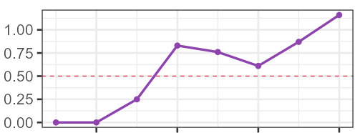
Case 1: Eosinophilia
Absolute eosinophil count
Upper limit of normal (500)
Vancomycin
Cefepime
1
2
3
4
5
6
7
8
9
10
11
12
13
14
15
16
17
18
19
Vancomycin
SAVR
Hospital discharge
Port removed
Cefepime
Notes:
plot_df <- df_CBC %>%
filter(component == "eos", type == "ABS") %>%
group_by(Date_rel) %>%
summarise(
abs_eos = first(value, order_by = Date),
WBC = first(WBC, order_by = Date),
Date = first(Date, order_by = Date),
.groups = "drop"
) %>%
arrange(Date)
plot_df %>%
filter(between(Date_rel, 0, 8)) %>%
ggplot(aes(x = Date_rel)) +
geom_hline(yintercept = .5, linetype="dashed", color="#DC4C64") +
geom_line(aes(y = abs_eos, color = "Absolute eos"), linewidth = 1.2) +
geom_point(aes(y = abs_eos, color = "Absolute eos"), size = 2.4) +
scale_y_continuous(n.breaks = 6,
name = "Absolute eosinophils (x10^3)"
) +
scale_x_continuous(breaks = 0:4*2, minor_breaks = 0:8) +
scale_color_manual(values = c("Absolute eos" = "#8E44AD",
"Total WBC" = "grey")) + # #003f5c
labs(
x = NULL,
color = NULL
) +
theme_bw(base_size = 20) +
theme(
legend.position = "top",
axis.title.y.left = element_text(color = "#8E44AD")
)

Slide 51
Case 1: Eosinophilia
Switched to daptomycin…
Absolute eosinophil count
Upper limit of normal (500)
Vancomycin
1
2
3
4
5
6
7
8
9
10
11
12
13
14
15
16
17
18
19
Vancomycin
Daptomycin
Cefepime
Notes:
plot_df <- df_CBC %>%
filter(component == "eos", type == "ABS") %>%
group_by(Date_rel) %>%
summarise(
abs_eos = first(value, order_by = Date),
WBC = first(WBC, order_by = Date),
Date = first(Date, order_by = Date),
.groups = "drop"
) %>%
arrange(Date)
plot_df %>%
filter(between(Date_rel, 0, 8)) %>%
ggplot(aes(x = Date_rel)) +
geom_hline(yintercept = .5, linetype="dashed", color="#DC4C64") +
geom_line(aes(y = abs_eos, color = "Absolute eos"), linewidth = 1.2) +
geom_point(aes(y = abs_eos, color = "Absolute eos"), size = 2.4) +
scale_y_continuous(n.breaks = 6,
name = "Absolute eosinophils (x10^3)"
) +
scale_x_continuous(breaks = 0:4*2, minor_breaks = 0:8) +
scale_color_manual(values = c("Absolute eos" = "#8E44AD",
"Total WBC" = "grey")) + # #003f5c
labs(
x = NULL,
color = NULL
) +
theme_bw(base_size = 20) +
theme(
legend.position = "top",
axis.title.y.left = element_text(color = "#8E44AD")
)

Slide 52
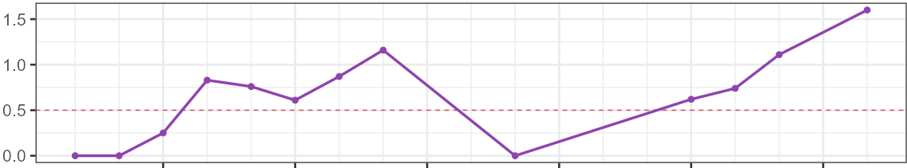
Case 1: Eosinophilia
Switched to daptomycin…with no improvement (perhaps worsened?)
Absolute eosinophil count
SAVR
Upper limit of normal
(500)
1
2
3
4
5
6
7
8
9
10
11
12
13
14
15
16
17
18
19
Vancomycin
Daptomycin
Cefepime
Notes:
plot_df <- df_CBC %>%
filter(component == "eos", type == "ABS") %>%
group_by(Date_rel) %>%
summarise(
abs_eos = first(value, order_by = Date),
WBC = first(WBC, order_by = Date),
Date = first(Date, order_by = Date),
.groups = "drop"
) %>%
arrange(Date)
plot_df %>%
filter(!is.na(abs_eos)) %>%
filter(between(Date_rel, 0, 19)) %>%
ggplot(aes(x = Date_rel)) +
geom_line(aes(y = WBC * scale_factor, color = "Total WBC"),
linewidth = 1.2) +
geom_hline(yintercept = .5, linetype="dashed", color="#DC4C64") +
geom_line(aes(y = abs_eos, color = "Absolute eos"), linewidth = 1.2) +
geom_point(aes(y = abs_eos, color = "Absolute eos"), size = 2.4) +
scale_y_continuous(n.breaks = 6,
name = "Absolute eosinophils (x10^3)"
) +
scale_x_continuous(breaks = 0:6*3, minor_breaks = 0:19) +
scale_color_manual(values = c("Absolute eos" = "#8E44AD",
"Total WBC" = "grey")) + # #003f5c
labs(
x = NULL,
color = NULL
) +
theme_bw(base_size = 20) +
theme(
legend.position = "top",
axis.title.y.left = element_text(color = "#8E44AD")
)

Slide 53
Case 1: Eosinophilia
Switched to daptomycin…with no improvement (perhaps worsened?)
Still asymptomatic
Eosinophils still rising
At discharge:
1600 (8.5%)
Absolute eosinophil count
SAVR
Upper limit of normal
(500)
1
2
3
4
5
6
7
8
9
10
11
12
13
14
15
16
17
18
19
Vancomycin
Daptomycin
Cefepime

Slide 54
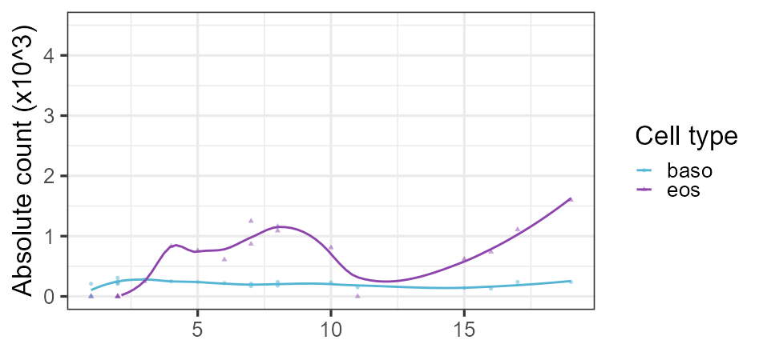
Case 1: Full differential (w/o neutrophils)
Eos
Baso
Notes:
df_CBC %>%
filter(type=="ABS") %>%
filter(component!="neut") %>%
# filter(component %in% c("eos", "baso")) %>%
filter(!is.na(value)) %>%
filter(between(Date_rel, 0, 19)) %>%
ggplot(aes(x = Date_rel)) +
geom_point(aes(y=value, color=component, shape=component), alpha=.5) +
# geom_line(aes(y=value, color=component)) +
geom_smooth(aes(y=value, color=component),se = F, span=.4) +
# scale_color_manual(values = c("eos" = "#DC4C64",
# "baso" = "#2C3E50",
# "mono" = "#0c622e",
# "lymph"="#2f5aa2")) +
scale_color_manual(values = c("eos" = "#8E44AD",
"baso" = "#54B4D3",
"mono" = "#896110",
"lymph"="#1F7A6C")) +
theme_bw(base_size = 20) +
scale_y_continuous(limits = c(0,4.5)) +
labs(x=NULL, y="Absolute count (x10^3)", color="Cell type", shape="Cell type")

Slide 55
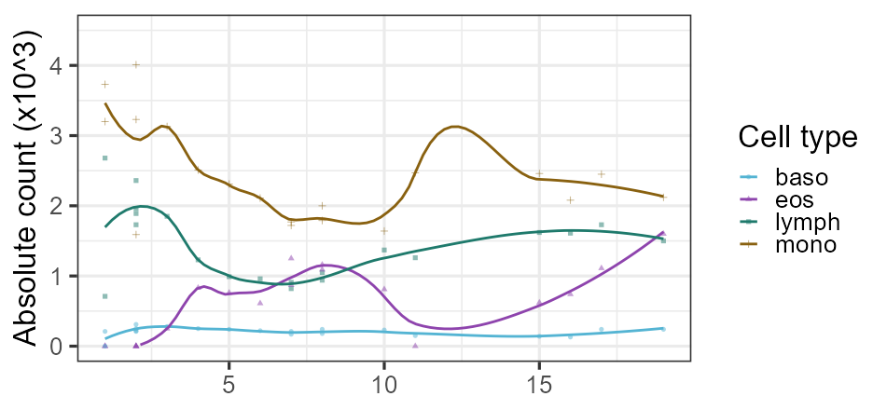
Case 1: Full differential (w/o neutrophils)
Mono
Lymph
Eos
Baso
SAVR
Notes:
df_CBC %>%
filter(type=="ABS") %>%
filter(component!="neut") %>%
# filter(component %in% c("eos", "baso")) %>%
filter(!is.na(value)) %>%
filter(between(Date_rel, 0, 19)) %>%
ggplot(aes(x = Date_rel)) +
geom_point(aes(y=value, color=component, shape=component), alpha=.5) +
# geom_line(aes(y=value, color=component)) +
geom_smooth(aes(y=value, color=component),se = F, span=.4) +
# scale_color_manual(values = c("eos" = "#DC4C64",
# "baso" = "#2C3E50",
# "mono" = "#0c622e",
# "lymph"="#2f5aa2")) +
scale_color_manual(values = c("eos" = "#8E44AD",
"baso" = "#54B4D3",
"mono" = "#896110",
"lymph"="#1F7A6C")) +
theme_bw(base_size = 20) +
scale_y_continuous(limits = c(0,4.5)) +
labs(x=NULL, y="Absolute count (x10^3)", color="Cell type", shape="Cell type")

Slide 56
Case 1: Full differential (w/o neutrophils)
Disclosure
I used a local (non-cloud) from of AI to extract these numbers from screenshots; I spot checked them, but did not confirm all 1000 data points were read correctly
Mono
Lymph
Eos
Baso
SAVR
Notes:
df_CBC %>%
filter(type=="ABS") %>%
filter(component!="neut") %>%
# filter(component %in% c("eos", "baso")) %>%
filter(!is.na(value)) %>%
filter(between(Date_rel, 0, 19)) %>%
ggplot(aes(x = Date_rel)) +
geom_point(aes(y=value, color=component, shape=component), alpha=.5) +
# geom_line(aes(y=value, color=component)) +
geom_smooth(aes(y=value, color=component),se = F, span=.4) +
# scale_color_manual(values = c("eos" = "#DC4C64",
# "baso" = "#2C3E50",
# "mono" = "#0c622e",
# "lymph"="#2f5aa2")) +
scale_color_manual(values = c("eos" = "#8E44AD",
"baso" = "#54B4D3",
"mono" = "#896110",
"lymph"="#1F7A6C")) +
theme_bw(base_size = 20) +
scale_y_continuous(limits = c(0,4.5)) +
labs(x=NULL, y="Absolute count (x10^3)", color="Cell type", shape="Cell type")

Slide 57
Case 1: OPAT
Discharged to SNF
Having nose bleeds (Brilinta)
No other concerns (per staff at SNF)
Notes:
df_CBC %>%
filter(type=="ABS") %>%
filter(component!="neut") %>%
# filter(component %in% c("eos", "baso")) %>%
filter(!is.na(value)) %>%
filter(between(Date_rel, 0, 19)) %>%
ggplot(aes(x = Date_rel)) +
geom_point(aes(y=value, color=component, shape=component), alpha=.5) +
# geom_line(aes(y=value, color=component)) +
geom_smooth(aes(y=value, color=component),se = F, span=.4) +
# scale_color_manual(values = c("eos" = "#DC4C64",
# "baso" = "#2C3E50",
# "mono" = "#0c622e",
# "lymph"="#2f5aa2")) +
scale_color_manual(values = c("eos" = "#8E44AD",
"baso" = "#54B4D3",
"mono" = "#896110",
"lymph"="#1F7A6C")) +
theme_bw(base_size = 20) +
scale_y_continuous(limits = c(0,4.5)) +
labs(x=NULL, y="Absolute count (x10^3)", color="Cell type", shape="Cell type")

Slide 58
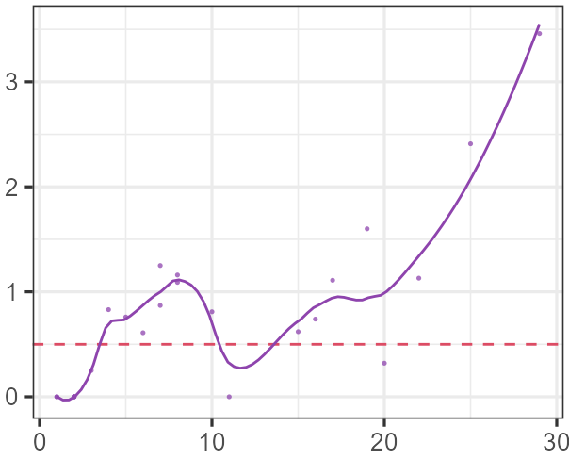
Case 1: OPAT
Discharged to SNF
Having nose bleeds (Brilinta)
No other concerns (per staff at SNF)
Those eosinophils just keep on rising
Now at 3500
Absolute eosinophil count
Admission (d/c = day 19)
Vanc / cefepime
Daptomycin
Notes:
df_CBC %>%
filter(type=="ABS") %>%
filter(component!="neut") %>%
# filter(component %in% c("eos", "baso")) %>%
filter(!is.na(value)) %>%
filter(between(Date_rel, 0, 19)) %>%
ggplot(aes(x = Date_rel)) +
geom_point(aes(y=value, color=component, shape=component), alpha=.5) +
# geom_line(aes(y=value, color=component)) +
geom_smooth(aes(y=value, color=component),se = F, span=.4) +
# scale_color_manual(values = c("eos" = "#DC4C64",
# "baso" = "#2C3E50",
# "mono" = "#0c622e",
# "lymph"="#2f5aa2")) +
scale_color_manual(values = c("eos" = "#8E44AD",
"baso" = "#54B4D3",
"mono" = "#896110",
"lymph"="#1F7A6C")) +
theme_bw(base_size = 20) +
scale_y_continuous(limits = c(0,4.5)) +
labs(x=NULL, y="Absolute count (x10^3)", color="Cell type", shape="Cell type")

Slide 59
Case 1: OPAT
Labs | Day 17
WBC | 20.6
Abs neut | 14.9
Abs eos | 1.1
CRP | 35
AST | ---
ALT | ---
AlkPhos | ---
Days since SAVR | 7
Shortly before discharge
Absolute eosinophil count
Admission (d/c = day 19)
Vanc / cefepime
Daptomycin

Slide 60
Case 1: OPAT
Labs | Day 17 | D22 | D25
WBC | 20.6 | 18.9 | 17.7
Abs neut | 14.9 | 15.5 | 11.6
Abs eos | 1.1 | 1.2 | 2.4
CRP | 35 | 32 | ---
AST | --- | 29 | 25
ALT | --- | 22 | 30
AlkPhos | --- | 71 | 149
Days since SAVR | 7 | 12 | 15
Absolute eosinophil count
Admission (d/c = day 19)
Vanc / cefepime
Daptomycin

Slide 61
Case 1: OPAT
ID clinic follow up
Labs | Day 17 | D22 | D25 | D29
WBC | 20.6 | 18.9 | 17.7 | 17.6
Abs neut | 14.9 | 15.5 | 11.6 | 11.1
Abs eos | 1.1 | 1.2 | 2.4 | 3.5
CRP | 35 | 32 | --- | 13
AST | --- | 29 | 25 | 53
ALT | --- | 22 | 30 | 57
AlkPhos | --- | 71 | 149 | 188
Days since SAVR | 7 | 12 | 15 | 19
Absolute eosinophil count
Admission (d/c = day 19)
Vanc / cefepime
Daptomycin

Slide 62
Case 1: OPAT
ID clinic follow up
Labs | Day 17 | D22 | D25 | D29
WBC | 20.6 | 18.9 | 17.7 | 17.6
Abs neut | 14.9 | 15.5 | 11.6 | 11.1
Abs eos | 1.1 | 1.2 | 2.4 | 3.5
CRP | 35 | 32 | --- | 13
AST | --- | 29 | 25 | 53
ALT | --- | 22 | 30 | 57
AlkPhos | --- | 71 | 149 | 188
Days since SAVR | 7 | 12 | 15 | 19
Absolute eosinophil count
Admission (d/c = day 19)
Normal platelets (200s-300s)
Chem7 unremarkable
CK normal (30s)
Vanc / cefepime
Daptomycin

Slide 63
Case 1: Clinic follow up
Absolute eosinophil count
Vanc / cefepime
Daptomycin
Admission (d/c = day 19)
A 73 y/o M with PMH including CLL (had port), AAA w/ h/o EVAR, OSA, seizures p/w native staph epi endocarditis s/p SAVR (day 11). c/f VGI but CTA normal. Developing profound eosinophilia…
And LFT problems…
…time to ask about Drug Reaction with Eosinophilia and Systemic Symptoms
Recent labs | Day 17 | D22 | D25 | D29
WBC | 20.6 | 18.9 | 17.7 | 17.6
Abs eos | 1.1 | 1.2 | 2.4 | 3.5
CRP | 35 | 32 | --- | 13
AST | --- | 29 | 25 | 53
ALT | --- | 22 | 30 | 57
AlkPhos | --- | 71 | 149 | 188
Since SAVR | 7 | 12 | 15 | 19

Slide 64
Case 1: ID clinic follow up
His breathing is fine
Though one must assume there are some eosinophils in his lungs…
His major concern is the nosebleeds
Absolute eosinophil count
Admission (d/c = day 19)
SNF
Vanc / cefepime
Daptomycin

Slide 65
Case 1: ID clinic follow up
His breathing is fine
Though one must assume there are some eosinophils in his lungs…
His major concern is the nosebleeds
But he has been having an itchy rash
Absolute eosinophil count
Rash
Itchy
Admission (d/c = day 19)
SNF
Vanc / cefepime
Daptomycin

Slide 66
Case 1: ID clinic follow up
He’s had itchy rashes before (more on this later), but never been this severe before

Slide 67
Case 1: ID clinic follow up
He’s had itchy rashes before (more on this later), but never been this severe before
Pruritus
Erythema
More intense pruritus

Slide 68
Case 1: ID clinic follow up
He’s had itchy rashes before (more on this later), but never been this severe before
Pruritus
Erythema
More intense pruritus
Zero improvement with:
Topical steroid cream
Benadryl

Slide 69
Case 1: ID clinic follow up
He’s had itchy rashes before (more on this later), but never been this severe before
Rash before abx
Started on bilateral legs
Lesser extent in webs of fingers
Pruritus
Erythema
More intense pruritus
Onset: Wife informs that he had a minor version of this same rash for maybe a month before hospitalization
Zero improvement with:
Topical steroid cream
Benadryl

Slide 70
Case 1: ID clinic follow up
He’s had itchy rashes before (more on this later), but never been this severe before
Rash before abx
Started on bilateral legs
Lesser extent in webs of fingers
Pruritus
Erythema
More intense pruritus
Onset: Wife informs that he had a minor version of this same rash for maybe a month before hospitalization
?
Zero improvement with:
Topical steroid cream
Benadryl
Improvement?
During hospital stay, “rash” did not spread to new areas
Patient thinks it’s because he was unable to itch himself

Slide 71
Case 1: ID clinic follow up
Rash before abx
Started on bilateral legs
Lesser extent in webs of fingers
Pruritus
Erythema
More intense pruritus
Onset: Wife informs that he had a minor version of this same rash for maybe a month before hospitalization
?
Worsening (at SNF)
New areas involved:
Abdomen → arms → face
Old areas:
Still have “rash” but not itchy
Severity:
Pruritis is way more intense than what he had prior to admission
Improvement?
During hospital stay, “rash” did not spread to new areas
Patient thinks it’s because he was unable to itch himself

Slide 72
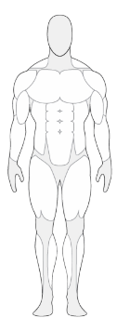
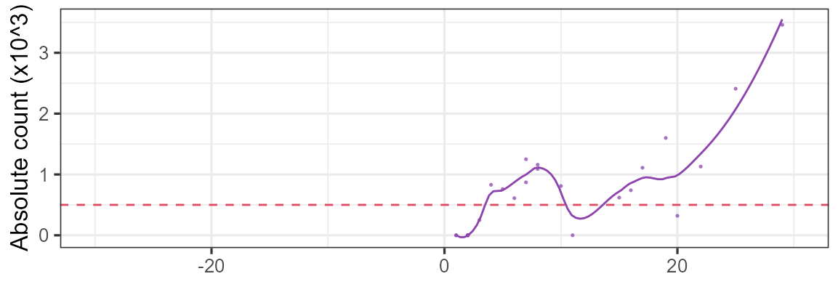
Case 1: Rash timeline
Rash before abx
Started on bilateral legs
Lesser extent in webs of fingers
Onset: Wife informs that he had a minor version of this same rash for maybe a month before hospitalization
Minor itchy rash
Not itchy rash
Notes:
### Month before admission
df_CBC %>%
filter(type=="ABS") %>%
filter(component!="neut") %>%
filter(component %in% c("eos")) %>%
filter(!is.na(value)) %>%
filter(between(Date_rel, -30, 31)) %>%
ggplot(aes(x = Date_rel)) +
geom_hline(yintercept = .5, linetype="dashed", color="#DC4C64", linewidth = 1) +
geom_point(aes(y=value, color=component, shape=component), alpha=.75) +
# geom_line(aes(y=value, color=component)) +
geom_smooth(aes(y=value, color=component),se = F, span=.4) +
# scale_color_manual(values = c("eos" = "#DC4C64",
# "baso" = "#2C3E50",
# "mono" = "#0c622e",
# "lymph"="#2f5aa2")) +
scale_color_manual(values = c("eos" = "#8E44AD",
"baso" = "#54B4D3",
"mono" = "#896110",
"lymph"="#1F7A6C")) +
theme_bw(base_size = 25) +
# scale_y_continuous(limits = c(0,4.5)) +
scale_x_continuous(limits = c(-30,30)) + guides(color="none", shape="none") +
labs(x=NULL, y="Absolute count (x10^3)", color="Cell type", shape="Cell type")

Slide 73
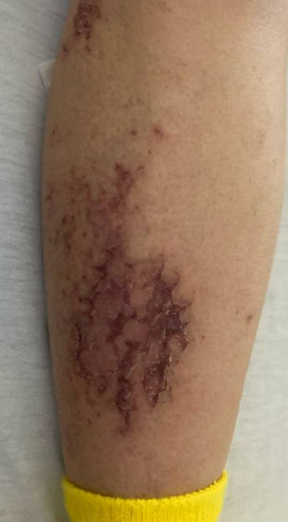
Case 1: Rash timeline
SNF
Minor itchy rash
Not itchy rash

Slide 74
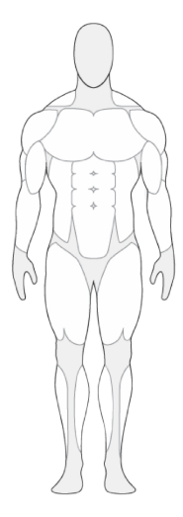
Case 1: Rash timeline
Worsening (at SNF)
New areas involved:
Abdomen → arms → face
Old areas: no longer itchy
Severity: Pruritis is way more intense
Severe itch
Rash in
new places
Minor itchy rash
Not itchy rash

Slide 75
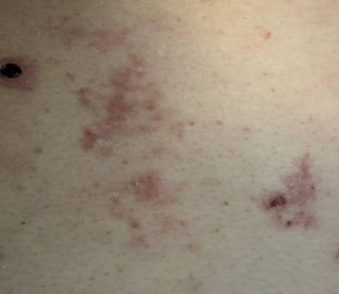
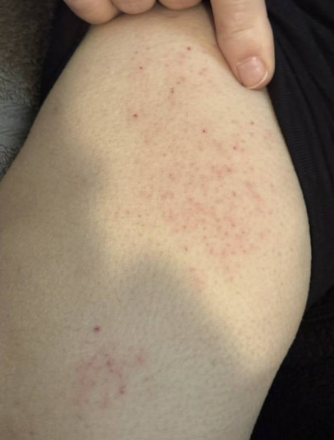
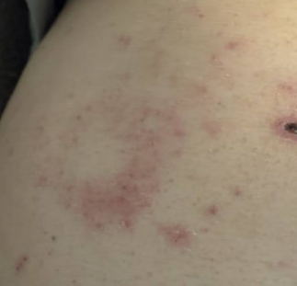
Case 1: Exam
Severe itch
Blanching rashes

Slide 76
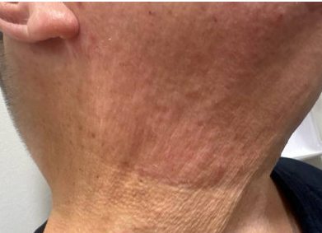
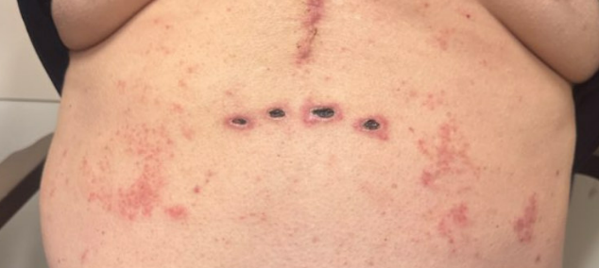
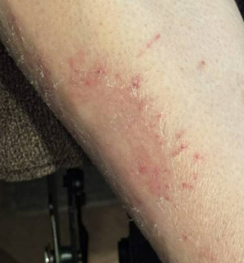
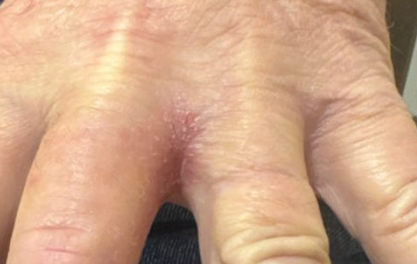
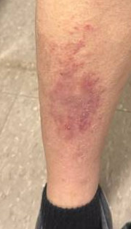
Severe itch
Not very itchy
Rash in
new places
Not itchy

Slide 77

Case 1: Rash timeline
Admission (d/c = day 19)
SNF
Maybe something distinct from new rash?
Vanc / cefepime
Daptomycin
Severe itch
Rash in
new places
Minor itchy rash
Not itchy rash
Notes:
### Month before admission
df_CBC %>%
filter(type=="ABS") %>%
filter(component!="neut") %>%
filter(component %in% c("eos")) %>%
filter(!is.na(value)) %>%
filter(between(Date_rel, -30, 31)) %>%
ggplot(aes(x = Date_rel)) +
geom_hline(yintercept = .5, linetype="dashed", color="#DC4C64", linewidth = 1) +
geom_point(aes(y=value, color=component, shape=component), alpha=.75) +
# geom_line(aes(y=value, color=component)) +
geom_smooth(aes(y=value, color=component),se = F, span=.4) +
# scale_color_manual(values = c("eos" = "#DC4C64",
# "baso" = "#2C3E50",
# "mono" = "#0c622e",
# "lymph"="#2f5aa2")) +
scale_color_manual(values = c("eos" = "#8E44AD",
"baso" = "#54B4D3",
"mono" = "#896110",
"lymph"="#1F7A6C")) +
theme_bw(base_size = 25) +
# scale_y_continuous(limits = c(0,4.5)) +
scale_x_continuous(limits = c(-30,30)) + guides(color="none", shape="none") +
labs(x=NULL, y="Absolute count (x10^3)", color="Cell type", shape="Cell type")

Slide 78
Case 1: Social history, exposures, & risk factors
Geographic & Travel | Lives on Ohio/WV border with wife of 35+ years No recent travel, never out of the country

Slide 79
Case 1: Social history, exposures, & risk factors
Geographic & Travel | Lives on Ohio/WV border with wife of 35+ years No recent travel, never out of the country
Occupational | No longer working Doesn’t spend much time outdoors anymore (used to hunt, but not as much in recent years; none this season)

Slide 80
Case 1: Social history, exposures, & risk factors
Geographic & Travel | Lives on Ohio/WV border with wife of 35+ years No recent travel, never out of the country
Occupational | No longer working Doesn’t spend much time outdoors anymore (used to hunt, but not as much in recent years; none this season)
Animals | Denies farm animal exposures, bird/reptile exposures, or other animal exposure (aside from their pet dog)

Slide 81
Case 1: Social history, exposures, & risk factors
Geographic & Travel | Lives on Ohio/WV border with wife of 35+ years No recent travel, never out of the country
Occupational | No longer working Doesn’t spend much time outdoors anymore (used to hunt, but not as much in recent years; none this season)
Animals | Denies farm animal exposures, bird/reptile exposures, or other animal exposure (aside from their pet dog)
Medications | Has been on Lamictal (seizures) and aspirin (CAD) for >8 years Started on Brilinta on admission (~day 1) after had PCI Started on amio (post-SAVR) for A-fib Allergy: Bactrim causes rash, no issues with other antibiotics in the past

Slide 82
[Q4] What is causing the rash?

Slide 83
[Q5] Eosinophilia:
How high is too high?
Assuming no symptoms

Slide 84
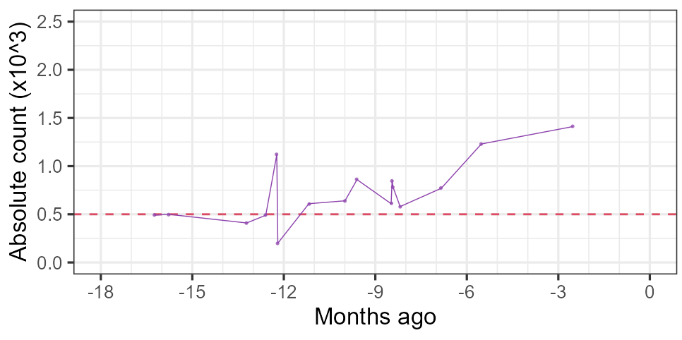
Case 1: Eosinophilia is not exactly new…
IE admission
Notes:
df_CBC %>%
filter(type=="ABS") %>%
filter(component!="neut") %>%
filter(component %in% c("eos")) %>%
filter(!is.na(value)) %>%
mutate(month_rel = Date_rel / (365/12)) %>%
filter(month_rel>=-18) %>%
filter(month_rel<=0) %>%
ggplot(aes(x = month_rel)) +
geom_hline(yintercept = .5, linetype="dashed", color="#DC4C64", linewidth = 1) +
geom_jitter(aes(y=value, color=component, shape=component), alpha=.75) +
geom_line(aes(y=value, color=component)) +
# geom_smooth(aes(y=value, color=component),se = F, span=.5) +
# scale_color_manual(values = c("eos" = "#DC4C64",
# "baso" = "#2C3E50",
# "mono" = "#0c622e",
# "lymph"="#2f5aa2")) +
scale_color_manual(values = c("eos" = "#8E44AD",
"baso" = "#54B4D3",
"mono" = "#896110",
"lymph"="#1F7A6C")) +
theme_bw(base_size = 25) +
scale_y_continuous(limits = c(0,2.5)) +
scale_x_continuous(limits = c(-18,0), minor_breaks = -18:0, breaks = -6:0*3) +
labs(x="Months ago", y="Absolute count (x10^3)", color="Cell type", shape="Cell type")

Slide 85
Imbruvica
IE admission
(ibrutinib)
Imbruvica
Notes:
df_CBC %>%
filter(type=="ABS") %>%
filter(component!="neut") %>%
filter(component %in% c("eos")) %>%
filter(!is.na(value)) %>%
mutate(month_rel = Date_rel / (365/12)) %>%
filter(month_rel>=-18) %>%
filter(month_rel<=0) %>%
ggplot(aes(x = month_rel)) +
geom_hline(yintercept = .5, linetype="dashed", color="#DC4C64", linewidth = 1) +
geom_jitter(aes(y=value, color=component, shape=component), alpha=.75) +
geom_line(aes(y=value, color=component)) +
# geom_smooth(aes(y=value, color=component),se = F, span=.5) +
# scale_color_manual(values = c("eos" = "#DC4C64",
# "baso" = "#2C3E50",
# "mono" = "#0c622e",
# "lymph"="#2f5aa2")) +
scale_color_manual(values = c("eos" = "#8E44AD",
"baso" = "#54B4D3",
"mono" = "#896110",
"lymph"="#1F7A6C")) +
theme_bw(base_size = 25) +
scale_y_continuous(limits = c(0,2.5)) +
scale_x_continuous(limits = c(-18,0), minor_breaks = -18:0, breaks = -6:0*3) +
labs(x="Months ago", y="Absolute count (x10^3)", color="Cell type", shape="Cell type")

Slide 86
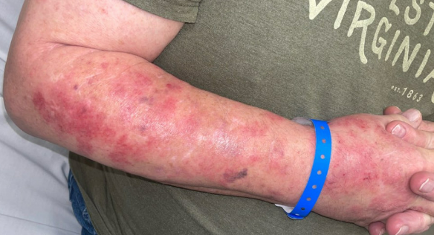
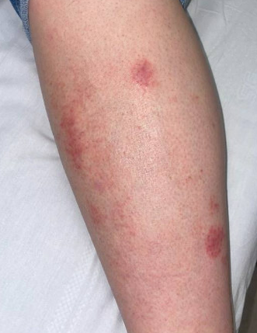
Imbruvica
(ibrutinib)
Imbruvica
Rash
Leg

Slide 87
Imbruvica
(ibrutinib)
Imbruvica
Rash
Bactrim
Doxy
Leg

Slide 88
Imbruvica
Calquence
(ibrutinib)
(acalabrutinib)
Imbruvica
Calquence
Rash
Resolved..?
Bactrim
Doxy

Slide 89
Bruton’s tyrosine kinase (BTK) inhibitors
Imbruvica
Calquence
Brukinsa
No chemo
(ibrutinib)
(acalabrutinib)
(zanubrutinib)
Just IVIG
Imbruvica
Calquence
Rash (severe)
Resolved..?
Rash again?
Minor
rash
Bactrim
Doxy

Slide 90
Bruton’s tyrosine kinase (BTK) inhibitors
Imbruvica
Calquence
Brukinsa
No chemo
(ibrutinib)
(acalabrutinib)
(zanubrutinib)
Just IVIG
Imbruvica
Calquence
Rash (severe)
Resolved..?
Rash again?
Minor
rash
Bactrim
Punch biopsy
Doxy

Slide 91
Case 1: Old Bx
Subacute spongiotic dermatitis with superficial lymphocytic cell infiltrates and actinic changes, see Comment
These findings are entirely non-specific and those of a subacute to chronic spongiotic dermatitis with superficial predominant perivascular infiltrates associated (possibly secondarily) with actinic damage. Eczematized actinic keratosis is possible; but Epic indicates this biopsy is a portion of a broader eruption. A spongiotic drug eruption is a possibility, or even an erythema reaction due to rubbing may also be explain these histopathologic findings.
There are no overt tumoral infiltrates to suggest a fully developed leukemia cutis. A connective tissue disorder is unlikely but cannot be excluded with complete surety. These histopathological features would not be characteristically seen in subacute cutaneous lupus nor Sweet's syndrome. The direct immunofluorescence studies are nonspecific.
Punch biopsy of arm
Imbruvica
Rash (severe)
Bactrim
Doxy

Slide 92
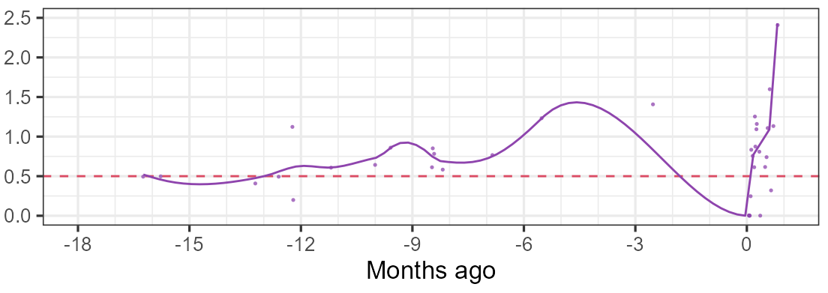
Case 1: ID clinic follow up
Did not suspect issues to be related to antibiotics
Still changed to Zyvox (hard to continue dapto with eosinophils > 2k)
Strongly advised prompt hematology follow up
Notes:
### Historic and one month
df_CBC %>%
filter(type=="ABS") %>%
filter(component!="neut") %>%
filter(component %in% c("eos")) %>%
filter(!is.na(value)) %>%
mutate(month_rel = Date_rel / (365/12)) %>%
filter(month_rel>=-18) %>%
filter(month_rel<=1) %>%
ggplot(aes(x = month_rel)) +
geom_hline(yintercept = .5, linetype="dashed", color="#DC4C64", linewidth = 1) +
geom_jitter(aes(y=value, color=component, shape=component), alpha=.75) +
# geom_line(aes(y=value, color=component)) +
geom_smooth(aes(y=value, color=component),se = F, span=.2) +
# scale_color_manual(values = c("eos" = "#DC4C64",
# "baso" = "#2C3E50",
# "mono" = "#0c622e",
# "lymph"="#2f5aa2")) +
scale_color_manual(values = c("eos" = "#8E44AD",
"baso" = "#54B4D3",
"mono" = "#896110",
"lymph"="#1F7A6C")) +
theme_bw(base_size = 25) +
scale_y_continuous(limits = c(0,2.5)) +
scale_x_continuous(limits = c(-18,1), minor_breaks = -18:1, breaks = -6:0*3) +
guides(color="none", shape="none") +
labs(x="Months ago", y="Absolute count (x10^3)", color="Cell type", shape="Cell type")

Slide 93
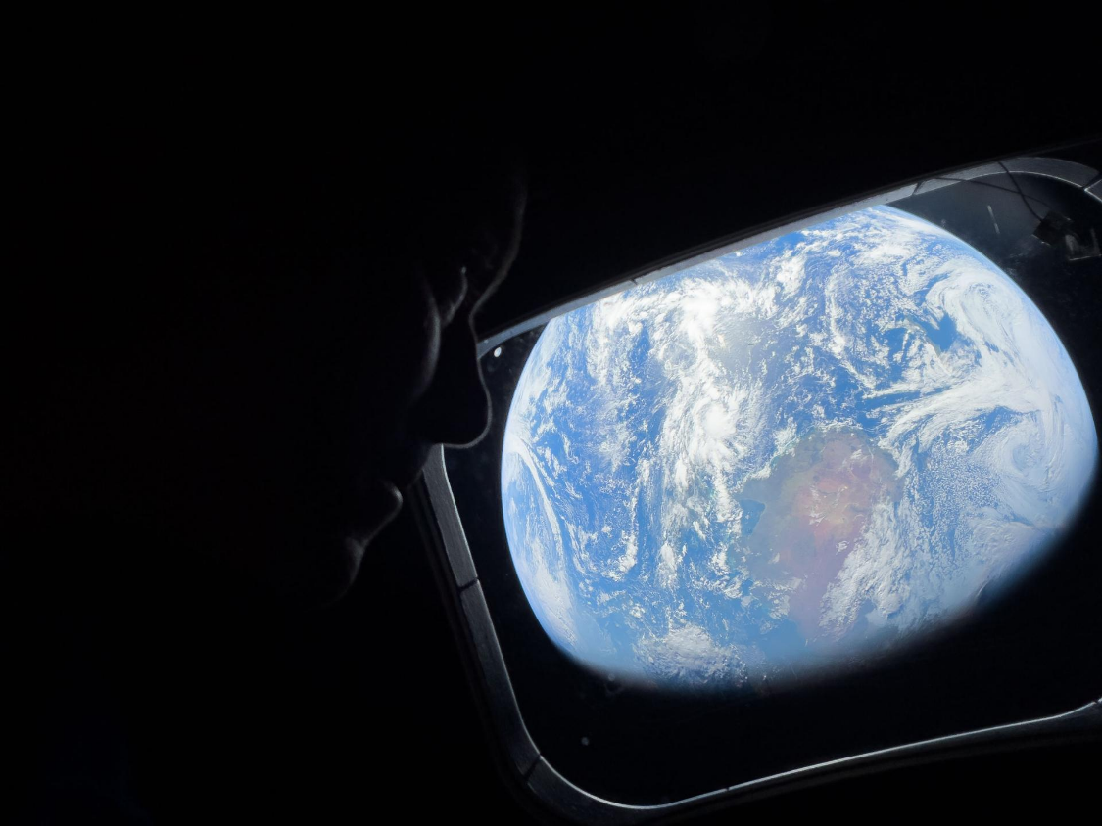
MARS call #2
Artemis II Commander Reid Wiseman peers out Orion's main cabin windows, as the crew travels towards the Moon
April 2nd, 2026
Image credit: JSC/NASA

Slide 94
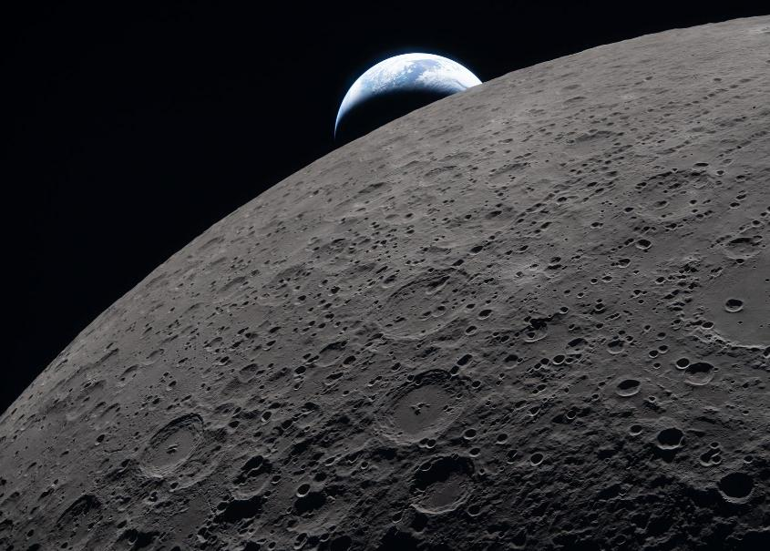
MARS #2: HPI
You are called after multiple crew members of the ISS have come down with progressive respiratory symptoms
Artemis II lunar flyby, captured three minutes before the Orion spacecraft went behind the Moon
Credit: NASA (4/6/2026 19:41 EDT)

Slide 95
MARS #2: HPI
A few months into an ISS expedition (mission month 2.5), two of the six crew members developed productive cough and dyspnea

Slide 96
MARS #2: HPI
A few months into an ISS expedition (mission month 2.5), two of the six crew members developed productive cough and dyspnea
For the past six days, two of the crew members have been feeling ill
Three days ago, one crew member (Crew A) developed fevers
Today, that same crew member developed increased work of breathing and looks pale

Slide 97
MARS #2: HPI
A few months into an ISS expedition (mission month 2.5), two of the six crew members developed productive cough and dyspnea
For the past six days, two of the crew members have been feeling ill
Three days ago, one crew member (Crew A) developed fevers
Today, that same crew member developed increased work of breathing and looks pale
Antibiotic | (more ill) Astronaut A | Astronaut B
Augmentin | No improvement | No improvement
Bactrim | No improvement | ---
Cipro | --- | Mild improvement

Slide 98
MARS #2: HPI
A few months into an ISS expedition (mission month 2.5), two of the six crew members developed productive cough and dyspnea for the past six days. Astronaut B had mild improvement with some Cipro, but Astronaut A now has fevers (for 3 days) and increased work of breathing (1 day), despite Augmentin and Bactrim
Epi risks | Quite ill | Sick | Healthy | Healthy | Healthy | Healthy
 | Crew A | Crew B | Crew C | Crew D | Crew E | Crew F
Toilet repairs | No | Yes | No | Yes | Yes | No
Electric panel repair | Yes | Yes | No | Yes | No | No
EVA? | Yes | Yes | Yes | No | No | Yes
Food source | Lot 1 | Lot 1 | Lot 1 | Lot 2 | Lot 2 | Lot 2

Slide 99
MARS #2: HPI
A few months into an ISS expedition (mission month 2.5), two of the six crew members developed productive cough and dyspnea for the past six days. Astronaut B had mild improvement with some Cipro, but Astronaut A now has fevers (for 3 days) and increased work of breathing (1 day), despite Augmentin and Bactrim. No clear shared epidemiologic risk factors.
Today (day of consult), exam by the crew medical officer (not a physician)
Astronaut A
38.9°C (102.0°F) | 112 bpm | 108/64 | 91%
Accessory muscle use
Rales in RLL > LLL;
↓ breath sounds RLL
Astronaut B
37.8°C (100.0°F) | 104 bpm | 114/70 | 93%
Coughing on exam
Diffuse rhonchi & scattered crackles bilaterally

Slide 100
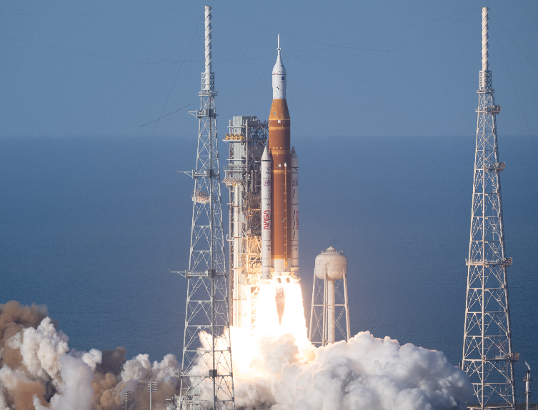
MARS 2: Summary
Do you abort the mission?
A few months into an ISS expedition (mission month 2.5), two of the six crew members developed productive cough and dyspnea for the past six days. No clear shared epidemiologic risk factors
Astronaut B had mild improvement with some Cipro, but Astronaut A now has fevers (for 3 days) and increased work of breathing (1 day), despite Augmentin and Bactrim.
Image Credit: NASA/Joel Kowsky (Artemis II Launch)

Slide 101
MARS: Space is dirty! [1][3]
Intuition: The ISS should be clean, like an operating room

Slide 102
MARS: Space is dirty! [1][3]
Intuition: The ISS should be clean, like an operating room
Over 15+ years, microbes have really built up
Mainly skin flora (staph, micrococcus, strep, bacillus)
But that’s not all…!
Reality: The microbiology of the ISS is much closer to an ICU

Slide 103
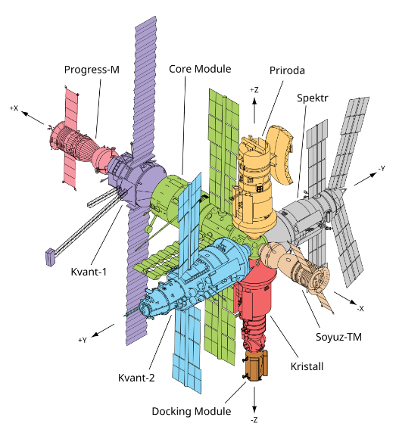
MARS: Space is dirty [3]
When NASA removed a service panel and found a humid cloud of condensate
Isolated from Mir in 1998, the first space station (Soviet station)

Slide 104
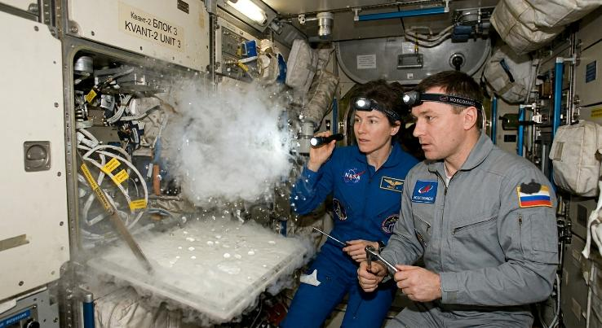
MARS: Space is dirty [3]
When NASA removed a service panel and found a humid cloud of condensate
Isolated from Mir in 1998, the first space station (Soviet station)
AI generated image (I have no idea what it looked like)
Notes:
During the NASA 6 mission (on the soviet space station Mir), they discovered a large free-floating mass of water behind a service panel in the Kvant-2 Module. This ‘‘free condensate’’ accumulated over time as water droplets coalesced in microgravity, and subsequent analysis isolated numerous pathogens behind the panel. Create an image depicting this "condensate" being discovered behind a panel

Slide 105
Guess what they isolated?

Slide 106
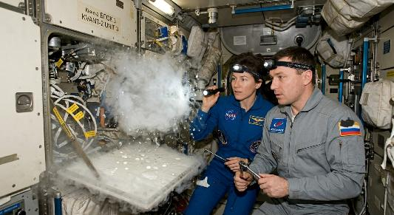
MARS: Space is dirty [3]
Isolated from Mir space station (1998)
Multiple species of:
Serratia (S liquefaciens, S marcescens)
Pseudomonas
Yersinia
Corynebacterium & Bacillus
Legionella (x2)
Citrobacter frundii (x2)
Enterobacter cloacae
Stenotrophomonas maltophilia
Elizabethkingia meningoseptica
Rhodococcus species
Space horses?
AI generated image (I have no idea what it looked like)

Slide 107
MARS: Space is dirty [3]
Fungal
Multiple species of Candida
Fusarium species (x3)
Penicillium species (x3)
Rhodotorula rubra (x3)
Cladosporium species (x2)
And more
Isolated from Mir space station (1998)
Multiple species of:
Serratia (S liquefaciens, S marcescens)
Pseudomonas
Yersinia
Corynebacterium & Bacillus
Legionella (x2)
Citrobacter frundii (x2)
Enterobacter cloacae
Stenotrophomonas maltophilia
Elizabethkingia meningoseptica
Rhodococcus species
Space horses?
AI generated image (I have no idea what it looked like)

Slide 108
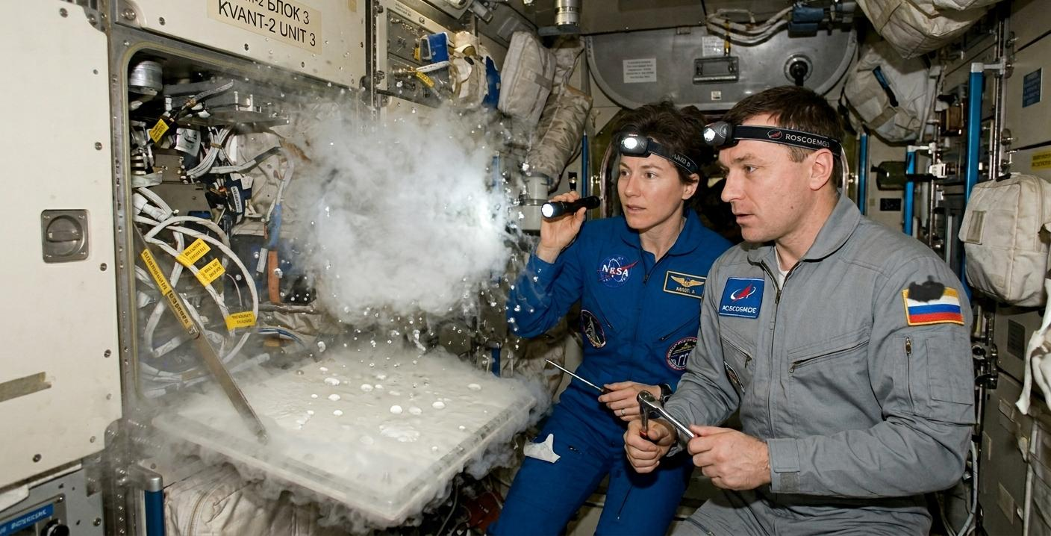
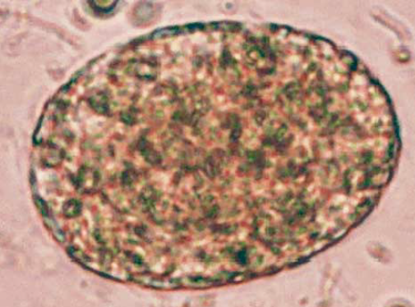
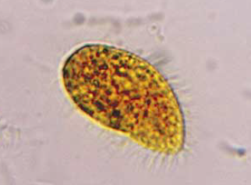
MARS: Space is dirty
MARS: Space is dirty [3]
Amoeba resembling Acanthamoeba or Hartmanella species
Ciliated protozoa resembling Stylonychia
species
AI generated image (I have no idea what it looked like)

Slide 109
MARS: Space is dirty
MARS: Space is dirty [3]
Isolated from Mir space station (1998)
Multiple species of Serratia, Pseudomonas, Yersinia, Corynebacterium, & Bacillus
Legionella (x2)
Citrobacter frundii & Enterobacter cloacae
Stenotrophomonas & Elizabethkingia
Rhodococcus species
Amoeba & protozoa
Fungal
Multiple species of Candida
Fusarium species (x3)
Penicillium species (x3)
Rhodotorula rubra (x3)
Cladosporium species (x2)
And more
Lyme? Lepto?
Electron microscopy suggested presence of spirochetes
No mycobacteria (at least yet)
AI generated image (I have no idea what it looked like)

Slide 110
Surely the life support systems aren’t as contaminated, right?
It’s not like they are drinking fluid from behind a service panel…
AI generated image (I have no idea what it looked like)

Slide 111
Surely the life support systems aren’t as contaminated, right?
During space shuttle program, the potable water (generated by the fuel cells) was commonly contaminated with low levels of Burkholderia cepacia
AI generated image (I have no idea what it looked like)

Slide 112
Surely the life support systems aren’t as contaminated, right?
During space shuttle program, the potable water (generated by the fuel cells) was commonly contaminated with low levels of Burkholderia cepacia
Outer space or an ICU?
Pseudomonas
Steno maltophilia
Burkholderia
Serratia, citrobacter, E cloacae
Candida krusei
AI generated image (I have no idea what it looked like)

Slide 113
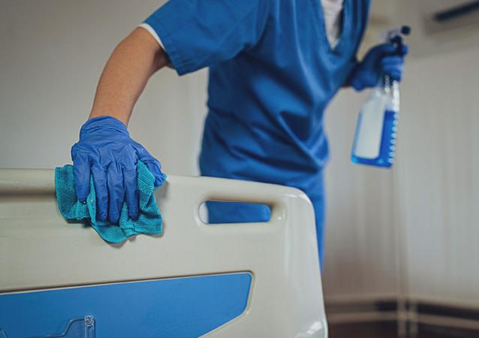
MARS: Infection Prevention & Control
Standard environmental disinfection practices (wipes, UV radiation) do not work well, because the bacteria are different
Because there is no gravity!

Slide 114
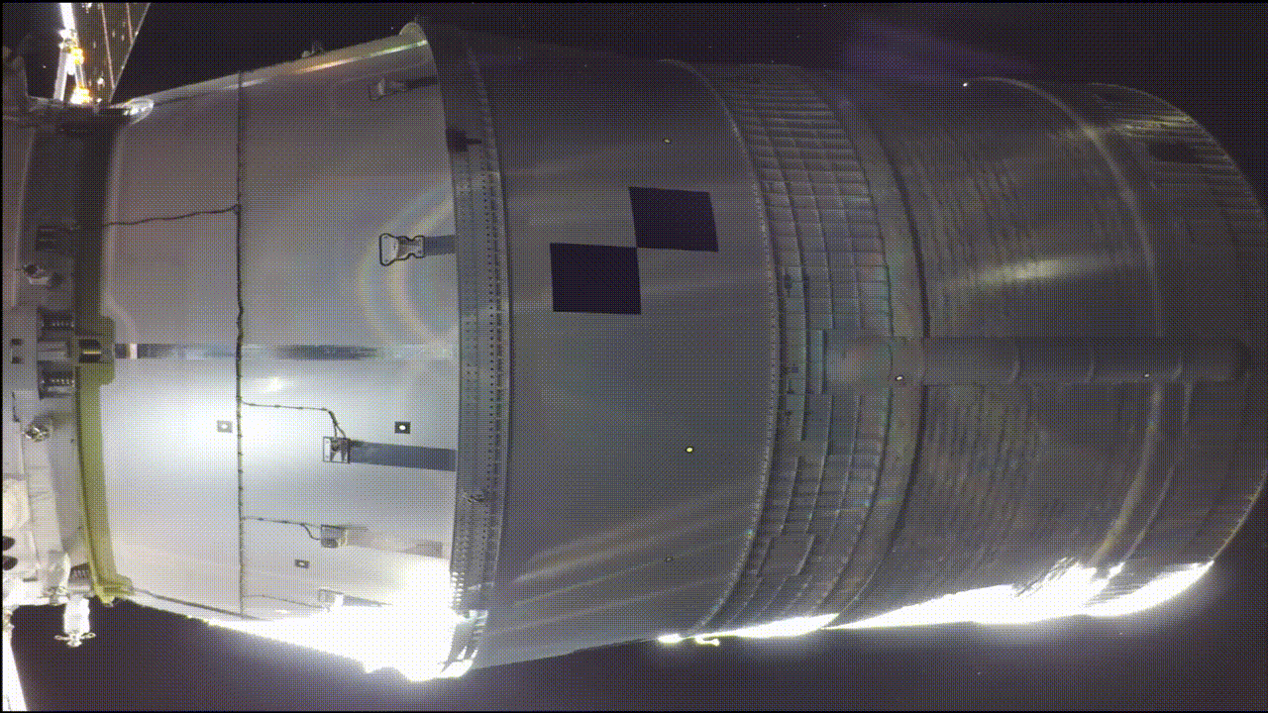
MARS: Pathogen responses to microgravity [1]
Spaceflight doesn’t just affect human physiology, it also affects pathogens too!
Driven by Lack of Gravity
Fluids are much more static (no convection) compared to terrestrial environment
Artemis II Upper Stage Separation
Image credit: NASA (4/1/2026)

Slide 115
MARS: Pathogen responses to microgravity [1]
Spaceflight doesn’t just affect human physiology, it also affects pathogens too!
Driven by Lack of Gravity
Fluids are much more static (no convection) compared to terrestrial environment
Bacteria rely on passive diffusion for nutrients and waste removal
Exception: Bacteria with flagella maintain active transport capabilities
Artemis II Upper Stage Separation
Image credit: NASA (4/1/2026)

Slide 116
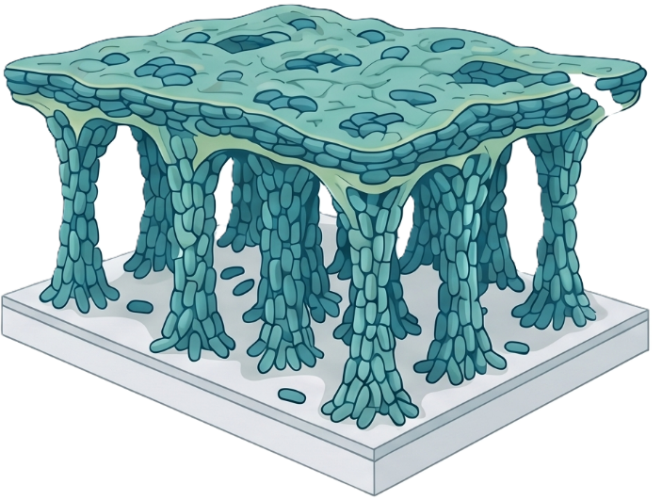
MARS: Pathogen responses to microgravity [1]
Pseudomonas overcomes diffusion limitations in microgravity by building unique biofilms [4]
Structure never seen on Earth:
Thicker overall matrix
"Column and canopy" architecture
Optimized for nutrient diffusion
AI generated image (Google NotebookLM)

Slide 117
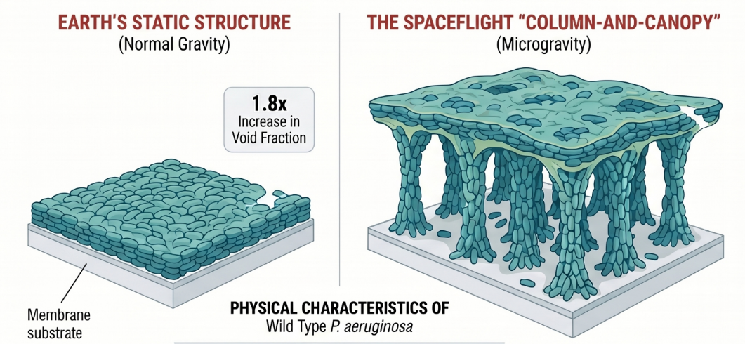
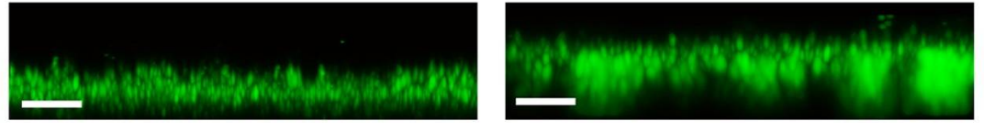
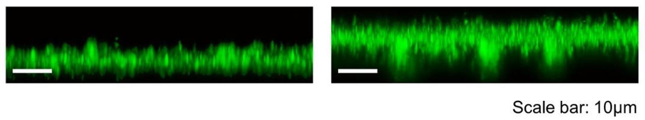
Real world data from Kim et al [4]

Slide 118
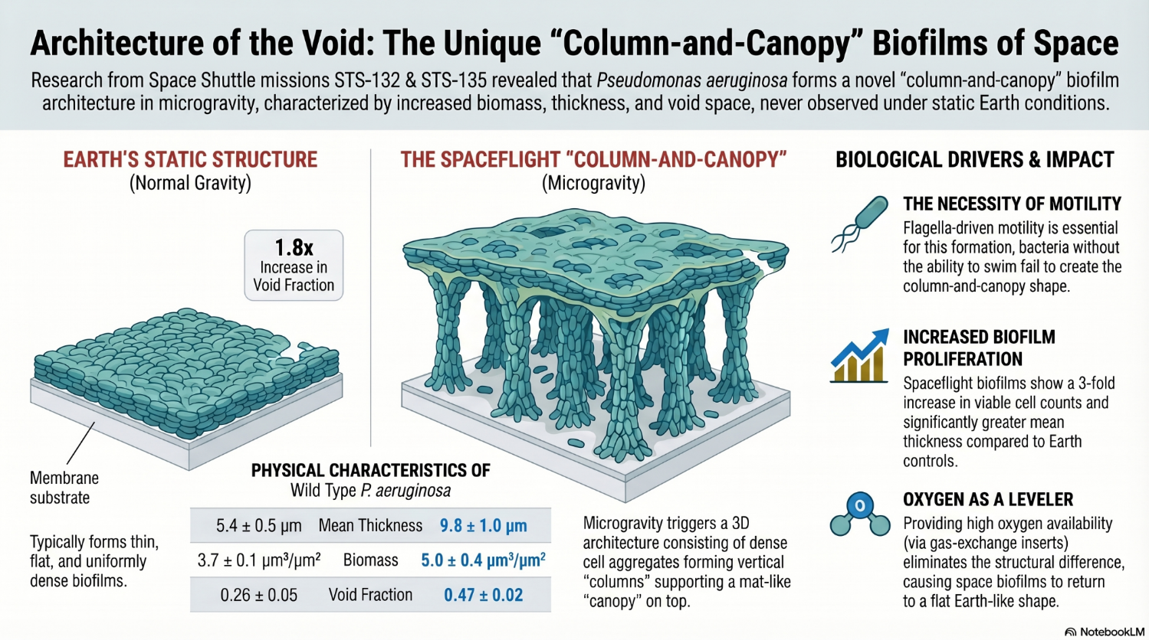
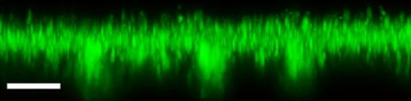

Slide 119

Returning to Earth
(Case #1)
Returning to Earth
Artemis II landing
Image Credit: NASA/Joel Kowsky
Mission Control (April 7th)
Image Credit: NASA/Robert Markowitz

Slide 120
Case 1: Readmission to OSH
Presents to local hospital due to worsening pruritus (and ?dyspnea)
Notes:
### Positive dates with eos only
df_CBC %>%
filter(type=="ABS") %>%
filter(component!="neut") %>%
filter(component %in% c("eos")) %>%
filter(!is.na(value)) %>%
filter(Date_rel>=0) %>%
filter(Date_rel!=35) %>%
ggplot(aes(x = Date_rel)) +
geom_hline(yintercept = .5, linetype="dashed", color="#DC4C64", linewidth = 1) +
geom_point(aes(y=value, color=component, shape=component), alpha=.75) +
geom_line(aes(y=value, color=component)) +
# geom_smooth(aes(y=value, color=component),se = F, span=.4) +
# scale_color_manual(values = c("eos" = "#DC4C64",
# "baso" = "#2C3E50",
# "mono" = "#0c622e",
# "lymph"="#2f5aa2")) +
scale_color_manual(values = c("eos" = "#8E44AD",
"baso" = "#54B4D3",
"mono" = "#896110",
"lymph"="#1F7A6C")) +
theme_bw(base_size = 25) +
# scale_y_continuous(limits = c(0,4.5)) +
guides(color="none", shape="none") +
labs(x=NULL, y="Absolute count (x10^3)", color="Cell type", shape="Cell type")

Slide 121
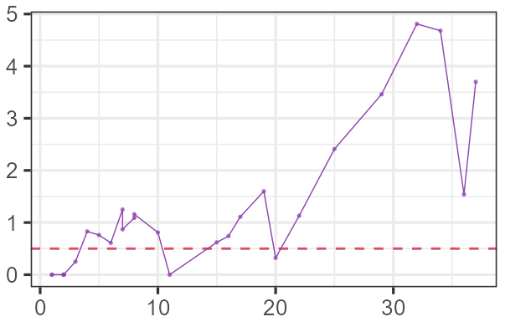
Case 1: Readmission to OSH
Presents to local hospital due to worsening pruritus (and ?dyspnea)
Absolute eosinophil count
Notes:
### Positive dates with eos only
df_CBC %>%
filter(type=="ABS") %>%
filter(component!="neut") %>%
filter(component %in% c("eos")) %>%
filter(!is.na(value)) %>%
filter(Date_rel>=0) %>%
filter(Date_rel!=35) %>%
ggplot(aes(x = Date_rel)) +
geom_hline(yintercept = .5, linetype="dashed", color="#DC4C64", linewidth = 1) +
geom_point(aes(y=value, color=component, shape=component), alpha=.75) +
geom_line(aes(y=value, color=component)) +
# geom_smooth(aes(y=value, color=component),se = F, span=.4) +
# scale_color_manual(values = c("eos" = "#DC4C64",
# "baso" = "#2C3E50",
# "mono" = "#0c622e",
# "lymph"="#2f5aa2")) +
scale_color_manual(values = c("eos" = "#8E44AD",
"baso" = "#54B4D3",
"mono" = "#896110",
"lymph"="#1F7A6C")) +
theme_bw(base_size = 25) +
# scale_y_continuous(limits = c(0,4.5)) +
guides(color="none", shape="none") +
labs(x=NULL, y="Absolute count (x10^3)", color="Cell type", shape="Cell type")

Slide 122
Case 1: Readmission to OSH
Presents to local hospital due to worsening pruritus (and ?dyspnea)
Gets steroids with improvement
Seen by hematology
Absolute eosinophil count
Notes:
### Positive dates with eos only
df_CBC %>%
filter(type=="ABS") %>%
filter(component!="neut") %>%
filter(component %in% c("eos")) %>%
filter(!is.na(value)) %>%
filter(Date_rel>=0) %>%
filter(Date_rel!=35) %>%
ggplot(aes(x = Date_rel)) +
geom_hline(yintercept = .5, linetype="dashed", color="#DC4C64", linewidth = 1) +
geom_point(aes(y=value, color=component, shape=component), alpha=.75) +
geom_line(aes(y=value, color=component)) +
# geom_smooth(aes(y=value, color=component),se = F, span=.4) +
# scale_color_manual(values = c("eos" = "#DC4C64",
# "baso" = "#2C3E50",
# "mono" = "#0c622e",
# "lymph"="#2f5aa2")) +
scale_color_manual(values = c("eos" = "#8E44AD",
"baso" = "#54B4D3",
"mono" = "#896110",
"lymph"="#1F7A6C")) +
theme_bw(base_size = 25) +
# scale_y_continuous(limits = c(0,4.5)) +
guides(color="none", shape="none") +
labs(x=NULL, y="Absolute count (x10^3)", color="Cell type", shape="Cell type")

Slide 123
Case 1: Readmission to OSH
Presents to local hospital due to worsening pruritus (and ?dyspnea)
Gets steroids with improvement
Seen by hematology
“Not due to chemo”
…because he isn’t on chemo
Absolute eosinophil count
Notes:
### Positive dates with eos only
df_CBC %>%
filter(type=="ABS") %>%
filter(component!="neut") %>%
filter(component %in% c("eos")) %>%
filter(!is.na(value)) %>%
filter(Date_rel>=0) %>%
filter(Date_rel!=35) %>%
ggplot(aes(x = Date_rel)) +
geom_hline(yintercept = .5, linetype="dashed", color="#DC4C64", linewidth = 1) +
geom_point(aes(y=value, color=component, shape=component), alpha=.75) +
geom_line(aes(y=value, color=component)) +
# geom_smooth(aes(y=value, color=component),se = F, span=.4) +
# scale_color_manual(values = c("eos" = "#DC4C64",
# "baso" = "#2C3E50",
# "mono" = "#0c622e",
# "lymph"="#2f5aa2")) +
scale_color_manual(values = c("eos" = "#8E44AD",
"baso" = "#54B4D3",
"mono" = "#896110",
"lymph"="#1F7A6C")) +
theme_bw(base_size = 25) +
# scale_y_continuous(limits = c(0,4.5)) +
guides(color="none", shape="none") +
labs(x=NULL, y="Absolute count (x10^3)", color="Cell type", shape="Cell type")

Slide 124
Case 1: Readmission to OSH
Outside ID note:
The cause of the eosinophilia is uncertain. I do not suspect this is due to Linezolid
While the steroids have resolved the eosinophils temporarily, needs workup to determine the etiology of the eosinophils (and evaluation for any end organ dysfunction - TTE pending).
Presents to local hospital due to worsening pruritus (and ?dyspnea)
Gets steroids with improvement
Seen by hematology
“Not due to chemo”
…because he isn’t on chemo
Seen by ID there
Outside ID note:
The cause of the eosinophilia is uncertain. I do not suspect this is due to Linezolid
While the steroids have resolved the eosinophils temporarily, needs workup to determine the etiology of the eosinophils (and evaluation for any end organ dysfunction - TTE pending).
Absolute eosinophil count
Notes:
### Positive dates with eos only
df_CBC %>%
filter(type=="ABS") %>%
filter(component!="neut") %>%
filter(component %in% c("eos")) %>%
filter(!is.na(value)) %>%
filter(Date_rel>=0) %>%
filter(Date_rel!=35) %>%
ggplot(aes(x = Date_rel)) +
geom_hline(yintercept = .5, linetype="dashed", color="#DC4C64", linewidth = 1) +
geom_point(aes(y=value, color=component, shape=component), alpha=.75) +
geom_line(aes(y=value, color=component)) +
# geom_smooth(aes(y=value, color=component),se = F, span=.4) +
# scale_color_manual(values = c("eos" = "#DC4C64",
# "baso" = "#2C3E50",
# "mono" = "#0c622e",
# "lymph"="#2f5aa2")) +
scale_color_manual(values = c("eos" = "#8E44AD",
"baso" = "#54B4D3",
"mono" = "#896110",
"lymph"="#1F7A6C")) +
theme_bw(base_size = 25) +
# scale_y_continuous(limits = c(0,4.5)) +
guides(color="none", shape="none") +
labs(x=NULL, y="Absolute count (x10^3)", color="Cell type", shape="Cell type")

Slide 125
Case 1: Readmission to OSH
Outside ID note:
The cause of the eosinophilia is uncertain. I do not suspect this is due to Linezolid
While the steroids have resolved the eosinophils temporarily, needs workup to determine the etiology of the eosinophils (and evaluation for any end organ dysfunction - TTE pending).
Presents to local hospital due to worsening pruritus (and ?dyspnea)
Gets steroids with improvement
Seen by hematology
“Not due to chemo”
…because he isn’t on chemo
Seen by ID there
Outside ID note:
The cause of the eosinophilia is uncertain. I do not suspect this is due to Linezolid
While the steroids have resolved the eosinophils temporarily, needs workup to determine the etiology of the eosinophils (and evaluation for any end organ dysfunction - TTE pending).
He is a hunter and while he does not report history of red meat allergy, alpha gal is a consideration given his recent bovine valve.
Absolute eosinophil count
Notes:
### Positive dates with eos only
df_CBC %>%
filter(type=="ABS") %>%
filter(component!="neut") %>%
filter(component %in% c("eos")) %>%
filter(!is.na(value)) %>%
filter(Date_rel>=0) %>%
filter(Date_rel!=35) %>%
ggplot(aes(x = Date_rel)) +
geom_hline(yintercept = .5, linetype="dashed", color="#DC4C64", linewidth = 1) +
geom_point(aes(y=value, color=component, shape=component), alpha=.75) +
geom_line(aes(y=value, color=component)) +
# geom_smooth(aes(y=value, color=component),se = F, span=.4) +
# scale_color_manual(values = c("eos" = "#DC4C64",
# "baso" = "#2C3E50",
# "mono" = "#0c622e",
# "lymph"="#2f5aa2")) +
scale_color_manual(values = c("eos" = "#8E44AD",
"baso" = "#54B4D3",
"mono" = "#896110",
"lymph"="#1F7A6C")) +
theme_bw(base_size = 25) +
# scale_y_continuous(limits = c(0,4.5)) +
guides(color="none", shape="none") +
labs(x=NULL, y="Absolute count (x10^3)", color="Cell type", shape="Cell type")

Slide 126
Case 1: Readmission to OSH
Outside ID note:
The cause of the eosinophilia is uncertain. I do not suspect this is due to Linezolid
While the steroids have resolved the eosinophils temporarily, needs workup to determine the etiology of the eosinophils (and evaluation for any end organ dysfunction - TTE pending).
Presents to local hospital due to worsening pruritus (and ?dyspnea)
Seen by ID there
IgE levels:
Tryptase:
Strongyloides:
Trichinella Ab:
Alpha gal profile:
Outside ID note:
The cause of the eosinophilia is uncertain. I do not suspect this is due to Linezolid
While the steroids have resolved the eosinophils temporarily, needs workup to determine the etiology of the eosinophils (and evaluation for any end organ dysfunction - TTE pending).
He is a hunter and while he does not report history of red meat allergy, alpha gal is a consideration given his recent bovine valve.
Absolute eosinophil count
Notes:
### Positive dates with eos only
df_CBC %>%
filter(type=="ABS") %>%
filter(component!="neut") %>%
filter(component %in% c("eos")) %>%
filter(!is.na(value)) %>%
filter(Date_rel>=0) %>%
filter(Date_rel!=35) %>%
ggplot(aes(x = Date_rel)) +
geom_hline(yintercept = .5, linetype="dashed", color="#DC4C64", linewidth = 1) +
geom_point(aes(y=value, color=component, shape=component), alpha=.75) +
geom_line(aes(y=value, color=component)) +
# geom_smooth(aes(y=value, color=component),se = F, span=.4) +
# scale_color_manual(values = c("eos" = "#DC4C64",
# "baso" = "#2C3E50",
# "mono" = "#0c622e",
# "lymph"="#2f5aa2")) +
scale_color_manual(values = c("eos" = "#8E44AD",
"baso" = "#54B4D3",
"mono" = "#896110",
"lymph"="#1F7A6C")) +
theme_bw(base_size = 25) +
# scale_y_continuous(limits = c(0,4.5)) +
guides(color="none", shape="none") +
labs(x=NULL, y="Absolute count (x10^3)", color="Cell type", shape="Cell type")

Slide 127
Case 1: Readmission to OSH
Outside ID note:
The cause of the eosinophilia is uncertain. I do not suspect this is due to Linezolid
While the steroids have resolved the eosinophils temporarily, needs workup to determine the etiology of the eosinophils (and evaluation for any end organ dysfunction - TTE pending).
Presents to local hospital due to worsening pruritus (and ?dyspnea)
Seen by ID there
IgE levels: 8.4 (normal)
Tryptase: 5.0 (normal)
Strongyloides:
Trichinella Ab:
Alpha gal profile:
Outside ID note:
The cause of the eosinophilia is uncertain. I do not suspect this is due to Linezolid
While the steroids have resolved the eosinophils temporarily, needs workup to determine the etiology of the eosinophils (and evaluation for any end organ dysfunction - TTE pending).
He is a hunter and while he does not report history of red meat allergy, alpha gal is a consideration given his recent bovine valve.
Absolute eosinophil count
Notes:
### Positive dates with eos only
df_CBC %>%
filter(type=="ABS") %>%
filter(component!="neut") %>%
filter(component %in% c("eos")) %>%
filter(!is.na(value)) %>%
filter(Date_rel>=0) %>%
filter(Date_rel!=35) %>%
ggplot(aes(x = Date_rel)) +
geom_hline(yintercept = .5, linetype="dashed", color="#DC4C64", linewidth = 1) +
geom_point(aes(y=value, color=component, shape=component), alpha=.75) +
geom_line(aes(y=value, color=component)) +
# geom_smooth(aes(y=value, color=component),se = F, span=.4) +
# scale_color_manual(values = c("eos" = "#DC4C64",
# "baso" = "#2C3E50",
# "mono" = "#0c622e",
# "lymph"="#2f5aa2")) +
scale_color_manual(values = c("eos" = "#8E44AD",
"baso" = "#54B4D3",
"mono" = "#896110",
"lymph"="#1F7A6C")) +
theme_bw(base_size = 25) +
# scale_y_continuous(limits = c(0,4.5)) +
guides(color="none", shape="none") +
labs(x=NULL, y="Absolute count (x10^3)", color="Cell type", shape="Cell type")

Slide 128
Case 1: Readmission to OSH
Outside ID note:
The cause of the eosinophilia is uncertain. I do not suspect this is due to Linezolid
While the steroids have resolved the eosinophils temporarily, needs workup to determine the etiology of the eosinophils (and evaluation for any end organ dysfunction - TTE pending).
Presents to local hospital due to worsening pruritus (and ?dyspnea)
Seen by ID there
IgE levels: 8.4 (normal)
Tryptase: 5.0 (normal)
Strongyloides: negative
Trichinella Ab: negative
Alpha gal profile: negative
Outside ID note:
The cause of the eosinophilia is uncertain. I do not suspect this is due to Linezolid
While the steroids have resolved the eosinophils temporarily, needs workup to determine the etiology of the eosinophils (and evaluation for any end organ dysfunction - TTE pending).
He is a hunter and while he does not report history of red meat allergy, alpha gal is a consideration given his recent bovine valve.
Absolute eosinophil count
Notes:
### Positive dates with eos only
df_CBC %>%
filter(type=="ABS") %>%
filter(component!="neut") %>%
filter(component %in% c("eos")) %>%
filter(!is.na(value)) %>%
filter(Date_rel>=0) %>%
filter(Date_rel!=35) %>%
ggplot(aes(x = Date_rel)) +
geom_hline(yintercept = .5, linetype="dashed", color="#DC4C64", linewidth = 1) +
geom_point(aes(y=value, color=component, shape=component), alpha=.75) +
geom_line(aes(y=value, color=component)) +
# geom_smooth(aes(y=value, color=component),se = F, span=.4) +
# scale_color_manual(values = c("eos" = "#DC4C64",
# "baso" = "#2C3E50",
# "mono" = "#0c622e",
# "lymph"="#2f5aa2")) +
scale_color_manual(values = c("eos" = "#8E44AD",
"baso" = "#54B4D3",
"mono" = "#896110",
"lymph"="#1F7A6C")) +
theme_bw(base_size = 25) +
# scale_y_continuous(limits = c(0,4.5)) +
guides(color="none", shape="none") +
labs(x=NULL, y="Absolute count (x10^3)", color="Cell type", shape="Cell type")

Slide 129
Case 1: Readmission to OSH
Outside ID note:
The cause of the eosinophilia is uncertain. I do not suspect this is due to Linezolid
While the steroids have resolved the eosinophils temporarily, needs workup to determine the etiology of the eosinophils (and evaluation for any end organ dysfunction - TTE pending).
Presents to local hospital due to worsening pruritus (and ?dyspnea)
Seen by ID there
IgE levels: 8.4 (normal)
Tryptase: 5.0 (normal)
Strongyloides: negative
Trichinella Ab: negative
Alpha gal profile: negative
Outside ID note:
The cause of the eosinophilia is uncertain. I do not suspect this is due to Linezolid
While the steroids have resolved the eosinophils temporarily, needs workup to determine the etiology of the eosinophils (and evaluation for any end organ dysfunction - TTE pending).
He is a hunter and while he does not report history of red meat allergy, alpha gal is a consideration given his recent bovine valve.
Absolute eosinophil count
Discharged with:
Steroids
Allergy referral
Derm follow up
Notes:
### Positive dates with eos only
df_CBC %>%
filter(type=="ABS") %>%
filter(component!="neut") %>%
filter(component %in% c("eos")) %>%
filter(!is.na(value)) %>%
filter(Date_rel>=0) %>%
filter(Date_rel!=35) %>%
ggplot(aes(x = Date_rel)) +
geom_hline(yintercept = .5, linetype="dashed", color="#DC4C64", linewidth = 1) +
geom_point(aes(y=value, color=component, shape=component), alpha=.75) +
geom_line(aes(y=value, color=component)) +
# geom_smooth(aes(y=value, color=component),se = F, span=.4) +
# scale_color_manual(values = c("eos" = "#DC4C64",
# "baso" = "#2C3E50",
# "mono" = "#0c622e",
# "lymph"="#2f5aa2")) +
scale_color_manual(values = c("eos" = "#8E44AD",
"baso" = "#54B4D3",
"mono" = "#896110",
"lymph"="#1F7A6C")) +
theme_bw(base_size = 25) +
# scale_y_continuous(limits = c(0,4.5)) +
guides(color="none", shape="none") +
labs(x=NULL, y="Absolute count (x10^3)", color="Cell type", shape="Cell type")

Slide 130

Case 1: Going to another system
Opts for a second opinion in another hospital system (agreed) and sees:
HemeOnc
Dermatology
Infectious Diseases

Slide 131
Case 1: Going to another system
Opts for a second opinion in another hospital system (agreed) and sees:
HemeOnc
Dermatology
Infectious Diseases
PET/CT and bone marrow Bx to confirm SLL still in remission
Results still pending

Slide 132
Case 1: Going to another system
Opts for a second opinion in another hospital system (agreed) and sees:
HemeOnc
Dermatology
Infectious Diseases
PET/CT and bone marrow Bx to confirm SLL still in remission
Results still pending
Felt to be eosinophilic dermatosis of hematologic malignancy
Gets punch Bx
Confirms the Dx
Might get Dupixent

Slide 133
Case 1: Going to another system
Opts for a second opinion in another hospital system (agreed) and sees:
HemeOnc
Dermatology
Infectious Diseases
PET/CT and bone marrow Bx to confirm SLL still in remission
Results still pending
Felt to be eosinophilic dermatosis of hematologic malignancy
Gets punch Bx
Confirms the Dx
Might get Dupixent
Do not think it is infectious
Order histoplasmosis & toxocara (negative)
Plan to use PET/CT to guide duration of the doxy

Slide 134

Alpha-Gal after bioprosthetic valve
Not that the patient had this, but great idea from OSH infectious disease team
Links to article discussed here

Slide 135


Alpha-gal & bioprosthetic valves [7]
Mechanism of complication
Presence of alpha-gal epitopes in bovine and porcine bioprosthetic valves
Potential Responses:
Eosinophilic infiltration of valve tissue
Risk of systemic anaphylaxis
Case report
Patient tolerated pork but reacted to beef. Management included:
Pre-treatment with steroids
Montelukast & Cetirizine
Diphenhydramine
Recommendation for "Challenge" Decision
Use an alpha-gal–specific IgE to total IgE ratio of 5% as a cutoff threshold to consider bioprosthetic valve challenge.
Note: Data is currently very limited regarding "challenging" with bioprosthetic valves.

Slide 136
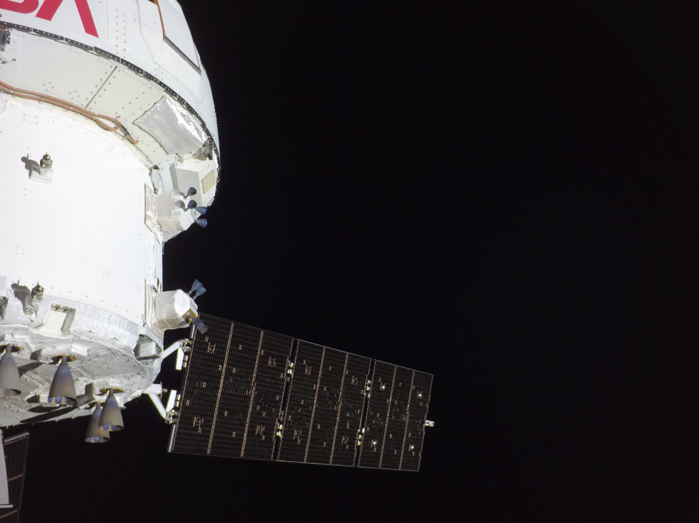

MARS call #3
NASA’s Orion spacecraft is pictured here from one of the cameras mounted on its solar array wings
April 7th, 2026 on 8:58 a.m. ET (mission day 7)
Image credit: JSC/NASA

Slide 137
MARS #3: HPI
A 31 y/o F astronaut presents on mission day 60 for erythema + calor on the skin surrounding a recent left elbow abrasion

Slide 138
MARS #3: HPI
A 31 y/o F astronaut presents on mission day 60 for erythema + calor on the skin surrounding a recent left elbow abrasion
A week ago, noticed a pimple over her elbow after a prolonged EVA
No overt lacerations or skin breakdown
In following days, noticed
Erythema developing around the area
Mild pain
EVA = “Spacewalk”
(Extravehicular Activity)

Slide 139
MARS #3: HPI
A 31 y/o F astronaut presents on mission day 60 for erythema + calor on the skin surrounding a recent left elbow abrasion
A week ago, noticed a pimple over her elbow after a prolonged EVA
No overt lacerations or skin breakdown
In following days, noticed
Erythema developing around the area
Mild pain
3 days ago, flight surgeon (at mission control) evaluated case
Felt to be skin and soft tissue infection
Recommended Augmentin
No improvement on antibiotics
EVA = “Spacewalk”
(Extravehicular Activity)

Slide 140
MARS #3: HPI
A 31 y/o F astronaut presents on mission day 60 for erythema + calor on the skin surrounding a recent left elbow abrasion
A week ago, noticed a pimple over her elbow after a prolonged EVA
No overt lacerations or skin breakdown
In following days, noticed
Erythema developing around the area
Mild pain
3 days ago, flight surgeon (at mission control) evaluated case
Felt to be skin and soft tissue infection
Recommended Augmentin
No improvement on antibiotics
EVA = “Spacewalk”
(Extravehicular Activity)

Slide 141
MARS #3: HPI
A 31 y/o F astronaut evaluated for abscess of left elbow that has been ongoing after prolonged EVA on mission day 60. On mission day 64, flight surgeon started Augmentin, with no improvement.
Mission control guides the crew medical officer (not a physician) on point of care ultrasound (day 67)
Identifies a 5mm abscess limited to SQ tissue
Performs an I&D with purulent discharge

Slide 142
MARS #3: HPI
A 31 y/o F astronaut evaluated for abscess of left elbow that has been ongoing after prolonged EVA on mission day 60. On mission day 64, flight surgeon started Augmentin, with no improvement.
Mission control guides the crew medical officer (not a physician) on point of care ultrasound (day 67)
Identifies a 5mm abscess limited to SQ tissue
Performs an I&D with purulent discharge
Pretend this was somehow available on board (unlikely to be the case)
Gram stain shows GPC in clusters
MecA testing was negative

Slide 143

MARS 3: Summary
What is the suspected pathogen?
Why isn’t she responding to Augmentin?
A 31 y/o F astronaut evaluated for abscess of left elbow that has been ongoing after prolonged EVA on mission day 60. On mission day 64, flight surgeon started Augmentin, with no improvement.
On day 67, POCUS shows 5mm abscess
I&D with purulent material
GPC in clusters on gram stain
MecA negative
T 37.6°C, HR 93, BP 100/64

Slide 144
MARS: Are the bacteria more virulent? [1]
Early in our ventures into space (Salyut 7), there was a great deal of concern that bacteria transformed into superbugs in space
Intuition: Hypermutations from radiation & stress of microgravity

Slide 145

MARS: Are the bacteria more virulent? [1]
Early in our ventures into space (Salyut 7), there was a great deal of concern that bacteria transformed into superbugs in space
In 1982, staph aureus isolates (seemingly) changed to appear morphologically similar to VISA
Intuition: Hypermutations from radiation & stress of microgravity

Slide 146
MARS: Are the bacteria more virulent? [1]
Early in our ventures into space (Salyut 7), there was a great deal of concern that bacteria transformed into superbugs in space
In 1982, staph aureus isolates (seemingly) changed to appear morphologically similar to VISA
Later studies found this to be a lab error
Intuition: Hypermutations from radiation & stress of microgravity

Slide 147

MARS: Are the bacteria more virulent? [1]
We can model microgravity pretty well on Earth using LSMMG
Mice studies with Salmonella found:
↑↑ acid tolerance
Faster colonization
↓↓ LD50
Similar findings for other gram negatives (Enterobacterales)
Low-Shear Modeled Microgravity
Ground based bioreactors (HARVs) simulate the space environment with constant suspension via rotation

Slide 148
MARS: Are the bacteria more virulent? [1]
We can model microgravity pretty well on Earth using LSMMG
Mice studies with Salmonella found:
↑↑ acid tolerance
Faster colonization
↓↓ LD50
Similar findings for other gram negatives (Enterobacterales)
Low-Shear Modeled Microgravity
Ground based bioreactors (HARVs) simulate the space environment with constant suspension via rotation

Slide 149



MARS: Are the bacteria more virulent? [1]
We can model microgravity pretty well on Earth using LSMMG
Mice studies with Salmonella found:
↑↑ acid tolerance
Faster colonization
↓↓ LD50
Similar findings for other gram negatives (Enterobacterales) [5]
Low-Shear Modeled Microgravity
LSMMG
Control
Ratio of survival in
acid stress (pH 3.5)

Slide 150
MARS: Are the bacteria more virulent? [1][5]
We can model microgravity pretty well on Earth using LSMMG
Might make gram negatives more virulent
For gram positives, microgravity seems to decrease virulence
Decreased hemolysins (MRSA)
Tendency to shift from planktonic → biofilm
Low-Shear Modeled Microgravity

Slide 151
MARS: Are the bacteria more virulent? [1][5]
We can model microgravity pretty well on Earth using LSMMG
Might make gram negatives more virulent
For gram positives, seems to decrease virulence
Low-Shear Modeled Microgravity
Spaceflight is more than microgravity
Numerous other factors in space, which are hard to replicate on Earth
Acceleration
Radiation
Electromagnetism
Vibration

Slide 152
MARS: Are the bacteria more virulent? [1][5]
We can model microgravity pretty well on Earth using LSMMG
Might make gram negatives more virulent
For gram positives, seems to decrease virulence
Low-Shear Modeled Microgravity
Spaceflight is more than microgravity
Acceleration
Radiation
Electromagnetism
Vibration
Good microbiology is hard in space
Specialized equipment = heavy
Limited space
Zero G = No convection
Astronaut time is at a premium
Contamination

Slide 153

MARS: Are the bacteria more virulent? [1][6]
We have studied worms in space
Roundworms brought to ISS
Did not make worm holes
AI generated image, but not a bad design for a roundworm (Nano Banana 2)
Notes:
Create an image of C. elegans (round worm) wearing a space suit, but instead of NASA it says "Nematode Aeronautics and Space Administration". The Nematode portion should be easily readable, and the spacesuit should look like it actually is practical for a roundworm

Slide 154
MARS: Are the bacteria more virulent? [1][6]
We have studied worms in space
Roundworms brought to ISS
Did not make worm holes
(vs ground) | Adult | Larvae
C albicans | ↓↓ (p=.06) | ↓↓
Listeria | ↓↓ | ↓↓
E faecalis | ↓↓ | ↓↓
MRSA | ↓↓ | ↓↓
AI generated image, but not a bad design for a roundworm (Nano Banana 2)
Notes:
Create an image of C. elegans (round worm) wearing a space suit, but instead of NASA it says "Nematode Aeronautics and Space Administration". The Nematode portion should be easily readable, and the spacesuit should look like it actually is practical for a roundworm

Slide 155


MARS: Are the bacteria more virulent? [1][6]
We have studied worms in space
Roundworms brought to ISS
Did not make worm holes
Spaceflight
Rotation
 | Spaceflight |  | Rotation
(vs ground) | Adult | Larvae | Adult | Larvae
C albicans | ↓↓ (p=.06) | ↓↓ | --- | ↓↓
Listeria | ↓↓ | ↓↓ | No change | No change
E faecalis | ↓↓ | ↓↓ | No change | ↓↓
MRSA | ↓↓ | ↓↓ | No change | No change
Notes:
Could not download the paper, but the table is on Semantic Scholar

Slide 156


MARS: If it’s not the pathogen, what is it? [1]
Antimicrobials on the ISS (in 2015)
Amikacin
Amoxicillin
Azithromycin
Bactrim
Vancomycin tablets
LSMMG on Earth [5]
Gram neg: ↑↑ virulence
Gram pos: ↓↓ virulence
Cefadroxil
Cipro
Flagyl
Many topicals
Nematodes [6]
Less susceptible to MRSA,
E faecalis, C albicans, and listeria

Slide 157

MARS: If it’s not the pathogen, what is it? [1]
Antimicrobials on the ISS (in 2015)
Amikacin
Amoxicillin
Azithromycin
Bactrim
Vancomycin tablets
LSMMG on Earth [5]
Gram neg: ↑↑ virulence
Gram pos: ↓↓ virulence
Cefadroxil
Cipro
Flagyl
Many topicals
Nematodes [6]
Less susceptible to MRSA,
E faecalis, C albicans, and listeria
1 in 12 don’t work
During the space shuttle program, 8% of medications were reported as non-efficacious
Medication stability
Medications don’t follow the same rules as on Earth

Slide 158
MARS: Medication stability in space [1]
The Study
35 formulations of medications
Compared Earth vs ISS
Stored for 28 months
Medication stability
Medications don’t follow the same rules as on Earth

Slide 159
MARS: Medication stability in space [1]
Findings
Substantial reduction in active ingredients were found in spaceflight medications compared to those kept on Earth
Augmentin
Bactrim
Medication stability
Medications don’t follow the same rules as on Earth

Slide 160
MARS: Medication stability in space [1]
Findings
Substantial reduction in active ingredients were found in spaceflight medications compared to those kept on Earth
Augmentin
Bactrim
Medication stability
Medications don’t follow the same rules as on Earth
Ionizing radiation
Production of reactive oxygen species & free radicals
Trace moisture from within the pill

Slide 161
MARS: Medication stability in space [1]
Findings
Substantial reduction in active ingredients were found in spaceflight medications compared to those kept on Earth
Augmentin
Bactrim
Medication stability
Medications don’t follow the same rules as on Earth
Ionizing radiation
Production of reactive oxygen species & free radicals
Degrades clavulonic acid
Oxidative stress
Trace moisture from within the pill

Slide 162
MARS: Medication stability in space [1]
Findings
Substantial reduction in active ingredients were found in spaceflight medications compared to those kept on Earth
Augmentin
Bactrim
Medication stability
Medications don’t follow the same rules as on Earth
Impact
Many of the medications in space would not pass US testing standards
Ionizing radiation
Production of reactive oxygen species & free radicals
Degrades clavulonic acid
Oxidative stress
Trace moisture from within the pill

Slide 163
Learning points & take aways

Slide 164


Learning points & take aways
Spaceflight causes functional immunocompromise
↓ T-cell function, lymphoid atrophy
↑ viral reactivation (HSV, VZV)
Shift in GI microbiome (↓ normal flora, ↑ gram-negatives)
Spacecraft can have a very dirty microbiome
Gram negatives (Pseudomonas, Burkholderia, Serratia), Candida, molds; even protozoa & spirochetes
Space affects both the humans and the pathogens
↓ convection → diffusion-dependent growth → stange biofilms
Some become more virulent (gram neg) but other become less virulent (gram pos)
Standard infection control processes may be less effective
Biofilms + fluid behavior limit sterilization
Outer space degrades medications (radiation + oxidation), making most ↓ potency over time; 1 in 12 are not effective
Slides available on hunterratliff1.com/talk/; Citations available via QR code or via the “citations” button on the website

