Slide 1
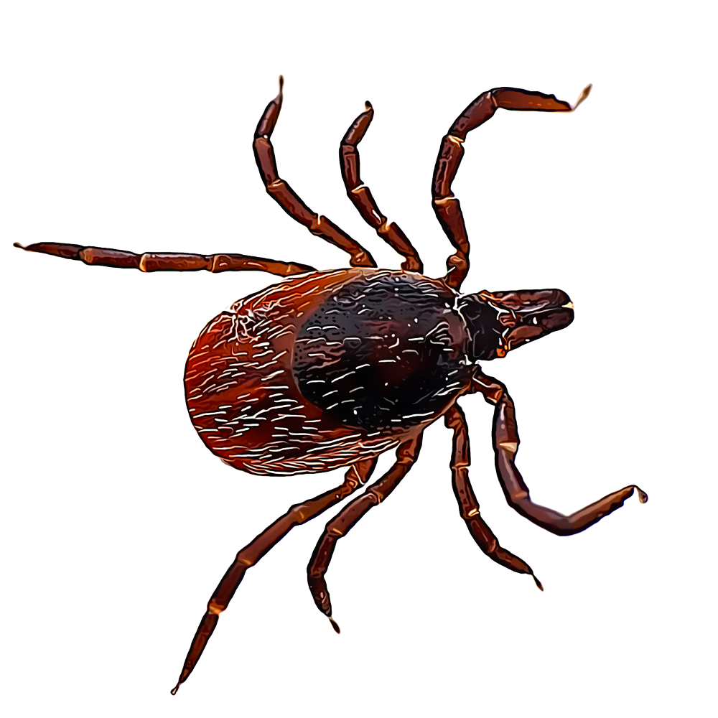

(s)TICK
season
CLINID conference
Hunter Ratliff
05/21/2026
Ages, dates, and other identifying information may have been changed
I have no conflict of interest in relation to this presentation

Slide 2

(s)TICK season
CLINID conference
Hunter Ratliff
05/21/2026
Ages, dates, and other identifying information may have been changed
I have no conflict of interest in relation to this presentation
Notes:
https://youtu.be/3qiI1P1rP6E?si=5rEWDG-D1659NMxM&t=34

Slide 3
Shortcuts
Case: Start | Summary 1 | prior to X-fer | H-score ||| final labs
Similar labs to anaplasmosis (HGA) HLH
HLH intro: Gentle intro | infectious triggers (start) | Dx criteria | treatment
Pathophys: Normal Th1 | +loop | w/ triggers | MΦ & ferritin | relation to Hscore
HGA-HLH: Cytokine levels | cellular activity | which ticks cause HLH
Takeaway slide
Key discussion slides
Main Topic | subtopic | subtopic
Main Topic | subtopic | subtopic
Main Topic | subtopic | subtopic

Slide 4

Notes:
https://youtu.be/3qiI1P1rP6E?si=5rEWDG-D1659NMxM&t=34

Slide 5
Case #1

Slide 6
Case 1: HPI
A 33 y/o M with PMH including obesity, OSA p/w five days of fever, cough, myalgias, diarrhea
USOH until 4 days PTA when he developed a nonproductive cough and myalgias
Despite cough, no dyspnea
Did feel like heart was racing/was having tachycardia (he is a medic)
Shortly after → fever & diarrhea
Diarrhea most bothersome
Really loose bowel movements with fecal incontinence (due to coughing).
He can not recall any rashes or skin changes, nor urinary changes

Slide 7
Case 1: Social history, exposures, & risk factors
Geographic & Travel | Lives 15 minutes NW of Uniontown, PA with female partner of many years No travel outside of country or recent domestic travel
Occupational | Works as EMT
Substance & needles | Former heavy EtOH a few years ago, rare EtOH now that on GLP-1 Never smoker, no drugs
Animals | Indoor cats Had construction in his home a few months ago and his cats find mice (but no exposure to rodent urine/feces)
Exposures | When not working, loves to spend time outdoors, including hiking, freshwater activities, and caves

Slide 8
Case 1: Social history, exposures, & risk factors
Geographic & Travel | Lives northwest of Uniontown with female partner. Never international, no recent travel
Occupational | Works as EMT
Substances | Remote heavy EtOH, rare EtOH now that on GLP-1. Never smoker, no drugs
Animals | Indoor cats. Recent construction. Cats will find mice, but no exposure to urine/feces
Exposures | Hiking: Does not regularly use bug spray when hiking, but can not recall finding any embedded ticks (but has seen ticks that were not embedded) Water: kayaking and canoeing - in freshwater Caves: A month ago, went to commercialized cave, might have been bats there

Slide 9
Case 1: Physical exam
BP | 127/84 | Pulse | 138 | SpO2 | 91 %
Temp | 39.7 °C (103.5 °F) | RR | 20 | BMI | 37 kg/m²
General | Alert and oriented, NAD, vitals reviewed
HEENT | NCAT; trachea appears midline, no gross LAD; EOMI
Resp | Normal respiratory effort, symmetric chest rise
CV | RRR; extremities perfused
GI | Non-distended; no TTP
Extremities | No clubbing, cyanosis, or edema
Neuro/MSK | Moves extremities
Psych | Normal mood; appropriate affect

Slide 10
Case 1: Labs
CBC | Result
WBC | 3.0
Hgb | 17.0
Platelets | 72
Neut % | 80%
Lymph % | 15%
Eos % | 0%
Chem7 | Result
Na | 125
K | 3.5
HCO3 | 17
BUN | 20
Cr | 1.7
LFTs | Result
AST | 335
ALT | 104
Alk Phos | 55
Bili | 1.1
Albumin | 3.5
Urine | Result
Heme | Pos
LeukEst | Neg
Protein | >1000
RBC | 0-2
WBC | 3-5
Other | Result
CRP | 215
Procal | 30.7
Other | Result
CK | 16,100

Slide 11
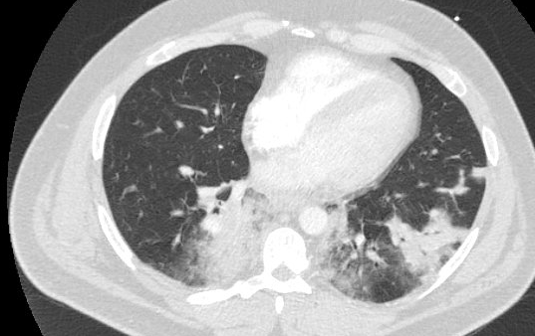
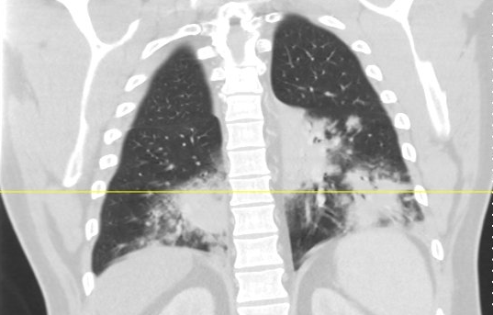
Case 1: Imaging
CT C/A/P w/wo (ED)

Slide 12
Case 1: Imaging
CT C/A/P w/wo (ED)
Multifocal airspace consolidation in the lower lobes concerning for atypical infection versus aspiration.
Hepatic steatosis.

Slide 13
Case 1: Imaging
CT C/A/P w/wo (ED)
Multifocal airspace consolidation in the lower lobes concerning for atypical infection versus aspiration.
Hepatic steatosis.
Lungs: Multifocal airspace consolidation in the lower lobes c/f atypical infection versus aspiration
Liver: Diffuse hypodensity of the liver suggesting hepatic steatosis
GI: Fibrofatty changes in the terminal ileitis suggesting chronic inflammation
Unremarkable: gallbladder, pancreas, spleen, adrenal glands, kidneys, GU, lymph nodes

Slide 14
Case 1: Summary
CBC/Inflm | Result
WBC | 3.0
Hgb | 17.0
Platelets | 72
CRP | 215
Procal | 30.7
Chem7 | Result
Na | 125
K | 3.5
HCO3 | 17
BUN | 20
Cr | 1.7
CK | 16k
A 33 y/o M with PMH including obesity, OSA p/w five days of cough + myalgias → high (103.5) fever + diarrhea. Stable vitals, non-toxic. CT C/A/P shows bilateral lower lobe pneumonia & terminal ileitis
Work=EMT, but play is…
Hiking (no bug spray), ?ticks
Freshwater (kayaking)
Caves (1 month ago), ?bats
Cats (mice?)
LFTs | Result
AST | 335
ALT | 104
Alk Phos | 55
Bili | 1.1
Albumin | 3.5

Slide 15
Case 1: Outside ED course
A 33 y/o M with PMH including obesity, OSA p/w five days of cough + myalgias → high (103.5) fever + diarrhea. Stable vitals, non-toxic. CT C/A/P shows bilateral lower lobe pneumonia & terminal ileitis
 | Result
COVID/Flu/RSV | Neg
Drug screen | Neg
EtOH | Neg
HIV screen | Neg
 | Result
Urine legionella | Neg
Hepatitis A | Neg
Hep B | Neg
Hep C | Neg
 | Result
GI biofire | Neg
Resp BF | Adenovirus
C diff | Neg

Slide 16
Case 1: Outside ED course
While in the ED, fever 103.5 °F (39.7 °C) → 106.3 °F (41.3 °C)
Rest of his vitals stable (still sinus tachycardia)
Nursing insists on taking tylenol
Patient declines tylenol or motrin
They try to give IV toradol → still says that he doesn’t need it
Recall, he works as EMT
This escalates…ends up in four point restraints

Slide 17
Case 1: Outside hospital course
A 33 y/o M with PMH including obesity, OSA p/w five days of cough + myalgias → high (103.5) fever + diarrhea. Stable vitals, non-toxic. CT C/A/P shows bilateral lower lobe pneumonia & terminal ileitis
Mildly low O2 sats → started nasal cannula
Continues to fever, but otherwise no new symptoms

Slide 18
Case 1: Outside hospital course
A 33 y/o M with PMH including obesity, OSA p/w five days of cough + myalgias → high (103.5) fever + diarrhea. Stable vitals, non-toxic. CT C/A/P shows bilateral lower lobe pneumonia & terminal ileitis
CMP | ED | #2 | #3 | #4
Na | 125
K | 3.5
HCO3 | 17
BUN | 20
Cr | 1.7
AST | 335
ALT | 104
ALkP | 55
Bili | 1.1
CBC/Inflm | ED | #2 | #3 | #4
WBC | 3.0
Hgb | 17
Platelets | 72
# Lymph | 0.45
CRP | 215
Procal | 30.7
CK | 16k

Slide 19
Case 1: Outside hospital course
A 33 y/o M with PMH including obesity, OSA p/w five days of cough + myalgias → high (103.5) fever + diarrhea. Stable vitals, non-toxic. CT C/A/P shows bilateral lower lobe pneumonia & terminal ileitis
CMP | ED | #2 | #3 | #4
Na | 125
K | 3.5
HCO3 | 17
BUN | 20
Cr | 1.7
AST | 335
ALT | 104
ALkP | 55
Bili | 1.1
CBC/Inflm | ED | #2 | #3 | #4
WBC | 3.0 | 4.1
Hgb | 17 | 15.4
Platelets | 72 | 75
# Lymph | 0.45 | 0.41
CRP | 215 | ---
Procal | 30.7 | ---
CK | 16k | 18k

Slide 20
Case 1: Outside hospital course
A 33 y/o M with PMH including obesity, OSA p/w five days of cough + myalgias → high (103.5) fever + diarrhea. Stable vitals, non-toxic. CT C/A/P shows bilateral lower lobe pneumonia & terminal ileitis
CMP | ED | #2 | #3 | #4
Na | 125
K | 3.5
HCO3 | 17
BUN | 20
Cr | 1.7
AST | 335
ALT | 104
ALkP | 55
Bili | 1.1
CBC/Inflm | ED | #2 | #3 | #4
WBC | 3.0 | 4.1 | 2.5
Hgb | 17 | 15.4 | 14.3
Platelets | 72 | 75 | 46
# Lymph | 0.45 | 0.41 | 0.73
CRP | 215 | --- | 215
Procal | 30.7 | --- | ---
CK | 16k | 18k | 21k

Slide 21
Case 1: Outside hospital course
A 33 y/o M with PMH including obesity, OSA p/w five days of cough + myalgias → high (103.5) fever + diarrhea. Stable vitals, non-toxic. CT C/A/P shows bilateral lower lobe pneumonia & terminal ileitis
CMP | ED | #2 | #3 | #4
Na | 125
K | 3.5
HCO3 | 17
BUN | 20
Cr | 1.7
AST | 335
ALT | 104
ALkP | 55
Bili | 1.1
CBC/Inflm | ED | #2 | #3 | #4
WBC | 3.0 | 4.1 | 2.5 | 3.4
Hgb | 17 | 15.4 | 14.3 | 12.5
Platelets | 72 | 75 | 46 | 42
# Lymph | 0.45 | 0.41 | 0.73 | 0.65
CRP | 215 | --- | 215 | 345
Procal | 30.7 | --- | --- | 59.9
CK | 16k | 18k | 21k | 19k

Slide 22
Case 1: Outside hospital course
A 33 y/o M with PMH including obesity, OSA p/w five days of cough + myalgias → high (103.5) fever + diarrhea. Stable vitals, non-toxic. CT C/A/P shows bilateral lower lobe pneumonia & terminal ileitis
CMP | ED | #2 | #3 | #4
Na | 125 | 132
K | 3.5 | 3.4
HCO3 | 17 | 14
BUN | 20 | 18
Cr | 1.7 | 1.4
AST | 335 | 334
ALT | 104 | 105
ALkP | 55 | 49
Bili | 1.1 | 0.7
CBC/Inflm | ED | #2 | #3 | #4
WBC | 3.0 | 4.1 | 2.5 | 3.4
Hgb | 17 | 15.4 | 14.3 | 12.5
Platelets | 72 | 75 | 46 | 42
# Lymph | 0.45 | 0.41 | 0.73 | 0.65
CRP | 215 | --- | 215 | 345
Procal | 30.7 | --- | --- | 59.9
CK | 16k | 18k | 21k | 19k

Slide 23
Case 1: Outside hospital course
A 33 y/o M with PMH including obesity, OSA p/w five days of cough + myalgias → high (103.5) fever + diarrhea. Stable vitals, non-toxic. CT C/A/P shows bilateral lower lobe pneumonia & terminal ileitis
CMP | ED | #2 | #3 | #4
Na | 125 | 132 | 135
K | 3.5 | 3.4 | 4.4
HCO3 | 17 | 14 | 16
BUN | 20 | 18 | 23
Cr | 1.7 | 1.4 | 1.27
AST | 335 | 334 | 481
ALT | 104 | 105 | 135
ALkP | 55 | 49 | 41
Bili | 1.1 | 0.7 | 1.1
CBC/Inflm | ED | #2 | #3 | #4
WBC | 3.0 | 4.1 | 2.5 | 3.4
Hgb | 17 | 15.4 | 14.3 | 12.5
Platelets | 72 | 75 | 46 | 42
# Lymph | 0.45 | 0.41 | 0.73 | 0.65
CRP | 215 | --- | 215 | 345
Procal | 30.7 | --- | --- | 59.9
CK | 16k | 18k | 21k | 19k

Slide 24
Case 1: Outside hospital course
A 33 y/o M with PMH including obesity, OSA p/w five days of cough + myalgias → high (103.5) fever + diarrhea. Stable vitals, non-toxic. CT C/A/P shows bilateral lower lobe pneumonia & terminal ileitis
CMP | ED | #2 | #3 | #4
Na | 125 | 132 | 135 | 133
K | 3.5 | 3.4 | 4.4 | 3.4
HCO3 | 17 | 14 | 16 | 17
BUN | 20 | 18 | 23 | 25
Cr | 1.7 | 1.4 | 1.27 | 0.98
AST | 335 | 334 | 481 | 538
ALT | 104 | 105 | 135 | 125
ALkP | 55 | 49 | 41 | 37
Bili | 1.1 | 0.7 | 1.1 | 1.2
CBC/Inflm | ED | #2 | #3 | #4
WBC | 3.0 | 4.1 | 2.5 | 3.4
Hgb | 17 | 15.4 | 14.3 | 12.5
Platelets | 72 | 75 | 46 | 42
# Lymph | 0.45 | 0.41 | 0.73 | 0.65
CRP | 215 | --- | 215 | 345
Procal | 30.7 | --- | --- | 59.9
CK | 16k | 18k | 21k | 19k

Slide 25
Case 1: Outside hospital course
A 33 y/o M with PMH including obesity, OSA p/w five days of cough + myalgias → high (103.5) fever + diarrhea. Stable vitals, non-toxic. CT C/A/P shows bilateral lower lobe pneumonia & terminal ileitis
CMP | ED | #2 | #3 | #4
Na | 125 | 132 | 135 | 133
K | 3.5 | 3.4 | 4.4 | 3.4
HCO3 | 17 | 14 | 16 | 17
BUN | 20 | 18 | 23 | 25
Cr | 1.7 | 1.4 | 1.27 | 0.98
AST | 335 | 334 | 481 | 538
ALT | 104 | 105 | 135 | 125
ALkP | 55 | 49 | 41 | 37
Bili | 1.1 | 0.7 | 1.1 | 1.2
CBC/Inflm | ED | #2 | #3 | #4
WBC | 3.0 | 4.1 | 2.5 | 3.4
Hgb | 17 | 15.4 | 14.3 | 12.5
Platelets | 72 | 75 | 46 | 42
# Lymph | 0.45 | 0.41 | 0.73 | 0.65
CRP | 215 | --- | 215 | 345
Procal | 30.7 | --- | --- | 59.9
CK | 16k | 18k | 21k | 19k
 | Result
Ferritin | 7,088
Triglycerides | 173
LDH | 1,501

Slide 26
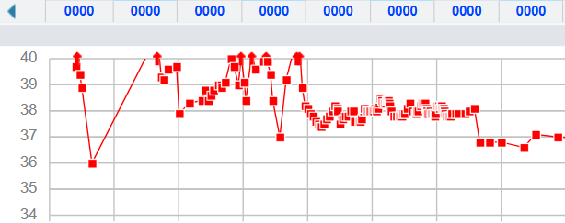
Case 1: Outside hospital course
Continues to fever despite:
Unasyn → Zosyn
Doxycycline
Azithro
Doxycycline
AMP/
SUL
Zosyn
Azithro (500)
ED
2
3
4
Then SpO2 begins to worsen
38 C

Slide 27
Case 1: Summary
CMP
Na | 125 ± 132
K | 3’s
HCO3 | 17 ± 2
BUN | 20s
Cr | 1.7 → 1.0
AST | 335 → 538
ALT | 104 → 125
ALkP | 40-50s
Bili | 1.0 ± 0.2
CBC/inflammatory
WBC | 3.0 ± 1
Hgb | 17 → 12
PLT | 72 → 42
CRP | 215 → 345
PCT | 30.7 → 59.9
CK | 21k (peak)
A 33 y/o M with PMH including obesity, OSA p/w five days of cough + myalgias → high (103.5) fever + diarrhea. Stable vitals, non-toxic. CT C/A/P shows bilateral lower lobe pneumonia & terminal ileitis
Continues to fever, worsening O2
Doxycycline
AMP/
SUL
Zosyn
Azithro (500)
ED
2
3
4
u-Legionella | Neg
GI biofire | Neg
Cv/Flu/RSV | Neg
HIV & Hep A-C | Neg
Ferritin | 7,088
LDH | 1,501

Slide 28
Case 1: Outside hospital course → Ruby MICU
Guess what the folks at Ruby did to cure the fever?
Doxycycline
AMP/
SUL
Zosyn
Azithro (500)
ED
2
3
4
Ruby
6
7
8
38 C

Slide 29
Case 1: Outside hospital course → Ruby MICU
Guess what the folks at Ruby did to cure the fever?
Doxycycline
AMP/
SUL
Zosyn
Dexamethasone
Azithro (500)
ED
2
3
4
Ruby
6
7
8
Antipyretics!!
Probs cooling blanket too

Slide 30
Case 1: Outside hospital course → Ruby MICU
Guess what the folks at Ruby did to cure the fever?
Doxycycline
AMP/
SUL
Zosyn
Dexamethasone
Azithro (500)
Levofloxacin
ED
2
3
4
Ruby
6
7
8
Antipyretics!!
(and levaquin)
Probs cooling blanket too

Slide 31
Case 1: Ruby MICU
Just prior to transfer, was started on high flow → BiPap
Wheezing on admission to MICU → intubated

Slide 32
Case 1: Ruby MICU
Just prior to transfer, was started on high flow → BiPap
Wheezing on admission to MICU → intubated
Hematology consulted for possible HLH
H-score is high
HScore for HLH |  | +0
Known underlying immunosuppression | ???
Temperature, °F | ???
Hepato/spleno-megaly | ???
Number of cytopenias | ???
Ferritin | ???
Triglycerides | ???
Fibrinogen | ???
AST | ???
Bone marrow Bx | ???

Slide 33
Case 1: Ruby MICU
Just prior to transfer, was started on high flow → BiPap
Wheezing on admission to MICU → intubated
Hematology consulted for possible HLH
H-score is high
70-80% chance of HLH
They order some sendout labs
HScore for HLH |  | +186
Known underlying immunosuppression | No
Temperature, °F | >102.9 | +49
Hepato/spleno-megaly | Neither
Number of cytopenias | 2 lines | +24
Ferritin | >6,000 | +50
Triglycerides | 132 - 354 | +44
Fibrinogen | >250
AST | >30 | +19
Bone marrow Bx | TBD

Slide 34
Case 1: Ruby MICU
Just prior to transfer, was started on high flow → BiPap
Wheezing on admission to MICU → intubated
Hematology consulted for possible HLH
H-score is high
70-80% chance of HLH
They order some sendout labs
MICU starts on steroids
Quickly extubated next day (got tons of IV fluids for treatment of rhabdo)
HScore for HLH |  | +186
Known underlying immunosuppression | No
Temperature, °F | >102.9 | +49
Hepato/spleno-megaly | Neither
Number of cytopenias | 2 lines | +24
Ferritin | >6,000 | +50
Triglycerides | 132 - 354 | +44
Fibrinogen | >250
AST | >30 | +19
Bone marrow Bx | TBD

Slide 35
What’s going on?

Slide 36
Ticks
Viral
Bacterial
Anaplasmosis
ds-DNA
(HSV, VZV, EBV)
Legionella
Lyme
Spirochete
(besides lyme)
HIV
Other
Other
Other
Non-infectious
Other infections
Autoimmune
Parasitic
Malignancy
Histoplasmosis
Drugs
Others

Slide 37
Case 1: Further workup
CMP
Na | 125 ± 132
K | 3’s
HCO3 | 17 ± 2
BUN | 20s
Cr | 1.7 → 1.0
AST | 335 → 538
ALT | 104 → 125
ALkP | 40-50s
Bili | 1.0 ± 0.2
Serologies | IgM | IgG
Lyme
Ehrlichia
Anaplasma
RMSF
CBC/inflammatory
WBC | 3.0 ± 1
Hgb | 17 → 12
PLT | 72 → 42
CRP | 215 → 345
PCT | 30.7 → 59.9
CK | 21k (peak)
Other
Parasite smear
Monospot
u-Legionella | Neg
GI biofire | Neg
Cv/Flu/RSV | Neg
HIV & Hep A-C | Neg
Biofires | Result
GI PCR | Neg
Resp PCR | Adeno

Slide 38
Case 1: Further workup
CMP
Na | 125 ± 132
K | 3’s
HCO3 | 17 ± 2
BUN | 20s
Cr | 1.7 → 1.0
AST | 335 → 538
ALT | 104 → 125
ALkP | 40-50s
Bili | 1.0 ± 0.2
Serologies | IgM | IgG
Lyme | Pos | Neg
Ehrlichia | ? | ?
Anaplasma | ? | ?
RMSF | ? | ?
CBC/inflammatory
WBC | 3.0 ± 1
Hgb | 17 → 12
PLT | 72 → 42
CRP | 215 → 345
PCT | 30.7 → 59.9
CK | 21k (peak)
Other
Parasite smear
Monospot
u-Legionella | Neg
GI biofire | Neg
Cv/Flu/RSV | Neg
HIV & Hep A-C | Neg
Biofires | Result
GI PCR | Neg
Resp PCR | Adeno

Slide 39
Case 1: Further workup
CMP
Na | 125 ± 132
K | 3’s
HCO3 | 17 ± 2
BUN | 20s
Cr | 1.7 → 1.0
AST | 335 → 538
ALT | 104 → 125
ALkP | 40-50s
Bili | 1.0 ± 0.2
Serologies | IgM | IgG
Lyme | Pos | Neg
Ehrlichia | ? | ?
Anaplasma | ? | ?
RMSF | ? | ?
CBC/inflammatory
WBC | 3.0 ± 1
Hgb | 17 → 12
PLT | 72 → 42
CRP | 215 → 345
PCT | 30.7 → 59.9
CK | 21k (peak)
Other | Result
Parasite smear | Neg
Monospot | Neg
u-Legionella | Neg
GI biofire | Neg
Cv/Flu/RSV | Neg
HIV & Hep A-C | Neg
Biofires | Result
GI PCR | Neg
Resp PCR | Adeno

Slide 40

Do ticks cause HLH?

Slide 41
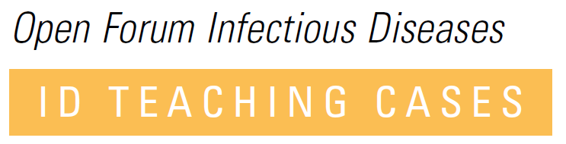
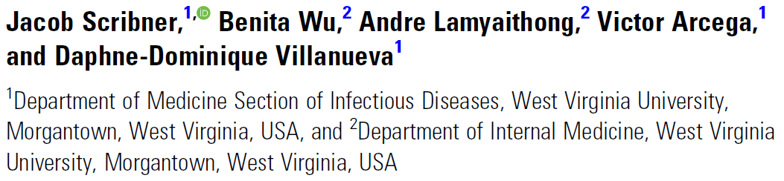
Lit review
When I saw this case, I came across a wonderful case report of Anaplasmosis-HLH
Anaplasmosis-Induced Hemophagocytic Lymphohistiocytosis: A Case Report and Review of the Literature

Slide 42
Lit review
When I saw this case, I came across a wonderful case report of Anaplasmosis-HLH
Case of HLH (confirmed by biopsy) from WVU
So I compared the labs…
Anaplasmosis-Induced Hemophagocytic Lymphohistiocytosis: A Case Report and Review of the Literature

Slide 43
Comparing with the case report [1]
Admit labs | Our patient
WBC | 3.0
Hgb | 17.0
Platelets | 72
Creat | 1.7
AST | 335
ALT | 104

Slide 44
Comparing with the case report [1]
Admit labs | Our patient | Case report
WBC | 3.0 | 3.3
Hgb | 17.0 | 13.9
Platelets | 72 | 16
Creat | 1.7 | 3.96
AST | 335 | 330
ALT | 104 | 183

Slide 45
Comparing with the case report [1]
Admit labs | Our patient | Case report
WBC | 3.0 | 3.3
Hgb | 17.0 | 13.9
Platelets | 72 | 16
Creat | 1.7 | 3.96
AST | 335 | 330
ALT | 104 | 183
Admission labs | Our patient | Case report | Normal range | In HLH
Ferritin | 8,830 (29 x ULN) | >33,511 (>110 x ULN) | 20-300 | ↑↑↑
Triglycerides | 173 | 448 | <150 | ↑
Fibrinogen | 697 | 256 | 200 - 400 | ↓
LDH | 1,501 | 1,337 | 125 - 220 | ↑
Soluble IL-2 receptor | 6,180 (7 x ULN) | 31,673 (37 x ULN) | 175 - 858 | ↑↑↑
D-dimer | --- | >5000 | <233 | ↑

Slide 46
Comparing with the case report [1]
Admit labs | Our patient | Case report
WBC | 3.0 | 3.3
Hgb | 17.0 | 13.9
Platelets | 72 | 16
Creat | 1.7 | 3.96
AST | 335 | 330
ALT | 104 | 183
Admission labs | Our patient | Case report | Normal range | In HLH
Ferritin | 8,830 (29 x ULN) | >33,511 (>110 x ULN) | 20-300 | ↑↑↑
Triglycerides | 173 | 448 | <150 | ↑
Fibrinogen | 697 | 256 | 200 - 400 | ↓
LDH | 1,501 | 1,337 | 125 - 220 | ↑
Soluble IL-2 receptor | 6,180 (7 x ULN) | 31,673 (37 x ULN) | 175 - 858 | ↑↑↑
D-dimer | --- | >5000 | <233 | ↑

Slide 47
Comparing with the case report [1]
Admit labs | Our patient | Case report
WBC | 3.0 | 3.3
Hgb | 17.0 | 13.9
Platelets | 72 | 16
Creat | 1.7 | 3.96
AST | 335 | 330
ALT | 104 | 183
Admission labs | Our patient | Case report | Normal range | In HLH
Ferritin | 8,830 (29 x ULN) | >33,511 (>110 x ULN) | 20-300 | ↑↑↑
Triglycerides | 173 | 448 | <150 | ↑
Fibrinogen | 697 | 256 | 200 - 400 | ↓
LDH | 1,501 | 1,337 | 125 - 220 | N/A
Soluble IL-2 receptor | 6,180 (7 x ULN) | 31,673 (37 x ULN) | 175 - 858 | ↑↑↑
D-dimer | --- | >5000 | <233 | N/A
Also made me wonder how often we only look at these numbers

Slide 48
Hemophagocytic Lympho-
Histiocytosis
What is HLH?
Diagnosis of HLH
Triggers for HLH
A closer look at the pathophys

Slide 49
What is HLH? [2]
Med student explanation
Immune system getting “stuck in the ON position”
Uncontrolled immune activation →
Cytokine storm →
Organ damage
Mediated by NK, cytotoxic T cells, and macrophages

Slide 50

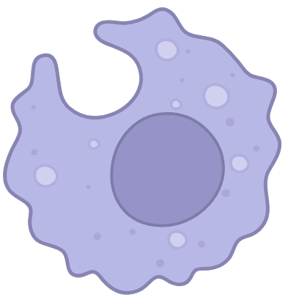

What is HLH? [2]
Med student explanation
Immune system getting “stuck in the ON position”
Uncontrolled immune activation →
Cytokine storm →
Organ damage
Mediated by NK, cytotoxic T cells, and macrophages
Clues: sky high ferritin, fevers, cytopenias
“Hemophagocytic” = macrophages phagocytosis blood cells in marrow/spleen

Slide 51



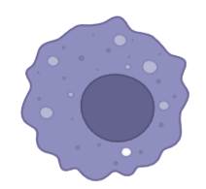


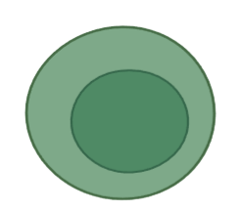
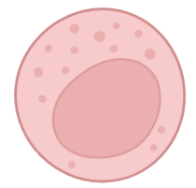
What is HLH? [2]
Cytokines
Macrophages
Intern explanation
Pathophys:
Impaired cytotoxic function (NK/CD8) → macrophage activation
Massive cytokine release (IFN-γ, IL-6) that can mimic sepsis
MΦ
Stimulates
Stimulates
Stimulates
IFN-γ
Releases
Apoptosis
CD8+
NK
Natural killer cells
Cytotoxic T cells

Slide 52
What is HLH? [2]
Cytokines
Macrophages
Intern explanation
Pathophys:
Impaired cytotoxic function (NK/CD8) → macrophage activation
Massive cytokine release (IFN-γ, IL-6) that can mimic sepsis
Can be genetic or secondary to a trigger:
Infectious (viral; not bacteremia)
Malignancy (lymphoma)
Rheum (called macrophage activation syndrome)
Reality: a mix of genes + trigger
MΦ
Stimulates
Stimulates
Stimulates
IFN-γ
Releases
Apoptosis
CD8+
NK
Natural killer cells
Cytotoxic T cells

Slide 53
HLH diagnostic criteria [2]
HScore
Known underlying immunosuppression
Temperature, °F
Hepato/spleno-megaly
Number of cytopenias
Ferritin
Triglycerides
Fibrinogen
AST
Bone marrow Bx
HLH-2004 (need >5)
Fever
Splenomegaly
Cytopenias (≥2 lineages)
Either (or both)
↑ triglycerides
↓ fibrinogen
Hemophagocytosis (BMBx, spleen, LN)
↓ NK cell activity
↑ Ferritin (≥500)
↑ Soluble IL-2 receptor
Included just FYI
The exact measures aren’t as important (normally heme who “officially” does the diagnosis)

Slide 54
What triggers HLH? [7]
In pooled systematic review of critically ill patients:
Half had an infectious trigger
Malignancy: 28%
Autoimmune: 12%
Unknown: 10%
Infectious
Malignancy
Auto-
immune
Unk

Slide 55
What triggers HLH? [7]
Viral
Other
EBV (12%)
CMV (3.3%), flu (2.1%)
Infectious
Malignancy
Auto-
immune
Unk

Slide 56
What triggers HLH? [7]
Not listed
Viral
Bacterial
EBV (12%)
CMV (3.3%), flu (2.1%)
Bacterial (10.1%)
Lymphoma is twice as common (21%)
Fungal (2.9%)
On par with Adult-onset Still (2.6%)
Infectious
Fungal
EBV
CMV
Flu
Lymphoma
SLE
Malignancy
Autoimmune
Unk

Slide 57
What triggers HLH? [7]
Not listed
Viral
Bacterial
EBV (12%)
CMV (3.3%), flu (2.1%)
Bacterial (10.1%)
Lymphoma is twice as common (21%)
Fungal (2.9%)
On par with Adult-onset Still (2.6%)
Infectious
Fungal
EBV
CMV
Flu
Lymphoma
SLE
Limitation
They did not give a full breakdown of the infections
Malignancy
Autoimmune
Unk

Slide 58
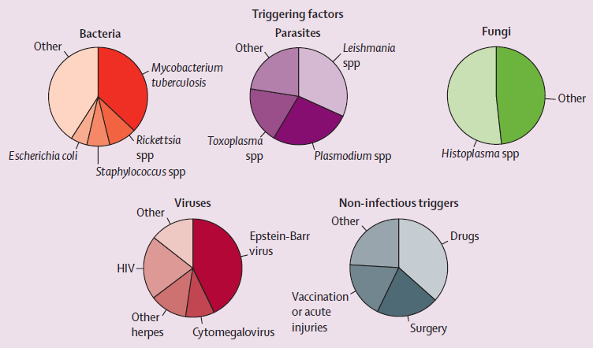
Which infections trigger HLH? [8]

Slide 59
Which infections trigger HLH? [8]
Infectious HLH triggers
Parasites (4.8%)
Fungal (3.3%)
Viral (69%)
Bacterial (18.6%)

Slide 60
Which infections trigger HLH? [8]
Viral triggers
Fungal, parasites, other
HIV
EBV
Viral (69%)
EBV (30%)
HIV (15%)
HSV (6.7%)
CMV (6.2%)
Other / not specified (6.1%)
Viral hepatitis (1.8%)
Influenza (1.3%)
Parvo B19 (1.3%)
HSV / CMV
Other viral
Bacterial
triggers

Slide 61
Which infections trigger HLH? [8]
Viral triggers
Strongest association with DNA viruses [3]:
Herpesviruses
(EBV > CMV > VZV, HHV-6, HHV-8)
Followed by other DNA viruses (parvo B19, adenoviruses)
Fungal, parasites, other
HIV
EBV
Viral (69%)
EBV (30%)
HIV (15%)
HSV (6.7%)
CMV (6.2%)
Other / not specified (6.1%)
Viral hepatitis (1.8%)
Influenza (1.3%)
Parvo B19 (1.3%)
EBV (30%)
HSV (6.7%)
CMV (6.2%)
Parvo B19 (1.3%)
HSV / CMV
Lesser extent RNA viruses [3]:
HIV
Influenza
Dengue
Hepatitis C
Other viral
Bacterial
triggers

Slide 62
Which infections trigger HLH? [8]
Herpesvirus family
Viral (69%)
EBV (30%)
HIV (15%)
HSV / CMV (15%)
Other / unk (6.1%)
Viral hepatitis (1.8%)
Influenza (1.3%)
Parvo B19 (1.3%)
Bacterial (18.6%)
TB (7.0%)
Other / not specified (7.7%)
Rickettsia spp (1.5%)
Staph spp (1.4%)
E coli (1.0%)
?
Unk
?
?
?
?
?
?
HIV
Other viral
TB

Slide 63
Which infections trigger HLH? [8]
Parasites (4.8%)
Leishmania (1.5%)
Malaria (1.3%)
Toxo (0.9%)
Herpesvirus family
Viral (69%)
EBV (30%)
HIV (15%)
HSV / CMV (15%)
Other / unk (6.1%)
Viral hepatitis (1.8%)
Influenza (1.3%)
Parvo B19 (1.3%)
Fungi (3.3%)
Histo (1.6%)
Other (1.7%)
Bacterial (18.6%)
TB (7.0%)
Other / not specified (7.7%)
Rickettsia (1.5%)
?
Unk
?
?
?
?
?
?
HIV
Other viral
TB

Slide 64
Which infections trigger HLH? [8]
Parasites (4.8%)
Leishmania (1.5%)
Malaria (1.3%)
Toxo (0.9%)
Herpesvirus family
Viral (69%)
EBV (30%)
HIV (15%)
HSV / CMV (15%)
Other / unk (6.1%)
Viral hepatitis (1.8%)
Influenza (1.3%)
Parvo B19 (1.3%)
Fungi (3.3%)
Histo (1.6%)
Other (1.7%)
Intracellular pathogens
Bacterial (18.6%)
TB (7.0%)
Other / not specified (7.7%)
Rickettsia (1.5%)
?
Unk
?
?
?
?
?
?
HIV
Other viral
TB

Slide 65
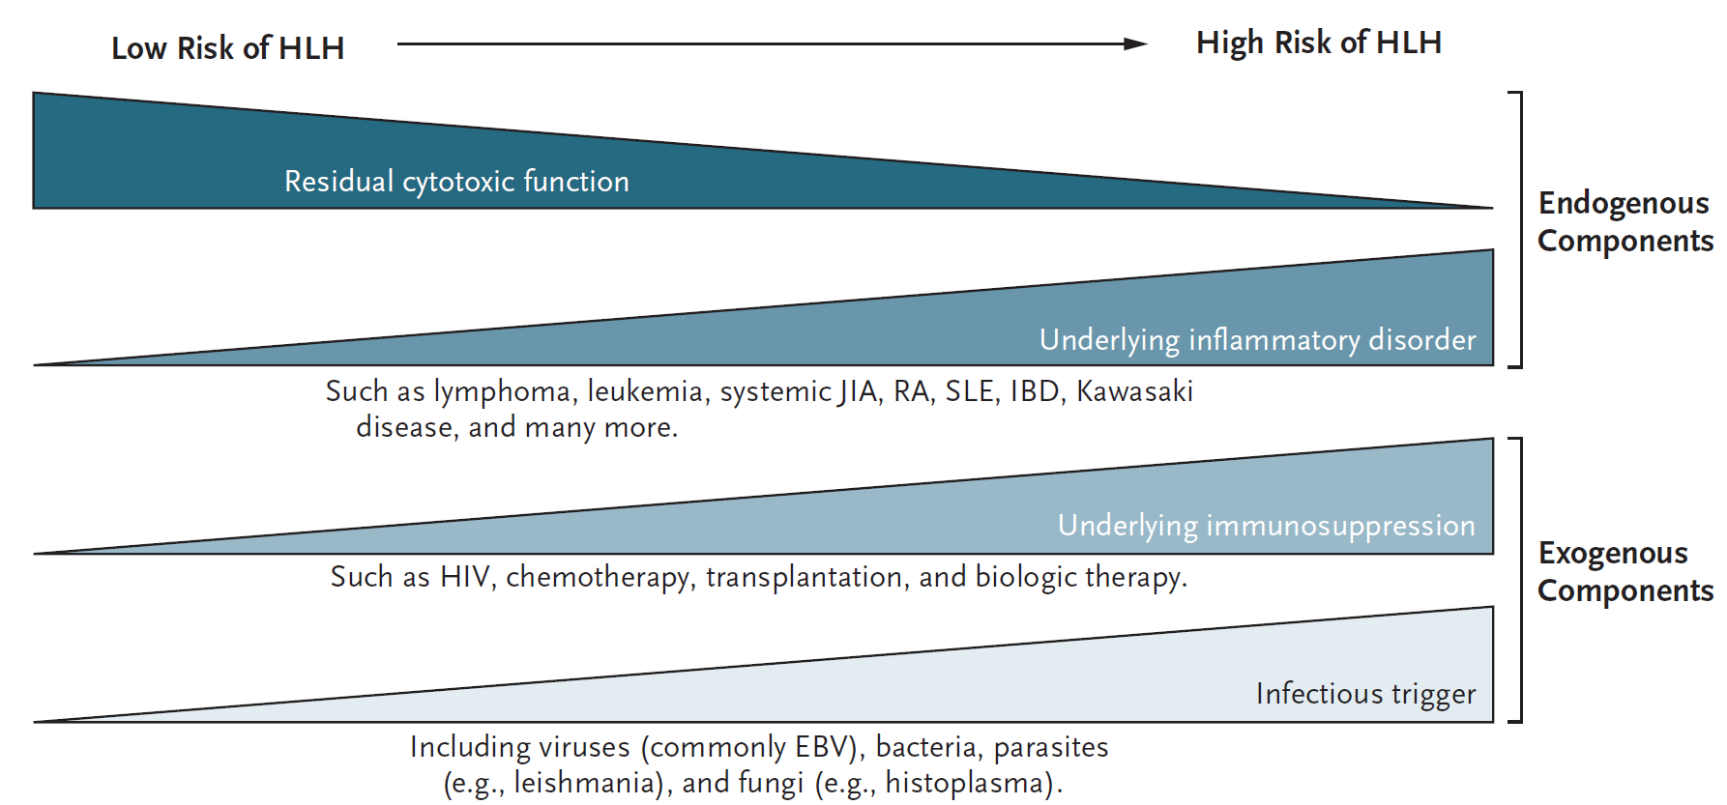
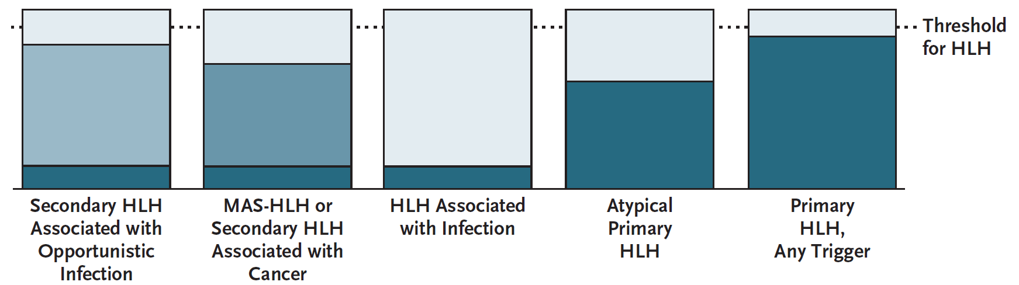
In reality, HLH exists on a spectrum and is multifactorial (i.e. not just infection or just cancer)
Figure 3: [2] Henter, 2025

Slide 66
Treatment of HLH
±
Subgroup analysis (of pooled systematic review) [7]
Infectious: IVIG reduced mortality 45%; chemo 7.6-fold increase
All others: No change (for better or worse)
Limited data on the role for immunosuppression with anaplasmosis [1]
Sepsis associated HLH, treating sepsis + anakinra has reduced mortality [2]
Primary HLH
(genetic form)
Steroids
Etoposide
Secondary HLH
Steroids
±
Chemo
Treat
underlying cause
&/or
&/or
IVIG
±
Immune
therapy

Slide 67
Refresher on the case…

Slide 68
Case 1: Summary
CMP
BUN | 20s
Cr | 1.7 → 1.0
AST | 335 → 538
ALT | 104 → 125
ALkP | 40-50s
Bili | 1.0 ± 0.2
CBC/inflammatory
WBC | 3.0 ± 1
Hgb | 17 → 12
PLT | 72 → 42
CRP | 215 → 345
PCT | 30.7 → 59.9
A healthy 33 y/o M p/w five days of cough + myalgias → high fever (103.5) + diarrhea. CT: pneumonia in bilateral lower lobes & terminal ileitis. Dx with HLH → improving with steroids
Ferritin | 7,088
LDH | 1,501
Work=EMT, but play is…
Hiking (no bug spray), ticks
Lyme IgM (+), lives in PA
Freshwater (kayaking)
Caves (1 month ago), ?bats
Cats (mice?)
Doxycycline
AMP/
SUL
Zosyn
Dexamethasone
Azithro (500)
ED
2
3
4
Ruby
6
7
8

Slide 69
Case 1: Further workup
CMP
Na | 125 ± 132
K | 3’s
HCO3 | 17 ± 2
BUN | 20s
Cr | 1.7 → 1.0
AST | 335 → 538
ALT | 104 → 125
ALkP | 40-50s
Bili | 1.0 ± 0.2
Serologies | IgM | IgG
Lyme | Pos | Neg
Ehrlichia | ? | ?
Anaplasma | ? | ?
RMSF | ? | ?
CBC/inflammatory
WBC | 3.0 ± 1
Hgb | 17 → 12
PLT | 72 → 42
CRP | 215 → 345
PCT | 30.7 → 59.9
CK | 21k (peak)
Other | Result
Parasite smear | Neg
Monospot | Neg
u-Legionella | Neg
GI biofire | Neg
Cv/Flu/RSV | Neg
HIV & Hep A-C | Neg
BMBx
CMV PCR | ?
EBV PCR | ?
Flow cyto | ?
Serum PCRs
Pending
Biofires | Result
GI PCR | Neg
Resp PCR | Adeno

Slide 70
Pathophysiology of “HLH”
The focus is full-blown HLH, but would think of it as “broken loop of Th1 cytokine storm”, including:
HLH
Macrophage activation syndrome
Cytokine release syndrome

Slide 71

Normal Th1 response [2]
Normal Th1 response
Positive loops
HLH triggers
MΦ & ferritin
Clinical manifestations
Antigen presenting cells
Macrophages
MΦ
CD8+
Cytotoxic T cells

Slide 72

Normal Th1 response [2]
Normal Th1 response
Positive loops
HLH triggers
MΦ & ferritin
Clinical manifestations
Infected APCs
Macrophages
Infected cells present antigens and activate macrophages via PAMPs (pathogen-associated molecular patterns)
Activates
MΦ
CD8+
Cytotoxic T cells

Slide 73
Normal Th1 response [2]
Normal Th1 response
Positive loops
HLH triggers
MΦ & ferritin
Clinical manifestations
Infected APCs
Macrophages
Infected cells present antigens and activate macrophages via PAMPs (pathogen-associated molecular patterns)
Antigen-specific CD8+ T cells are recruited and…
Activates
MΦ
Stimulates
CD8+
Cytotoxic T cells

Slide 74
Normal Th1 response [2]
Normal Th1 response
Positive loops
HLH triggers
MΦ & ferritin
Clinical manifestations
Infected APCs
Macrophages
Infected cells present antigens and activate macrophages via PAMPs (pathogen-associated molecular patterns)
Antigen-specific CD8+ T cells are recruited and…
Kill infected cells directly
Secrete interferon gamma
Activates
MΦ
Stimulates
Kills
Kills
IFN-γ
Releases
CD8+
Cytotoxic T cells

Slide 75
Normal Th1 response [2]
Normal Th1 response
Positive loops
HLH triggers
MΦ & ferritin
Clinical manifestations
Infected APCs
Macrophages
Infected cells present antigens and activate macrophages via PAMPs (pathogen-associated molecular patterns)
Antigen-specific CD8+ T cells are recruited and…
Kill infected cells directly
Secrete interferon gamma
IFN-γ in turn will…
Potent activator of macrophages
Activates
MΦ
Stimulates
Stimulates
Kills
IFN-γ
Releases
CD8+
Cytotoxic T cells

Slide 76
Normal Th1 response [2]
Normal Th1 response
Positive loops
HLH triggers
MΦ & ferritin
Clinical manifestations
Cytokines
Infected APCs
Macrophages
Infected cells present antigens and activate macrophages via PAMPs (pathogen-associated molecular patterns)
Antigen-specific CD8+ T cells are recruited and…
Kill infected cells directly
Secrete interferon gamma
IFN-γ in turn will…
Potent activator of macrophages
Induces MΦ to produce more cytokines
Activates
MΦ
Stimulates
Stimulates
Kills
IFN-γ
Releases
CD8+
Cytotoxic T cells

Slide 77
Positive feedback loop
Normal Th1 response
Positive loops
HLH triggers
MΦ & ferritin
Clinical manifestations
Cytokines
Cytokines
Infected APCs
Macrophages
Activated macrophages activate cytotoxic T cells
Activates
MΦ
Stimulates
Stimulates
IFN-γ
Releases
CD8+
Cytotoxic T cells

Slide 78
Positive feedback loop
Normal Th1 response
Positive loops
HLH triggers
MΦ & ferritin
Clinical manifestations
Cytokines
Cytokines
Infected APCs
Macrophages
Activated macrophages activate cytotoxic T cells
Cytotoxic T cells secrete IFN-γ
Activates
MΦ
Stimulates
Stimulates
IFN-γ
Releases
CD8+
Cytotoxic T cells

Slide 79
Positive feedback loop
Normal Th1 response
Positive loops
HLH triggers
MΦ & ferritin
Clinical manifestations
Cytokines
Cytokines
Infected APCs
Macrophages
Activated macrophages activate cytotoxic T cells
Cytotoxic T cells secrete IFN-γ
IFN-γ activates macrophages
Activates
MΦ
Stimulates
Stimulates
IFN-γ
Releases
CD8+
Cytotoxic T cells

Slide 80

What stops this cycle?
Normal Th1 response
Positive loops
HLH triggers
MΦ & ferritin
Clinical manifestations
Cytokines
Infected APCs
Macrophages
Successfully eliminating the infection
If infection is removed, PAMPs are not activating the macrophages
Activates
MΦ
Stimulates
Stimulates
Kills
IFN-γ
Releases
CD8+
Cytotoxic T cells

Slide 81
What stops this cycle?
Normal Th1 response
Positive loops
HLH triggers
MΦ & ferritin
Clinical manifestations
Cytokines
Infected APCs
Macrophages
Successfully eliminating the infection
If infection is removed, PAMPs are not activating the macrophages
When CD8+ successfully kill their target, they are able to disengage from the target synapse → can stop releasing cytokines
Activates
MΦ
Stimulates
Stimulates
Kills
IFN-γ
Release
CD8+
Cytotoxic T cells

Slide 82

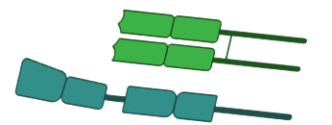


What stops this cycle?
Normal Th1 response
Positive loops
HLH triggers
MΦ & ferritin
Clinical manifestations
MΦ
TCR
Activate
Successfully eliminating the infection
If infection is removed, PAMPs are not activating the macrophages
When CD8+ successfully kill their target, they are able to disengage from the target synapse → can stop releasing cytokines
CD8+
MHC
APC
IFN-γ
CD8+
More specifically [3]
When the cytotoxic T cell finds an infected APC, it secretes cytokines

Slide 83
What stops this cycle?
Normal Th1 response
Positive loops
HLH triggers
MΦ & ferritin
Clinical manifestations
MΦ
TCR
Activate
Successfully eliminating the infection
If infection is removed, PAMPs are not activating the macrophages
When CD8+ successfully kill their target, they are able to disengage from the target synapse → can stop releasing cytokines
CD8+
MHC
APC
IFN-γ
CD8+
More specifically [3]
When the cytotoxic T cell finds an infected APC, it secretes cytokines
It stops secreting cytokines when it induces apoptosis successfully
CD8+
IFN-γ
Induce apoptosis

Slide 84
What stops this cycle?
Normal Th1 response
Positive loops
HLH triggers
MΦ & ferritin
Clinical manifestations
TCR
CD8+
Why it matters to us [3]
The most common infectious cause of HLH are viruses, namely large DNA viruses (herpesvirus family)
Over half of their genome is dedicated to immunomodulation
MHC
APC
IFN-γ
CD8+
CD8+
IFN-γ
Induce apoptosis

Slide 85
What stops this cycle?
Normal Th1 response
Positive loops
HLH triggers
MΦ & ferritin
Clinical manifestations
TCR
CD8+
Successfully eliminating the infection
If infection is removed, PAMPs are not activating the macrophages
When CD8+ successfully kill their target, they are able to disengage from the target synapse → can stop releasing cytokines
Why it matters to us [3]
The most common infectious cause of HLH are viruses, namely large DNA viruses (herpesvirus family)
Over half of their genome is dedicated to immunomodulation
When they are found → preventing successful apoptosis
MHC
APC
IFN-γ
CD8+
CD8+
IFN-γ
Induce apoptosis

Slide 86
What stops this cycle?
Normal Th1 response
Positive loops
HLH triggers
MΦ & ferritin
Clinical manifestations
Cytokines
Infected APCs
Macrophages
Successfully eliminating the infection
Macrophages stop activating CD8+
CD8+ successfully killing stops releasing cytokines
Natural killer cells regulate CD8+
Activates
MΦ
Stimulates
Stimulates
Kills
IFN-γ
Release
NK
CD8+
Natural killer cells
Cytotoxic T cells

Slide 87
What stops this cycle?
Normal Th1 response
Positive loops
HLH triggers
MΦ & ferritin
Clinical manifestations
Cytokines
Infected APCs
Macrophages
Successfully eliminating the infection
Macrophages stop activating CD8+
CD8+ successfully killing stops releasing cytokines
Natural killer cells regulate CD8+
When pathogens exist, NK cells are focused on infected APCs ^{[best I can tell]}
Activates
MΦ
Stimulates
Stimulates
Kills
Kills
IFN-γ
Release
NK
CD8+
Natural killer cells
Cytotoxic T cells

Slide 88
What stops this cycle?
Normal Th1 response
Positive loops
HLH triggers
MΦ & ferritin
Clinical manifestations
Cytokines
Infected APCs
Macrophages
Successfully eliminating the infection
Macrophages stop activating CD8+
CD8+ successfully killing stops releasing cytokines
Natural killer cells regulate CD8+
When pathogens exist, NK cells are focused on infected APCs ^{[best I can tell]}
When the infected APCs are gone, NK cells regulate cytotoxic cells by inducing apoptosis
MΦ
Stimulates
Stimulates
Kills
IFN-γ
Apoptosis
Release
NK
CD8+
Natural killer cells
Cytotoxic T cells

Slide 89
Th1 hyperactivation
Normal Th1 response
Positive loops
HLH triggers
MΦ & ferritin
Clinical manifestations
Cytokines
Infected APCs
Macrophages
Revisiting the causes of HLH (and related syndromes)
Activates
MΦ
Stimulates
Stimulates
Kills
IFN-γ
Releases
Apoptosis
CD8+
NK
Natural killer cells
Cytotoxic T cells

Slide 90



Th1 hyperactivation
Normal Th1 response
Positive loops
HLH triggers
MΦ & ferritin
Clinical manifestations
Cytokines
Autoimmune
Macrophages
Revisiting the causes of HLH (and related syndromes)
Autoimmune: Key player is macrophages (hence macrophage activation syndrome)
MΦ
IFN-γ
Apoptosis
CD8+
NK
Natural killer cells
Cytotoxic T cells

Slide 91
Th1 hyperactivation
Normal Th1 response
Positive loops
HLH triggers
MΦ & ferritin
Clinical manifestations
Cytokines
Infected APCs
Macrophages
Revisiting the causes of HLH (and related syndromes)
Autoimmune: Macrophages
Malignancy:
MΦ
Kills
IFN-γ
Apoptosis
CD8+
NK
Natural killer cells
Cytotoxic T cells

Slide 92

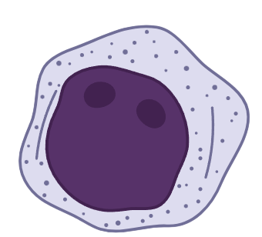
Th1 hyperactivation
Normal Th1 response
Positive loops
HLH triggers
MΦ & ferritin
Clinical manifestations
Cytokines
Cancer cells
Macrophages
Revisiting the causes of HLH (and related syndromes)
Autoimmune: Macrophages
Malignancy: Lymphomas (and others) act as a persistent source of “antigens”
MΦ
IFN-γ
Apoptosis
CD8+
NK
Natural killer cells
Cytotoxic T cells

Slide 93
Th1 hyperactivation
Normal Th1 response
Positive loops
HLH triggers
MΦ & ferritin
Clinical manifestations
Cytokines
Infected APCs
Macrophages
Revisiting the causes of HLH (and related syndromes)
Autoimmune: Macrophages
Malignancy: Persistent antigens
CAR-T:
MΦ
Kills
IFN-γ
Apoptosis
CD8+
NK
Natural killer cells
Cytotoxic T cells

Slide 94
Th1 hyperactivation
Normal Th1 response
Positive loops
HLH triggers
MΦ & ferritin
Clinical manifestations
Cytokines
Macrophages
Cancer cells
Revisiting the causes of HLH (and related syndromes)
Autoimmune: Macrophages
Malignancy: Persistent antigens
CAR-T: Cytokine release syndrome from chimeric T-cell receptor therapy can cause massive activation of T cells
MΦ
IL-6
TCR
CD8+
Cytotoxic T cells

Slide 95
Th1 hyperactivation
Normal Th1 response
Positive loops
HLH triggers
MΦ & ferritin
Clinical manifestations
Cytokines
Infected APCs
Macrophages
Revisiting the causes of HLH (and related syndromes)
Autoimmune: Macrophages
Malignancy: Persistent antigens
CAR-T: T-cell activation
Infections:
MΦ
Kills
IFN-γ
Apoptosis
CD8+
NK
Natural killer cells
Cytotoxic T cells

Slide 96
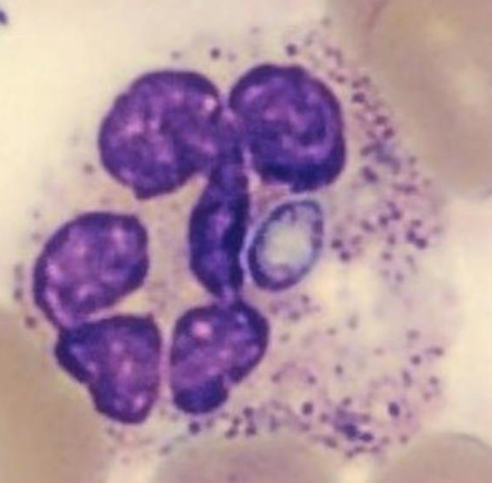
Th1 hyperactivation
Normal Th1 response
Positive loops
HLH triggers
MΦ & ferritin
Clinical manifestations
Cytokines
Histoplasmosis
Macrophages
Revisiting the causes of HLH (and related syndromes)
Autoimmune: Macrophages
Malignancy: Persistent antigens
CAR-T: T-cell activation
Infections: Intracellular pathogens that target immune cells drive a strong T cell response (including viruses)
MΦ
IFN-γ
Apoptosis
CD8+
NK
Natural killer cells
Cytotoxic T cells

Slide 97
Macrophages & ferritin
Normal Th1 response
Positive loops
HLH triggers
MΦ & ferritin
Clinical manifestations
Ferritin
IFN-γ → MΦ → Ferritin axis
IFN-γ → MΦ → Ferritin axis
In all these conditions, the common downstream effector cells are macrophages
MΦ
Although IFN-γ is one of the stronger inducers of ferritin release (mainly from macrophages), there are other mechanisms that can cause ferritin release too (e.g. ischemic hepatitis)
IFN-γ
CD8+
Cytotoxic T cells

Slide 98
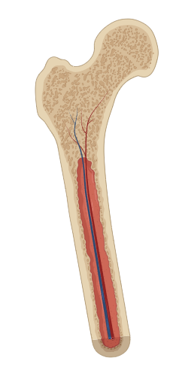
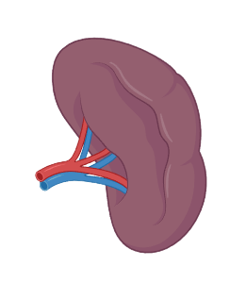
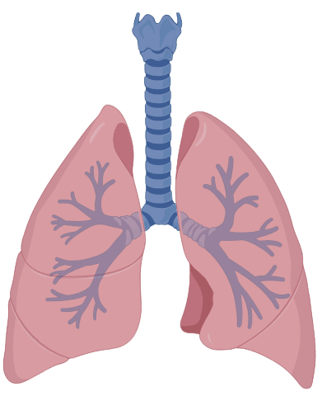
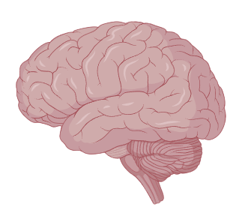
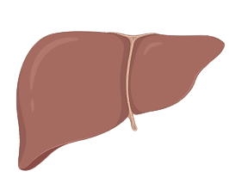
Macrophages
Normal Th1 response
Positive loops
HLH triggers
MΦ & ferritin
Clinical manifestations
Macrophages live in…
MΦ
Bone
Lungs
Blood
Brain
Liver
Red pulp (spleen)
Monocytes
Microglia
Kupffer cells
Littoral cells
Alveolar macrophages
Osteoclast

Slide 99
Macrophages
Normal Th1 response
Positive loops
HLH triggers
MΦ & ferritin
Clinical manifestations
Macrophages live in…
Liver (Kupffer cells)
Red pulp of the spleen
Bone marrow
Lungs
MΦ
Part of the Hscore
Bone
Lungs
Liver
Red pulp (spleen)
Kupffer cells
Littoral cells
Alveolar macrophages
Osteoclast

Slide 100
Macrophages
Normal Th1 response
Positive loops
HLH triggers
MΦ & ferritin
Clinical manifestations
HScore for HLH |  | +224
immunosuppression | No
Temperature, °F | >102.9 | +49
Hepato/spleno-megaly | Both | +38
Number of cytopenias | 2 lines | +24
Ferritin | >6,000 | +50
Triglycerides | 132 - 354 | +44
Fibrinogen | >250
AST | >30 | +19
Bone marrow Bx | TBD
Macrophages live in…
Liver (Kupffer cells)
Red pulp of the spleen
Bone marrow
Lungs
Part of the Hscore

Slide 101
Macrophages
Normal Th1 response
Positive loops
HLH triggers
MΦ & ferritin
Clinical manifestations
Macrophages live in…
Liver (Kupffer cells)
Red pulp of the spleen
Bone marrow
Lungs
MΦ
Part of the Hscore
Bone
Influenza (HLH trigger)
COVID-19 (↑↑ ferritin)
Lungs
Liver
Red pulp (spleen)
Kupffer cells
Littoral cells
Alveolar macrophages
Osteoclast

Slide 102
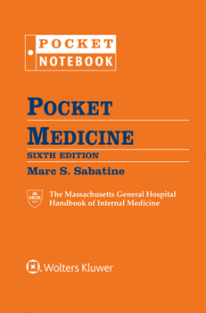
HyperFerritinemia
Normal Th1 response
Positive loops
HLH triggers
MΦ & ferritin
Clinical manifestations
Clinical pearl (from MS3)
Causes of ferritin >10,000
IFN-γ → MΦ → Ferritin axis

Slide 103
HyperFerritinemia
Normal Th1 response
Positive loops
HLH triggers
MΦ & ferritin
Clinical manifestations
Clinical pearl (from MS3)
Causes of ferritin >10,000
Rickettsial infection
Histoplasmosis
Revisiting the causes of HLH (and related syndromes)
Autoimmune: Macrophages
Malignancy: Persistent antigens
CAR-T: T-cell activation
Infections: Intracellular pathogens that target immune cells drive a strong T cell response (including viruses)

Slide 104
HyperFerritinemia
Normal Th1 response
Positive loops
HLH triggers
MΦ & ferritin
Clinical manifestations
Clinical pearl (from MS3)
Causes of ferritin >10,000
Rickettsial infection
Histoplasmosis
Adult onset Still's disease
Lymphoma
Revisiting the causes of HLH (and related syndromes)
Autoimmune: Macrophages
Malignancy: Persistent antigens
CAR-T: T-cell activation
Infections: Intracellular pathogens that target immune cells drive a strong T cell response (including viruses)

Slide 105
HyperFerritinemia
Normal Th1 response
Positive loops
HLH triggers
MΦ & ferritin
Clinical manifestations
Clinical pearl (from MS3)
Causes of ferritin >10,000
Rickettsial infection
Histoplasmosis
Adult onset Still's disease
Lymphoma
Hepatitis causing liver failure (viral)
Severe viral infections (HSV, CMV, EBV)
Revisiting the causes of HLH (and related syndromes)
Autoimmune: Macrophages
Malignancy: Persistent antigens
CAR-T: T-cell activation
Infections: Intracellular pathogens that target immune cells drive a strong T cell response (including viruses)
MΦ

Slide 106
Conceptual overview
Normal Th1 response
Positive loops
HLH triggers
MΦ & ferritin
Clinical manifestations
Cytokine release: Fever (IL-6)
Impaired target-cell killing
T-cell activation →
↑↑ soluble CD25 (IL-2 receptor)
Reduced NK activity
Macrophage activation
↑↑ Ferritin
CD8+
MΦ
Induce apoptosis

Slide 107
Conceptual overview
Normal Th1 response
Positive loops
HLH triggers
MΦ & ferritin
Clinical manifestations
Cytokine release: Fever (IL-6)
Impaired target-cell killing
T-cell activation →
↑↑ soluble CD25 (IL-2 receptor)
Reduced NK activity
Macrophage activation
↑↑ Ferritin
Hemophagocytosis (in bone marrow or other tissues)
MΦ
CD8+
MΦ
Induce apoptosis
Hyperfibrinolysis
Hypofibrinogenemia
↑ D-dimer
↑↑ triglyceridemia (↓ lipoprotein lipase)

Slide 108
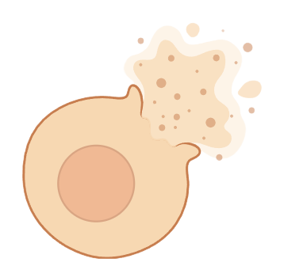
Conceptual overview
Normal Th1 response
Positive loops
HLH triggers
MΦ & ferritin
Clinical manifestations
Cytokine release: Fever (IL-6)
Impaired target-cell killing
T-cell activation →
↑↑ soluble CD25 (IL-2 receptor)
Reduced NK activity
Macrophage activation
↑↑ Ferritin
Hemophagocytosis (in bone marrow or other tissues)
Infiltration by lymphocytes and histiocytes
Splenomegaly
Hepatomegaly
↑ LFTs (hepatocellular)
MΦ
CD8+
MΦ
Induce apoptosis
Hyperfibrinolysis
Hypofibrinogenemia
↑ D-dimer
Cell destruction/death
Cytopenias (multifactorial)
↑ LDH
↑↑ triglyceridemia (↓ lipoprotein lipase)

Slide 109
Conceptual overview
Normal Th1 response
Positive loops
HLH triggers
MΦ & ferritin
Clinical manifestations
Cytokine release: Fever (IL-6)
Impaired target-cell killing
T-cell activation →
↑↑ soluble CD25 (IL-2 receptor)
Reduced NK activity
Macrophage activation
↑↑ Ferritin
Hemophagocytosis (in bone marrow or other tissues)
Infiltration by lymphocytes and histiocytes
Splenomegaly
Hepatomegaly
↑↑ LFTs (hepatocellular)
MΦ
CD8+
Hyperfibrinolysis
Hypofibrinogenemia
↑ D-dimer
Cell destruction/death
Cytopenias (multifactorial)
↑↑ LDH
Included in H-Score
Included in HLH-2004 criteria
↑↑ triglyceridemia (↓ lipoprotein lipase)

Slide 110
Conceptual overview
Normal Th1 response
Positive loops
HLH triggers
MΦ & ferritin
Clinical manifestations
Cytokine release: Fever (IL-6)
Infiltration by lymphocytes and histiocytes
Splenomegaly
Hepatomegaly
↑ LFTs (hepatocellular)
Admit labs | Our patient | Case report
WBC | 3.0 | 3.3
Hgb | 17.0 | 13.9
Platelets | 72 | 16
Creat | 1.7 | 3.96
AST | 335 | 330
ALT | 104 | 183
Ferritin | 8,830 (29 x ULN) | >33,511 (>110 x ULN)
LDH | 1,501 | 1,337
Often, we only look at these numbers
Cell destruction/death
Cytopenias (multifactorial)
↑ LDH
But what about these?

Slide 111
Do tick-borne diseases cause HLH?
Anaplasmosis → HLH reported in the literature
Infectious pathogens that trigger HLH are intracellular (most obligate intracellular)
DNA viruses > other viruses
TB, Rickettsia, Histo, Leishmania
“Tick appearing labs” look similar to HLH labs
Cytopenias + LFTs
Typhoidal syndrome clinically
Serologies | IgM | IgG
Lyme | Pos | Neg
Ehrlichia | ? | ?
Anaplasma | ? | ?
RMSF | ? | ?

Slide 112
Cytokine levels in anaplasmosis induced HLH [6]
An older study evaluated 29 patients:
With laboratory confirmed anaplasmosis
Verus controls
Suspected to have anaplasmosis
But all lab testing indicated otherwise (negative serologies, PCR, smear)

Slide 113
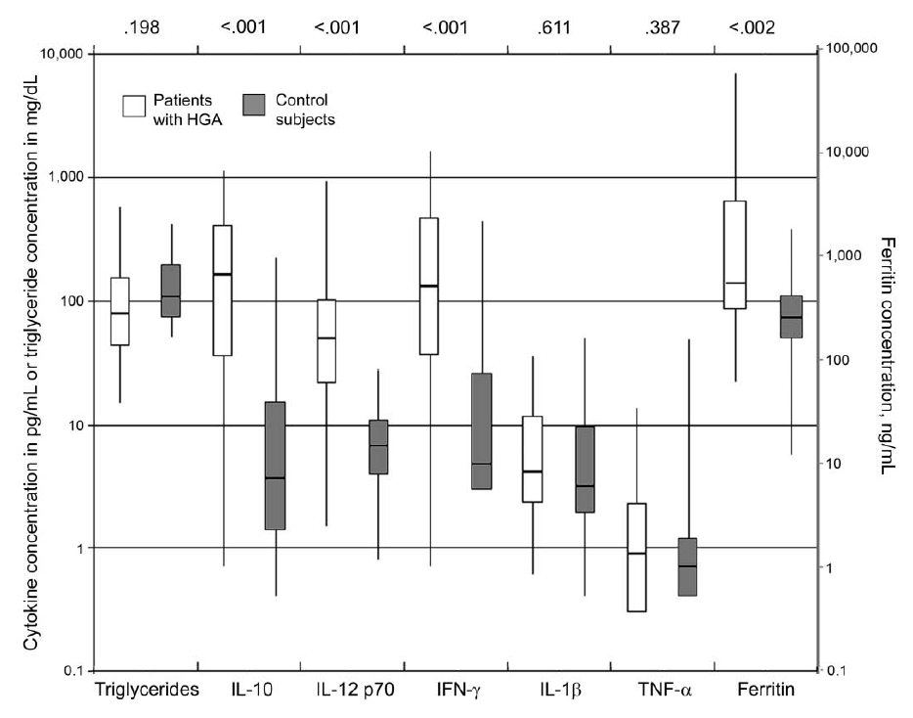
Cytokine levels in anaplasmosis induced HLH [6]
Control
subjects
An older study evaluated 29 patients:
With laboratory confirmed anaplasmosis
Verus controls
Suspected to have anaplasmosis
But all lab testing indicated otherwise (negative serologies, PCR, smear)
Patients with anaplasmosis had some cytokines elevated higher than would be expected
Higher levels of IL-10, IL-12, IFN-γ

Slide 114
Cytokine levels in anaplasmosis induced HLH [6]
Cytokines
Macrophages
An older study evaluated 29 patients:
With laboratory confirmed anaplasmosis
Verus controls
Suspected to have anaplasmosis
But all lab testing indicated otherwise (negative serologies, PCR, smear)
Patients with anaplasmosis had some cytokines elevated higher than would be expected
Higher levels of IL-10, IL-12, IFN-γ
MΦ
IL-12
IFN-γ
CD8+
Cytotoxic T cells

Slide 115
Cytokine levels in anaplasmosis induced HLH [6]
Cytokines
Macrophages
An older study evaluated 29 patients:
With laboratory confirmed anaplasmosis
Verus controls
Suspected to have anaplasmosis
But all lab testing indicated otherwise (negative serologies, PCR, smear)
Patients with anaplasmosis had some cytokines elevated higher than would be expected
Higher levels of IL-10, IL-12, IFN-γ
But others were not (TNF-𝛂 was normal) implying a slightly different mechanism than Ehrlichia
MΦ
IL-12
IFN-γ
CD8+
Cytotoxic T cells

Slide 116
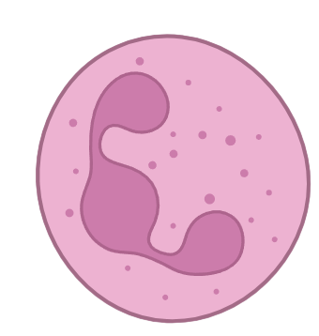
But…
Normal APCs
Anaplasmosis does not infect APCs, neutrophils are infected
Neutrophils

Slide 117
Front Immunol [5]
Normal APCs
Cytokines
Animal model (of human cells)
Looking at cellular functionality
MΦ
IFN-γ
Kills
Neutrophils
CD8+
NK
Cytotoxic T lymphs

Slide 118
Front Immunol [5]
Normal APCs
Cytokines
Animal model (of human cells)
Looking at cellular functionality
MΦ
Cytotoxic T lymphocytes don’t work when exposed to anaplasmosis
IFN-γ
Kills
Neutrophils
CD8+
NK
Cytotoxic T lymphs

Slide 119
Front Immunol [5]
Normal APCs
Cytokines
Animal model (of human cells)
Looking at cellular functionality
MΦ
Cytotoxic T lymphocytes don’t work when exposed to anaplasmosis
Don’t degranulate
IFN-γ
Kills
Neutrophils
CD8+
NK
Cytotoxic T lymphs

Slide 120
Front Immunol [5]
Normal APCs
Cytokines
Animal model (of human cells)
Looking at cellular functionality
MΦ
Cytotoxic T lymphocytes don’t work when exposed to anaplasmosis
Don’t degranulate
Also don’t secrete IFN-γ
IFN-γ
Kills
Neutrophils
CD8+
NK
Cytotoxic T lymphs

Slide 121
Front Immunol [5]
Normal APCs
Cytokines
Animal model (of human cells)
Looking at cellular functionality
MΦ
Cytotoxic T lymphocytes don’t work when exposed to anaplasmosis
Don’t degranulate
Also don’t secrete IFN-γ
Possibly due to poor presentation by MHC I infected cells
MHC I
IFN-γ
Kills
Neutrophils
CD8+
NK
Cytotoxic T lymphs

Slide 122
Front Immunol [5]
Cytokines
???
Animal model (of human cells)
Looking at cellular functionality
MΦ
Implication
Something else in the immune system may be driving the IFN-γ release
NLRC5
(PAMP)
IFN-γ
Kills
Neutrophils
CD8+
NK
Cytotoxic T lymphs

Slide 123
Case 1: Hospital course
Serologies | IgM | IgG
Lyme | Pos | Neg
Ehrlichia | ? | ?
Anaplasma | ??? | ???
RMSF | ? | ?
Serum PCR | Copies
Anaplasmosis
Lyme
Adenovirus
HSV
CMV
EBV
Bone marrow Bx
CMV PCR
EBV PCR
Flow cyto
Other | Result
Parasite smear | Neg
Monospot | Neg

Slide 124
Case 1: Hospital course
Serologies | IgM | IgG
Lyme | Pos | Neg
Ehrlichia | <1:20 | <1:64
Anaplasma | <1:20 | <1:64
RMSF | Neg | Neg
Serum PCR | Copies
Anaplasmosis | ?
Lyme | ?
Adenovirus | ?
HSV | ?
CMV | ?
EBV | ?
Bone marrow Bx
CMV PCR | ?
EBV PCR | ?
Flow cyto | ?
Other | Result
Parasite smear | Neg
Monospot | Neg

Slide 125


Case 1: Hospital course
Serologies | IgM | IgG
Lyme | Pos | Neg
Ehrlichia | <1:20 | <1:64
Anaplasma | <1:20 | <1:64
RMSF | Neg | Neg
Serum PCR | Copies
Anaplasmosis | ?
Lyme | ?
Adenovirus | ?
HSV | ?
CMV | ?
EBV | ?
 | IgM
Lyme | Pos
Bone marrow Bx
CMV PCR | ?
EBV PCR | ?
Flow cyto | ?
4 results
Other | Result
Parasite smear | Neg
Monospot | Neg
Well, then does Lyme cause HLH?

Slide 126

Hemophagocytic Lymphohistiocytosis (HLH) in Patients with Tick-Borne Illness: A Scoping Review of 98 Cases [9]
Ehrlichia spp (n=45)
Of their 98 cases identified
Ehrlichia spp (n=45)
Anaplasma spp (n=12)
Anaplasma
spp (n=12)

Slide 127
Hemophagocytic Lymphohistiocytosis (HLH) in Patients with Tick-Borne Illness: A Scoping Review of 98 Cases [9]
Ehrlichia spp (n=45)
Rickettsia spp (n=14)
Of their 98 cases identified
Ehrlichia spp (n=45)
Anaplasma spp (n=12)
Rickettsia spp (n=14)
Babesia spp (n=10)
Anaplasma
spp (n=12)
Babesia
spp (n=10)

Slide 128
Hemophagocytic Lymphohistiocytosis (HLH) in Patients with Tick-Borne Illness: A Scoping Review of 98 Cases [9]
Ehrlichia spp (n=45)
Rickettsia spp (n=14)
Of their 98 cases identified
Ehrlichia spp (n=45)
Anaplasma spp (n=12)
Rickettsia spp (n=14)
Babesia spp (n=10)
Orientia spp (n=8)
Coxiella spp (n=5)
Heartland virus (n=3)
Bunyavirus spp (n=1)
Anaplasma
spp (n=12)
Babesia
spp (n=10)
But no Lyme!

Slide 129
Case 1: Hospital course
Serologies | IgM | IgG
Lyme | Pos | Neg
Ehrlichia | <1:20 | <1:64
Anaplasma | <1:20 | <1:64
RMSF | Neg | Neg
Serum PCR | Copies
Anaplasmosis | ?
Lyme | ?
Adenovirus | ?
HSV | ?
CMV | ?
EBV | ?
Bone marrow Bx
CMV PCR | ?
EBV PCR | ?
Flow cyto | ?
Other | Result
Parasite smear | Neg
Monospot | Neg
Well, then does Lyme cause HLH?
Nope!

Slide 130
Case 1: Hospital course
Serologies | IgM | IgG
Lyme | Pos | Neg
Ehrlichia | <1:20 | <1:64
Anaplasma | <1:20 | <1:64
RMSF | Neg | Neg
Serum PCR | Copies
Anaplasmosis | 0
Lyme | 0
Adenovirus | ???
HSV | 0
CMV | 0
EBV | ???
Bone marrow Bx
CMV PCR | ?
EBV PCR | ?
Flow cyto | ?
Bone marrow Bx
CMV PCR | Neg
EBV PCR | Pos
Flow cyto | Normal
Other | Result
Parasite smear | Neg
Monospot | Neg

Slide 131
Case 1: Hospital course
Serologies | IgM | IgG
Lyme | Pos | Neg
Ehrlichia | <1:20 | <1:64
Anaplasma | <1:20 | <1:64
RMSF | Neg | Neg
Serum PCR | Copies
Anaplasmosis | 0
Lyme | 0
Adenovirus | 23,648
HSV | 0
CMV | 0
EBV | IgG+
Bone marrow Bx
CMV PCR | Neg
EBV PCR | Pos
Flow cyto | Normal
Other | Result
Parasite smear | Neg
Monospot | Neg
Didn’t send PCR :(
Discharged on 21 days of doxy (while waiting on these tests)

Slide 132
Learning points & take aways

Slide 133
Learning points & take aways
HLH is a hyperinflammatory syndrome that can mimic severe infection or sepsis
Clues: persistent fever, cytopenias, splenomegaly, hepatitis/transaminitis, hyperferritinemia, hypertriglyceridemia, hypofibrinogenemia, and elevated soluble IL-2 receptor
Driven by macrophages / IFN-γ / Th1 response
Infectious triggers are common, almost always intracellular pathogens (viral infections, especially EBV; bacterial, fungal, and parasitic infections also possible)
Can be tick-borne (ehrlichiosis, anaplasmosis, babesiosis), but uncommon to be from lyme
That said, viral is still by far the most common
Delays in diagnosis and treatment can be fatal → consider HLH (or at minimum ordering a ferritin)
May or may not need immunosuppression, but for non-EBV often okay to just treat the infection +/- steroids
Slides available on hunterratliff1.com/talk/; Citations available via QR code or via the “citations” button on the website

