Slide 1

Being right
(for the wrong reasons)
CLINID conference
Hunter Ratliff
06/04/2026
Ages, dates, and other identifying information may have been changed
I have no conflict of interest in relation to this presentation

Slide 2
Shortcuts
Case 1: Start
Case 2: Start
Inadvertent treatment for lyme?
CSF mNGS | Limitations

Slide 3
Case #1

Slide 4
Case 1: HPI
A 32 y/o F with PMH including seasonal allergies, multiple sclerosis (on Cladribine) w/ prior right optic neuritis p/w new intractable migraines.

Slide 5
Case 1: HPI
A 32 y/o F with PMH including seasonal allergies, multiple sclerosis (on Cladribine) w/ prior right optic neuritis p/w new intractable migraines.
ED (-25d) - New neck pain of lateral right neck. Been having a few days of right sided throbbing headache as well. CT normal, discharged
ED #1
-29
-26
-25
-23
22
21
20
19
18
17
16
15
14
13
12
11
10
-9
-8
-7
-6
-5
-4
-3
-2
-1
0
Headache (right)
Neck pain (right)

Slide 6
Case 1: HPI
A 32 y/o F with PMH including seasonal allergies, multiple sclerosis (on Cladribine) w/ prior right optic neuritis p/w new intractable migraines.
ED (-25d) - New right neck pain + a few days of right sided throbbing headache
Clinic (-23d) - Noted to have nausea & mild photophobia; left ear feels full
ED #1
-29
-26
-25
-23
22
21
-20
19
18
17
16
15
14
13
12
11
10
-9
-8
-7
-6
-5
-4
-3
-2
-1
0
Headache (right)
Neck pain (right)
Photophobia
Nausea

Slide 7
Case 1: HPI
A 32 y/o F with PMH including seasonal allergies, multiple sclerosis (on Cladribine) w/ prior right optic neuritis p/w new intractable migraines.
ED (-25d) - New right neck pain + a few days of right sided throbbing headache
Clinic (-23d) - Noted to have nausea & mild photophobia; left ear feels full → medrol dose pack and Cefdinir; really starts to feel better
ED #1
Cefdinir
Steroids
-29
-26
-25
-23
22
21
19
18
17
16
15
14
13
12
11
10
-9
-8
-7
-6
-5
-4
-3
-2
-1
0
Headache (right)
Neck pain (right)
Photophobia
Nausea

Slide 8
Case 1: HPI
A 32 y/o F with PMH including seasonal allergies, multiple sclerosis (on Cladribine) w/ prior right optic neuritis p/w new intractable migraines.
ED (-25d) - New right neck pain + a few days of right sided throbbing headache
Clinic (-23d) - Noted to have nausea & mild photophobia; left ear feels full → medrol dose pack and Cefdinir; really starts to feel better
Pharm starts valtrex secondary PPx (her oral HSV tends to recur with her Cladribine)
Valtrex
Cefdinir
Cladribine
Steroids
-29
-26
-25
-23
22
21
19
-18
17
16
15
14
13
-12
11
10
-9
-8
-7
-6
-5
-4
-3
-2
-1
0
Headache (right)
Neck pain (right)
Photophobia
Nausea

Slide 9
Case 1: HPI
A 32 y/o F with PMH including seasonal allergies, multiple sclerosis (on Cladribine) w/ prior right optic neuritis p/w new intractable migraines.
ED #2 (-6d) - Symptoms have returned, but worse than before
Valtrex
Cefdinir
Cladribine
Steroids
-29
-26
-25
-23
22
21
19
-18
17
16
15
14
13
-12
11
10
-9
-8
-7
-6
-5
-4
-3
-2
-1
0
Headache (right)
Headache & neck pain (R>L)
Neck pain (right)
Photophobia
Photophobia & nausea
Nausea

Slide 10
Case 1: HPI
A 32 y/o F with PMH including seasonal allergies, multiple sclerosis (on Cladribine) w/ prior right optic neuritis p/w new intractable migraines.
ED #2 (-6d) - Symptoms have returned, but worse than before. Now painful to move the neck and pain behind the eyes.
Valtrex
Cefdinir
Cladribine
Steroids
-29
-26
-25
-23
22
21
19
-18
17
16
15
14
13
-12
11
10
-9
-8
-7
-6
-5
-4
-3
-2
-1
0
Headache (right)
Headache & neck pain (R>L)
Neck pain (right)
Painful moving neck
Photophobia
Photophobia & nausea
Nausea
Retrobulbar pain (R>L)

Slide 11
Case 1: HPI
A 32 y/o F with PMH including seasonal allergies, multiple sclerosis (on Cladribine) w/ prior right optic neuritis p/w new intractable migraines.
ED #2 (-6d) - Symptoms have returned, but worse than before. Now painful to move the neck and pain behind the eyes. Exam & labs reassuring (and recent MRI orbits okay), so they try steroids again & send her home
MRI orbits: Normal
Valtrex
Cefdinir
Cladribine
Steroids
Steroids
-29
-26
-25
-23
22
21
19
17
16
15
14
13
-12
11
10
-9
-8
-7
-6
-5
-4
-3
-2
-1
0
Headache (right)
Headache & neck pain (R>L)
Neck pain (right)
Painful moving neck
Photophobia
Photophobia & nausea
Nausea
Retrobulbar pain (R>L)

Slide 12
Case 1: HPI
A 32 y/o F with PMH including seasonal allergies, multiple sclerosis (on Cladribine) w/ prior right optic neuritis p/w new intractable migraines.
ED #2 (-6d) - Symptoms have returned, but worse than before. Now painful to move the neck and pain behind the eyes. Exam & labs reassuring (and recent MRI orbits okay), so they try steroids again & send her home
This time, she does not get better / worsens
Valtrex
Cefdinir
Cladribine
Steroids
Steroids
-29
-26
-25
-23
22
21
19
17
16
15
14
13
-12
11
10
-9
-8
-7
-6
-5
-4
-3
-2
-1
0
Headache (right)
Headache & neck pain (R>L)
Worsening
Neck pain (right)
Painful moving neck
Worsening
Photophobia
Photophobia & nausea
Worsening
Nausea
Retrobulbar pain (R>L)
Worsening

Slide 13
Case 1: Physical exam
BP | 137/80 | Pulse | 99 | SpO2 | 99 %
Temp | 36.4 °C (97.5 °F) | RR | 18 | BMI | 28 kg/m²
General | Alert and oriented, NAD, pleasant and interactive
HEENT | NCAT; trachea appears midline, no gross LAD; EOMI, no ulcers
Resp | Normal respiratory effort, symmetric chest rise
CV | RRR; extremities perfused
GI | Non-distended; no TTP
Extremities | No clubbing, cyanosis, or edema
Neuro/MSK | Moves extremities, no deficits
Psych | Normal mood; appropriate affect

Slide 14
Case 1: Labs
CBC | Result
WBC | 3.1
Hgb | 11.2
Platelets | 191
Neut % | 69
Lymph # | 370
Eos % | 0%
Chem7 | Result
Na | 140
K | 3.8
HCO3 | 23
BUN | 9
Cr | 0.8
LFTs | Result
AST | 11
ALT | 9
Alk Phos | 41
Bili | 0.8
Albumin | 3.3

Slide 15
Case 1: Summary
Has had progressively worsening headache with meningeal signs (but no fevers or constitutional sx) for the past 4 weeks, progressively worsening with no improvement aside from transient improvement with a course of steroids/cefdinir, but only the first time around
A 32 y/o F with PMH including seasonal allergies, multiple sclerosis (on Cladribine) w/ prior right optic neuritis p/w status migrainosus
CBC
WBC | 3.1
Hgb | 11.2
Platelets | 191
Lymph # | 370
Valtrex
Cefdinir
Cladribine
Steroids
Steroids
-29
-26
-25
-23
22
21
19
17
16
15
14
13
-12
11
10
-9
-8
-7
-6
-5
-4
-3
-2
-1
0
Headache (right)
Headache & neck pain (R>L)
Worsening
Neck pain (right)
Painful moving neck
Worsening
Photophobia
Photophobia & nausea
Worsening
Nausea
Retrobulbar pain (R>L)
Worsening

Slide 16
Case 1: Social history, exposures, & risk factors
Geographic & Travel | Lives in WV w/ partner & young kid No recent travel, never outside of the country
Occupational | Science educator (quite knowledgeable) Partner works in a correctional facility, but reportedly normal TB testing
Animals | Only (exclusively indoor) cat, no birds
Exposures

Slide 17
Case 1: Social history, exposures, & risk factors
Geographic & Travel | Lives in WV w/ partner & young kid No recent travel, never outside of the country
Occupational | Science educator (quite knowledgeable) Partner works in a correctional facility, but reportedly normal TB testing
Animals | Only (exclusively indoor) cat, no birds
Exposures | Spends a fair amount of time outdoors in the yard; not in long grass or the woods Has seen ticks this season, none were embedded There is a farm uphill from where she lives…water is well water Some gardening & soil exposures

Slide 18
Case 1: Lumbar puncture
Lumbar Puncture
Opening Pr | 22 cm H2O
WBC | 58
Lymph % | 92
RBC | 145
Protein | 108
Glucose | 41
Serum
CSF:Serum
Lactate | 4.1
Serum WBC ~3.0

Slide 19
Case 1: Lumbar puncture
Lumbar Puncture
Opening Pr | 22 cm H2O
WBC | 58
Lymph % | 92
RBC | 145
Protein | 108
Glucose | 41
Serum | 94
CSF:Serum | 0.44
Lactate | 4.1
Serum WBC ~3.0

Slide 20
Case 1: Lumbar puncture
Lumbar Puncture
Opening Pr | 22 cm H2O
WBC | 58
Lymph % | 92
RBC | 145
Protein | 108
Glucose | 41
Serum | 94
CSF:Serum | 0.44
Lactate | 4.1
CSF | Result
Biofire | ???
HSV PCR | ???
VDRL | ???
Serum | Result
HIV | Negative
Syphilis | ???

Slide 21
Case 1: MRI brain W/WO
Prior MRI was just MRI of the orbits
MRI brain W/WO: Let my wife explain!

Slide 22
Case 1: MRI brain W/WO
Prior MRI was just MRI of the orbits
MRI brain W/WO: Nonspecific pachymeningeal enhancement. Enhancement along the cisternal segments of bilateral oculomotor & trigeminal nerves, new compared to prior exam. Findings could be seen in the setting of meningitis. No new MS lesions.

Slide 23
Case 1: Lumbar puncture
Lumbar Puncture
Opening Pr | 22 cm H2O
WBC | 58
Lymph % | 92
RBC | 145
Protein | 108
Glucose | 41
Serum | 94
CSF:Serum | 0.44
Lactate | 4.1
CSF | Result
Biofire | ???
HSV PCR | ???
VDRL | ???
…
Serum | Result
HIV | Negative
Syphilis | ???
…
…
…

Slide 24
Case 1: Lumbar puncture
Lumbar Puncture
Opening Pr | 22 cm H2O
WBC | 58
Lymph % | 92
RBC | 145
Protein | 108
Glucose | 41
Serum | 94
CSF:Serum | 0.44
Lactate | 4.1
CSF | Result
Biofire | Negative
HSV PCR | Negative
VDRL | Negative
CryptoAg | ?
Serum | Result
HIV | Negative
Syphilis | Negative
Lyme | ?
Tick panel | ?
QuantGold | ?

Slide 25
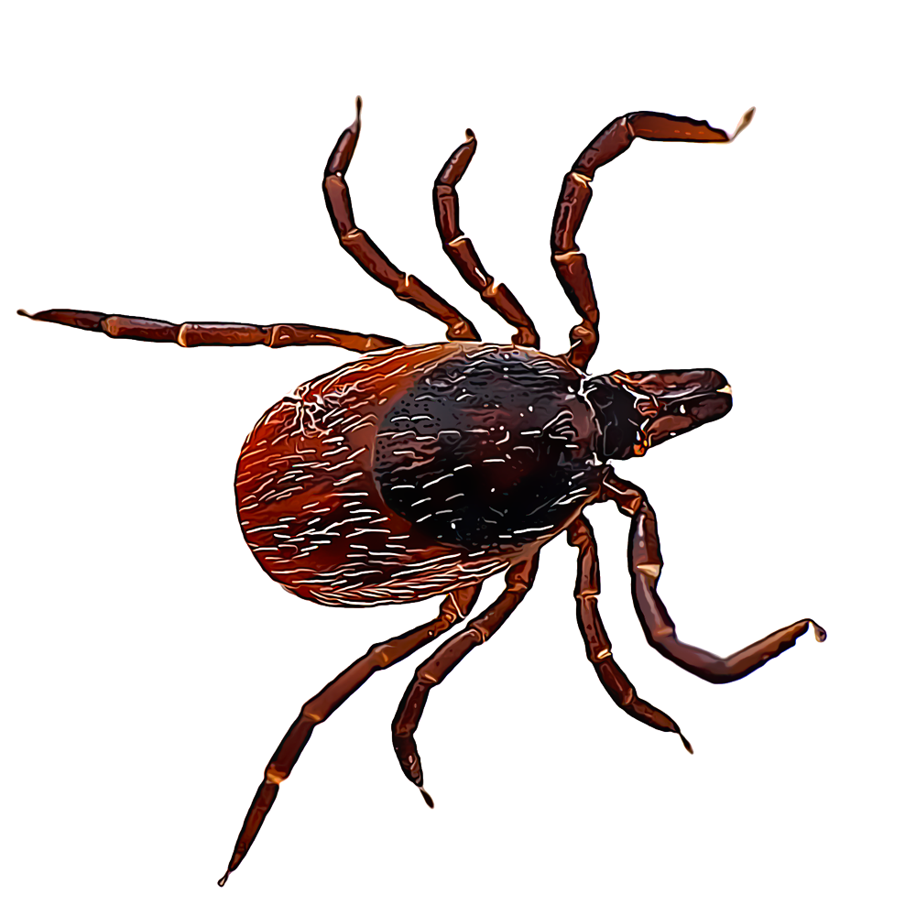
Case 1: Lumbar puncture
Lumbar Puncture
Opening Pr | 22 cm H2O
WBC | 58
Lymph % | 92
RBC | 145
Protein | 108
Glucose | 41
Serum | 94
CSF:Serum | 0.44
Lactate | 4.1
Right sided Bell’s palsy develops 12-24 hours before tick screening returns
CSF | Result
Biofire | Negative
HSV PCR | Negative
VDRL | Negative
CryptoAg | Negative
Serum | Result
HIV | Negative
Syphilis | Negative
Lyme | ?
Tick panel | ?
QuantGold | Negative

Slide 26
Case 1: Lumbar puncture
Lumbar Puncture
Opening Pr | 22 cm H2O
WBC | 58
Lymph % | 92
RBC | 145
Protein | 108
Glucose | 41
Serum | 94
CSF:Serum | 0.44
Lactate | 4.1
Right sided Bell’s palsy develops 12-24 hours before tick screening returns
CSF | Result
Biofire | Negative
HSV PCR | Negative
VDRL | Negative
CryptoAg | Negative
Serum | Result
HIV | Negative
Syphilis | Negative
Lyme | Positive
Tick panel | Negative
QuantGold | Negative

Slide 27
Case 1: Revisiting the history
A 32 y/o F with PMH including seasonal allergies, multiple sclerosis (on Cladribine) w/ prior right optic neuritis p/w new intractable migraines.
Clinic (-23d) - Noted to have nausea & mild photophobia; left ear feels full → medrol dose pack and Cefdinir
ED #2 (-6d) - Exam & labs reassuring (and recent MRI orbits okay), so they send home with steroids (but no antibiotics)
Valtrex
Cefdinir
Cladribine
Steroids
Steroids
-29
-26
-25
-23
22
21
19
17
16
15
14
13
-12
11
10
-9
-8
-7
-6
-5
-4
-3
-2
-1
0
Headache (right)
Headache & neck pain (R>L)
Worsening
Neck pain (right)
Painful moving neck
Worsening
Photophobia
Photophobia & nausea
Worsening
Nausea
Retrobulbar pain (R>L)
Worsening

Slide 28
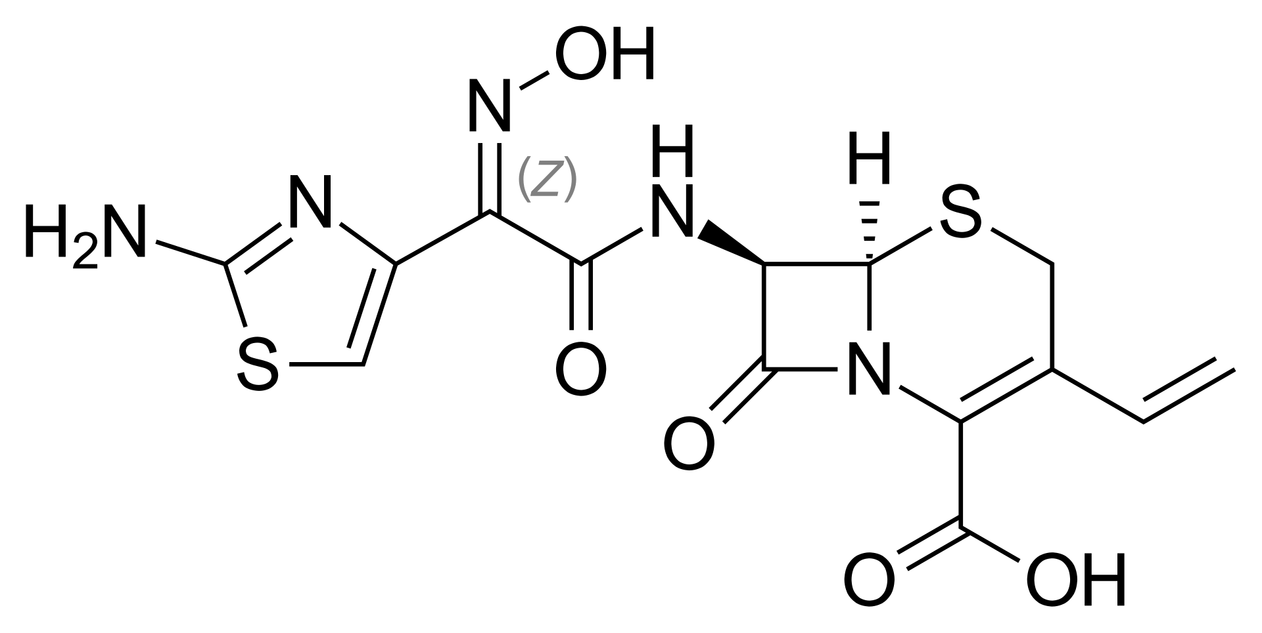
Case 1: Revisiting the history
A 32 y/o F with PMH including seasonal allergies, multiple sclerosis (on Cladribine) w/ prior right optic neuritis p/w new intractable migraines.
INTERVAL EVENTS / SUBJECTIVE
No events overnight, patient seen at bedside accompanied by spouse. Headache a little better. Says she was feeling better while receiving IV antibiotic that started with “cefe-” [cefepime]
Clinic (-23d) - Noted to have nausea & mild photophobia; left ear feels full → medrol dose pack and Cefdinir
ED #2 (-6d) - Exam & labs reassuring (and recent MRI orbits okay), so they send home with steroids (but no antibiotics)
Valtrex
Cefdinir
Cladribine
Steroids
Steroids
-29
-26
-25
-23
22
21
19
17
16
15
14
13
-12
11
10
-9
-8
-7
-6
-5
-4
-3
-2
-1
0
Headache (right)
Headache & neck pain (R>L)
Worsening
Neck pain (right)
Painful moving neck
Worsening
Cefdinir (looks a lot like ceftriaxone)
Photophobia
Photophobia & nausea
Worsening
Nausea
Retrobulbar pain (R>L)
Worsening

Slide 29
Inadvertent treatment for lyme?

Slide 30


Inadvertent treatment for Lyme
2006 IDSA guidelines [1]
In contrast to the:
second-generation cephalosporin cefuroxime and
certain third-generation cephalosporins (e.g., ceftriaxone) [125]...
2nd gen (cefuroxime)
3rd gen
(ceftriaxone)

Slide 31

Inadvertent treatment for Lyme
1st gen
(Keflex)
2006 IDSA guidelines [1]
In contrast to the:
second-generation cephalosporin cefuroxime and
certain third-generation cephalosporins (e.g., ceftriaxone) [125]...
first-generation cephalosporins, such as cephalexin [133], are inactive in vitro against B. burgdorferi and are ineffective clinically
2nd gen (cefuroxime)
3rd gen
(ceftriaxone)

Slide 32

Inadvertent treatment for Lyme
1st gen
(Keflex)
2006 IDSA guidelines [1]
In contrast to the:
second-generation cephalosporin cefuroxime and
certain third-generation cephalosporins (e.g., ceftriaxone) [125]...
first-generation cephalosporins, such as cephalexin [133], are inactive in vitro against B. burgdorferi and are ineffective clinically
2nd gen (cefuroxime)
3rd gen
(ceftriaxone)
3rd gen
(cefdinir / Omnicef)

Slide 33
Lyme & oral cephalosporins [2]
In vitro study of activity against B. burgdorferi
Cephalosporin | Gen | MIC₉₀ (mg/L)
Ceftriaxone (Rocephin) | 3rd | 0.06
Cefuroxime (Ceftin) | 2nd | 0.25
Cefdinir (Omnicef) & cefixime | 3rd | 1.0
Cefpodoxime (Vantin) | 3rd | 8
Cefaclor | 2nd | 16
Ceftibuten | 3rd | 32
However… did not look at bioavailability, tissue distribution, etc
INTERVAL EVENTS / SUBJECTIVE
Says she was feeling better while receiving IV antibiotic that started with “cefe-”

Slide 34
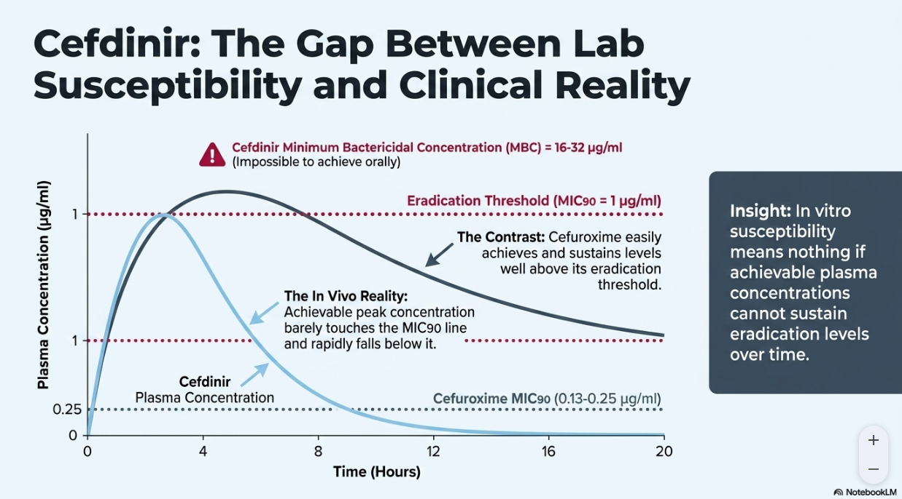
AI generated content
This is what Google’s Gemini / NotebookLM thought, but I did not validate that it calculated the AUC correctly

Slide 35

What about cefepime? [3]
An even older in vitro study (1999, 3 years before LOTR two towers was released)
Investigating a new drug (everninomicin) that only made it to phase III
But also compared it to other new-er antibiotics (cefepime, linezolid, Merrem)
Cefepime had activity, but not great

Slide 36
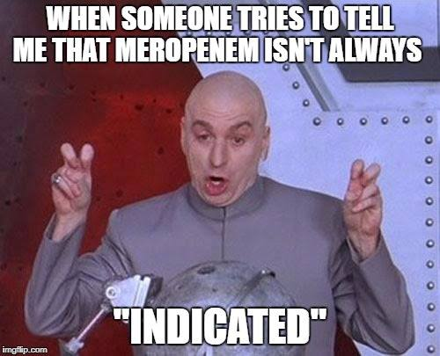
What about cefepime Merrem? [3]
An even older in vitro study (1999, 3 years before LOTR two towers was released)
Investigating a new drug (everninomicin) that only made it to phase III
But also compared it to other new-er antibiotics (cefepime, linezolid, Merrem)
Cefepime had activity, but not great
However, meropenem had excellent activity
Time-kill (@ x2 MIC) was comparable to ceftriaxone
Better than doxycycline

Slide 37
Case #2

Slide 38
Case 2: HPI
A 53 y/o F with PMH including decompensated NASH cirrhosis (ascites, PSE, EV), treated HCV, prior HBV, CKD, CAD, recent admission for left femur Fx (s/p IMN 4 months ago) c/b SBO & HRS + dialysis dependent AKI p/w GI symptoms & AMS from SNF

Slide 39
Case 2: HPI - prior hospital stay
A 53 y/o F with PMH including decompensated NASH cirrhosis (ascites, PSE, EV), treated HCV, prior HBV, CKD, CAD, recent admission for left femur Fx (s/p IMN 4 months ago) c/b SBO & HRS + dialysis dependent AKI p/w GI symptoms & AMS from SNF
-4 mo
Femur Fx
Four months ago, slipped on some ice at home and broke left femur
  Uneventful ORIF
Then had AKI → needed trialysis CVC for possible iHD
  Ileus vs possible SBO
During line placement, had emesis & aspiration → intubated and sent to MICU
  Started on CRRT
Hepatorenal → CRRT → iHD
Ileus vs SBO
PEG / Port / tunneled line
Now
Present day
AMS

Slide 40
Case 2: HPI - prior hospital stay
A 53 y/o F with PMH including decompensated NASH cirrhosis (ascites, PSE, EV), treated HCV, prior HBV, CKD, CAD, recent admission for left femur Fx (s/p IMN 4 months ago) c/b SBO & HRS + dialysis dependent AKI p/w GI symptoms & AMS from SNF
-4 mo
Femur Fx
SBO: Failed swallow studies → got PEG
Nutrition: was on TPN → port placed (for TPN)
AKI/HRS: CRRT → iHD
  Temp CVC removed → tunneled line placed
Hepatology stuff: Delisted due to prolonged intubation
  CT showed new splenic thrombosis (post-op)
ID stuff: Not really much, treated for aspiration
Hepatorenal → CRRT → iHD
Ileus vs SBO
PEG / Port / tunneled line
Now
Present day
AMS

Slide 41
Case 2: HPI - since last hospital stay
A 53 y/o F with PMH including decompensated NASH cirrhosis (ascites, PSE, EV), treated HCV, prior HBV, CKD, CAD, recent admission for left femur Fx (s/p IMN 4 months ago) c/b SBO & HRS + dialysis dependent AKI p/w GI symptoms & AMS from SNF
-4 mo
Femur Fx
Discharged to SNF from that month long admission
After about 1.5 months, no longer needing HD → tunneled line removed
Hepatorenal → CRRT → iHD
Ileus vs SBO
PEG / Port / tunneled line
-1 mo
Off of iHD
Now
Present day
AMS

Slide 42
Case 2: HPI - since last hospital stay
A 53 y/o F with PMH including decompensated NASH cirrhosis (ascites, PSE, EV), treated HCV, prior HBV, CKD, CAD, recent admission for left femur Fx (s/p IMN 4 months ago) c/b SBO & HRS + dialysis dependent AKI p/w GI symptoms & AMS from SNF
-4 mo
Femur Fx
Subsequent admission 2-3 weeks ago for SBO symptoms
Managed nonoperatively with NG tube
  …despite the fact that she already had a PEG tube?
They got a urine culture…
  Why did they get a urine culture? Who knows!
  Grew ESBL E coli → Rx Cipro (until ID Gold says fosfomycin)
Hepatorenal → CRRT → iHD
Ileus vs SBO
PEG / Port / tunneled line
-1 mo
Off of iHD
-2 wk
Admit for ?SBO
ESBL UTI
Now
Present day
AMS

Slide 43
Case 2: HPI - Present admission
A 53 y/o F with PMH including decompensated NASH cirrhosis (ascites, PSE, EV), treated HCV, prior HBV, CKD, CAD, recent admission for left femur Fx (s/p IMN 4 months ago) c/b SBO & HRS + dialysis dependent AKI p/w GI symptoms & AMS from SNF
-4 mo
Femur Fx
Sent from SNF to OSH by EMS (same OSH as prior admits)
Periumbilical pain
Nausea + intractable vomiting
No diarrhea, dyspnea, fevers, dysuria
Hepatorenal → CRRT → iHD
Ileus vs SBO
PEG / Port / tunneled line
-1 mo
Off of iHD
Initial H&P not focused much on mentation / neuro, but does note she seems “disoriented” but can respond non-verbally to questions
-2 wk
Admit for ?SBO
ESBL UTI
Now
Present day
AMS

Slide 44
Case 2: Social history, exposures, & risk factors
Geographic & Travel
Occupational
Substance & needles
Animals
Exposures
Unable to obtain

Slide 45
Case 2: Physical exam
BP | 145/102 | Pulse | 106 | SpO2 | 96 %
Temp | 36.7 °C (98.1 °F) | RR | 20 | BMI | 27 kg/m²
General | “mumbling and making no sense”, NAD, vitals reviewed
HEENT | NCAT; trachea appears midline, dry mucous membranes
Resp | Normal respiratory effort, symmetric chest rise
CV | RRR; extremities perfused
GI | Slight distention; periumbilical tenderness to palpation
Extremities | No clubbing, cyanosis; 1+ BLE edema
Neuro/MSK | “No focal deficit present”

Slide 46
Case 2: Labs
CBC | Result
WBC | 16.2
Hgb | 11.4
Platelets | 141
Neut % | 87%
Lymph # | 700
Eos % | 0%
Chem7 | Result
Na | 136
K | 3.6
HCO3 | 37
BUN | 12
Cr | 1.18
LFTs | Result
AST | 18
ALT | 14
Alk Phos | 111
Bili | 3.5
More or less baseline
Unclear baseline, but peak (prior to CRRT last admission) was 2.0

Slide 47
Case 2: Imaging
CT C/A/P WO:
Liver: Cirrhotic morphology
Gallbladder: Surgically absent
Bowel: PEG tube in the stomach. Air-fluid levels throughout the small intestine
Bones: Surgical hardware left hip
Impression:
Air-fluid levels in the stomach and small bowel. These findings are nonspecific but could be due to an ileus. An early or partial small bowel obstruction is not excluded

Slide 48
Case 2: Initial hospital course
# Intractable nausea and vomiting
# Possible ileus
- CT results reviewed
- NPO for now use percutaneous endoscopic gastrostomy tube
- Consult General surgery appreciate recs
- LR 75 mL/HR continuous
The following day
Perhaps we should get a CT brain, since this isn’t her baseline…

Slide 49
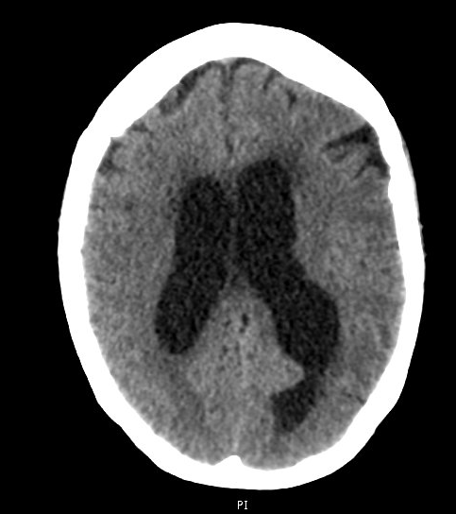
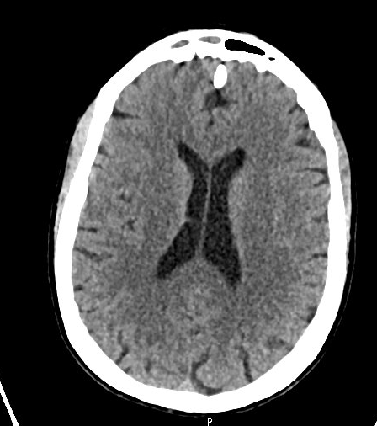
Case 2: CT head
Current admission
Femur fracture admission

Slide 50
Case 2: CT head
CT head WO
New onset hydrocephalus pattern with probable subependymal edema in the periventricular region.
No obvious obstructing mass or intraventricular/intracranial bleed is seen as an etiology on this scan. Differential considerations need to include the possibility of infectious etiology causing difficulty resorbing CSF
Current admission

Slide 51
Case 2: Summary
A 53 y/o F with PMH including decompensated NASH cirrhosis (ascites, PSE, EV), treated HCV, prior HBV, CKD, CAD, recent admission for left femur Fx (s/p IMN 4 months ago) c/b SBO & HRS + dialysis dependent AKI p/w abd pain, n/v, & AMS from SNF
Initially thought symptoms were related to intra-abdominal process, but once they figured out her mental status was not at baseline → discovered CSF flow was also not at baseline
Current admission
Femur fracture admission
CBC
WBC | 16.2
Hgb | 11.4
Platelets | 141
Neut % | 87%
Lymph # | 700
Eos % | 0%
Chem7
Na | 136
K | 3.6
HCO3 | 37
BUN | 12
Cr | 1.18
LFTs
AST | 18
ALT | 14
Alk Phos | 111
Bili | 3.5

Slide 52
Case 2: Ruby transfer
“ Initial pressure was low”
IRRAflow CSF
Opening Pr | ???
WBC | 86
Neut % | 75
RBC | 367
Protein | 145
Glucose | 56
Serum | 166
CSF:Serum | 0.33
Admitted to NCCU
Overnight IRRAflow placed
MRI brain ordered (more on this later)
CSF studies return…
Started CNS vanco & ceftriaxone
…but no blood cultures
…or droplet precautions
CSF | Result
VZV PCR | …
HSV PCR | …
S pneumo Ag | …
CryptoAg | …
Biofire | …
Serum | Result
HIV | Negative
HCV PCR | TND

Slide 53
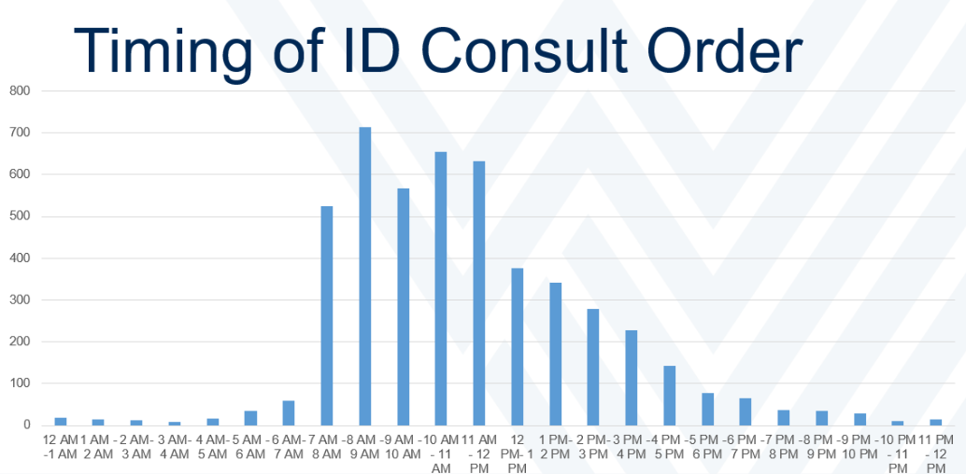

You are here
4pm

Slide 54
Case 2: MRI brain
Let my wife explain it

Slide 55
Case 2: MRI brain W/WO
IMPRESSION:
Purulent fluid layering within the occipital horns of the lateral ventricles, with small amount of hemorrhage in the right lateral ventricle
  Stable positioning of right frontal approach EVD
Abnormal leptomeningeal enhancement along the:
  Brainstem - medulla & pons
  Right cerebellum
  Cranial nerves - right oculomotor, R abducens, R CN ⅞ complex
Nonsuppression of CSF signal on FLAIR in the basal cisterns (interpeduncular & prepontine) and within the cerebral sulci
Findings are concerning for ventriculitis and meningitis

Slide 56
Case 2: CSF studies & initial ID plan
CSF | Result
VZV PCR | …
HSV PCR | …
S pneumo Ag | …
CryptoAg | …
Biofire | …

Slide 57
Case 2: CSF studies & initial ID plan
Add ampicillin
Droplet isolation
Send CSF biofire
  Not validated for ventricular fluid
Follow cultures
  However, patient got a dose of ertapenem at OSH (ESBL “UTI”)
CSF | Result
VZV PCR | Negative
HSV PCR | Negative
S pneumo Ag | Negative
CryptoAg | Negative
Biofire | ???

Slide 58

Case 2: The next 48 hours
CSF | Day 1 | Day 3
EVD mode | Drain only | Irrigation
WBC | 86 | 160
Neut % | 75% | 83%
RBC | 367 | 13
Protein | 145 | 18
Glucose | 56 | 32
Routine Cx | NG@2D | G/S neg
Fungal Cx | NG@2D | …
AFB Cx | Smear (-) | …
Remains afebrile (but cirrhosis)
Mental status not better
Starts getting very weird nystagmus
Next steps?

Slide 59
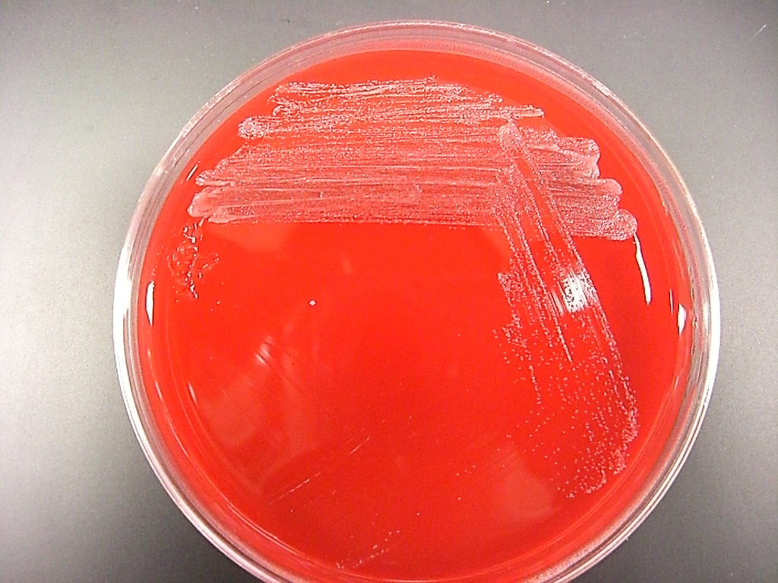
Case 2: patience is a virtue
Apparently mNGS does increase diagnostic yield…
…CSF cultures finally started growing the day after we sent the expensive test

Slide 60

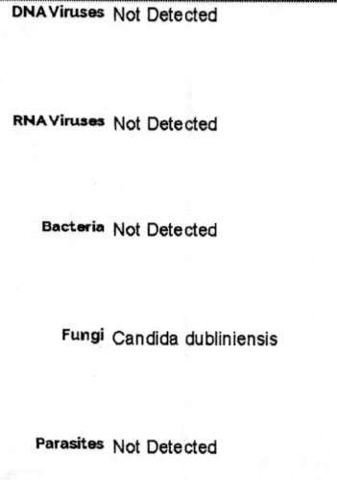

Case 2: The results
CSF culture: <5 Colonies Candida dubliniensis
5-FC: 0.06 (S)
Flucon: 0.50 (S)
Reads aligning to Candida dubliniensis were identified at a subthreshold level, below that for formal reporting thresholds.
As a commensal organism of human flora, this detection may represent environmental or mucocutaneous contamination. Clinical correlation is recommended.
SPECIMEN NOTES
Sample contains high DNA background, there is decreased sensitivity for detection of DNA viruses, bacteria, fungi, and parasites.

Slide 61
mNGS

Slide 62

Alphabet soup of molecular testing [7]
Targeted PCR (singleplex): Targets specific nucleic acid sequences using primers for that pathogen
Examples: HSV or VZV PCR
Pros: Cheap, often done in house
Cons: Limited to single pathogen, so you must be explicit in your DDx based on clinic or epidemiologic history
PCR panel (multiplex): Amplifies two or more target sequences (in the same reaction) using multiple primers
Examples: Biofire
Pros: Often done in house, not as expensive as the other tests talked about here
Cons: Culprit must be on the panel (e.g. if that strain of enterovirus is not on the biofire [source], the test will be negative)

Slide 63
Alphabet soup of molecular testing [7]
Universal PCR (broad range): utilizes primers to amplify and sequence conserved areas of the genome (bacteria=16S rRNA, fungi=28S rRNA)
Pro: Untargeted, broad testing
Limitations:
  Does not detect viruses or parasites
  May fail to identify unusual bacterial/fungal pathogens outside the primers specificity
Traditional PCR
Targeted PCR (HSV, VZV)
Multiplex PCR (Biofire)
Uses primer(s) specific to desired pathogen(s)
Pros: Affordable, faster turn around
Need to know what you’re testing for: If it’s not on the PCR/panel, won’t show up

Slide 64
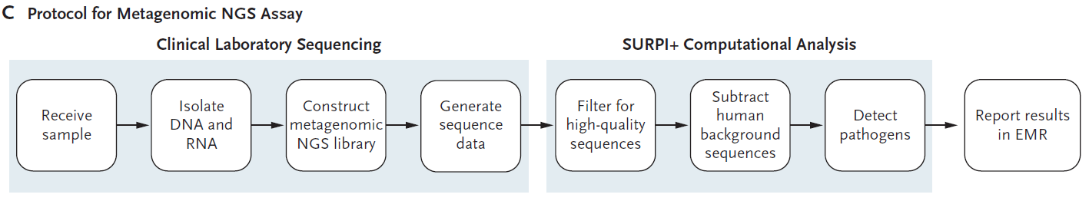
Alphabet soup of molecular testing [7]
Universal PCR (broad range): utilizes primers to amplify and sequence conserved areas of the genome (bacteria=16S rRNA, fungi=28S rRNA)
Pro: Untargeted, broad testing
Limitations: No viruses or unusual bacteria/fungi
Metagenomic NGS (mNGS): sequences any nucleic acid fragments present (including host) → uses bioinformatics to filter out host DNA
Traditional PCR
Targeted PCR (HSV, VZV)
Multiplex PCR (Biofire)
Uses primer(s) specific to desired pathogen(s)
Pros: Affordable, faster turn around
Need to know what you’re testing for: If it’s not on the PCR/panel, won’t show up

Slide 65
Alphabet soup of molecular testing [7]
Universal PCR (broad range): utilizes primers to amplify and sequence conserved areas of the genome (bacteria=16S rRNA, fungi=28S rRNA)
Pro: Untargeted, broad testing
Limitations: No viruses or unusual bacteria/fungi
Metagenomic NGS (mNGS): sequences any nucleic acid fragments present (including host) → uses bioinformatics to filter out host DNA
Pro: Unbiased (like uPCR), may identify resistance (ESBL)
Con: Requires the most clinical interpretation, because it’s a hypothesis free test
  Expensive: $2000 - $3500
Traditional PCR
Targeted PCR (HSV, VZV)
Multiplex PCR (Biofire)
Uses primer(s) specific to desired pathogen(s)
Pros: Affordable, faster turn around
Need to know what you’re testing for: If it’s not on the PCR/panel, won’t show up

Slide 66
Does mNGS provide clinical benefit?
Advanced molecular testing has a role if extensive workup is negative
e.g. 2014 case where a teenager had 30+ conventional tests, only for mNGS to diagnosed neuro-leptospirosis [7]

Slide 67

Does mNGS provide clinical benefit? [5]
Landmark multicenter trial (NEJM, 2019)
204 adult & pediatric patients enrolled, who were pretty ill
  49% admitted to ICU
  11% mortality
Conventional &/or mNGS diagnosed 58 CNS infections
58 CNS infections diagnosed

Slide 68
Does mNGS provide clinical benefit? [5]
Landmark multicenter trial (NEJM, 2019)
204 patients, 58 CNS infections
55% (n=32) had mNGS diagnosis
  22% (n=13) were only from mNGS
  33% on both mNGS & conventional
Of the 26 infections (45%) not detected on mNGS
  19% (n=11) from serologic testing
  12% (n=7) from tissue Dx
  14% (n=8) presumably diagnosed from CSF
Serologic Dx
Dx on mNGS
Tissue Dx

Slide 69

More recently out of China [9]
Single institution retrospective review (June 2022 - March 2024)
Inclusion / exclusion:
Patients suspected of having possible encephalitis meningoencephalitis (n=285)
Had a lumbar puncture
Got antibiotics before LP
Exclude: No definitive diagnosis (n=22)
Defining “definitive diagnosis”
Consensus of 3 senior neurologists based on predefined criteria including:
Clinical presentation
CSF analysis
Cultures
Conventional molecular testing
  Serologies
  Antibody indices
  PCR (targeted or broad range)
Response to therapy

Slide 70
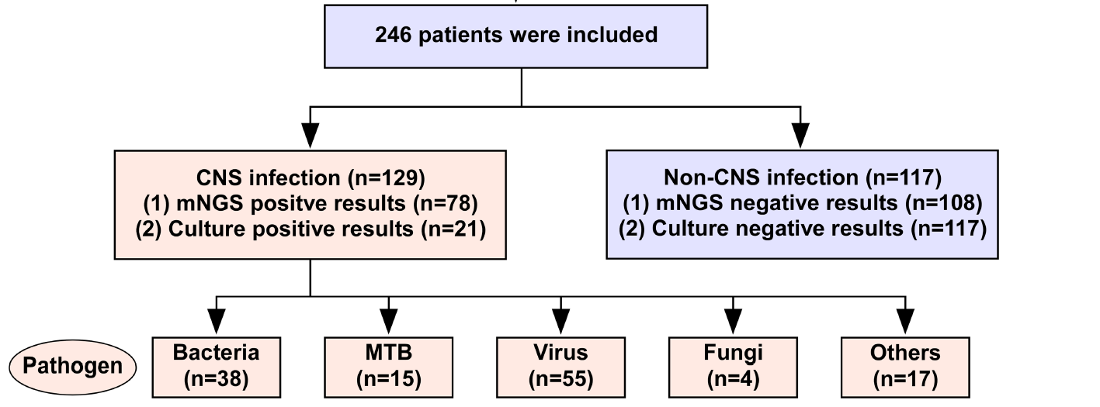
More recently out of China [9]
Single institution retrospective review (June 2022 - March 2024)

Slide 71
More recently out of China [9]
mNGS Diagnosed
(and cultures missed)
Cultures Grew
(with negative mNGS)
Streptococcus pneumoniae (x2)
Acinetobacter spp (x2)
Pseudomonas aeruginosa
Cryptococcus neoformans
Aspergillus flavus
Legionella cincinnatiensis
Staphylococcus epidermidis
Staphylococcus hominis
Staphylococcus capitis

Slide 72
More recently out of China [9]
Concordance between “consensus definitive diagnosis” and…
mNGS: 73.2%
Conventional: 61%
Culture alone: 54.1%
 | Concordance with definitive diagnosis
 | mNGS | Culture | Conventional
Fungal | 100% (4/4) | 50% (2/4) | 75% (3/4)
MTB | 46.7% (7/15) | N/A | 26.7% (4/15)
Overall | 60.5% (78/129) | 28.8% (17/59) | 42.6% (55/129)

Slide 73
More recently out of China [9]
Concordance between “consensus definitive diagnosis” and…
mNGS: 73.2%
Conventional: 61%
Culture alone: 54.1%
Cut for time [6]
A separate study from UCSF (done in Ugandan adults w/ HIV) used mNGS and machine learning to distinguish between TB meningitis & it’s mimics
Sensitivity: 89%
Specificity: 87%
 | Concordance with definitive diagnosis
 | mNGS | Culture | Conventional
Fungal | 100% (4/4) | 50% (2/4) | 75% (3/4)
MTB | 46.7% (7/15) | N/A | 26.7% (4/15)
Overall | 60.5% (78/129) | 28.8% (17/59) | 42.6% (55/129)

Slide 74

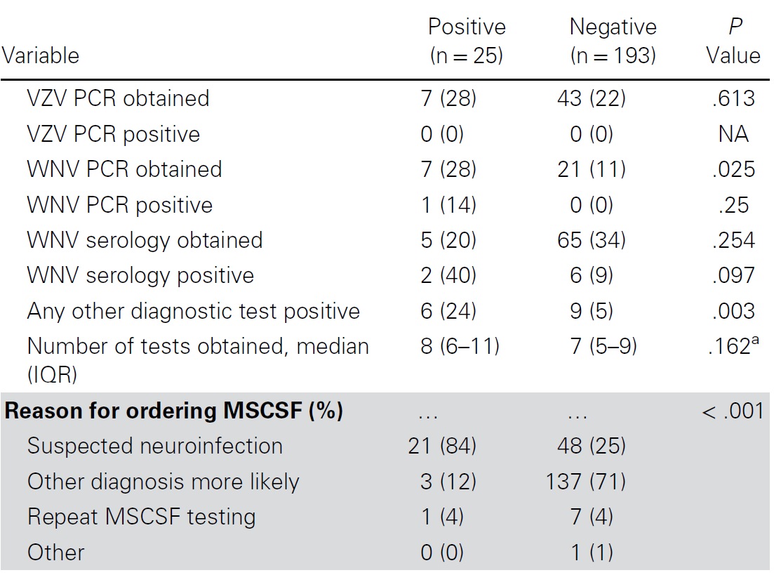
Mayo clinic review [8]
Mayo clinic did a retrospective review after using mNGS on CSF (n = 210 adults)
The most interesting results are in the 69 patients where suspected neurologic infection was top of the DDx
  19 patients tested positive, 63% of whom were diagnosed on mNGS only
  Sensitivity of 64.3%

Slide 75
Mayo clinic review [8]
Mayo clinic did a retrospective review after using mNGS on CSF (n = 210 adults)
The most interesting results are in the 69 patients where suspected neurologic infection was top of the DDx
  19 patients tested positive, 63% of whom were diagnosed on mNGS only
  Sensitivity of 64.3%
Odds of positive test
Clinically high pretest suspicion of infection OR=20.1 (5.8-70.5)
Immunosuppression OR=3.5 (1.4 - 8.9)
Antibiotics before LP OR=4.4 (1.7 - 11.3)

Slide 76
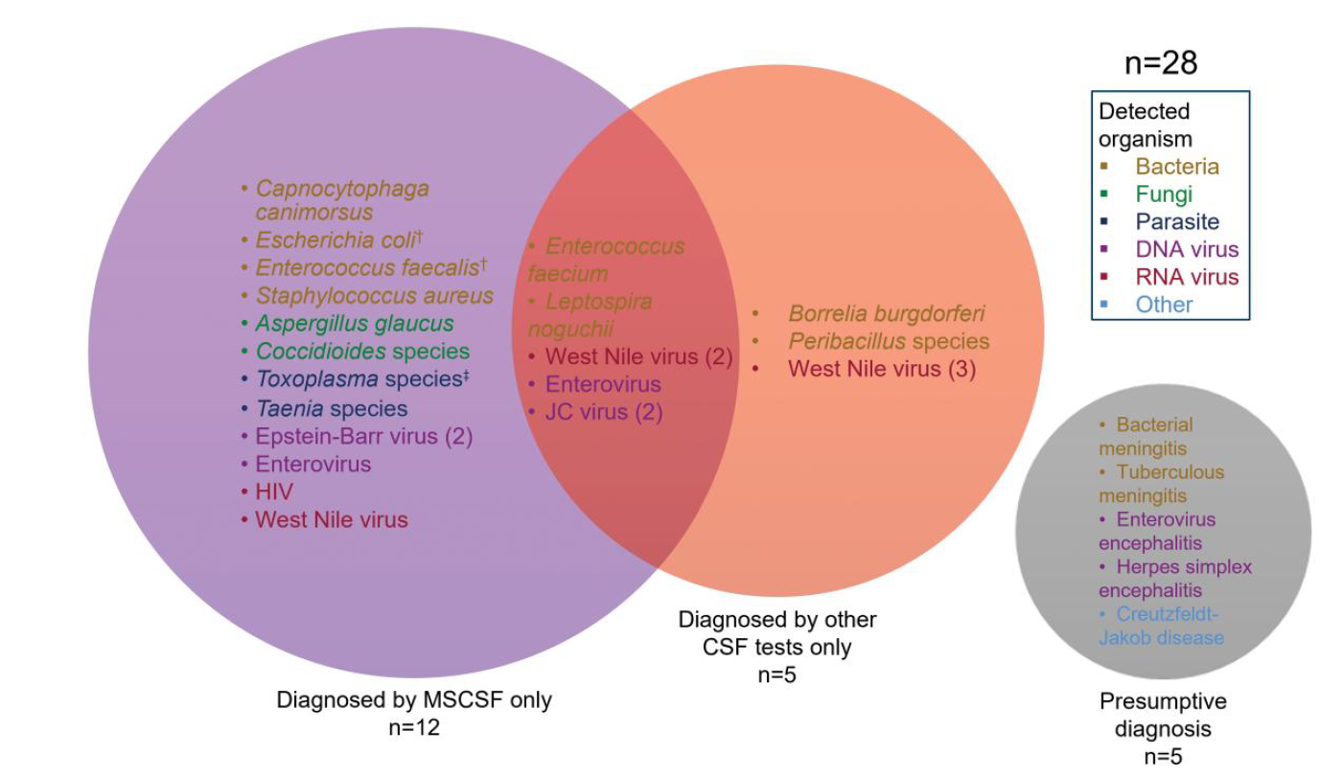
Mayo clinic review [8]

Slide 77
Mayo clinic review [8]
…but most of Mayo’s testing (64%) was when some other diagnosis was more likely
This probably isn’t the most cost effective, right?

Slide 78

Ruling out infection [4]
Used a retrospective cohort (2010-2017) of patients diagnosed with either:
  CNS infections or
  Autoimmune encephalitis
Used these patients to model how mNGS could have changed management
  Excluded: patients who had a diagnosis in <48h or positive Biofire
  Used Bayesian models to compare routine care --vs-- mNGS sent on the initial LP

Slide 79
Ruling out infection [4]
Used a retrospective cohort (2010-2017) of patients diagnosed with either:
  CNS infections or
  Autoimmune encephalitis
Used these patients to model how mNGS could have changed management
  Excluded: patients who had a diagnosis in <48h or positive Biofire
  Used Bayesian models to compare routine care --vs-- mNGS sent on the initial LP
Among the 29 patients with confirmed autoimmune encephalitis, doing upfront mNGS would:
Avoid 126 etiologic tests (4.3 per patient)
Avoided 297 days of ruling out infection (10.2 per patient)

Slide 80
Ruling out infection [4]
Greatest benefit was autoimmune cohort
Reduced infectious testing by 92% (vs 64% in infectious cohort)
Reduced time to diagnosis by 10.2 days (vs 6.9 days)
Used a retrospective cohort (2010-2017)
  Excluded: patients who had a diagnosis in <48h or positive Biofire
  Used Bayesian models to compare routine care --vs-- mNGS sent on the initial LP
 | Total number avoided (per patient)
 | LPs | Etiologic tests | Days saved
DNA virus (n=23) | 2 (0.09) | 88 (3.8) | 145 (6.3)
Bacterial (n=16) | 12 (0.75) | 30 (1.9) | 144 (9)
Fungal (n=7) | 3 (0.49) | 29 (4.1) | 61 (8.7)
Autoimmune (n=29) | 2 (0.10) | 126 (4.3) | 297 (10.2)

Slide 81

What about cost?
Estimated cost to organization
$100-250
Lyme IgG, CSF
West Nile RNA, CSF
Rabies Ab Screen RFFIT
Multiple sclerosis profile, serum & CSF
$700: CSF biofire
$850: MOG Ab w/ reflex titer, CSF
$1000: NMDA receptor antibody test
$1000: Tick-borne disease, acute molecular panel
$3000: MRI brain W/WO
$250-500
Serum autoimmune & paraneoplastic panel
AQP4 Ab w/ reflex to titer (serum + CSF)
Notes:
$3070: MRI brain W/WO
$1070: Tick-borne disease, acute molecular panel, non-lyme
$1000: NMDA receptor antibody test
$850: MOG Ab w/ reflex titer, CSF
$700: CSF biofire
$500: AQP4 Ab w/ reflex to titer (serum & CSF)
$350: ENCEPHALOPATHY, AUTOIMMUNE/PARANEOPLASTIC EVALUATION,SERUM
$180: Multiple sclerosis profile, serum & CSF
$160: Rabies Antibody Screen RFFIT
$130: West Nile RNA, CSF
$130: Lyme IgG, CSF

Slide 82
What about cost?
Estimated cost to organization
$100-250
Lyme IgG, CSF
West Nile RNA, CSF
Rabies Ab Screen RFFIT
Multiple sclerosis profile, serum & CSF
$700: CSF biofire
$850: MOG Ab w/ reflex titer, CSF
$1000: NMDA receptor antibody test
$1000: Tick-borne disease, acute molecular panel
$3000: MRI brain W/WO
$250-500
Serum autoimmune & paraneoplastic panel
AQP4 Ab w/ reflex to titer (serum + CSF)
The literature says DelveDetect runs around $2000 - $3500
Notes:
$3070: MRI brain W/WO
$1070: Tick-borne disease, acute molecular panel, non-lyme
$1000: NMDA receptor antibody test
$850: MOG Ab w/ reflex titer, CSF
$700: CSF biofire
$500: AQP4 Ab w/ reflex to titer (serum & CSF)
$350: ENCEPHALOPATHY, AUTOIMMUNE/PARANEOPLASTIC EVALUATION,SERUM
$180: Multiple sclerosis profile, serum & CSF
$160: Rabies Antibody Screen RFFIT
$130: West Nile RNA, CSF
$130: Lyme IgG, CSF

Slide 83
What about cost?
Rabies?
mNGS has diagnosed rabies on the CSF [10]
Estimated cost to organization
$100-250
Lyme IgG, CSF
West Nile RNA, CSF
Rabies Ab Screen RFFIT
Multiple sclerosis profile, serum & CSF
$100-250
Lyme IgG, CSF
West Nile RNA, CSF
Rabies Ab Screen RFFIT
Multiple sclerosis profile, serum & CSF
$700: CSF biofire
$850: MOG Ab w/ reflex titer, CSF
$1000: NMDA receptor antibody test
$1000: Tick-borne disease, acute molecular panel
$3000: MRI brain W/WO
$250-500
Serum autoimmune & paraneoplastic panel
AQP4 Ab w/ reflex to titer (serum + CSF)
The literature says DelveDetect runs around $2000 - $3500
Notes:
$3070: MRI brain W/WO
$1070: Tick-borne disease, acute molecular panel, non-lyme
$1000: NMDA receptor antibody test
$850: MOG Ab w/ reflex titer, CSF
$700: CSF biofire
$500: AQP4 Ab w/ reflex to titer (serum & CSF)
$350: ENCEPHALOPATHY, AUTOIMMUNE/PARANEOPLASTIC EVALUATION,SERUM
$180: Multiple sclerosis profile, serum & CSF
$160: Rabies Antibody Screen RFFIT
$130: West Nile RNA, CSF
$130: Lyme IgG, CSF

Slide 84
Limitations with mNGS [7]
Two key principles:
Detection requires a pathogen’s nucleic acid to be in the CSF
Presence of nucleic acid does not necessarily mean it is causing the illness

Slide 85
Limitations with mNGS [7]
Specimen Handling
Nucleic acid degrades at room temperature, especially neuroinvasive RNA viruses
Sterile processing to limit contamination
Key principles
Pathogen DNA/RNA must be in CSF to be detected
Detection of DNA/RNA does not necessarily mean it is causing the illness

Slide 86
Limitations with mNGS [7]
Specimen Handling
Nucleic acid degrades at room temperature, especially neuroinvasive RNA viruses
Sterile processing to limit contamination
Anatomic Factors
Only tests the CSF, not the entire nervous system
Expect negative results for walled off or epidural abscesses
Key principles
Pathogen DNA/RNA must be in CSF to be detected
Detection of DNA/RNA does not necessarily mean it is causing the illness

Slide 87
Limitations with mNGS [7]
Specimen Handling
Nucleic acid degrades at room temperature, especially neuroinvasive RNA viruses
Sterile processing to limit contamination
Anatomic Factors
Only tests the CSF, not the entire nervous system
Expect negative results for walled off or epidural abscesses
Pathogen Factors
DNA/RNA concentrations fluctuate; use serologies when appropriate
Paucicellular infections: Low loads in neuroborreliosis & neurosyphilis
  TB is just hard to diagnose, but maybe not with machine learning on host gene expression; see citation [6]
Temporal Clearance: Viral loads peak days before symptom onset in arboviral (e.g. WNV) & tick-borne encephalitis
Key principles
Pathogen DNA/RNA must be in CSF to be detected
Detection of DNA/RNA does not necessarily mean it is causing the illness

Slide 88
Limitations with mNGS [7]
Host Factors
Nucleic acid from host cells (WBC, RBC) compete with pathogen nucleic acid during sequencing
If host response > pathogen abundance (pleocytosis > 200 [5]), may decrease sensitivity
Perhaps this is why mNGS does better with immunocompromise
The host-response limitation is not present in uPCR (broad range), since they have set primers (16S, 28S)
Specimen Handling
Nucleic acid degrades at room temperature, especially neuroinvasive RNA viruses
Sterile processing to limit contamination
Anatomic Factors
Only tests the CSF, not the entire nervous system
Expect negative results for walled off or epidural abscesses
Pathogen Factors
DNA/RNA concentrations fluctuate; use serologies when appropriate
Paucicellular infections: Low loads in neuroborreliosis & neurosyphilis
  TB is just hard to diagnose, but maybe not with machine learning on host gene expression; see citation [6]
Temporal Clearance: Viral loads peak days before symptom onset in arboviral (e.g. WNV) & tick-borne encephalitis
Key principles
Pathogen DNA/RNA must be in CSF to be detected
Detection of DNA/RNA does not necessarily mean it is causing the illness

Slide 89
Reframing the role of mNGS
“Rather than triaging a narrow set of suspected pathogens based on pretest probability, clinicians now must interpret unbiased sequencing data within the clinical context. In this way, mNGS redefines the clinician’s role—from choosing what to test to discerning what the findings mean. Far from replacing it, clinical judgment remains integral to the impact and utility of mNGS”
“Clinical interpretation…cannot be reduced to a simple yes/no readout and requires careful integration with the patient’s presentation and other diagnostic data…in a hypothesis-free testing framework, it is the interpretation that determines whether an mNGS result advances clinical decision-making.”
— Waldrop & Reddy (Clin Infect Dis, 2026) [7]

Slide 90
Intrathecal antimicrobials

Slide 91
Revisiting a topic from my first conference [link]
A 53 y/o F with PMH including decompensated NASH cirrhosis (ascites, PSE, EV), treated HCV, prior HBV, CKD, CAD, recent admission for left femur Fx (s/p IMN 4 months ago) c/b SBO & hepatorenal syndrome + dialysis dependent AKI p/w abd pain, n/v, & AMS from SNF and found to have Candida dubliniensis rhombencephalitis.
CBC
WBC | 6.1
Hgb | 7.6
Platelets | 34
Chem7
Na | 141
K | 3.5
HCO3 | 24
BUN | 12
Cr | 1.18
Today is “day 0” of clear CSF
Are we really going to swing multiple weeks of AmBisome
What is the role of IT antimicrobials?
Baseline creatinine is 0.75
When she needed dialysis, creatine _{max} = 2.0

