Slide 1
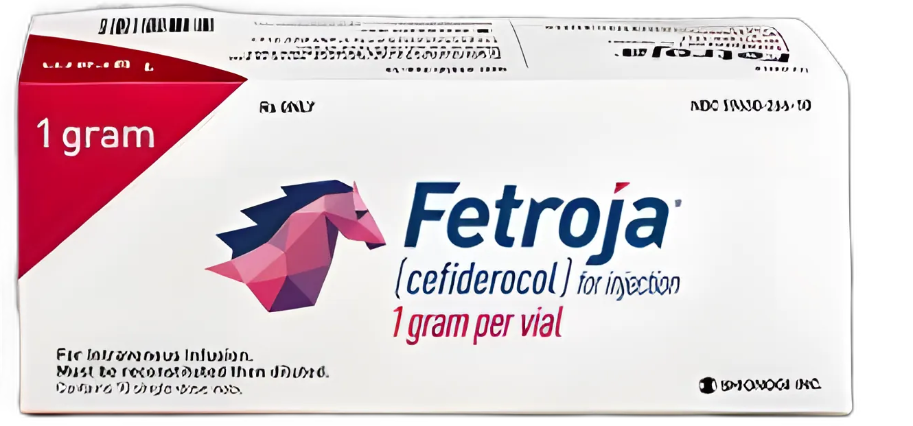
Choose your own
adventure
antibiotics
CLINID conference
Hunter Ratliff
10/29/2026
Ages, dates, and other identifying
information may have been changed
I have no conflict of interest in relation to this presentation

Slide 2
Shortcuts
Case 1: Start | Day 0 | Overview
Discussion: Start | Objectives
Polls: Q-D.1 | Q-D.2
Takeaways
Key discussion slides
Clonal isn't uniform | Selection | One specimen
His micro | Antibiogram | Day 11–105 | Weird case
Cefiderocol | Hard to test | CREDIBLE-CR | MERINO
Back to the patient | Cure | Was he a 60?

Slide 3

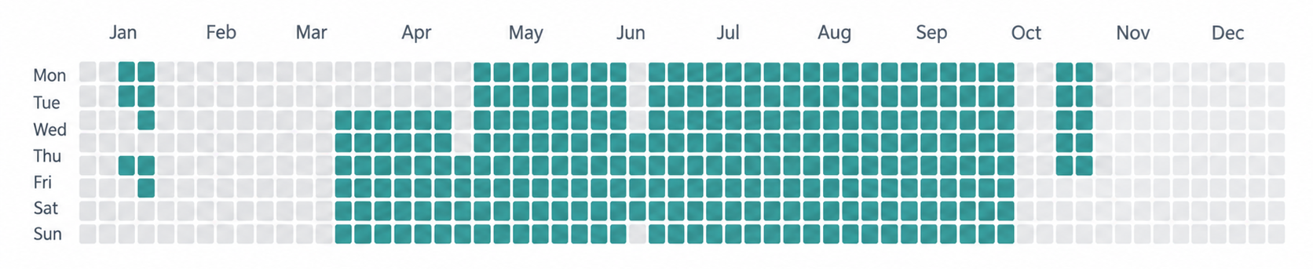
Can we do it? Yes we can (maybe)
Today we are going to cover 200 days worth of data (~75% of the year so far)
Buckle up!
Responsible use of AI
Claude Opus 5.5 (Anthropic) drafted the slide design, first-draft text, and created timeline graphics
ChatGPT 6 (Open AI) and Nano Bannana 2 (Google) created some graphics, but Anthropic is a more ethical choice
I chose the content and cases, educational points, and verified the literature search. Hunter is responsible for content and accuracy of this presentation
No patient identifiers were shared with the AI (aside from Abridge, which was clutch)
Dates are presented as hospital days relative to date of admission

Slide 4
Case 1: Never achieved source control
procedures
inpatient
leak
5 mo prior
4 mo
3 mo
2 mo
1 mo
Day 0
A 57 y/o M with no major PMH presents 5 months after partial cholecystectomy
5 months prior: RUQ pain; lap chole found a gangrenous, perforated gallbladder → subtotal cholecystectomy + drain; no antibiotics at discharge
1 week later: drain removed, pus expressed → retained stone in the gallbladder fossa → perc chole tube; 4 days of Augmentin
4 months prior: failed cap trial; fluoro showed a stump leak and a patent cystic duct draining into the CBD
3 months prior: ERCP with CBD stent
Developed ERCP pancreatitis into ongoing biliary leak :(

Slide 5
Case 1: Post-ERCP pancreatitis and the ICU
procedures
inpatient
leak
5 mo prior
4 mo
3 mo
2 mo
1 mo
Day 0
3 months prior: post-ERCP pancreatitis, the day after the ERCP
Serratia marcescens bacteremia
Multiorgan failure requiring CRRT; abdominal compartment syndrome
3 laparotomies in 5 days: 2 decompressive, then closure with bridging mesh
Treated with Merrem and Zosyn; discharged after 1 month

Slide 6
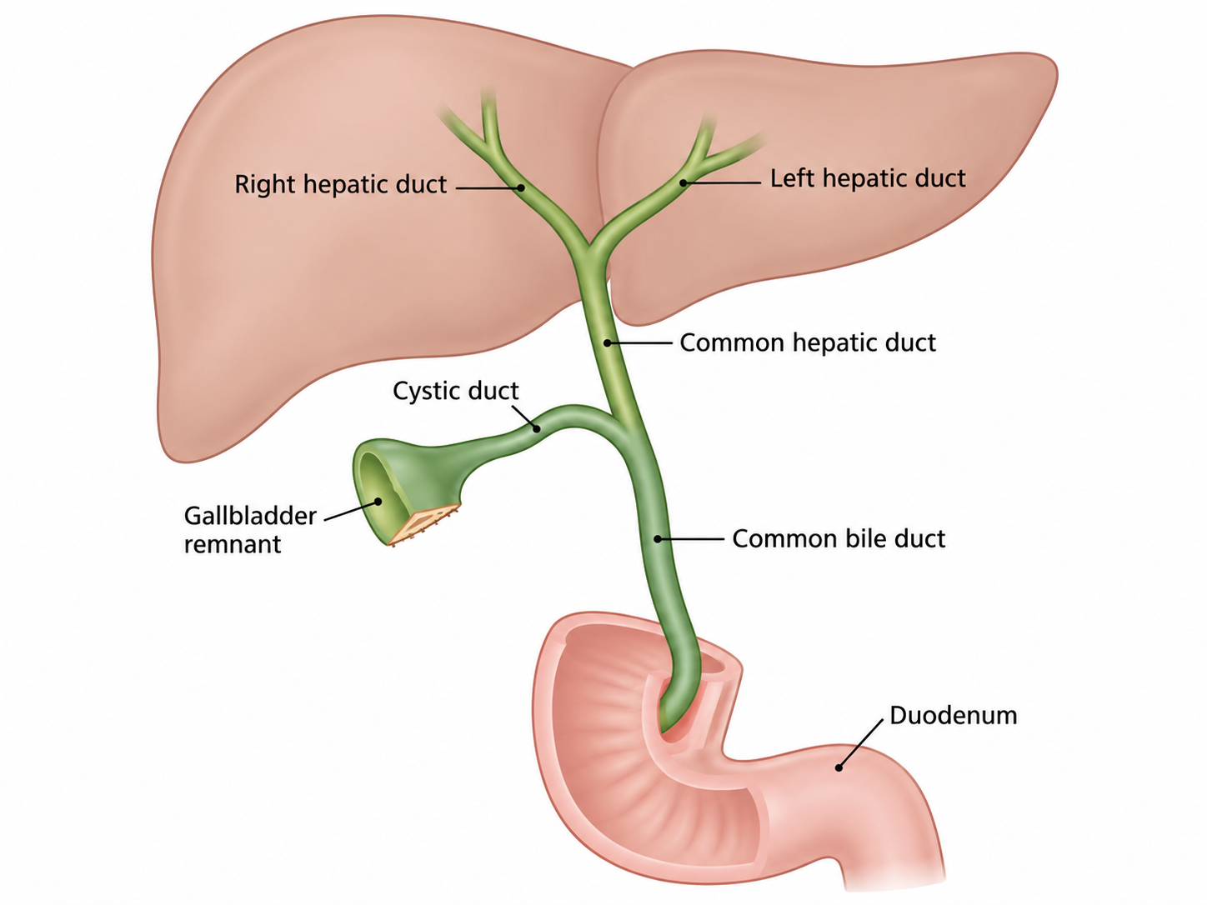
Case 1: Infected necrosis, ongoing leak
procedures
inpatient
leak
5 mo prior
4 mo
3 mo
2 mo
1 mo
Day 0
7 weeks prior: admitted here with lobulated free fluid c/w peritonitis and pancreatitis
IR drain grew mixed flora; bilateral ureteral stents for compression
EUS with LAMS: Pseudomonas + Serratia → Merrem + micafungin; 2 necrosectomies
2.5 weeks prior: ERCP confirmed the cystic duct leak → new cystic duct + CBD stents
Discharged on Merrem + micafungin; readmitted 4 days later (Day 0)
Before Day 0:
13 procedures
leak documented for 100+ days

Slide 7
Day 0
Don’t worry, details are not (that) important
Well, some are, but we’ll touch on them again

Slide 8
1: Admitted for VRE bacteremia
Admitted with sepsis
Found to have VRE bacteremia
Was on Merrem & micafungin OPAT
Started on linezolid / daptomycin (& eravacycline)
BCx cleared quickly
Had IR drain upsize (day 10)
  No micro sent :(
blood
D0 VRE
(on MEM + MICA)
airway
abdomen
MEM · 30 d
FEP
LZD
DAP · 11 d
MICA · 34 d
D10 drain upsize
MTZ
ERV · 7 d
D0
D10
D20
D30
ICU

Slide 9
2: MDRO gram negative pneumonia
1 VRE BSI
2 MDR VAP / HAP
Admitted with sepsis 2/2 VRE bacteremia
Was on Merrem & micafungin OPAT
Started on linezolid & daptomycin
Got IR drain upsize, no micro
blood
D0 VRE
(on MEM + MICA)
D11 tracheal aspirate
PsAr + BCC
airway
abdomen
Developed pneumonia while on daptomycin & eravacycline
3+ & 2+ MDR Pseudomonas aeruginosa (2 strains)
3+ Mucoid Pseudomonas aeruginosa
3+ Burkholderia cepacia complex
MEM · 30 d
FEP
8 d
LZD
DAP · 11 d
Pseudomonas testing
Resistant: Cefepime, Zosyn, Merrem
Sensitive: ceftolaz/tazo (Zerbaxa), cefiderocol (Fetroja)
Burkholderia cepacia complex
Don’t you wish we could
MICA · 34 d
D10 drain upsize
not cultured
MTZ
ERV · 7 d
D0
D10
D20
D30
ICU

Slide 10
2: MDRO gram negative pneumonia
1 VRE BSI
2 MDR VAP / HAP
Developed pneumonia while on daptomycin & eravacycline
3+ & 2+ MDR Pseudomonas aeruginosa (2 strains)
3+ Mucoid Pseudomonas aeruginosa
3+ Burkholderia cepacia complex
blood
D0 VRE
(on MEM + MICA)
D11 tracheal aspirate
PsAr + BCC
→ FDC started D15
D20 repeat: PsAr (C/T I, TOB S) + BCC
→ FDC + SXT + inhaled TOB
airway
abdomen
Started on cefiderocol (Fetroja), which should treat both the PsAr and Burkholderia cepacia complex (BCC)
MEM · 30 d
FEP
8 d
FDC · 15 d
LZD
DAP · 11 d
SXT · 9 d
Repeat trach Cx flora shifting:
3+ Burkholderia cepacia complex
1+ Pseudomonas aeruginosa
This is only after a few days of therapy
Bactrim is added, but the pseudomonas looks different
MICA · 34 d
D10 drain upsize
not cultured
D17 drain
MTZ
ERV · 7 d
D0
D10
D20
D30
ICU

Slide 11
2: MDRO gram negative pneumonia
1 VRE BSI
2 MDR VAP / HAP
blood
D0 VRE
(on MEM + MICA)
D11 tracheal aspirate
PsAr + BCC
→ FDC started D15
D20 repeat: PsAr (C/T I, TOB S) + BCC
→ FDC + SXT + inhaled TOB
airway
abdomen
Day | D11 |  | D20
Cefepime | R | R | R
Ceftazidime | I | R | R
Meropenem | R | R | R
Pip-tazo (TZP) | R | R | R
Ceftaz-avibactam (CZA) | S | R | S
Ceftolozane-tazo (C/T) | S | S | I
Cefiderocol (FDC) | S | S | S
Tobramycin | S | S | S
MEM · 30 d
FEP
8 d
FDC · 15 d
LZD
DAP · 11 d
SXT · 9 d
MICA · 34 d
D10 drain upsize
not cultured
D17 drain
MTZ
ERV · 7 d
D0
D10
D20
D30
ICU

Slide 12
3-5: Series of bacteremias
Low grade Candida lusitaniae fungemia
Micafungin & cleared BCx
1 VRE BSI
3
Candidemia
2 MDR VAP / HAP
blood
D0 VRE
(on MEM + MICA)
D26 Candida
(19 d off MICA)
airway
D11 tracheal aspirate
PsAr + BCC
→ FDC started D15
D20 repeat: PsAr (C/T I, TOB S) + BCC
→ FDC + SXT + inhaled TOB
abdomen
MEM · 30 d
FEP
8 d
FDC · 15 d
4 d
LZD
DAP · 11 d
LZD
SXT · 9 d
MICA · 34 d
MICA · 15 d
D10 drain upsize
not cultured
D21 abd wall abscess I&D
Cx lost in transit
D17 drain
MTZ
ERV · 7 d
D0
D10
D20
D30
D40
D50
D60
ICU

Slide 13
3-5: Series of bacteremias
Low grade Candida lusitaniae fungemia
Micafungin & cleared BCx
1 VRE BSI
3
Candidemia
2 MDR VAP / HAP
4
BCC bacteremia
2 days after stopping BCC coverage, develops prolonged Burkholderia cepacia complex bacteremia
Lines exchanged but still BCx (+)
Proceduralists try to get source control
No micro sent
D0 VRE
(on MEM + MICA)
D26 Candida
(19 d off MICA)
D32–39 BCx BCC
blood
D11 tracheal aspirate
PsAr + BCC
→ FDC started D15
2 d after FDC + SXT stopped
airway
D20 repeat: PsAr (C/T I, TOB S) + BCC
→ FDC + SXT + inhaled TOB
abdomen
MEM · 30 d
FEP
8 d
FDC · 15 d
4 d
Cefiderocol · 27 d
Also, we can’t get susceptibilities on BCC from the blood, so treating blindly
LZD
DAP · 11 d
LZD
SXT · 9 d
Bactrim · 24 d
MICA · 34 d
MICA · 15 d
D10 drain upsize
not cultured
D21 abd wall abscess I&D
Cx lost in transit
D24 cystic duct embolization
+ biloma drain exchange
D17 drain
MTZ
ERV · 7 d
D0
D10
D20
D30
D40
D50
D60
ICU

Slide 14
3-5: Series of bacteremias
Low grade Candida lusitaniae fungemia
Micafungin & cleared BCx
1 VRE BSI
3
Candidemia
5
Recurrent VRE BSI
2 MDR VAP / HAP
4
BCC bacteremia
2 days after stopping BCC coverage, develops prolonged Burkholderia cepacia complex bacteremia
Lines exchanged but still BCx (+)
Proceduralists try to get source control
No micro sent
D0 VRE
(on MEM + MICA)
D26 Candida
(19 d off MICA)
D32–39 BCx BCC
D43–45 VRE
(8 d since LZD/DAP)
blood
D11 tracheal aspirate
PsAr + BCC
→ FDC started D15
2 d after FDC + SXT stopped
airway
D20 repeat: PsAr (C/T I, TOB S) + BCC
→ FDC + SXT + inhaled TOB
abdomen
MEM · 30 d
FEP
8 d
FDC · 15 d
4 d
Cefiderocol · 27 d
Also, we can’t get susceptibilities on BCC from the blood, so treating blindly
LZD
DAP · 11 d
LZD
LZD
LZD
DAP · 17 d
SXT · 9 d
Bactrim · 24 d
MICA · 34 d
MICA · 15 d
Lastly, the VRE comes back in the blood
D10 drain upsize
not cultured
D21 abd wall abscess I&D
Cx lost in transit
D24 cystic duct embolization
+ biloma drain exchange
D50 IR drain
D17 drain
not cultured
MTZ
ERV · 7 d
Flagyl · 15 d
D0
D10
D20
D30
D40
D50
D60
ICU

Slide 15
6: VARD → pneumonias &/or IAI
Day | D11 |  | D20
Ceftazidime | I | R | R
Ceftaz-avibactam (CZA) | S | R | S
Ceftolozane-tazo (C/T) | S | S | I
Cefiderocol (FDC) | S | S | S
Tobramycin | S | S | S
1 VRE BSI
3
Candidemia
5
Recurrent VRE BSI
6 Recurrent MDR pulmonary / IAI flares
7 abd flare
2 MDR VAP / HAP
4
BCC bacteremia
D32–39 BCx BCC
After prolonged course of abx, deemed stable enough for surgery (VARD)
blood
D0 VRE
(on MEM + MICA)
D26 Candida
(19 d off MICA)
D43–45 VRE
(8 d since LZD/DAP)
D102 VSE, LZD-R
(1 of 2 BCx; 13 d off LZD)
D11 tracheal aspirate
PsAr + BCC
→ FDC started D15
2 d after FDC + SXT stopped
airway
D20 repeat: PsAr (C/T I, TOB S) + BCC
→ FDC + SXT + inhaled TOB
D66 BAL post-VARD
(x2 PsAr, low burden)
D103–104 BAL: x2 PsAr
(20k → 5–6k CFU/mL)
Aspirated in PACU → SICU problem now
BAL showed Pseudomonas
Started on Avycaz (CZA)..?
D105 drain
(VRE 3+, PsAr 2+)
abdomen
MEM · 30 d
FEP
8 d
FDC · 15 d
4 d
Cefiderocol · 27 d
5 d
CZA
FDC · 22 d
6 d
TZP · 11 d
LZD
DAP · 11 d
LZD
LZD
LZD
DAP · 17 d
LZD · 14 d
DAP · 11 d
But gets better anyways → extubated
6 days of abx (STOP-IT)
SXT · 9 d
Bactrim · 24 d
SXT · 7 d
MICA · 34 d
MICA · 15 d
D10 drain upsize
D21 abd wall abscess I&D
Cx lost in transit
But then develops fever & WBC
Concern about infected hematoma
Another long course
not cultured
D24 cystic duct embolization
+ biloma drain exchange
D50 IR drain
D66 VARD
not cultured
not cultured
D103 drain lost
D105 drain replaced
D17 drain
2+ PsAr
3+ VRE
MTZ
ERV · 7 d
Flagyl · 15 d
MTZ · 22 d
D0
D10
D20
D30
D40
D50
D60
D70
D80
D90
D100
D110
D120
ICU

Slide 16
7: Another flare of the belly?
P. aeruginosa
E. faecium (VRE)
BCC
Candida
inhaled tobramycin
negative blood cx
no PsAr-directed β-lactam
1 VRE BSI
3
Candidemia
5
Recurrent VRE BSI
6 Recurrent MDR pulmonary / IAI flares
7 abd flare
2 MDR VAP / HAP
4
BCC bacteremia
D32–39 BCx BCC
Cardiac arrest on day 87 with quick ROSC
Pseudomonas from lungs (still??)
Added on Bactrim for 1 wk course
blood
D0 VRE
(on MEM + MICA)
D26 Candida
(19 d off MICA)
D43–45 VRE
(8 d since LZD/DAP)
D102 VSE, LZD-R
(1 of 2 BCx; 13 d off LZD)
D11 tracheal aspirate
PsAr + BCC
→ FDC started D15
2 d after FDC + SXT stopped
airway
D20 repeat: PsAr (C/T I, TOB S) + BCC
→ FDC + SXT + inhaled TOB
D66 BAL post-VARD
(x2 PsAr, low burden)
D88 BAL post-aspiration
(x2 PsAr + Achromobacter)
D103–104 BAL: x2 PsAr
(20k → 5–6k CFU/mL)
abdomen
D105 drain
(VRE 3+, PsAr 2+)
One week after stopping abx: fever, low O2
MEM · 30 d
FEP
8 d
FDC · 15 d
4 d
Cefiderocol · 27 d
5 d
CZA
FDC · 22 d
6 d
LZD
DAP · 11 d
LZD
LZD
LZD
DAP · 17 d
LZD · 14 d
BCx: E faecium, linezolid resistant
BAL: Pseudomonas, susecpt pending
SXT · 9 d
Bactrim · 24 d
SXT · 7 d
MICA · 34 d
MICA · 15 d
D10 drain upsize
D21 abd wall abscess I&D
Cx lost in transit
IR drain comes out
Gets replaced, and micro was sent!
not cultured
D24 cystic duct embolization
+ biloma drain exchange
D50 IR drain
D66 VARD
not cultured
not cultured
D103 drain lost
D105 drain replaced
D17 drain
2+ PsAr
3+ VRE
MTZ
ERV · 7 d
Flagyl · 15 d
MTZ · 22 d
D0
D10
D20
D30
D40
D50
D60
D70
D80
D90
D100
D110
D120
ICU

Slide 17
7: Another flare of the belly?
P. aeruginosa
E. faecium (VRE)
BCC
Candida
inhaled tobramycin
negative blood cx
no PsAr-directed β-lactam
1 VRE BSI
3
Candidemia
5
Recurrent VRE BSI
6 Recurrent MDR pulmonary / IAI flares
7 abd flare
2 MDR VAP / HAP
4
BCC bacteremia
D32–39 BCx BCC
ID decides to do dapto & zosyn
Zosyn has not been confirmed to be susceptible
…but he still does just fine..? Why???
blood
D0 VRE
(on MEM + MICA)
D26 Candida
(19 d off MICA)
D43–45 VRE
(8 d since LZD/DAP)
D102 VSE, LZD-R
(1 of 2 BCx; 13 d off LZD)
D11 tracheal aspirate
PsAr + BCC
→ FDC started D15
2 d after FDC + SXT stopped
airway
D20 repeat: PsAr (C/T I, TOB S) + BCC
→ FDC + SXT + inhaled TOB
D66 BAL post-VARD
(x2 PsAr, low burden)
D88 BAL post-aspiration
(x2 PsAr + Achromobacter)
D103–104 BAL: x2 PsAr
(20k → 5–6k CFU/mL)
abdomen
D105 drain
(VRE 3+, PsAr 2+)
MEM · 30 d
FEP
8 d
FDC · 15 d
4 d
Cefiderocol · 27 d
5 d
CZA
FDC · 22 d
6 d
TZP · 11 d
LZD
DAP · 11 d
LZD
LZD
LZD
DAP · 17 d
LZD · 14 d
DAP · 11 d
SXT · 9 d
Bactrim · 24 d
SXT · 7 d
MICA · 34 d
MICA · 15 d
D10 drain upsize
not cultured
D21 abd wall abscess I&D
Cx lost in transit
D24 cystic duct embolization
+ biloma drain exchange
D50 IR drain
D66 VARD
D103 drain lost
D105 drain replaced
D17 drain
not cultured
not cultured
2+ PsAr
3+ VRE
MTZ
ERV · 7 d
Flagyl · 15 d
MTZ · 22 d
D0
D10
D20
D30
D40
D50
D60
D70
D80
D90
D100
D110
D120
ICU

Slide 18
Discussion

Slide 19
[Q1] What % of infections with a resistant isolate still respond?
Treated with that drug anyway.
For comparison: about 90% respond when the isolate is susceptible.
Scales slider (0–100%)
Notes:
Give the room the 90 and ask for the 60. Answer: about 60% [1]. Create in Mentimeter as a Scales question, 0 to 100%. Results go on the next slide.

Slide 20
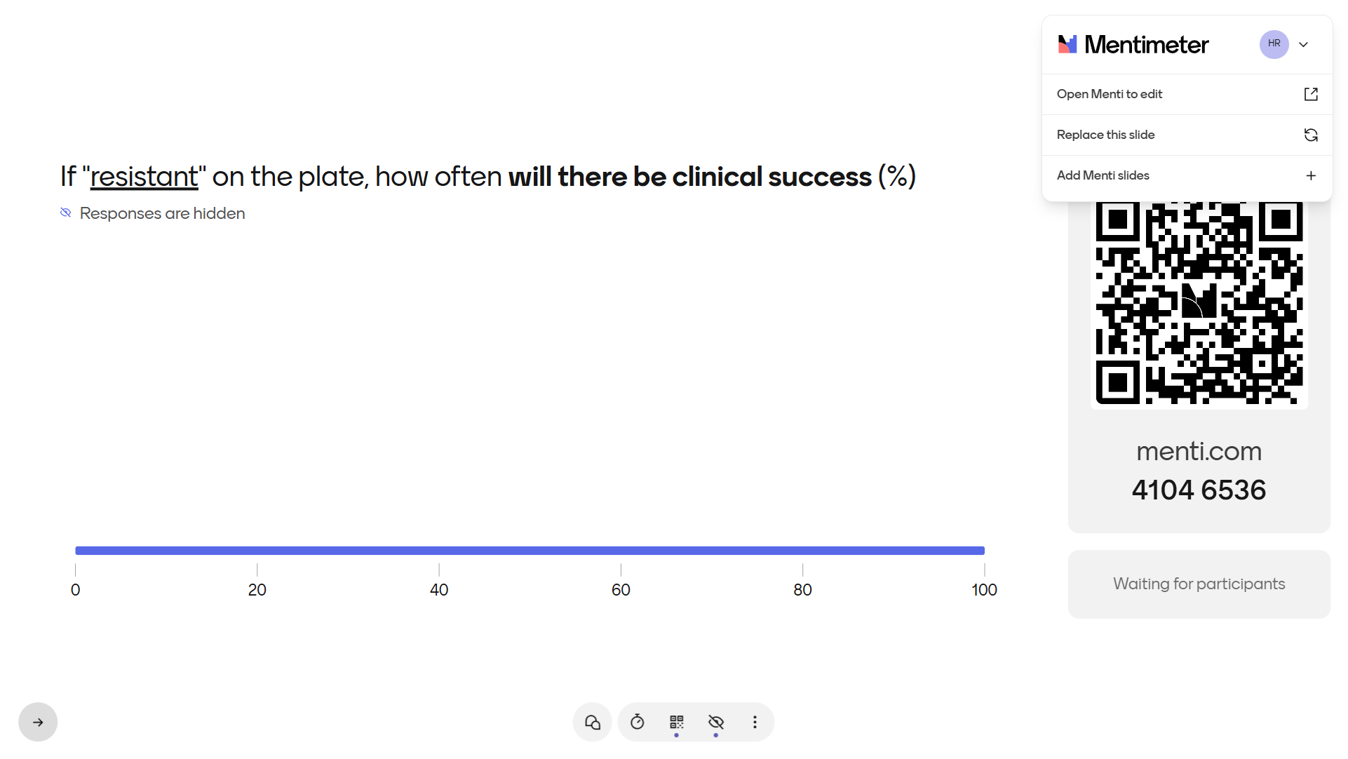
IMAGE: Mentimeter results, [Q1]

Slide 21
The 90-60 rule [1]
Susceptible isolate, treated with that drug
~90% respond
10%
S, and still failed
the 10%
Resistant isolate, treated with that drug anyway
~60% respond
40%
R, and got better
the 60%
The 30-point gap is why we test. The 10% and the 60% are why the test doesn’t settle it.
Notes:
Poll answer: about 60%. Rex and Pfaller summarized more than 30 years of antibacterial data as the '90-60 rule': infections due to susceptible isolates respond to appropriate therapy about 90% of the time, and infections due to resistant isolates still respond about 60% of the time. Their paper is about antifungal testing, which they argued has similar predictive value [1]. The figures are pooled and approximate, not an estimate for any one syndrome. The 30-point gap is why susceptibility testing matters; the rule is not 'testing doesn't matter'. The 'why an S can still fail' list is general ID knowledge, not from [1].

Slide 22

The isolate, not the patient
Objectives
Explain why a clonal population can hold resistant subpopulations, and what that costs the bacterium
Describe what a routine antibiogram samples, and what it misses
Apply the 90-60 rule when a result and the clinical course disagree
60% of the time,
it works
90% of the time
Why the 60 happens, and why the 10 does

Slide 23
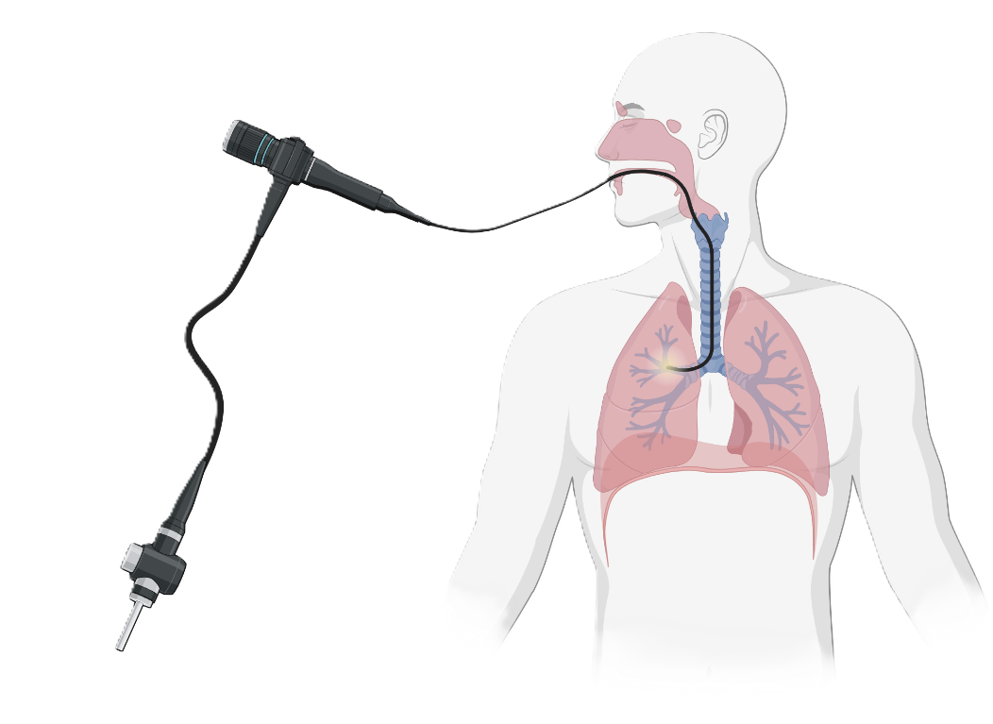

How we usually picture it
One bacterium divides
Into a large population of identical copies
A specimen (here, a BAL) goes to the lab
1
2
3
The model the lab report implies.
Notes:
The model the lab report implies, laid out so we can test each step. Steps 1 and 2 are corrected next (heteroresistance, fitness cost), then steps 3 and 4 (what the lab samples), step 5 (what S and R mean), and step 6 (cure). Common misconception at step 4: the same BAL fluid does not go to MALDI and AST. Colonies are picked from the plate first, and identification and susceptibility testing both start from those colonies.

Slide 24
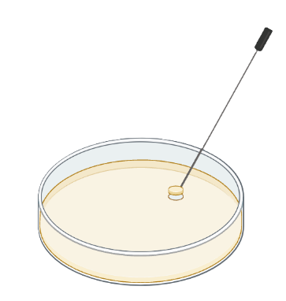
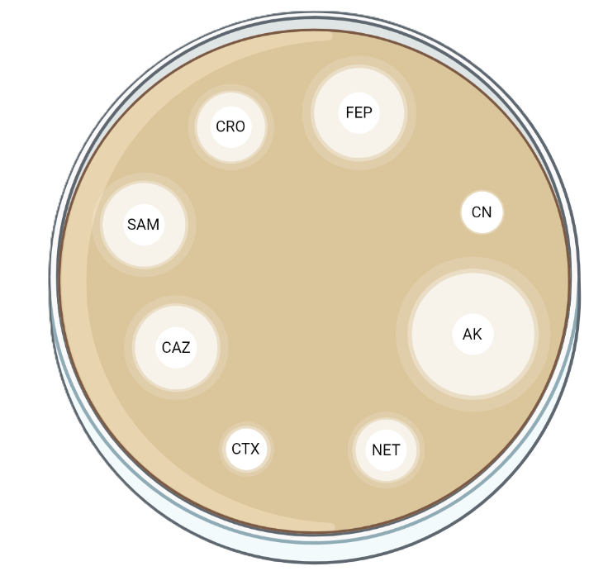
How we usually picture it
One bacterium divides
Into a large population of identical copies
A specimen (here, a BAL) goes to the lab
1
2
3
What grows on the plate is what’s in the patient
S = it kills all of them
R = it kills none
Give the S drug, and the patient is cured
4
5
6
The model the lab report implies.
Notes:
The model the lab report implies, laid out so we can test each step. Steps 1 and 2 are corrected next (heteroresistance, fitness cost), then steps 3 and 4 (what the lab samples), step 5 (what S and R mean), and step 6 (cure). Common misconception at step 4: the same BAL fluid does not go to MALDI and AST. Colonies are picked from the plate first, and identification and susceptibility testing both start from those colonies.

Slide 25

Clonal isn’t uniform
Variants arise constantly
A large population almost always carries rare, less susceptible mutants
In Pseudomonas, these are mostly chromosomal changes: porins, AmpC, efflux
It costs the bacterium
Resistance often slows growth. Off the drug, susceptible cells outgrow the resistant ones
Example: very high gene copy numbers slowed growth by about 40% in lab strains [2]
Heteroresistance
A resistant subpopulation a routine panel can't see. Real, but hard to prove at the bedside [3]
Resistance is a trade-off, not a free upgrade
Notes:
Definitions vary; many studies call it heteroresistance when a subpopulation grows at 8 times or more the MIC of the main population by population analysis profiling. (Check Box 1 of [3] before quoting a frequency threshold.) Nicoloff et al.: up to 27% of 766 isolate-drug combinations were heteroresistant, mostly through gene amplification, which is unstable; no P. aeruginosa isolates were in that set [3]. Caveat: amplification-type heteroresistance is mostly shown in Enterobacterales and Acinetobacter. Carbapenem resistance in P. aeruginosa is mostly chromosomal mutation (porin loss, AmpC, efflux). The fitness-cost figures come from lab strains of E. coli, Klebsiella and Salmonella exposed in vitro [2]. Our patient's isolates show diversity and then convergence, not proven heteroresistance: no population analysis profiling was done.

Slide 26



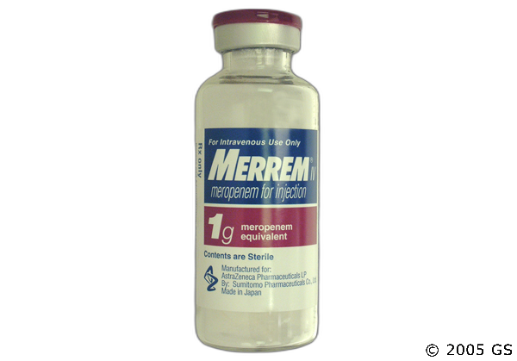

Selection: on drug, off drug [2][3]
Drug stopped:
no selective pressure
The costly resistance is lost, and the population reverts [2][3]
Cheaper mutations replaced the costly gene copies within ~100 generations in the lab, keeping high-level resistance at a 2–4% cost [2]
Natural genetic variation
The resistant fraction expands [3]

Slide 27
Selection: on drug, off drug [2][3]
Drug stopped:
no selective pressure
The costly resistance is lost, and the population reverts [2][3]
Natural genetic variation
Heteroresistance is often a stage on the way to stable resistance (CRE, beta-lactams) [4]
Speculation: low drug levels inside an undrained collection may widen that window
Cheaper mutations replaced the costly gene copies within ~100 generations in the lab, keeping high-level resistance at a 2–4% cost [2]
Notes:
Band and Weiss saw heteroresistance supplanted by resistance over years of use in carbapenem-resistant Enterobacterales; only ceftazidime-avibactam suggested heteroresistance arising from susceptibility, and the authors call for more evidence [4]. This is a hypothesis, not an established sequence. The compensation work: E. coli, Klebsiella and Salmonella at 24 times MIC in vitro; in 94% of compensated mutants the copy number roughly halved while lower-cost resistance mutations were gained; the fitness cost fell from about 40% to 2-4% in about 100 generations [2]. The undrained-collection line is speculation: it extrapolates from the idea that low drug levels widen the window, and nobody has tested it in this setting.

Slide 28
Case 1: Ongoing leak
procedures
inpatient
leak
5 mo prior
4 mo
3 mo
2 mo
1 mo
Day 0
7 weeks prior: admitted here with lobulated free fluid c/w peritonitis and pancreatitis
IR drain grew mixed flora; bilateral ureteral stents for compression
EUS with LAMS: Pseudomonas aeruginosa + Serratia → Merrem + micafungin; 2 necrosectomies
2.5 weeks prior: ERCP confirmed the cystic duct leak → new cystic duct + CBD stents
Discharged on Merrem + micafungin; readmitted 4 days later (Day 0)
→ Day 11: three Pseudomonas populations in the airway, all meropenem-resistant
Before Day 0: 82 of 153 days inpatient · 13 procedures · leak documented for 100+ days

Slide 29


One specimen, more than one answer
Heteroresistance [3]
Mixed strains
Evolution
One strain, with a small resistant subpopulation
Often unstable: can fade off the drug
Two or more strains in one specimen
Each can carry different resistance
Resistance arises in the patient during therapy
Last week’s isolate may not be today’s
Notes:
Heteroresistance: a subpopulation with a higher MIC at low frequency, often unstable once the drug is removed [3]. Definitions vary across studies; many use a subpopulation growing at ≥8 times the MIC of the main population by population analysis profiling. Mixed strains and evolution on treatment create the same bedside problem: the panel describes the colonies that were tested.

Slide 30
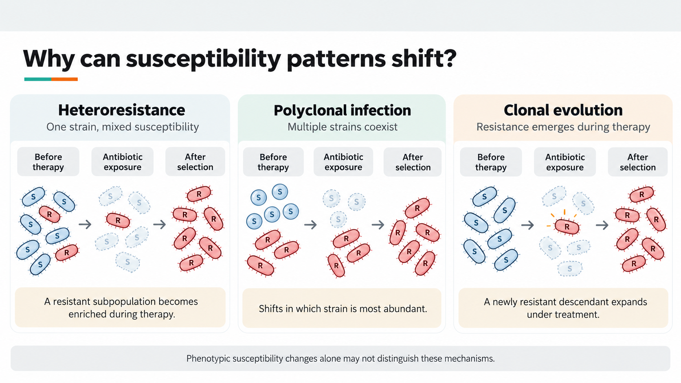

Slide 31
How we usually picture it
One bacterium divides
Into a large population of identical copies
A specimen (here, a BAL) goes to the lab
1
2
3
What grows on the plate is what’s in the patient
S = it kills all of them
R = it kills none
Give the S drug, and the patient is cured
4
5
6
Next: steps 3–4, what the lab actually sees
Notes:
The model the lab report implies, laid out so we can test each step. Steps 1 and 2 are corrected next (heteroresistance, fitness cost), then steps 3 and 4 (what the lab samples), step 5 (what S and R mean), and step 6 (cure). Common misconception at step 4: the same BAL fluid does not go to MALDI and AST. Colonies are picked from the plate first, and identification and susceptibility testing both start from those colonies.

Slide 32
What goes into an antibiogram
Several colonies that look alike are pooled into one inoculum, giving one MIC panel [5]
MIC panel
“isolate 2”
A colony that looks different gets its own panel: your lab's “isolate 2” and “isolate 3”
MIC panel
“isolate 3”
A game of chance: The plate doesn’t have the same selective pressure that is applied to the patient
Notes:
EUCAST asks labs to use several morphologically similar colonies when possible, to avoid picking an atypical variant [5]. CLSI's broth microdilution standard has a similar colony-selection step (its text was not checked for this talk). Distinct morphotypes are worked up as separate isolates, which is how one BAL produced 'isolate 2' and 'isolate 3'. A resistant subpopulation at low frequency inside the picked colonies, or a colony type present at low abundance, would not show up on a routine panel.

Slide 33
Let’s go back to the micro
1
One bacterium divides
2
Into a large population of identical copies
3
A specimen (here, a BAL) goes to the lab
4
What grows on the plate is what’s in the patient
5
S = it kills all of them
R = it kills none
6
Give the S drug, and the patient is cured

Slide 34
His Pseudomonas: First 3 weeks
— not tested | Day 11 asp. A | Day 11 asp. B
Cefepime | R | R
Ceftazidime | I | R
Pip-tazo | R | R
Meropenem | R | R
Ciprofloxacin | S | I
Levofloxacin | I | R
Ceftaz-avibactam | S | 16/4
Ceftolozane-tazo | S | S
Tobramycin | S | S
Cefiderocol | S | S
Day 11: First time he grows a resistant pseudomonas (two phenotypes)
CRE, as expected since was recently on
One isolate R-Avycaz (ceftaz-avi)
Started on
  Due to Burkholderia cepacia complex
Merrem
Cefiderocol
D11 tracheal aspirate
PsAr + BCC
→ FDC started D15
airway
MEM · 30 d
FEP
8 d
FDC · 15 d
LZD
DAP · 11 d
MTZ
ERV · 7 d
SXT · 9 d
MICA · 34 d
D0
D10
D20
D30
ICU
Notes:
Phenotypes only. Each BAL's two isolates are lab-assigned picks of distinct colony types. Day 11: two MDR strains (A and B) from one aspirate; a third, mucoid strain from the same aspirate is not shown (tobramycin R). Cefiderocol tested S on every isolate it was reported for (Days 11 to 103) and was not reported on Day 105; tobramycin was S on every isolate from Day 20 on. Unexplained details: piperacillin-tazobactam was R on Days 20 and 66 and I on Days 103 and 105; ciprofloxacin moved from S/I to R without fluoroquinolone exposure during this admission. Different populations being sampled, testing variability and cross-resistance (e.g., efflux) are all possible; none is established. Day 66 isolates, add-on testing: aztreonam R and polymyxin I (MIC 1) on both. Under current CLSI, polymyxins have no S category for P. aeruginosa, so I is the best possible result. Imipenem was not reported.

Slide 35
His Pseudomonas: First 3 weeks
Day 20: Five days into his he grows the same “bacteria”
— not tested | Day 11 asp. A | Day 11 asp. B | Day 20 asp.
Cefepime | R | R | R
Ceftazidime | I | R | R
Pip-tazo | R | R | R
Meropenem | R | R | R
Ciprofloxacin | S | I | R
Levofloxacin | I | R | R
Ceftaz-avibactam | S | 16/4 | S
Ceftolozane-tazo | S | S | I
Tobramycin | S | S | S
Cefiderocol | S | S | S
Cefiderocol
Now resistant to fluoroquinolones (even though he did not receive any)
Still susceptible to cefiderocol
  Maybe he just needs a longer course?
D11 tracheal aspirate
PsAr + BCC
→ FDC started D15
D20: PsAr + BCC
airway
MEM · 30 d
FEP
8 d
FDC · 15 d
LZD
DAP · 11 d
MTZ
ERV · 7 d
SXT · 9 d
MICA · 34 d
D0
D10
D20
D30
ICU
Notes:
Phenotypes only. Each BAL's two isolates are lab-assigned picks of distinct colony types. Day 11: two MDR strains (A and B) from one aspirate; a third, mucoid strain from the same aspirate is not shown (tobramycin R). Cefiderocol tested S on every isolate it was reported for (Days 11 to 103) and was not reported on Day 105; tobramycin was S on every isolate from Day 20 on. Unexplained details: piperacillin-tazobactam was R on Days 20 and 66 and I on Days 103 and 105; ciprofloxacin moved from S/I to R without fluoroquinolone exposure during this admission. Different populations being sampled, testing variability and cross-resistance (e.g., efflux) are all possible; none is established. Day 66 isolates, add-on testing: aztreonam R and polymyxin I (MIC 1) on both. Under current CLSI, polymyxins have no S category for P. aeruginosa, so I is the best possible result. Imipenem was not reported.

Slide 36
His Pseudomonas: After 6 weeks of
 | Day 11 asp. A | Day 11 asp. B | Day 20 asp. | Day 66 BAL 2 | Day 66 BAL 3
Cefepime | R | R | R | R | R
Ceftazidime | I | R | R | R | R
Pip-tazo | R | R | R | R | R
Meropenem | R | R | R | R | R
Ciprofloxacin | S | I | R | S | I
Levofloxacin | I | R | R | I | I
Ceftaz-avibactam | S | R | S | R | R
Ceftolozane-tazo | S | S | I | I | R
Tobramycin | S | S | S | S | S
Cefiderocol | S | S | S | S | S
Day 66
Two phenotypes in one BAL
Has been on 6 weeks of cefiderocol at this point
Recall prolonged Burkholderia bacteremia
Surely it must be R-cefiderocol??
 | Day 11 asp. A | Day 11 asp. B | Day 20 asp. | Day 66 BAL 2 | Day 66 BAL 3
Cefepime | R | R | R | R | R
Ceftazidime | I | R | R | R | R
Pip-tazo | R | R | R | R | R
Meropenem | R | R | R | R | R
Ciprofloxacin | S | I | R | S | I
Levofloxacin | I | R | R | I | I
Ceftaz-avibactam | S | R | S | R | R
Ceftolozane-tazo | S | S | I | I | R
Tobramycin | S | S | S | S | S
Cefiderocol | S | S | S | S | S
Nope! MIC 0.12
However…
Despite not having received either (yet), he is now resistant to:
Avycaz (Ceftaz-avibactam)
Zerbaxa (ceftolozane-tazobactam)
Notes:
Phenotypes only. Each BAL's two isolates are lab-assigned picks of distinct colony types. Unexplained details: piperacillin-tazobactam was R on Days 20 and 66 and I on Days 103 and 105; ciprofloxacin moved from S/I to R without fluoroquinolone exposure during this admission. Different populations being sampled, testing variability and cross-resistance (e.g., efflux) are all possible; none is established. Day 66 isolates, add-on testing: aztreonam R and polymyxin I (MIC 1) on both. Under current CLSI, polymyxins have no S category for P. aeruginosa, so I is the best possible result. Imipenem was not reported.

Slide 37
His Pseudomonas: 60-90%
 | Day 11 asp. A | Day 11 asp. B | Day 20 asp. | Day 66 BAL 2 | Day 66 BAL 3
Ciprofloxacin | S | I | R | S | I
Levofloxacin | I | R | R | I | I
Ceftaz-avibactam | S | R | S | R | R
Ceftolozane-tazo | S | S | I | I | R
Tobramycin | S | S | S | S | S
Cefiderocol | S | S | S | S | ???
???
???
???
Of course, so you don’t know these results immediately
Team assumes that cefiderocol won’t work after 6 weeks of exposure (fair)
They start him on Avycaz (CZA; ceftazidime-avibactam)
Only 2k & 4k cfu on qBAL
He gets better
You are here
D11 tracheal aspirate
PsAr + BCC
D20 PsAr (C/T I, TOB S) + BCC
D66 BAL post-VARD
(x2 PsAr, low burden)
They say they have source control
I apply STOP-IT with Zerbaxa (the least wrong answer abx wise)
MEM · 30 d
FEP
8 d
FDC · 15 d
4 d
Cefiderocol · 27 d
5 d
CZA
?
LZD
DAP · 11 d
LZD
LZD
LZD
DAP · 17 d
SXT · 9 d
Bactrim · 24 d
D66 VARD
MICA · 34 d
MICA · 15 d
not cultured
D0
D10
D20
D30
D40
D50
D60
D70
ICU

Slide 38
Wrong duration of abx
20
D66 VARD
D73 fever
(one spike)
D75 restart
D88 BAL
200
CRP 130, PCT 0.6
(no recent baseline)
16.3
12.8
WBC stable D78–85 (not plotted)
WBC (×10³/µL)
CRP (mg/L)
10
100
normal WBC
0
0
Ceftaz-avibactam
Ceftolozane-
tazo
Cefiderocol · 14+ d
Cefiderocol
off
antibiotics
LZD · 14 d
Linezolid
Metronidazole
66
68
70
72
74
76
78
80
82
84
86
88
90
Hospital day

Slide 39
His Pseudomonas: 8 weeks of
— not tested | Day 11 asp. A | Day 11 asp. B | Day 20 asp. | Day 66 BAL 2 | Day 66 BAL 3 | Day 88 BAL 2 | Day 88 BAL 3
Cefepime | R | R | R | R | R | I | R
Ceftazidime | I | R | R | R | R | I | R
Pip-tazo | R | R | R | R | R | — | —
Meropenem | R | R | R | R | R | R | R
Ciprofloxacin | S | I | R | S | I | S | I
Levofloxacin | I | R | R | I | I | I | R
Ceftaz-avibactam | S | R | S | R | R | S | R
Ceftolozane-tazo | S | S | I | I | R | S | R
Tobramycin | S | S | S | S | S | S | S
Cefiderocol | S | S | S | S | S | S | S
Day 88
Has PEA arrest so another BAL is done
2,000 cfu Pseudomonas
5,000 cfu Pseudomonas
That’s 2,000 not >100,000 cfu
— not tested | Day 11 asp. A | Day 11 asp. B | Day 20 asp. | Day 66 BAL 2 | Day 66 BAL 3 | Day 88 BAL 2 | Day 88 BAL 3
Cefepime | R | R | R | R | R | I | R
Ceftazidime | I | R | R | R | R | I | R
Pip-tazo | R | R | R | R | R | — | —
Meropenem | R | R | R | R | R | R | R
Ciprofloxacin | S | I | R | S | I | S | I
Levofloxacin | I | R | R | I | I | I | R
Ceftaz-avibactam | S | R | S | R | R | S | R
Ceftolozane-tazo | S | S | I | I | R | S | R
Tobramycin | S | S | S | S | S | S | S
Cefiderocol | S | S | S | S | S | S | S
Kinda looks like the original
This is the most divergent pair so far (can’t call them strains since no sequencing done)
???
???
Notes:
Phenotypes only. Each BAL's two isolates are lab-assigned picks of distinct colony types. Unexplained details: piperacillin-tazobactam was R on Days 20 and 66 and I on Days 103 and 105; ciprofloxacin moved from S/I to R without fluoroquinolone exposure during this admission. Different populations being sampled, testing variability and cross-resistance (e.g., efflux) are all possible; none is established. Day 66 isolates, add-on testing: aztreonam R and polymyxin I (MIC 1) on both. Under current CLSI, polymyxins have no S category for P. aeruginosa, so I is the best possible result. Imipenem was not reported.

Slide 40
7: Another flare of the belly?
P. aeruginosa
E. faecium (VRE)
BCC
Candida
inhaled tobramycin
negative blood cx
no PsAr-directed β-lactam
1 VRE BSI
3
Candidemia
5
Recurrent VRE BSI
6 Recurrent MDR pulmonary / IAI flares
7 abd flare
2 MDR VAP / HAP
4
BCC bacteremia
D32–39 BCx BCC
One week after stopping abx: fever, low O2
blood
D0 VRE
(on MEM + MICA)
D26 Candida
(19 d off MICA)
D43–45 VRE
(8 d since LZD/DAP)
D102 VSE, LZD-R
(1 of 2 BCx; 13 d off LZD)
D11 tracheal aspirate
PsAr + BCC
→ FDC started D15
2 d after FDC + SXT stopped
airway
D20 repeat: PsAr (C/T I, TOB S) + BCC
→ FDC + SXT + inhaled TOB
D66 BAL post-VARD
(x2 PsAr, low burden)
D88 BAL post-aspiration
(x2 PsAr + Achromobacter)
D103–104 BAL: x2 PsAr
(20k → 5–6k CFU/mL)
BCx: E faecium, linezolid resistant
BAL: Pseudomonas, susecpt pending
abdomen
D105 drain
(VRE 3+, PsAr 2+)
IR drain comes out
Gets replaced, and micro was sent!
MEM · 30 d
FEP
8 d
FDC · 15 d
4 d
Cefiderocol · 27 d
5 d
CZA
FDC · 22 d
6 d
TZP · 11 d
LZD
DAP · 11 d
LZD
LZD
LZD
DAP · 17 d
LZD · 14 d
DAP · 11 d
SXT · 9 d
Bactrim · 24 d
SXT · 7 d
MICA · 34 d
MICA · 15 d
D10 drain upsize
not cultured
D21 abd wall abscess I&D
Cx lost in transit
D24 cystic duct embolization
+ biloma drain exchange
D50 IR drain
D66 VARD
D103 drain lost
D105 drain replaced
D17 drain
not cultured
not cultured
2+ PsAr
3+ VRE
MTZ
ERV · 7 d
Flagyl · 15 d
MTZ · 22 d
D0
D10
D20
D30
D40
D50
D60
D70
D80
D90
D100
D110
D120
ICU

Slide 41
His Pseudomonas, Day 11 to Day 105
— not tested | Day 11 asp. A | Day 11 asp. B | Day 20 asp. | Day 66 BAL 2 | Day 66 BAL 3 | Day 88 BAL 2 | Day 88 BAL 3 | Day 103 BAL ×2 | Day 105 drain
Cefepime | R | R | R | R | R | I | R | R | R
Ceftazidime | I | R | R | R | R | I | R | R | R
Pip-tazo | R | R | R | R | R | — | — | I | I
Meropenem | R | R | R | R | R | R | R | R | R
Ciprofloxacin | S | I | R | S | I | S | I | R | I
Levofloxacin | I | R | R | I | I | I | R | R | R
Ceftaz-avibactam | S | R | S | R | R | S | R | R | R
Ceftolozane-tazo | S | S | I | I | R | S | R | R | R
Tobramycin | S | S | S | S | S | S | S | S | S
Cefiderocol | S | S | S | S | S | S | S | S | —
Days 103–105
Airway and drain isolates nearly identical, both DTR
Both novel β-lactam combinations now resistant
Phenotypes only: without typing, “same strain” is not established
Notes:
Phenotypes only. Each BAL's two isolates are lab-assigned picks of distinct colony types. Day 11: two MDR strains (A and B) from one aspirate; a third, mucoid strain from the same aspirate is not shown (tobramycin R). Cefiderocol tested S on every isolate it was reported for (Days 11 to 103) and was not reported on Day 105; tobramycin was S on every isolate from Day 20 on. Unexplained details: piperacillin-tazobactam was R on Days 20 and 66 and I on Days 103 and 105; ciprofloxacin moved from S/I to R without fluoroquinolone exposure during this admission. Different populations being sampled, testing variability and cross-resistance (e.g., efflux) are all possible; none is established. Day 66 isolates, add-on testing: aztreonam R and polymyxin I (MIC 1) on both. Under current CLSI, polymyxins have no S category for P. aeruginosa, so I is the best possible result. Imipenem was not reported.

Slide 42
7: Another flare of the belly?
P. aeruginosa
E. faecium (VRE)
BCC
Candida
inhaled tobramycin
negative blood cx
no PsAr-directed β-lactam
1 VRE BSI
3
Candidemia
5
Recurrent VRE BSI
6 Recurrent MDR pulmonary / IAI flares
7 abd flare
2 MDR VAP / HAP
4
BCC bacteremia
D32–39 BCx BCC
One week after stopping abx: fever, low O2
blood
D0 VRE
(on MEM + MICA)
D26 Candida
(19 d off MICA)
D43–45 VRE
(8 d since LZD/DAP)
D102 VSE, LZD-R
(1 of 2 BCx; 13 d off LZD)
D11 tracheal aspirate
PsAr + BCC
→ FDC started D15
2 d after FDC + SXT stopped
airway
D20 repeat: PsAr (C/T I, TOB S) + BCC
→ FDC + SXT + inhaled TOB
D66 BAL post-VARD
(x2 PsAr, low burden)
D88 BAL post-aspiration
(x2 PsAr + Achromobacter)
D103–104 BAL: x2 PsAr
(20k → 5–6k CFU/mL)
BCx: E faecium, linezolid resistant
BAL: Pseudomonas, susecpt pending
abdomen
D105 drain
(VRE 3+, PsAr 2+)
IR drain comes out
Gets replaced, and micro was sent!
MEM · 30 d
FEP
8 d
FDC · 15 d
4 d
Cefiderocol · 27 d
5 d
CZA
FDC · 22 d
6 d
TZP · 11 d
LZD
DAP · 11 d
LZD
LZD
LZD
DAP · 17 d
LZD · 14 d
DAP · 11 d
SXT · 9 d
Bactrim · 24 d
SXT · 7 d
MICA · 34 d
MICA · 15 d
ID decides to do dapto & zosyn
…but he still does just fine..? Why???
D10 drain upsize
not cultured
D21 abd wall abscess I&D
Cx lost in transit
D24 cystic duct embolization
+ biloma drain exchange
D50 IR drain
D66 VARD
D103 drain lost
D105 drain replaced
D17 drain
not cultured
not cultured
2+ PsAr
3+ VRE
MTZ
ERV · 7 d
Flagyl · 15 d
MTZ · 22 d
D0
D10
D20
D30
D40
D50
D60
D70
D80
D90
D100
D110
D120
ICU

Slide 43
Why this is a weird case

Slide 44
His isolates don’t follow the script
Inhaled tobramycin, three courses
S on every isolate since Day 20
D0 VRE
(on MEM + MICA)
D26 Candida
(19 d off MICA)
D32–39 BCx BCC
D43–45 VRE
(8 d since LZD/DAP)
D102 VSE, LZD-R
(1 of 2 BCx; 13 d off LZD)
blood
D11 tracheal aspirate
PsAr + BCC
→ FDC started D15
2 d after FDC + SXT stopped
airway
D20 repeat: PsAr (C/T I, TOB S) + BCC
→ FDC + SXT + inhaled TOB
D66 BAL post-VARD
(x2 PsAr, low burden)
D88 BAL post-aspiration
(x2 PsAr + Achromobacter)
D103–104 BAL: x2 PsAr
(20k → 5–6k CFU/mL)
abdomen
D105 drain
(VRE 3+, PsAr 2+)
MEM · 30 d
FEP
8 d
FDC · 15 d
4 d
Cefiderocol · 27 d
5 d
CZA
FDC · 22 d
6 d
TZP · 11 d
LZD
DAP · 11 d
LZD
LZD
LZD
DAP · 17 d
LZD · 14 d
DAP · 11 d
SXT · 9 d
Bactrim · 24 d
SXT · 7 d
MICA · 34 d
MICA · 15 d
Notes:
Phenotypes only, no typing. The Day 88 isolate 2 and the Day 103 isolates may not be the same lineage. Between Day 88 and Day 103 he received cefiderocol, linezolid, metronidazole, TMP-SMX and inhaled tobramycin. Discussion prompt: ask the room for hypotheses before showing any of the four. This slide can become a speaker note if the talk runs long.

Slide 45
His isolates don’t follow the script
Inhaled tobramycin, three courses
S on every isolate since Day 20
Cefiderocol, ~9 weeks
Still S on Day 103
Cefiderocol · 64 d
D0 VRE
(on MEM + MICA)
D26 Candida
(19 d off MICA)
D32–39 BCx BCC
D43–45 VRE
(8 d since LZD/DAP)
D102 VSE, LZD-R
(1 of 2 BCx; 13 d off LZD)
blood
D11 tracheal aspirate
PsAr + BCC
→ FDC started D15
2 d after FDC + SXT stopped
airway
D20 repeat: PsAr (C/T I, TOB S) + BCC
→ FDC + SXT + inhaled TOB
D66 BAL post-VARD
(x2 PsAr, low burden)
D88 BAL post-aspiration
(x2 PsAr + Achromobacter)
D103–104 BAL: x2 PsAr
(20k → 5–6k CFU/mL)
abdomen
D105 drain
(VRE 3+, PsAr 2+)
MEM · 30 d
FEP
8 d
FDC · 15 d
4 d
Cefiderocol · 27 d
5 d
CZA
FDC · 22 d
6 d
TZP · 11 d
LZD
DAP · 11 d
LZD
LZD
LZD
DAP · 17 d
LZD · 14 d
DAP · 11 d
SXT · 9 d
Bactrim · 24 d
SXT · 7 d
MICA · 34 d
MICA · 15 d
Notes:
Phenotypes only, no typing. The Day 88 isolate 2 and the Day 103 isolates may not be the same lineage. Between Day 88 and Day 103 he received cefiderocol, linezolid, metronidazole, TMP-SMX and inhaled tobramycin. Discussion prompt: ask the room for hypotheses before showing any of the four. This slide can become a speaker note if the talk runs long.

Slide 46
His isolates don’t follow the script
Inhaled tobramycin, three courses
S on every isolate since Day 20
Cefiderocol, ~9 weeks
Still S on Day 103
Avycaz (CZA) & Zerbaxa (C/T)
S on a Day 88 isolate
R by Day 103
no exposure in between (last was: 6 days, starting Day 66)
Cefiderocol · 64 d
D0 VRE
(on MEM + MICA)
D26 Candida
(19 d off MICA)
D32–39 BCx BCC
D43–45 VRE
(8 d since LZD/DAP)
D102 VSE, LZD-R
(1 of 2 BCx; 13 d off LZD)
blood
D11 tracheal aspirate
PsAr + BCC
→ FDC started D15
2 d after FDC + SXT stopped
airway
D20 repeat: PsAr (C/T I, TOB S) + BCC
→ FDC + SXT + inhaled TOB
D66 BAL post-VARD
(x2 PsAr, low burden)
D88 BAL post-aspiration
(x2 PsAr + Achromobacter)
D103–104 BAL: x2 PsAr
(20k → 5–6k CFU/mL)
abdomen
D105 drain
(VRE 3+, PsAr 2+)
MEM · 30 d
FEP
8 d
FDC · 15 d
4 d
Cefiderocol · 27 d
5 d
CZA
FDC · 22 d
6 d
TZP · 11 d
LZD
DAP · 11 d
LZD
LZD
LZD
DAP · 17 d
LZD · 14 d
DAP · 11 d
SXT · 9 d
Bactrim · 24 d
SXT · 7 d
MICA · 34 d
MICA · 15 d
Notes:
Phenotypes only, no typing. The Day 88 isolate 2 and the Day 103 isolates may not be the same lineage. Between Day 88 and Day 103 he received cefiderocol, linezolid, metronidazole, TMP-SMX and inhaled tobramycin. Discussion prompt: ask the room for hypotheses before showing any of the four. This slide can become a speaker note if the talk runs long.

Slide 47
How we usually picture it
One bacterium divides
Into a large population of identical copies
A specimen (here, a BAL) goes to the lab
1
2
3
What grows on the plate is what’s in the patient
S = it kills all of them
R = it kills none
Give the S drug, and the patient is cured
4
5
6
Next: step 5, when S is suspect
Notes:
The model the lab report implies, laid out so we can test each step. Steps 1 and 2 are corrected next (heteroresistance, fitness cost), then steps 3 and 4 (what the lab samples), step 5 (what S and R mean), and step 6 (cure). Common misconception at step 4: the same BAL fluid does not go to MALDI and AST. Colonies are picked from the plate first, and identification and susceptibility testing both start from those colonies.

Slide 48
[Q2] New Gram-negative rods in the blood. What do you start?
His most recent Pseudomonas (Day 103): meropenem R, CZA R, C/T R, pip-tazo I, tobramycin S, cefiderocol S
A. Cefiderocol
B. High-dose extended-infusion pip-tazo
C. Cefiderocol + tobramycin
D. Something else
E. At this point, Ivermectin
Multiple choice · hypothetical

Slide 49
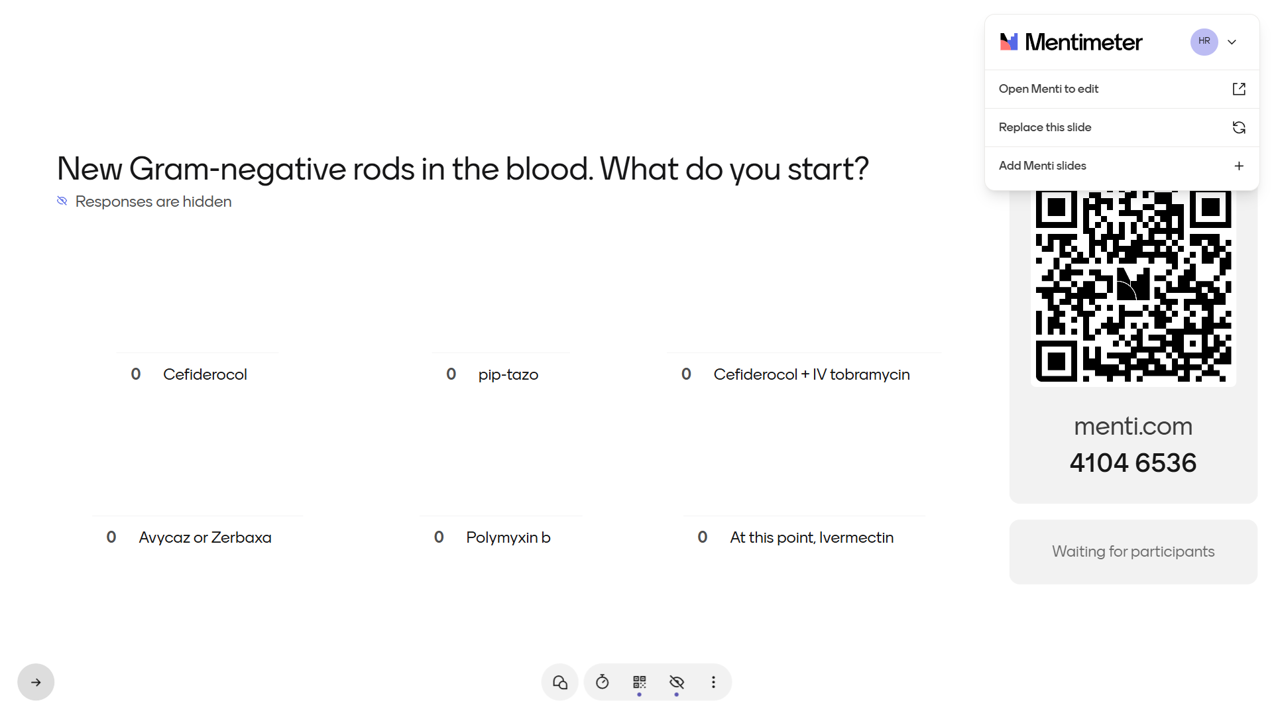
IMAGE: Mentimeter results, [q2]

Slide 50



Cefiderocol heteroresistance: S on the disk, failure in mice
407 isolates, two hospitals in China, 2018–2022 [6]
Isolates | Prior cefiderocol | Result
D66 BAL (both) | 2 courses, ~6 weeks | S
D103 BAL (both) | 3 courses, ~9 weeks | S
27.9% of carbapenem-resistant Pseudomonas were heteroresistant (14.5% overall)
Also S on the D11, D20 and D88 isolates; not reported on D105
73% of heteroresistant isolates tested S by disk diffusion
Mouse peritonitis: cefiderocol failed against them
First reported as widespread in US isolates [7]
After prolonged exposure, treat a cefiderocol S as a “soft” susceptible
Not: “cefiderocol doesn’t work”
Notes:
Cefiderocol courses by hospital day: D15–30, D34–61 and D75–97. The Day 66 isolates had about 6 weeks of prior exposure; the Day 103 isolates about 9 weeks. Cefiderocol also tested S on the Day 11 and Day 20 isolates (before and early in the first course) and on the Day 88 isolates (about 8 weeks cumulative); it was not reported on Day 105. Liu et al.: 407 isolates (2018–2022), heteroresistance by population analysis profiling (subpopulation at ≥8 times the reference concentration); 27.9% of carbapenem-resistant P. aeruginosa, 23.8% of CRE, 17.4% of CRAB; 43 of 59 heteroresistant isolates tested S by disk diffusion. Mouse survival differs between their abstract (4/6) and results (1/6) [6]. Choby et al. first reported widespread cefiderocol heteroresistance in US carbapenem-resistant isolates [7]. None of this shows cefiderocol fails clinically; it shows an S result can hide a resistant subpopulation.

Slide 51
Cefiderocol is hard to test [8]
Systematic review (2025) of cefiderocol susceptibility testing methods
41%
very major errors with gradient strips
Authors advise limiting their use
14%
very major errors, disks pooled
Disks also overcall R: 29% major errors
75–85%
essential agreement, commercial MIC panels
Target is ≥90%; the reference broth method needs iron-depleted media and lacks reproducibility
Very major error: the test says S, the reference says R

Slide 52
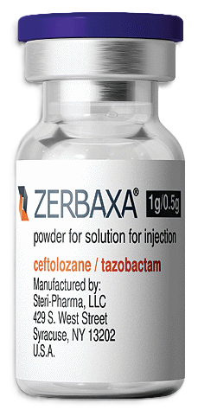


Resistance can move together [9]
16 patients, before and after ceftolozane-tazobactam
4 of 16 pairs: cefiderocol MIC rose ≥4-fold; only 1 left S
2 isolates with one AmpC change (E247K):
C/T (Zerbaxa) 0.5 → 256
CZA rose too (16 → 64, 8 → 32)
Small and exploratory
Zerbaxa drove cefiderocol resistance?

Slide 53
Resistance can move together [9]
16 patients, before and after ceftolozane-tazobactam
4 of 16 pairs: cefiderocol MIC rose ≥4-fold; only 1 left S
2 isolates with one AmpC change (E247K):
C/T (Zerbaxa) 0.5 → 256
CZA rose too (16 → 64, 8 → 32)
Small and exploratory
Our patient
 | FDC MIC | CZA | C/T
Day 66 (×2) | 0.12 | R, R | I, R
Day 88 #1 | 0.12 | S | S
Day 88 #2 | 0.5 | R | R
Day 103 (×2) |  | R, R | R, R
Zerbaxa drove cefiderocol resistance?
Speculation: was the isolate whose cefiderocol MIC rose 4-fold is the one already R to CZA and C/T?
Would have been cool to sequence them

Slide 54
CREDIBLE-CR: cefiderocol vs BAT [10]
Population: serious carbapenem-resistant Gram-negative infections (HAP/VAP, BSI/sepsis, cUTI); 150 enrolled
Intervention: cefiderocol 2 g q8h Comparator: best available therapy (66% colistin-based)
Cefiderocol (n=80)
34% all-cause mortality, end of study
Best available therapy (n=38)
18% all-cause mortality, end of study
Hypothesis (Weiss lab): cefiderocol heteroresistance could explain the gap. Inferred from regional prevalence; trial isolates not tested [7]
Counterpoint: APEKS-NP (double-blind, nosocomial pneumonia, n=300): 14-day mortality 12.4% vs 11.6% with high-dose extended-infusion meropenem; non-inferior [11]

Slide 55
One specimen, more than one answer
Heteroresistance [3]
Mixed strains
Evolution
One strain, with a small resistant subpopulation
Often unstable: can fade off the drug
Two or more strains in one specimen
Each can carry different resistance
Resistance arises in the patient during therapy
Last week’s isolate may not be today’s
Day 88: two Pseudomonas from one BAL, cefiderocol MIC 0.12 and 0.5.
Which card is it? The antibiogram can't say.
Key principle: a routine antibiogram can’t tell these apart, and the bedside consequence is the same. The panel you get may not describe the population you’re treating.
Notes:
Heteroresistance: a subpopulation with a higher MIC at low frequency, often unstable once the drug is removed [3]. Definitions vary across studies; many use a subpopulation growing at ≥8 times the MIC of the main population by population analysis profiling. Mixed strains and evolution on treatment create the same bedside problem: the panel describes the colonies that were tested.

Slide 56
This looks familiar
MERINO [12][13]
Ceftriaxone-R E. coli / Klebsiella bacteremia, all pip-tazo S
30-day mortality: 12.3% pip-tazo vs 3.7% meropenem [12]
Reanalysis by reference MIC: ~6% weren't S, and excluding them shrank the gap to 5% (CI crossed 0) [13]
Inducible AmpC [14]
E. cloacae, K. aerogenes, C. freundii: test S to ceftriaxone
Resistance can emerge on therapy (about 1 in 5 in clinical reports)
IDSA: avoid ceftriaxone for invasive infections; cefepime instead
His Serratia: low-risk group (<5%)
Susceptible isolate, treated with that drug
~90% respond
10%

Slide 57
Does BCC susceptibility predict outcome? [15]
Population: 47 patients with B. cepacia complex infection (27 bloodstream, 20 respiratory); one hospital in Beijing, 2014–2024
Outcome: unfavorable = death, treatment failure, worsening, or discharge for terminal illness. 11 of 47
Analysis: susceptibility to meropenem, ceftazidime, TMP-SMX and minocycline vs outcome, adjusted (Firth and Bayesian regression)
No susceptibility result independently predicted outcome
Only age did: OR 0.86 per year for a favorable outcome (95% CI 0.76–0.94)
No detectable association ≠ no predictive value
Meropenem non-susceptible, unfavorable outcome: OR 1.90 (95% CI 0.45–8.30), unadjusted. With 11 events, that interval runs from half to 8 times the odds
Authors: “AST results should be interpreted cautiously and integrated with host risk assessment, source control, and overall clinical status rather than used in isolation.”
Notes:
Qin et al.: Peking Union Medical College Hospital, Oct 2014 to Oct 2024; 47 patients with monomicrobial B. cepacia complex infection (27 bloodstream, 20 respiratory); median age 62, 85% with comorbidities. Susceptibility stayed high: TMP-SMX 95.6%, minocycline 95.7%, ceftazidime 91.1%. Unfavorable outcome = all-cause death, treatment failure, worsening, or discharge against advice for a terminal condition; no fixed time window. The meropenem OR 1.90 (0.45–8.30) is the unadjusted estimate (Table 2: 4 of 12 non-susceptible patients had an unfavorable outcome); the Bayesian adjusted OR for a favorable outcome with meropenem susceptibility was 5.05 (0.66–45.6). Age: Bayesian OR 0.86 per year for a favorable outcome. Source-control timing was not consistently available, so it could not be adjusted for (Methods). Their discussion: source control, such as catheter removal or drainage, may be essential even when the isolate appears susceptible.

Slide 58
How we usually picture it
One bacterium divides
Into a large population of identical copies
A specimen (here, a BAL) goes to the lab
1
2
3
What grows on the plate is what’s in the patient
S = it kills all of them
R = it kills none
Give the S drug, and the patient is cured
4
5
6
Next: step 6, back to the patient
Notes:
The model the lab report implies, laid out so we can test each step. Steps 1 and 2 are corrected next (heteroresistance, fitness cost), then steps 3 and 4 (what the lab samples), step 5 (what S and R mean), and step 6 (cure). Common misconception at step 4: the same BAL fluid does not go to MALDI and AST. Colonies are picked from the plate first, and identification and susceptibility testing both start from those colonies.

Slide 59
The 90-60 rule [1]
Susceptible isolate, treated with that drug
Why an S can still fail
~90% respond
10%
Host: immune status, comorbidity, severity
Dose and pharmacokinetics
Drug penetration to the site
Inoculum and biofilm
Heteroresistance, mixed populations
An undrained collection
Resistant isolate, treated with that drug anyway
~60% respond
40%
S, and still failed
the 10%
R, and got better
the 60%
The 30-point gap is why we test. The 10% and the 60% are why the test doesn’t settle it.
Notes:
Back to the 90: why can an S fail? Poll answer: about 60%. Rex and Pfaller summarized more than 30 years of antibacterial data as the '90-60 rule': infections due to susceptible isolates respond to appropriate therapy about 90% of the time, and infections due to resistant isolates still respond about 60% of the time. Their paper is about antifungal testing, which they argued has similar predictive value [1]. The figures are pooled and approximate, not an estimate for any one syndrome. The 30-point gap is why susceptibility testing matters; the rule is not 'testing doesn't matter'. The 'why an S can still fail' list is general ID knowledge, not from [1].

Slide 60
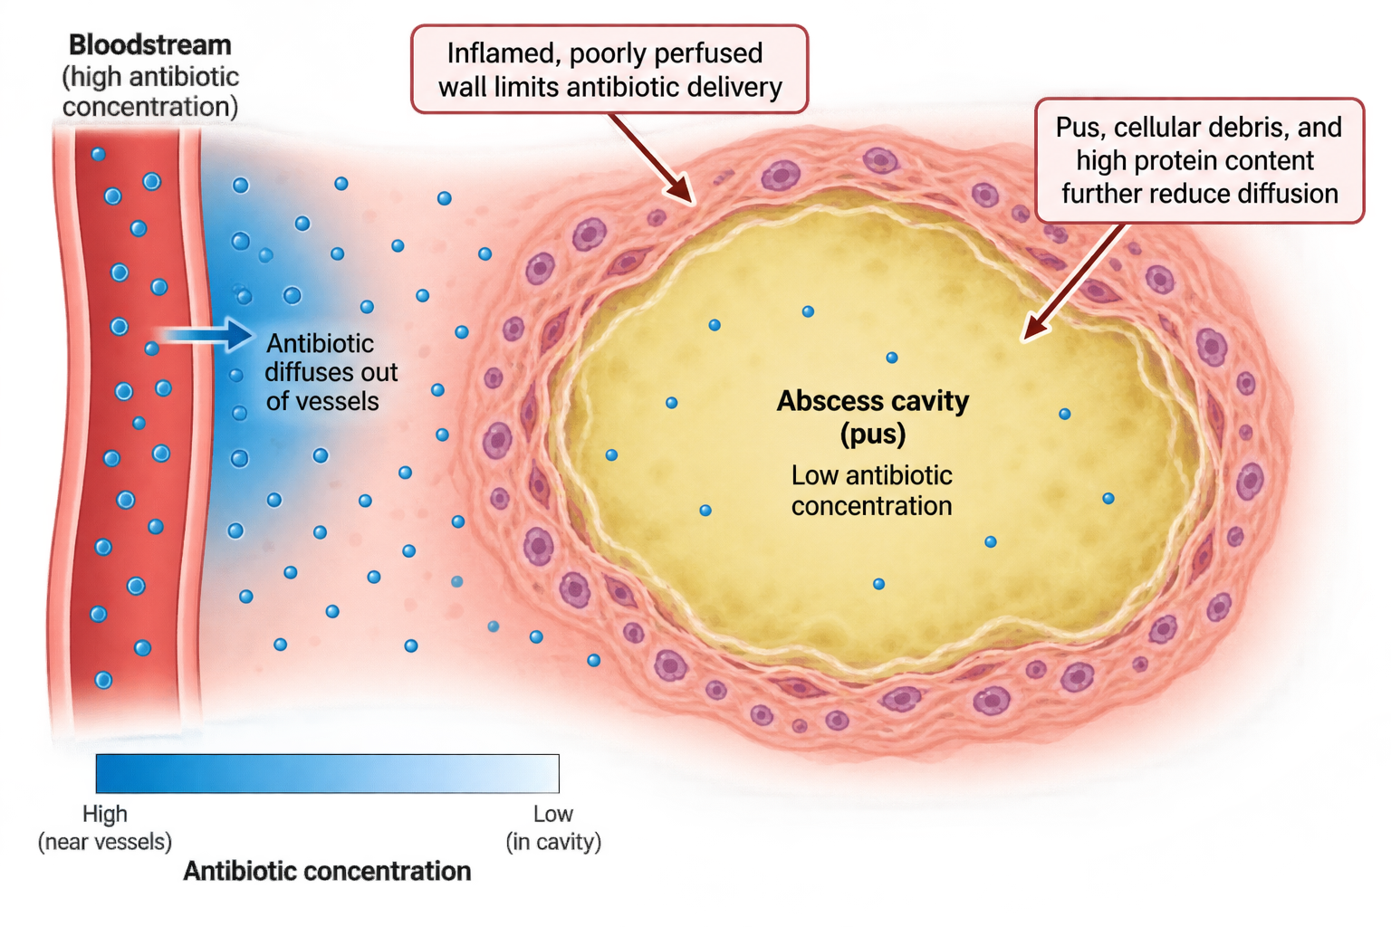
Cure is more than the drug
When the intuition holds
An uncomplicated infection, an active drug, and a host that finishes the job
R, and got better
Immune clearance plus drainage
Prolonged pressure, no drainage
Survivors are selected; resistance can become stable
e.g. cystitis
e.g. empyema
The 60%
AI generated (GPT-6)
Notes:
No citations: general ID knowledge. Column 1 is the textbook case the intuition describes. Column 2 is the 60% in the 90-60 rule: resistant isolates whose patients still improve, usually through immune clearance and drainage. Column 3 is our patient: long exposure with no drainage selects survivors, and resistance can become stable. The column 1 example is still to be chosen (uncomplicated cystitis is often self-limited, so a cleaner example may be an uncomplicated infection with a clear drug effect).

Slide 61
60-90%
Resistant isolate, treated with that drug anyway
~60% respond
40%
1 VRE BSI
3
Candidemia
5
Recurrent VRE BSI
6 Recurrent MDR pulmonary / IAI flares
7 abd flare
2 MDR VAP / HAP
4
BCC bacteremia
D0 VRE
(on MEM + MICA)
D26 Candida
(19 d off MICA)
D32–39 BCx BCC
D43–45 VRE
(8 d since LZD/DAP)
D102 VSE, LZD-R
(1 of 2 BCx; 13 d off LZD)
blood
D11 tracheal aspirate
PsAr + BCC
→ FDC started D15
2 d after FDC + SXT stopped
airway
D20 repeat: PsAr (C/T I, TOB S) + BCC
→ FDC + SXT + inhaled TOB
D66 BAL post-VARD
(x2 PsAr, low burden)
D88 BAL post-aspiration
(x2 PsAr + Achromobacter)
D103–104 BAL: x2 PsAr
(20k → 5–6k CFU/mL)
abdomen
D105 drain
(VRE 3+, PsAr 2+)
MEM · 30 d
FEP
8 d
FDC · 15 d
4 d
Cefiderocol · 27 d
5 d
CZA
FDC · 22 d
6 d
TZP · 11 d
LZD
DAP · 11 d
LZD
LZD
LZD
DAP · 17 d
LZD · 14 d
DAP · 11 d
SXT · 9 d
Bactrim · 24 d
SXT · 7 d
MICA · 34 d
MICA · 15 d
D10 drain upsize
not cultured
D21 abd wall abscess I&D
Cx lost in transit
ID decides to do dapto & zosyn
…but he still does just fine..? Why??? (drain)
D24 cystic duct embolization
+ biloma drain exchange
D50 IR drain
D66 VARD
D103 drain lost
D105 drain replaced
D17 drain
not cultured
not cultured
2+ PsAr
3+ VRE
MTZ
ERV · 7 d
Flagyl · 15 d
MTZ · 22 d
D0
D10
D20
D30
D40
D50
D60
D70
D80
D90
D100
D110
D120
ICU

Slide 62
Learning points & take aways

Slide 63
Learning points & take aways
The antibiogram describes the colonies the lab picked, not the population in the patient. Heteroresistance, mixed strains and evolution in the patient all look the same on a panel.
S isn’t cure, and R isn’t failure (90-60). When the result and the patient’s course disagree, check the source, host, site and dose before switching drugs to match the panel.
After long exposure, treat an S as a soft S, especially for cefiderocol: the testing is unreliable and heteroresistance is common. That doesn’t mean the drug doesn’t work.
Resistance has a cost, but it isn’t always temporary. Off the drug, costly resistance can fade, but compensatory mutations can lock it in. Time off antibiotics doesn’t guarantee susceptibility comes back.
Slides available on hunterratliff1.com/talk/

Slide 64
Case 1: Overview timeline
P. aeruginosa
E. faecium (VRE)
BCC
Candida
inhaled tobramycin
negative blood cx
no PsAr-directed β-lactam
1 VRE BSI
3
Candidemia
5
Recurrent VRE BSI
6 Recurrent MDR pulmonary / IAI flares
7 abd flare
2 MDR VAP / HAP
4
BCC bacteremia
D0 VRE
(on MEM + MICA)
D26 Candida
(19 d off MICA)
D32–39 BCx BCC
D43–45 VRE
(8 d since LZD/DAP)
D102 VSE, LZD-R
(1 of 2 BCx; 13 d off LZD)
blood
D11 tracheal aspirate
PsAr + BCC
→ FDC started D15
2 d after FDC + SXT stopped
airway
D20 repeat: PsAr (C/T I, TOB S) + BCC
→ FDC + SXT + inhaled TOB
D66 BAL post-VARD
(x2 PsAr, low burden)
D88 BAL post-aspiration
(x2 PsAr + Achromobacter)
D103–104 BAL: x2 PsAr
(20k → 5–6k CFU/mL)
abdomen
D105 drain
(VRE 3+, PsAr 2+)
MEM · 30 d
FEP
8 d
FDC · 15 d
4 d
Cefiderocol · 27 d
5 d
CZA
FDC · 22 d
6 d
TZP · 11 d
LZD
DAP · 11 d
LZD
LZD
LZD
DAP · 17 d
LZD · 14 d
DAP · 11 d
SXT · 9 d
Bactrim · 24 d
SXT · 7 d
MICA · 34 d
MICA · 15 d
D10 drain upsize
not cultured
D21 abd wall abscess I&D
Cx lost in transit
D24 cystic duct embolization
+ biloma drain exchange
D50 IR drain
D66 VARD
D103 drain lost
D105 drain replaced
D17 drain
not cultured
not cultured
2+ PsAr
3+ VRE
MTZ
ERV · 7 d
Flagyl · 15 d
MTZ · 22 d
D0
D10
D20
D30
D40
D50
D60
D70
D80
D90
D100
D110
D120
ICU

