Slide 1
Case Conference
Hunter Ratliff – 12/22/23

Slide 2
HPI
CC: ARDS from HCA
34 y/o male transferred from OSH to MICU for hypoxemic resp failure
Admitted to OSH 12 days ago for three weeks of f/c, dyspnea, dry cough prior to admission at OSH; had similar symptoms two month ago (which somewhat improved after Tx w/ LVX). On admission had leukocytosis and b/l GGO on CXR. Was treated with VAN + CEF + TMP/SMX (& 4 days of solumedrol) at OSH but had progressive hypoxia.
Intubated one day PTA & transferred to ECMO capable facility for bronch & further care
PMH: Asthma, recent ?CAP
Meds: None (that we know about)
Social: Smokes/vapes
FMHx / PSxHx: Unable to obtain
Notes:
Admitted 9/4.
This patient was initially admitted to HCA west in July with SOB fevers and chills where he was diagnosed with multifocal pneumonia and discharged on a course of Levaquin which he completed. He reported feeling well for several weeks but began feeling chills, fevers and a dry cough towards the end of August for which he returned to HCA west and was re-admitted on 8/23 with an elevated white count and mixed interstitial and airspace opacities on chest x-ray. He was treated with Bactrim and cefepime, however, his respiratory status continued to deteriorate until he was intubated on 9/3. He was transferred to Memorial Hermann for a higher level of care and to receive a bronchoscopy for further workup of his illness

Slide 3
Physical Exam
T: 35.9 HR: 91 BP: 105/73 (84) on NE BMI: 20
AC/VC 20/450/14/100%
GEN: Intubated & sedated
HEENT: NC/AT, constricted pupils, no scleral icterus
Lungs: Symmetric chest rise, no wheeze, plateau pressure 25
CV: RRR, 2+ pulses, BSUS unremarkable
Abd: Soft, NTND
Heme/MSK: No palpable LAD
Skin: No rash or wounds (aside from scratches on RLE)
Neuro: Sedated but asynch w/ vent (on propofol, versed, fentanyl)

Slide 4
Initial Labs
135
101
24
11.2
128
16.7
360
5.3
MCV: 85
Neut: 97%
31
0.8
7.37 / 54 / 63 / 31
pH / pCO2 / pO2 / HCO3
LFTs
AST | 37
ALT | 121
AkP | 90
Bili | 0.3
Alb | 1.7
Pro | 5.0
Lactate | 3.2
Coags | Normal
UA | Normal
Procal | 0.90
ESR / CRP | 35 / 14.3
LDH | 405
Cv/flu/RSV | Neg
OSH labs:
Viral Resp PCR: Negative
BCx: NGTD
RCx: NGTD (but unable to do BAL)
HIV screen: Negative

Slide 5
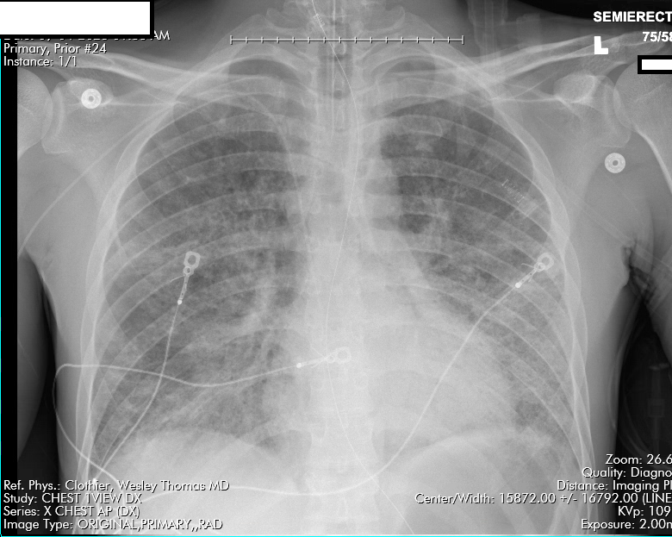
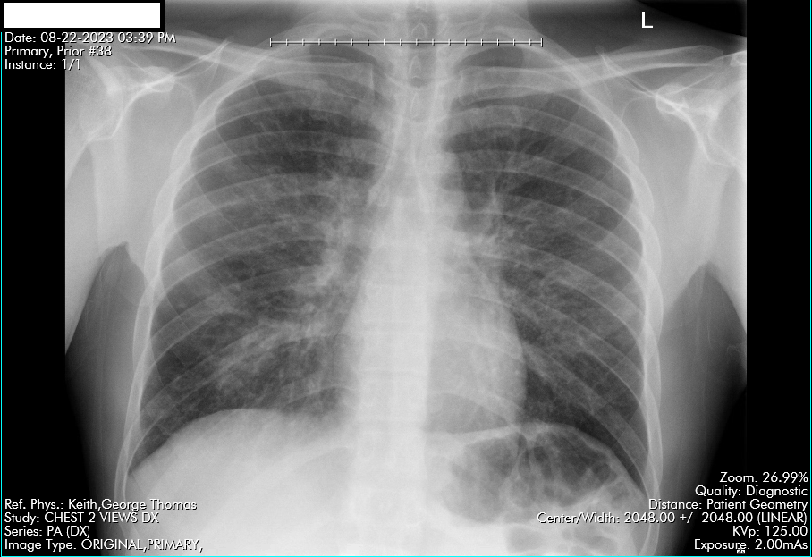
Initial Imaging
For some reason, the patient got a CXR (shown above) at MHSW the day before his HCA admission

Slide 6
Summary Statement
Summary: 34 y/o M
7.37 / 54 / 63 / 31
Lactate | 3.2
ALT | 121
Pro / Alb | 5.0 / 1.7
Procal | 0.90
ESR / CRP | 35 / 14.3
LDH | 405
Cv/flu/RSV | Neg
11
16.7
360
34 y/o male PMH vaping & smoking
4 weeks of f/c, dyspnea, dry cough. Similar episode -2 mo (Tx w/ LVX)
Worsening despite VAN + CEF + TMP/SMX + steroids
Hypotensive on levophed
DDx:
Neuro
CV
Renal
Rheum
ID
Pulm
GI
Endo
Heme/Onc
135
101
24
5.3
31
0.8
Next steps?

Slide 7
Summary / Differential
Summary: 34 y/o M asthma, vaper p/w
Neuro:
1.
Cardiovascular:
1.
Renal:
1.
Rheum:
1.
Infectious Disease:
1.
Pulmonary:
1.
GI/hepatology
1.
Heme/Onc
1.
Endo
1.
Msk:
1.
Psych:
1.
Next Steps????
1.

Slide 8
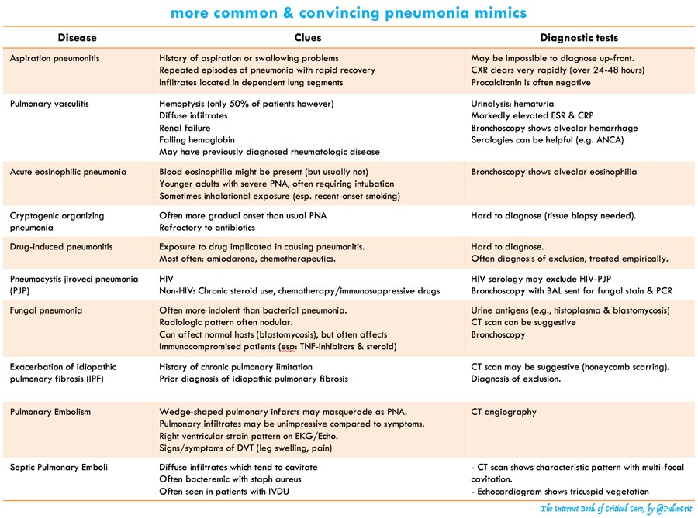

Slide 9
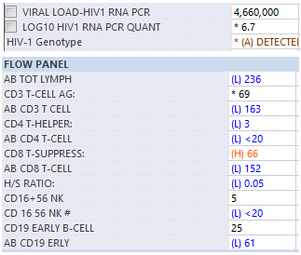
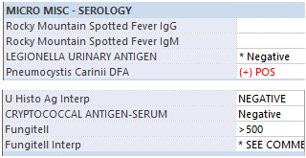
Labs

Slide 10
Hospital Course/Diagnosis

Slide 11
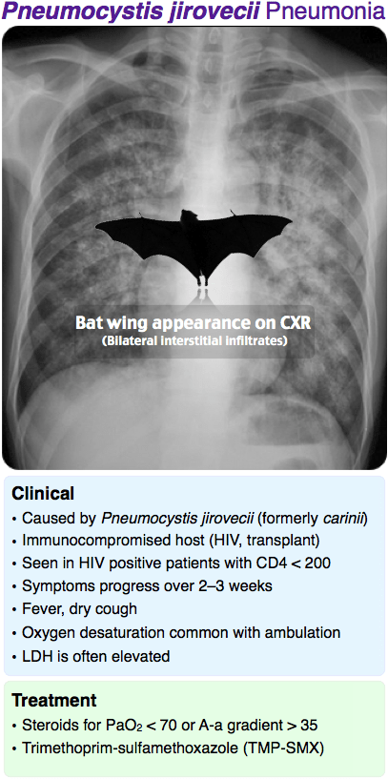
Pneumocystis jirovecii pneumonia
7.37 / 54 / 63 / 31
pH / pCO2 / pO2 / HCO3
Lactate | 3.2
ALT | 121
Pro / Alb | 5.0 / 1.7
Procal | 0.90
ESR / CRP | 35 / 14.3
LDH | 405
Cv/flu/RSV | Neg
Source: @GeraldMD

Slide 12
Acute HIV
Acute HIV:
Most folks have some symptoms, but they’re nonspecific
DDx: Other acute viral syndromes (EBV, CMV, hepatitis), syphilis
Fever | 75%
Fatigue | 68%
Myalgia / arthralgia | 30 – 49%
Rash | 48%
Headache | 45%
Sore throat | 40%
Lymphadenopathy | 39%
Source: MKSAP-19

Slide 13
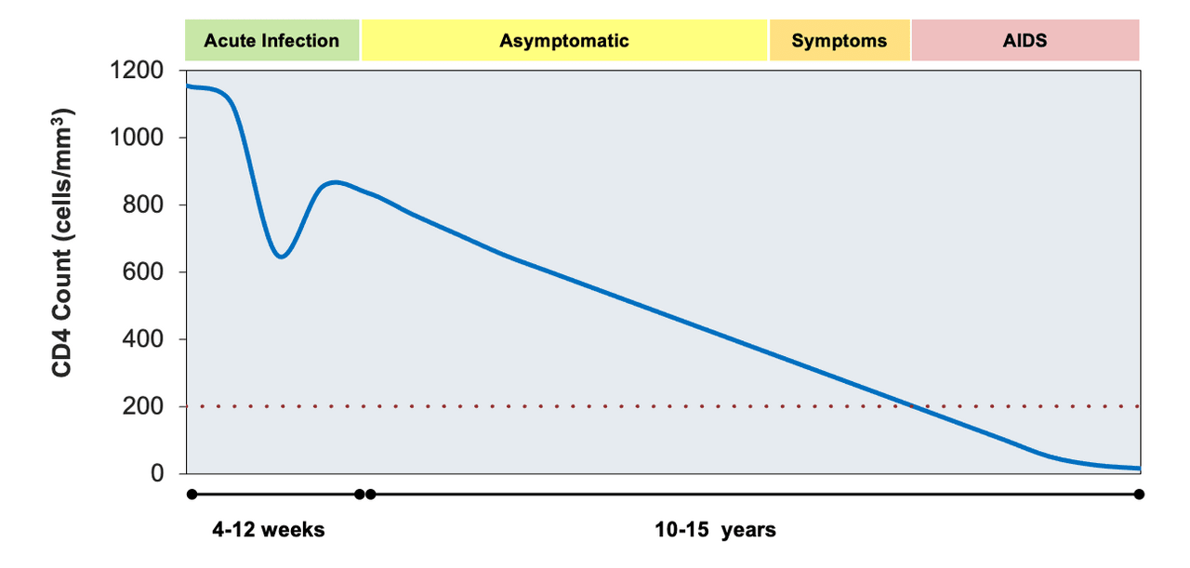
Acute HIV
Acute HIV:
Most folks have some symptoms, but they’re nonspecific
High levels of viremia (>100k) and transient CD4 drop

Slide 14
Acute HIV
Acute HIV:
Most folks have some symptoms, but they’re nonspecific
High levels of viremia (>100k) and transient CD4 drop
AIDS defining illnesses (such as PJP) are uncommon in acute HIV
This case is an exception, not the rule

Slide 15
Testing for HIV

Slide 16
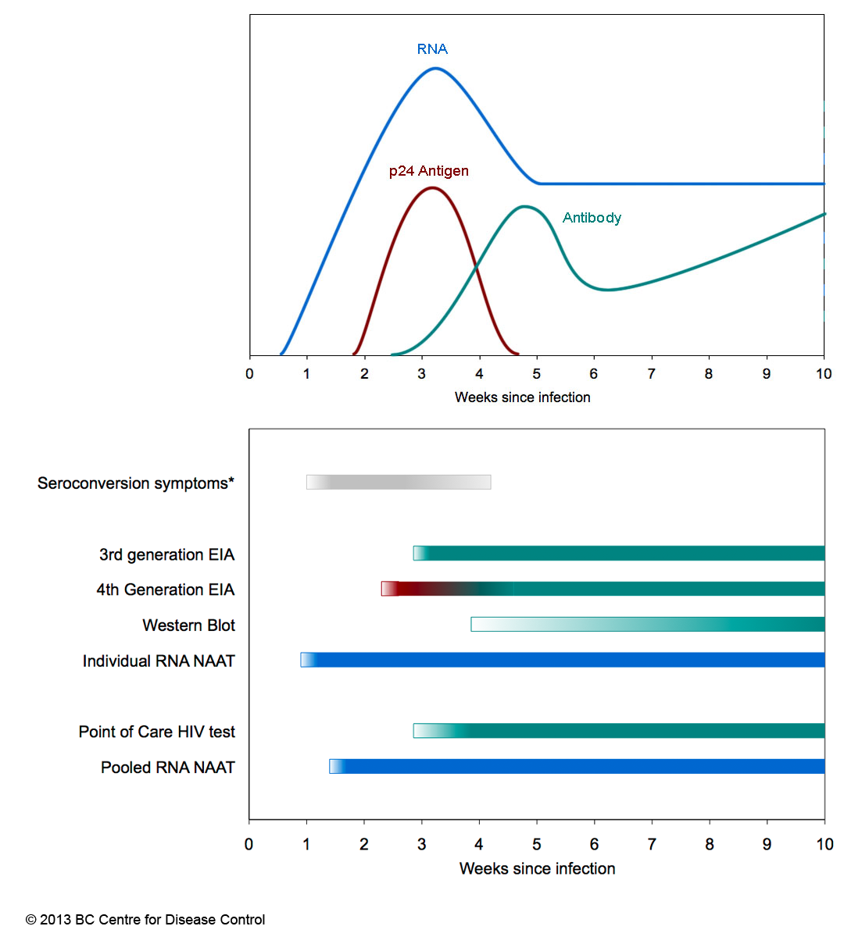
Testing for HIV
Generation | Biomarkers
1st & 2nd | IgG antibodies
3rd | IgM antibodies + IgG antibodies
4th | p24 antigen + IgM antibodies + IgG antibodies
Source: https://www.grepmed.com/GeraldMD
Notes:
Important take away: Screening can be positive without antibody being positive

Slide 17
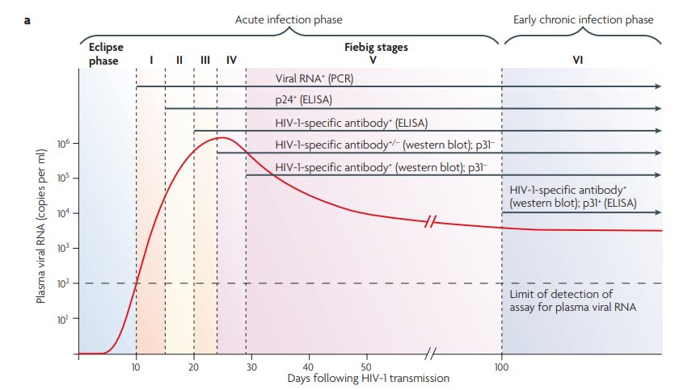
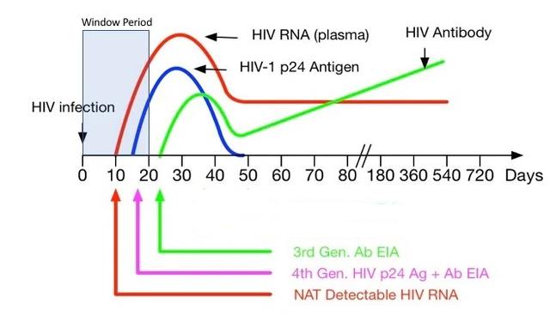
Window period
Window: time between infection and when a test can reliably detect infection
Window period is determined by:
Eclipse period: Early period where no test or lab can detect the virus/disease
The type of test: 4th gen, 3rd gen, etc
Characteristics of the virus & host
Source: @TakaMatsuo_ID
Notes:
During eclipse period, virus is replicating in sub-mucosal cells and not the blood

Slide 18
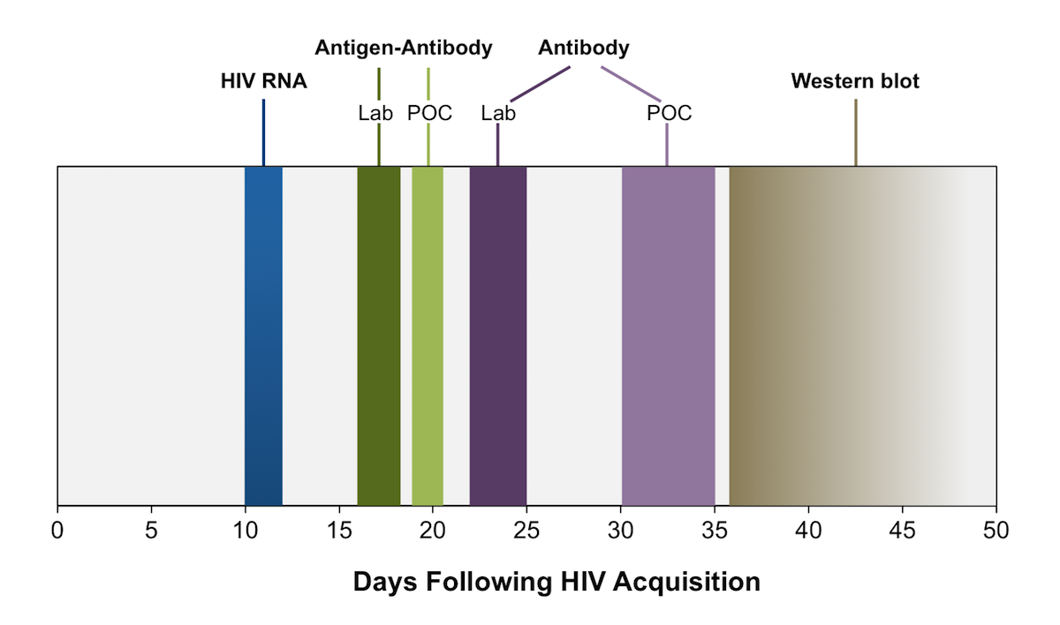
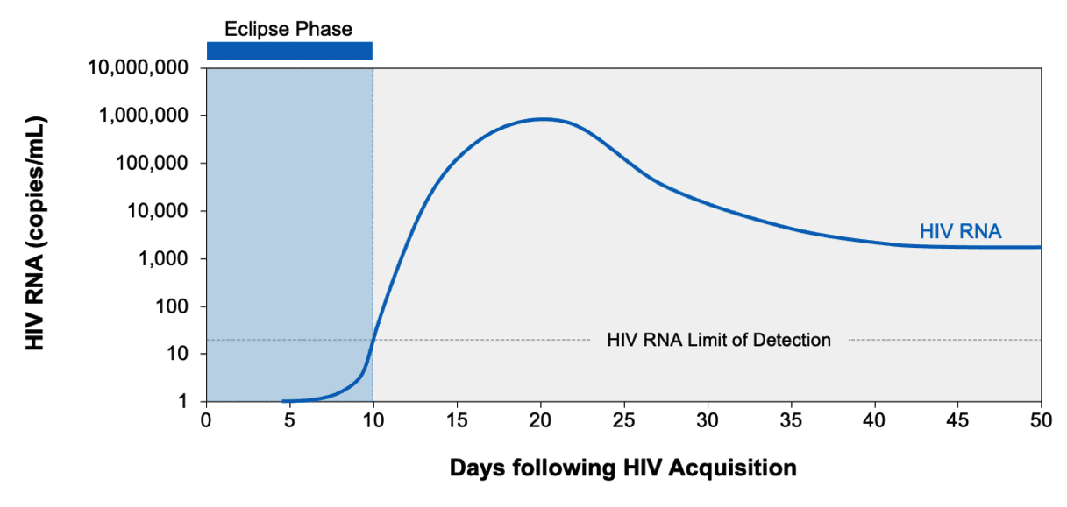
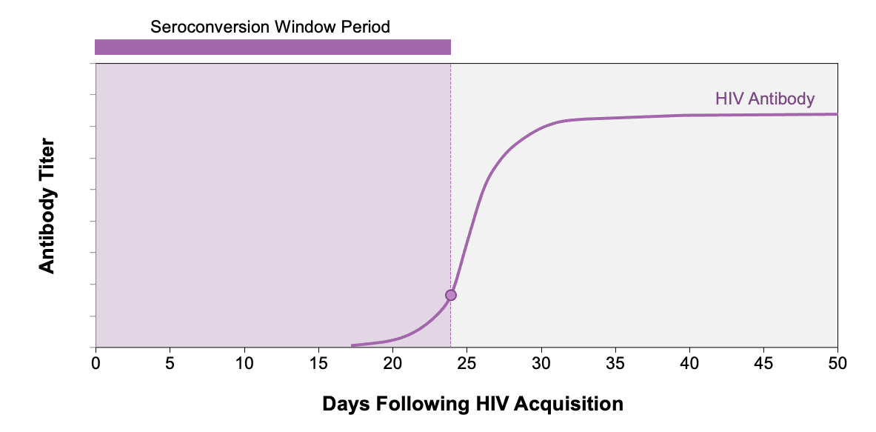
Window Duration
Source: hiv.uw.edu – HIV diagnostic testing
Notes:
B: NAT

Slide 19
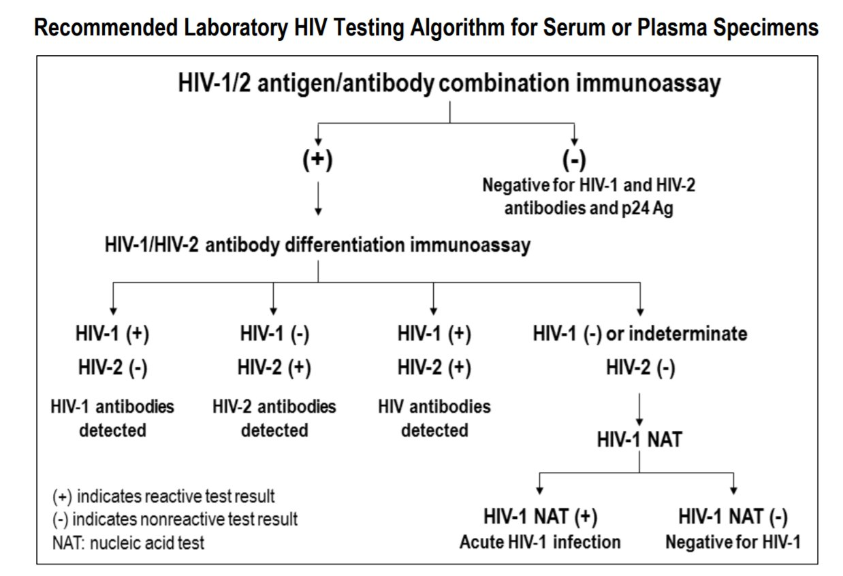
HIV Screening Algorithm
A
A
B
C
B
C
Source: https://www.cdc.gov/hiv/pdf/guidelines_testing_recommendedLabTestingAlgorithm.pdf
Notes:
https://www.cdc.gov/hiv/pdf/guidelines_testing_recommendedLabTestingAlgorithm.pdf

Slide 20
What about the OSH labs?
False negative?
In the US, approved tests all have >98% sensitivity for detecting chronic HIV (4th gen)
Reasons for a false negative are:
Testing in acute HIV
Lab error
Receiving potent ART very early after HIV acquisition or while on PrEP
Immunodeficiencies or immunosuppressants (rare)
OSH labs:
Viral Resp PCR: Negative
BCx: NGTD
RCx: NGTD
HIV screen: Negative
Source: hiv.uw.edu – HIV diagnostic testing
Notes:
B: NAT

Slide 21
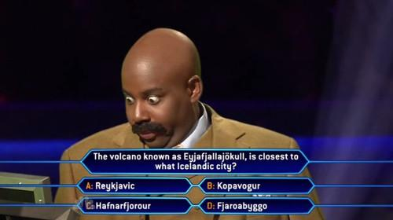
MKSAP Questions
Notes:
B: NAT

Slide 22
MKSAP Question
A 36-year-old man is evaluated for fatigue, headache, myalgia, arthralgia, and sore throat of 2 days' duration. He is also seeking HIV pre-exposure prophylaxis initiation. He has had multiple male and female sexual partners, with rare condom use. His last sexual encounter was approximately 2 weeks ago. He takes no medications.
On physical examination, vital signs are normal. Examination of the head and neck reveals anterior cervical and occipital lymphadenopathy; the remainder of the examination is unremarkable.
Laboratory testing shows a negative fourth-generation HIV-1/2 antigen/antibody combination immunoassay and negative serum rapid plasma reagin test.
MKSAP19: #86
Check absolute CD4 cell count
Perform HIV-1 RNA nucleic acid amplification testing
Start tenofovir-emtricitabine
Start tenofovir-emtricitabine plus dolutegravir
Notes:
B: NAT

Slide 23
MKSAP Question
A 36-year-old man is evaluated for fatigue, headache, myalgia, arthralgia, and sore throat of 2 days' duration. He is also seeking HIV pre-exposure prophylaxis initiation. He has had multiple male and female sexual partners, with rare condom use. His last sexual encounter was approximately 2 weeks ago. He takes no medications.
On physical examination, vital signs are normal. Examination of the head and neck reveals anterior cervical and occipital lymphadenopathy; the remainder of the examination is unremarkable.
Laboratory testing shows a negative fourth-generation HIV-1/2 antigen/antibody combination immunoassay and negative serum rapid plasma reagin test.
MKSAP19: #86
Check absolute CD4 cell count
Perform HIV-1 RNA nucleic acid amplification testing
Start tenofovir-emtricitabine
Start tenofovir-emtricitabine plus dolutegravir
Notes:
B: NAT

Slide 24
MKSAP Question
A 31-year-old man is seen for follow-up discussion of HIV testing. He reports a single extra-marital encounter 6 weeks ago without the use of a condom. He has never been diagnosed with a sexually transmitted infection. He has been symptom free and takes no medications.
The physical examination is unremarkable.
Subsequent testing shows a:
reactive fourth generation HIV-1/2 antigen/antibody combination assay,
negative HIV-1 differentiation immunoassay, and
negative HIV-1/2 RNA nucleic acid amplification test.
MKSAP19: #93
Check CD4 cell count
Provide HIV postexposure prophylaxis
Repeat testing in 1 month
Reinforce safe sexual practice counseling
Notes:
D: Safe sex, as always

Slide 25
MKSAP Question
A 31-year-old man is seen for follow-up discussion of HIV testing. He reports a single extra-marital encounter 6 weeks ago without the use of a condom. He has never been diagnosed with a sexually transmitted infection. He has been symptom free and takes no medications.
The physical examination is unremarkable.
Subsequent testing shows a:
reactive fourth generation HIV-1/2 antigen/antibody combination assay,
negative HIV-1 differentiation immunoassay, and
negative HIV-1/2 RNA nucleic acid amplification test.
MKSAP19: #93
Check CD4 cell count
Provide HIV postexposure prophylaxis
Repeat testing in 1 month
Reinforce safe sexual practice counseling
Notes:
D: Safe sex, as always

