Slide 1

Journal Club
Hunter Ratliff & Matt Lokant
07/16/2025

Slide 2
Article 1

Slide 3
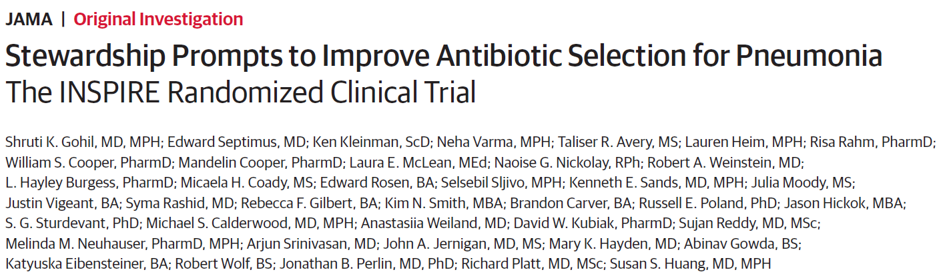

Slide 4
Background & purpose
HCA developed a classification algorithm using AI to predict a patient’s risk of various MRDOs
  MRSA, pseudomonas, ESBL
Prediction based on over 50 variables
  Demographics,
  Healthcare exposures
  Prior antibiotic use
  Hx of MDROs, comorbidities
  Hospital-specific MDRO prevalence
Prediction was incorporated AI into their CPOE for pneumonia
Purpose
Evaluate whether computerized provider order entry (CPOE) prompts providing patient- and pathogen-specific MDRO infection risk estimates could reduce empiric extended-spectrum antibiotics for non–critically ill patients admitted with pneumonia

Slide 5
Design
Cluster-randomized trial conducted in 59 US community hospitals within the HCA Healthcare system
Phases of study
18-month baseline (4/2017 - 9/2018)
6-month phase in (10/2018 - 3/2019)
15-mo intervention (4/2019 - 6/2020)
Hospitals

Slide 6
Design
Cluster-randomized trial conducted in 59 US community hospitals within the HCA Healthcare system
Hospitals paired based on baseline era data → randomized hospitals (1:1)
Phases of study
18-month baseline (4/2017 - 9/2018)
6-month phase in (10/2018 - 3/2019)
15-mo intervention (4/2019 - 6/2020)
Baseline era
Control
Intervention

Slide 7
Design
Cluster-randomized trial conducted in 59 US community hospitals within the HCA Healthcare system
Hospitals paired based on baseline era data → randomized hospitals (1:1)
Phases of study
18-month baseline (4/2017 - 9/2018)
6-month phase in (10/2018 - 3/2019)
15-mo intervention (4/2019 - 6/2020)
Inclusion: Non–critically ill adults hospitalized with pneumonia on admission
Exclusion: Incarceration or transferred to ICU within 48h of admission
Baseline era
Control
Intervention

Slide 8

Study arms
Stewardship alone group (n = 30 hospitals)
Received standard educational materials
Quarterly coaching calls for stewardship
Prospective deescalation based on micro results (MRSA screen, sputum cultures)

Slide 9

Study arms
Stewardship alone group (n = 30 hospitals)
Received standard educational materials
Quarterly coaching calls for stewardship
Prospective deescalation based on micro results (MRSA screen, sputum cultures)
Stewardship + CPOE group (n = 29 hospitals)
Same as control group --plus-- if starting broad spectrum ABX and patient-pathogen risk <10% → CPOE prompted antimicrobial change
Prompts were tailored to the specific extended spectrum antimicrobial that was ordered
Gave them a single click option to change
MRSA risk <10% → click to “stop vancomycin”
Pseud <10% → click to “change Zosyn to ceftriaxone”

Slide 10
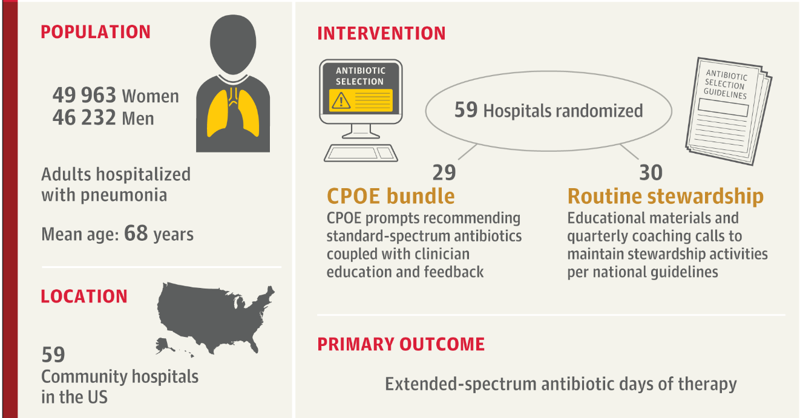
Design
Measured as individual antibiotic days during first 72-hours

Slide 11
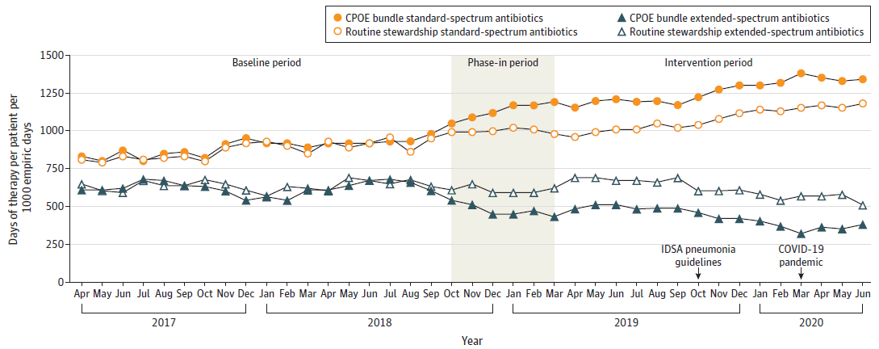
Results

Slide 12
Results
Outcome | CPOE group |  |  | Control group |  |  | Rate/Hazard Ratio of difference-in-differences
 | Before | After | RR/HR | Before | After | RR/HR
(1) Extended spec days | 614 | 429 | 0.68* | 633 | 615 | 0.94 | 0.72* (0.66-0.78)
Primary outcome: CPOE bundle group experienced a 28.4% reduction in empiric extended spectrum days of therapy (within first 72 hours)
12.5% of prompts resulted in extended → standard-spectrum antibiotic

Slide 13
Results
Outcome | CPOE group |  |  | Control group |  |  | Rate/Hazard Ratio of difference-in-differences
 | Before | After | RR/HR | Before | After | RR/HR
(1) Extended spec days | 614 | 429 | 0.68* | 633 | 615 | 0.94 | 0.72* (0.66-0.78)
Vanco days | 235 | 161 | 0.68* | 241 | 219 | 0.89* | 0.77* (0.71-0.83)
Anti-pseud days | 342 | 240 | 0.67* | 357 | 361 | 0.98 | 0.68* (0.61-0.75)
Secondary outcomes: CPOE bundle group had reduction in anti-MRSA and anti-pseudomonal antibiotics

Slide 14
Results
Outcome | CPOE group |  |  | Control group |  |  | Rate/Hazard Ratio of difference-in-differences
 | Before | After | RR/HR | Before | After | RR/HR
(1) Extended spec days | 614 | 429 | 0.68* | 633 | 615 | 0.94 | 0.72* (0.66-0.78)
Vanco days | 235 | 161 | 0.68* | 241 | 219 | 0.89* | 0.77* (0.71-0.83)
Anti-pseud days | 342 | 240 | 0.67* | 357 | 361 | 0.98 | 0.68* (0.61-0.75)
Length of stay (days) | 6.9 | 7.1 | 1.00 | 6.9 | 6.8 | 1.04 | 0.96 (0.91-1.01)
Days to ICU transfer | 6.6 | 7.1 | 1.06 | 6.7 | 6.5 | 1.02 | 1.04 (0.89-1.21)
Days to ABX escalation | 5.5 | 6.1 | 0.81* | 5.4 | 5.3 | 0.99 | 0.82* (0.69-0.97)
Safety outcomes: Similar LOS & time to ICU transfer
CPOE group had delayed time to ABX escalation (18% longer), but didn’t affect other safety outcomes

Slide 15
Results
Outcome | CPOE group |  |  | Control group |  |  | Rate/Hazard Ratio of difference-in-differences
 | Before | After | RR/HR | Before | After | RR/HR
(1) Extended spec days | 614 | 429 | 0.68* | 633 | 615 | 0.94 | 0.72* (0.66-0.78)
Vanco days | 235 | 161 | 0.68* | 241 | 219 | 0.89* | 0.77* (0.71-0.83)
Anti-pseud days | 342 | 240 | 0.67* | 357 | 361 | 0.98 | 0.68* (0.61-0.75)
Length of stay (days) | 6.9 | 7.1 | 1.00 | 6.9 | 6.8 | 1.04 | 0.96 (0.91-1.01)
Days to ICU transfer | 6.6 | 7.1 | 1.06 | 6.7 | 6.5 | 1.02 | 1.04 (0.89-1.21)
Days to ABX escalation | 5.5 | 6.1 | 0.81* | 5.4 | 5.3 | 0.99 | 0.82* (0.69-0.97)
Other notable findings: Algorithm classified 96% of patients as low risk of MDRO
Less than 2% of these patients grew MDROs

Slide 16
Conclusions & Limitations
AI assisted computerized provider order entry prompts seems to be an effective (and likely safe) intervention to improve antibiotic stewardship in pneumonia treatment
Limitations
COVID: Intervention period occurred during COVID
Hawthorne effect: Getting prompts may have contributed to stewardship (irrespective of patient risk)
  But does it matter why providers changed behavior?
Is 10% the right cut off? Is a 5% risk of MRSA the same in a COPD patient vs neutropenic fever?

Slide 17
Article 2

Slide 18

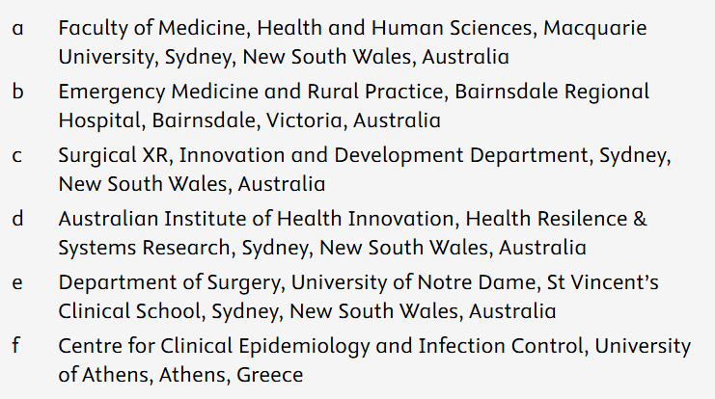
Article 2
Veronica Preda [a], Zehurn Ong [a], Chandana Wijeweera [b], Terence Carney [c], Robyn Clay-Williams [d], Denuka Kankanamge [a], Tamara Preda [e], Ioannis Kopsidas [f], Michael Keith Wilson [a,c]
Artificial intelligence (AI) use for personal protective equipment training, remediation, and education in health care

Slide 19

Background & purpose
Donning and doffing PPE correctly are critical skills for HCWs
  Failure to do so → nosocomial infections
  Many may not know there are doing it incorrectly

Slide 20

Background & purpose
Donning and doffing PPE correctly are critical skills for HCWs
  Failure to do so → nosocomial infections
  Many may not know there are doing it incorrectly
Regular training & monitoring can improve rates of correct PPE usage

Slide 21
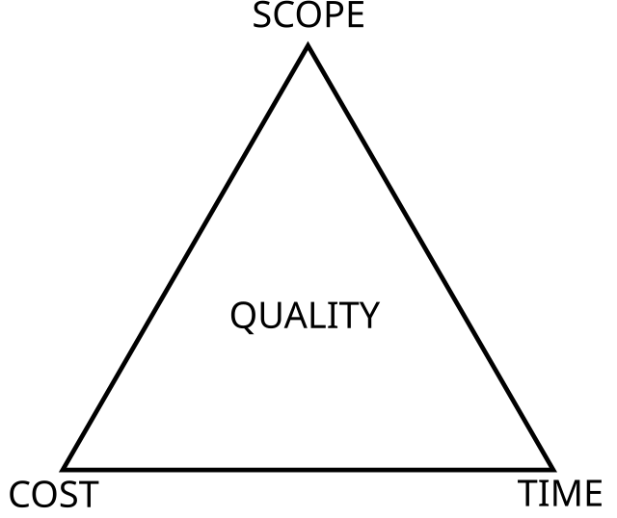

Background & purpose
Donning and doffing PPE correctly are critical skills for HCWs
  Failure to do so → nosocomial infections
  Many may not know there are doing it incorrectly
Regular training & monitoring can improve rates of correct PPE usage
Costs money & time to do so

Slide 22
Background & purpose
Donning and doffing PPE correctly are critical skills for HCWs
  Failure to do so → nosocomial infections
  Many may not know there are doing it incorrectly
Regular training & monitoring can improve rates of correct PPE usage
Costs money & time to do so
Purpose
To assess the efficacy of Surgical XR AI-PPE (SXR AI-PPE) in training and remediating HCW (health care workers) in correct personal protective equipment (PPE) donning and doffing techniques

Slide 23
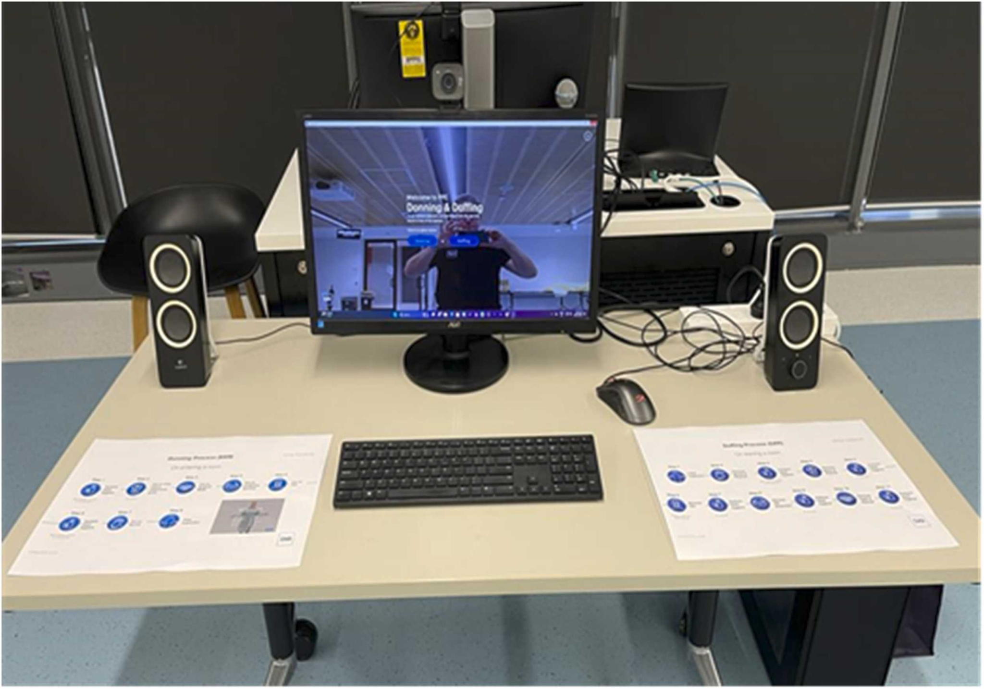
The SXR AI-PPE Platform
Utilizes AI and computer vision to analyze and assess user donning and doffing

Slide 24
The SXR AI-PPE Platform
Utilizes AI and computer vision to analyze and assess user donning and doffing
Veronica Preda [a], Zehurn Ong [a], Chandana Wijeweera [b], Terence Carney [c], Robyn Clay-Williams [d], Denuka Kankanamge [a], Tamara Preda [e], Ioannis Kopsidas [f], Michael Keith Wilson [a,c]

Slide 25
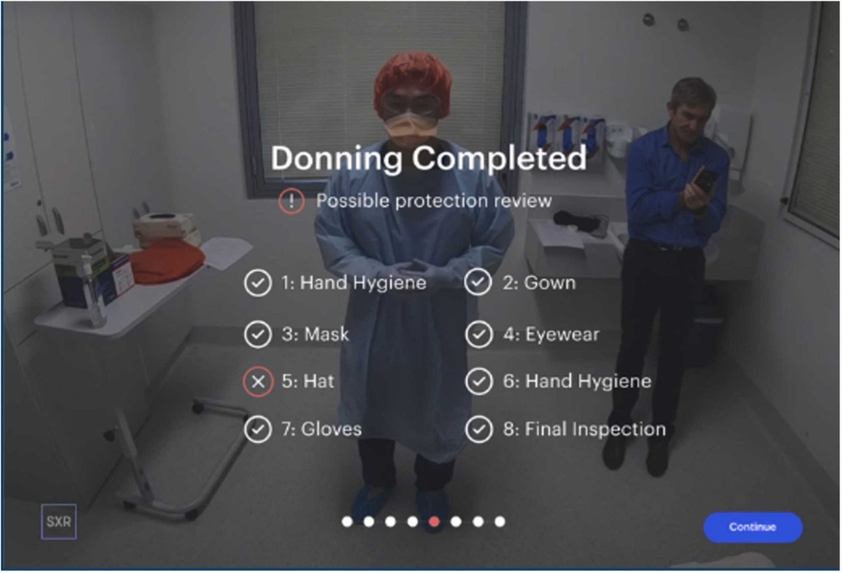
The SXR AI-PPE Platform
Utilizes AI and computer vision to analyze and assess user donning and doffing
Real-time Feedback: Provides real-time feedback on the user’s performance, helping to identify and remediate user errors promptly for improved technique

Slide 26
The SXR AI-PPE Platform
Guided Mode: Offers a step-by-step walkthrough of the PPE donning/doffing process, ideal for those unfamiliar with PPE protocols or needing a refresher

Slide 27

The SXR AI-PPE Platform
Guided Mode: Offers a step-by-step walkthrough of the PPE donning/doffing process, ideal for those unfamiliar with PPE protocols or needing a refresher
Unguided Mode: designed for more experienced users and providing a quicker, more streamlined assessment

Slide 28
Study design
“Single-center, mixed-methods, prospective cohort study (?) involving 293 HCWs (?) in Sydney, Australia”

Slide 29
Study design
This differs some from what is in the text
“Single-center, mixed-methods, prospective cohort study (?) involving 293 HCWs (?) in Sydney, Australia”
Assessed donning & doffing
Components of donning & doffing
Hand hygiene
Gown
Mask
Eyewear
Hat
Gloves

Slide 30
Study design
This differs some from what is in the text
“Single-center, mixed-methods, prospective cohort study (?) involving 293 HCWs (?) in Sydney, Australia”
Assessed donning & doffing
Accuracy - Did they do it correctly?
Speed - How long did it take?
Longitudinal component - Did they remember over time?
  More on this later
Components of donning & doffing
Hand hygiene
Gown
Mask
Eyewear
Hat
Gloves

Slide 31
Study design
This differs some from what is in the text
“Single-center, mixed-methods, prospective cohort study (?) involving 293 HCWs (?) in Sydney, Australia”
Assessed donning & doffing
Accuracy - Did they do it correctly?
Speed - How long did it take?
Longitudinal component - Did they remember over time?
  More on this later
Also did before-after surveys to assess confidence in correct PPE use
Components of donning & doffing
Hand hygiene
Gown
Mask
Eyewear
Hat
Gloves

Slide 32
Study design
This differs some from what is in the text
“Single-center, mixed-methods, prospective cohort study (?) involving 293 HCWs (???) in Sydney, Australia”
Assessed donning & doffing
Accuracy
Speed
Longitudinal component
Done for the entire
group (n=293) on
guided mode
Only 20 medical students

Slide 33
Study design
This differs some from what is in the text
“Single-center, mixed-methods, prospective cohort study (?) involving 293 HCWs (???) in Sydney, Australia”
Assessed donning & doffing
Accuracy
Speed
Longitudinal component
Done for the entire group (n=293) on guided mode
Only 20 medical students
3 mo
3 mo
Guided mode
t = 0
Unguided mode
t = 3 months
Unguided mode
t = 6 months

Slide 34
Study design
“Single-center, mixed-methods, prospective cohort study (?) involving 293 HCWs (?) in Sydney, Australia”
Paper calls this prospective cohort…

Slide 35
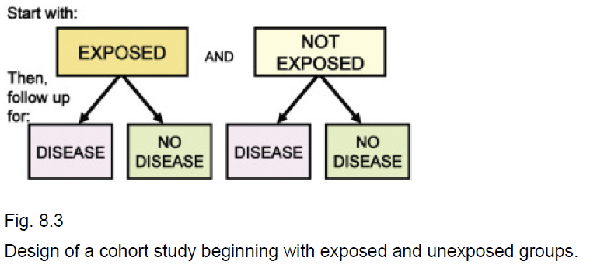
Study design
“Single-center, mixed-methods, prospective cohort study (?) involving 293 HCWs (?) in Sydney, Australia”
Paper calls this prospective cohort, but I disagree
Prospective cohort studies
Select individuals without the outcome of interest but at risk for it, and following them over time
The aim is to compare the incidence of outcomes between groups based on exposure status
Exposure: smokers vs non-smokers
Outcome: lung cancer vs no cancer
Gordis Epidemiology (Chapter 8), probs like the 2019 version

Slide 36
Study design
“Single-center, mixed-methods, prospective cohort study (?) involving 293 HCWs (?) in Sydney, Australia”
Prospective cohort studies
Select individuals without the outcome of interest but at risk for it, and following them over time
This part checks out
The aim is to compare the incidence of outcomes between groups based on exposure status
Exposure: …
Outcome: Good vs poor PPE use
Population
HCWs
No exposures
Exposure
Outcome
Poor PPE use
Good PPE use

Slide 37
Study design
“Single-center, mixed-methods, prospective cohort study (?) involving 293 HCWs (?) in Sydney, Australia”
Prospective cohort studies
Select individuals without the outcome of interest but at risk for it, and following them over time
The aim is to compare the incidence of outcomes between groups based on exposure status
Exposure: PPE training vs ???
Outcome: Good vs poor PPE use
Population
HCWs
Exposure
AI training
???
Outcome
Poor PPE
Good PPE
Poor PPE
Good PPE
Exposed
Unexposed

Slide 38
Study design
“Single-center, mixed-methods, prospective cohort study (?) involving 293 HCWs (?) in Sydney, Australia”
Unexposed
Exposed
Pre-post study
Follows a single group over time and measures outcomes before and after an intervention
Measures within-subject change (no separate control group)
Within subject comparison
Outcome
Before outcomes
After outcomes
AI training
Population
HCWs
(untrained)
HCWs
(trained)

Slide 39
Study design
“Single-center, mixed-methods, prospective cohort study (?) involving 293 HCWs (?) in Sydney, Australia”
Prospective cohort studies
Select individuals without the outcome of interest but at risk for it, and following them over time
The aim is to compare the incidence of outcomes between groups based on exposure status
Just because an investigation is prospective doesn’t make it a prospective cohort
Pre-post study
Follows a single group over time and measures outcomes before and after an intervention
Measures within-person change (no separate control group)

Slide 40
Results
Entire group
(n=293) on
guided mode
Table 1 | No | Percent
Medical student | 221 | 75%
Nursing | 7 | 2%
Administrative staff | 15 | 5%
Junior medical officer | 13 | 4%
Surgeon | 3 | 1%
Path/lab science | 31 | 11%
Physician | 3 | 1%

Slide 41
Results
Entire group
(n=293) on
guided mode
Table 1 | No | Percent
Medical student | 221 | 75%
Nursing | 7 | 2%
Administrative staff | 15 | 5%
Junior medical officer | 13 | 4%
Surgeon | 3 | 1%
Path/lab science | 31 | 11%
Physician | 3 | 1%
Percent failed | Donning | Doffing
Hand hygiene | 29% | 4%
Gown | 50% | 0%
Mask | 23% | 1%
Eyewear | 43% | 0%
Hat | 10% | 21%
Gloves | 14% | 0%

Slide 42
Results
Entire group
(n=293) on
guided mode
Table 1 | No | Percent
Medical student | 221 | 75%
Nursing | 7 | 2%
Administrative staff | 15 | 5%
Junior medical officer | 13 | 4%
Surgeon | 3 | 1%
Path/lab science | 31 | 11%
Physician | 3 | 1%
Percent failed | Donning | Doffing
Hand hygiene | 29% | 4%
Gown | 50% | 0%
Mask | 23% | 1%
Eyewear | 43% | 0%
Hat | 10% | 21%
Gloves | 14% | 0%
PPE time (seconds) | Before | After | Difference
Donning | 208 | 193 | 15 sec (7.2%)
Doffing | 195 | 173 | 22 sec (11.3%)

Slide 43
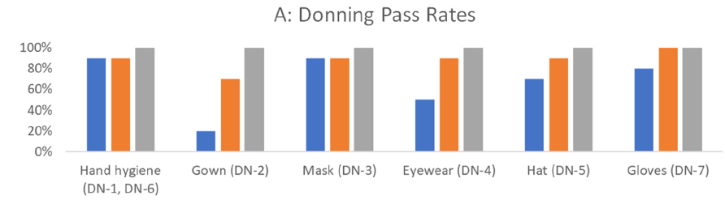
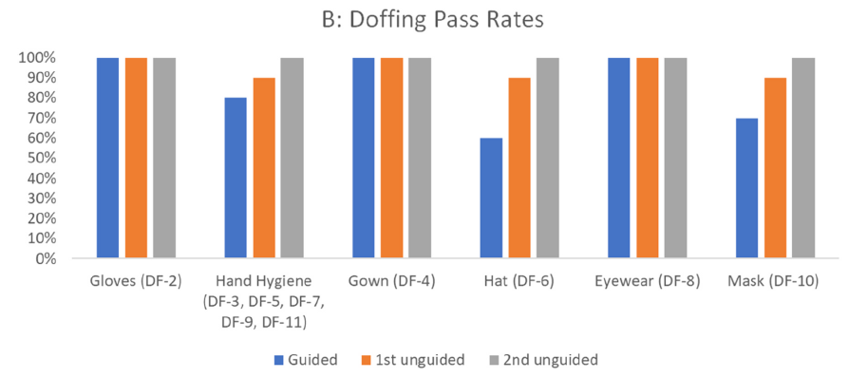
Results
Longitudinal component
20 medical students
Percent failing (n=20) | Hand hygiene |  | Gown |  | Mask |  | Eyewear |  | Hat |  | Gloves
 | DoNN | DoFF | DoNN | DoFF | DoNN | DoFF | DoNN | DoFF | DoNN | DoFF | DoNN | DoFF
Baseline | 5 | 10 | 40 | 0 | 5 | 15 | 25 | 0 | 5 | 20 | 10 | 0
3 months | 5 | 5 | 15 | 0 | 5 | 5 | 5 | 0 | 5 | 5 | 0 | 0
6 months | 0 | 0 | 0 | 0 | 0 | 0 | 0 | 0 | 0 | 0 | 0 | 0

Slide 44
Results
Longitudinal component
20 medical students
Percent failing (n=20) | Hand hygiene |  | Gown |  | Mask |  | Eyewear |  | Hat |  | Gloves
 | DoNN | DoFF | DoNN | DoFF | DoNN | DoFF | DoNN | DoFF | DoNN | DoFF | DoNN | DoFF
Baseline | 5 | 10 | 40 | 0 | 5 | 15 | 25 | 0 | 5 | 20 | 10 | 0
3 months | 5 | 5 | 15 | 0 | 5 | 5 | 5 | 0 | 5 | 5 | 0 | 0
6 months | 0 | 0 | 0 | 0 | 0 | 0 | 0 | 0 | 0 | 0 | 0 | 0

Slide 45
Conclusions & Limitations
Really is a pretty cool concept with a fair amount of potential
  It’s just the paper itself doesn’t really demonstrate that potential
Good points made by the authors (even if it’s a sales pitch)
Simulation based learning is effective
Scaleable (only tech is a screen and camera)
Avoids some potential issues with the hierarchy of medicine
Limitations
Conflict of interest
No comparison group
Majority medical students

Slide 46

Conclusions & Limitations
Really is a pretty cool concept with a fair amount of potential
  It’s just the paper itself doesn’t really demonstrate that potential
Seems like it may be suited for surveillance & auditing
Each participant started by logging in to their individual…account via contactless facial recognition
Trials were recorded in a variety of settings with both natural and artificial light as well as differing backgrounds to mimic variable clinical settings such as wards and outpatient clinics
See BlueMirror.ai

Slide 47
Emphasis (#2f5aa2)
Primary (#3B71CA)
BG subtle (#e2eaf7)
Emphasis (#b03d50)
Danger (#DC4C64)
BG subtle (#fae4e8)
Emphasis (#C1443C)
Pink (#FF6F61)
BG subtle (#FFE9E6)
Emphasis (#3b7e94)
Info (#54B4D3)
BG subtle (#e5f4f8)
Emphasis (#0c622e)
Success (#14A44D)
BG subtle (#dcf1e4)
Emphasis (#1F7A6C)
Mint/Aqua (#48C9B0)
BG subtle (#f1f2f3)
Emphasis (#404247)
Secondary (#9FA6B2)
BG subtle (#f1f2f3)
Emphasis (#896110)
Warning (#E4A11B)
BG subtle (#fbf1dd)
Emphasis (#6C3483)
Purple (#8E44AD)
BG subtle (#F0E6F5)
Emphasis (#2C3E50)
Slate grey (#5D6D7E)
BG subtle (#E8ECF1)

