Slide 1
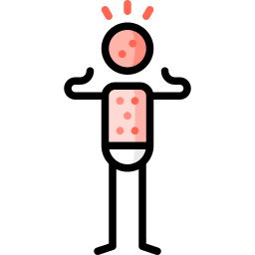
Measles..?
WVU–Jamaica Teleconference
Hunter Ratliff
11/04/2026
Ages, dates, and other identifying information may have been changed
I have no conflict of interest in relation to this presentation

Slide 2
Shortcuts
Case 1: Start | Alternate version of Case 1 (measles PEP)
Discussion: Does MMR “cause” ‘measles’?
Distinguishing VARI from wild type | Martin et al | test to order | Is timing reliable | 3C & Koplik

Slide 3

Responsible use of AI
Use of AI
Claude Opus 5.5 (Anthropic) was used for slide design, & first-draft text. ChatGPT 6 (Open AI) created some graphics, but Anthropic is a more ethical choice. Also used Opus 5, since 5.5 downgraded me when I started using immunology & virology prompts
I chose the content and cases, educational points, and verified the literature search. Hunter is responsible for content and accuracy of this presentation
No patient identifiers were shared with AI

Slide 4
Why now? Measles in 2026
Americas: 55,792 confirmed cases and 77 deaths in 17 countries (through Oct 3), the most since 2004 ^{[12]}

Slide 5
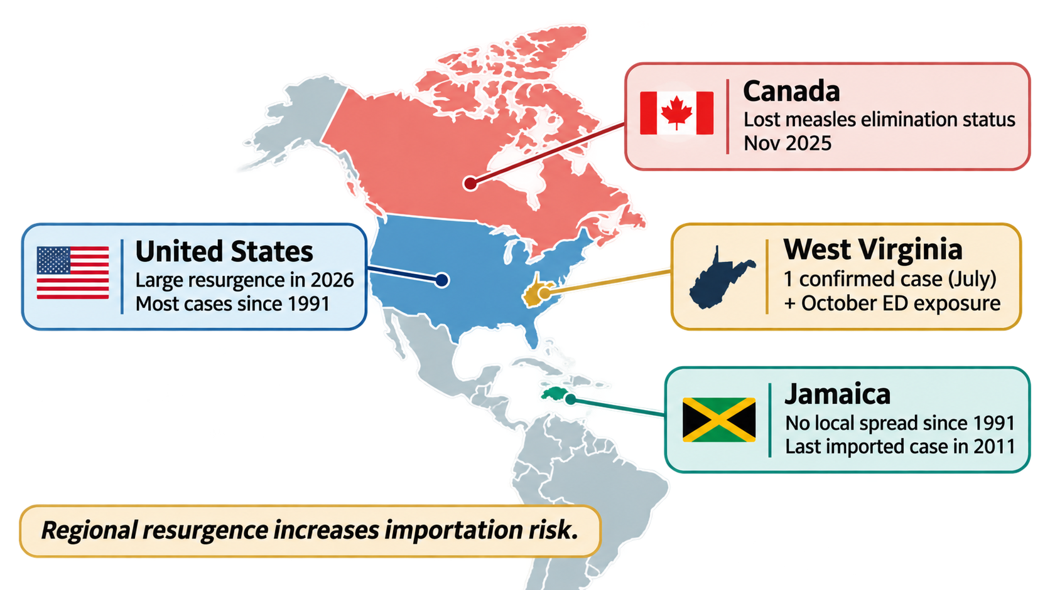
Why now? Measles in 2026
Americas: 55,792 confirmed cases and 77 deaths in 17 countries (through Oct 3), the most since 2004 ^{[12]}
[12]
[13]
[14]
[15]

Slide 6
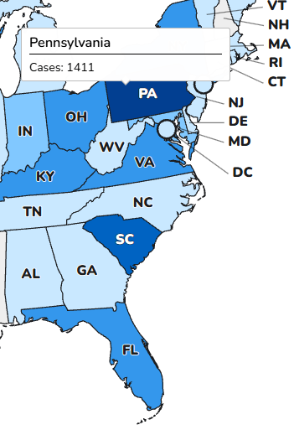
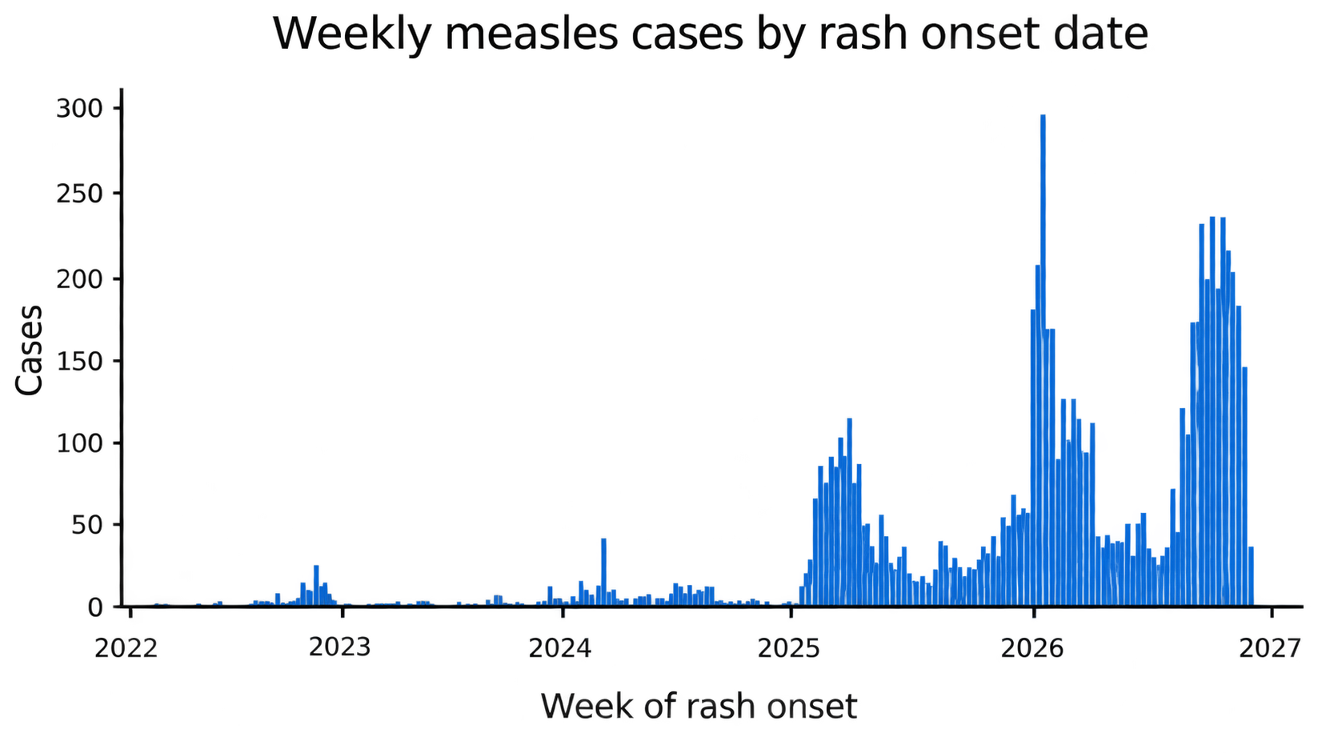
Why now? Measles in 2026
2026 Measles cases by state
Americas: 55,792 confirmed cases and 77 deaths in 17 countries (through Oct 3), the most since 2004 ^{[12]}
You are here

Slide 7
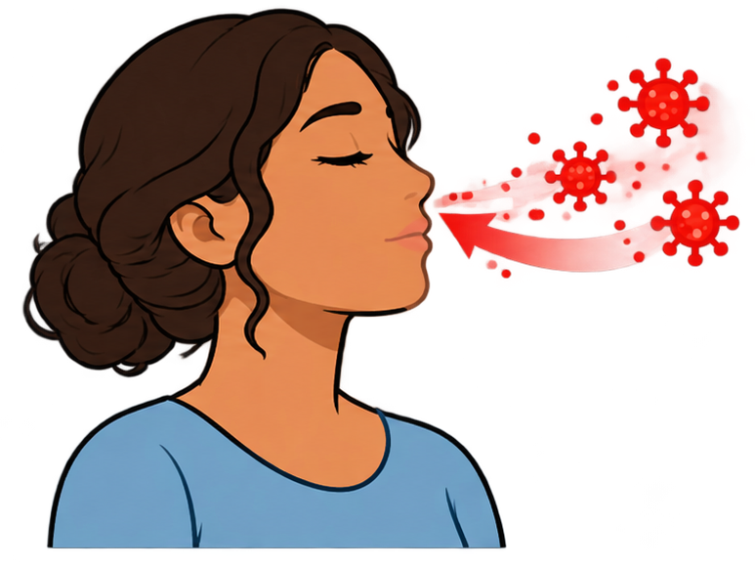
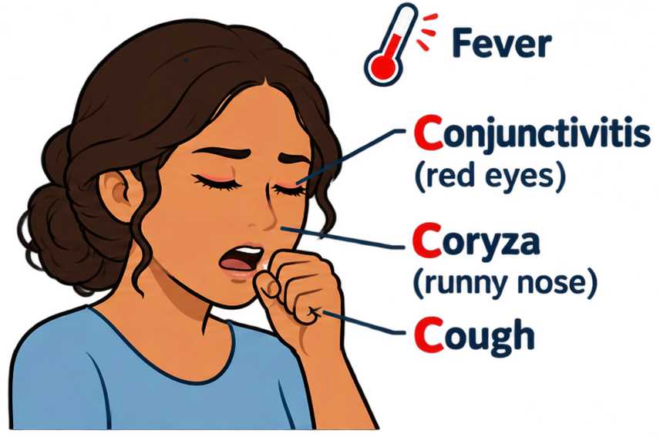
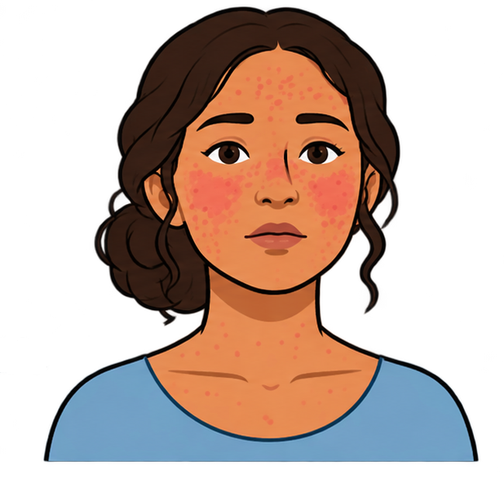
Measles 101 [21, 22]
Incubation
7–14 days after exposure, no symptoms
Prodrome (3–5 days)
High fever (up to 40.5 °C), cough, coryza, conjunctivitis, Koplik spots
Rash (~day 14)
Maculopapular; face and hairline, then trunk and limbs over ~3 days; lasts 4–8 days
Contagious: 4 days before to 4 days after rash onset

Slide 8
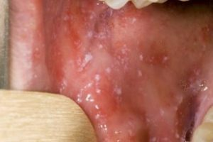
[1] Are Koplik spots pathognomonic for active measles?

Slide 9
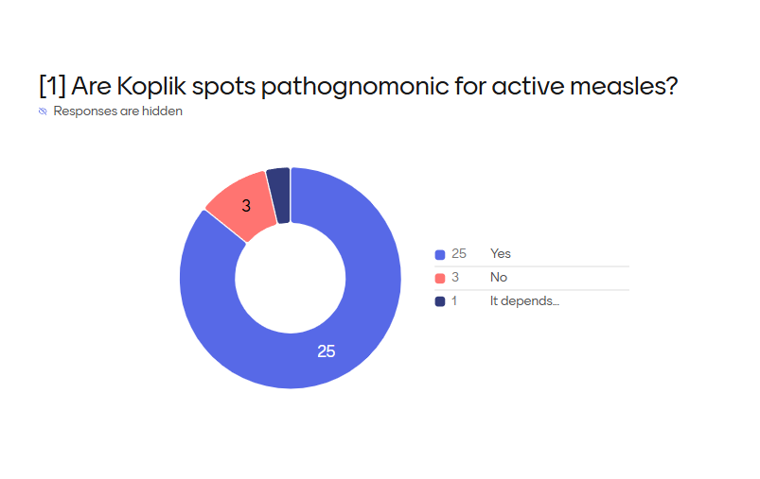

Slide 10
Setting the scene
It’s Wendsday afternoon in the ED / urgent care
The waiting room has been full all day
You are finishing up for the day, when…

Slide 11
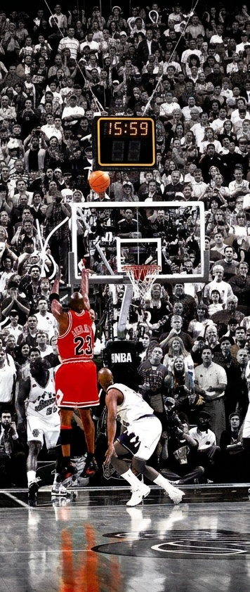
Setting the scene
AI generated content
(Nano Banana 2)
It’s Wendsday afternoon in the ED / urgent care
The waiting room has been full all day
You are finishing up for the day, when…
At 3:59pm, a new patient checks in…
ED/07
Chief complaint | measles r/o
Hoping to go home today? | Yes
Triage callback number | 170725

Slide 12
Case 1: HPI (per triage)
A 35 y/o F with no PMH p/w concern for measles

Slide 13
Case 1: HPI (per triage)
A 35 y/o F with no PMH p/w concern for measles
Monday: Developed body aches, headache, mild sore throat
Tues: Bumps on face → red spots on chest

Slide 14
Case 1: HPI (per triage)
A 35 y/o F with no PMH p/w concern for measles
Monday: Developed body aches, headache, mild sore throat
Tues: Bumps on face → red spots on chest
Exposure history (travel, sick contacts, local outbreak): not asked yet
Recently received MMR vaccine because she was not immune

Slide 15
Case 1: HPI (per triage)
A 35 y/o F with no PMH p/w concern for measles
Monday: Developed body aches, headache, mild sore throat
Tues: Bumps on face → red spots on chest
Measles PEP guidance (NYC.gov)
Measles immune status | Type of PEP
Non-immune | Give MMR vaccine
1 dose MMR | Give 2nd MMR vaccine
Unknown status | Give MMR vaccine
Exposure history (travel, sick contacts, local outbreak): not asked yet
Recently received MMR vaccine because she was not immune

Slide 16
Case 1: HPI - Timeline
A 35 y/o F with no PMH p/w concern for measles due to a rash developing 13 days after MMR
14 days ago: Received MMR vaccine
MMR vaccine
ED
1
2
3
…
10
11
12
13
14

Slide 17
Case 1: HPI - Timeline
A 35 y/o F with no PMH p/w concern for measles due to a rash developing 13 days after MMR
14 days ago: Received MMR vaccine
Sun/Mon: Developed body aches, headache, mild sore throat (all better now)
Body ache
Sore throat
MMR vaccine
ED
1
2
3
…
10
11
12
13
14

Slide 18
Case 1: HPI - Timeline
A 35 y/o F with no PMH p/w concern for measles due to a rash developing 13 days after MMR
14 days ago: Received MMR vaccine
Sun/Mon: Developed body aches, headache, mild sore throat (all better now)
  Mid Mon: Runny nose and congestion (almost gone now)
Body ache
Sore throat
Runny nose
MMR vaccine
ED
1
2
3
…
10
11
12
13
14

Slide 19
Case 1: HPI - Timeline
A 35 y/o F with no PMH p/w concern for measles due to a rash developing 13 days after MMR
14 days ago: Received MMR vaccine
Sun/Mon: Developed body aches, headache, mild sore throat (all better now)
  Mid Mon: Runny nose and congestion (almost gone now)
Tues: Bumps on face → red spots on chest
Body ache
Sore throat
Runny nose
MMR vaccine
Rash
ED
1
2
3
…
10
11
12
13
14

Slide 20


Case 1: HPI - Timeline
A 35 y/o F with no PMH p/w concern for measles due to a rash developing 13 days after MMR. Rash prodrome was body aches + sore throat, then runny nose, onset just a few days before rash.
No fever (but did have body aches)
No noticeable cough
Eyes have not been red or watery
Body ache
Sore throat
(now resolved)
Runny nose
coryza?
MMR vaccine
Rash
ED
1
2
3
…
10
11
12
13
14

Slide 21
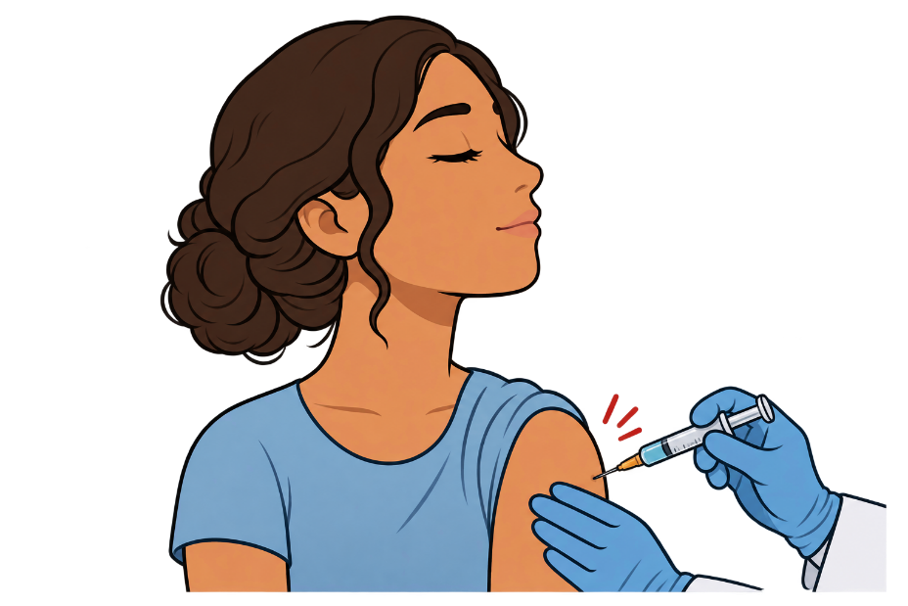
What is the MMR vaccine? [23, 24]
M = Measles
Three live attenuated (weakened) viruses
Protection against measles:
  1 dose: 93%
  2 doses: 97%
Two doses:
  Jamaica at 12 and 18 months ^{[25]}
  US at 12–15 months and 4–6 years
Live vaccine: not given in pregnancy or severe immunocompromise
M = Mumps
R = Rubella
Also can be given as post-exposure prophylaxis (after measles exposure)

Slide 22
Case 1: HPI - The rash
A 35 y/o F with no PMH p/w concern for measles due to a rash developing 13 days after MMR. Rash prodrome was body aches + sore throat, then runny nose, onset just a few days before rash.
Last night while brushing her teeth, noticed what appeared to be acne appear on face
During shower, saw similar lesions on her right shoulder
  Unclear if these appeared before, after, or at the same time as the rash on her face
This morning, rash on the face was more numerous
  Also now has some rash on her forearms
Body ache
Sore throat
(now resolved)
Runny nose
coryza?
MMR vaccine
Rash
ED
1
2
3
…
10
11
12
13
14

Slide 23
Case 1: Physical exam
BP | 138/87 | Pulse | 90 | SpO2 | 98 %
Temp | 36.7 °C (98.1 °F) | RR | 18 | BMI | 26 kg/m²
General | Alert and oriented, NAD, vitals reviewed
ENT | Buccal mucosa: Normal, no lesions (the flashlight in the room doesn’t work)
Eyes | Anicteric sclerae; No injection
Skin | Next slide

Slide 24
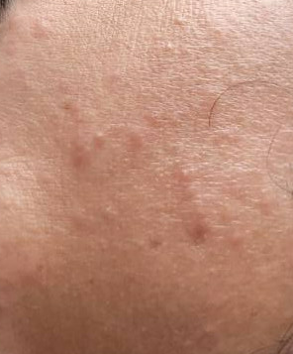
Case 1: Physical exam
Small (<5mm) nonblanching lesions
Maculopapular (papules/raised > macules)
  Some do look more acneiform
Only mild erythema/hyperpigmentation
Distribution:
Most pronounced on the face but also
  anterior chest/shoulder > forearms >> back
Not diffuse, plenty of adjacent skin is uninvolved
  minimal to no rash on upper arms and neck
  None on the legs
  Spares the palms
Unable to take actual pictures due to isolation

Slide 25
Case 1: Labs
CBC | Result
WBC | 5.2
Hgb | 12.1
Platelets | 224
Neut % | 49%
Eos % | 6%
Chem7 | Result
Na | 141
K | 3.8
HCO3 | 23
BUN | 15
Cr | 0.71

Slide 26
Case 1: Summary
Small (<5mm) nonblanching lesions
Maculopapular (papules/raised > macules)
  Some do look more acneiform
Only mild erythema/hyperpigmentation
Distribution:
Most pronounced on the face but also
  anterior chest/shoulder > forearms >> back
Not diffuse, plenty of adjacent skin is uninvolved
  minimal to no rash on upper arms and neck
  None on the legs
  Spares the palms
A 35 y/o F with no PMH p/w concern for measles due to a rash developing 13 days after MMR. Rash prodrome was body aches + sore throat, then runny nose, onset just a few days before rash.
The rash is certainly worsening
Seems like it’s likely spreading cephalocaudal (head-to-chest)
Body ache
Sore throat
(now resolved)
Runny nose
coryza?
Rash
ED
11
12
13
14

Slide 27
[2] Is this measles?

Slide 28
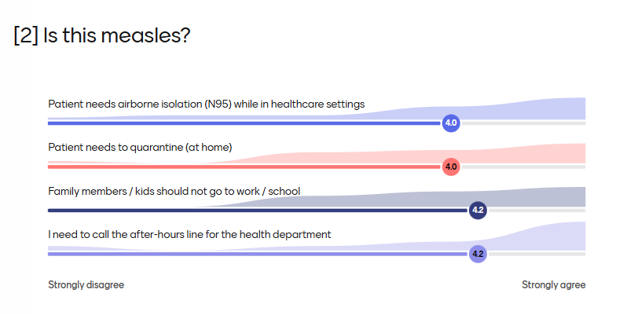

Slide 29
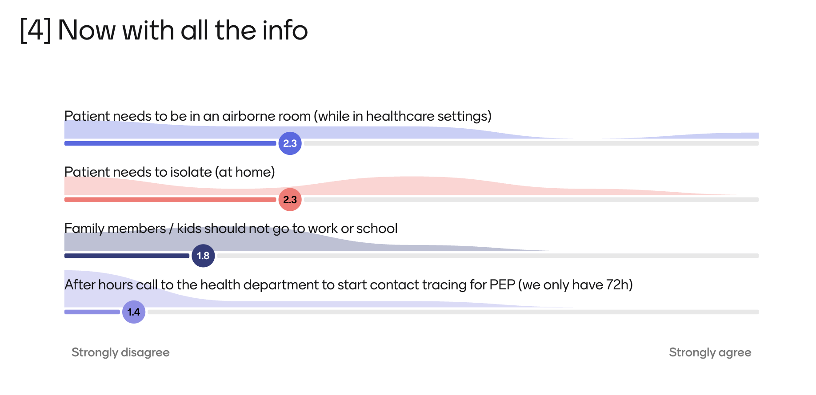
Notes:
This is what the ID faculty said (I actually disagree with their assessment, the Jamaica-WVU conference’s assessment is closer to what I’d want)

Slide 30
Before they reach the waiting room [16]
If they call ahead: tell them which entrance to use and to wear a mask
Mask the patient at triage and separate them from other patients
Airborne isolation room if available; otherwise a private room, door closed, patient masked
Only staff with evidence of immunity go in, wearing an N95
Leave the room empty for up to 2 hours after the patient leaves
Notify public health on suspicion, not on confirmation ^{[15]}

Slide 31
[3] How should we manage this?
She calls ahead. What do you tell her?
Options:
Come straight to the ED
Come to clinic
Stay home: phone or video assessment
Stay home: call public health

Slide 32
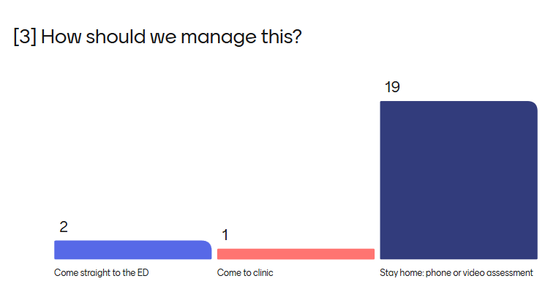

Slide 33
Disaster case
An unvaccinated patient had a possible measles exposure
They were given the MMR vaccine for post exposure prophylaxis
…now they develop a rash
Is the rash from:
The vaccine --or--
Wild type measles (that was not prevented by PEP)

Slide 34
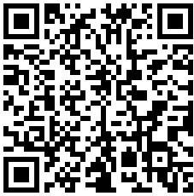
Does MMR “cause” ‘measles’?
Links to articles discussed here
My journey through the weirdest literature search I’ve done in awhile…

Slide 35
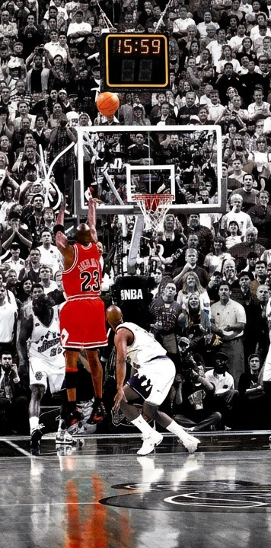
Follow me along my journey
Measles that broke through MMR PEP?
Doesn’t the MMR vaccine cause a rash..?
Do I really need to deal with this at 4pm?
Why are they in the ED? They might be spreading measles!

Slide 36
Reactions to MMR vaccine
* I’m using the term “side effects” for self limiting reactions, which is distinct from any long lasting sequela, i.e. neurologic changes (see this Cochrane review)
MMR vaccine is well tolerated, but it does have some predictable side effects *
Doesn’t the MMR vaccine cause a rash..?
Notes:
Expected side effects are not always a bad thing. If you crash a car and get a bruise from the seatbelt, the bruise is a side effect of the seatbelt; the bruise might be unwanted, but it’s a sign that it worked

Slide 37
Reactions to MMR vaccine
* I’m using the term “side effects” for self limiting reactions, which is distinct from any long lasting sequela, i.e. neurologic changes (see this Cochrane review)
MMR vaccine is well tolerated, but it does have some predictable side effects *
Most common systemic† side effects ^{[2]}
Fevers (5 - 15%)
Rash (around 5%)
† excludes injection site reactions
Doesn’t the MMR vaccine cause a rash..?

Slide 38
Reactions to MMR vaccine
MMR vaccine is well tolerated, but it does have some predictable side effects *
Most common systemic† side effects ^{[2]}
Fevers (5 - 15%)
Rash (around 5%)
† excludes injection site reactions
When do these reactions happen?
5 to 12 days ^{[2,4,6]}

Slide 39
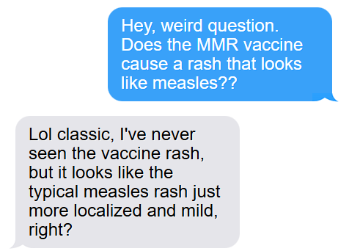
…am I starting to flirt with anti-vax?
Maybe MMR causes measles…
Then I talked to my friend who is a general pediatrician…

Slide 40
…am I starting to flirt with anti-vax?
Then I talked to my friend who is a general pediatrician…
Rash after the MMR vaccine is one of those “clinical experience” things that you learn
  Kids like to get rashes (pediatrics doesn’t get as excited for rashes as we do)
  She thinks the rash looks like “mild measles” but she’s not peds-ID
But I was able to find the “pubmed” terms describing the rash following the MMR vaccine:
MMR vaccine exanthem
Vaccine-associated rash illness (VARI)
Refined search strategy
No more searching “does the MMR vaccine cause measles?”

Slide 41
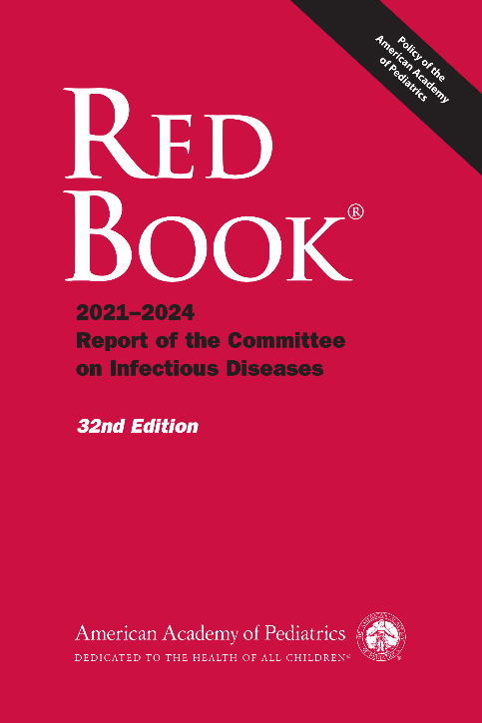

What does the Red Book say? [6]
MEASLES
Adverse Events. … Transient rashes have been reported in approximately 5% of vaccine recipients.
581
Receives MMR
Develops fever &/or rash

Slide 42
The more common situation
Doesn’t the MMR vaccine cause a rash..?
MEASLES
Adverse Events. … Transient rashes have been reported in approximately 5% of vaccine recipients.
581
Receives MMR
Develops fever &/or rash
Routine / elective MMR
VARI

Slide 43
What does the Red Book say? [6]
MEASLES
Adverse Events. … Transient rashes have been reported in approximately 5% of vaccine recipients. Although recipients who develop fever and/or rash are not considered contagious and are not at risk for long-term sequelae of measles, suspicion for wild-type measles may be high, especially if vaccine was administered as part of an outbreak response.
581
Receives MMR
Develops fever &/or rash

Slide 44

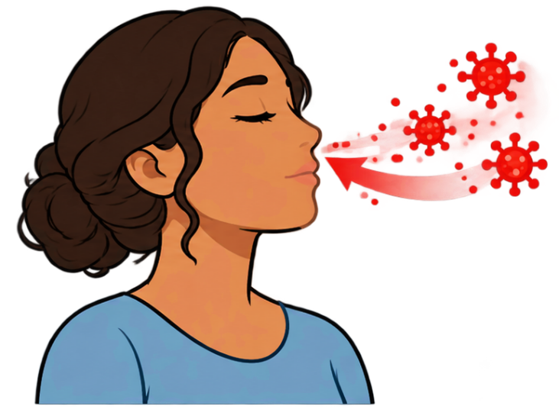
The scary situation
Measles despite MMR PEP?
MEASLES
Adverse Events. … Transient rashes have been reported in approximately 5% of vaccine recipients. Although recipients who develop fever and/or rash are not considered contagious and are not at risk for long-term sequelae of measles, suspicion for wild-type measles may be high, especially if vaccine was administered as part of an outbreak response.
581
Measles exposure
Receives MMR
Develops fever &/or rash
VARI

Slide 45
Distinguishing VARI from “real measles”
 | Wild-type measles | Vaccine
Fever | ✔ | ✔
Rash | ✔ | ✔
Symptoms | ??? | ???
Timing | ??? | ???

Slide 46
[4] How to distinguish VARI from wild type measles?
Distribution of the rash
Timing of the rash
The three C’s
Koplik spots
Sequencing

Slide 47
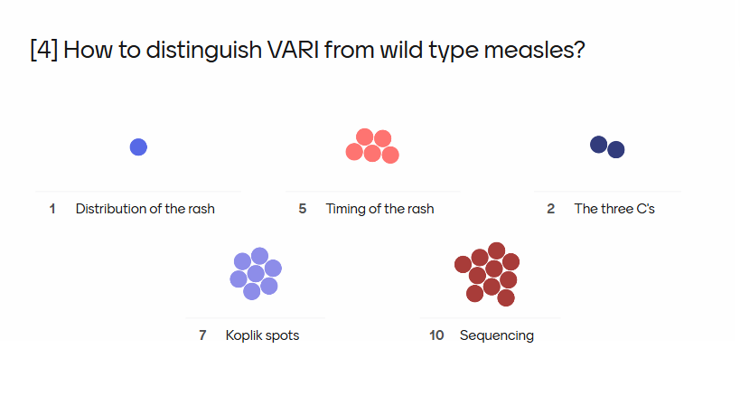

Slide 48
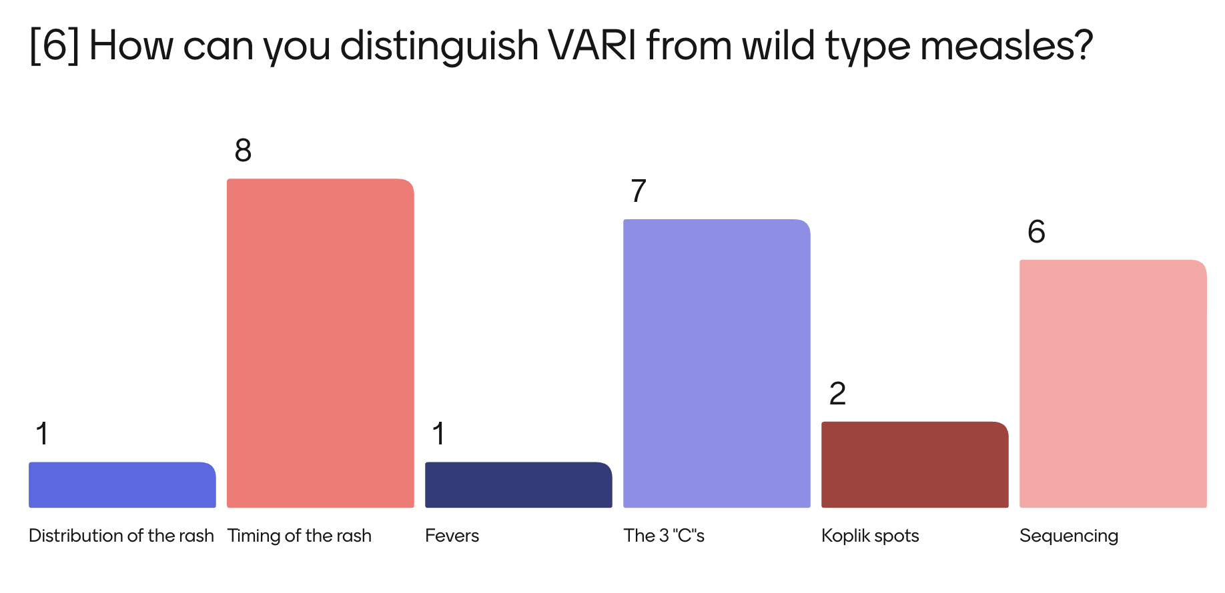
Notes:
This is what the ID faculty said

Slide 49

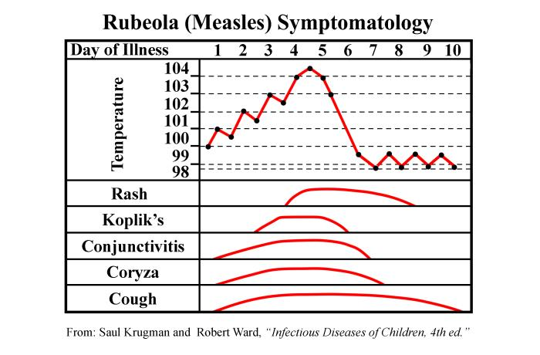
Symptoms & timing of measles
Plenty of variation is the duration of symptoms, but data/experience is consistent that rash in not the first symptom
https://wwwn.cdc.gov/phil/Details.aspx?pid=16475

Slide 50
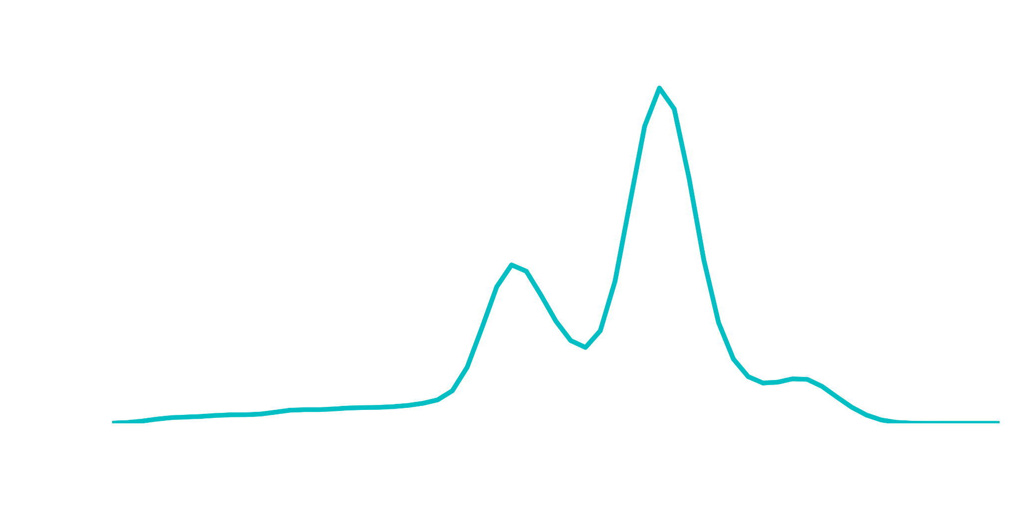
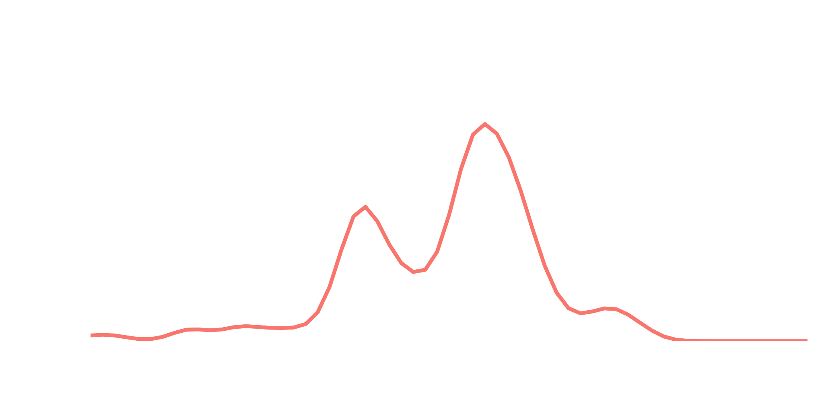
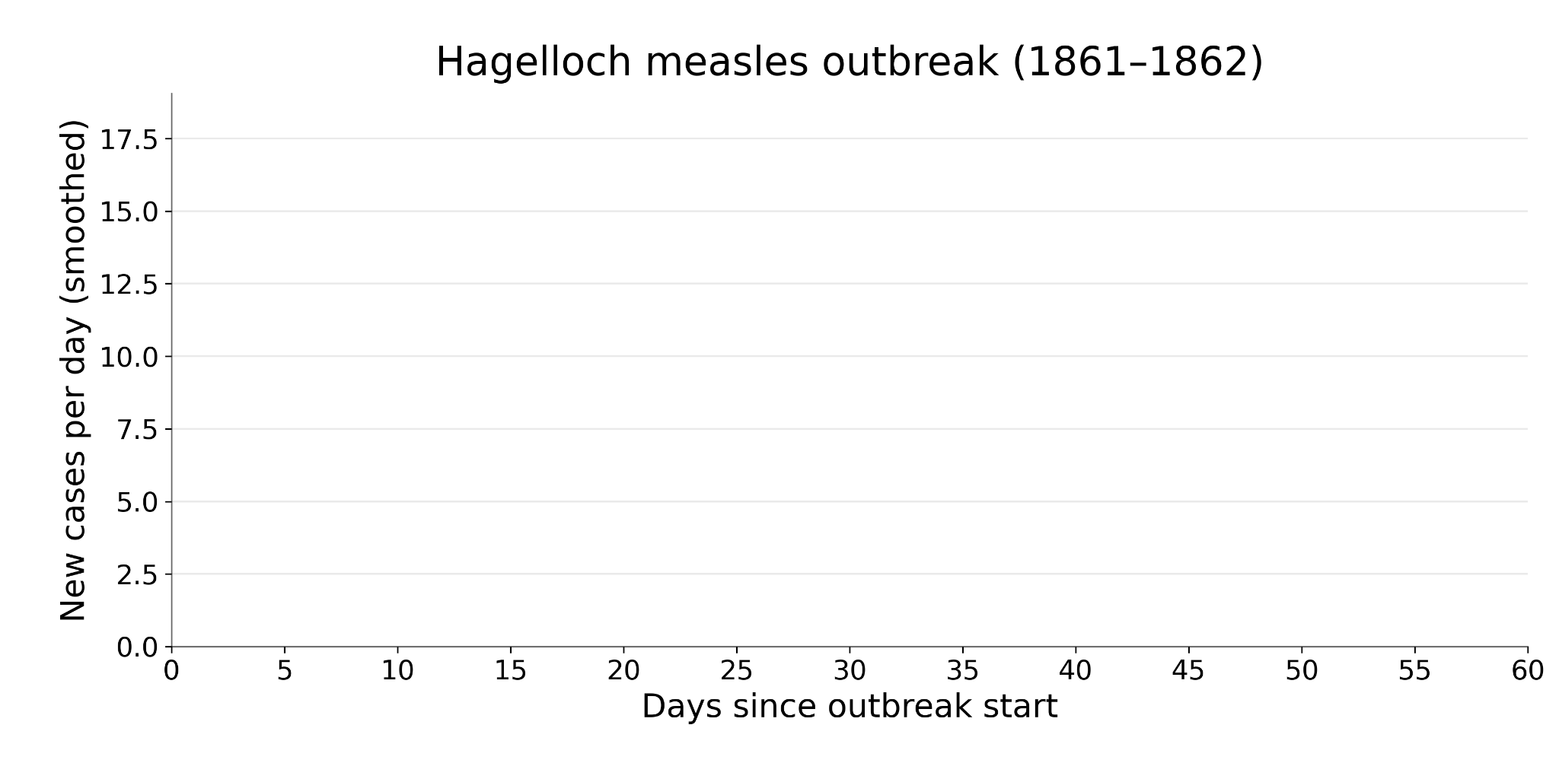
Rash
Prodrome

Slide 51
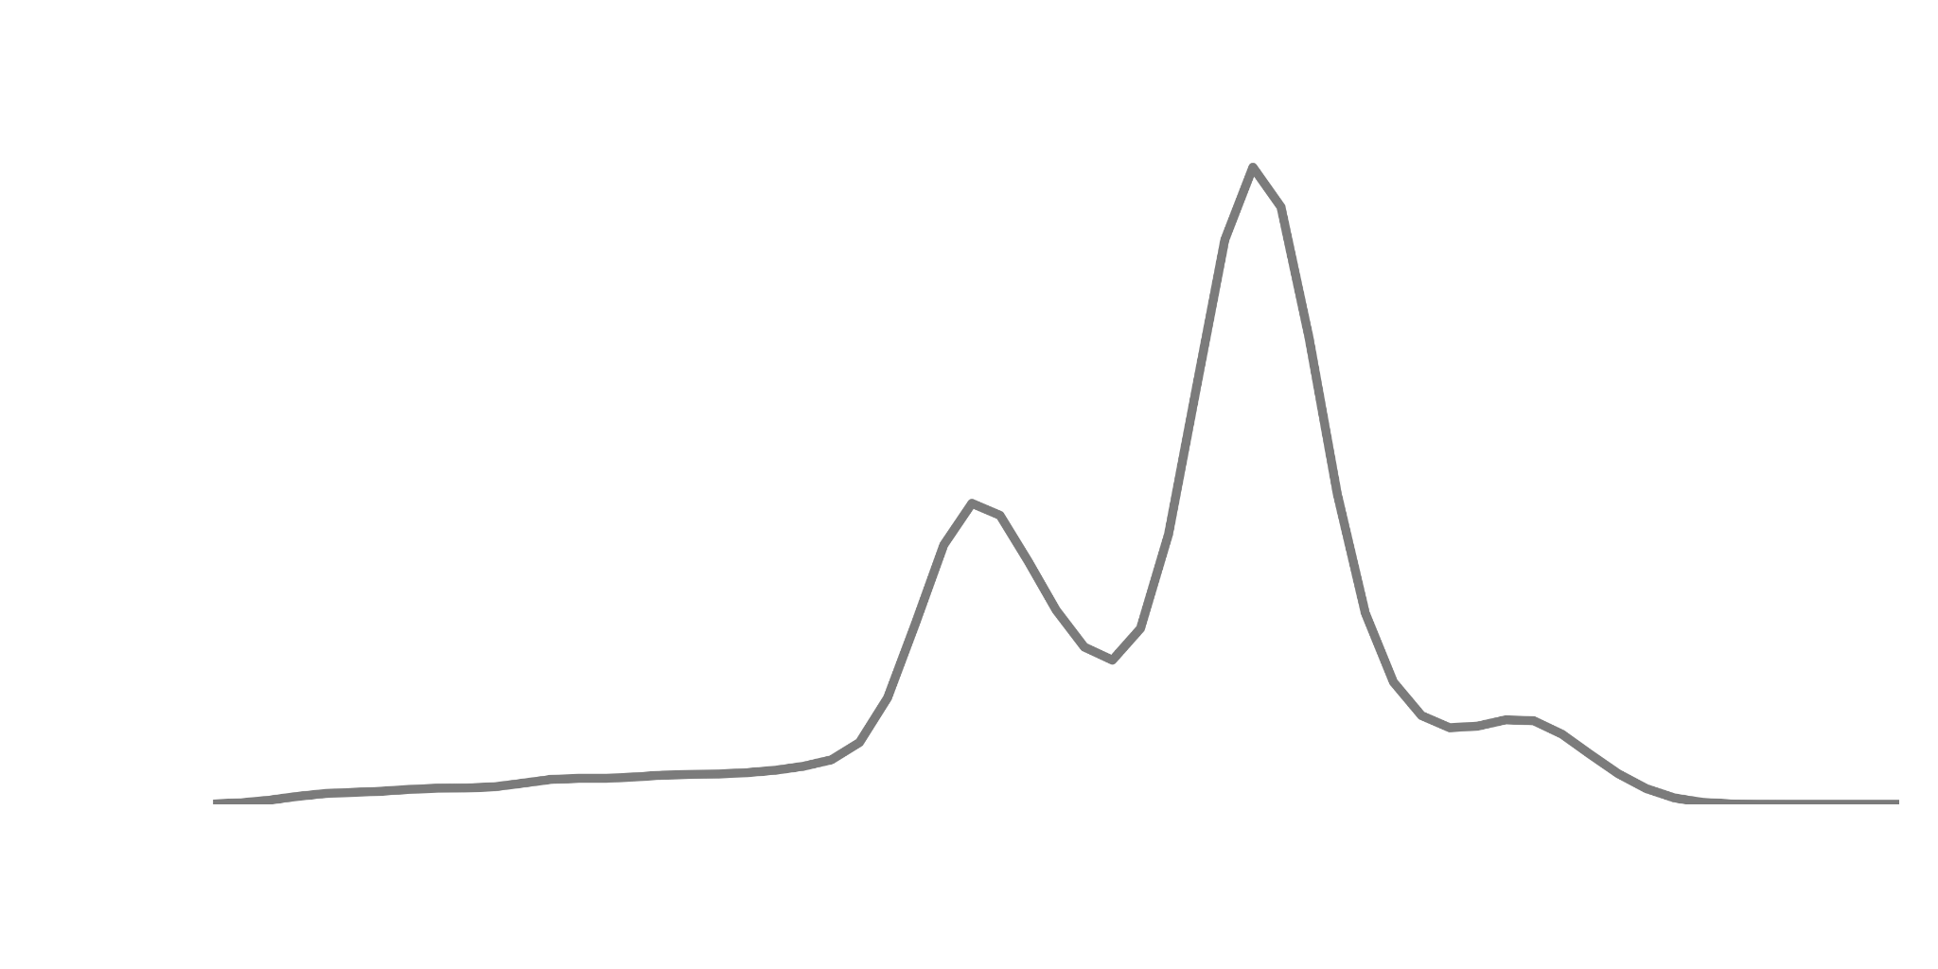
SHIFTED!!
Prior slide has the real data

Slide 52
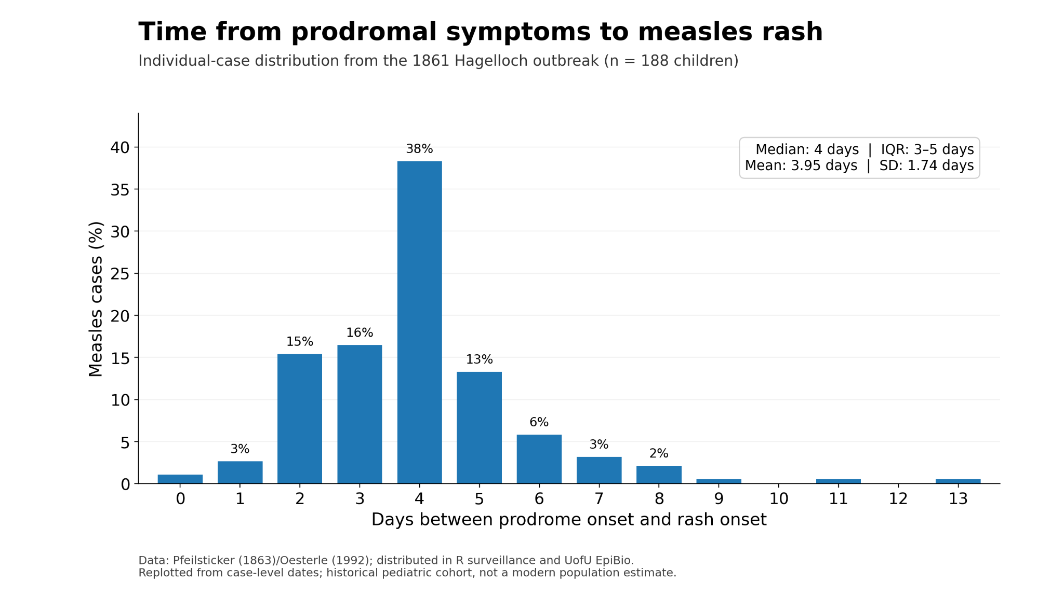



Slide 53
Reactions to MMR - Timing of reactions [5]
MMR vaccine is well tolerated, but it does have some predictable side effects *
Most common systemic† side effects ^{[2]}
Fevers (5 - 15%)
Rash (around 5%)
Normally develops 5 to 12 days after the vaccine ^{[2,4,6]}
When exactly do reactions occur?
From an old study in 1986 ^{[5]}
Robust design
  Double blinded, placebo controlled
  Matched 581 pairs of twins
Might be unethical to do now
  Ironically, based out of Helsinki, Finland
  Done during their rollout of MMR (1982-83)

Slide 54
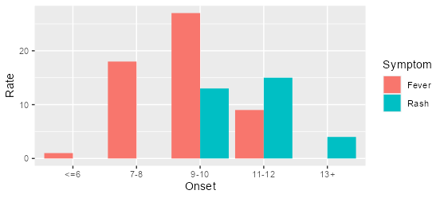
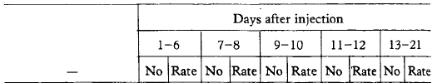
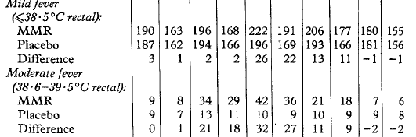
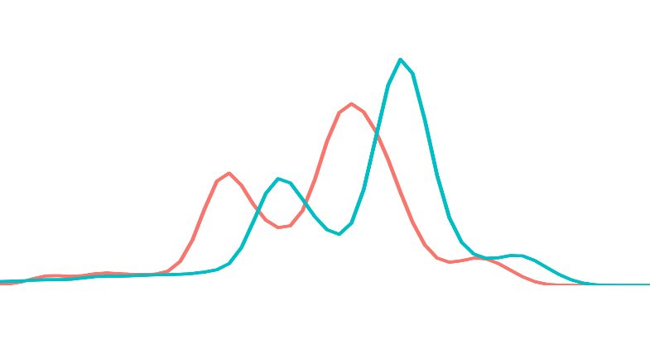

Reactions to MMR - Timing of reactions [5]
When exactly do reactions occur?
Placebo vs MMR matched study ^{[5]}
Moderate fever peaked at day 9
  38.6 - 39.5 C (101.5 - 103.1 F)
Generalized rash peaked at day 11
The distribution of symptom onset implies that fever comes before rash (similar to wild type measles)

Slide 55
Multiple mechanisms
 | Wild-type measles | Vaccine
Fever | ✔ | ✔
Rash | ✔ | ✔
Fever, then rash | ✔ | ✔
Symptoms | ??? | ???
Similar timing | ??? | ???

Slide 56
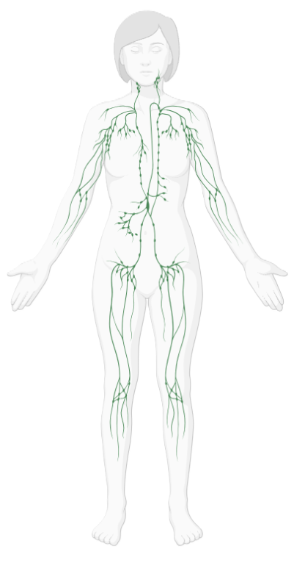


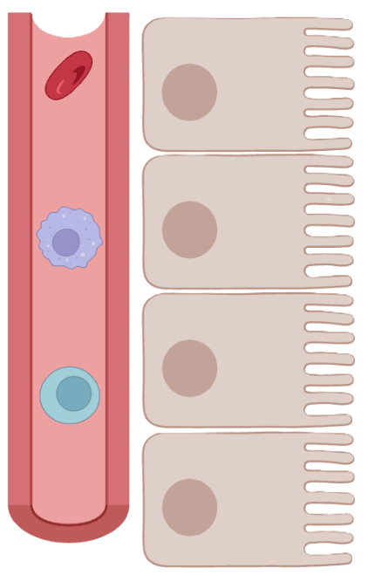

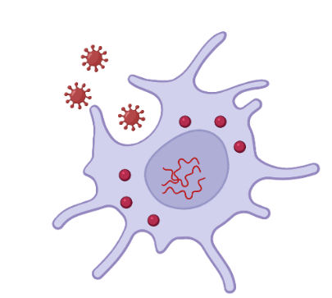


How measles moves through the body ^{[16, 18–20]}
Lymphatic replication
Dendritic cell
Exposure
Reaches epithelium
(from the inside)
B cell
Symptom onset
1
2
3
…

Slide 57

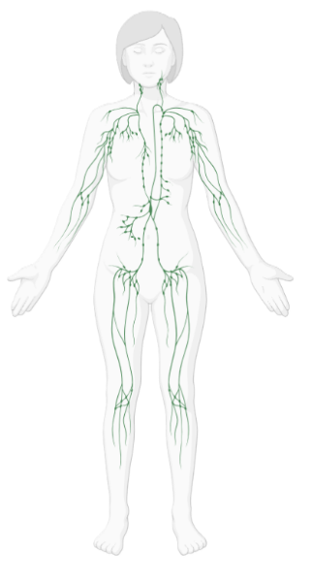


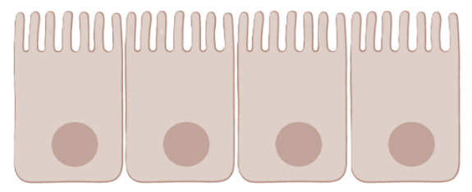


How measles moves through the body ^{[16, 18–20]}
Prodrome
Fever
Upper (nose) & lower (lungs) respiratory mucosa
Eyes
Direct manifestation of the virus
Rash ^{[18]}
Adaptive immune response (T cells) to the dermal endothelium
Reaches epithelium
(from the inside)
Exposure
1
2
3
…
11
12
13
14
15
16
17

Slide 58
Similar timelines, distinct mechanisms ^{[16, 18–20]}
Rash
(cell mediated)
Prodrome
Prodrome
Rash ^{[18]}
Rash onset
(contagious rash -4 to +4 days)
Contagious, but no symptoms yet
Rash → viral “clearance”
Exposure
1
2
3
…
11
12
13
14
15
16
17
Notes:
Simplifications: 'cell-associated viremia' means virus travels mostly inside infected leukocytes rather than free in plasma, partly shielded from antibody (one plausible reason passive IG works best early). The textbook 'primary then secondary viremia' scheme is a simplification of early and amplified phases, not two clean waves. The older model of airway epithelium as the first target was superseded by the SLAM and nectin-4 receptor work. Day numbers are approximate; incubation ranges roughly 9-19 days to clinical signs [18].

Slide 59
Do tropical viral rashes work the same way?
Dengue ^{[26]}
May work like measles
Zika ^{[29]} & chikungunya ^{[28]}
Less likely
Rash biopsies after dengue vaccine or challenge infection show perivascular lymphocytes and almost no virus
Similar mechanism to measles, but not exactly the same
Zika: within 3 days of onset, when viral load is highest
Chikungunya: at about day 3–4, while viral load is still at its peak
Timing is the clue: measles rash arrives as the virus is being cleared; Zika and chikungunya rashes arrive while viral load is still high

Slide 60
Distinguishing them clinically
 | Wild-type measles | Vaccine
Fever | ✔ | ✔
Rash | ✔ | ✔
Fever, then rash | ✔ | ✔
Symptoms | ??? | ???
Similar timing | ??? | ???

Slide 61

Martin et al [7]
During 2017, Minnesota experienced a major measles outbreak
This population had low MMR vaccination rates (the 2014 birth cohort had 42% MMR uptake)
As part of the public health response, they administered over 51,000 MMR doses (beyond expected)
Unintended consequences
They experienced a surge in VARI
(while measles was also surging)

Slide 62
Martin et al [7]
When they compared wild-type measles cases to VARI cases:
Both cases had high rates of fevers
  And by definition, everyone had rashes
Measles cases presented more “C”lassically
 | Measles n=71 | VARI n=34
Fever | 100% | 94%
Cough | 94% | 41%
Coryza | 83% | 47%
Conjunctivitis | 66% | 24%

Slide 63
Martin et al [7]
When they compared wild-type measles cases to VARI cases:
Both cases had high rates of fevers
  And by definition, everyone had rashes
Measles cases presented more “C”lassically
 | Measles n=71 | VARI n=34
Fever | 100% | 94%
Cough | 94% | 41%
Coryza | 83% | 47%
Conjunctivitis | 66% | 24%
Any of the 3 C’s | 96% | 74%
All three C’s | 58% | 6%
But wait… How do I tell the difference?

Slide 64
Martin et al [7]
When they compared wild-type measles cases to VARI cases:
Both cases had high rates of fevers
  And by definition, everyone had rashes
Measles cases presented more “C”lassically
Measles cases presented with more severe disease
Higher rates of hospitalization
 | Measles n=71 | VARI n=34
Fever | 100% | 94%
Cough | 94% | 41%
Coryza | 83% | 47%
Conjunctivitis | 66% | 24%
Any of the 3 C’s | 96% | 74%
All three C’s | 58% | 6%
Contact with a known case | 99% | 0%

Slide 65
Martin et al [7]
When they compared wild-type measles cases to VARI cases:
Both cases had high rates of fevers
  And by definition, everyone had rashes
Measles cases presented more “C”lassically
Measles cases presented with more severe disease
Higher rates of hospitalization
 | Measles n=71 | VARI n=34
Fever | 100% | 94%
Cough | 94% | 41%
Coryza | 83% | 47%
Conjunctivitis | 66% | 24%
Any of the 3 C’s | 96% | 74%
All three C’s | 58% | 6%
Contact with a known case | 99% | 0%
All VARI cases still needed isolation for 4 days from rash onset (or until wild-type infection was ruled out)
But this was in the context of an outbreak (unlike our patient)

Slide 66
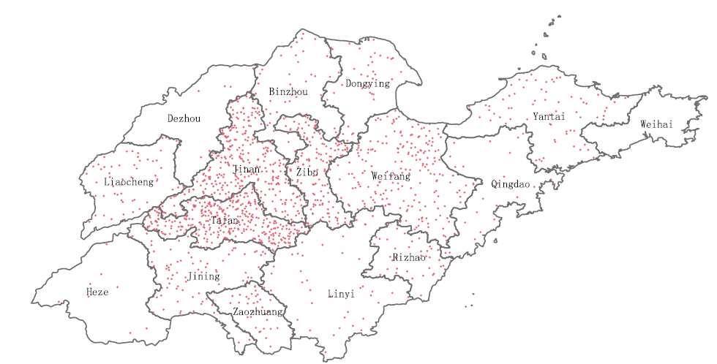

Who else has experienced this problem before?
Figure 2: Wang et al ^{[11]}

Slide 67

Cui et al [10]
Large study from China from 2011 to 2018
Surveillance Data: The study utilized data from the Measles Surveillance System (MSS) and the Chinese Measles Laboratory Network (CMLN)
Case Identification: identified 15,169 cases confirmed by genotyping
  14,902 wild-type measles cases
  Only 101 VARI cases

Slide 68

Cui et al [10]
Large study from China from 2011 to 2018
Surveillance Data: The study utilized data from the Measles Surveillance System (MSS) and the Chinese Measles Laboratory Network (CMLN)
Case Identification: identified 15,169 cases confirmed by genotyping
  14,902 wild-type measles cases
  Only 101 VARI cases
Clinical Symptom | VARI Cases (n=76) | Wild-Type (n=9,533) | P-Value
Fever | 99% | 99% | 0.516
Rash | 100% | 99% | 1.000
"3Cs" (any) | 49% | 92% | <0.001
Cough | 39% | 91% | <0.001
Coryza | 26% | 67% | <0.001
Conjunctivitis | 18% | 64% | <0.001
Koplik Spots | 25% | 47% | <0.001

Slide 69
Case 1: Hospital course
Patient was able to access her vaccination records
Vaccinated for measles (one vaccine) in childhood, but it wasn’t the MMR
No known exposures or risk factors for wild type exposure
 | Measles n=71 | VARI n=34
Fever | 100% | 94%
Cough | 94% | 41%
Coryza | 83% | 47%
Conjunctivitis | 66% | 24%
Any of the 3 C’s | 96% | 74%
All three C’s | 58% | 6%
Contact with a known case | 99% | 0%

Slide 70
VARI: Looks like measles, but doesn’t spread
Mimics measles
But doesn't spread
Triggers a real immune response (the point of the vaccine)
Fever (5–15%) and rash (~5%) ^{[2]}
Positive standard measles RT-PCR ^{[8]}
Attenuated vaccine strain (genotype A) ^{[10]}
No documented person-to-person spread ^{[10]}
Not considered contagious ^{[6]}
A positive PCR after recent MMR needs vaccine-specific PCR or genotyping ^{[8]}

Slide 71
At the first visit: collect, notify, then wait [17]
Collect a throat or NP swab for RT-PCR (preferred over urine) plus serum IgM as soon as measles is suspected ^{[17]}
Swab early: in one Chinese study, only 30% of VARI swabs could be genotyped, likely because of late collection ^{[11]}
Standard RT-PCR can't tell vaccine from wild type; genotyping or vaccine-specific PCR can, through your public health lab ^{[8]}
Notify public health now; don't wait for results ^{[15]}

Slide 72
Take-home points
A rash 5–12 days after MMR is common (about 1 in 20) and is not contagious ^{[2, 6]}
What to tell patients: it's an expected vaccine reaction, not measles disease
After PEP or in an outbreak, treat it as measles until proven otherwise: isolate and notify
The 3 Cs, Koplik spots, and a known exposure favor wild type, but none rules it out ^{[7, 10]}
Slides at hunterratliff1.com/talk/; citations via the “citations” button on the website

Slide 73
Questions?
Links to articles discussed here

