Slide 1
Salmonella & Yersinia infections
Fellows Curriculum Conference
Hunter Ratliff
03/24/2025

Slide 2
Learning objectives
For Salmonella & Yersinia:
Understand the classification and microbiology
Describe epidemiology, transmission, and risk factors
Recognize clinical syndromes
Review diagnostic approaches and treatment strategies

Slide 3
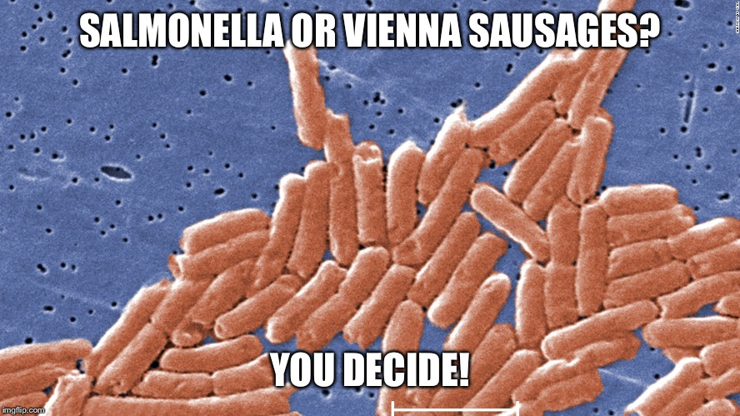
Salmonella: Classification & microbiology
Gram negative bacilli

Slide 4
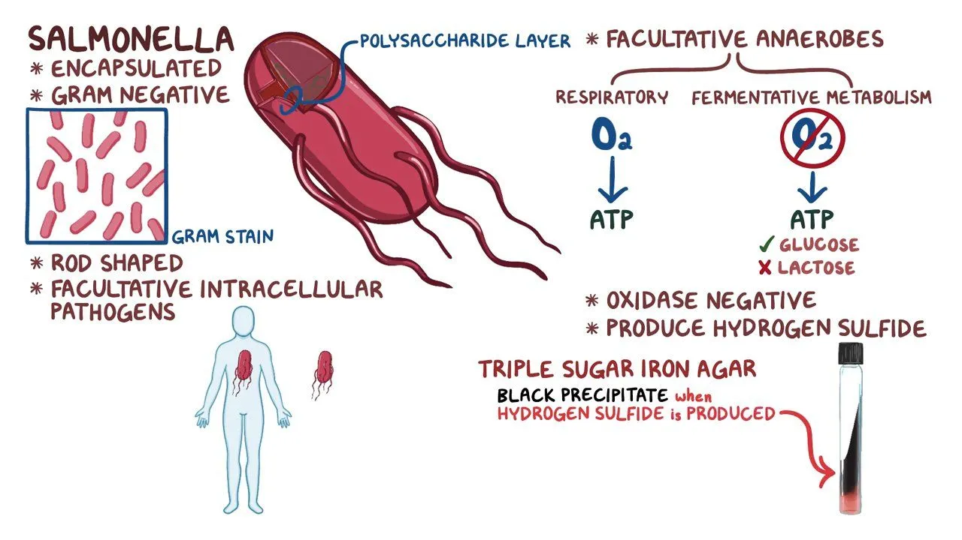
Salmonella: Classification & microbiology

Slide 5
Salmonella: Classification & microbiology

Slide 6
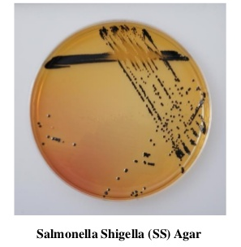
Salmonella: Classification & microbiology

Slide 7
Classification & microbiology of Salmonella
Nontyphoidal Salmonella
Numerous serotypes (e.g., S. enteritidis, S. typhimurium)
Nontyphoidal Salmonella
Typhoidal Salmonella
S. enterica serotype Typhi and Paratyphi A, B, and C
Typhoidal Salmonella
S. enterica serotype Typhi and Paratyphi A, B, and C

Slide 8
Salmonella: Transmission, reservoirs, and risk factors

Slide 9

Salmonella: Transmission
Nontyphoidal Salmonella
Mostly foodborne transmission
Most commonly: Chickens → Eggs

Slide 10

Salmonella: Transmission
Nontyphoidal Salmonella
Mostly foodborne transmission
Most commonly: Chickens → Eggs
Other foodborne outbreaks have also happened
Poultry: Turkey
Dairy: Ice cream (cross contamination)
Fruit/veggies: Onions, peaches

Slide 11
Salmonella: Transmission
Nontyphoidal Salmonella
Mostly foodborne transmission
Most commonly: Chickens → Eggs
Other foodborne outbreaks have also happened: poultry, ice cream, onions, peaches
Animals: Reptiles and amphibians
Snakes
Turtles
Iguanas, lizards
Frogs

Slide 12
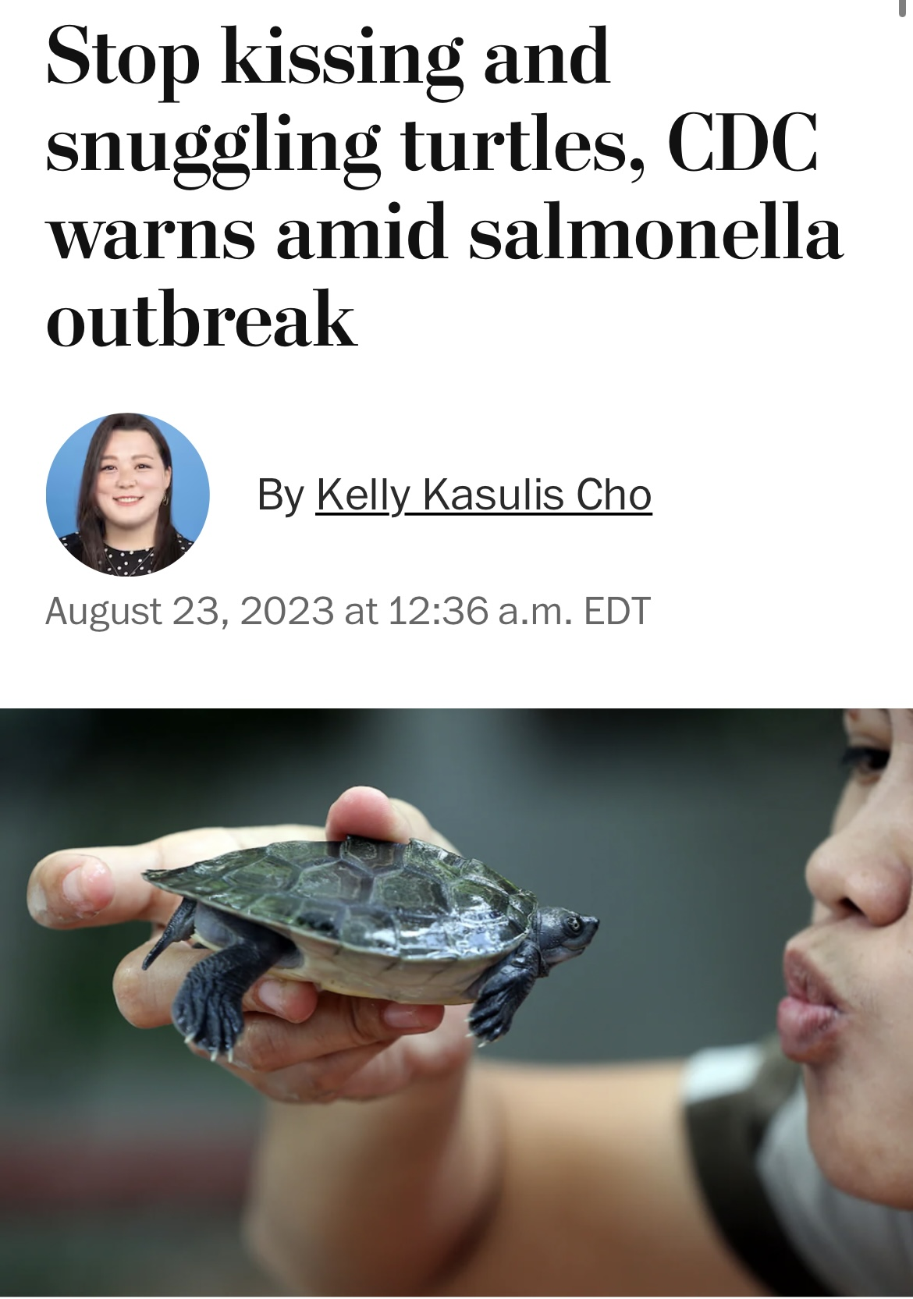
Salmonella: Transmission
Nontyphoidal Salmonella
Mostly foodborne transmission
Most commonly: Chickens → Eggs
Other foodborne outbreaks have also happened: poultry, ice cream, onions, peaches
Animals: Reptiles and amphibians
Snakes
Turtles
Iguanas, lizards
Frogs

Slide 13
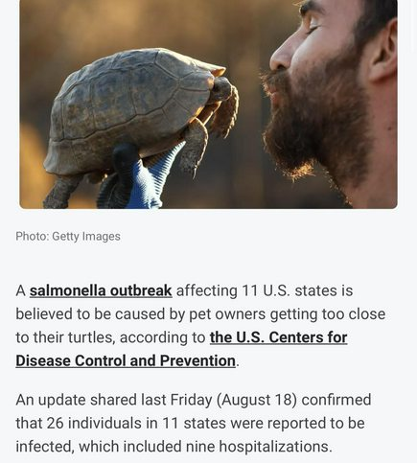
Salmonella: Transmission
Nontyphoidal Salmonella
Mostly foodborne transmission
Most commonly: Chickens → Eggs
Other foodborne outbreaks have also happened: poultry, ice cream, onions, peaches
Animals: Reptiles and amphibians
When possible, don’t kiss turtles
Hugs may be acceptable if: ^{[citation needed]}
Patient is >5 y/o
Immunocompetent
Not snapping turtle
Turtle gives consent

Slide 14
Salmonella: Transmission
Nontyphoidal Salmonella
Typhoidal Salmonella
Mostly foodborne transmission
Most commonly: Chickens → Eggs
Other foodborne outbreaks have also happened: poultry, ice cream, onions, peaches
Animals: Reptiles and amphibians
When possible, don’t kiss turtles
Hugs may be acceptable ^{[citation needed]}
Ingestion of contaminated food & water
Contaminated water
Contaminated food
Household spread

Slide 15
Salmonella: Transmission
Nontyphoidal Salmonella
Typhoidal Salmonella
Mostly foodborne transmission
Most commonly: Chickens → Eggs
Other foodborne outbreaks have also happened: poultry, ice cream, onions, peaches
Animals: Reptiles and amphibians
When possible, don’t kiss turtles
Hugs may be acceptable ^{[citation needed]}
Ingestion of contaminated food & water
Contaminated water: S typhi > paratyphi
Contaminated food (“street food”): S paratyphi
Household spread: S typhi, for hygiene reasons
Vaccinated travelers: S paratyphi

Slide 16
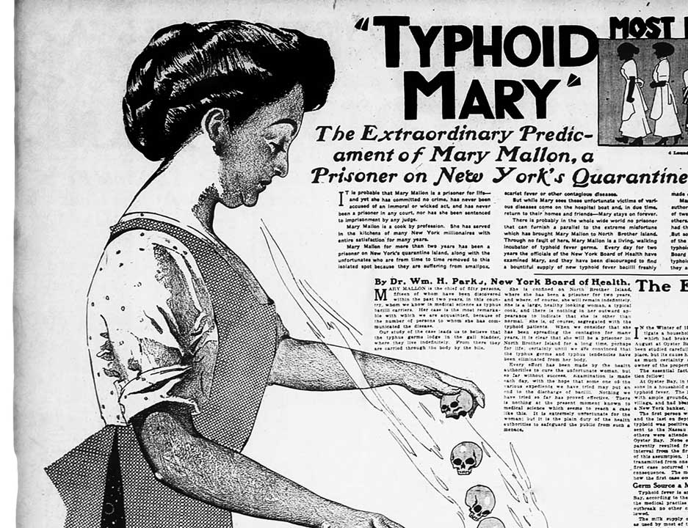
Salmonella: Transmission
Nontyphoidal Salmonella
Typhoidal Salmonella
Mostly foodborne transmission
Most commonly: Chickens → Eggs
Other foodborne outbreaks have also happened: poultry, ice cream, onions, peaches
Animals: Reptiles and amphibians
When possible, don’t kiss turtles
Hugs may be acceptable ^{[citation needed]}
Typhoid Mary (Mary Mallon)
Asymptomatic carrier of Salmonella Typhi who worked as a cook in the early 1900s
Unknowingly spread typhoid fever to multiple households, leading to outbreaks
Forcibly quarantined for over 20 years after public health officials eventually traced the infections to her

Slide 17
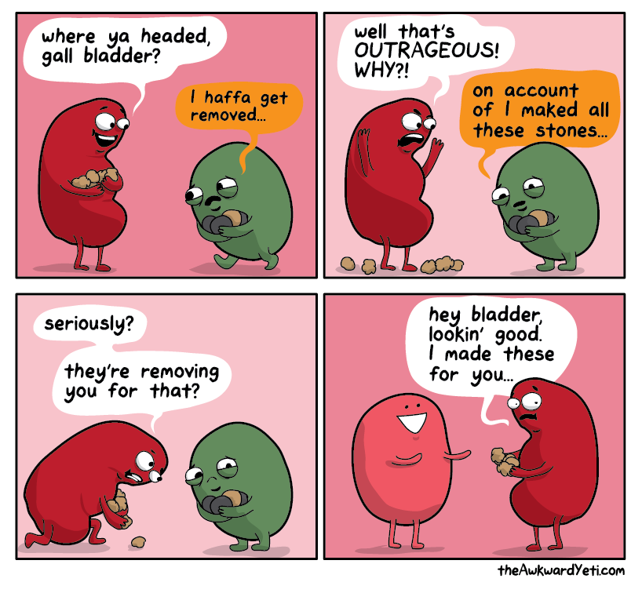
Salmonella: Chronic carriage
Nontyphoidal Salmonella
Typhoidal Salmonella
Def: Bacterial shedding for >1 year
Occurs in 4% of enteric fever
Extremes of age
Biliary tract abnormalities (esp gallstones)
Notes:
About 4% of patients with enteric fever, predominantly infants, elderly people and women, may become chronic carriers (citation).

Slide 18
Salmonella: Chronic carriage
Nontyphoidal Salmonella
Typhoidal Salmonella
Def: Bacterial shedding for >1 year
Occurs in 4% of enteric fever
Extremes of age
Biliary tract abnormalities (esp gallstones)
Clinical spectrum varies
May be asymptomatic
If immunosuppressed, ↑ risk of recurrent disease

Slide 19
Salmonella: Chronic carriage
Nontyphoidal Salmonella
Typhoidal Salmonella
Def: Bacterial shedding for >1 year
Occurs in 4% of enteric fever
Extremes of age
Biliary tract abnormalities (esp gallstones)
Clinical spectrum varies
May be asymptomatic
If immunosuppressed, ↑ risk of recurrent disease
Treatment
Prolonged course of abx (1-3 months of quinolone, bactrim, amoxicillin)
Surgery in some cases

Slide 20
Salmonella: Chronic carriage
Nontyphoidal Salmonella
Typhoidal Salmonella
Many cases will also have prolonged shedding
Median: 5 weeks
Longer: if younger or severe disease
Not true “chronic carriage”
Def: Bacterial shedding for >1 year
Occurs in 4% of enteric fever
Extremes of age
Biliary tract abnormalities (esp gallstones)
Clinical spectrum varies
May be asymptomatic
If immunosuppressed, ↑ risk of recurrent disease
Treatment
Prolonged course of abx (1-3 months of quinolone, bactrim, amoxicillin)
Surgery in some cases

Slide 21
Salmonella: Chronic carriage
Nontyphoidal Salmonella
Typhoidal Salmonella
Many cases will also have prolonged shedding
Median: 5 weeks
Longer: if younger or severe disease
Most often asymptomatic
No role for prolonged antibiotics or surgery
Should still quarantine prior to returning to work
Def: Bacterial shedding for >1 year
Occurs in 4% of enteric fever
Extremes of age
Biliary tract abnormalities (esp gallstones)
Clinical spectrum varies
May be asymptomatic
If immunosuppressed, ↑ risk of recurrent disease
Treatment
Prolonged course of abx (1-3 months of quinolone, bactrim, amoxicillin)
Surgery in some cases

Slide 22
Salmonella: Transmission
Nontyphoidal Salmonella
Typhoidal Salmonella
Transmission | Foodborne transmission (chickens & eggs) Reptiles and amphibians (turtles) | Ingestion of contaminated food & water Limited person to person, including asymptomatic carriers
Reservoirs | Reptiles, amphibians, live poultry | Humans only
Carriage | Often has prolonged fecal shedding (weeks to months) Mostly asymptomatic No clear role for abx or surgery | Can have true carrier state (4%) May be a/w gallstones +/- symptoms Some risk of relapse Tx: Prolonged abx &/or remove GB

Slide 23
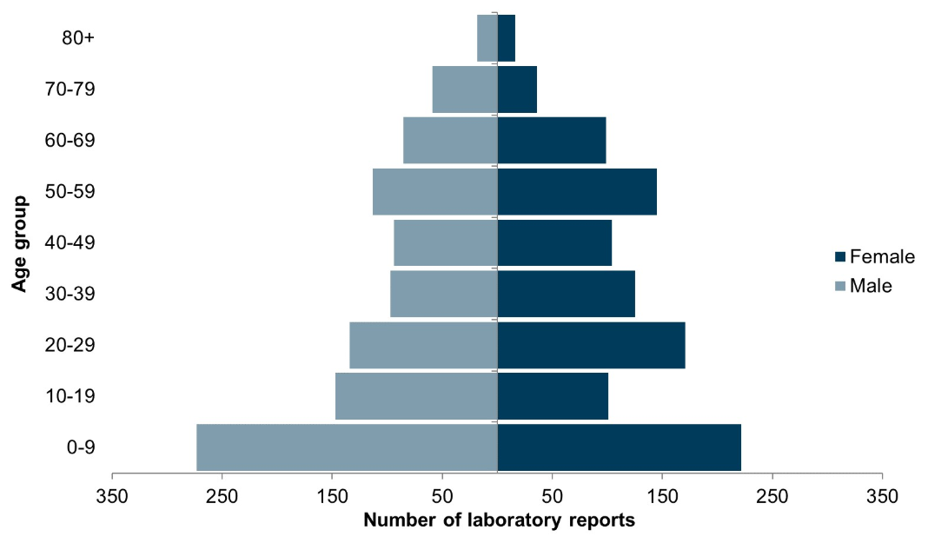
Salmonella: Risk factors
Nontyphoidal Salmonella
Extremes of age (>60, infants)
Impaired cellular immunity: HIV, steroids, cancer, transplant

Slide 24
Salmonella: Risk factors
Nontyphoidal Salmonella
Extremes of age (>60, infants)
Impaired cellular immunity: HIV, steroids, cancer, transplant
Altered microbiome: Recent antibiotics
Why?
Salmonella compete with normal gut flora
PPx antimicrobial therapy ↑ frequency of salmonellosis in travelers

Slide 25
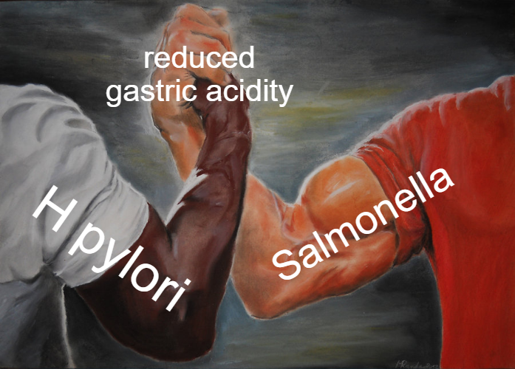
Salmonella: Risk factors
Nontyphoidal Salmonella
Why?
Salmonella can adapt to acidic environments (if exposed to weakly acidic environment beforehand)
Allows it to survive the stomach → infect the intestines
Extremes of age (>60, infants)
Impaired cellular immunity: HIV, steroids, cancer, transplant
Altered microbiome: Recent antibiotics
Reduced gastric acid: PPI, H2 blockers, gastric surgery

Slide 26
Salmonella: Risk factors
Nontyphoidal Salmonella
Extremes of age (>60, infants)
Impaired cellular immunity: HIV, steroids, cancer, transplant
Altered microbiome: Recent antibiotics
Reduced gastric acid: PPI, H2 blockers, gastric surgery
For invasive disease: prosthetic material, endovascular disease

Slide 27
Salmonella: Risk factors
Nontyphoidal Salmonella
Typhoidal Salmonella
Extremes of age
Impaired cellular immunity
Altered microbiome
Reduced gastric acid
Main risk factor is exposures (rather than host characteristics)

Slide 28
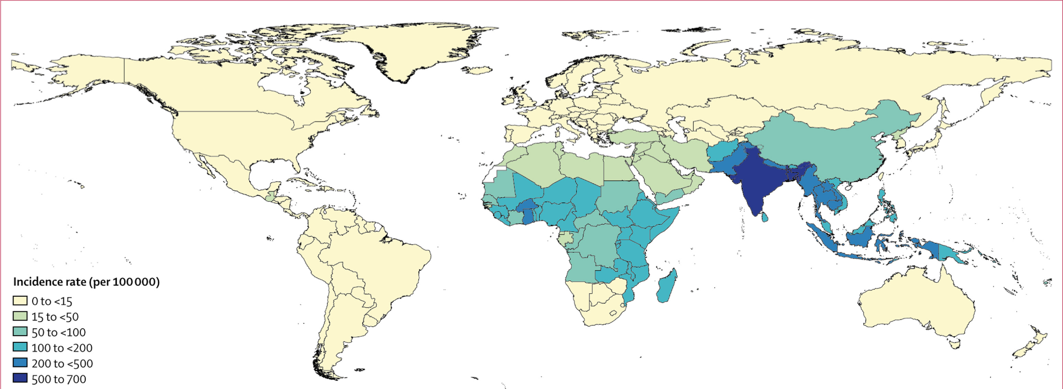
Salmonella: Risk factors
Typhoidal Salmonella (2017)
Extremes of age
Impaired cellular immunity
Altered microbiome
Reduced gastric acid
Main risk factor is exposures (rather than host characteristics)

Slide 29
Salmonella: Clinical manifestations

Slide 30
Salmonella: Clinical manifestations
Nontyphoidal Salmonella
Gastroenteritis
Bacteremia
Metastatic manifestations
Endovascular
UTI
Bone & joint
CNS
Typhoidal Salmonella
Classic typhoid fever
Complications

Slide 31
Pathophysiology
Nontyphoidal Salmonella
Ingestion
(or licking turtles, I suppose)
Stomach → Intestine
Survive stomach acid & normal flora
Mucosal invasion
Of intestinal lymph tissue in Peyer's patches
Intracellular survival
Within vacuoles (including in macrophages)
Phagocytosis
Tricks non-phagocytic cells (e.g. enterocytes) to eat them
Fussy immune system
Cytokine release
Inflammation
Neutrophils come in → attack lymph tissue → diarrhea
+/-
Hematogenous seeding
Spread via the lymphatics and bloodstream

Slide 32
Clinical manifestations
Nontyphoidal Salmonella
Gastroenteritis

Slide 33
Clinical manifestations
Nontyphoidal Salmonella
Time to onset: 8 - 72 hours
Symptoms: diarrhea, nausea, vomiting, fever, and abdominal cramping
Diarrhea most often watery
Many are asymptomatic
Improvement: symptoms generally gone within a week (+/- 3 days)
Defevrece sooner (2-3 days)
Higher inoculum
↑↑ inoculum ⇒ ↓ time to symptoms & ↑ disease severity
Gastroenteritis

Slide 34
Clinical manifestations
Nontyphoidal Salmonella*
Can also be seen in Typhoidal, but less common
Nontyphoidal bacteremia occurs in 1 in 20 cases of nontyphoidal gastroenteritis
Gastroenteritis
Bacteremia

Slide 35
Clinical manifestations
Nontyphoidal Salmonella*
Can also be seen in Typhoidal, but less common
Nontyphoidal bacteremia occurs in 1 in 20 cases of nontyphoidal gastroenteritis
Risk factors (compared to uncomplicated gastroenteritis)
Immune defects
Chronic liver disease
Hemoglobinopathies (especially sickle cell disease)
Iron overload
Malaria
Schistosomiasis
Common theme: ↑ intestinal permeability ⇒ ↑ bacterial translocation
Gastroenteritis
Bacteremia

Slide 36
Clinical manifestations
Nontyphoidal Salmonella*
Can also be seen in Typhoidal, but less common
Endovascular
UTI
Bone & joint
CNS
Gastroenteritis
Bacteremia
Metastatic infection

Slide 37
Clinical manifestations
Nontyphoidal Salmonella*
Can also be seen in Typhoidal, but less common
Endovascular
UTI
Bone & joint
CNS
Most common: aortitis
Accounts for 40% of infectious aortitis
Most common with ↑ age, pre-existing aneurysm
Rare: endocarditis
Quite uncommon (<1%)
High mortality (45-70%)
Gastroenteritis
Bacteremia
Metastatic infection

Slide 38
Clinical manifestations
Nontyphoidal Salmonella*
Can also be seen in Typhoidal, but less common
Endovascular
UTI
Bone & joint
CNS
Manifestations: cystitis, pyelonephritis, renal abscess
Relation to schistosomiasis
Egg migration through tissues → urinary inflammation
Gastroenteritis
Bacteremia
Metastatic infection

Slide 39
Clinical manifestations
Nontyphoidal Salmonella*
Can also be seen in Typhoidal, but less common
Endovascular
UTI
Bone & joint
CNS
Reactive arthritis (2%)
Often polyarticular, large joints
Associated with HLA B27
Septic arthritis (0.1-0.2%), a/w prosthetic joint
Osteomyelitis (hematogenous spread)
Hematogenous spread
Seen with kids & sickle cell disease
Gastroenteritis
Bacteremia
Metastatic infection

Slide 40
Clinical manifestations
Nontyphoidal Salmonella*
Can also be seen in Typhoidal, but less common
Endovascular
UTI
Bone & joint
CNS
Can cause:
Meningitis
Ventriculitis
Brain abscess
Second most common cause of gram negative meningitis in neonates
Gastroenteritis
Bacteremia
Metastatic infection

Slide 41
Salmonella: Clinical manifestations
Nontyphoidal Salmonella
Gastroenteritis
Bacteremia
Metastatic manifestations
Endovascular
UTI
Bone & joint
CNS
Typhoidal Salmonella
Classic typhoid fever
Complications

Slide 42
Pathophysiology
Typhoidal Salmonella
Ingestion
Stomach → Intestine
Survive stomach acid & normal flora
Mucosal invasion
Of intestinal lymph tissue in Peyer's patches
Intracellular survival
Within vacuoles (including in macrophages)
Phagocytosis
Tricks non-phagocytic cells (e.g. enterocytes) to eat them
Fussy immune system
Cytokine release
Spread through RES
Reticuloendothelial system
Notes:
The review article isn’t super clear if this is typhoidal or NTS, but this is a fellows lecture, not a dissertation
https://www.tandfonline.com/doi/full/10.1080/21553769.2015.1051243#d1e472

Slide 43
Clinical manifestations
Typhoidal Salmonella
Incubation period: 1-3 weeks
First week: rising ("stepwise") fever and bacteremia
Faget sign
Pulse temperature dissociation
Seen with bacteria that have an intracellular life cycle
Not actually very common
Notes:
https://www.tandfonline.com/doi/full/10.1080/21553769.2015.1051243

Slide 44
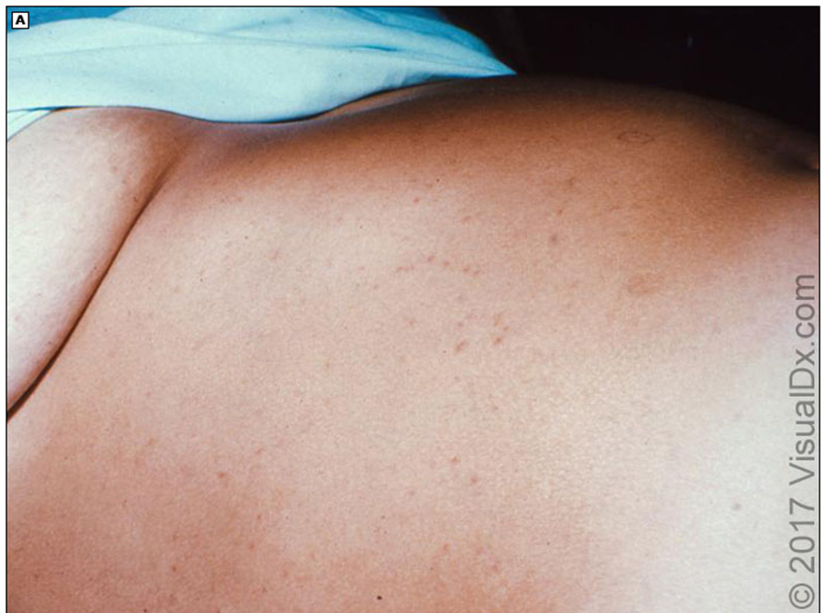
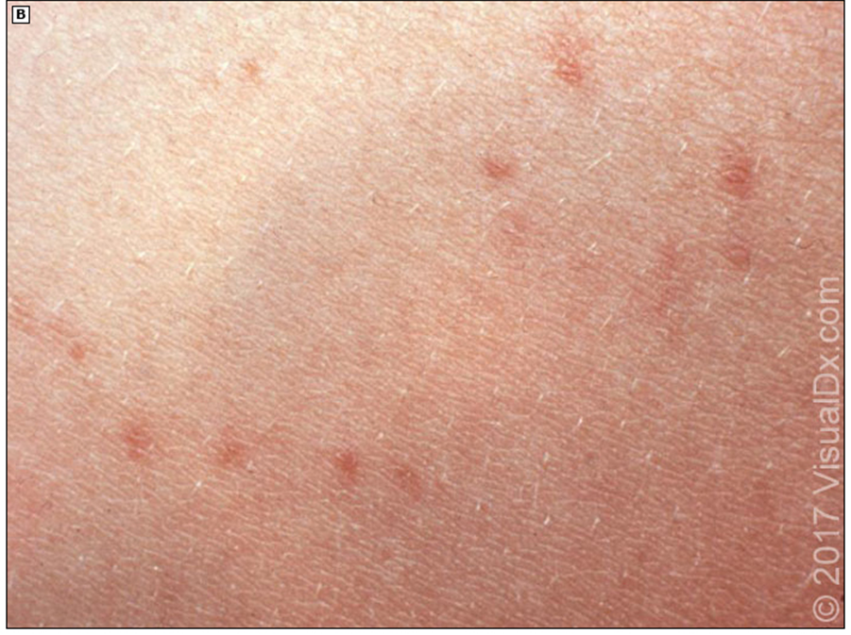
Clinical manifestations
Typhoidal Salmonella
Incubation period: 1-3 weeks
First week: rising ("stepwise") fever and bacteremia
Second week: high grade fever, abdominal pain and "rose spots"
Notes:
https://www.tandfonline.com/doi/full/10.1080/21553769.2015.1051243

Slide 45
Clinical manifestations
Typhoidal Salmonella
Incubation period: 1-3 weeks
First week: rising ("stepwise") fever and bacteremia
Second week: high grade fever, abdominal pain and "rose spots"
Third week: hepatosplenomegaly, intestinal bleeding, and perforation due to ileocecal lymphatic hyperplasia of the Peyer's patches may occur
Diarrhea is variable (may have constipation)
Notes:
https://www.tandfonline.com/doi/full/10.1080/21553769.2015.1051243

Slide 46
Complications
Typhoidal Salmonella
Compared to nontyphoidal Salmonella, complications (outside of Typhoid fever syndrome, prior slide) are less common
Most common complication is intestinal perforation (during 3rd week)
Reports of CNS manifestations
Most commonly headaches
Can developed typhoid encephalopathy → bad prognostic sign
Meningitis and focal central nervous infections are rare
IV dexamethasone may have benefit

Slide 47
Salmonella: Treatment

Slide 48
Salmonella: Who to treat?
Most cases: Supportive therapy alone
Antimotility agents are discouraged
Antibiotics can cause harm
Doesn’t decrease duration
Does increase relapse (recall abx are a risk factor)

Slide 49
Salmonella: Who to treat?
Most cases: Supportive therapy alone
Antimotility agents are discouraged
Antibiotics can cause some harm
Doesn’t decrease duration
Does increase relapse
Indications for treatment
Patients at risk for invasive disease
Severe cases of Salmonella
Risk for severe disease
Old & young (under 3 months, over 50 yr)
Endovascular abnormalities, substantial joint disease
Immunosuppression: HIV, steroids, IBD, hemoglobinopathies
Severe disease
Severe diarrhea (>9 or 10 stools / day)
High or persistent fever
Bloodstream infection
Hospitalization

Slide 50
What to treat with?
Nontyphoidal Salmonella
Agents
Fluoroquinolone
Bactrim
Cefixime
Azithromycin (prefered if acquired in South Asia)
Duration
Immunocompetent: 3-7 days
Immunocompromised: at least 14 days
Gastroenteritis

Slide 51
What to treat with?
Nontyphoidal Salmonella
Agents
IV Fluoroquinolone
3G cephalosporin
Bactrim
Ampicillin
Carbapenems (due to ↑ rates of resistance)
Duration
Immunocompetent: 14 days
Immunocompromised: 4-6 weeks
Gastroenteritis
Bacteremia

Slide 52
What to treat with?
Typhoidal Salmonella
Uncomplicated
Fluoroquinolone
Azithromycin (prefered if acquired in South Asia)
Complicated
3G cephalosporin
Carbapenem (XDR)

Slide 53
Drug resistance
Typhoidal Salmonella
Rates of drug resistance is increasing globally
South Asia has high resistance to fluoroquinolones
Pakistan or Iraq may have XDR
Very important to get cultures to guide susceptibilities (not just the biofire!)
Stool cultures will most often be negative during first week
Most sensitive Dx: Bone marrow biopsy (even if they’ve gotten antibiotics)

Slide 54
Indications for vaccination
US travelers (even short-term travelers) to endemic areas
Intimate exposure to a documented S. Typhi chronic carrier
Individuals whose work exposes them to cultures or specimens containing S. Typhi

Slide 55
Yersiniosis

Slide 56
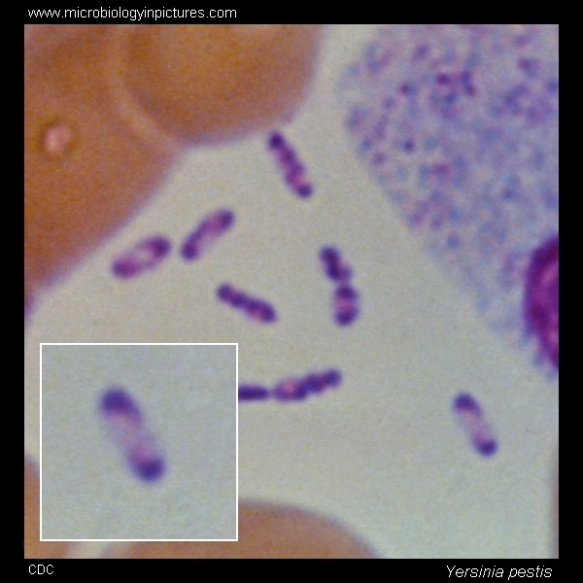
Yersinia: Microbiology
Gram negative rods
Motile at low (72-84 F), nonmotile at human body temperatures
Bipolar staining (“safety pin”)
Order: Enterobacterales
Genus: Yersinia
Y enterocolitica
Y pestis
Y pseudotuberculosis

Slide 57
Yersinia: Microbiology
Gram negative rods
Motile at low (72-84 F), nonmotile at human body temperatures
Bipolar staining (“safety pin”)
Order: Enterobacterales
Genus: Yersinia
Y enterocolitica
Y pestis
Y pseudotuberculosis
See Case #1

Slide 58
Yersiniosis: Transmission, reservoirs, and risk factors

Slide 59
Yersiniosis: epidemiology & risk factors
Y enterocolitica
Y pseudotuberculosis
Transmission | Mostly foodborne, sometimes waterborne
 | Raw/undercooked pork | Reports from contaminated produce
Notes:
https://www.ncbi.nlm.nih.gov/books/NBK430717/ - Pseudotuberculosis

Slide 60
Yersiniosis: epidemiology & risk factors
Y enterocolitica
Y pseudotuberculosis
Transmission | Mostly foodborne, sometimes waterborne
 | Raw/undercooked pork | Reports from contaminated produce
Cross contamination influences some of these patterns
Tofu contaminated from spring water (Y enterocolitica)
Outbreak of contaminated lettuce (Y pseudotuberculosis)
Notes:
https://www.ncbi.nlm.nih.gov/books/NBK430717/ - Pseudotuberculosis

Slide 61
Yersiniosis: epidemiology & risk factors
Y enterocolitica
Y pseudotuberculosis
Transmission | Mostly foodborne, sometimes waterborne
 | Raw/undercooked pork | Reports from contaminated produce
Reservoirs | Main association: Pigs / pork / swine Colonizes healthy swine, esp throat Also seen in domesticated animals & wildlife | Numerous mammals & birds Europe = brown hares Australia = sheep New Zealand = deer
Cross contamination influences some of these patterns
Tofu contaminated from spring water (Y enterocolitica)
Outbreak of contaminated lettuce (Y pseudotuberculosis)
Notes:
https://www.ncbi.nlm.nih.gov/books/NBK430717/ - Pseudotuberculosis

Slide 62
Yersiniosis: epidemiology & risk factors
Y enterocolitica
Y pseudotuberculosis
Transmission | Mostly foodborne, sometimes waterborne
 | Raw/undercooked pork | Reports from contaminated produce
Reservoirs | Main association: Pigs / pork / swine Colonizes healthy swine, esp throat Also seen in domesticated animals & wildlife | Numerous mammals & birds Europe = brown hares Australia = sheep New Zealand = deer
Cross contamination influences some of these patterns
Tofu contaminated from spring water (Y enterocolitica)
Outbreak of contaminated lettuce (Y pseudotuberculosis)
Children are at increased risk (especially infants)
Notes:
https://www.ncbi.nlm.nih.gov/books/NBK430717/ - Pseudotuberculosis

Slide 63
Yersiniosis: Clinical manifestations & treatment

Slide 64
Pathogenesis
Ingestion → small intestine
Mucosal invasion
Of intestinal lymph tissue in Peyer's patches
Blocked phagocytosis
By type III secretion system & YOP
Spread through mesenteric lymph nodes
Iron scavenging
Y pseudotuberculosis has a siderophore-mediated iron scavenging system
Iron overloaded states are risk factor
Mesenteric lymphadenitis
Goes to liver & spleen
Notes:
https://pmc.ncbi.nlm.nih.gov/articles/PMC9076465/#sec3
https://www.ncbi.nlm.nih.gov/books/NBK430717/

Slide 65
Acute yersiniosis
Symptoms: Fever, abdominal pain, & diarrhea
Bloody diarrhea mainly occurs in kids, rare in adults
Timing: Compared to other causes of febrile diarrhea, more subacute pattern
Longer incubation period (~5 days)
Symptoms may last longer (2-3 weeks)

Slide 66
Yersiniosis: Mimicker of other conditions
Pseudoappendicitis
Easily confused with appendicitis
RLQ pain, fever, diarrhea, leukocytosis
Manifestation of mesenteric lymphadenitis in terminal ileum
Can often grow Yersinia on Cx
Histopathology of appendix itself normal
Has resulted in “outbreaks of appendicitis”

Slide 67
Yersiniosis: Mimicker of other conditions
Pseudoappendicitis
Pharyngitis
Easily confused with appendicitis
RLQ pain, fever, diarrhea, leukocytosis
Manifestation of mesenteric lymphadenitis in terminal ileum
Can often grow Yersinia on Cx
Histopathology of appendix itself normal
Has resulted in “outbreaks of appendicitis”
Some patients (up to 20%) may have pharyngitis
Recall: Yersinia likes to go lymphoid tissue (tonsils) in humans and pigs
Y pseudotuberculosis has mimicked Scarlet fever
Fever, pharyngitis, arthralgia
Morbilliform → desquamating rash
Diarrhea is not common for Scarlet fever/strep throat

Slide 68
Yersiniosis: Complications
Compared to nontyphoidal & typhoidal Salmonella, complications from Yersiniosis are much less common
GI complications: GI ulceration, perforation, intussusception, bowel necrosis
Extraintestinal: abscesses, endovascular, CNS/eye, bone/joint, etc
Exception: Bacteremia can occur during acute infection, especially in infants, immunosuppression, iron overload
Post-infectious sequelae
Fairly common (comparatively)
Up to 30% of adults
Reactive arthritis (like NTS)
Most common w/ HLA-B27
+/- conjunctivitis &/or uveitis
Erythema nodosum
More common in women
Self-limited

Slide 69
Yersiniosis: Treatment
Supportive treatment alone for:
Mild to moderate gastroenteritis
Mesenteric lymphadenitis
Often resistant to
Penicillin, ampicillin
Macrolides
+/- fluoroquinolones
Who/when to treat?
Neonates
Immunosuppression
Derangement of iron metabolism
Extraintestinal disease
Treatment options
Ceftriaxone + gentamicin
Quinolones + gentamicin
Bactrim & doxy (step down therapy)

Slide 70
Learning points & take aways

Slide 71

Learning points & take aways
See handout: https://docs.google.com/document/d/1_P8KQ-xP_5dWS93kwPwqPbHiy7yypStn71blBknmdXM/
Sources: Mostly Jackie Moore’s old lecture
Additional sources noted in the comments section of each slide
Slides available on hunterratliff1.com/talk/

