Slide 1
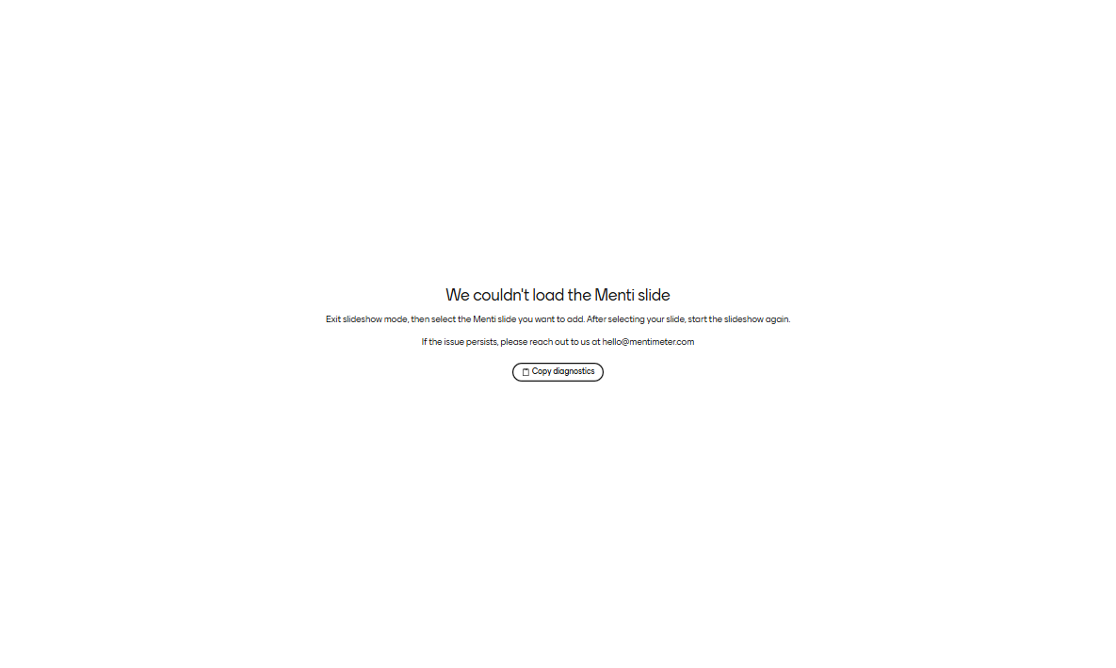
Mentimeter slide
INTERNAL MEDICINE RESIDENCY CONFERENCE · 10/20/2026
TB for the Internist
Suspecting it, isolating it, treating it: disease and infection
Hunter Ratliff, MD, MPH
Infectious Diseases · WVU School of Medicine
Notes:
Slides from a 30-minute internal medicine residency conference at WVU (October 2026). These notes are written for anyone reading or downloading the deck: they add context, caveats and sources rather than a script. Both cases are real patients; details have been simplified or changed to protect privacy. Bracketed numbers on the slides refer to the numbered references at the end.

Slide 2
TB for the Internist
INTERNAL MEDICINE RESIDENCY CONFERENCE · 10/20/2026
Suspecting it, isolating it, treating it: disease and infection
Hunter Ratliff, MD, MPH
Infectious Diseases · WVU School of Medicine
Notes:
Slides from a 30-minute internal medicine residency conference at WVU (October 2026). These notes are written for anyone reading or downloading the deck: they add context, caveats and sources rather than a script. Both cases are real patients; details have been simplified or changed to protect privacy. Bracketed numbers on the slides refer to the numbered references at the end.

Slide 3
Disclosures
BEFORE WE START
A conflict of interest
Use of AI
I’m the hospital epidemiologist. Every patient with TB who isn’t isolated becomes my contact investigation.
Claude (Anthropic) drafted the slide design, first-draft text, speaker notes and literature search
I chose the content and cases, rewrote and reorganized the slides, and reviewed every citation
No patient identifiers were shared with the AI
So I have a deeply personal stake in you masking, isolating and calling us early.
Financial disclosures: [none]
Notes:
The conflict of interest is tongue-in-cheek but true. When a patient with infectious TB isn’t isolated promptly, infection prevention runs a contact investigation: building exposure lists, testing staff and roommates, and following up anyone whose test converts. That work scales with every hour of unprotected exposure. On AI use: Claude (Anthropic) helped with layout, first-draft text, these notes and the literature search. I chose the cases and content, revised the slides, and checked the citations against their sources; any remaining errors are mine.

Slide 4
Rare here, and that is why it gets missed
WHY IT MATTERS
WORLDWIDE · 2024
UNITED STATES · 2025
WEST VIRGINIA · 2025
10.7M
10,260
9
people fell ill with TB and 1.2 million died. Still the leading infectious killer. [1]
provisional cases (3.0 per 100,000). 77% in people born outside the US. [2]
cases (0.5 per 100,000). When you rarely see it, you rarely think of it. [2]
Notes:
Global figures are WHO estimates for 2024: about 10.7 million people developed TB and 1.2 million died, making TB the leading infectious cause of death worldwide [1]. US figures are CDC provisional surveillance data for 2025, reported as of February 12, 2026 [2]: 10,260 cases (3.0 per 100,000), about 1% fewer than in 2024 (10,395), after counts rose each year from 2021 through 2024. CDC still describes US cases as above pre-pandemic levels. Provisional numbers can change when final data are published. About 77% of US cases occurred in people born outside the US (15.4 vs 0.8 cases per 100,000 in US-born people). West Virginia reported 9 cases in 2025 (0.5 per 100,000). Low local incidence cuts both ways: it is why the diagnosis gets missed, and it is also why testing low-risk people for TB infection produces many false positives (see the testing slides). The roughly 22% of US cases in US-born people still matter: Case 1 is one of them.

Slide 5

Infection and disease are different states
THE BASICS
Exposure
TB infection
TB disease
Shared air with someone who has infectious pulmonary TB
Formerly “latent TB”
Positive IGRA or skin test
No symptoms, normal CXR
Not contagious
Symptoms, imaging findings, or both
Pulmonary disease can spread
5–10% of untreated infections over a lifetime; about half within 2 years
HIGHER RISK OF PROGRESSION
Big ones: HIV · TNF-α inhibitors and other immunosuppression · transplant
Don't forget: dialysis · diabetes · silicosis · fibrotic scars on CXR · low body weight · smoking
Notes:
Oversimplification alert: TB is better described as a spectrum (infection, incipient and subclinical disease, then symptomatic disease), and people can move in both directions. The two-box model is used here because it drives management: infection gets a short preventive regimen, disease gets multidrug therapy. “TB infection” is the current preferred term for what was called latent TB infection (LTBI); “TB disease” is what most clinicians call active TB. The 5–10% lifetime risk of progression, about half of it in the first 2 years, is the commonly quoted figure for immunocompetent adults. It comes from older cohort data and varies by population; risk is far higher with HIV (especially without antiretroviral therapy) and other immunosuppression. The risk-factor list is not exhaustive: recent infection (within about 2 years), young children, gastrectomy or jejunoileal bypass, and head and neck cancer also raise the risk. The key idea to carry forward: IGRA and skin tests measure immune memory of exposure, not disease activity, so they can’t rule TB disease in or out.

Slide 6

A 74-year-old man coughing up blood
CASE 1 · ADMISSION
Presentation:
A month of worsening cough
A week of weight loss, fevers and night sweats
New large-volume hemoptysis yesterday
History:
Diabetes (A1c 9.4)
2 packs a day since age 12
Former heavy alcohol use
Doesn't "doctor" much
Exposures: lives in rural Ohio; no travel or known TB contacts; lots of time outdoors.
What do you do in the first hour?
Notes:
A real patient from our hospital; details simplified. He presented with about a month of worsening chronic cough, a week of weight loss, subjective fevers and night sweats, then frank, large-volume hemoptysis: at least 150 mL of bright red blood in the bedside container. He was afebrile with an SpO2 of 92%. The prior TB history is deliberately withheld on this slide because the admitting team didn’t know it; it came out only when ID reviewed outside records (see the results slide). The first hour for this patient includes two parallel tracks: TB precautions (surgical mask, airborne infection isolation room, N95 or CAPR for staff, notify infection prevention, sputum for testing) and management of massive hemoptysis (airway protection, pulmonology and interventional radiology). In the Ohio River Valley, histoplasmosis and blastomycosis also belong on the differential for a cavitary lung lesion, especially with lots of time outdoors.

Slide 7

When to think TB [3]
CASE 1 · RECOGNIZE
Symptoms
Epidemiology
Imaging
Cough for 2–3 weeks or more
Fever and night sweats
Weight loss
Hemoptysis
Use my .TBRISKFACTORS smartphrase
High-incidence country of birth or residence
Known TB contact
Congregate settings; HIV or other immunosuppression
Upper-lobe or superior-segment disease (TB likes oxygen)
Cavitation
Miliary nodules
Advanced HIV: lower zones, nodes, effusion, or a normal film
Laryngeal TB: hoarseness, painful swallowing, or a lesion that looks like cancer on scope. Rare, usually alongside pulmonary TB, and highly contagious. [4]
Notes:
No single feature makes or excludes the diagnosis; it is the combination of symptoms, epidemiology and imaging [3]. Risk factors are only as good as the history: .TBRISKFACTORS is a WVU Epic smartphrase that prompts a structured TB risk history, and as Case 1 shows, the most important risk factor can still be missed. Imaging is simplified here. The apical predilection of reactivation TB is usually attributed to higher oxygen tension at the lung apices (the “TB likes oxygen” shorthand), with superior segments of the lower lobes also favored; primary TB more often shows mid or lower zone infiltrates with hilar adenopathy. In advanced HIV the picture is often atypical: lower-zone disease, adenopathy, effusion, or a normal chest film with positive sputum. Laryngeal TB: hoarseness is the most common symptom, followed by painful swallowing and a foreign-body sensation. It usually accompanies pulmonary, often cavitary, disease (in one series, 12 of 15 patients had lung involvement), though isolated laryngeal TB occurs. It can look like laryngeal cancer on laryngoscopy, and the two can coexist, so it is often diagnosed on ENT biopsy, which exposes the procedure team. Once present in about a third of pulmonary TB cases in the pre-antibiotic era, it is now reported in under 1%; those figures come from a 2022 case report and review (Raj et al., BMJ Case Rep, PMID 35131802) and are approximate. The CDC infection-control guideline treats laryngeal TB as highly infectious [4]. A related pitfall not on the slide: fluoroquinolones have real activity against M. tuberculosis, so a “pneumonia” that improved on levofloxacin hasn’t excluded TB, and empiric fluoroquinolones can delay the diagnosis and select for resistance.

Slide 8
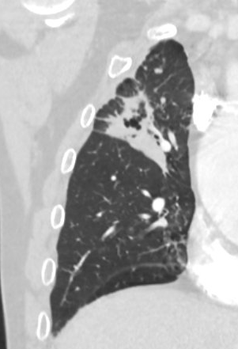
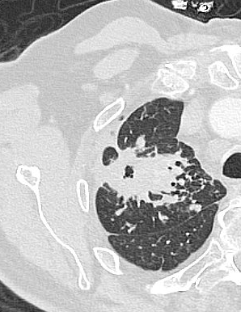
Case 1: CT chest
CASE 1 · RECOGNIZE
Radiology report
Indication: “c/o shortness of breath and hemoptysis since yesterday, smoker 2ppd”
Worsening multifocal infectious or inflammatory process, most likely, with a chronic thick-walled right upper lobe cavity
Numerous nodules in both lungs
New nodular opacification in the left lower lobe
Notes:
CT findings: a chronic, thick-walled right-upper-lobe cavity, numerous nodules in both lungs, and a new nodular opacity in the left lower lobe. The word “chronic” means older imaging exists, and comparing with it is often the fastest way to recognize a known, possibly incompletely treated, process. A chronic cavity with new nodules elsewhere raises concern for an active, spreading process. Differential for a cavity in this setting: TB, nontuberculous mycobacteria, histoplasmosis and blastomycosis, anaerobic lung abscess, squamous cell carcinoma, septic emboli, and granulomatosis with polyangiitis. Note that the imaging indication doesn’t mention TB; neither did the initial differential.

Slide 9
Case 1: How do you rule out TB?
CASE 1 · RULE OUT
Poll: select all that apply
Which of these meaningfully lowers the chance that this is TB?
3 negative sputum AFB smears
Negative sputum TB PCR
Negative BAL TB PCR
No TB risk factors
Negative QuantiFERON
Recent diagnosis of lung cancer
Notes:
Live poll; more than one answer can be right. Three negative AFB smears: weak for ruling out TB. Smear sensitivity is often quoted around 50–60%, so negative smears speak mainly to infectiousness, not to whether this is TB. Negative sputum TB PCR (NAAT): the strongest single test listed, more sensitive than smear (less so in smear-negative disease), and one or two negative Xpert results are FDA-cleared to support isolation decisions [6]. Negative BAL TB PCR: helpful, but a single bronchoscopy can miss what serial sputa catch. In one older study of smear-negative, culture-positive TB, three induced sputum samples identified 26 of 27 cases and a single bronchoscopy identified 14 (McWilliams et al., Thorax 2002). That is one small study comparing several sputa with one bronchoscopy, not a head-to-head comparison of single specimens. No TB risk factors: strong, because pretest probability drives everything, but only as good as the history (see Case 1). Negative QuantiFERON: does not meaningfully lower the probability (next slide). Recent diagnosis of lung cancer: an alternative explanation helps, but cancer and TB can coexist, particularly in a cavity, so it lowers the probability without excluding TB.

Slide 10

QuantiFERON can’t rule out TB disease [5]
CASE 1 · RULE OUT
Why it fails
What the result does to your estimate
Misses about 1 in 5 cases of active TB (sensitivity about 80%)
Roughly the same as TTE for endocarditis
Much worse with HIV, immunosuppression and severe illness: the patients you worry about most
Before | QFT negative | QFT positive
20% | 6% | 49%
30% | 10% | 62%
70% | 37% | 90%
Assumes sensitivity 80%, specificity 79% in people evaluated for TB
Worried enough to order a QuantiFERON? Then you’re worried enough to isolate and send sputum.
Notes:
Test characteristics come from the TBNET meta-analysis [5]: in blood, QuantiFERON-TB Gold In-Tube had a pooled sensitivity of 80% for active TB and a specificity of 79% for distinguishing active TB from other diagnoses among people being evaluated for it (T-SPOT.TB: 81% and 59%). That gives a negative likelihood ratio of about 0.25 and a positive likelihood ratio of about 3.8; the table applies those to three pretest probabilities using Bayes’ theorem. A negative result moves a 30% suspicion to about 10% and a 70% suspicion only to about 37%, far too high to stop the workup or end isolation. Caveats: the specificity estimate comes from low-incidence European settings, and specificity is higher in people with little background TB infection (such as many US-born patients), which makes a positive result somewhat more informative but does not rescue the negative. Sensitivity is lower in HIV, other immunosuppression, older age and severe illness, and indeterminate results are common in exactly those patients. The newer QuantiFERON-TB Gold Plus performs similarly. The comparison with transthoracic echocardiography for endocarditis is approximate: TTE sensitivity for vegetations varies widely by study and valve type. Practical point: an IGRA ordered during an inpatient workup for pulmonary TB signals that the team is worried; respond with isolation and sputum (smear, culture and NAAT).

Slide 11
The first hour: isolate on suspicion [4]
CASE 1 · ISOLATE
Do now
Coming off isolation
Surgical mask on the patient
Airborne isolation room (negative pressure)
Contact infection prevention (“Ruby Infection Prevention” on Epic chat) or myself
Use CAPR or fit-tested N95 to enter the room
Report to the health department on suspicion, not confirmation (once IP is involved, we do this for you)
SUSPECTED TB
Infection prevention and I decide, based on:
Pretest probability, or an alternative diagnosis
Sputum PCR: 1–2 negative Xpert results are FDA-cleared for this [6]
AFB smears (older standard: 3 negative)
CONFIRMED TB
Effective therapy, clinical improvement and 3 consecutive negative smears. Discharge plans go through the health department.
Notes:
Airborne precautions start on clinical suspicion, not on test results [4]: a surgical mask on the patient (including during transport), an airborne infection isolation room with negative pressure, and a fit-tested N95 respirator or a CAPR for anyone entering. The contact details on the slide are specific to WVU Medicine/J.W. Ruby Memorial Hospital; elsewhere, the equivalent is your infection prevention team. TB is reportable to the health department on suspicion, not just on culture confirmation. For suspected TB, removal from isolation weighs pretest probability (or a convincing alternative diagnosis) against testing. The 2005 CDC guideline used three negative AFB smears [4]. In 2015 the FDA cleared Xpert MTB/RIF for use, together with clinical judgment, in decisions about removing patients from airborne isolation based on one or two negative results; the supporting multicenter study is reference [6]. Hospitals differ on whether they require one or two negative NAATs, and some still use smears. For confirmed TB, criteria are effective multidrug therapy, clinical improvement and three consecutive negative sputum smears. A patient who is still smear-positive can sometimes be discharged home if the health department agrees and there are no new susceptible household contacts, such as young children or immunocompromised people; that decision belongs to the health department.

Slide 12
Three sputa and a NAAT, then culture [3]
CASE 1 · TEST
Specimens
Reading the first results
Sputum ×3 for AFB smear and culture: 8–24 h apart, at least one early-morning
NAAT on the early AM specimen: results in hours, more sensitive than smear (higher NPV), flags rifampin resistance
Can’t produce sputum? Induce before bronchoscopy
If concern for TB, need to also test for HIV
 | NAAT + | NAAT −
Smear + | TB: treat, isolate, report | Think NTM (or a false-negative NAAT)
Smear − | Presumptive TB: treat while culture is pending | Less likely, not excluded: clinical judgment
Notes:
Per the 2017 ATS/IDSA/CDC diagnosis guideline [3]: three sputum specimens 8 to 24 hours apart, at least one early-morning, for AFB smear microscopy and mycobacterial culture, with NAAT on at least one specimen (the guideline says the initial specimen; running it on the early-morning sample is a practical choice). NAAT (for example Xpert MTB/RIF Ultra) is more sensitive than smear, especially in smear-negative disease, returns in hours, and detects rpoB mutations associated with rifampin resistance; it does not detect resistance to other drugs. If the patient can’t produce sputum, sputum induction is usually tried before bronchoscopy. Culture remains the reference standard and is required for full phenotypic susceptibility testing; liquid culture usually turns positive in 1 to 3 weeks, and solid media take longer. Everyone with TB, or with enough suspicion to be worked up, should be tested for HIV. The 2×2 table is simplified. Smear-negative, NAAT-positive results are treated as presumptive TB. Smear-positive, NAAT-negative results should raise concern for nontuberculous mycobacteria (such as MAC or M. kansasii), because NAAT is positive in nearly all smear-positive TB; repeat the NAAT and wait for culture speciation. A double negative lowers the probability but does not exclude TB; if suspicion stays high, empiric treatment with reassessment at 2 months is reasonable. Other baseline labs before treatment: CBC, CMP, hemoglobin A1c, hepatitis B and C serologies if risk factors, and visual acuity and color vision testing before ethambutol.

Slide 13
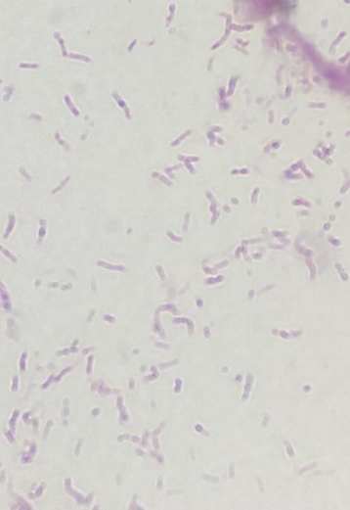
Back to our patient
CASE 1 · RESULTS
1
Smear: AFB smear positive
2
PCR: MTB PCR positive; no rifampin-resistance mutation detected
3
Clinical worsening: intubated on hospital day 3 for massive hemoptysis
Notes:
Sputum AFB smear and MTB PCR were both positive, with no rifampin-resistance mutation detected. Other studies (PJP PCR, fungal antigens, routine bacterial culture) were negative. The missing history: once ID reviewed outside records, it emerged that he had been treated for right-upper-lobe cavitary TB since 2021, through several courses, and had stopped treatment on his own in 2024. He had also been seen in our ED earlier in 2024 for streaky hemoptysis and sent home. The risk factor that mattered most, prior incompletely treated TB, was invisible until someone looked. Interrupted treatment is also how drug resistance is acquired, so anyone with prior TB needs full susceptibility testing and ID involvement. For teaching purposes, some details of his prior susceptibility results and his actual regimen are left out of this deck. Hospital course: intubated on day 3 for hemoptysis; endobronchial blocker on day 4; right bronchial artery embolization by interventional radiology on day 5; rebleeding on day 10 requiring two blockers; extubated on day 13; transferred out of the MICU on day 18; reintubated for hypoxia on day 21, followed by severe shock. After a goals-of-care discussion he was transitioned to comfort care and died on day 23. TB remains a disease people die of, including in the US.

Slide 14
How would you treat
CASE 1 · TREAT
How would you treat?
Smear and PCR positive, no rifampin resistance detected, prior interrupted treatment, now intubated.
RIPE for 6 months
RIPE, planning for 9 months
4-month rifapentine-moxifloxacin regimen (HPMZ)
Hold treatment until culture and susceptibilities return
Notes:
Live poll. Start RIPE (rifampin, isoniazid, pyrazinamide, ethambutol) now: waiting for culture and susceptibilities is not appropriate in a smear-positive, critically ill patient. Six versus nine months is decided later: the continuation phase is extended to 9 months total when the initial film shows cavitation and the 2-month culture is still positive [8], so “RIPE, reassess at 2 months” is the best answer, and 9 months is likely given his cavity. The 4-month rifapentine–moxifloxacin regimen is a poor fit here: it was studied in outpatients with presumed drug-susceptible pulmonary TB; prior interrupted treatment raises concern for resistance and calls for expert consultation; and moxifloxacin adds QT risk in an ICU patient. Simplification: the real patient’s regimen reflected details of his prior susceptibility testing that are left out of this deck. Whatever the regimen, send full susceptibilities and involve ID and the health department.

Slide 15

How would you treat?
CASE 1 · TREAT
Smear and PCR positive, no rifampin resistance detected, prior interrupted treatment, now intubated.
RIPE for 6 months
RIPE, planning for 9 months
4-month rifapentine-moxifloxacin regimen (HPMZ)
Hold treatment until culture and susceptibilities return
Notes:
Live poll. Start RIPE (rifampin, isoniazid, pyrazinamide, ethambutol) now: waiting for culture and susceptibilities is not appropriate in a smear-positive, critically ill patient. Six versus nine months is decided later: the continuation phase is extended to 9 months total when the initial film shows cavitation and the 2-month culture is still positive [8], so “RIPE, reassess at 2 months” is the best answer, and 9 months is likely given his cavity. The 4-month rifapentine–moxifloxacin regimen is a poor fit here: it was studied in outpatients with presumed drug-susceptible pulmonary TB; prior interrupted treatment raises concern for resistance and calls for expert consultation; and moxifloxacin adds QT risk in an ICU patient. Simplification: the real patient’s regimen reflected details of his prior susceptibility testing that are left out of this deck. Whatever the regimen, send full susceptibilities and involve ID and the health department.

Slide 16


RIPE: side effects and interactions
ACTIVE TB · KNOW YOUR DRUGS
Side effects [7]
Rifampin lowers levels [8, 9]
Drug | Watch for
Isoniazid | Major hepatitis risk, neuropathy (give B6)
Rifampin | Hepatitis (alkP), orange fluids, DDI
Pyrazinamide | Hepatitis, gout
Ethambutol | Optic neuritis
Anticoagulants: DOACs, warfarin
Contraceptives: pill, patch, ring
HIV: PIs, bictegravir, dolutegravir
Transplant: tacrolimus, cyclosporine
Methadone and other opioids
Azoles: voriconazole, itraconazole
Steroids, antiseizure drugs, statins
Liver injury (ALT >3× ULN with symptoms, >5× without): hold INH, RIF and PZA; call ID.
Notes:
Side effects [7]. Isoniazid: hepatitis (risk rises with age, alcohol use and chronic liver disease) and peripheral neuropathy; give pyridoxine, at minimum for anyone at neuropathy risk (diabetes, HIV, alcohol use, CKD, malnutrition, pregnancy). Rifampin: hepatitis, often with a cholestatic pattern (rising alkaline phosphatase and bilirubin), harmless orange discoloration of urine, sweat and tears (it stains soft contact lenses), rare cytopenias, and drug–drug interactions. Pyrazinamide: hepatitis (in combination regimens it is often considered the most hepatotoxic of the three), hyperuricemia with gout or arthralgia, and rash. Ethambutol: optic neuritis; check visual acuity and color discrimination at baseline and monthly, and adjust the dose for creatinine clearance under 30 mL/min. The liver injury thresholds come from the 2006 ATS statement [7]: interrupt therapy for ALT at least 3 times the upper limit of normal with symptoms or jaundice, or at least 5 times without symptoms. Look for other causes (viral hepatitis, alcohol, acetaminophen, other drugs). Drugs are reintroduced one at a time under ID guidance, usually rifampin first, then isoniazid; pyrazinamide is often not restarted, which lengthens the course. Interactions [8, 9]: rifampin is one of the most potent enzyme inducers in clinical use (CYP3A4, 2C9, 2C19, UGT1A1 and P-glycoprotein). Induction builds over about 1–2 weeks and wears off over about 2 weeks after stopping, so watch for toxicity from other drugs when rifampin stops. The list on the slide is not exhaustive; use an interaction checker and involve pharmacy. Avoid DOACs; warfarin needs large dose increases and frequent INR checks. Combined hormonal pills, patches and rings become unreliable; use an IUD, injectable or barrier method, continuing backup for about a month after the last dose. HIV: dolutegravir goes to 50 mg twice daily; bictegravir and boosted protease inhibitors are not given with rifampin; efavirenz can be. Calcineurin inhibitor levels fall sharply; rifabutin, a weaker inducer, is the usual substitute when interactions can’t be managed. Methadone: expect withdrawal within days. Corticosteroid doses often need to roughly double. Tofacitinib (Case 2) levels also fall substantially with rifampin.

Slide 17
Treating drug-susceptible TB
ACTIVE TB · TREAT
Standard · 6 months [8]
New option (2025) · 4 months [10, 11]
RIPE · 2 mo
RI · 4 mo
HPMZ · 8 wk
HPM · 9 wk
Rifampin, isoniazid, pyrazinamide, ethambutol
Stop ethambutol once the isolate is pan-susceptible
Cavity plus positive 2-month culture: 9 months total
Pyridoxine with isoniazid; DOT via the health department
Rifapentine, moxifloxacin, isoniazid (INH), pyrazinamide
Age ≥12, weight ≥40 kg, pulmonary, presumed susceptible
Not for pregnancy, most extrapulmonary TB, CD4 under 100
Notes:
Standard regimen [8]: 2 months of rifampin, isoniazid, pyrazinamide and ethambutol, then 4 months of isoniazid and rifampin. Ethambutol can stop once the isolate is known to be pan-susceptible. The continuation phase is extended to 7 months (9 months total) when the initial chest film shows cavitation and the 2-month culture is still positive. Directly observed therapy through the health department is standard of care. The 4-month regimen (HPMZ) is based on TBTC Study 31/ACTG A5349: daily rifapentine 1,200 mg, moxifloxacin 400 mg, isoniazid 300 mg and weight-based pyrazinamide for 8 weeks, then rifapentine, moxifloxacin and isoniazid for 9 weeks, taken with food. CDC issued interim guidance in 2022 [10]; the 2025 ATS/CDC/ERS/IDSA guideline gave it a conditional recommendation with moderate certainty of evidence [11]. It applies to people 12 and older, weighing at least 40 kg, with presumed drug-susceptible pulmonary TB. The slide’s exclusions are abbreviated; the full list includes pregnancy or breastfeeding, most extrapulmonary disease, HIV with CD4 under 100 cells/µL or antiretrovirals other than efavirenz, QT prolongation or interacting drugs, and known or suspected resistance. In practice, regimen choice is made with ID and the health department.

Slide 18
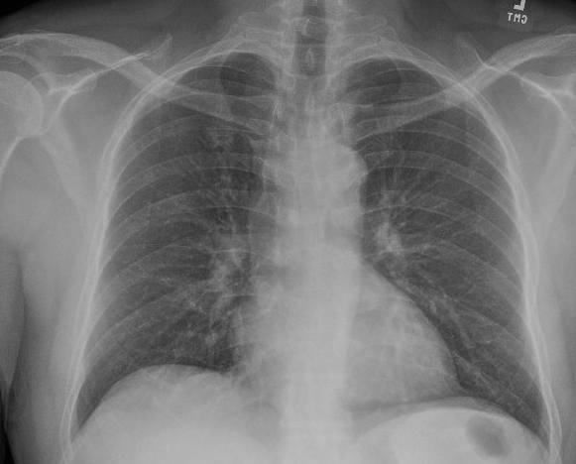
A positive IGRA before a JAK inhibitor
CASE 2 · CLINIC
A man in his 50s with seropositive RA recently started tofacitinib, with a dramatic response.
Born in India; in the US since 2020. Rheumatology’s screening QuantiFERON is positive, so they hold tofacitinib and refer him to ID.
No symptoms. He says he has never been treated for TB.
Poll: what next?
Repeat the IGRA · Start 4R · CT chest · Clear him for tofacitinib · Get more history
Notes:
A real clinic patient; details simplified and partly changed for privacy. Live poll. Best answer: get more history. Repeating the IGRA adds nothing, since a positive result reflects immune memory and a second result won’t change management. Starting 4R is reasonable on the information shown, which is exactly the trap. A CT chest isn’t needed with no symptoms and a clear chest film. Clearing him for tofacitinib turns out to be the right destination, but not on this information. Teaching point: patients often hear “Have you ever been treated for TB?” as “Have you ever had active TB?” Ask about pills taken for a positive skin or blood test, and check outside records and pharmacy fill history.

Slide 19

What is your next step?
CASE 2 · CLINIC
A man in his 50s with seropositive RA recently started tofacitinib, with a dramatic response.
Born in India; in the US since 2020. Rheumatology’s screening QuantiFERON is positive, so they hold tofacitinib and refer him to ID.
No symptoms. He says he has never been treated for TB.
Poll: what next?
Repeat the IGRA · Start 4R · CT chest · Clear him for tofacitinib · Get more history
Notes:
A real clinic patient; details simplified and partly changed for privacy. Live poll. Best answer: get more history. Repeating the IGRA adds nothing, since a positive result reflects immune memory and a second result won’t change management. Starting 4R is reasonable on the information shown, which is exactly the trap. A CT chest isn’t needed with no symptoms and a clear chest film. Clearing him for tofacitinib turns out to be the right destination, but not on this information. Teaching point: patients often hear “Have you ever been treated for TB?” as “Have you ever had active TB?” Ask about pills taken for a positive skin or blood test, and check outside records and pharmacy fill history.

Slide 20

Test the people you would treat [3, 12]
TB INFECTION · WHO
More likely infected
More likely to progress
Born or lived in a high-incidence country
Close contact of infectious TB
Incarceration, homeless shelters, other congregate settings
Health care workers, at baseline
HIV
Before TNF-α inhibitors, other biologics, JAK inhibitors, chemotherapy, transplant
Prednisone ≥15 mg/day for a month or more
Dialysis, silicosis, diabetes
Low pretest probability means low positive predictive value: in a low-risk person, a positive IGRA is often a false positive.
Notes:
Targeted testing: test people at increased risk of infection or of progression, and only if a positive result would lead to treatment [3]. The USPSTF (2023, grade B) recommends screening asymptomatic adults at increased risk, mainly people born in or who have lived in countries with higher TB prevalence and people who have lived in congregate settings such as homeless shelters and correctional facilities [12]. Screening before immunosuppression (TNF-α inhibitors, other biologics and JAK inhibitors per their labeling, transplant, chemotherapy, and prednisone 15 mg/day or more for a month or longer) is a separate, indication-driven recommendation. The epidemiology point: with a low pretest probability, even a fairly specific test has a low positive predictive value, so testing low-risk people produces false positives, unnecessary treatment and occasional harm. For health care workers, CDC and the National TB Controllers Association (2019) recommend baseline testing and no routine annual testing absent a known exposure or ongoing transmission.

Slide 21
IGRA or skin test? [3]
TB INFECTION · WHICH TEST
 | IGRA | Tuberculin skin test
BCG cross-reaction | No | Yes
Preferred for | Most adults, especially after BCG or if unlikely to return | When IGRA isn’t available; needs a read at 48–72 h
Positive means | Above the cutoff; near-cutoff results often revert | ≥5, ≥10 or ≥15 mm, by risk group
Pitfalls | Indeterminate with lymphopenia or immunosuppression | Reader variability, boosting, NTM cross-reaction
Neither test separates infection from disease or rules out active TB, and both usually stay positive after treatment.
Notes:
IGRAs (QuantiFERON-TB Gold Plus, T-SPOT.TB) measure interferon-γ release in response to ESAT-6 and CFP-10, antigens absent from BCG strains and most nontuberculous mycobacteria (exceptions include M. kansasii, M. szulgai and M. marinum) [3]. The 2017 ATS/IDSA/CDC guideline prefers IGRA over TST for people 5 and older who are likely infected and at low or intermediate risk of progression, for BCG-vaccinated people, and when a return visit to read a skin test is unlikely. TST cutoffs, simplified: 5 mm or more for HIV, recent contacts, fibrotic changes on chest X-ray, transplant and other immunosuppression; 10 mm or more for recent arrivals from high-prevalence countries, people who inject drugs, residents and staff of congregate settings, certain medical conditions and young children; 15 mm or more for people with no risk factors. An indeterminate IGRA usually reflects a failed mitogen control (lymphopenia, immunosuppression or specimen handling); repeat it or use a TST. In serial testing of low-risk people such as health care workers, results just above the cutoff often revert on repeat. Neither test distinguishes infection from disease or rules out active TB. Both usually stay positive after treatment; some IGRAs do revert, but reversion is not a reliable marker of cure, so once someone has a documented positive result there is little reason to retest (see Case 2).

Slide 22

Rule out disease, then treat short [13]
TB INFECTION · TREAT
First: symptom review and chest X-ray, with sputum if anything is abnormal. One or two drugs for unrecognized active TB breeds resistance.
Regimen | Schedule | Notes
3HP · isoniazid + rifapentine | Weekly × 12 doses | Often used by health dept; often with directly observed therapy
4R · rifampin | Daily × 4 months | Most commonly used; limited by DDI
3HR · isoniazid + rifampin | Daily × 3 months | Same rifampin interactions
6H or 9H · isoniazid | Daily × 6–9 months | Only if rifamycins can't be used; more liver injury, lower completion
Notes:
Before treating TB infection: a symptom screen and chest X-ray, with sputum for smear, culture and NAAT if anything is abnormal. Giving one or two drugs to someone with unrecognized TB disease risks acquired resistance. The 2020 NTCA/CDC guideline [13] prefers the short rifamycin-based regimens: 3HP (once-weekly isoniazid plus rifapentine for 12 doses), 4R (daily rifampin for 4 months) and 3HR (daily isoniazid plus rifampin for 3 months). Note on 3HP: since a 2018 CDC update, it can be given by directly observed therapy or self-administered; many health departments still use DOT. Six or 9 months of isoniazid are alternatives when rifamycins can’t be used, with more hepatotoxicity and lower completion. In a large randomized trial, 4R was noninferior to 9 months of isoniazid, with higher completion and fewer serious adverse events (Menzies et al., NEJM 2018). 4R is also preferred after exposure to isoniazid-resistant TB. For people with HIV, regimen choice depends on the antiretroviral regimen. The same drug-interaction rules apply as for active TB. Check baseline liver tests in people with liver disease, alcohol use, HIV, pregnancy or within 3 months postpartum, or other hepatotoxic drugs.

Slide 23
Back to our patient
CASE 2 · ANSWERS
1
Chart review: positive IGRAs since 2021, across several health systems.
2
Already treated: a prior rheumatologist gave him 4R in 2024, and the pharmacy confirmed the fill.
3
IGRAs stay positive after treatment. Don’t repeat them; document “TB infection, treated (4R, 2024).”
4
No disease, no new exposure: no retreatment. He can resume tofacitinib, with a low threshold to evaluate symptoms.
Notes:
Details simplified and partly changed for privacy. (1) Chart review found positive IGRAs going back to 2021 at several health systems, plus an earlier ID referral he never attended. (2) Those referral documents showed that a previous rheumatologist had treated him with 4 months of rifampin in 2024; the pharmacy confirmed the prescription was filled, and a family member described him as reliable with long medication courses. He had denied prior treatment, most likely because “TB treatment” was understood as treatment for active TB. (3) IGRAs reflect immune memory and usually stay positive after successful treatment, so a repeat test can’t confirm cure or detect reinfection. Recording the treatment history where the next clinician will see it (problem list, allergy-style alert or similar) prevents repeat referrals. (4) After a documented, completed course of a recommended regimen, with no symptoms, a clear chest film and no new exposure, retreatment isn’t routinely indicated, even before a JAK inhibitor. Things that would change that: a new close contact with infectious TB, a course that can’t be verified, or new symptoms or imaging findings. Experts differ on retreatment after high-risk re-exposure in someone about to be heavily immunosuppressed. Had treatment been needed, rifampin substantially lowers tofacitinib levels, so pharmacy and rheumatology need to weigh in. What his previous rheumatologist did in 2024 (test before immunosuppression, rule out disease, treat with a short rifamycin regimen) was exactly right.

Slide 24
Five take aways
TAKE HOME
Isolate and report on suspicion, TB is rare, but rare cases come to Ruby
Three sputa for smear and culture, TB PCR on one of them
Rule out disease ("active"), then treat infection ("latent") with a short rifamycin regimen
Rifampin interacts with nearly everything: pharmacy reviews the list first
QuantiFERON testing has advantages to PPD, but is still a very imperfect test
Notes:
A summary of the main points; each is covered with more nuance on the earlier slides and in their notes. The most important practical message: call infection prevention and ID early. Hearing about a possible case on day one is much better than hearing about it on day five.

Slide 25
References
FURTHER READING
1. World Health Organization. Global Tuberculosis Report 2025. Geneva: WHO; 2025. who.int
2. CDC. 2025 Provisional TB Data (as of Feb 12, 2026). cdc.gov
3. Lewinsohn DM, et al. Diagnosis of TB in adults and children (ATS/IDSA/CDC). Clin Infect Dis. 2017;64:111–5. PMID 28052967
4. Jensen PA, et al. Preventing TB transmission in health-care settings. MMWR Recomm Rep. 2005;54(RR-17). PMID 16382216
5. Sester M, et al. IGRAs for the diagnosis of active TB: meta-analysis. Eur Respir J. 2011;37:100–11. PMID 20847080
6. Luetkemeyer AF, et al. Xpert MTB/RIF vs AFB smear and culture in suspected TB. Clin Infect Dis. 2016;62:1081–8. PMID 26839383
7. Saukkonen JJ, et al. Hepatotoxicity of antituberculosis therapy (ATS). Am J Respir Crit Care Med. 2006;174:935–52. PMID 17021358
8. Nahid P, et al. Treatment of drug-susceptible TB (ATS/CDC/IDSA). Clin Infect Dis. 2016;63:e147–95. PMID 27516382
9. DHHS Panel on Opportunistic Infections in Adults and Adolescents with HIV. Mycobacterium tuberculosis. clinicalinfo.hiv.gov
10. Carr W, et al. Interim guidance: 4-month rifapentine-moxifloxacin regimen. MMWR. 2022;71:285–9. PMID 35202353
11. Saukkonen JJ, et al. Treatment of DS- and DR-TB (ATS/CDC/ERS/IDSA). Am J Respir Crit Care Med. 2025;211:15–33. PMID 40693952
12. US Preventive Services Task Force. Screening for latent TB infection in adults. JAMA. 2023;329:1487–94. PMID 37129649
13. Sterling TR, et al. Treatment of latent TB infection (NTCA/CDC). MMWR Recomm Rep. 2020;69(1):1–11. PMID 32053584
Notes:
Numbers match the bracketed tags on the slides; PMIDs link to PubMed. Sources mentioned only in the notes: Raj R, et al. Laryngeal tuberculosis: a neglected diagnosis. BMJ Case Rep. 2022;15(2):e248095 (PMID 35131802). McWilliams T, et al. Induced sputum and bronchoscopy in the diagnosis of pulmonary tuberculosis. Thorax. 2002;57(12):1010–1014. Menzies D, et al. Four months of rifampin or nine months of isoniazid for latent tuberculosis in adults. N Engl J Med. 2018. Dorman SE, et al. Four-month rifapentine regimens with or without moxifloxacin for tuberculosis. N Engl J Med. 2021. Sosa LE, et al. TB screening, testing and treatment of US health care personnel. MMWR. 2019.

