Slide 1
Malaria cases
Clinical Correlation Cases
MS2 MICB 820 course
Hunter Ratliff, MD MPH
HunterRatliff1.com
08/04/2026
Ages, dates, and other identifying information may have been changed
I have no conflict of interest in relation to this presentation

Slide 2
Learning Objectives
Recognize the importance of considering Malaria in any febrile illness in a returning traveler
Understand life cycle and pathogenesis
Identify drugs used for prevention and treatment

Slide 3
In the past 5 years, where was the closest locally acquired malaria case?

Slide 4
Case #1

Slide 5
Case 1: HPI
A previously healthy 22 year old male presents with high fevers, chills, and shortness of breath
Was feeling normal when he returned from study abroad around a week ago
3 days after returning, he developed high fever, chills, confusion
  Went to urgent care → diagnosed as having a viral upper respiratory infection
Went to ED because feeling much worse
Social & exposure history
Housing/Occupation: Engineering student, about to graduate. Lives with his family near Washington, PA
Hobbies: Hiking & spending time outdoors
Sex, drugs: One female partner, no condoms; occasional alcohol & THC

Slide 6
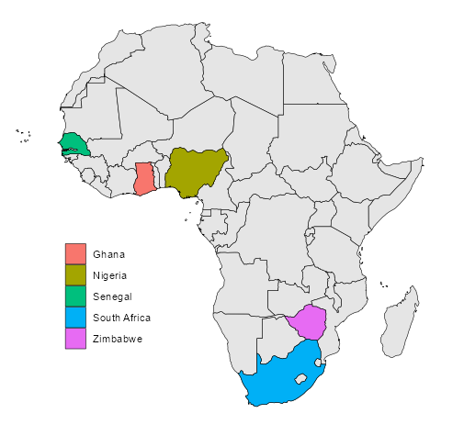
Case 1: Travel history
Study abroad in South Africa:
He also traveled to other countries in East, Central and West Africa

Slide 7
Why is travel such a strong risk factor?

Slide 8


How to make malaria
The pathogen
Plasmodium
High-yield
Prioritize knowing this information
Geography
Climate
Rx, prophylaxis
Genetics
Mosquitos
The vector
Humans
The reservoir
Mosquito control
The more you know
This is potentially helpful information to understand, but the details are less likely to be tested

Slide 9
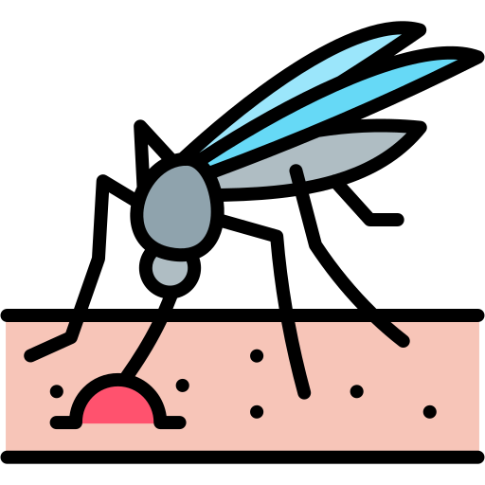
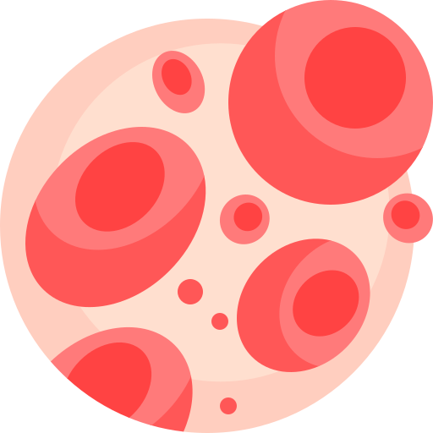
How to make malaria
To establish endemic malaria, three critical components must coexist:
01 Pathogen
Plasmodium
Parasitic single-celled eukaryotes (protozoa)
Unicellular nature makes them highly adaptable compared to multicellular organisms (like us)
Has a complex life cycle that somewhat varies by species (e.g., P. falciparum, P. vivax)
02 Vector
Anopheles
Transmitted exclusively by the female mosquito
Found globally, represented by diverse regional species
Key species like A. gambiae strongly prefer human hosts, driving rapid spread
03 Host
Human Reservoir
Humans serve as the only reservoir for the deadliest malaria species
Disease of the RBCs
In endemic areas, asymptomatic carriers infect new vectors, creating a continuous cycle of transmission

Slide 10
Plasmodium species
01 Pathogen
Plasmodium
Main species to know, in order of importance:
P. Falciparum - most Fatal
P. vivax/ovale - can relapse (hypnozoites)
P. malariae - lingers (sometimes for years)
P. knowlesi - macaque-associated zoonosis (forested Southeast Asia) that has potential to cause severe disease. Not nearly as important as the ones above

Slide 11
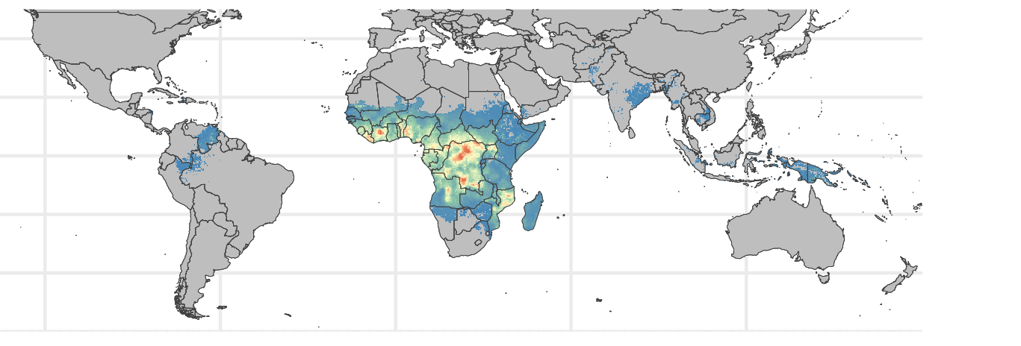
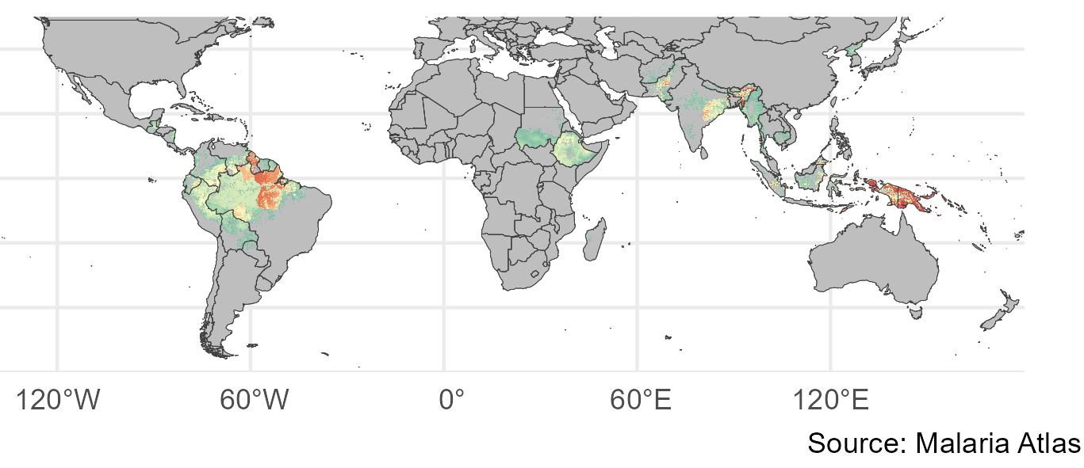
Plasmodium species
P. falciparum
Sub-Saharan Africa
SE Asia & Amazon basin
01 Pathogen
Plasmodium
P. vivax & ovale
Central America
South Asia
Oceania
Main species to know, in order of importance:
P. Falciparum - most Fatal
P. vivax/ovale - can relapse (hypnozoites)
P. malariae - lingers (sometimes for years)
P. knowlesi - macaque-associated zoonosis (forested Southeast Asia) that has potential to cause severe disease. Not nearly as important as the ones above
Those maps are too similar..?
What’s going on
Warning
Geography can clue you in, but it does not ever rule one species out

Slide 12
Malaria lifecycle: Vectors & climate
01 Pathogen
Plasmodium
Has a complex life cycle that somewhat varies by species (e.g., P. falciparum often Fatal, P. vivax)
Transmitted exclusively by the female Anopheles mosquito (men are worthless…)
A. gambiae → malaria in large areas of Africa
But numerous other species of Anopheles mosquitoes also transmit malaria, including Plasmodium falciparum
Why doesn’t malaria exist everywhere there are mosquitos?
02 Vector
Anopheles
Not here
Not here
Not here
A. gambiae lives here
P.falciparum prevalence (2020)

Slide 13
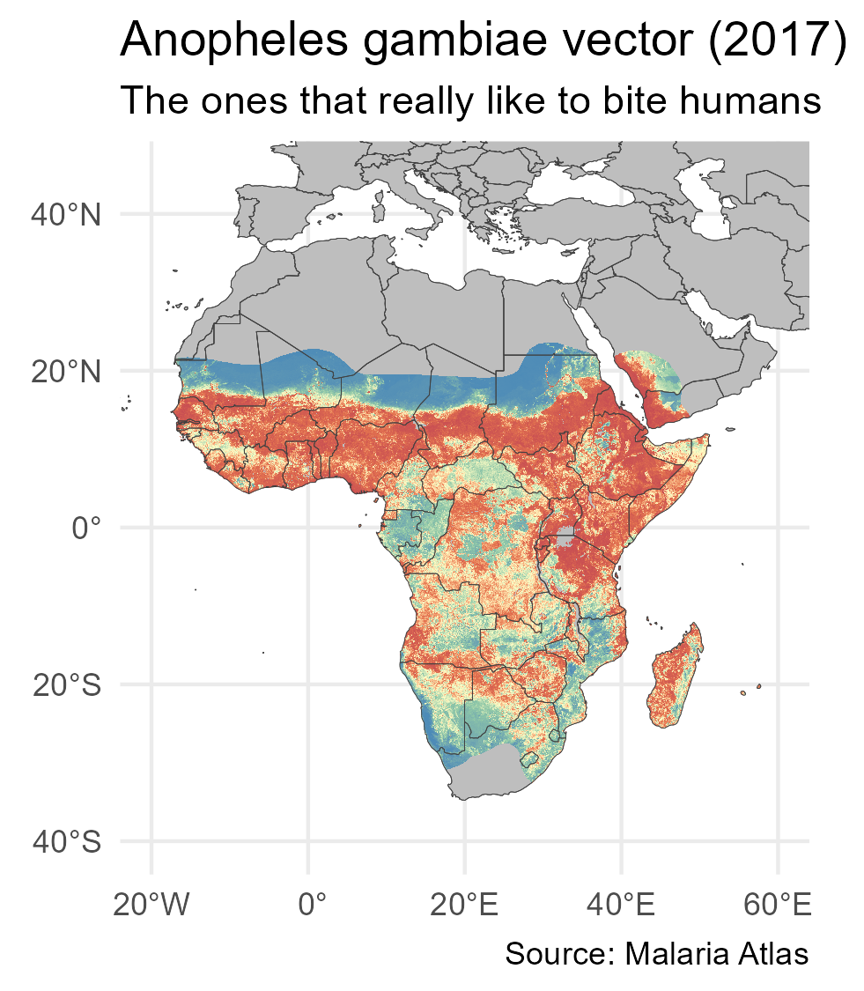
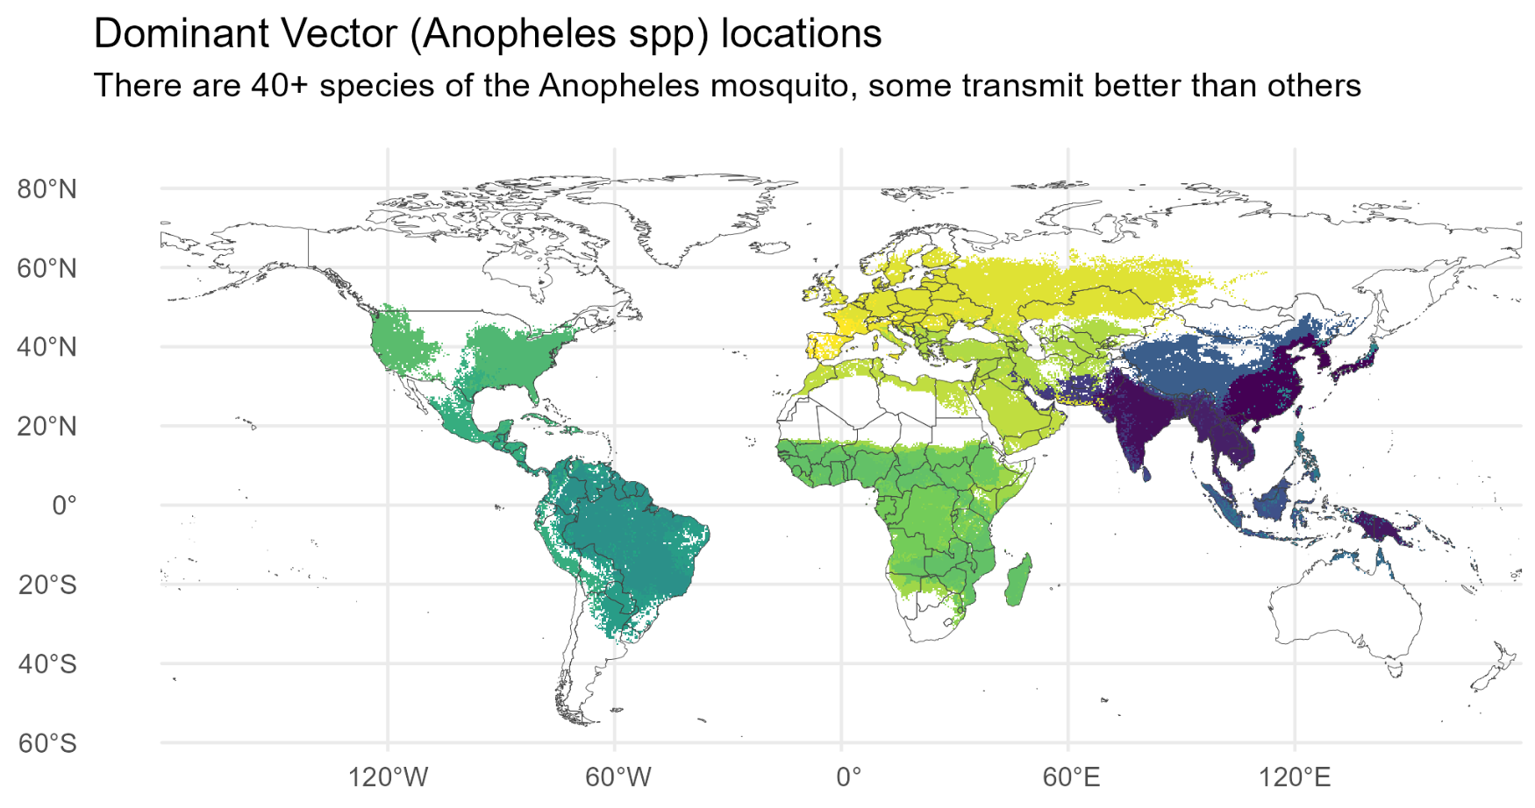
Malaria lifecycle: Vectors & climate
Applies to whole slide
All species of Anopheles mosquitoes require stagnant water (fresh or brackish) to breed
  Raining more often → more mosquitos
Desert

Slide 14
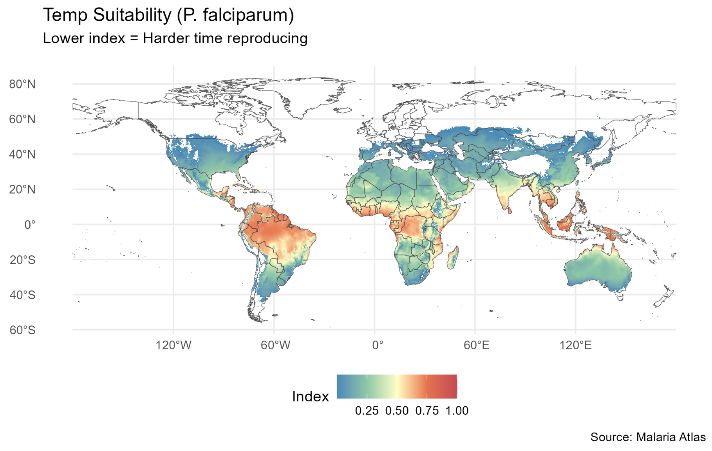
Malaria lifecycle: Vectors & climate
Applies to whole slide
All species of Anopheles mosquitoes require stagnant water (fresh or brackish) to breed
  Raining more often → more mosquitos
Both the vector (mosquitoes) and pathogen (plasmodium) do better when it’s warmer
  Mosquitos thrive in humidity
  Part of Plasmodium’s life cycle depends on the heat
Many, many other influences (but this slide unlikely to be on the exam)
Notes:
Unlikely to be on the exam, at least until climate change kicks in more

Slide 15
Back to case 1
A previously healthy 22 year old male presents with 3 days of high fevers, chills, and shortness of breath. One week ago returned from a semester in Africa. Initial thought was viral URI (headache, myalgias/arthralgias), but now doing much worse

Slide 16
Case 1: Physical exam & labs
Temp | 39.5 °C (103.1 °F) | Pulse | 118 | SpO2 | 90 %
General | Quite ill appearing, confused
GI | Non-tender, splenomegaly
Neuro | Grossly intact, no neck stiffness
CBC | Result | Normal
WBC | 5 | 3.7-11
Hgb | 8.7→7 | 11-16
Platelets | 17 | 150-400
Coags
PT | 16 | 25-35
PTT | 39 | 11-14
Chem7 | Result | Normal
Na | 140 | 136-145
K | 4.9 | 3.5-5.1
HCO3 | 21 | 23-31
BUN | 47 | 8-25
Cr | 1.5 | 0.6-1.1
LFTs | Result | Normal
AST | 135 | 11-34
ALT | 279 | <31
Alk Phos | 140 | 55-145
Bili | 6.0 | 0.3-1.3
(Unconj) | 5.4

Slide 17
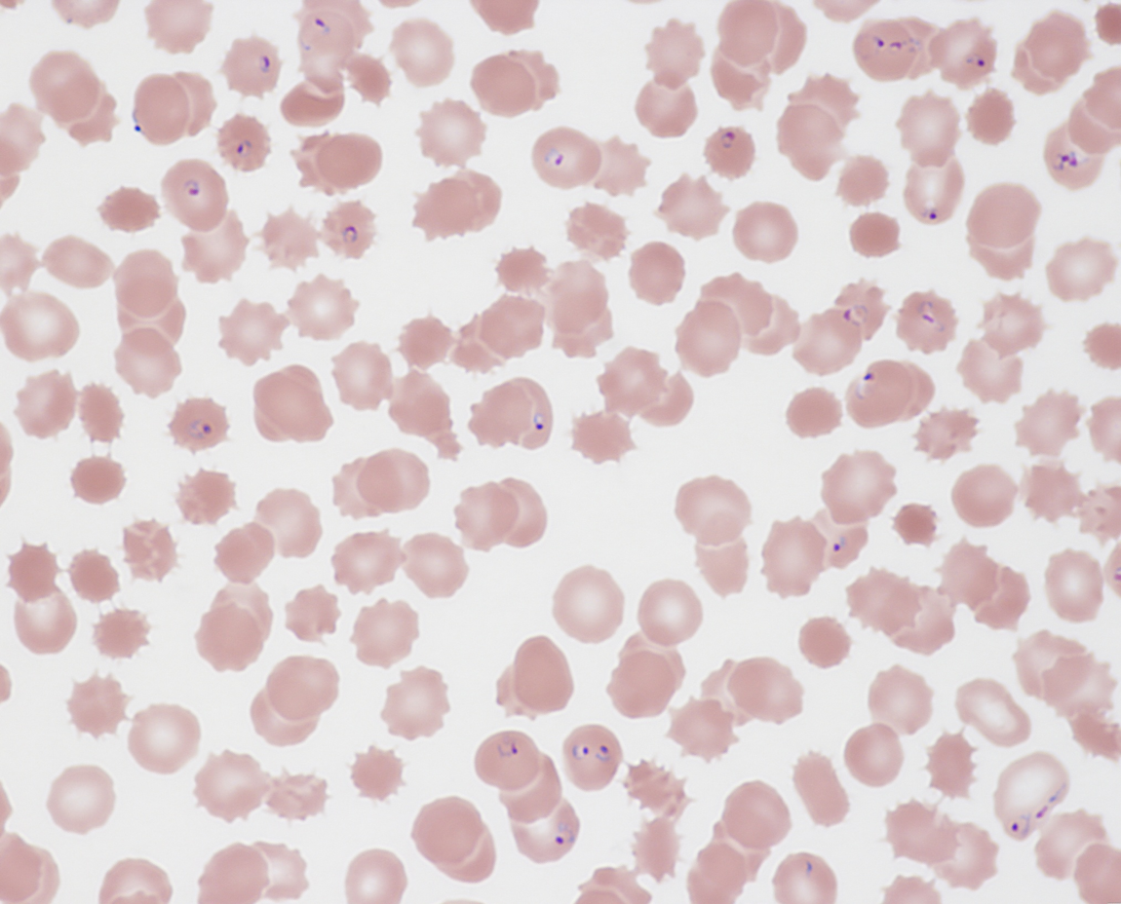
Case 1
Blood smear
Giemsa stain
Develops respiratory distress
  Requires intubation
Blood smear reveals his diagnosis
Started on treatment
  Gradually improves in coming days

Slide 18
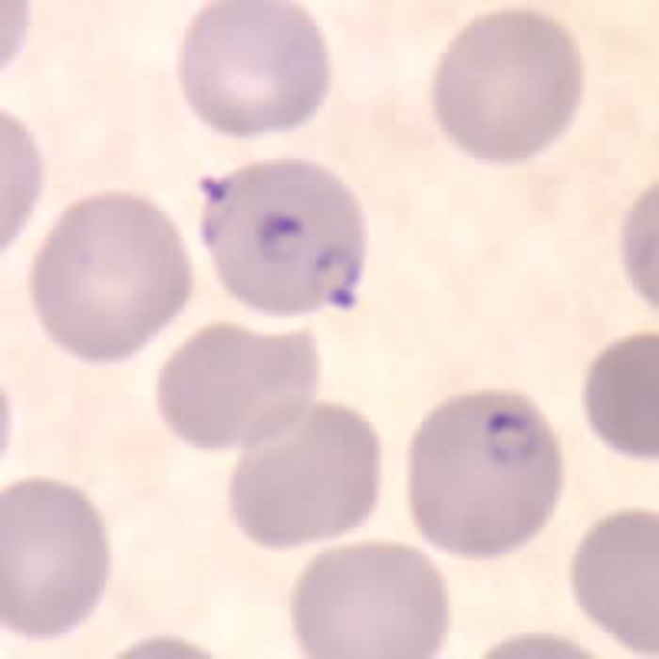
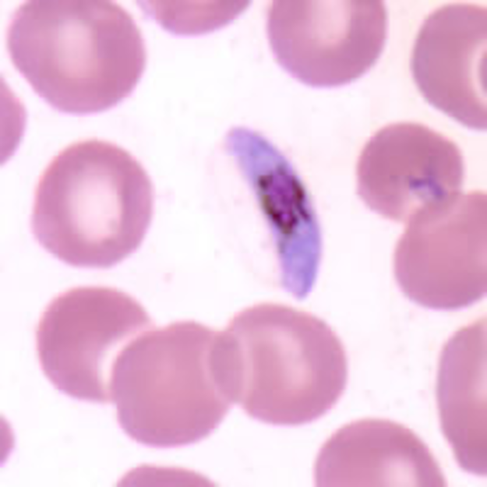
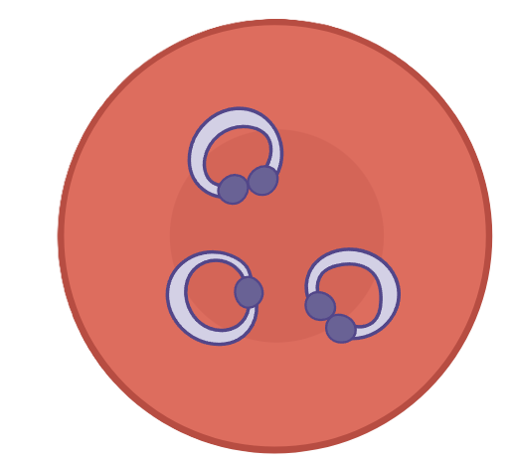
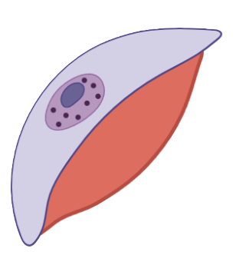
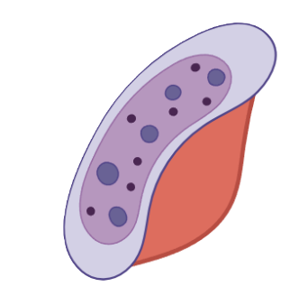


Giemsa stains
Banana-shaped gametocyte (Plasmodium falciparum)
Ring form trophozoites (Plasmodium falciparum)

Slide 19
Clinical
&
Laboratory manifestations

Slide 20
Malaria: Clinical & laboratory manifestations
Typical presentation
Fever and chills
  Often accompanied by headache, myalgias, arthralgias, fatigue/weakness
  “Flu like illness”
Variable: nausea, vomiting, and diarrhea
Severe malaria (often P falciparum)
Altered mental status, seizures, or coma
Hypoglycemia
Acute kidney injury
Pulmonary edema or acute respiratory distress
Severe anemia, jaundice
Shock, or other multiorgan dysfunction
Physical exam
Pallor (from anemia)
Splenomegaly
Jaundice (when severe)
No lymphadenopathy
Labs
Anemia
Thrombocytopenia
↑ bilirubin
Normal/low WBC

Slide 21
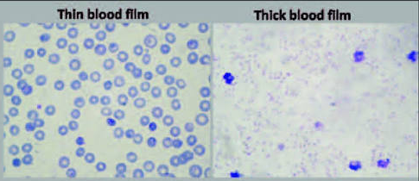

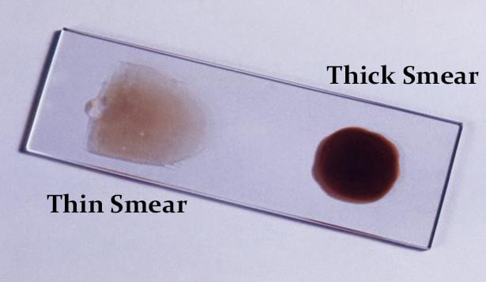

Malaria: Diagnosis
Gold standard: Giemsa-stained thick and thin peripheral blood smears
Thick smear: More sensitive for parasite detection
Thin smear: Identifies Plasmodium species and quantifies parasitemia
Additional diagnostic methods
Rapid antigen-detection tests
Acridine orange fluorescence staining
PCR or other nucleic acid amplification tests
Source
If the initial smear is negative but suspicion remains high, repeat every 12–24 hours for a total of three sets
Source

Slide 22
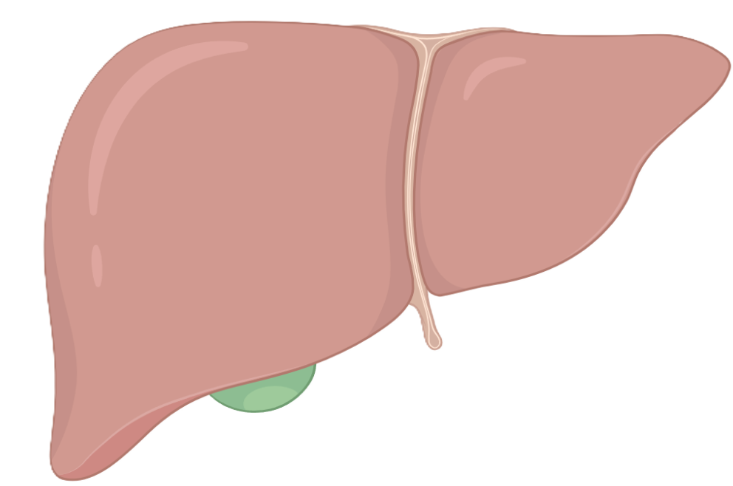
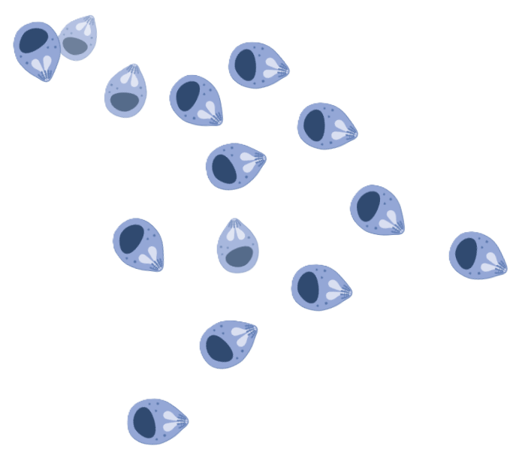
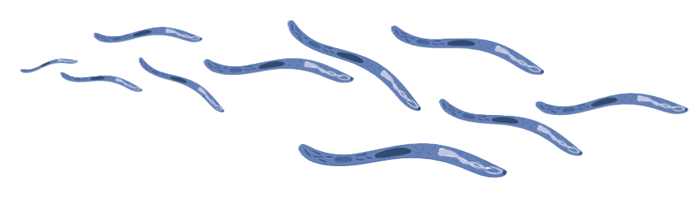
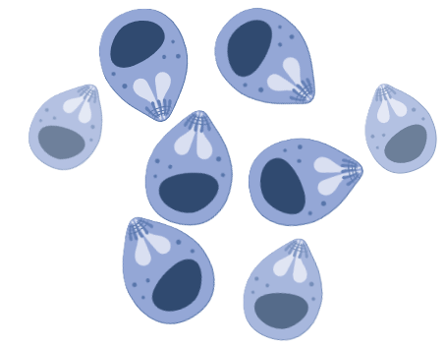
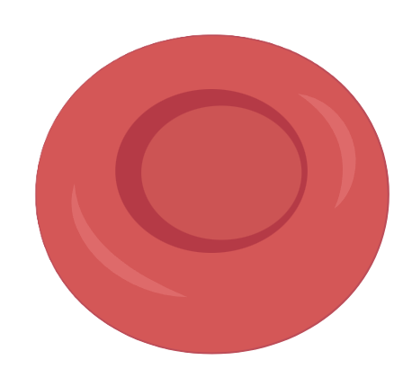
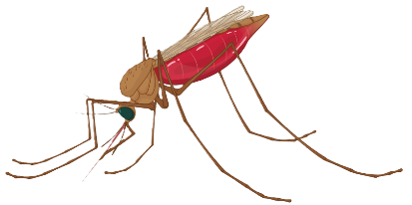
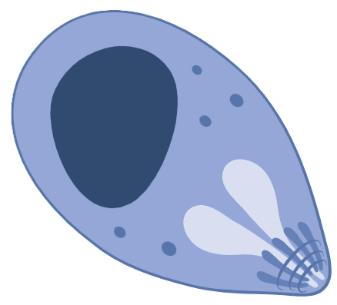

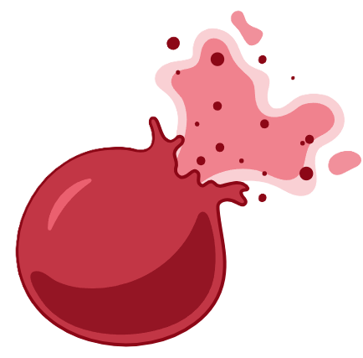
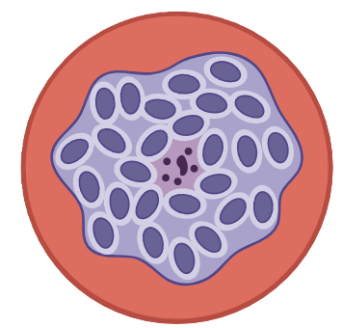
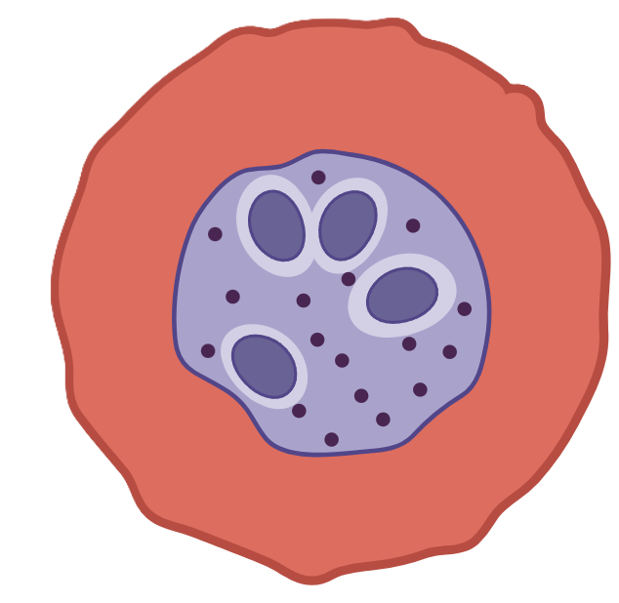
Malaria: Clinical & laboratory manifestations
Incubation period
Asymptomatic until the erythrocytic stage)
erythrocytic stage
Variable by species, climate, genetics
Many with vivax/ovale got ill 90+ days from return (majority before 3 years)
Incubation period typically 1-4 weeks
Incubation period
Should be on DDx if been in an endemic area within past 3 months (esp for falciparum)
Asymptomatic
Infected mosquito bite
2
4
1
3
Infected RBC
Merozoites release
Sporozoites
Merozoites (hepatocytes)
Ring
form
1-3
Exo-erythrocytic cycle
RBC lysis
5
4-6
Erythrocytic cycle
6
Schizont
Trophozoites

Slide 23
Pathogenesis
&
Life cycle

Slide 24
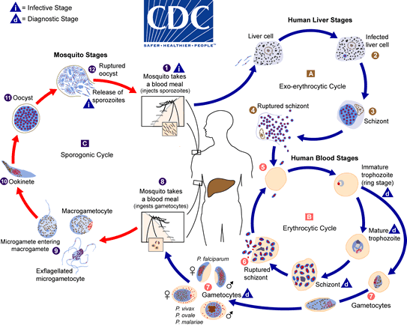

Slide 25


Infected mosquito bite
2
1
Sporozoites
3
Merozoites (+/- hypnozoites)
1-3
Liver / incubation period
Exo-erythrocytic cycle
How I conceptualize the life cycle
When the illness occurs
Blood / “erythrocytic” cycle
Asexual reproduction
Ruptured
RBC
9
4-6
4
Ring
form
6
Infected RBC
7-9
Sexual reproduction
“Sporogonic” cycle
Transmission
5
Gametocytes
Trophozoite
& schizont
8
7

Slide 26
Infected mosquito bite
2
1
Sporozoites
Merozoites (hepatocytes)
3
Merozoites release
A simplified version of the life cycle
Infected mosquito bites → releases sporozoites. These quickly migrate to the liver (hepatocytes)
1
Within hepatocytes, mature into merozoites*
* Not always the case, with P vivax/ovale, more later
4
Ring
form
2
6
Infected RBC
3
Merozoites are released into the blood
4
Merozoites invade healthy RBCs → become ring form
Trophozoites
5
5
Ring form reproduces asexually*, using up lots of the cells resources to make copies
* We will discuss the sexual reproduction in the coming slides
Schizont
6
RBC lysis → Merozoites able to infect more RBCs

Slide 27
Pop quiz:
What resources are y’all using for micro?
(besides this lecture)
Sketchy Microbiology
Anki: AnKing deck
Anki: Pepper deck
Amboss
Boards & Beyond
Something else
Bonus points if someone sends me an updated Sketchy video (:

Slide 28
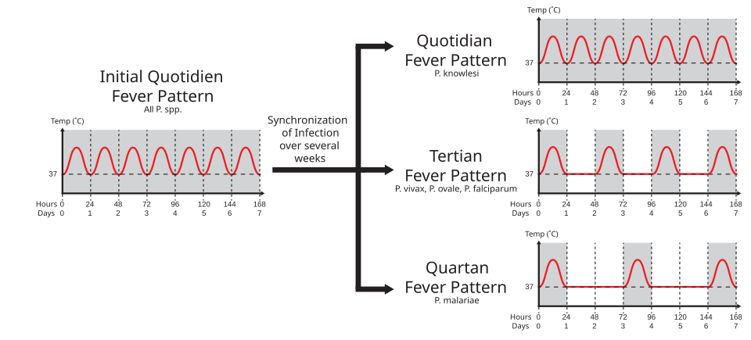
Infected mosquito bite
2
1
Sporozoites
Merozoites (hepatocytes)
3
In the blood (“erythrocytic” cycle)
Merozoites release
Rupture of RBCs (6) accounts for much of symptoms
6
Can have a paroxysmal, cyclical fever pattern
4
Ring
form
6
Infected RBC
Cyclical fevers take weeks to establish, no not a reliable clue
Trophozoites
5
Schizont
Source

Slide 29
Infected mosquito bite
2
1
Sporozoites
Merozoites (hepatocytes)
3
In the blood (“erythrocytic” cycle)
Merozoites release
TNF-α
Rupture of RBCs (6) accounts for much of symptoms
6
Can have a paroxysmal, cyclical fever pattern
  Fevers driven by massive release of cytokines like TNF-α
TNF-α
4
Ring
form
Hemolysis → anemia, ↑ bili
6
Infected RBC
Trophozoites
5
Schizont

Slide 30

Pathogenesis: In the blood (“erythrocytic” cycle)
Rupture of RBCs (6)
Fevers driven by massive release of cytokines like TNF-α
Hemolysis → anemia, ↑ bili
Infected RBCs (4) go to spleen → splenic sequestration
Splenomegaly
↓ Platelets
Splenic rupture
6
4
Duffy antigen & P vivax
Duffy
receptor
P vivax uses the duffy antigen to enter reticulocytes
Duffy neg = ↓↓ rates of P vivax
Duffy (+)
RBC
Duffy (neg)
RBC
5
6
4
TNF-α
Schizont
Trophozoites
Ring form
Infected RBC

Slide 31
Pathogenesis: In the blood (“erythrocytic” cycle)
Rupture of RBCs (6)
Fevers driven by massive release of cytokines like TNF-α
Hemolysis → anemia, ↑ bili
Severe malaria isn’t from hemolysis alone (6), it can can also be from the asexual replication (5)
Infected RBCs (4) go to spleen → splenic sequestration
Splenomegaly
↓ Platelets
Splenic rupture
6
4
6
5
Anaerobic glycolysis by the parasite:
↓ glucose
Lactic acidosis
Duffy neg = ↓↓ rates of P vivax
P falciparum avoids splenic sequestration by cytoadherence to the microvasculature
5
6
4
TNF-α
Schizont
Trophozoites
Ring form
Infected RBC

Slide 32
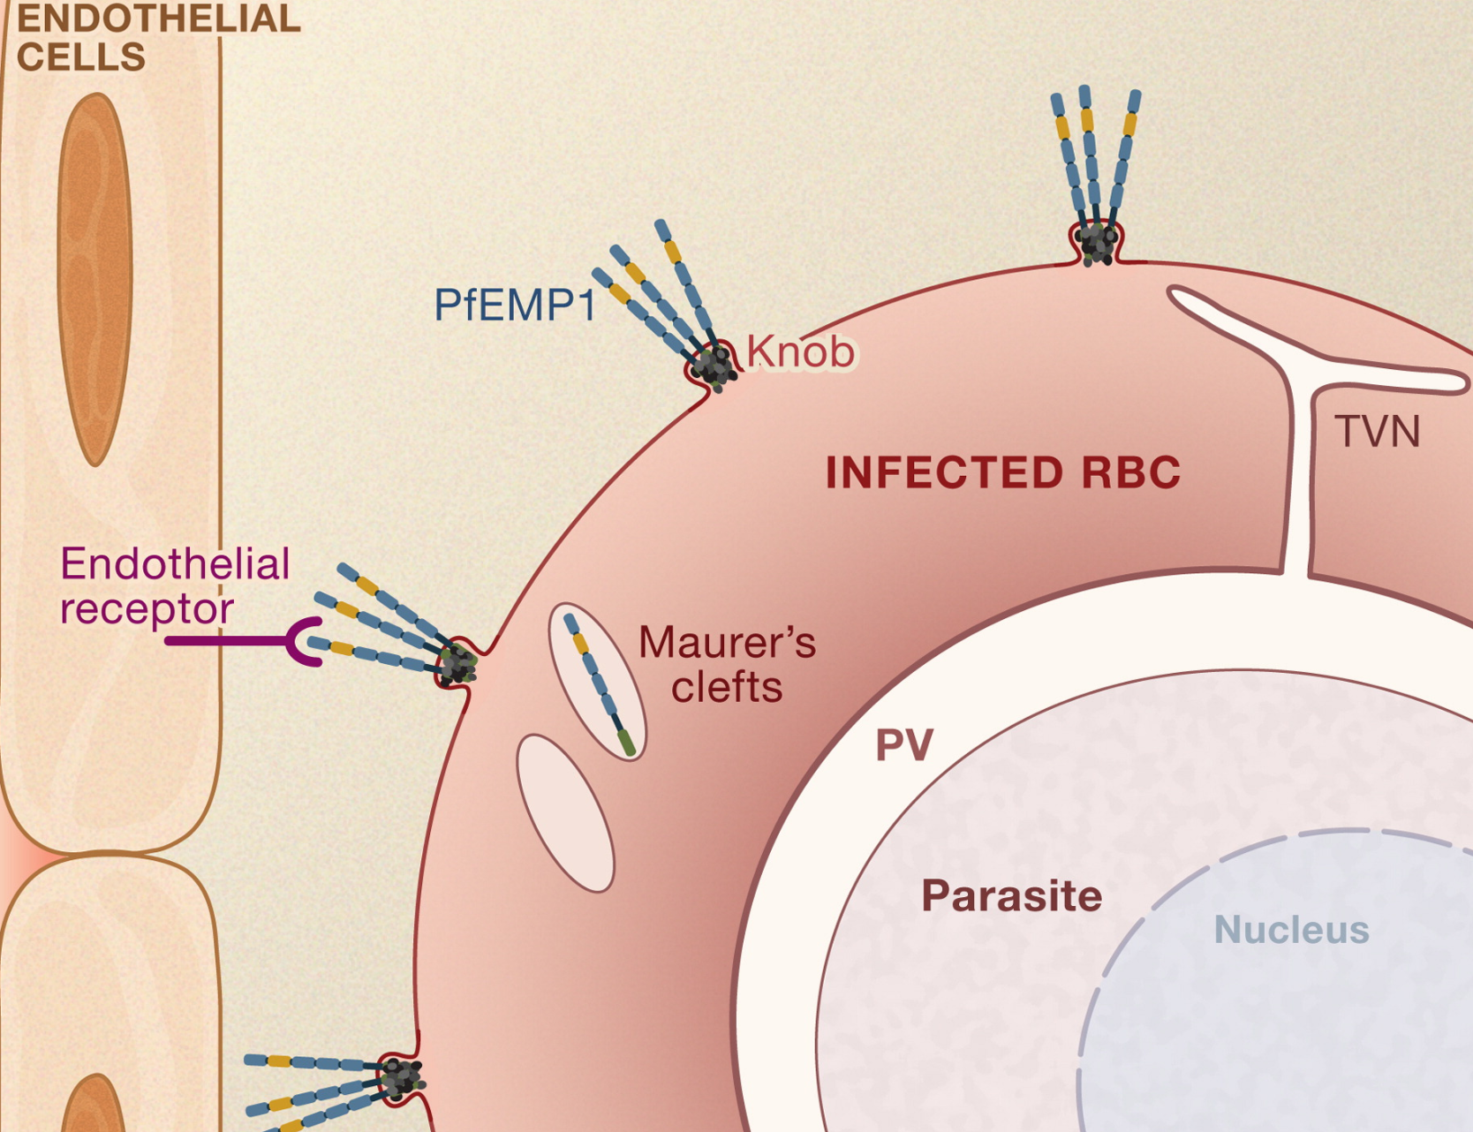
P falciparum: Microvascular cytoadherence
P falciparum evades immune system (splenic sequestration) by cytoadherence to the microvasculature
P. falciparum’s trophozoites produce a polymorphic protein that is expressed on infected RBCs membranes
PfEMP1: Plasmodium falciparum erythrocyte membrane protein 1
Anchors RBCs in the periphery by binding to endothelial receptors in the microvasculature (e.g. ICAM-1)
  Almost mimics leukocyte adhesion (but with RBCs)
These PfEMP1 antigens change substantially each cycle
  Immune system evaded by antigenic variation
4-6
Severe malaria isn’t from hemolysis alone (6), it can can also be from the asexual replication (5)
5
6
Source
5
Schizont
Trophozoites
Ring form

Slide 33
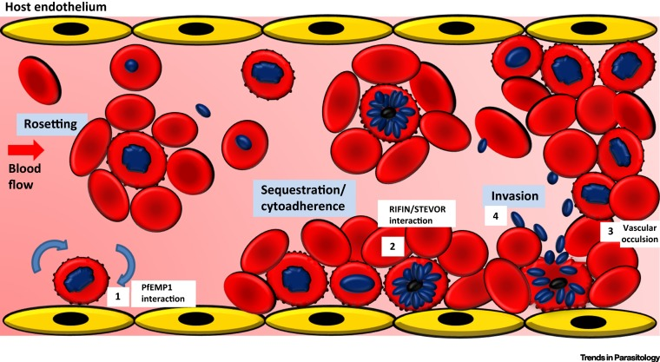
P falciparum: Pathophys of severe malaria
P falciparum evades immune system (splenic sequestration) by cytoadherence to the microvasculature
Infected schizonts bind to uninfected RBCs causing rosetting (big clumps of RBCs)
Clinical manifestations vary based on the site (of the microvasculature):
Brain - neuro Sx, cerebral malaria
Kidneys - Renal failure
Bone marrow - cytopenias
Lungs - respiratory failure
Liver, heart - end organ failure
5
Yam et al (2017)
Schizont
Trophozoites
Ring form

Slide 34
Revisiting: Clinical & laboratory manifestations
Typical presentation
Fever and chills
  Often accompanied by headache, myalgias, arthralgias, fatigue/weakness
  “Flu like illness”
Variable: nausea, vomiting, and diarrhea
Severe malaria (often P falciparum)
Altered mental status, seizures, or coma
Hypoglycemia
Acute kidney injury
Pulmonary edema or acute respiratory distress
Severe anemia, jaundice
Shock, or other multiorgan dysfunction
Fever and chills
TNF-α
Physical exam
Pallor (from anemia)
Jaundice (when severe)
No lymphadenopathy
Labs
Anemia
↑ bilirubin
Normal/low WBC
Anemia
↑ bilirubin
Microvasculature cytoadherence
(P falciparum)
RBC lysis
Splenomegaly
Thrombocytopenia
Splenic sequestration
of infected RBCs

Slide 35

Speaking of callbacks
Host genetics
Sickle cell
An evolutionary trade off from dying of malaria as a kid -vs- dying from sickle cell
HbS “sickles” in periphery → ↓ parasite growth in peripheral vessels
Also disrupts PfEMP-1 → ↓ cytoadherence
The pathogen
Plasmodium
Geography
Climate
Similar dynamic with thalassemias
Coevolution
Malaria developed PfEMP1 to evade immune system
What did humans do?
Mosquitos
The vector
Humans
The reservoir

Slide 36
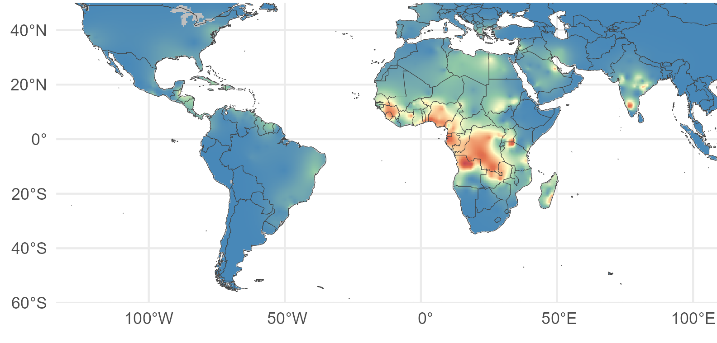
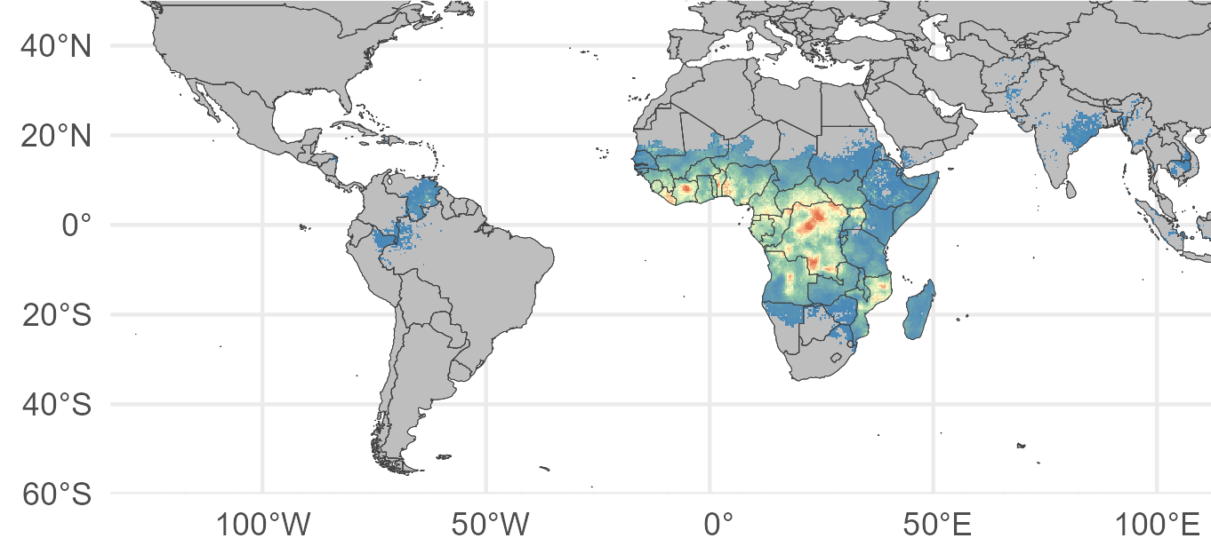
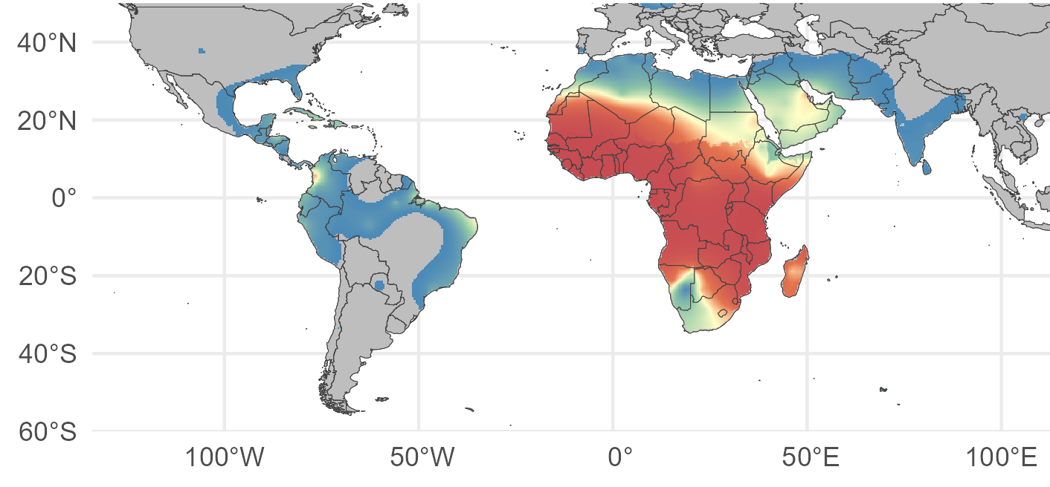
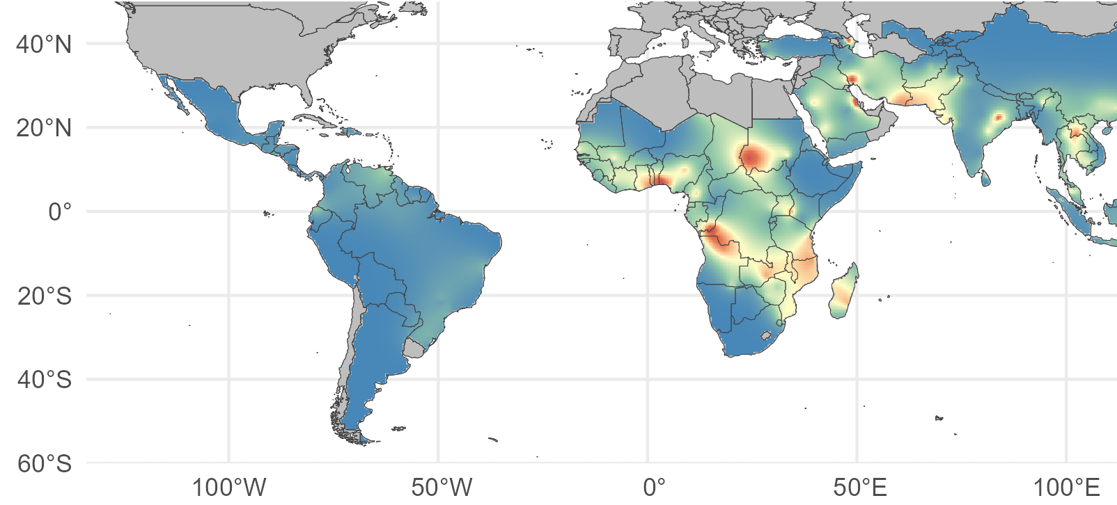
Infected mosquito bite
Host genetics
Host genetics: evolutionary trade offs
Sickle cell
An evolutionary trade off from dying of malaria as a kid -vs- dying from sickle cell
P.falciparum prevalence (2020)
HbS “sickles” in periphery → ↓ parasite growth in peripheral vessels
Also disrupts PfEMP-1 → ↓ cytoadherence
HbS allele freq (2012)
Similar dynamic with thalassemias
Duffy negative phenotype (2012)
G6PD allele freq (2012)

Slide 37
Infected mosquito bite
2
1
Sporozoites
Merozoites (hepatocytes)
3
9
Merozoites release
Lots of steps here to become a bunch of sporozoites
again
Process is fastest in warmer climates
1-3
Exo-erythrocytic cycle
4-6
Erythrocytic cycle (asexual)
7-9
Sexual reproduction & Sporogonic cycle
4
Ring
form
6
Infected RBC
Transmission
Trophozoites
5
Schizont
Mosquito ingests ♂ & ♀ gametocytes from infected human
8
7
Gametocytes

Slide 38
Case #2

Slide 39
Case 2
A 25M WVU student traveled home to India for holidays after staying in US for 3 years
He was seen in ED, where he was found to have:
Low WBC of 3.5 (lower limit normal: 3.7)
Low platelet count of 90 (LLN: 150)
Hemoglobin had dropped to 11g
Splenomegaly
He was told he could have leukemia
Within 4 months of his return to Morgantown, he developed fever & chills
What additional history would you like?
What additional laboratory data would you obtain?

Slide 40
Most likely way this patient acquired his infection?
Bite of an infected female Anopheles mosquito
Tick bite
Blood transfusion with infected RBCs
Reactivation of dormant hepatic P falciparum
Relapse from dormant hepatic P vivax or P ovale

Slide 41
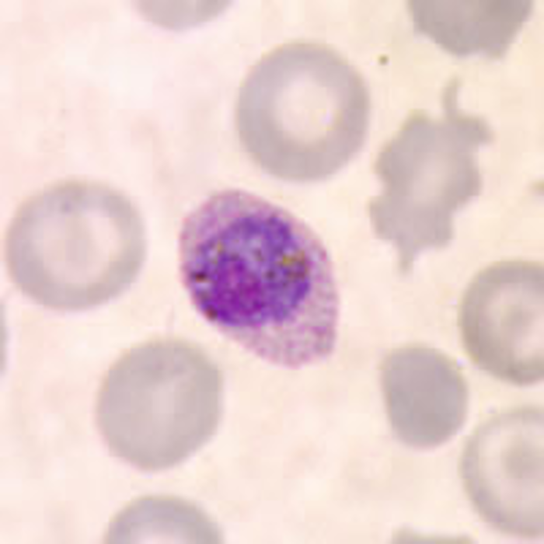
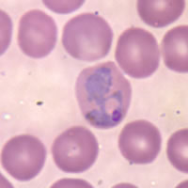
Giemsa stains
Plasmodium vivax (trophozoite)
Plasmodium ovale (trophozoite)

Slide 42
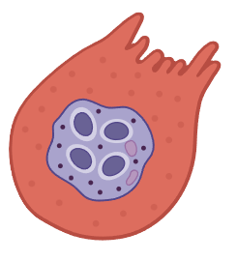
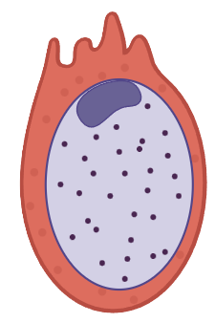
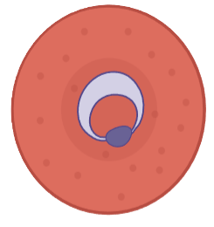
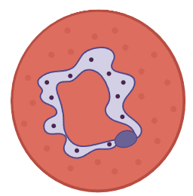
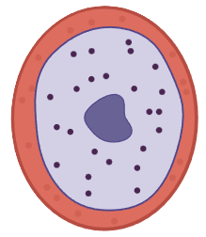
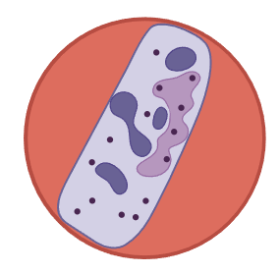
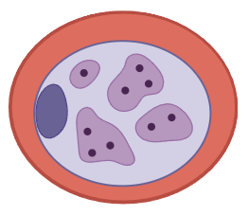
 | RBC size | Ring form Rings per RBC | Trophozoite | Gametocyte
P falciparum | Normal | Can be multiple | Frequently not seen on smear (sequestered in the periphery) | Elongated “banana shaped”
P ovale | Enlarged | Single ring | Ragged edges More oval shaped* | Ragged edges More oval shaped*
P vivax | Enlarged | Single ring | Ameboid shaped * Can also be oval shaped | * Can also be oval shaped
P malariae | Normal | Single ring | Band shaped

Slide 43
 | RBC size | Ring form Rings per RBC | Trophozoite | Gametocyte
P falciparum | Normal | Can be multiple | Frequently not seen on smear (sequestered in the periphery) | Elongated “banana shaped”
P ovale | Enlarged | Single ring | Ragged edges More oval shaped* | Ragged edges More oval shaped*
P vivax | Enlarged | Single ring | Ameboid shaped * Can also be oval shaped | * Can also be oval shaped
P malariae | Normal | Single ring | Band shaped

Slide 44
 | RBC size | Ring form Rings per RBC | Trophozoite | Gametocyte
P falciparum | Normal | Can be multiple | Frequently not seen on smear (sequestered in the periphery) | Elongated “banana shaped”
P ovale | Enlarged | Single ring | Ragged edges More oval shaped* | Ragged edges More oval shaped*
P vivax | Enlarged | Single ring | Ameboid shaped * Can also be oval shaped | * Can also be oval shaped
P malariae | Normal | Single ring | Band shaped
Ring form
Trophozoites
Gametocytes

Slide 45
What do I need to know about each species?
 | P Falciparum | P vivax & ovale | P Malariae
Which RBCs? | Infect RBC’s of all ages | Only young RBC’s (reticulocytes) | Only Mature RBC’s
Severity
Peripheral sequestration? | Yes (part of why is Fatal in up to 30% of cases) | No (less deadly)
Immune factors | Severe disease if no immunity (children, pregnancy, travel) | Hypnozoites → Late relapses | Low grade infection (can persist >40 years) → immune complex → glomerulonephritis
Geography | All of them are in the tropics (with great overlap) so do not rule out based on geography alone
Slight preferences | Sub-Saharan Africa | Everywhere else

Slide 46
What if he didn’t travel anywhere internationally?
Bite from Anopheles mosquito in Florida
Ixodes tick bite
Drinking unpurified water from a river
Blood transfusion with infected RBCs
Sexual exposure
Domestic air travel
What other ways can malaria (and its domestic mimics) be transmitted?

Slide 47
Aside: Malaria & Babesia are very similar
 | Malaria (Plasmodium spp) | Babesiosis (Babesia microti)
Pathophys | Infected RBC → hemolysis
Transmitted by | Anopheles mosquito spp | Ixodes tick (just like Lyme)
Geography | Tropics: Sub-Saharan Africa, Oceana, Central America, S/SE Asia | USA: Northeast (inc WV), west coast, great lakes
Diagnosis | Blood smear (thick & thin) showing pathogens in RBCs
Clinical presentation | Mild: flu-like illness (fevers/chills/myalgia), can be asymptomatic Moderate: Hemolytic anemia (↓ Hgb, ↑ bili), ↓ Plts, splenomegaly Severe: end organ damage (kidney, lungs, brain)
Who is at greatest risk? | Children Pregnancy Travelers | Asplenia Immunocompromise

Slide 48
How life cycle
informs treatment
Not a joke about pharmacology

Slide 49
Infected mosquito bite
2
1
Sporozoites
3
Merozoites (+/- hypnozoites)
1-3
Liver / incubation period
Exo-erythrocytic cycle
How I conceptualize the life cycle
When the illness occurs
Blood / “erythrocytic” cycle
Asexual reproduction
Ruptured
RBC
9
4-6
4
Ring
form
6
Infected RBC
7-9
Sexual reproduction
“Sporogonic” cycle
Transmission
5
Gametocytes
Trophozoite
& schizont
8
7

Slide 50
Infected mosquito bite
P. vivax & P. ovale can go dormant (called hypnozoites), allowing for relapses
2
2
1
Sporozoites
3
Merozoites (+/- hypnozoites)
The liver cycle (“exo-erythrocytic” cycle)
Infected mosquito bites → sporozoites go to liver where they (2) mature into merozoites* within hepatocytes
1
2
Only some drugs work hepatocytes, others only work on the blood
* P vivax & P ovale can hibernate in hepatocytes (hypnozoites = “sleeper cell”)
Can cause relapse weeks (sometimes years) later
Must use specific drugs to kill hypnozoites (primaquine)
3
Merozoites are released into the blood
It is only at this point that symptoms develop (incubation period: 1-4 wk)

Slide 51
Treatment algorithm
Severe malaria (any species)
AMS, seizures, or CNS disease
Acute kidney injury
Pulmonary edema / ARDS
Severe anemia, jaundice
Shock / DIC
Parasitemia >5% on blood smear
Finish with primaquine to kill hypnozoites
Severe disease?
Yes
IV artesunate
G6PD testing first!!
Improves
Yes
No
Uncomplicated malaria
generally use combination therapy
Treat the blood first
Artemether–lumefantrine
Prefered due to ↓ resistance
“Broad spectrum” including for P. Falciparum
Dormant liver hypnozoites?
Only Vivax/Ovale?
Alternate agents
Other ATCs
Nope
(e.g. P. falciparum)
ATC (artemisinin combo therapy)
Combination meds that start with “Art”
artemether + lumefantrine
artesunate + mefloquine
Atovaquone-Proguanil
Chloroquine only if from a chloroquine sensitive area (or P vivax)
Nothing else is needed!

Slide 52



Prophylaxis choices
Medication | Pro | Con | Pregnancy?
Atovaquone-Proguanil (Malarone) | Tolerated well | More expensive (for long trips) | ✔
Doxycycline | Cheap | Photosensitivity (sunscreen) | X
Mefloquine | Weekly | Neuropsychiatric issues Need to start >2 weeks before | ✔
Chloroquine | Weekly | Only useful in chloroquine-sensitive areas | ✔

Slide 53
Recap

Slide 54
Learning Objectives
Recognize the importance of considering Malaria in any febrile illness in a returning traveler
Understand life cycle and pathogenesis
Identify drugs used for prevention and treatment

Slide 55
Clinical & laboratory manifestations
TNF-α
Typical presentation
Fever and chills
  Often accompanied by headache, myalgias, arthralgias, fatigue/weakness
  “Flu like illness”
Variable: nausea, vomiting, and diarrhea
Severe malaria (often P falciparum)
Altered mental status, seizures, or coma
Hypoglycemia
Acute kidney injury
Pulmonary edema or acute respiratory distress
Severe anemia, jaundice
Shock, or other multiorgan dysfunction
Fever and chills
Physical exam
Pallor (from anemia)
Jaundice (when severe)
No lymphadenopathy
Labs
Anemia
↑ bilirubin
Normal/low WBC
Anemia
↑ bilirubin
RBC lysis
Microvasculature cytoadherence
(P falciparum)
Splenomegaly
Thrombocytopenia
Splenic sequestration
of infected RBCs

Slide 56
Female Anopheles mosquito
P. vivax & P. ovale can go dormant (called hypnozoites), allowing for relapses
2
1
Sporozoites
Merozoites (hepatocytes)
3
Merozoites release
A simplified version of the life cycle
Infected mosquito bites → releases sporozoites. These quickly migrate to the liver (hepatocytes)
1
Within hepatocytes, mature into merozoites*
* P vivax/ovale, can become latent (hypnozoites) and cause a relapse late on
4
Ring
form
2
6
Infected RBC
3
Merozoites are released into the blood
4
Merozoites invade healthy RBCs → become ring form
Trophozoites
5
5
Ring form reproduces asexually*, using up lots of the cells resources to make copies
* Or can become gametocyte
Schizont
6
RBC lysis → Merozoites able to infect more RBCs

Slide 57
 | RBC size | Ring form Rings per RBC | Trophozoite | Gametocyte
P falciparum | Normal | Can be multiple | Frequently not seen on smear (sequestered in the periphery) | Elongated “banana shaped”
P ovale | Enlarged | Single ring | Ragged edges More oval shaped* | Ragged edges More oval shaped*
P vivax | Enlarged | Single ring | Ameboid shaped * Can also be oval shaped | * Can also be oval shaped
P malariae | Normal | Single ring | Band shaped
Ring form
Trophozoites
Gametocytes

Slide 58
What do I need to know about each species?
 | P Falciparum | P vivax & ovale | P Malariae
Which RBCs? | Infect RBC’s of all ages | Only young RBC’s (reticulocytes) | Only Mature RBC’s
Severity
Peripheral sequestration? | Yes (part of why is Fatal in up to 30% of cases) | No (less deadly)
Immune factors | Severe disease if no immunity (children, pregnancy, travel) | Hypnozoites → Late relapses | Low grade infection (can persist >40 years) → immune complex → glomerulonephritis
Geography | All of them are in the tropics (with great overlap) so do not rule out based on geography alone
Slight preferences | Sub-Saharan Africa | Everywhere else

Slide 59
Treatment algorithm
Severe malaria (any species)
AMS, seizures, or CNS disease
Acute kidney injury
Pulmonary edema / ARDS
Severe anemia, jaundice
Shock / DIC
Parasitemia >5% on blood smear
Finish with primaquine to kill hypnozoites
Severe disease?
Yes
IV artesunate
G6PD testing first!!
Improves
Yes
No
Uncomplicated malaria
generally use combination therapy
Treat the blood first
Artemether–lumefantrine
Prefered due to ↓ resistance
“Broad spectrum” including for P. Falciparum
Dormant liver hypnozoites?
Only Vivax/Ovale?
Alternate agents
Other ATCs
Nope
(e.g. P. falciparum)
ATC (artemisinin combo therapy)
Combination meds that start with “Art”
artemether + lumefantrine
artesunate + mefloquine
Atovaquone-Proguanil
Chloroquine only if from a chloroquine sensitive area (or P vivax)
Nothing else is needed!

Slide 60
Prophylaxis choices
Medication | Pro | Con | Pregnancy?
Atovaquone-Proguanil (Malarone) | Tolerated well | More expensive (for long trips) | ✔
Doxycycline | Cheap | Photosensitivity (sunscreen) | X
Mefloquine | Weekly | Neuropsychiatric issues Need to start >2 weeks before | ✔
Chloroquine | Weekly | Only useful in chloroquine-sensitive areas | ✔

Slide 61
Answers to MentiMeter questions
(will be uploaded afterwards)

Slide 62
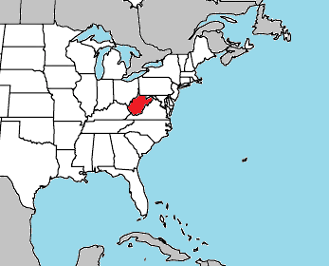
In the past 5 years, where was the closest locally acquired malaria case?
Maryland (2023)

Slide 63
Most likely way case #2 acquired his infection?
Bite of an infected female Anopheles mosquito
Tick bite - Not how malaria is transmitted
Blood transfusion with infected RBCs - Possible
Reactivation of dormant hepatic P falciparum - not part of falciparum life cycle
Relapse from dormant hepatic P vivax or P ovale - hypnozoite relapse

Slide 64
What if case 2 didn’t travel anywhere internationally?
What other ways can malaria (and its domestic mimics) be transmitted?
Bite from Anopheles mosquito in Florida - “Autochthonous” malaria
Ixodes tick bite - Can cause babesia
Drinking unpurified water from a river - That’s Giardiasis
Blood transfusion with infected RBCs - Malaria or Babesia
Sexual exposure - Neither are spread that way
Domestic air travel - “Airport” malaria

