Slide 1
Healthcare Epidemiology
Hunter Ratliff, MD, MPH
09/03/2026
I have no conflict of interest in relation to this presentation
These fictionalized composites cases are heavily based on real epidemiological principles, historical outbreaks, and my own clinical experiences, but no actual patient cases, true outbreaks, or other identifying information are presented here. Views & opinions are my own

Slide 2





What do I do?

Slide 3







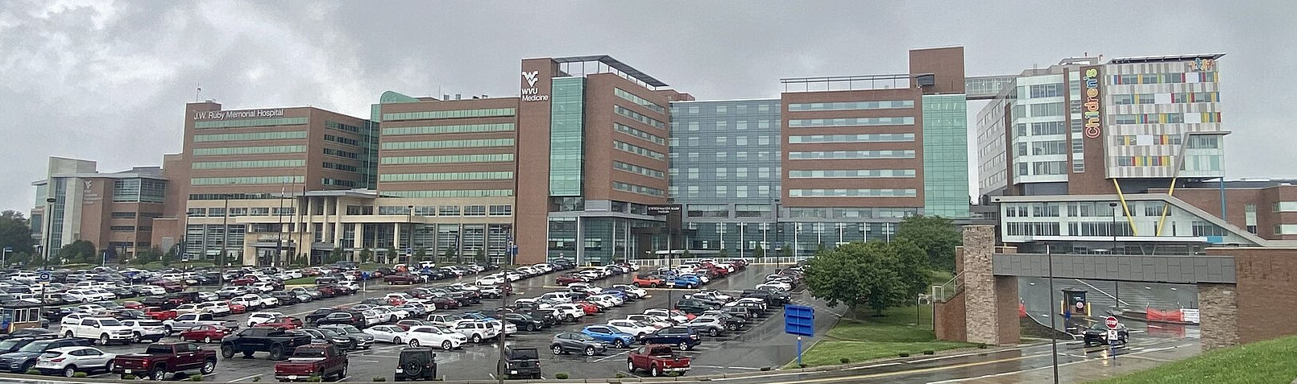
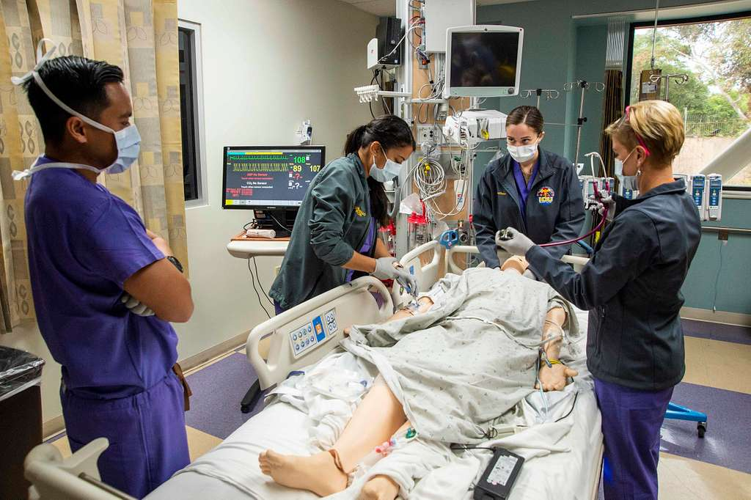
Infectious Disease Physician
Healthcare Epidemiologist
The "Patient": One person at a time
The goal: Diagnose & cure
The "Patient": Entire hospital
The Goal: Prevent and protect
(1,000+ patients & staff)
picryl.com
Wikipedia

Slide 4

Infectious Disease Physician
Healthcare Epidemiologist
The "Patient": One person at a time
The goal: Diagnose & cure
The "Patient": Entire hospital
The Goal: Prevent and protect
(1,000+ patients & staff)
I am the consultant other doctors call when a patient has a rare, stubborn, or complex infection(s)
Can be anything from mysterious fevers & tropical diseases to severe infections (of the heart, brain, bones, bloodstream)
I use public health principles to stop infections from spreading within the healthcare system
Often these are healthcare-associated infections, but also involves measles, TB, respiratory virus, diarrheal illnesses
And I do a little bit of teaching
(including right now!)

Slide 5
Infectious Disease Physician
Diagnose & treat one patient
Healthcare Epidemiologist
Prevent & protect entire hospital
Myth: I spend my time in a lab
Most of the time is interviewing and examining patients at the bedside
We have excellent microbiology techs that are far better than me in the lab
Myth: It’s a lot of spreadsheets
There are some spreadsheets, but that’s the easy part
The fun (and hard) part is translating the data & evidence into policy → changing behavior
Fact: Most of both jobs are lots of talking to people, synthesizing data, & making
shared decisions based off my findings
Asking strangers fun questions:
Sex, drugs, & rock & roll
Pets, outdoor activities
Travel, hobbies/work
Cut down any trees recently?
How long should we use the antibiotics? (for super-bugs)
How do we safely do construction on the transplant unit without exposing patients? Or do we need to shut it down?
Am I worried about TB enough
to keep a patient in isolation?

Slide 6
How I got here
Spoiler alert:
Luck chance
was involved

Slide 7

My path here: Undergrad
Somehow selected biochemistry as my major, of which I recall very little of now, unlike…
Minor #1: Started as computer science (this was a decade before ChatGPT)
Really liked the data science aspect
Dropped this minor to focus on social sciences
Minor #2: Psychology → sociology
Sociology Of Health introduced me to the “public health lens”
Applied to medical school
Wanted to do psychiatry
Backup plan was grad school (MPH or biostatistics)

Slide 8
My path here: Med school / MPH
Initially wanted to do psychiatry
Microbiology was one of my least favorite portions of med school
Fell in love with the clinical aspect of infectious diseases
Very similar detective work to public health
-- AND --
Had enough interest in public health sphere to do a MPH too
But: I wanted to do chronic disease &/or addiction epidemiology
Started my MPH…
…in the Fall of (COVID-)19…

Slide 9
My path here: After school
ID physician
Academic medicine
How can I merge these two?
Will I see my impact?
Population health
EIS fellowship?
Epidemic Intelligence Service (CDC)
Work at CDC / other health department?
Funding
Politics
Competitive

Slide 10

My path here: After school
ID physician
Academic medicine
How can I merge these two?
I see the impact every day
Population health
I am my own “health department”
Funding is a little more reliable
Politics still exist, but more local

Slide 11
My path here: The role of luck
Admissions Lottery
Acceptance to medical school involves a large degree of chance
There are other paths besides being a physician
An admissions decision is not a measure of your worth
Right Mentors
If my wife didn’t have to re-apply to residency, I wouldn’t have ended up here
I did not know healthcare epidemiology was a thing until I came here
MD Safety Net
Being a healthcare provider provides immense job security (especially MD/DO)
Public health is highly rewarding, but notoriously underfunded
Systemic Privilege
Per Executive Order No. 3-25, you’ll have to take some sociology classes to see what I mean 😉
See: “Social Determinants of Health”
Plan B
My path is the most technically difficult. Consider NP, PA, MHA, MBA, PhD etc
If doing a standalone MPH
Pair a MPH with something else (nursing, data science, administration) gives job security and makes you a far better candidate

Slide 12
My path here: The role of luck
After discovery of antibiotics
Sanitation, vaccines
Democracy
Economically developed country
  Good taxpayer funded K-12
Born as a human (hard to get a job if not human)
Past performance is no guarantee of future societal progress. Institutions, infrastructure, and public goods subject to change
(if we all don’t put in the effort)

Slide 13
How can you get here?
There are multiple paths
MD+MPH paired with infectious diseases was my path
But I had no idea that would be my path
MPH is probably a good idea
Pair it with something else (does not have to be MD)
Be strategic, but open minded (would have not guessed I would love ID as much as I do)
Learn about the field & develop mentors!
The Society for Healthcare Epidemiology of America (SHEA) is a great resource for healthcare epidemiology

Slide 14


Practical Disease Transmission

Slide 15
Which news story keeps me up at night?
Ebola
Hantavirus
Measles
Cyclospora (Taco Bell)
COVID-19
Influenza

Slide 16

Which news story keeps me up at night?

Slide 17
Case #1

Slide 18
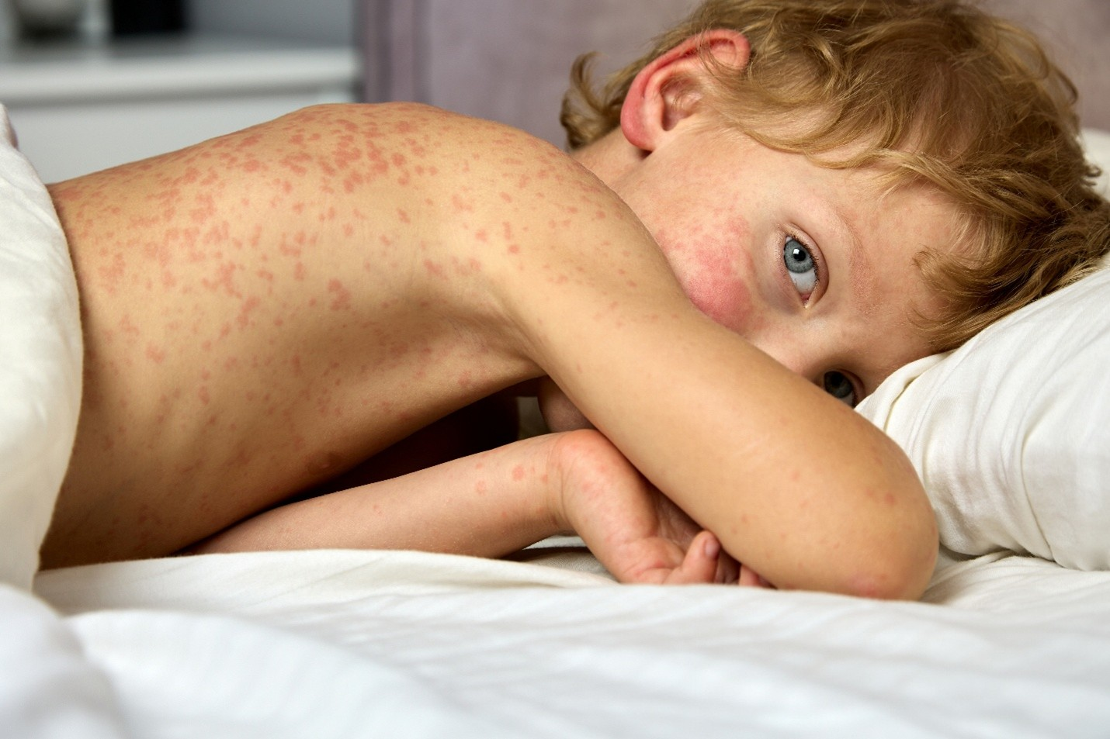
Case 1: The scenario
A 5-year-old unvaccinated child returns from international travel and develops a fever, cough, red eyes, and a rash
The parents take them to your hospital's packed pediatric urgent care. The child sits in the waiting room for 45 minutes, is seen in Exam Room 3, and gets discharged home
The next day, the state health department calls you: the child's swab came back positive for measles
familydoctor.org

Slide 19
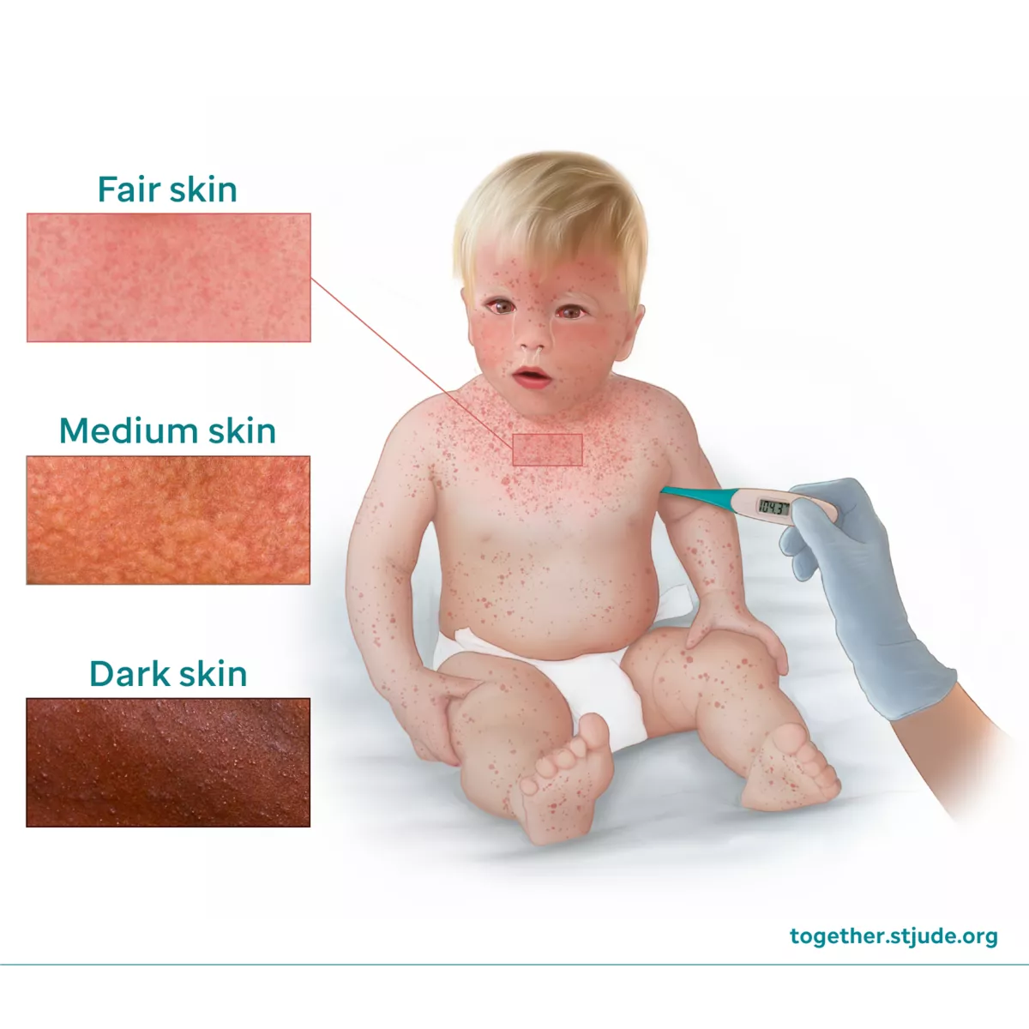
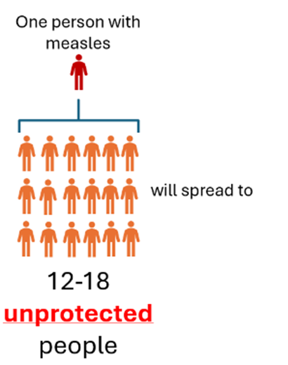
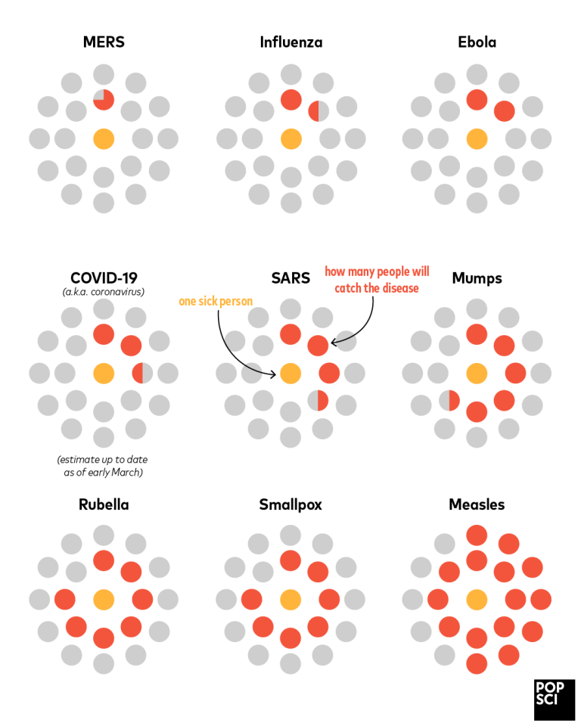
Case 1: The virus
Measles is one of the most contagious diseases that infects humans (R₀ around 15)
R naught (R₀) is the average number of people who will catch a disease from one single infected person (in a totally non-immune group)
R₀ < 1 → Disease slowly fades away
R₀ = 1 → Stays stable (influenza is 1-2)
R₀ > 1 → Can become widespread → epidemic
sbm.org
Adapted from popsci.org

Slide 20


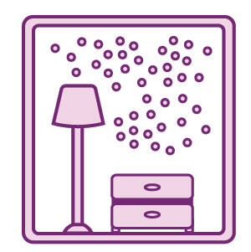
Case 1: Transmission in the air
Measles is spread via coughing and sneezing
Measles is unique in that the virus can survive in the air for up to two hours
Referred to as “airborne” transmission (also the case for tuberculosis [TB] and varicella [chickenpox/shingles])
CDC
CDC

Slide 21
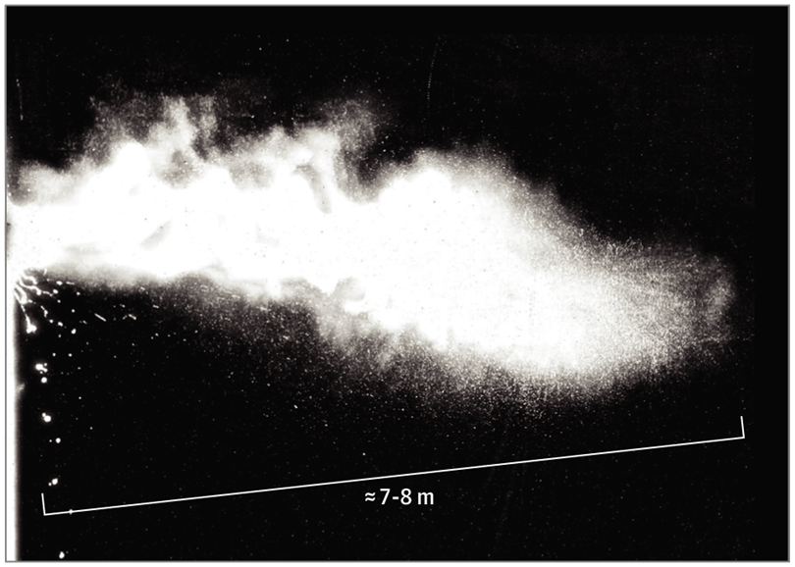
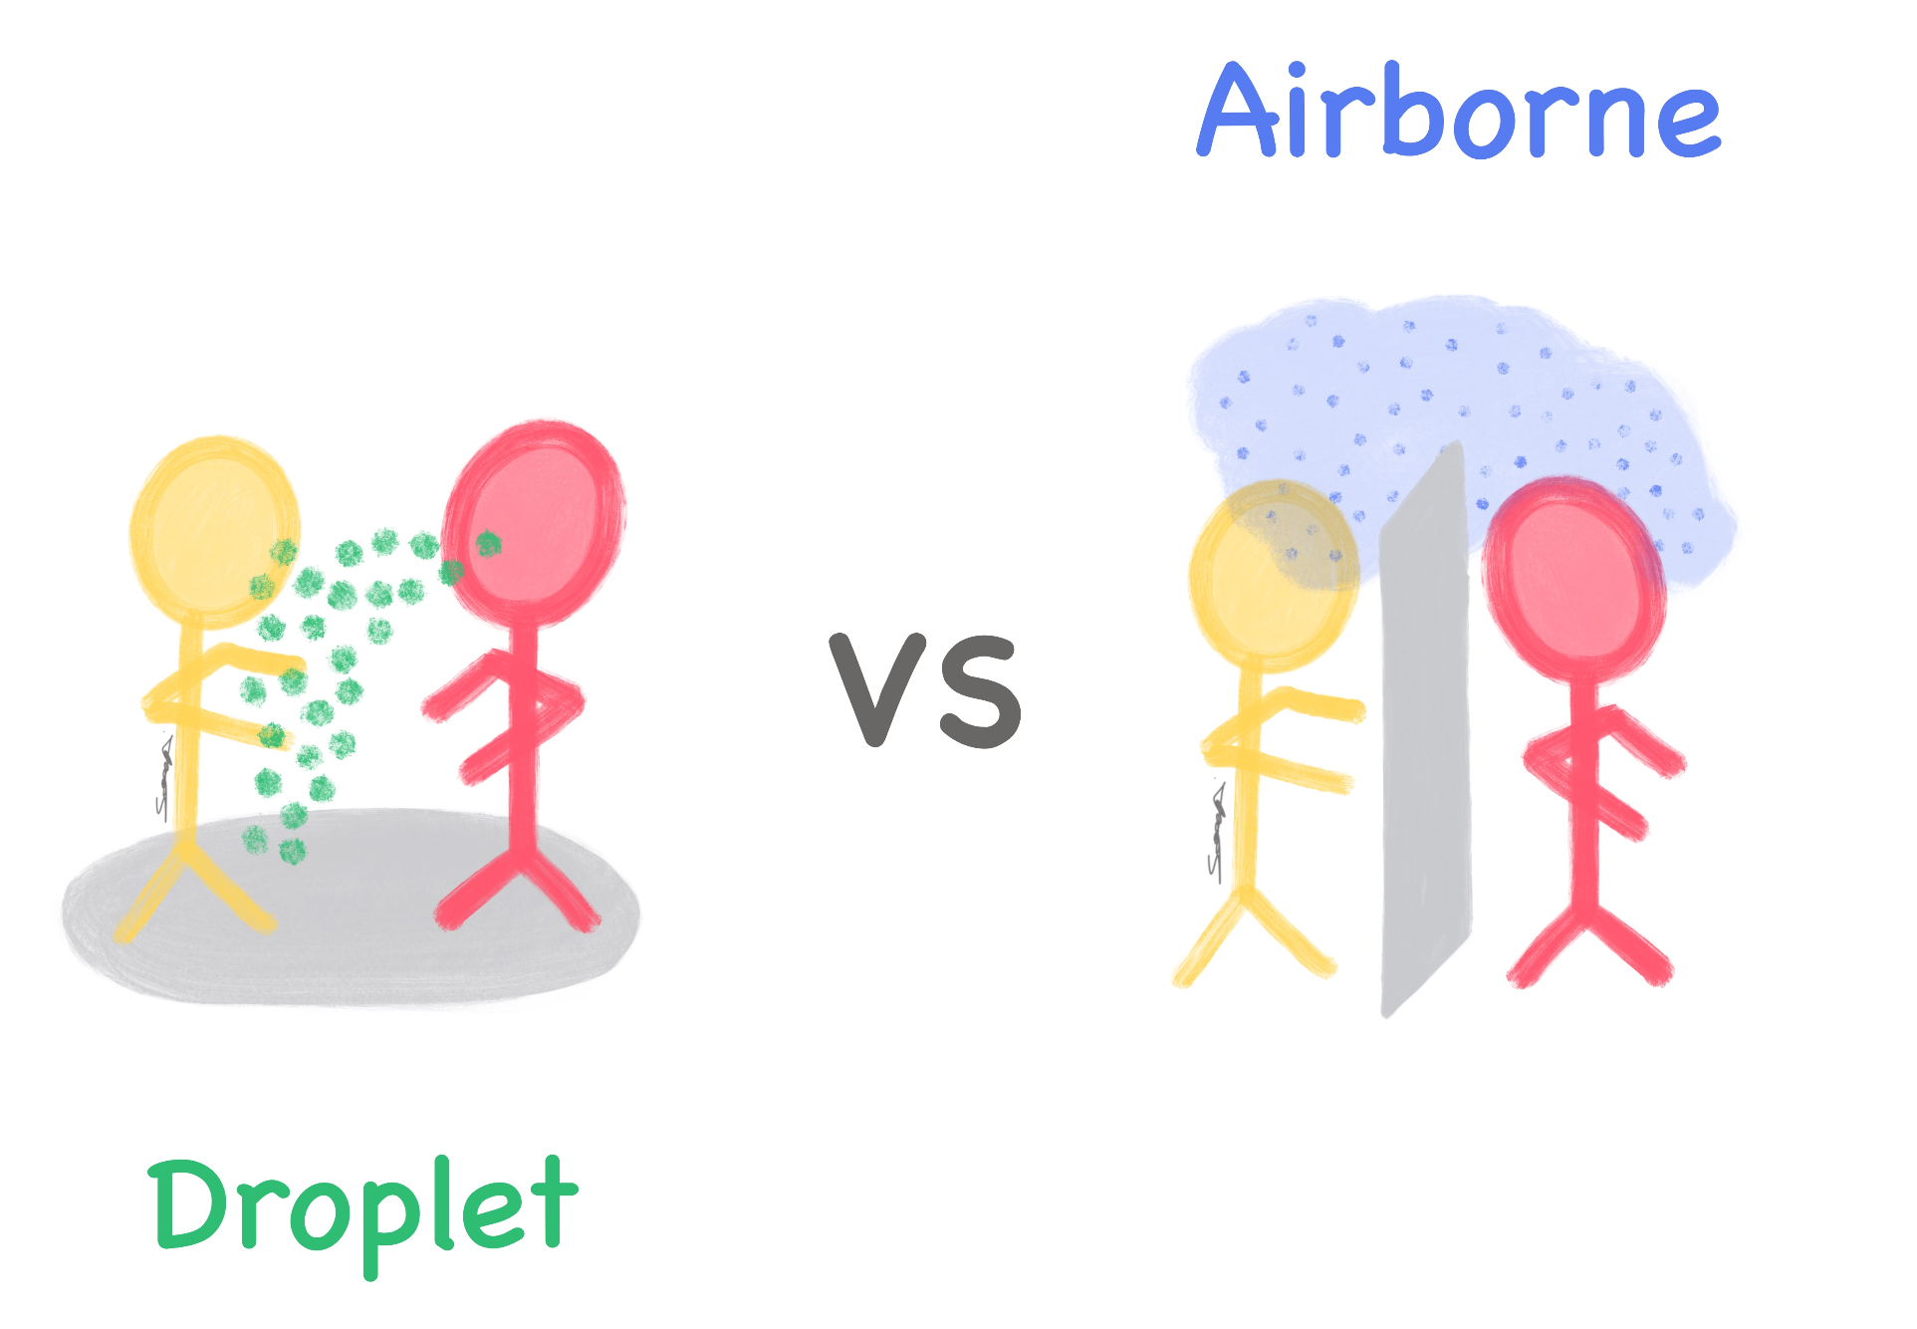
Case 1: Transmission in the air
Turbulent Gas Cloud From a Human Sneeze (Bourouiba, 2020)
Measles is spread via coughing and sneezing
Measles is unique in that the virus can survive in the air for up to two hours
Referred to as “airborne” transmission (also the case for tuberculosis [TB] and varicella [chickenpox/shingles])
Compared with “droplet” (for most other respiratory infections)
CDC
Droplet ("cannonballs")
Large respiratory drops (>5 µm)
Heavier → fall to the floor w/in 6 ft
Airborne ("floaters")
Tiny droplet nuclei (less than 5 µm)
Evaporate → stay in the air
TheScrubNurse.com

Slide 22
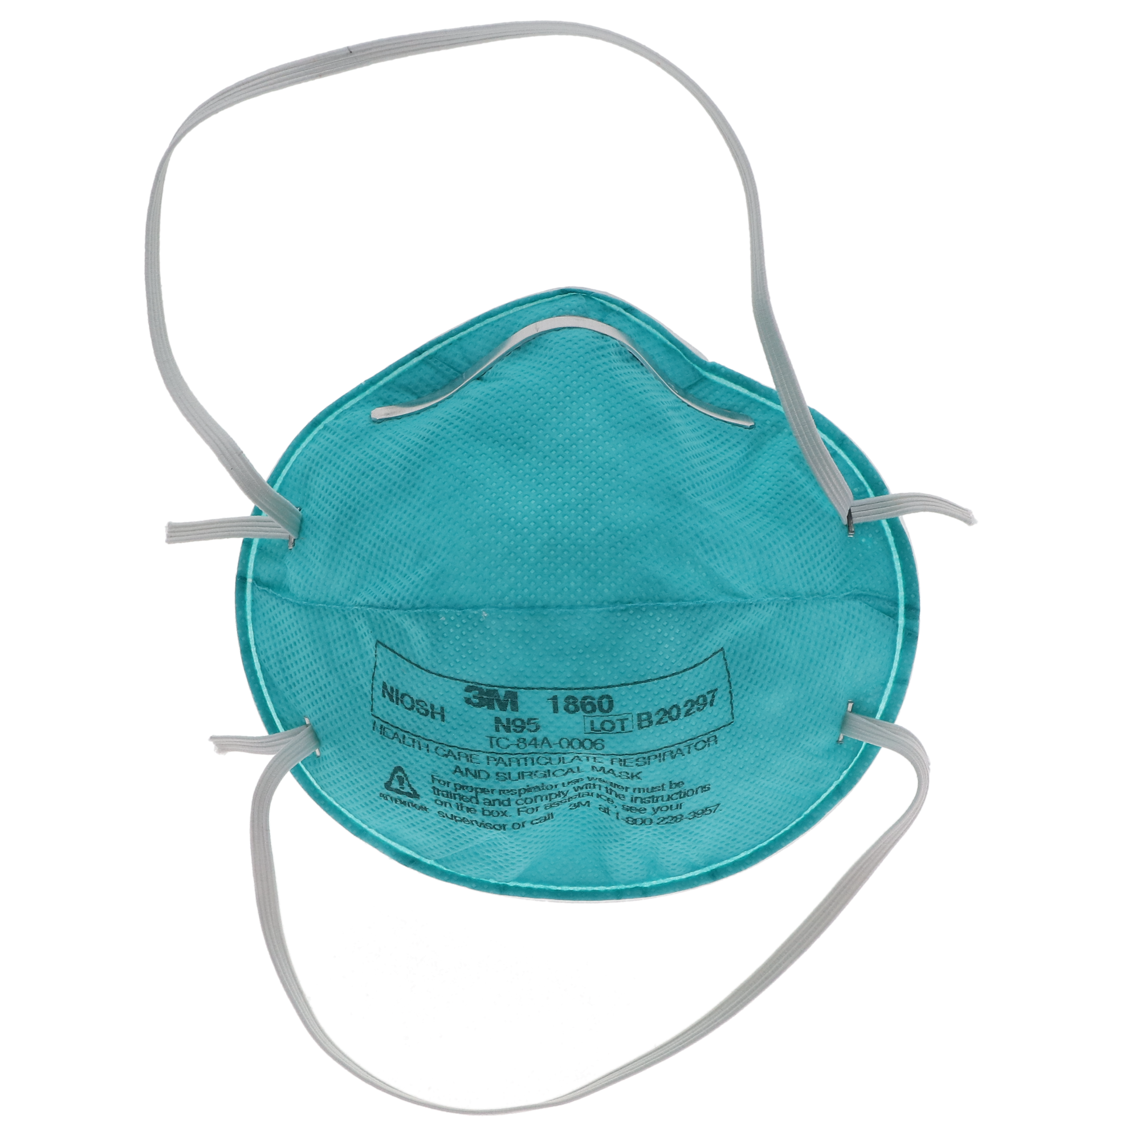
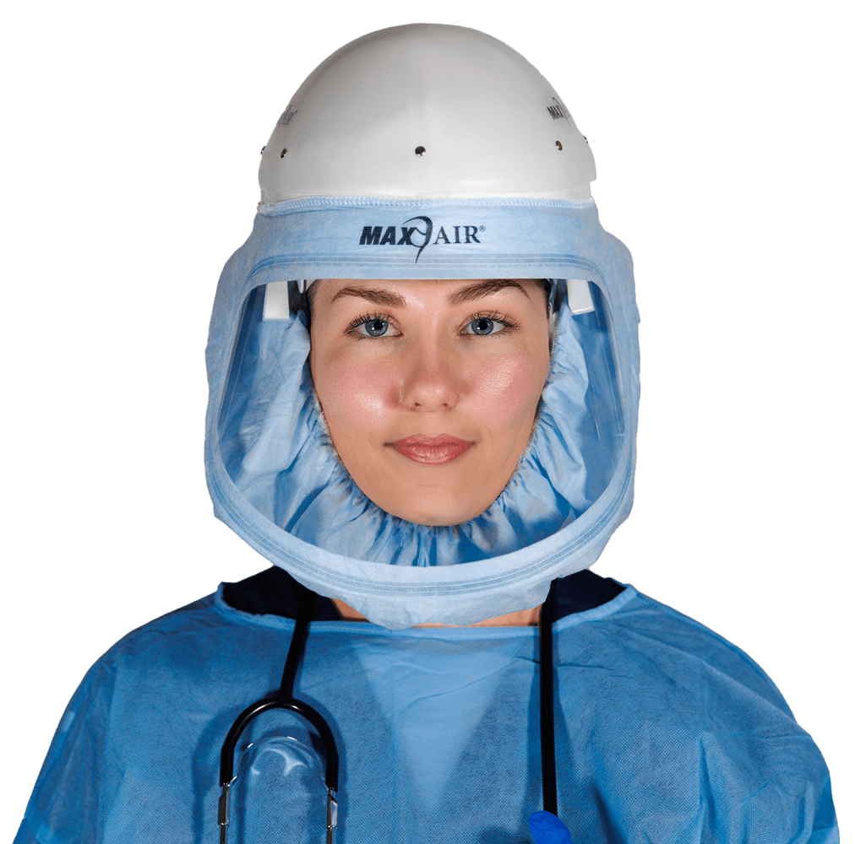
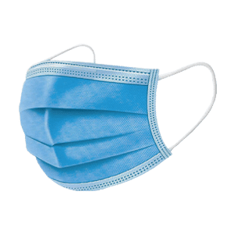
Case 1: An aside
Turbulent Gas Cloud From a Human Sneeze (Bourouiba, 2020)
During COVID, we found out this is actually much more complicated (it is a continuum)
Actually behaves more like smoke (dependent on ventilation)
Droplet ("cannonballs")
Large respiratory drops (>5 µm)
Heavier → fall to the floor w/in 6 ft
Airborne ("floaters")
Tiny droplet nuclei (less than 5 µm)
Evaporate → stay in the air
TheScrubNurse.com

Slide 23

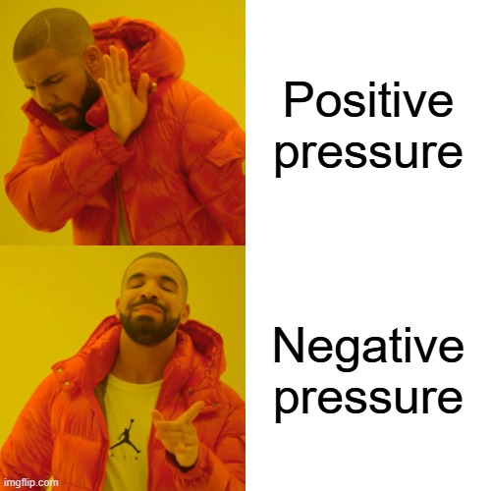
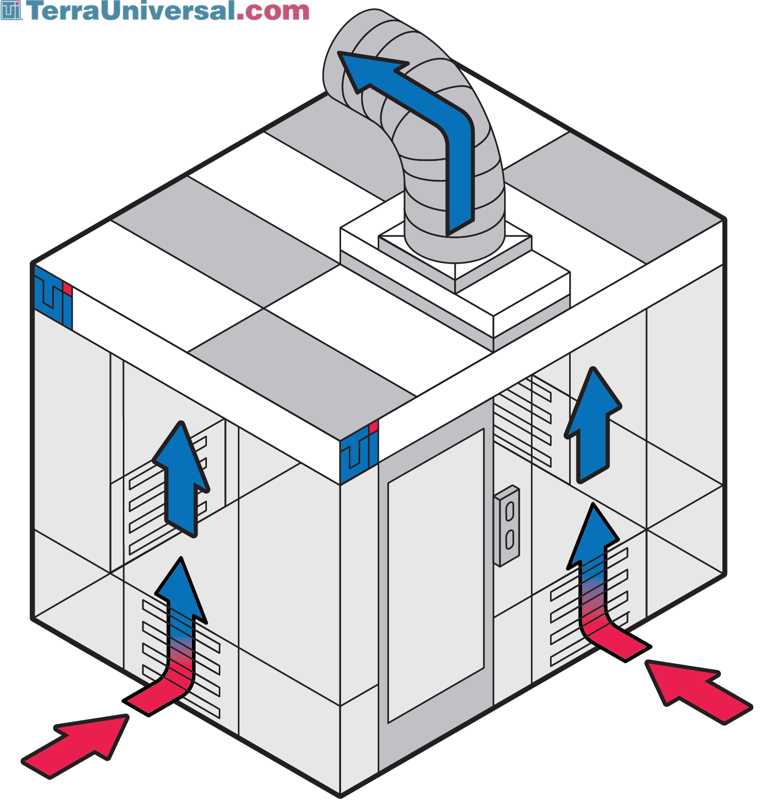
Case 1: Speaking of ventilation
Negative pressure rooms prevent air from escaping into the hallway (Source)

Slide 24
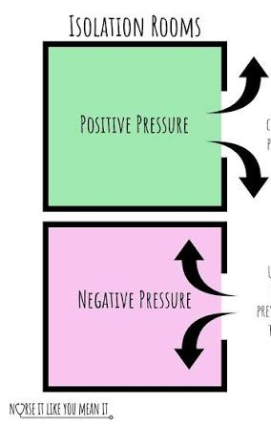
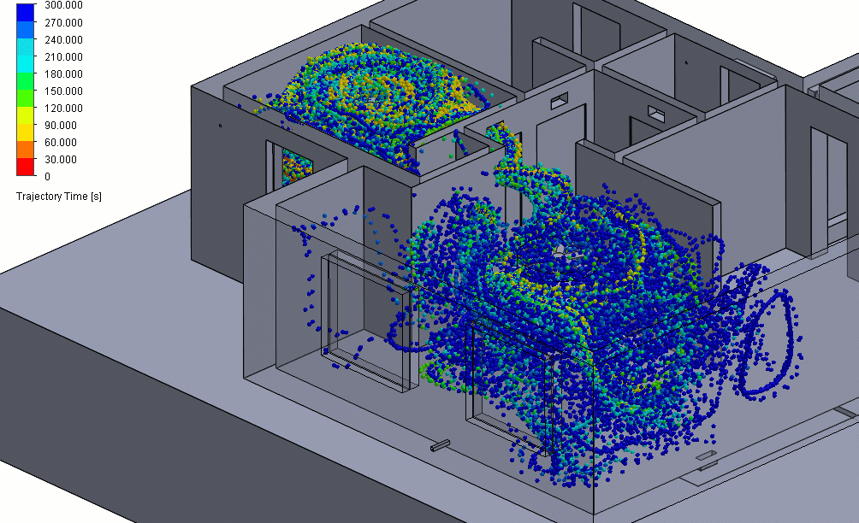
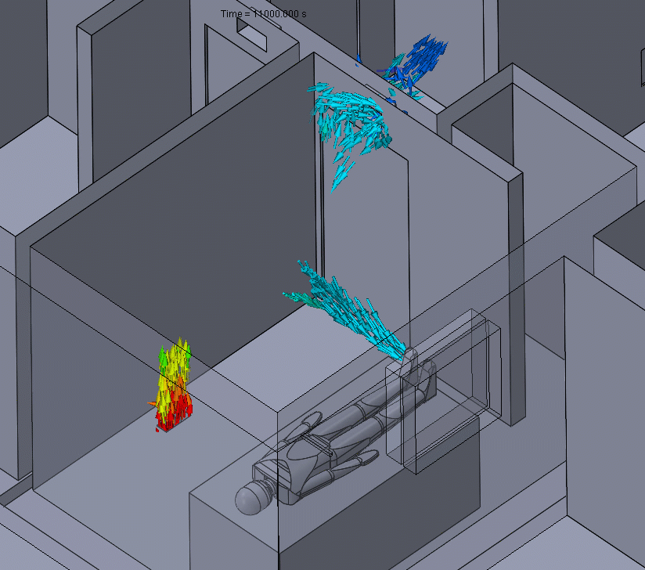
Case 1: Positive pressure room (bad for measles)
Positive pressure room (Source)
Instagram
What you don’t want to happen (Source)

Slide 25

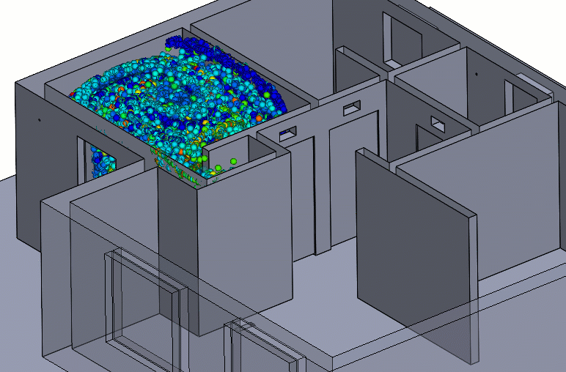
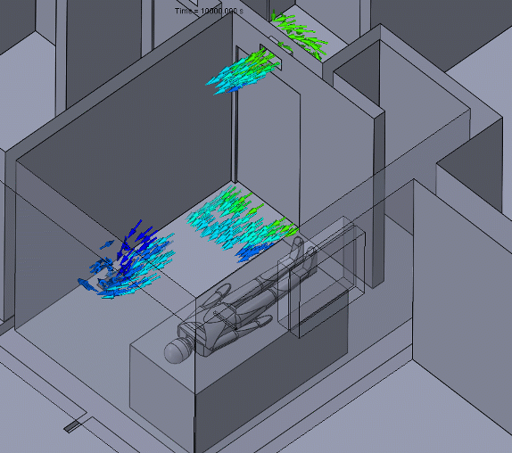
Case 1: Negative pressure room (good)
Negative pressure room (Source)
What we want for measles (Source)

Slide 26
Case 1: Back to the case
Exam room 3
I now need to identify every single patient, visitor, and staff member who:
Shared the waiting room with them*
Were in the exam room after them*
Cared for the child
Cleaned the exam room*
Checked them in
I now need to identify every single patient, visitor, and staff member who:
The packed waiting room
(*) Since measles hangs out in the air for 2 hours, this could extend to the 2 hours after they left (if we didn’t cycle the air)
The child sits in the waiting room for 45 minutes, is seen in Exam Room 3, and gets discharged home

Slide 27
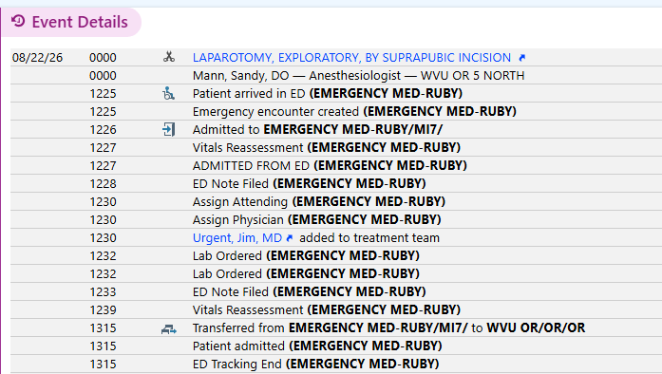
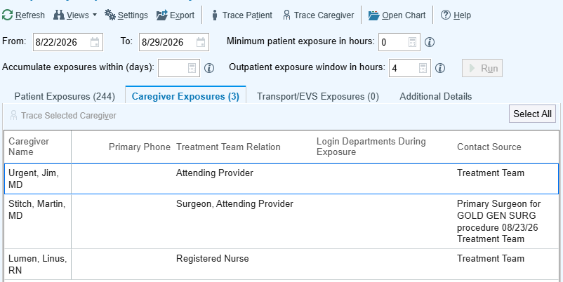
Case 1: Back to the case
Contact tracing: The process of identifying and notifying people who may have been exposed to an infectious disease
For measles, you have 72 hours to get them post-exposure prophylaxis
I now need to identify every single patient, visitor, and staff member who:
Shared the waiting room with them*
Were in the exam room after them*
Cared for the child
Cleaned the exam room*
Checked them in
I now need to identify every single patient, visitor, and staff member who:
Fortunately, the electronic medical record (EMR) is incredibly helpful here
Not real patient data
(*) Since measles hangs out in the air for 2 hours, this could extend to the 2 hours after they left (if we didn’t cycle the air)
Not real patient data
This is simulated data, but it looks the same in real life (except the number of exposures would be much higher)

Slide 28
Case 1: The aftermath
Patient exposures
Healthcare workers
Support staff
We can target them first
Can use EMR to identify highest risk patients
<1 year olds
Pregnant women
Cancer patients
Employee health reviews vaccination records & bloodwork from when they were hired
Unless there is clear proof of immunity documented, furlough from work from days 5 through 21 after exposure
Very close coordination with the health department (like we text after hours)
Provide exposed people (who are non-immune to measles) with post-exposure prophylaxis

Slide 29
Measles: What I spend most of my time on
Outbreak investigations, especially with measles, are fortunately pretty rare
Healthcare Epidemiologist
More of my time is spent planning for these situations and developing / evaluating our policies
Use public health principles to prevent and stop infections from spreading within the hospital

Slide 30
Case #2

Slide 31
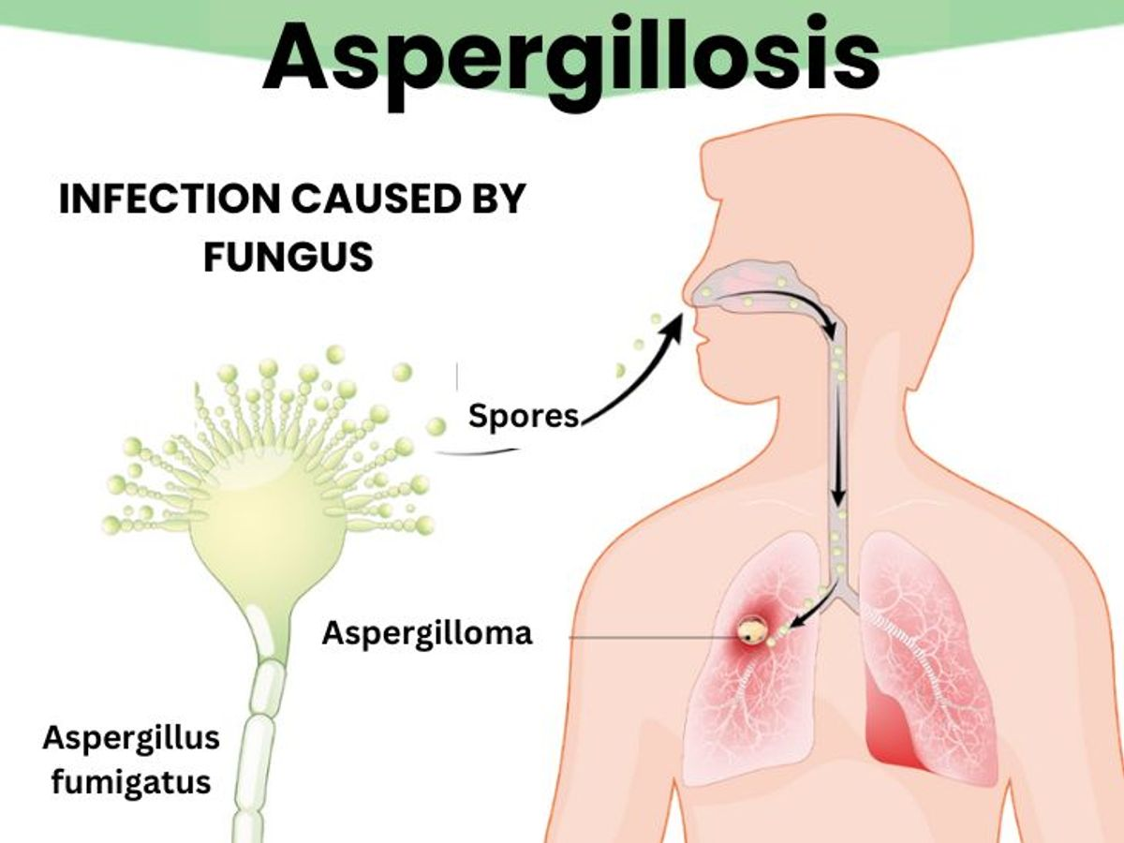
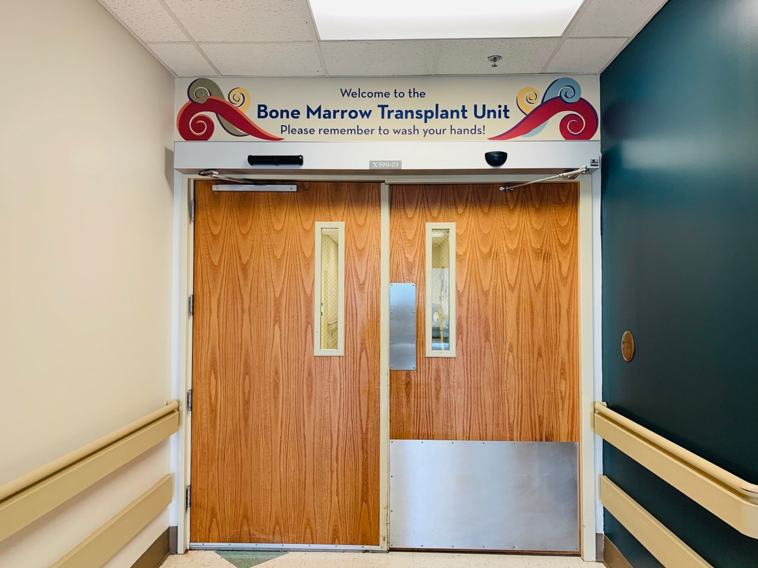
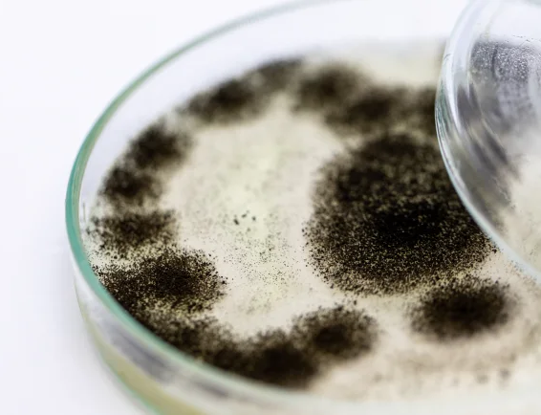
Case 2: The scenario
You receive a call from your transplant infectious disease colleague who says over the past three weeks, she’s noticed two cases of bone marrow transplant patients who have developed a rare mold infection (Aspergillus) in their lungs
You know that Aspergillus
Is everywhere in the environment
Lives in soil and rotting leaves
Spread by spores
Should not be inside a sterile transplant unit
Source
Mainly infects people without immune systems (cancer, transplant, HIV off of meds)
Source
Source

Slide 32
Is this a breakout?

Slide 33

Is this a breakout?

Slide 34
Case 2: Is this an outbreak?
You receive a call from your transplant infectious disease colleague who says over the past three weeks, she’s noticed two cases of bone marrow transplant patients who have developed a rare mold infection (Aspergillus) in their lungs
You know that Aspergillus
Month | Cases | Pt_days | Rate
January | 1 | 612 | 1.63
February | 0 | 425 | 0.00
March | 1 | 428 | 2.34
April | 1 | 598 | 1.677
May | 2 | 631 | 3.17
June | 3 | 905 | 3.31
July | 3 | 933 | 3.25
August | 2 | 310 | 6.45
Is everywhere in the environment
Lives in soil and rotting leaves
Spread by spores
Should not be inside a sterile transplant unit
Mainly infects people without immune systems (cancer, transplant, HIV off of meds)

Slide 35
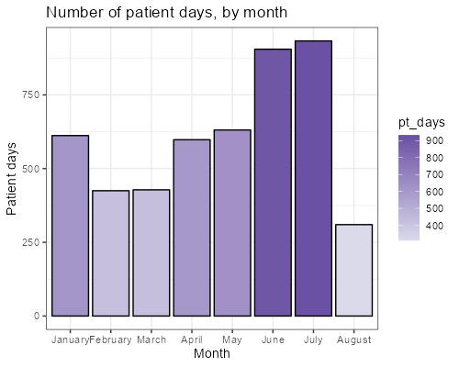
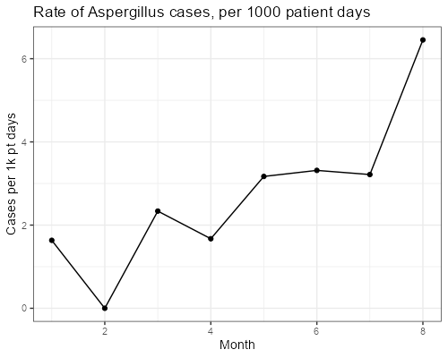
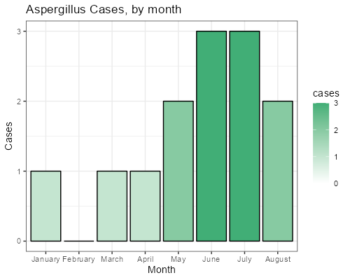
Case 2: Is this an outbreak?
Seasonal trends: It’s common for mold cases to spike in the humid summer months (outside of the hospital)
Construction: hospital walls and ceilings are full of dust → when you move that dust, it becomes airborne
Month | Cases | Pt_days | Rate
January | 1 | 612 | 1.63
February | 0 | 425 | 0.00
March | 1 | 428 | 2.34
April | 1 | 598 | 1.677
May | 2 | 631 | 3.17
June | 3 | 905 | 3.31
July | 3 | 933 | 3.25
August | 2 | 310 | 6.45
Half of beds closed for renovations

Slide 36
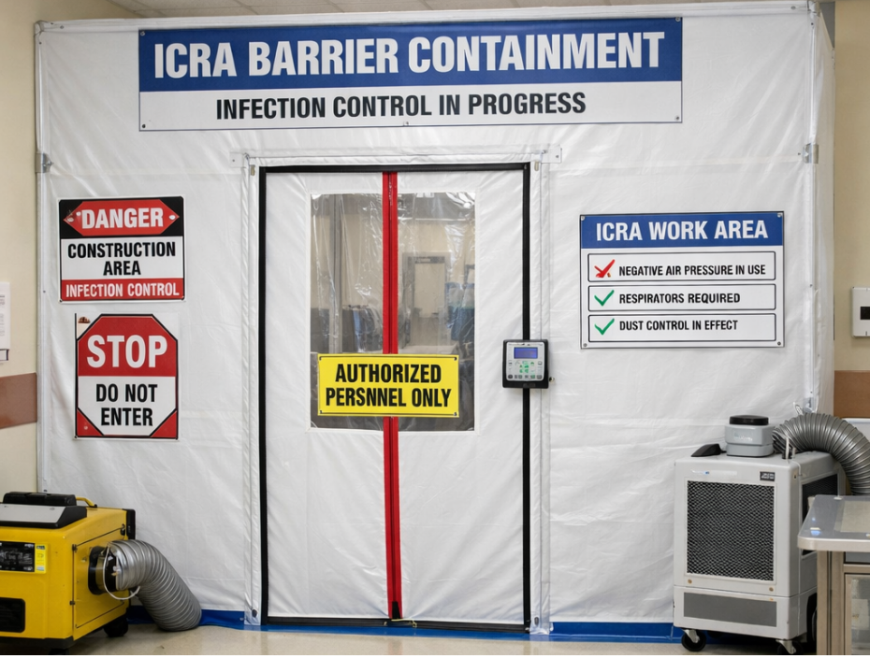
Case 2: The epi investigation
Since you know construction is going on near the unit, I’d skip the crunching the numbers. Instead, you grab the infection preventionist who is in charge of construction, take the elevator up from your office, and physically walk around the hospital
What are we looking for?
Is the plastic barrier intact?
Is the zipper all the way zipped?
Are ceiling tiles fully in place?
The barrier: Is the construction zone sealed?
The airflow: Which way is the wind blowing?
Is the workspace negative pressure?
(Source)

Slide 37

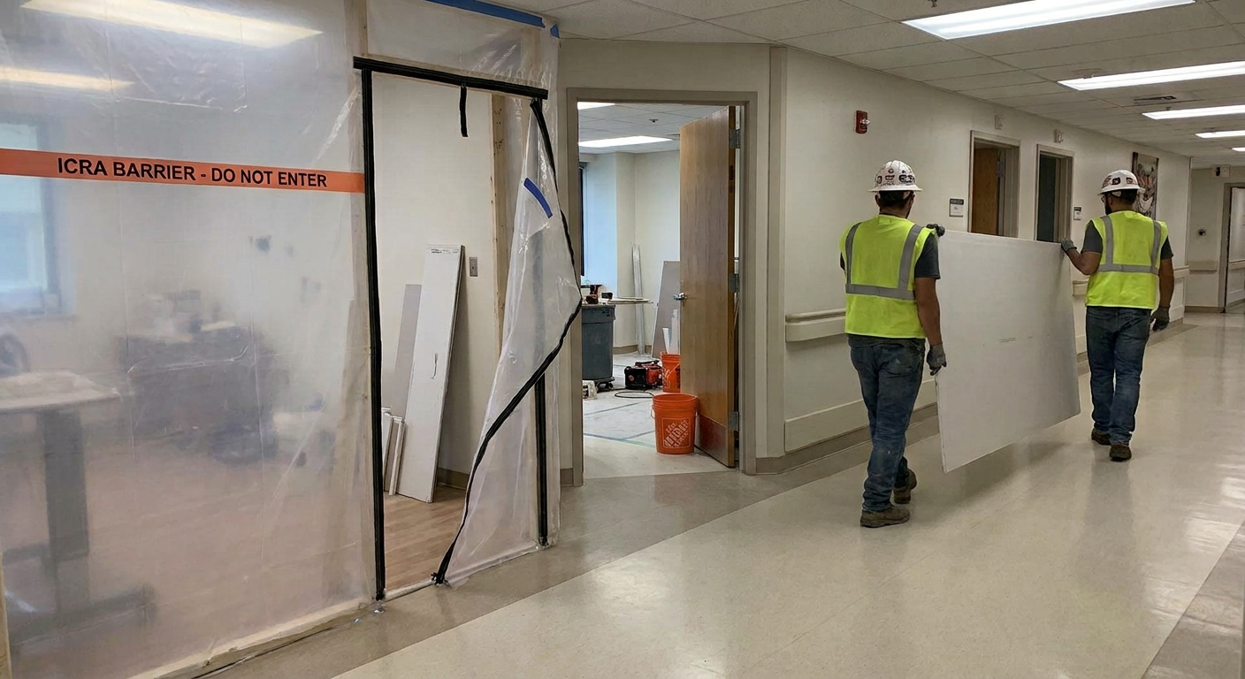
Case 2: The epi investigation
Since you know construction is going on near the unit, I’d skip the crunching the numbers. Instead, you grab the infection preventionist who is in charge of construction, take the elevator up from your office, and physically walk around the hospital
(NASA)
What are we looking for?
Workers prop door wide open (to make it easier to haul materials)
No sticky mat for cleaning dust off boots
Transporting materials uncovered in patient facing spaces (hallway)
The barrier: Is the construction zone sealed?
The airflow: Which way is the wind blowing?
The humans: How are workers and trash moving?
AI generated
Nano Banana Pro / Gemini 3

Slide 38

Case 2: Transmission isn’t always textbook
Even if mold infections (like Aspergillus) are “transmitted” through inhalation, preventing infections (in healthcare and beyond) often comes down to human factors (often far removed from the actual patient)
Much of my job is talking to people, synthesizing data, & making
shared decisions based off my findings (including construction signs in Spanish)
AI generated
Nano Banana Pro / Gemini 3
Source

Slide 39
Case #3

Slide 40

Case 3: The scenerio
On a Friday evening, you get an email from the hospital CEO
She has been looking at the quarterly safety dashboard
Hospital-wide C. diff rates are in the red (higher than expected)

Slide 41
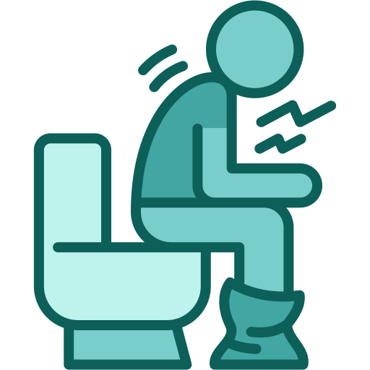
Case 3: The scenerio
On a Friday evening, you get an email from the hospital CEO
She has been looking at the quarterly safety dashboard
Hospital-wide C. diff rates are in the red (higher than expected)
The bacteria
Clostridioides difficile (C diff) causes severe, sometimes fatal diarrhea
The Reservoir (Asymptomatic Carriers)
Many people have C. diff in their guts right now doing zero harm
It only becomes a problem when antibiotics wipe out the "good" gut flora, allowing C. diff to overgrow
The spores
C. diff poops out spores. These spores are not killed by hand sanitizer or routine disinfectants
Only way to kill it is bleach, or washing hands with soap & water (goes down the drain)
Prevention
Wear gown & gloves
Wash hands with soap & water
Avoid antibiotics (when able)

Slide 42

Case 3: What are HAIs?
The cost of HAIs
The government incentives hospitals to prevent healthcare associated infections (HAIs)
High rates of HAIs (like C diff) can cost a hospital tons of money
  Nobody likes to talk about money in healthcare
  But these can result in funding cuts to important programs
On a Friday evening, you get an email from the hospital CEO
She has been looking at the quarterly safety dashboard
Hospital-wide C. diff rates are in the red (higher than expected)
I see the impact every day
I am my own “health department”
Funding is a little more reliable
Politics still exist, but more local

Slide 43
Where do I start?
Walk blindly around the hospital?
Blame the doctors?
Ignore it and hope it goes away?
Look at the data?

Slide 44
Where do we start?

Slide 45

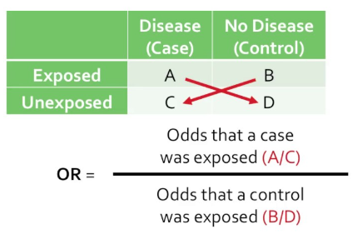
Case 3: I can’t be everywhere at once
unit | Had C diff | No C diff | odds_ratio | p.value | conf.95
Maternity | 2 | 650 | 0.206 | 0.028 | 0.034–0.661
ICU | 10 | 800 | 0.931 | 0.838 | 0.444–1.76
4-West | 21 | 600 | 3.5 | 4.461 × 10⁻⁶ | 2.02–5.91

Slide 46
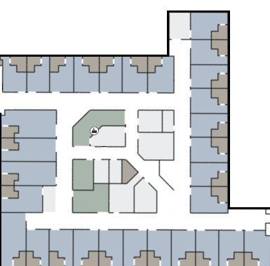
Case 3: What’s wrong with 4-West?
Besides not being a real unit in my hospital
On review of the cases in the past 3 months:
23
Does not look like they occurred on similar dates
No clear shared risk factors (e.g. coming from the same skilled nursing facility before admission)
22
30
29
28
27
26
25
24
21
20
But the manager for 4-West does point out…
1
19
2
18
 | odds_ratio | 95% CI
Maternity | 0.206 | 0.034–0.661 (p=0.03)
ICU | 0.931 | 0.444–1.76 (p=0.838)
4-West | 3.5 | 2.02–5.91 (p<0.001)
3
17
4
16
5
6
7
8
9
10
11
12
13
14
15

Slide 47
Case 3: What’s wrong with 4-West?
Cases over the past month:
23
22
Location | C diff cases
Bed 3 | 1
Bed 12 | 1
Bed 13 | 2
Bed 15 | 1
Bed 16 | 1
Bed 20 | 1
Bed 29 | 1
30
29
28
27
26
25
24
21
20
1
19
Is this a cluster?
2
18
3
17
4
16
Fun fact: We actually don’t have a “room 13”
5
6
7
8
9
10
11
12
13
14
15

Slide 48
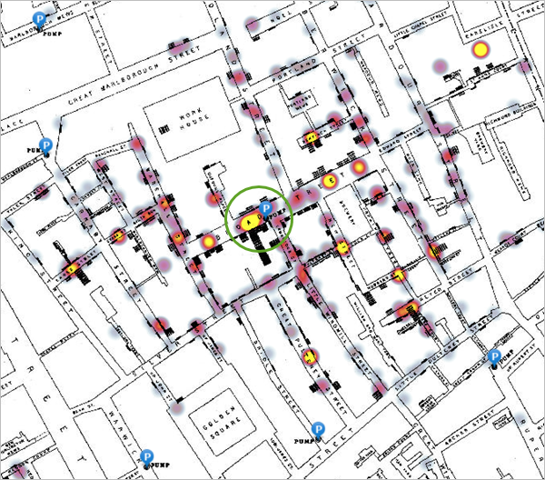

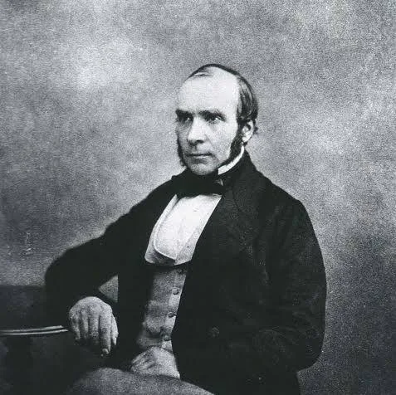
Case 3: John Snow
John Snow
(Game of Thrones)
John Snow (epidemiology)
John Snow’s cholera map,1855 (Source)

Slide 49
Case 3: Doing some observations
Are there things going from room-to-room? (stethoscopes, heart monitors, glucose machines)
How are they cleaned? Bleach vs alcohol wipes
Shared medical equipment?
23
22
30
29
28
27
26
25
24
21
20
1
19
2
18
The spores
These spores are not killed by routine disinfectants (alcohol wipes)
Only way to kill it is bleach
3
17
4
16
5
6
7
8
9
10
11
12
13
14
15

Slide 50
Case 3: Doing some observations
Shared medical equipment?
23
Personal protective equipment?
22
Are there gowns & gloves?
Are people actually using them?
30
29
28
27
26
25
24
21
20
1
19
2
18
The spores
These spores are not killed by routine disinfectants (alcohol wipes)
Only way to kill it is bleach
Transmission
Wear gown & gloves
Wash hands with soap & water
3
17
4
16
5
6
7
8
9
10
11
12
13
14
15

Slide 51
Case 3: Doing some observations
Shared medical equipment?
23
Personal protective equipment?
22
Wash your hands!!! (you work in a hospital)
21
30
29
28
27
26
25
24
How often do staff fully wash their hands?
20
Where are the sinks located?
1
19
2
18
The spores
These spores are not killed by routine disinfectants (alcohol wipes)
Only way to kill it is bleach
Transmission
Wear gown & gloves
Wash hands with soap & water
Transmission
Wear gown & gloves
Wash hands with soap & water
3
17
4
16
5
6
7
8
9
10
11
12
13
14
15

Slide 52
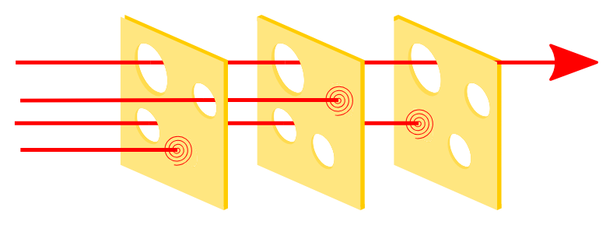
Case 3: Human factors & safety culture
Complex human systems (slices) will have failures (holes)
We stack them to prevent the holes from lining up
Swiss cheese model
(NASA)
Keep isolation patients close to sinks
Keep one can of bleach wipes on cleaning carts
Human factors engineering
Designing a system that accounts for human psychology and fatigue
If a nurse has to walk to the other side of the unit to find a gown, it’s the system that is failing the patient
Store extra gowns
Swiss cheese model (Wikipedia)

Slide 53
Case 3: Teamwork
Individual healthcare workers can do their part, but it takes a village to prevent the spread of infections in healthcare
Nursing leadership
Prioritizing the rooms that are close to the sink for C diff patients is far easier than building new sinks
Environmental services (EVS)
Keep the patient rooms and shared, high touch surfaces (e.g. computers) clean
These folks probably do more to prevent infections than I ever could
Facilities & architecture
Designing hospitals with infection prevention in mind
Government
Regulatory agencies to keep the incentives aligned
Healthcare economics might also be a good course to take

Slide 54
Learning points & take aways

Slide 55
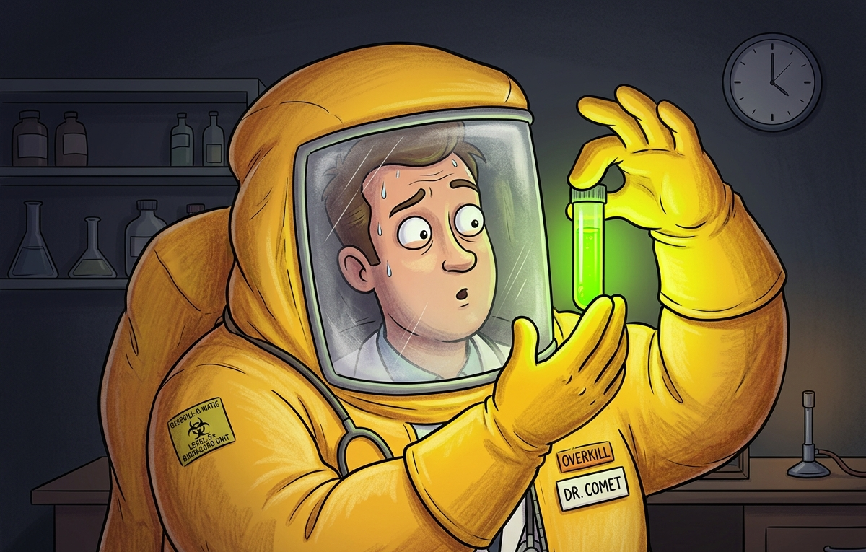
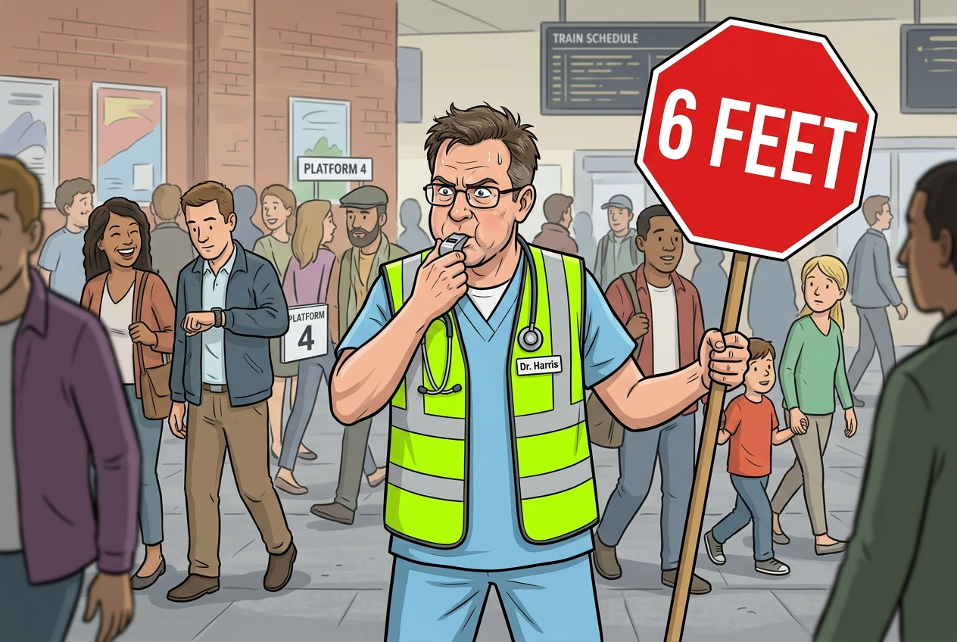

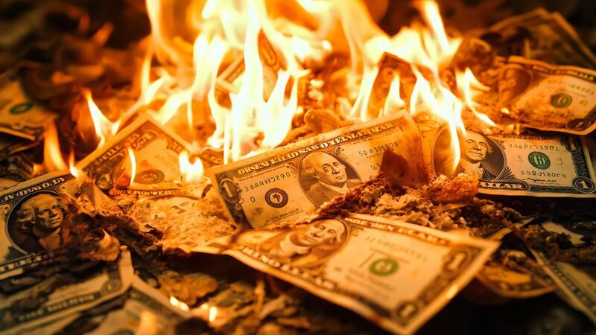

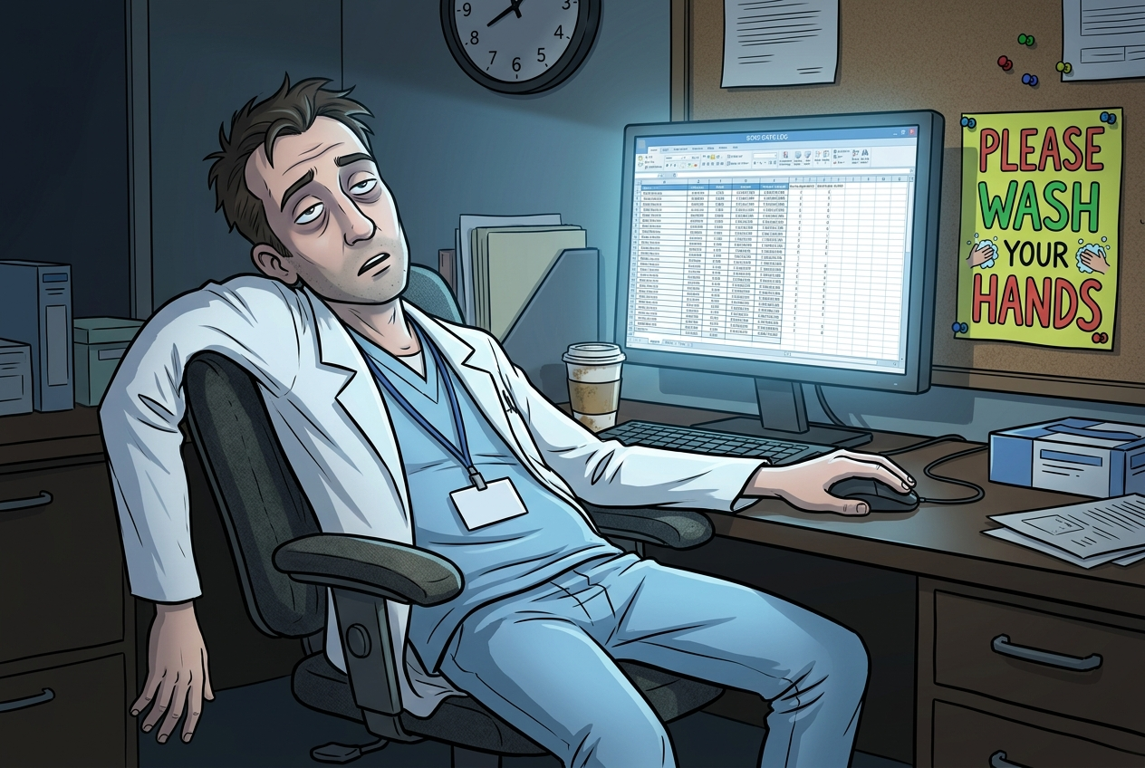
Healthcare Epidemiology
(Source)
Nano Banana 2
Nano Banana 2
What my friends think I do
What society thinks I do
What other doctors think I do
Nano Banana 2
(Source)
(Source)
What administrators think I do
What I think I do
What I actually do

Slide 56
Questions?
Human behavior is “a vector” too: The core of transmission is still what the textbook says (droplet, bloodborne, fomite, sexual), but human behavior twists these definitions in unique ways
Internalize the fundamentals: The real world is messy, but you can begin to decipher it with the principles of basic public health (and don’t forget the denominator)
Data can identify the problem, but cannot solve it: I got into this because of the data, but my passion comes from the “boots-on-the-ground” and multidisciplinary aspect (but the data is still really fun)
Embrace the non-linear path: You don’t have to have it all figured out (I sure don’t). Talk to mentors, pair your degree strategically, and be open minded (and don't let setbacks derail your public health impact)
Use of AI
Claude 5, Gemini 3.1 Pro - Case design, text generation
Nano Banana 2 & Pro - Image generation
Google Slides - Visual design
Slides available on hunterratliff1.com/talk/

